Slide 1
A MINI PROJECT ON MACHINE LEARNING

Slide 2

HOUSE PRICE PREDICTION
DONE BY:
225229106
CHARUMATHI M
I MSC DS A

Slide 3
Problem Definition
Predicting the House Prices with the help of Housing Data.
The predicted price of house depends upon various factors like avg area, avg bed room size, area population and price.

Slide 4
Implementation Steps
Importing Data
Data Cleaning
Removal of Outliers
Model Building
Testing different models and deciding upon the best one

Slide 5
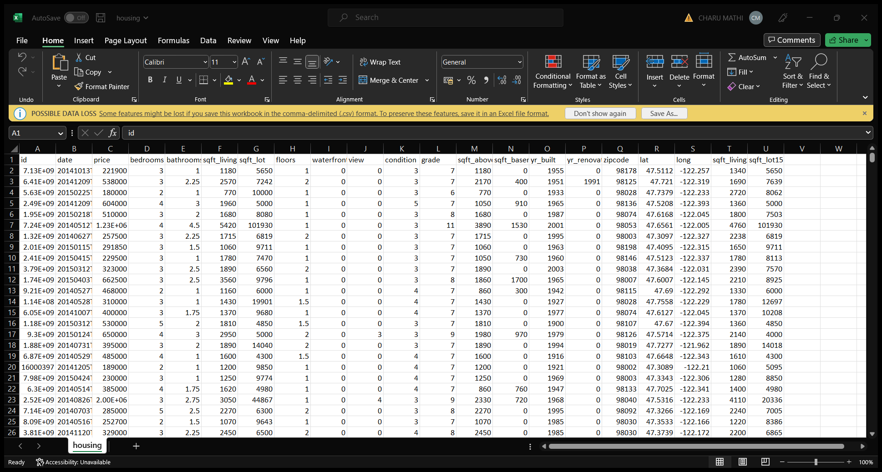
Dataset

Slide 6
Importing the necessary libraries
import pandas as pd
import numpy as np
import matplotlib.pyplot as plt
import seaborn as sns
from sklearn.preprocessing
import StandardScaler
from sklearn.model_selection
import train_test_split
from sklearn.linear_model
import LinearRegression
from sklearn.linear_model
import LogisticRegression
from sklearn.metrics
import r2_score

Slide 7
Printing the properties
Such as shape of the data, size of the data, coumns of the data, Info() of the data, datatype of the data.

Slide 8
Reading our input data for House Price Prediction.
customers=pd.read_csv("housing.csv")
customers.head()

Slide 9
Splitting our data for training and test purposes
X_train, X_test, y_train, y_test = train_test_split(X, y, test_size=0.3,random_state=101)

Slide 10
Train and evaluating Models
Linear regression
Random forest regressor
Gradient boosting regressor

Slide 11
5) Testing different models and deciding upon the best one
Use GridSearchCV to test and compare different models.
Predict the Price.

Slide 12
A) Linear Regression
Linear regression attempts to model the relationship between two variables by fitting a linear equation to observed data. One variable is considered to be an explanatory variable, and the other is considered to be a dependent variable.
The most common method for fitting a regression line is the method of least-squares. This method calculates the best-fitting line for the observed data by minimizing the sum of the squares of the vertical deviations from each data point to the line
A linear regression line has an equation of the form Y = a + bX, where X is the explanatory variable and Y is the dependent variable. The slope of the line is b, and a is the intercept (the value of y when x = 0).

Slide 13
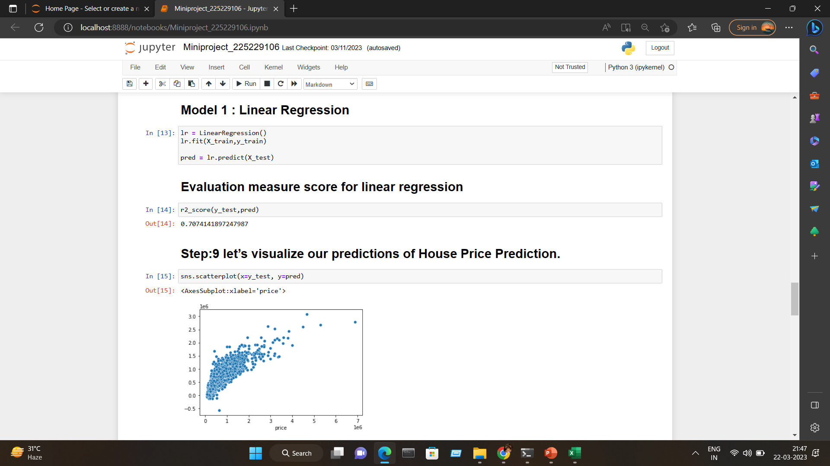

Slide 14
Random Forest Regressor¶
Random Forest is an ensemble technique capable of performing both regression and classification tasks with the use of multiple decision trees and a technique called Bootstrap and Aggregation, commonly known as bagging. The basic idea behind this is to combine multiple decision trees in determining the final output rather than relying on individual decision trees.
Random Forest has multiple decision trees as base learning models. We randomly perform row sampling and feature sampling from the dataset forming sample datasets for every model. This part is called Bootstrap.

Slide 15
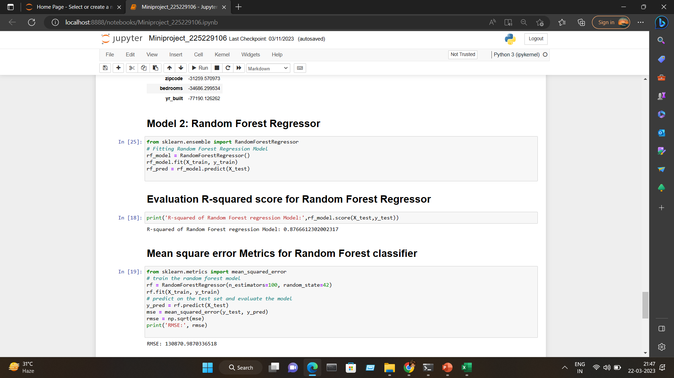

Slide 16
Gradient Boosting Regressor
Gradient Boosting is a popular boosting algorithm. In gradient boosting, each predictor corrects its predecessor’s error. In contrast to Adaboost, the weights of the training instances are not tweaked, instead, each predictor is trained using the residual errors of predecessor as labels.

Slide 17
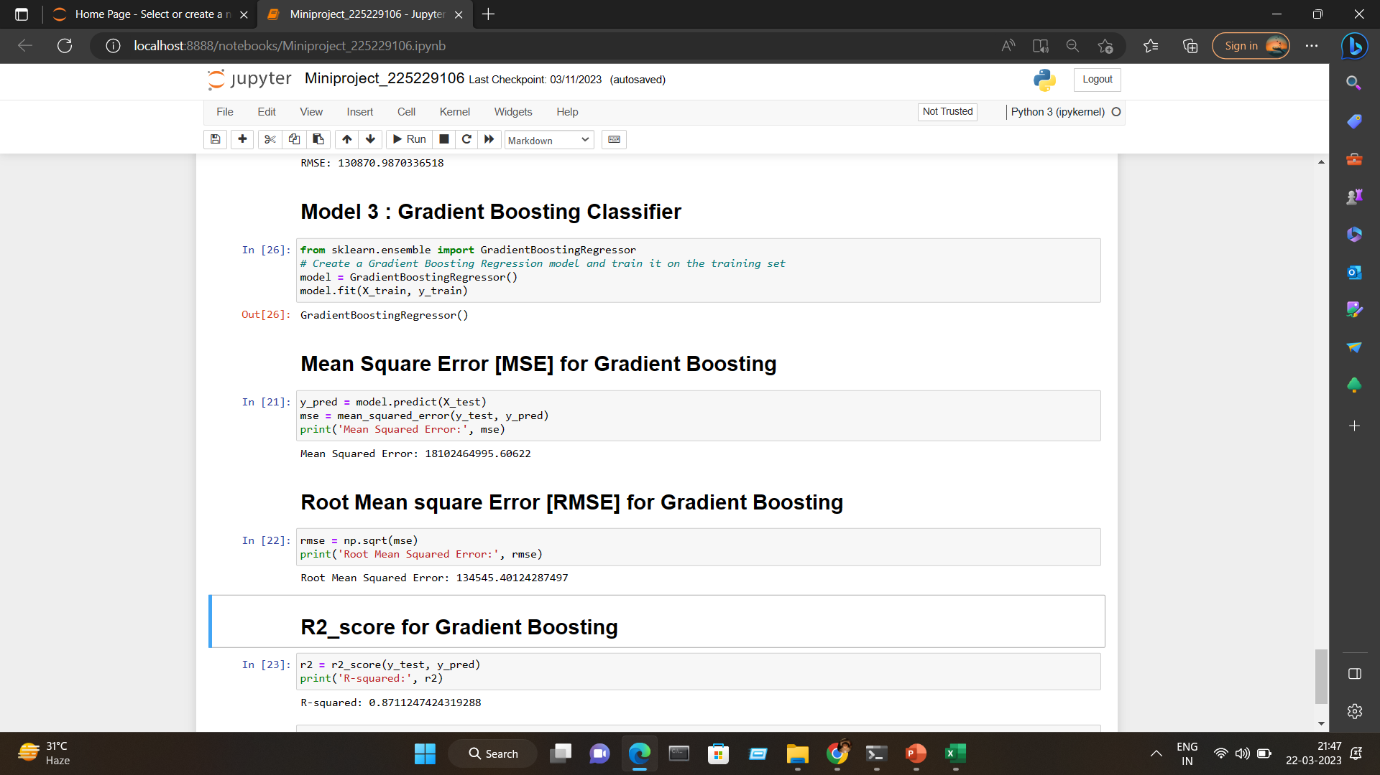

Slide 18
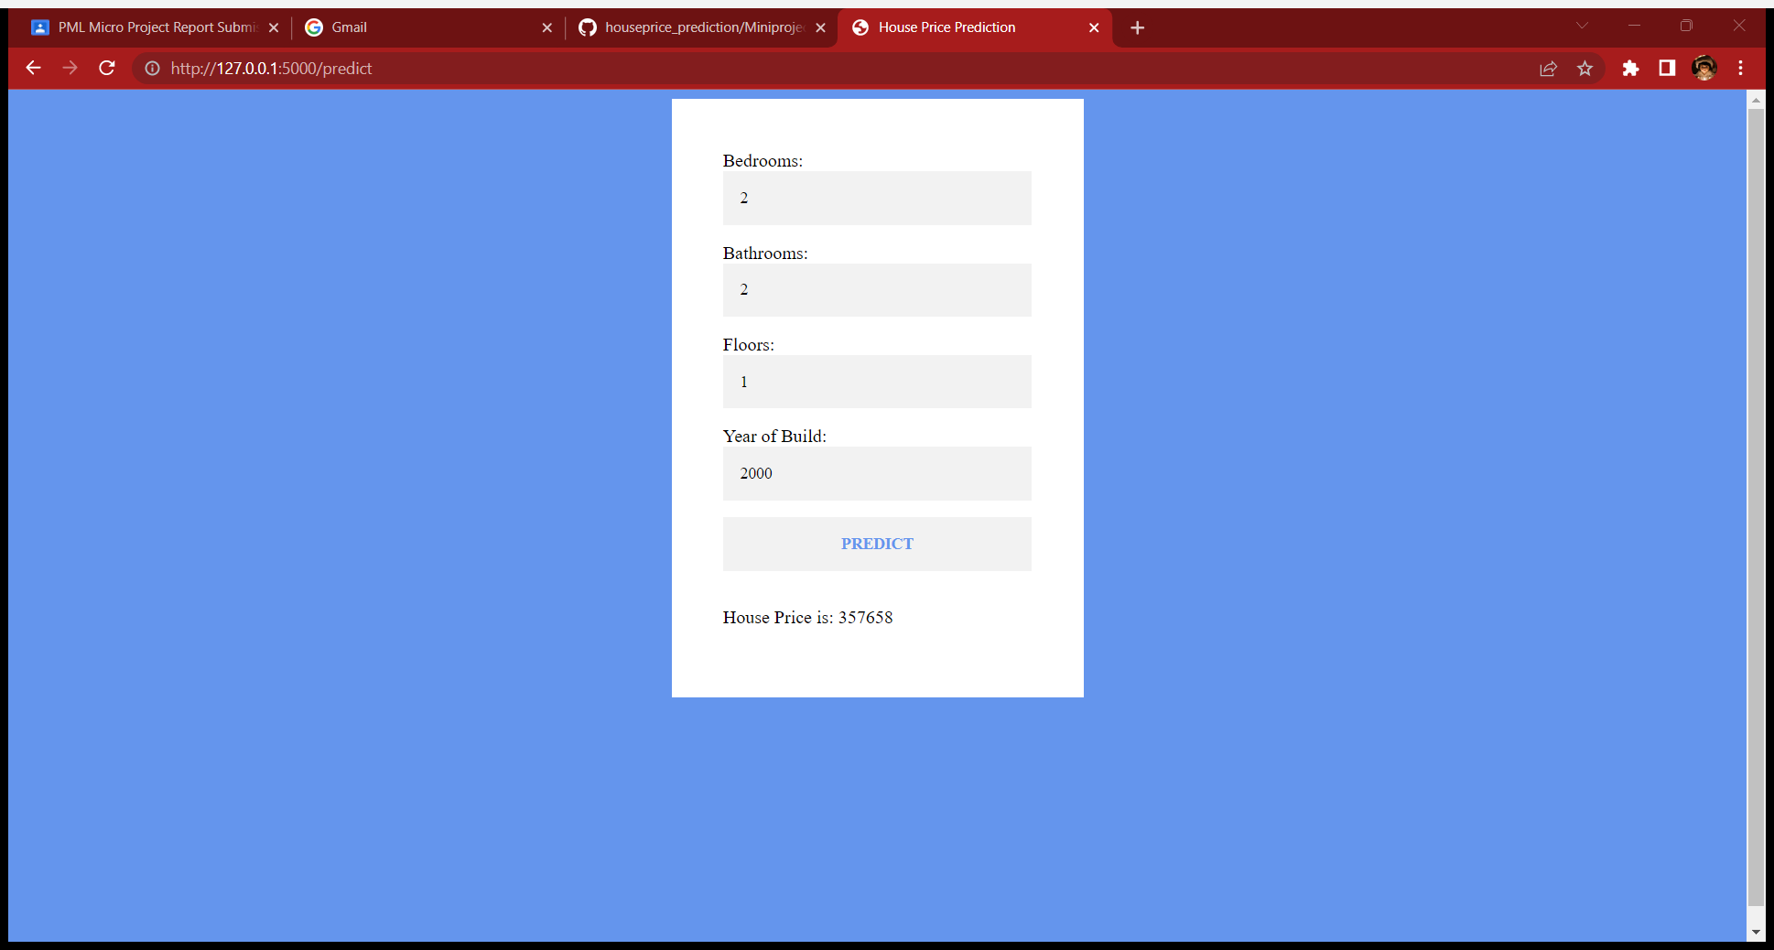
House Price Prediction

Slide 19
THANK YOU

