Slide 1
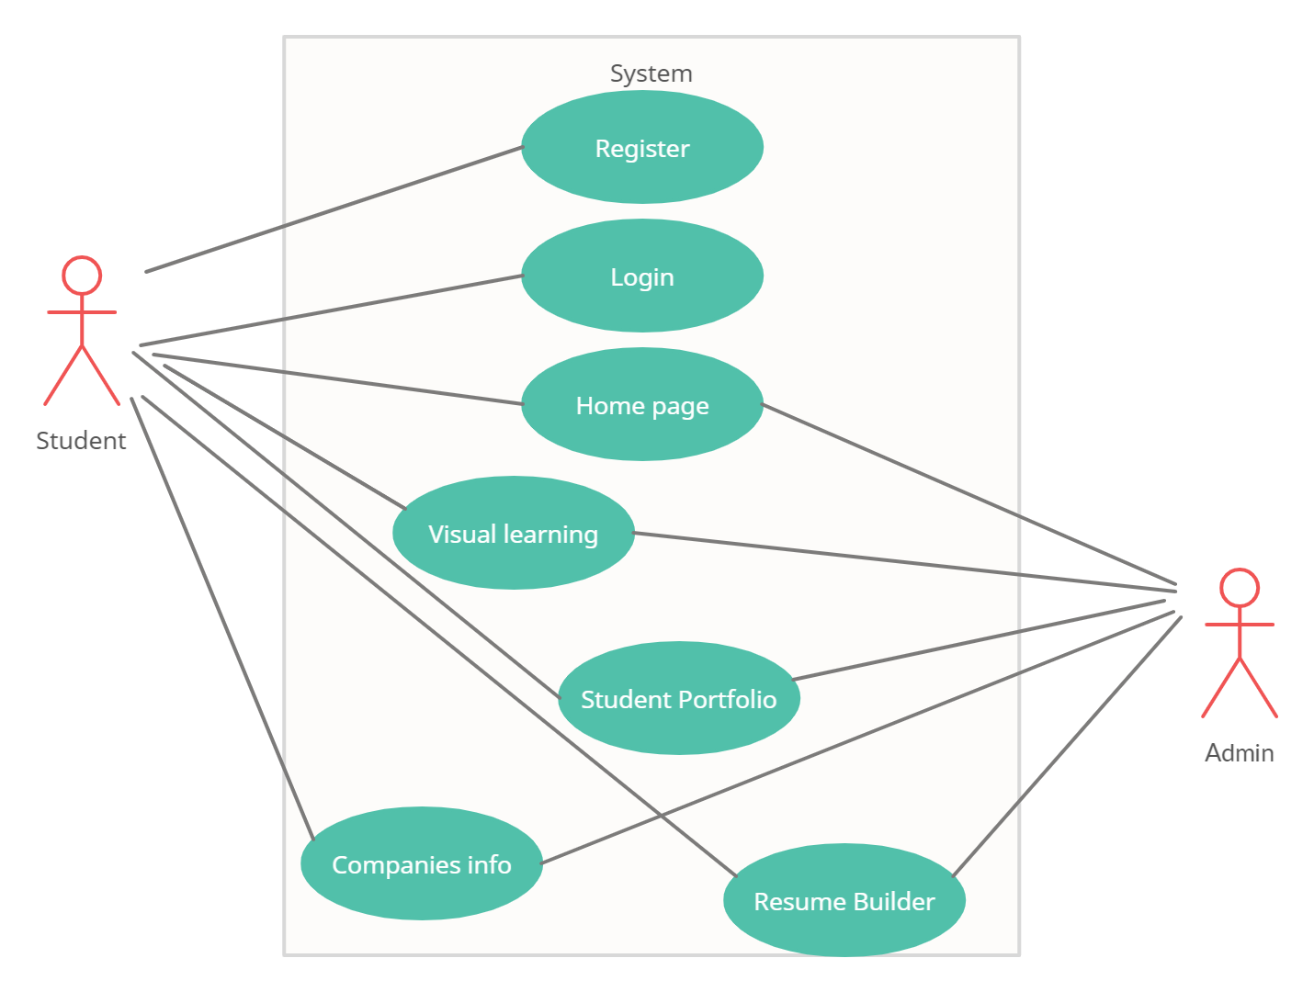
Use Case
---
----------------
-----------------------------------
-------------------------------

Slide 2



LOGIN PAGE
LOGIN
REGISTRATION
USERNAME/EMAIL ID
PASSWORD
CONTACT US

Slide 3
HOME PAGE
STUDENT
PORTFOLIO
VISUAL LEARNING
COMPANIES INFO
RESUME
BUILDING

Slide 4

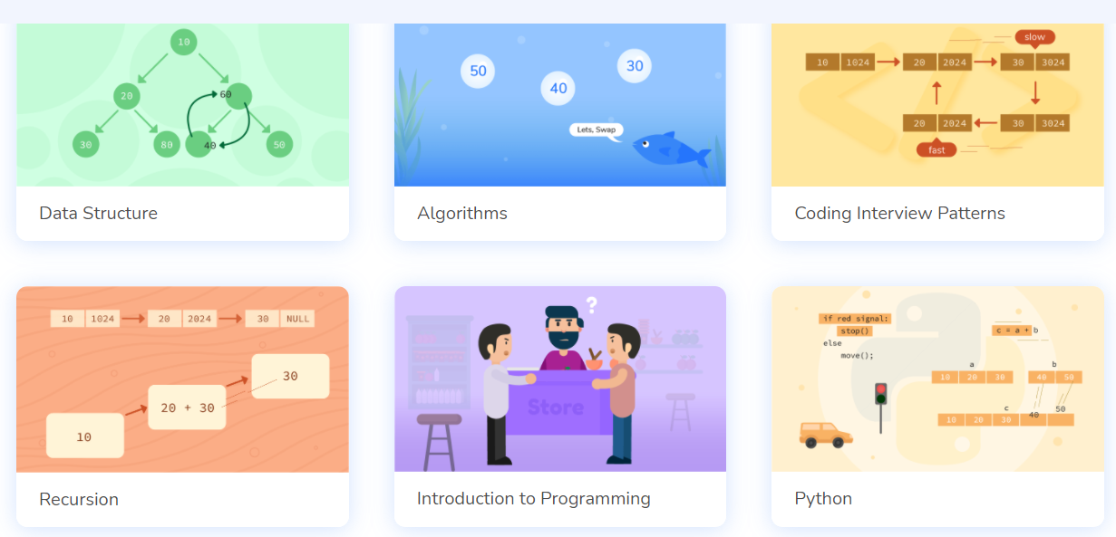
VISUAL LEARNING
search….

Slide 5
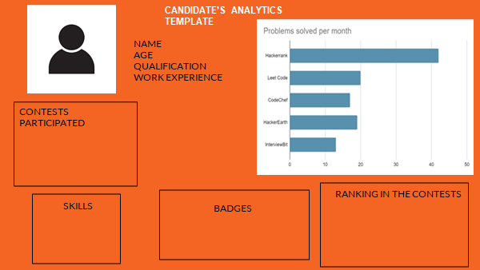
Student Portfolio

Slide 6








Slide 7
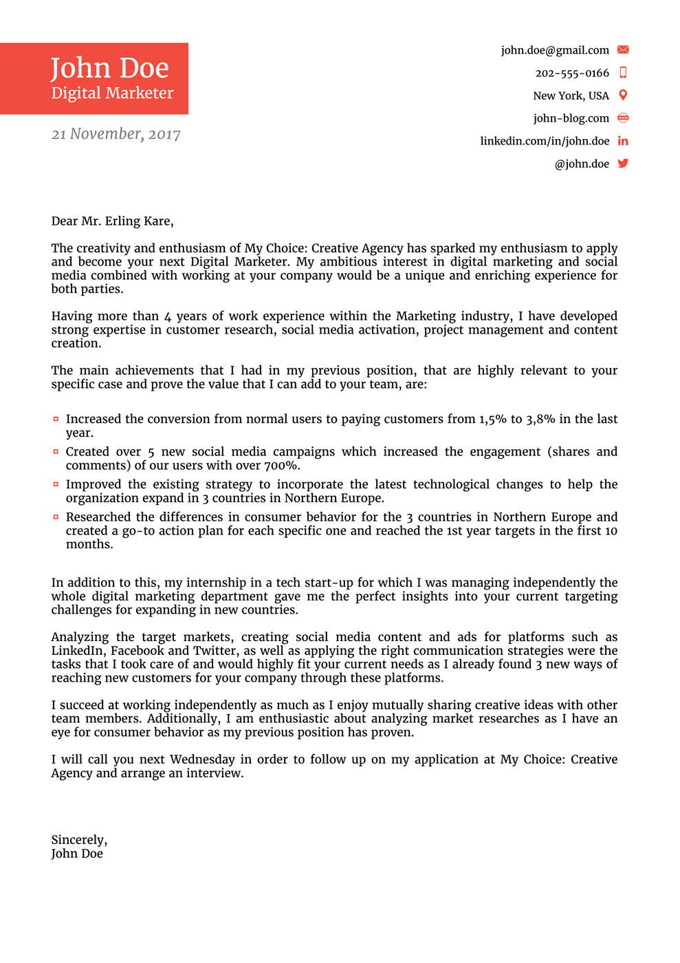
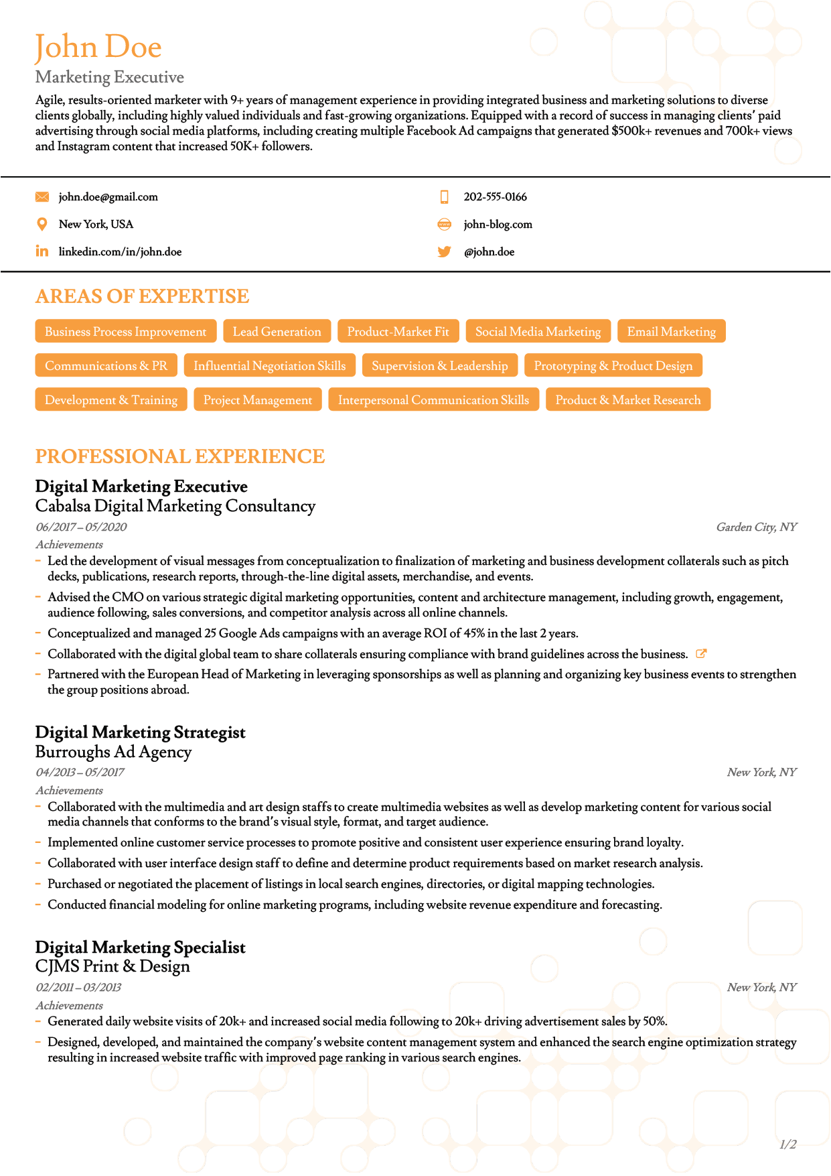
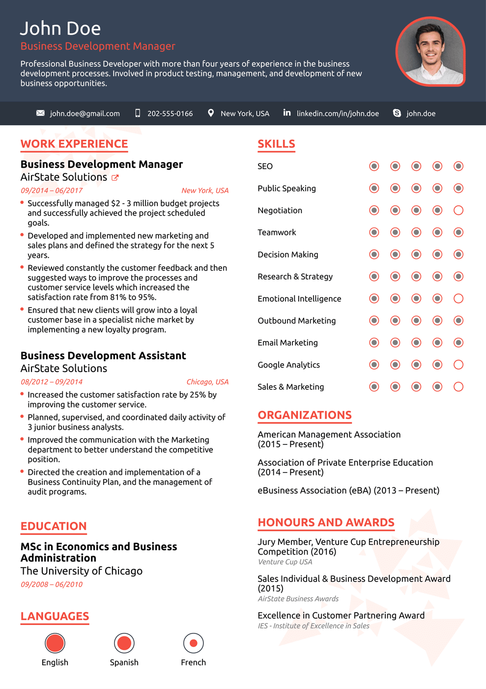
Resume Building

Slide 8
THANK YOU

