Slide 1
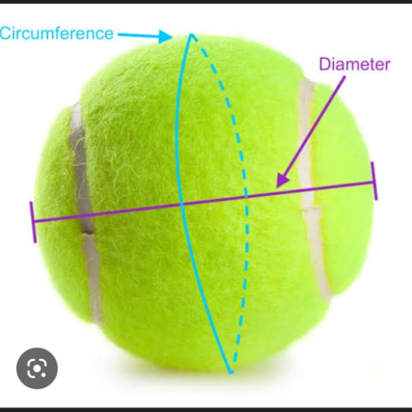
To Measure The Diameter Of an Object Within an Image
BY: CHARVEE SARAIYA B220
KHUSHI TALAVIYA B204

Slide 2
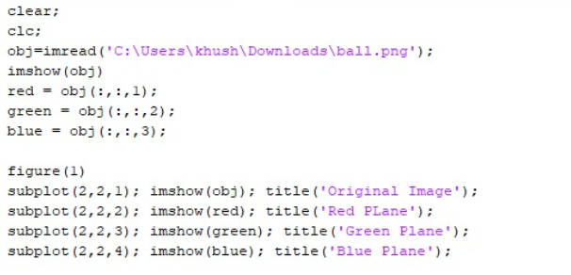
Measuring objects within an image or frame can be an important capability for many applications where computer vision is required instead of making physical measurements.
To segment the image into a binary image to differentiate the background from the desired object

Slide 3
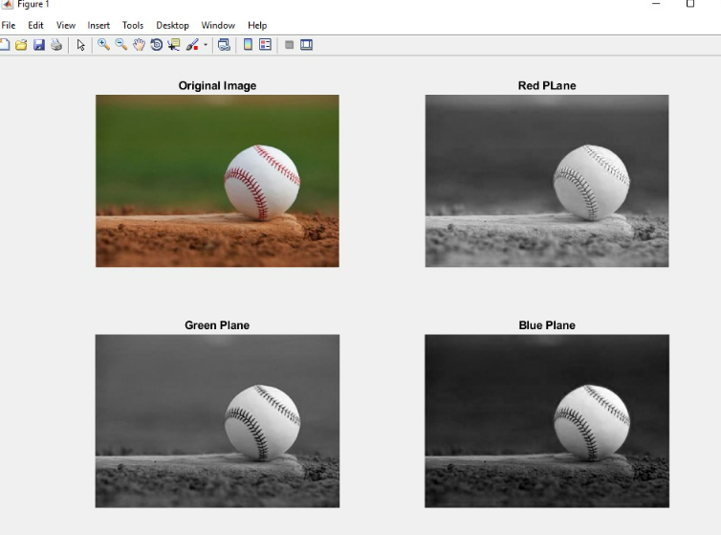

Slide 4
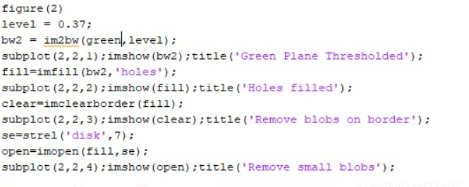
2. The Green plane is the best choice to use for Image Thresholding because it provides the most contrast between the desired object (foreground) and the background.

Slide 5
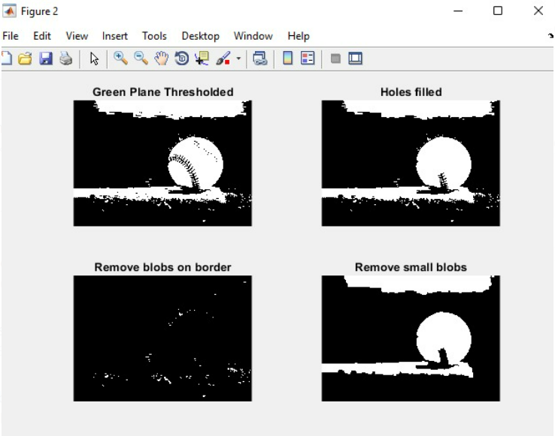
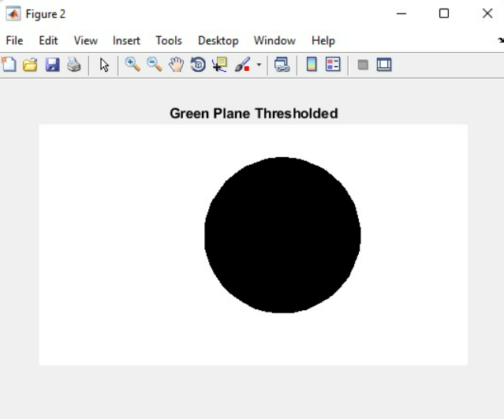
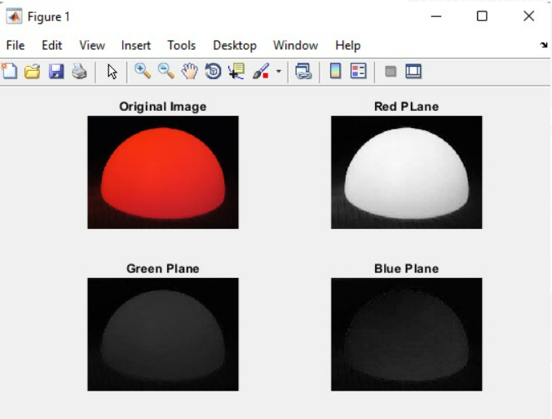
Normal Ball:
Red Ball:
Hollow Ball:

Slide 6
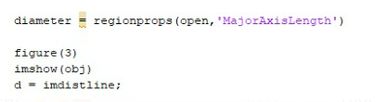
3. There is quite a bit of “noise” and we need to clean the image up significantly to improve the accuracy of our diameter measurement.

Slide 7
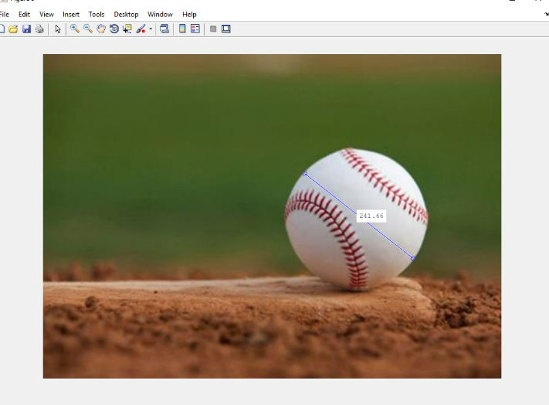
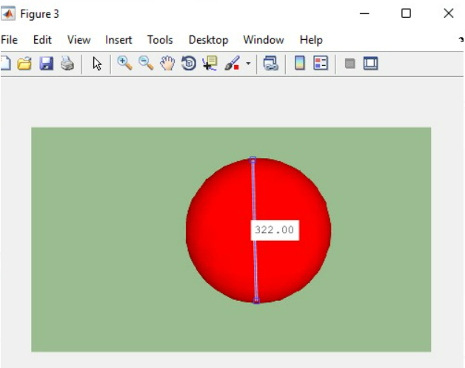
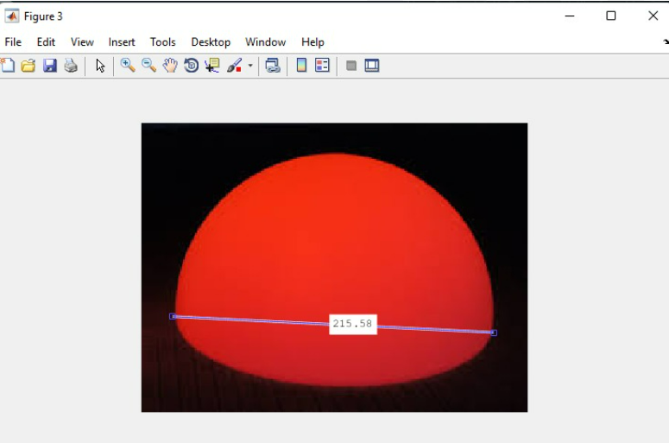
Measured using imdistline which allows measuring manually from an image
Normal Ball:
Red Ball:
Hollow Ball:

Slide 8
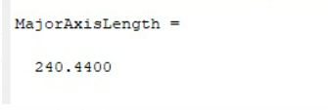

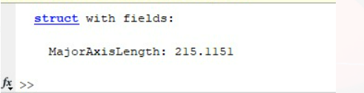
Desired output:
Normal Tennis Ball:
Red Ball:
Hollow Ball:

Slide 9
THANK YOU

