Slide 1

Voting system

Slide 2

Voting system
MY DEATAILS:-
Name:- VEMAVARAPU LAKSHMIPRASANNAKUMAR
Email id:- lakshmiprasannakumar026@gmail.com
College Name :- SRI SIVANI COLLEGE OF ENGINEERING
College State :- ANDHRA PRADESH
Internship Domain :- ANDROID APP DEVELOPMENT
Internship Start and End date:- 01-06-2023 to 31-07-2023

Slide 3
-:PROJECT TOPIC:-
VOTING SYSTEM
Online Voting System can allow users to cast their ballot from anywhere in the world. The app would work by allowing users to create an account and then log in to their account on the day of the election. Once they have logged in, they would be able to see all of the candidates and issues on the ballot. They would then be able to select their choice and submit their ballot. The app would also allow users to view results and get updates on election night.

Slide 4
AGENDA :-
The project “Online Election System” / “Online Voting Software” aims at making the voting process easy in any type of elections. Presently voting is performed using ballot paper and the counting is done manually, hence it consumes a lot of time. There can be possibility of invalid votes. All these make election a tedious task. In recent times in India, due to elections the second wave of COVID transmission also made huge loss of human lives. In our proposed system voting and counting is done with the help of computer in Online.

Slide 5
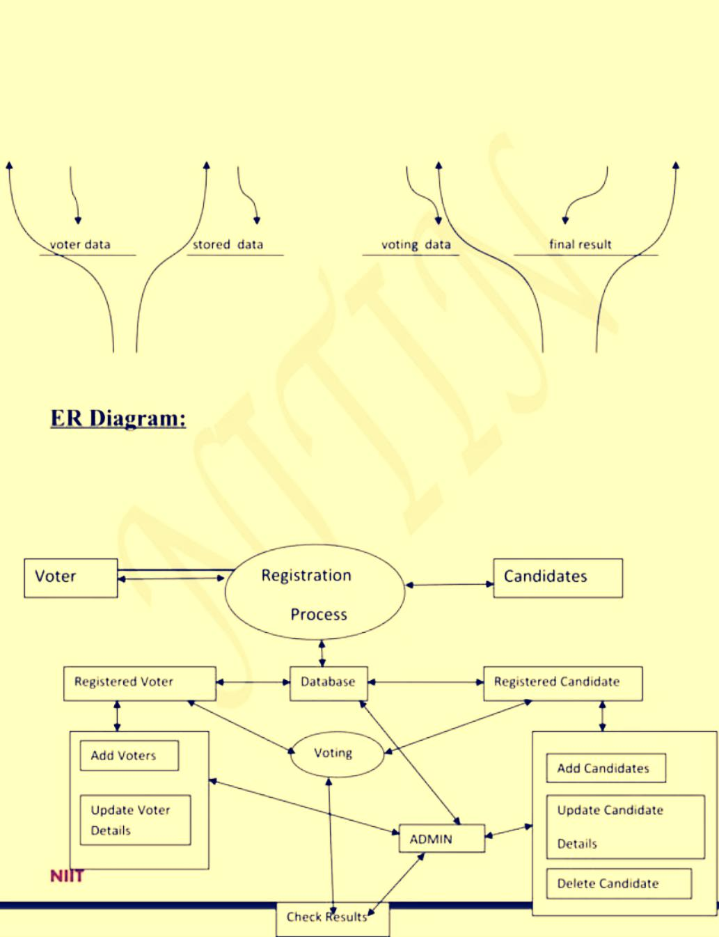
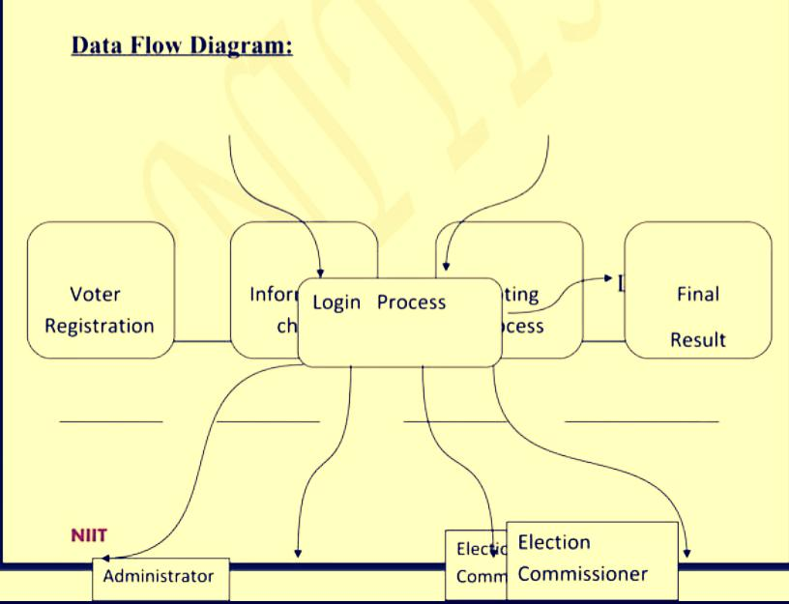
-:Project overview :-

Slide 6
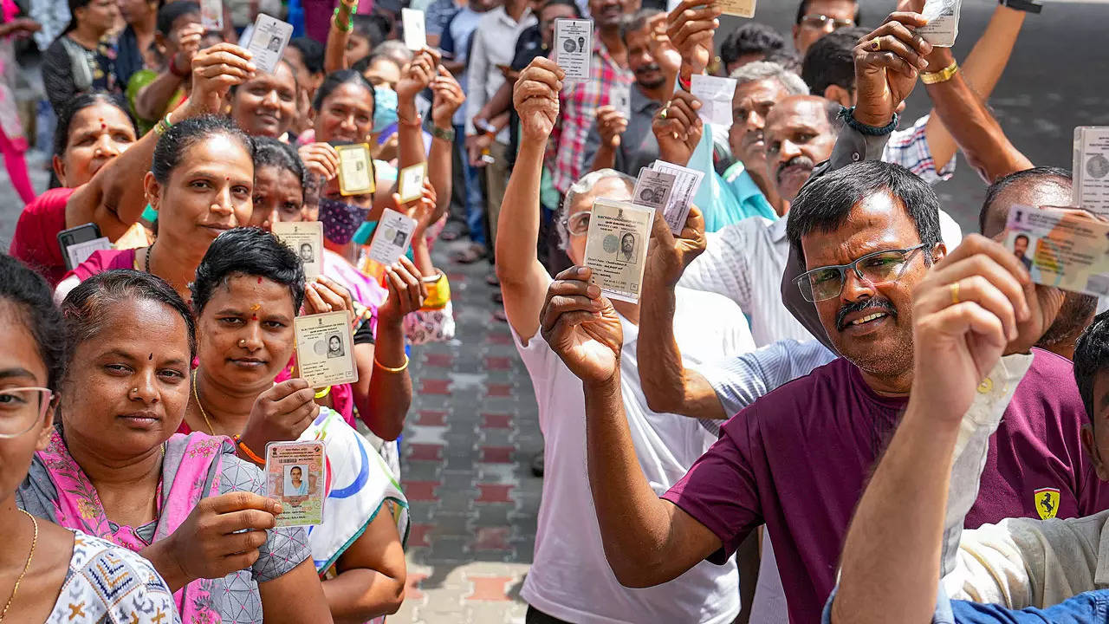
-:EXISTING SYSTEM:-
Existing system is a manual one in which users and the details of the candidates are stored in books. The users have to wait a long time in queues for voting. Wrong and unwanted votes are given. Counting of votes are done manually which takes lots of time and inaccurate counting is done. It is very difficult to maintain historical data.
In the existing system, there is compulsory need in physical presence in the time of election polling or vote counting.

Slide 7
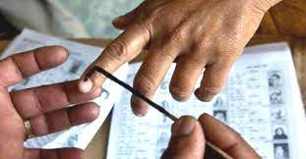
DISADVANTAGES OF EXISTING SYSTEM:-
If elections are conducted in existing system model in the pandemic time, then there is sure spread of disease like COVID, which happened in the recent elections in India. It is difficult to maintain important information in books. More manual hours are needed for counting of votes.

Slide 8

PROPOSED SYSTEM:
The Online Voting System is a software application which avoids more manual hours that need to spend in record keeping and calculating votes. Through this the users and the candidates are registered online. Their information is stored in the database the admin can easily access the details of the voters and the candidates. The voters are allowed to vote online they can even vote by sitting at home. Every User allowed to vote only once so there is no chance of duplicated votes.

Slide 9
ADVANTAGES OF PROPOSED SYSTEM:
The objective of the VOTING SOFTWARE is to provide better information for the users of this system easily they can vote from anywhere without facing any difficulty. The proposed system does not require any physical presence during vote polling or counting. So it is very easy to conduct elections even during the pandemic situations without any spread of disease or human live losses. The proposed system has good authentication so only authorized person can able to vote and also cannot vote multiple types. Vote Counting can be made very quickly and results will be displayed in few minutes.

Slide 10


Slide 11
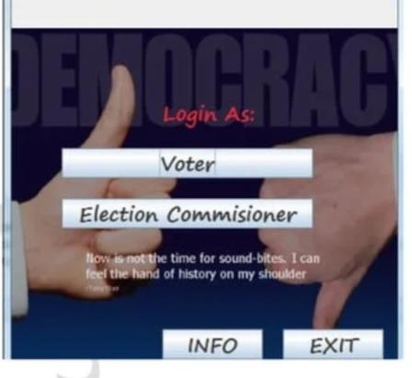
MODULES:
Admin Module Add Elections Add Candidate. View Voter and approve voters View the Vote and results Voter Module Voter Registration View Candidate details Vote

Slide 12
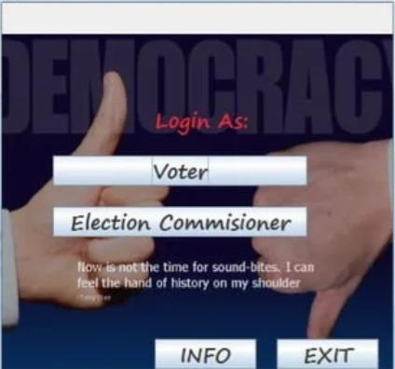
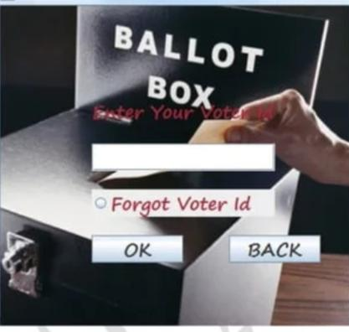
-:Modeling:-

Slide 13
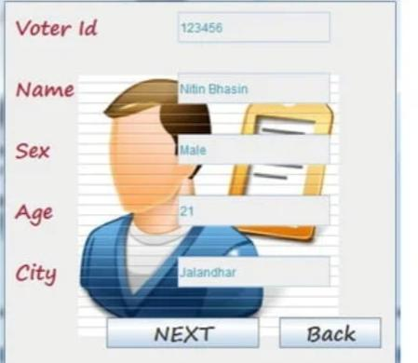
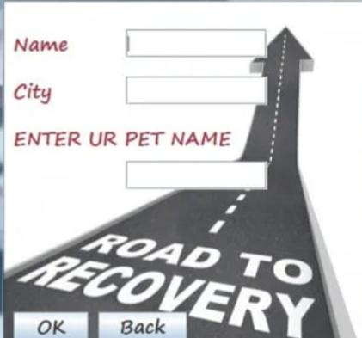

Slide 14
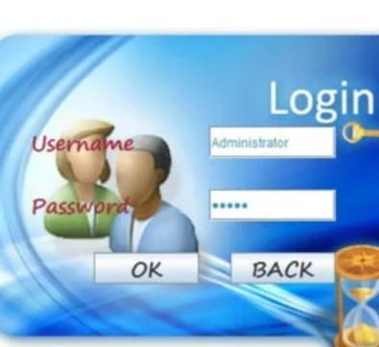
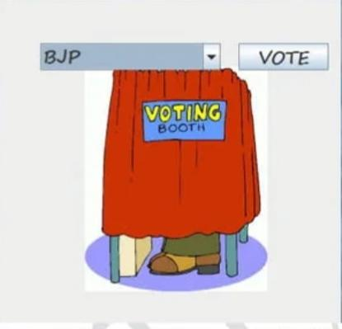

Slide 15
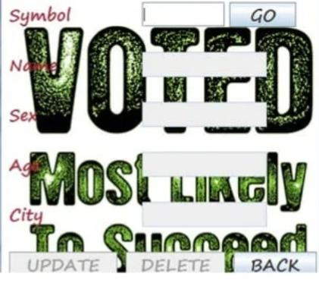

-:RESULT:-

Slide 16
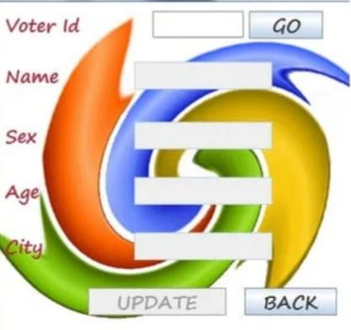

Slide 17
-:Link’s:-
https://github.com/Charvik143/VOTING_SYSTEM.git
git@github.com:Charvik143/VOTING_SYSTEM.git
Gh repo clone Charvik143/VOTING_SYSTEM

Slide 18


