Slide 1


Economics
ICT SEM 4
Group 6

Slide 2
Group members
Maunil Vyas 1401007
Deep Patel 1401010
Shreyas Patel 1401025
Jay Dangar 1401043
Pratham Solanki 1401049
Ashutosh Kakadiya 1401075
Deep Talati 1401085
Harsh Mehta 1401086
Kishan Raval 1401117

Slide 3

Market Analysis Of Onion

Slide 4
Market Classification
Market
Time
Regulation
Based on Volume of business
Based on Nature of goods
Competition
Area
Demand and Supply
Transactions

Slide 5
Based on time (Sub Classification)
Time
Very short period
Short period
Long period
Very long period

Slide 6
Based on time
Onion belongs to a “Short period Market”
Reason:
The onion is a perishable product, so the amount of time when onion is there in market is lesser.

Slide 7
Based on regulation (Sub Classification)
Regulation
Regulated
Non-
regulated

Slide 8
Based on regulations
Onion Belongs to “Regulated Market”
Reason:
Generally the trading of onion takes place according to rules and regulations made by the central bodies (here APMC, Government)

Slide 9
Based on Area (Sub Classification)
Area
Local
Regional
National
International

Slide 10
International Market :-
There is a lot of demand of indian’s onions, specially red onions worldwide.
The India has exported 12,38,102.60 MT of fresh onion to the world for the worth of Rs. 2,300.57 crores during the year 2014-15.
Major Export Destinations (2014-15) : Bangladesh, Malaysia, Sri Lanka, United Arab Emirates, and Nepal.

Slide 11
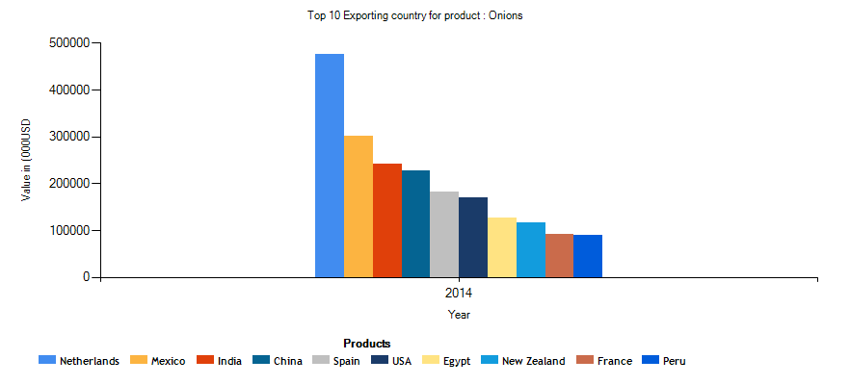
Export
India ranked second among the top 10 onion exporting countries for several years. However, this position has taken a hit. In 2014, it is 3rd.

Slide 12
One major effect is neighboring countries such as China and Pakistan have begun producing onions of the same quality and pungency and their onions are a lot more cheaper in the international markets.
Moreover, Thailand, Indonesia and Sri Lanka who were traditional buyers of the Indian onions have begun to produce onions and also export them. Since the competitiveness has increased, India has not been able to match up both in terms of quality and policies.

Slide 13
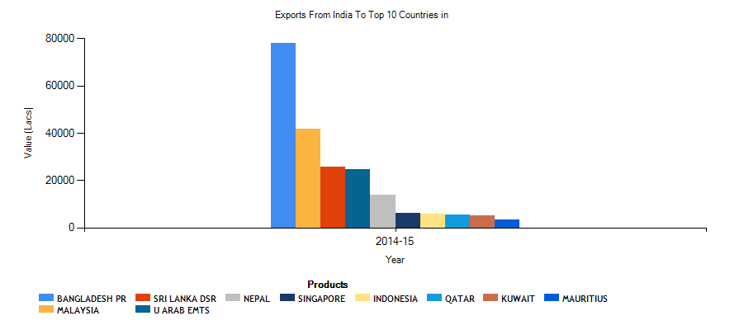
TOP 10 EXPORT DESTINATION

Slide 14
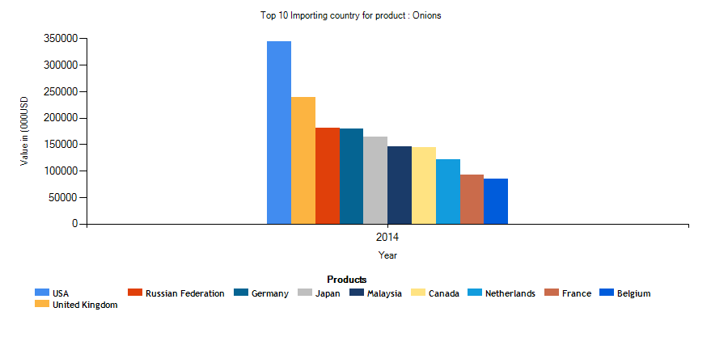
IMPORT
India ranks 115 for importing the onions.
India has imported 813 MT onion of worth 253 (000USD), which is only 0.01% of total import across the all country.

Slide 15
Based on volume of business (Sub Classification)
Volume of business
Wholesale
Retail

Slide 16
Based on volume of business
“Wholesale” and “Retail Market”
When we consider market of farmers and traders it is considered as wholesale market(APMC Market), but when it is seen from point of view of local vendors and consumers it is considered as retail market(Vegetable Market).

Slide 17
Based on nature of goods (Sub Classification)
Based on nature of goods
Commodity market
Capital market

Slide 18
Based on nature of goods
Onion belongs to “Commodity Market”
The Onion is considered as Agricultural Commodity and thus its market is called commodity market.

Slide 19
Based on competition (Sub Classification)
Competition
Perfectly Competitive Market
Monopoly Market
Monopolistic Market
Oligopoly Market

Slide 20
Nature of competition
Onion belongs to “Perfectly Competitive Market”
Reasons:
Large numbers of sellers and consumers
All sellers are selling identical products
Some sellers have relatively small market shares (not all)
Buyers have complete information about the product
Sellers are price takers (not always)
Free entry and exit. (very less restrictions)

Slide 21
Based on Demand and Supply (Sub Classification)
Demand and Supply
Seller’s Market
Buyer’s Market

Slide 22
Demand and Supply
Seller’s Market and Consumer’s Market
Here, this classification changes according to time.
Two Conditions are Possible
Supply > Demand : Consumer’s Market
Demand > Supply : Seller’s Market

Slide 23
Based on transaction(Sub Classification)
Transaction
Spot
Future

Slide 24
Based on transactions
Onion belongs to both of this market categories based on it’s transaction
Spot Transaction
The transaction between local sellers(Retailers) and traders termed as “Spot transaction”.
Future Transaction
When there is need of export and import of onions at that time one has to consider the future effect on onion so this kind transaction termed as “Future Transaction”

Slide 25
Special Thanks to….
Mr. Chittranjan M. Patel (Joint Director, Department of Horticulture, Government of Gujarat).
Guided By,
Rita Sharma
Anmol Anubhai

