Slide 1
Economics Project – 2 Market Analysis of Air Conditioner
Group - 13

Slide 2
Group Members
Raj Shah – 1401050
Kashish Shah – 1401048
Akash Soni – 1401047
Deval Shah – 1401060
Abhishek Chaudhary-1401059
Maharshi Bhavsar – 1401061
Jeet Parekh – 1401011
Deep Parekh – 1401001
Malav Vora - 1401062

Slide 3
Outline
Resources
Theories of Economics
- Economic Terms related to market economy
Types of market
Characteristics Of Market
Equilibrium Graphs :Short and Long Run
Introduction
Analysis of market
Study of dynamics of AC market
Porter Five Force Analysis
Conclusion

Slide 4
Resources
www.economicsonline.co.uk
www.investopedia.com
Information Resources about AC Market provided by ADITI Enterprise.
ISHRAE Document
http://www.prnewswire.com/news-releases/india-air-conditioners-market-forecast--opportunities-2018-215502641.html
http://www.voltas.com/news/cooling_appliances/All-India_ac_market_leader_Voltas_AC.asp
http://timesofindia.indiatimes.com/business/india-business/Voltas-topples-LG-to-be-No-1-in-AC-business/articleshow/45391642.cms

Slide 5
Market Economy Terms
MARGINAL COST: In economics, marginal cost is the change in the total cost that arises when the quantity produced is incremented by one unit, that is, it is the cost of producing one more unit of a good.
MARGINAL REVENUE: Marginal revenue (R') is the additional revenue that will be generated by increasing product sales by one unit.
AVERAGE COST: Average cost (AC), also known as average total cost (ATC), is the average cost per unit of output.
ATC = TC/Q. (TC = FIXED COST + VARIABLE COST)
Max Profit Point : A point when company stops producing additional quantity and has reached a point where for a given quantity they can achieve max profit –> Marginal Revenue = Marginal Cost .
After this point company incurs loss as MC > MR.
AVERAGE REVENUE: It is revenue generated per unit sold.

Slide 6
Types of Market
Perfectly Competitive
Monopoly
Oligopoly
Monopolistic

Slide 7
Perfectly Competitively Market
Perfect competition is a market structure where many firms offer a homogeneous product.
Because there is freedom of entry and exit and perfect information, firms will make normal profits and prices will be kept low by competitive pressures. The characteristics are as follows –
Many firms.
Freedom of entry and exit, this will require low sunk costs.
All firms produce an identical or homogeneous product.
All firms are price takers, therefore the firm’s demand curve is perfectly elastic.
Firms can only make normal profits in the long run, although they can make abnormal (super-normal) profits in the short run.

Slide 8
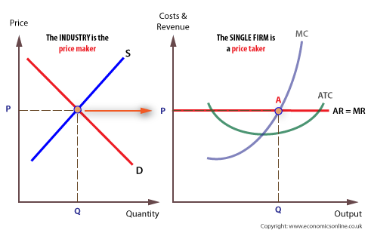
FIRM AS PRICE TAKER
The single firm takes its price from the industry, and is, consequently, referred to as a price taker.
The industry is composed of all firms in the industry and the market price is where market demand is equal to market supply.
Each single firm must charge this price and cannot diverge from it.

Slide 9
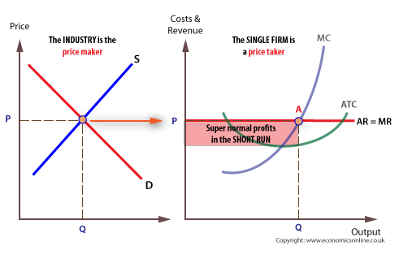
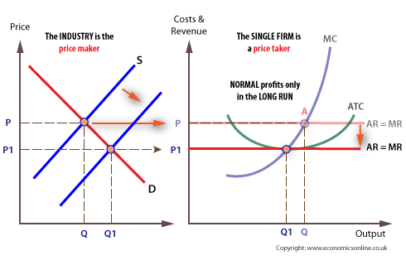
Equilibrium in Perfect Competitive Market
In the short run
Under perfect competition, firms can make super-normal profits or losses.
In the long run
The effect of this entry into the industry is to shift the industry supply curve to the right, which drives down price until the point where all super-normal profits are exhausted.
If firms are making losses, they will leave the market as there are no exit barriers, and this will shift the industry supply to the left, which raises price and enables those left in the market to derive normal profits.

Slide 10
Monopoly Market
A pure monopoly is a single supplier in a market.
For the purposes of regulation, monopoly power exists when a single firm controls 25% or more of a particular market.
Occurrence of monopoly of producer can be due to various reasons.
Producers may have patents over designs, or copyright over ideas, characters, images, sounds or names, giving them exclusive rights to sell a good or service, such as a song writer having a monopoly over their own material.
Characteristics are as follows :
Sellers are price makers
Buyers are price takers
Sellers do not engage in strategic behaviour
No new Firms can enter the market.
The buyers have no other alternative option to product sold in monopoly(pure monopoly).

Slide 11
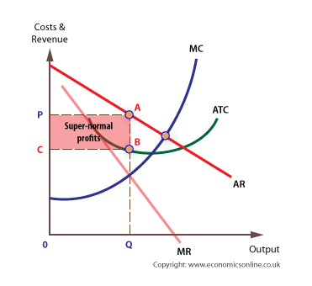
Equilibrium in monopoly market
Monopolies can maintain super-normal profits in the long run. As with all firms, profits are maximized when MC = MR.
In general, the level of profit depends upon the degree of competition in the market, which for a pure monopoly is zero.
At profit maximization, MC = MR, and output is Q and price P. Given that price (AR) is above ATC at Q, supernormal profits are possible (area PABC).
With no close substitutes, the monopolist can derive super-normal profits, area PABC.
A monopolist with no substitutes would be able to derive the greatest monopoly power.

Slide 12
Advantages
Disadvantages
Domestic monopolies can become dominant in their own territory and then penetrate overseas markets, earning a country valuable export revenues. This is certainly the case with Microsoft.
It has been consistently argued by some economists that monopoly power is required to generate dynamic efficiency, that is, technological progressiveness. This is because:
High profit levels boost investment in R&D.
Innovation is more likely with large enterprises and this innovation can lead to lower costs than in competitive markets.
A firm needs a dominant position to bear the risks associated with innovation.
Monopolies can be criticized because of their potential negative effects on the consumer, including:
Restricting output onto the market.
Charging a higher price than in a more competitive market.
Reducing consumer surplus and economic welfare.
Restricting choice for consumers.
Reducing consumer sovereignty.

Slide 13
Oligopoly Market
An oligopoly is a market structure in which a few firms dominate. When a market is shared between a few firms, it is said to be highly concentrated.
Although only a few firms dominate, it is possible that many small firms may also operate in the market.
Oligopolies may be identified using concentration ratios, which measure the proportion of total market share controlled by a given number of firms. When there is a high concentration ratio in an industry, economists tend to identify the industry as an oligopoly.
The main characteristics of oligopoly markets are :
An industry which is dominated by a few firms.
Interdependence of firms, firms will be affected by how other firms set price and output.
Barriers to entry, but less than monopoly due to following reasons:
Economies of large scale production.
Ownership or control of a key scarce resource
High set-up costs
High R&D costs
Differentiated products, advertising is often important
Most common market structure

Slide 14
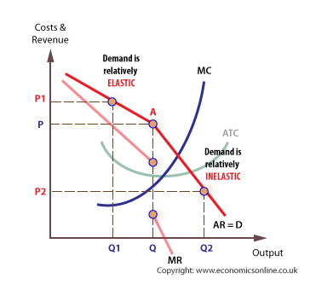
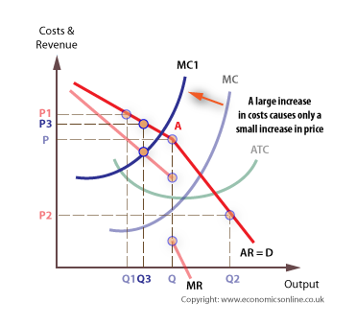
Equilibrium In Oligopoly Market
The reaction of rivals to a price change depends on whether price is raised or lowered.
Even when there is a large rise in marginal cost, price tends to stick close to its original, given the high price elasticity of demand for any price rise.

Slide 15
Monopolistic Market
Monopolistic is a market structure which combines elements of monopoly and competitive markets.
A monopolistic market has the following characteristics:
Many firms.
Freedom of entry and exit.
Each firm makes independent decisions about price and output, based on its product, its market, and its costs of production.
The entrepreneur has a more significant role than in firms that are perfectly competitive because of the increased risks associated with decision making.
Make normal profits in the long run, but could make supernormal profits in the short term.
A central feature of monopolistic competition is that products are differentiated. There are four main types of differentiation:
Physical product differentiation,
Marketing differentiation
Human capital differentiation
Differentiation through distribution

Slide 16
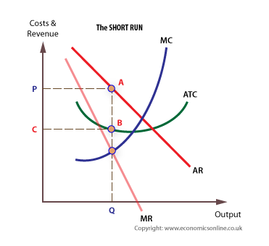
Equilibrium In Monopolistic Market
In Short Run
In the short run supernormal profits are possible, but in the long run new firms are attracted into the industry, because of low barriers to entry, good knowledge and an opportunity to differentiate.
At profit maximization, MC = MR, and output is Q and price P. Given that price (AR) is above ATC at Q, supernormal profits are possible (area PABC).
As new firms enter the market, demand for the existing firm’s products becomes more elastic and the demand curve shifts to the left, driving down price. Eventually, all super-normal profits are eroded away.

Slide 17
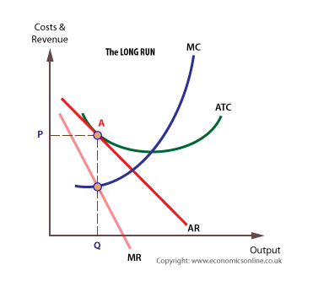
Equilibrium In Monopolistic Market
In Long Run
Super-normal profits attract in new entrants, which shifts the demand curve for existing firm to the left. New entrants continue until only normal profit is available.
At this point, firms have reached their long run equilibrium.
Clearly, the firm benefits most when it is in its short run and will try to stay in the short run by innovating, and further product differentiation.

Slide 18
Analysis of AC market
In air conditioner market, there are different firms and each firm makes independent decisions about the price and output based on it’s product, it’s market and the cost of production.
The entrepreneur has a more significant role than in firms that are perfectly competitive because of the increased risks associated with decision making.
There is freedom to enter or leave the market, as there are no major barriers of entry or exit.
In AC market many companies like LG,Samsung, Voltas etc. have sustained a certain amount of market share over last decade after entering the market.
While some other new companies like Microtek,Videocon etc. have recently entered the market and are getting grip of share due to low cost and effective marketing.

Slide 19
There are enough firms in this type of market that one firm's decision does not set off a chain reaction.
Producers have some control over the price. They are price makers and not the price takers.
Also the companies have to heavily depend on advertising of their products due to immense competition as different companies provide air conditioners with varying technologies and features.
In the short run supernormal profits are possible, but in the long run new firms are attracted into the industry, because of low barriers to entry, good knowledge and an opportunity to differentiate.
For an AC market , we cannot actually predict the long run of a firm because the tech variations in product are huge and innovations can increase the brand value of that firm and incur huge profits

Slide 20
The demand curve has a downward slope because each firm makes a unique product, it can charge a higher or lower price than its rivals. The firm can set its own price and does not have to ‘take' it from the industry as a whole, though the industry price may be a guideline, or becomes a constraint.
Due to the range of similar offerings, demand is highly elastic in monopolistic competition. In other words, demand is very responsive to price changes.
Consumer is benefited due to rivalry between competitors resulting to drop in price of AC.

Slide 21
Product Differentiation
Physical Differentiation:
Companies are spending huge capital in R & D for making AC more and more Compaq and visually attractive to look apart from there competitors.
The consumer is constantly looking for reason for where the marginal benefit for him/her is more , in which product and thus physical differentiation plays a vital role in AC market.
Marketing Differentiation:
Different air conditioner companies try to differentiate their products in terms of packaging and other promotional techniques .
For e.g. LG spent about 5-6% sales in solely advertising to increase brand awareness by sponsoring 2003 cricket world cup .
The company announced that it would spend around Rs 400-500 million on advertising during the World Cup.
There marketing strategy played a huge role in making LG a global brand in AC MARKET as well other FMCG (Fast Moving Consumer Goods).

Slide 22
Human Capital Differentiation:
Here the firms create differences through the skill of its employees, the level of training received, distinctive uniforms, and so on.
Many AC Companies have moved from employing labours to employing machines.
Companies like Samsung and LG that are leading brands of AC have replaced around 12 % labour with machines over past decade resulting into huge production and cutting out the cost of labour wage and labour training.
Differentiation through distribution:
The distribution channel Is very important for a product like AC because AC being a Fast Moving Consumer Good ,the distribution channels have to be structured well enough to acquire customers needs from overall market with less expense.
Every company have a different structure of distribution channel and the company which brings its product as fast to consumers is considered to be well structured from distribution point of view.

Slide 23
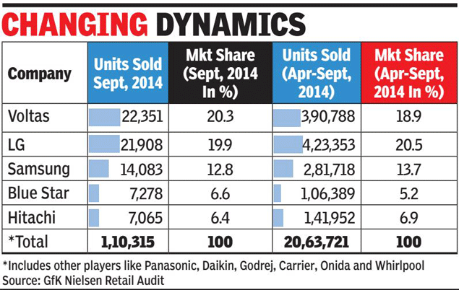
Market Share Of Q2-2014
As of last year , the leading AC brand LG has been overtaken by Voltas in terms of market share in September 2014.
These shows competitiveness in AC market.
And recently entered companies like Samsung and Blue Star have acquired market share of Carrier and Diakin through innovative marketing and distribution strategy in INDIA.

Slide 24
Porter Five Force Analysis
What are 'Porter's 5 Forces‘??
Porter's 5 Forces are named after Michael E. Porter, this model identifies and analyzes 5 competitive forces that shape every industry, and helps determine an industry's weaknesses and strengths.
1. Competition in the industry 2. Potential of new entrants into industry 3. Power of suppliers 4. Power of customers 5. Threat of substitute products

Slide 25
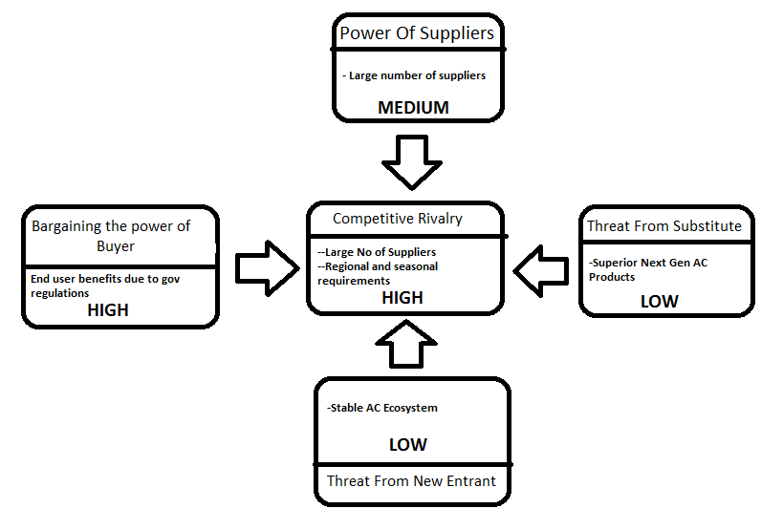
Porter Five Force Analysis For AC Market
Source : BIS RESEARCH REPORT FOR GLOBAL AC MARKET

Slide 26
Bargaining power of buyer
The bargaining of buyer is high and estimated to remain same.
User benefits because of government regulations by getting more energy efficient cooling solutions and environmental less hazardous products.
There is huge technology/price war among competitors which results cheaper AC product for consumer.
Threat From New Entrant
The threat from new entrant is causing negligible impact on current leading companies because of heavy technical and R&D requirements needed to enter AC market.
The AC ecosystem is pretty stable and is dominated by big companies like Diakin , Carrier etc. having very strong associations among consumers and hence put a big constraint on new entrants.
Bargaining power of supplier
The suppliers have medium bargaining power as they are facing huge competition among themselves.
Compliance to the govt. regulations and providing the customers with technically better product at a lower price is main reason of competition in AC market.
Regulations are implying constraints on AC cooling capacity.

Slide 27
Competitive Rivalry
There is huge competition majorly dominated by about 7 brands across world.
Also it is due to regional and seasonal requirements.
Threat From Substitute
There is no major substitute threat in AC market because R & D costs huge capital in this area ,so there are very less companies that actually invests in it leading to innovation of new category.
There are substitutes in market ,but most consumers are reluctant to buy them due to high cost’s and less awareness of actual product morality.

Slide 28
Conclusion
AC Market in INDIA currently stands as a monopolistic market.
The entrepreneur has the liberty to enter and leave the market any time.
Different brand in AC market decides their own product price.
According market analysis , leading AC brand in India is Voltas .
Porter Five Force Analysis suggests that AC market is very dynamic and to hold a great amount of market share in such a market for long period is very tough.
Overall market of AC is multi-billion dollar industry and new entrants are seen market , but the market is dominated by leading brands like Diakin , LG ,Voltas etc.

Slide 29
END

