Slide 1
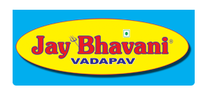
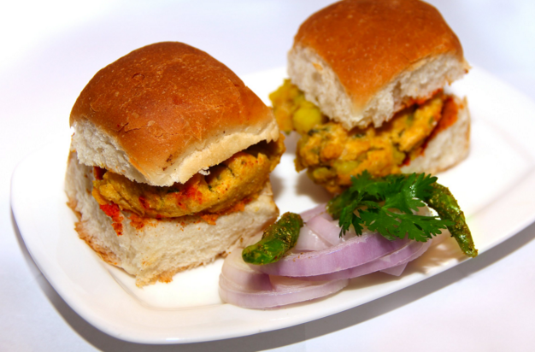
Economics
Group-4
Case Study : JAY BHAVANI

Slide 2
“Economics is the science of wealth” -Adam Smith (Father of political Economy)
“In market , both supplier and consumer want to win”.
- Rajubhai ( Managing head, Jay Bhavani)

Slide 3
Let’s Peep into the history
Three wheeler stall ‘Bhavani Maa’ at Municipal market with initial capital investment of only 5 thousand rupees , have now grown more than a thousand times with 23 outlets in Ahmedabad is itself a brand.
Now JB has about 54 outlets all around Gujarat.
They were much of initial investors in field of providing a quality Vadapav and having a vision of making it a big business.
Jay Bhavani brand has gone through lots of transition and transformations since 1997 till today.
MOTO : Convenience, Quality, Cleanliness, Service, and Value and of course the best food.

Slide 4
Topics Covered
Demand
Demand distribution
Change in demand vs change in Quantity demanded
Supply Curve
Why there are no Frequent change in price?
Equilibrium
Margin

Slide 5
Cross Elasticity
Income Elasticity
Conclusion
S.W.O.T Analysis
FC vs Vc
Revenue Source

Slide 6
Graphs Included
Demand
Variation in demand
Reason for abnormal demand hike
Supply
Number of employee
Outlet
Year vs supply
Others
Income Elasticity
Jay Bhavani Franchises
Price
Price vs Year
Revenue Distribution

Slide 7
Demand
Demand = Desire + Ability to pay + will to spend
It has been observed that demand of “Jay Bhavani’s vadapav” has increased exponentially.
Comparing cost of vadapav it has ben seen through survey that price of Jay Bhavani’s vadapav was always higher then other sources but the demand remained same.
But still prices has not affected demand much.

Slide 8
Demand distribution
It almost two decades and demands are growing exponentially.
Demand has always surpassed the supply for JB especially.
Market has always demanded for more and more outlets in different area for quality vadapav.
Franchised outlets doubles the supply of Jay Bhavani and adds to source of revenue generation.
Demand to open up franchise at different districts of Gujarat has arisen. Even there are proposals to set up an outlet in other states as well as in America.
Wedding seasons, functions, stalls give hike of 1.5 times the selling in each outlet.
Weekends give rise 40% in sales. i.e. if sales on regular day for all branches is 10,000 on a regular days, on weekends around 14,000 vadapav’s are sold.
Graph of sales and variation in demand is as follow :

Slide 9
Variation in demand

Slide 10
Reason for abnormal demand hike
Irrational behavior of consumer - People’s will to eat vadapav has risen irrespective of rise in cost of vadapav. Reason being taste, brand name, status symbol etc.
“Jay bhavani” has tried to maintain its taste and quality of vadapav since it started

Slide 11
Change in Demand vs Change in Quantity Demanded
Change in Demand : A change in demand of a product means a change of the whole purchase plan. It is caused by factors other than the change in the price of the product.
Change in demand has been observed when a new product is introduced. However for Vadapav particularly for a particular price , demand has always increased.
Change in quantity demanded : A change in quantity demanded of a product refers to a change of quantity demanded as a result of price change of the product.
As observed , inverse relation between price and demand does not exist for Jay Bhavani.
Due to local competition change in quantity demand was around 15%.

Slide 12
Supply curve
Outlet is setup when firm expects 30% increase in total revenue.
Only one outlet is established in 3km area supplying to the demand from consumer.
There are in total two factories catering demand of this outlets.
First factory (producing buns and required material) established around 2004 while another factory was recently inaugurated in 2015 keeping in mind production for 54 branches.
Total staff of 450 in their 23 outlets.
Graph for staff is as follow:

Slide 14
Year vs supply

Slide 15
Price vs Year

Slide 16
Why there are no frequent changes in price?
Abnormal consumer behavior has been observed
On increasing price from time to time demand is constantly increasing .
This is a different case of market where it is neither elastic or non-elastic in regular sense.

Slide 17
Equilibrium
Market equilibrium is achieved when consumer is ready to purchase at price where producer want to sell.
JB has not increased prices since last 3 years and is constant at Rs.22 this has given sustainability and equilibrium has achieved where both producer and consumer are satisfied on a particular price.
Though complete equilibrium is not achieved due competition.
Competition affects sales of vadapav by 10-15% due to offers given by other brands.

Slide 18
Margin
Margin decides profit
Formula : price-cost= Profit
It has fluctuating value , earlier margin was more but customers were less. Now, as consumers have increased at higher rate so it compensates more than the profit earned earlier.
E.g. :- Margin 3rs * 500 customers = 1500rs. Profit
Margin 2.5rs* 1000 customers = 2500 rs.profit.

Slide 19
Revenue sources
Revenue is the income a firm retains from selling its products once it has paid indirect tax.
Maximum revenue which jay Bhavani gets is through its 23 branches across Ahmedabad.
Along with this it also earns revenue through other sources like
31 Franchises
College festival
Marriage and other Function etc.

Slide 21
FC vs VC
Fixed Cost
Variable Cost
Fixed cost - costs that are independent of output.
Rent, Machinery, various bills etc. are some of fixed cost.
Variable cost - costs that vary with output.
Ingredients , paper napkin, plate, transportation, tax etc. are some of the example of fixed cost.

Slide 22
Cross Elasticity
Cross Elasticity measures the responsiveness of demand for good X following a change in the price of a related good Y.
Substitutes like maskabun , dabeli were introduced from time to time.
There more than 35 products sold at Jay Bhavani .
However instead of affecting the main product , it helped in attracting customers.
Most products are of nearly similar price.
Thus, No negative effect of cross elasticity is observed.
On introducing maskabun as a second product of JB gave rise to 15% sale of vadapav.

Slide 23
Income Elasticity
Income elasticity = % change in demand / % change in income
Monthly income of an individual from 1999-00 was 1572 rupees.
Monthly income of an individual from 2012-13 was 8081 rupees.
Monthly sale of vadapav in year 1999-00 was around 11000.
Monthly sale of vadapav in year 2012-13 was around 60000.
Income elasticity = 514 / 545.45
= 0.9423
Year | Monthly Income of Individual | Monthly sale of vadapav
1999-00 | 1572 Rupees | 11000
2004-05 | 2403 Rupees | 21000
2007-08 | 3786 Rupees | 40500
2012-13 | 8081 Rupees | 60000

Slide 24
Income Elasticity

Slide 25
Conclusion
Market type : monopolistic
With competitors like Shreeji , karnavati ,Bombay vadapav ,etc
Changing culture and mindset of people about food habits.
Increasing income
Supply fulfilling the consumer demand
Attracting consumers by introducing other products.
Free home delivery has boosted market sales twice in four months.

Slide 26
S.W.O.T Analysis
Strength:-
Quality and taste of vadapav
Brand
Services
Variety of products available
Weakness :-
Higher prices
Less Advertising
Opportunity:-
Faithful consumers
Wide spread branches
Franchised market
Growing demand
Threats:-
Market Competition
Reaching out to market Demand

Slide 27
Jay Bhavani franchise

Slide 28
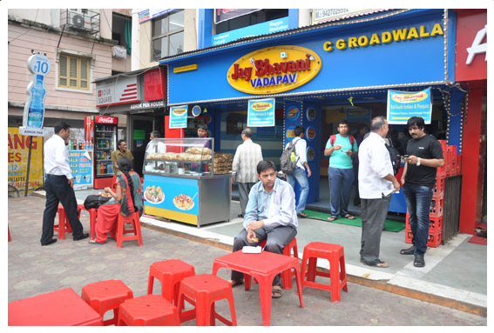
Credentials
Jay A Joshi (1401005)
Nirav Akbari (1401008)
Amee Bhuva (1401009)
Subhashi Dobariya (1401012)
Krima Doshi (1401035)
Rahul Rachh (1401057)
Jainil Vachhani (1401116)
Yash Turakhia (1401118)

