Slide 1
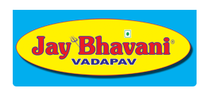
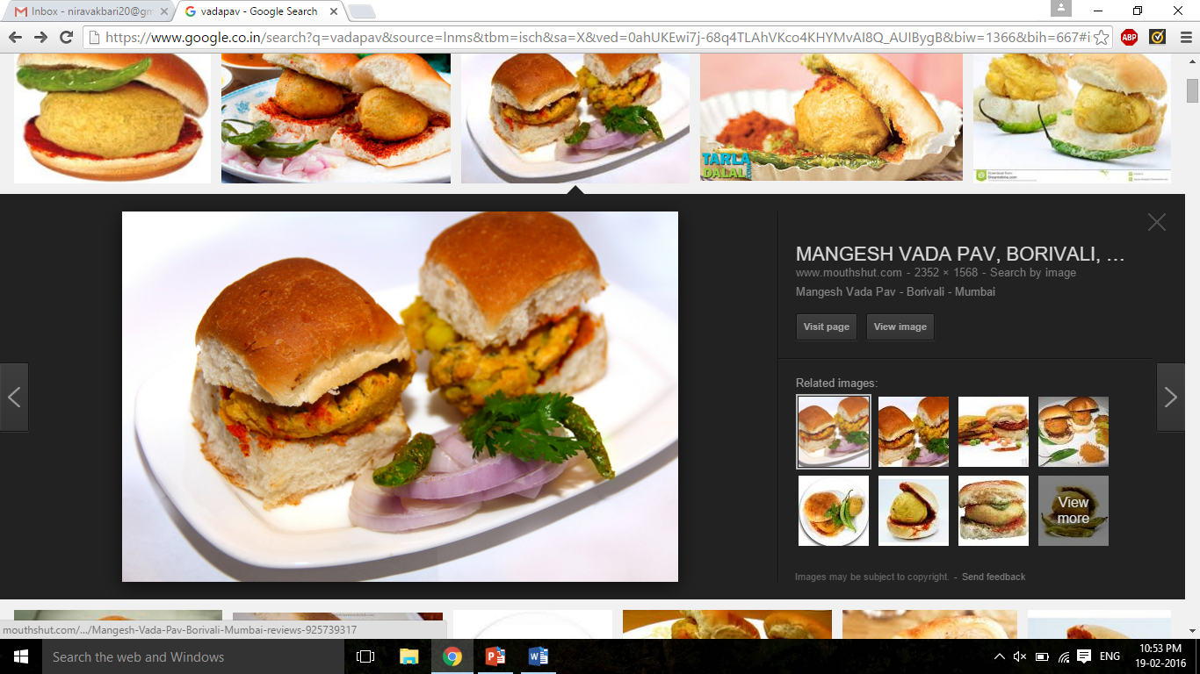

Economics
Market Analysis: JAY BHAVANI

Slide 2
Topics to ponder :-
Market volume
Emerging competition
Clients Characteristics
Changing trends
Regulations
Business strategies (Fiscal policies of JB)
Product R & D
Services

Slide 3
Brief about past
Market : Completely Free(Competitive) market
Being a small stall selling vadapav with so many such producers with same product and almost the same price justifies it to be a Free market.
Competitors : All local stalls as well as branded food shops.
Clients : People working in near by shops
Trend : Considered as snacks
Products : Vadapav , maksabun , dabeli
Outlets : Very limited

Slide 4
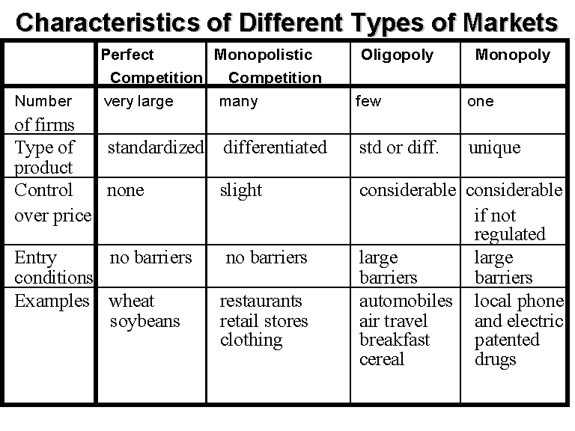

Slide 5
Turning to be a monopolistic market……

Slide 6
Market Volume : Today and Tomorrow
Now
Next 3 years
23 self owned branches
31 franchised branches.
Branches across cities.
Mainly Ahmedabad centered.
With minimum 2 branches increasing every year in recent past, and 15 % rise in their business every year.
Their self owned branches can increase up to 35 all over Gujarat.
Targeting different cities and increasing the number of valued customers.

Slide 7
Emerging Competition :- Good image always benefits in monopolistic market
Competitors now
In near future
Local vendors
Other brands in same field.
Eg.
Bombay vadapav,
Katchhi king
Shreeji vadapav
Karnavati dabeli
Providing almost similar types of products in similar price range.
Due to increasing number of products and recently opened restaurant shows that it will now be competing with big firms in their sector.
As branches would develop in different cities, regional competition would come into play along with existing.

Slide 8
Client Characteristics: Who are they and what are their needs ?
Now
Later
JB has become a brand.
There is vital role of faithful customers who have always preferred JB in place of others.
Client expects quality food which is always satisfied .
College students, workers , Sophisticates, Elderly …Every class and age of people.
Demand to setup outlets in other countries have arisen recently.
They will have different taste and preferences.
Also, branches in different cities and states would have different approach towards client depending upon their food habits and requirements.

Slide 9
Transitions : Satisfying demand-supply in market
From Local to Regional to International markets

Slide 10
Changing trends
Now
Few years later
More people would be ready to pay higher price for good ambience.
More then food , it will become a place for hangouts and meetings.
Expectations for variety of food incrreases.
Easy and nearby availability i.e. location would play important role.
Local people generally visit JB for quality food that is worth to their money.
Taste is given preference along with complementary products like chatni .
Variety of food available there.
Price is always a factor.

Slide 11
Regulations:
A certificate of standardization as standardized food safety inspection officer is issued to all Candidates who successfully complete the standardization process in US.
Food safety and standards authority of India(FSSAI) is the governing authority that keeps a check on quality of food produced.
JB is approved by Food Safety Officers(FSO) from FSSAI.
It provides food license to sell the approved products based on ingredients used.
FSSAI was established in 2006 , which has served strictly in maintaining the quality food
Prevention of Food Adulteration Act & Rules (PFA Act), 1954 has definition of harmful ingredients and adulteration which keeps a check on Seller.
For more details :-
http://www.fssai.gov.in/portals/0/pdf/food-act.pdf
Government policies that keeps an eye on the quality of the product sold by retail food sellers.

Slide 12
Business Strategies : Non-preservable products
Finance management becomes prime concern for a growing firm.
Jay Bhavani has been on drivers side.
Supply is controlled based on changing everyday demand.
To meet the consumer demands they have started giving franchised branches so that they can reach out to maximum people.
Income is generated from total sale of their main product(vadapav) along with other products which now contributes well enough in revenue generation.
Handling cross elasticity of main product.

Slide 13
Produce and sell strategy :-
Profit remains center of all decisions.
Number of daily customers decides the profit incurred.
Production is demand driven.
Advertising cost is saved by Jay Bhavani, as they believe in customer satisfaction more than advertising their product.
Saved cost is used up in product development and quality maintenance.
Prices of raw material fluctuates on daily basis however margin is maintained.
Production contracts are given as well as self production provide all-round stability.

Slide 14
Market Expectations
Jay Bhavani has prices higher than competitors that gives them added benefits to experiment with their strategies.
Margins is directly proportional to price and inversely proportional to cost of product.
High margin incurs more profit.
There are long term and short term needs to be fulfilled based on market expectations.
Long term needs like setting up a branch, installing manufacturing machines ,etc requires a lot of calculations before execution.
Eg. Setting up a branch : Factors like location , available customer pool ,profit potential etc. play important role.
Short term needs like maintenance has to be taken care of and requires comparatively less investment.

Slide 15
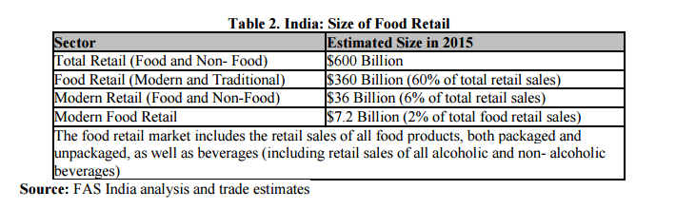

Slide 16
Role of Product R&D
To maintain quality of product approved by FSSAI.
It is not a long lasting product, so food storage and maintaining nutrition level comes under task of this department.
Seasonal changes in raw material should not affect the integrity of taste.
Margin handling(cost cutting).
Introducing new food products.
Competing with same products of other brands.

Slide 17
Services : In a Retail food depo
Free Home Delivery
Becoming customer centric
Customers tempt to eat the quality food products by JB.
So , JB have introduced a profitable solution to provide food to customers at their home.
This gave sudden rise in number of customers.(almost 1.5 times in just two months)
Customer feedback regarding taste , hygiene are take care.
Functions , party services are a real boost to their sales, however they are seasonal.
Almost all branches of Jay Bhavani provides servings to the customer table.

Slide 18
S.W.O.T Analysis
Strength:-
Quality and taste of vadapav
Brand
Services
Variety of products available
Weakness :-
Higher prices
Less Advertising
Opportunity:-
Faithful consumers
Wide spread branches
Franchised market
Growing demand
Threats:-
Market Competition
Reaching out to market Demand

Slide 19
Project by:-
Under Guidance of :-
Prof. Rita Sharma
Anmol Annubhai
Jay A Joshi (1401005)
Nirav Akbari (1401008)
Amee Bhuva (1401009)
Subhashi Dobariya (1401012)
Krima Doshi (1401035)
Rahul Rachh (1401057)
Jainil Vachhani (1401116)
Yash Turakhia (1401118)

Slide 20
Thank You

