Slide 1
Economics
Group-4
Evaluating Regional Rural Banks (RRBs)

Slide 2
Economy can be classified into 3 main sectors:
Agricultural sector
Industrial sector
Service sector

Slide 3
RBB(Regional Rural Banks) is initiative in service sector specially dedicated to uplift rural population by means of banking.

Slide 4
Types of bank :-
Scheduled Banks
Commercial Banks
Public Sector Banks
Private Sector Banks
Cooperative Banks
Urban Cooperative
RBI
Ministry of Finance
Foreign Banks
State Cooperative
Regional Rural Banks

Slide 5
Introduction :-
Regional Rural Banks are operating at the bottom rung of banking organizations in India. They have been set-up with the basic objective of providing credit facilities to the rural population, who had very limited access to the formal credit system.
The area of operation of RRBs is confined to what Government of India had notified, to include one or many districts in a State.
The RRBs came into existence to facilitate the poor section of people, called as the "Target Group". In 1975, during the regime of former Prime Minister of India, Indira Gandhi, the Narasimham Working Group recommended to set up RRBs, as the major portion of the society – about 70% – in India comprised of rural areas.
The RRBs are owned by the Governments at the center and the states and the Sponsor Banks.

Slide 6
With an objective to ensure sufficient institutional credit for agriculture and non - agricultural sectors.
The RRBs mobilize financial resources from rural and semi-urban areas, and grant loans and advances, mostly to small and marginal farmers, agricultural laborers, and rural artisans.
For the purpose of classification of bank branches, the Reserve Bank of India defines a rural area as a place with a population of less than 10,000 people.

Slide 7
Rural India
69% - India’s Population.
86% - earns less than $2/day.
0.33% - reached graduation level (0.29% men & 0.04% women).
50% - economy contributes nearly half of the country’s GDP
50% - the sales FMCG and Durable companies come from the rural areas.
2% - had to travel > 30 minutes (whereas 13% in 2010).
24% - don’t have a bank account today (of below poverty line and reasons like poor access or usage).
The McKinsey report on the rise on consumer market in India predicts that in twenty years the rural Indian market will be larger than the total consumer markets in countries such as South Korea or Canada today
Notes:
Rural India constitutes 69% of India’s population.
86% of Rural population earns less than $2 per day (most of Indian BoP households earn $67 per month).
Only 0.29 per cent of the male population has reached the graduation level (0.04% for women) and 6.% of the rural males arc educated up to the middle level.
Connectivity – In 2006: 13% in rural India had to travel > 30 minutes; 2011: just 2%.
When it comes to connectivity, Rural Indian BOP segment has grown more than urban in last year.
The rural economy contributes nearly half of the country’s GDP
More than 50 percent of the sales FMCG and Durable companies come from the rural areas.
The McKinsey report (2007) on the rise on consumer market in India predicts that in twenty years the rural Indian market will be larger than the total consumer markets in countries such as South Korea or Canada today
It is almost four times the size of today’s urban Indian market and estimated the size of the rural market at $577 Billion.
According to estimates, approximately 245 million adults (24%) in rural India do not have a bank account today
60 million out of 245 million may not need banking services because they are below the poverty line
approximately 185 million “potentially bankable” people do not use formal banking services because of reasons like poor access or usage

Slide 8
Rural Bank in India
Rural banking in India started since the establishment of banking sector in India.
India being agricultural country , development of country lies in its development of this sector
Rural Banks in those days mainly focused upon the agro sector.
Today, commercial banks and Regional Rural Banks in India are penetrating every corner of the country are extending a helping hand in the growth process of the rural sector in the country.

Slide 9
Banking products
Debit Cards
Overdraft
GIRO (General Interbank Recurring Order )
Cheques
Credit Cards
Stored Value Facilities
Money Changers
Remittance

Slide 10
Rural Banking
Started since the establishment of banking sector in India.
Mainly focused upon the agro sector.
14,475 rural banks in the country of which 2126 (91%) are located in remote rural areas.
SBI – Largest bank catering to Rural banking.
A high proportion of rural lending is from informal sources.
About 500-600 million people in India still do not have bank accounts.
Current demand for credit in Rural India is around Rs.1,33,000 Crs.
Commercial Bank branches cover only 7% of rural sector and large market is still untapped.

Slide 11
Scope of banking in rural
India has 200 million households and 400 million middleclass population
Increase in economic activity
Increase in the purchasing power.
Nuclear family concept is gaining much importance

Slide 12
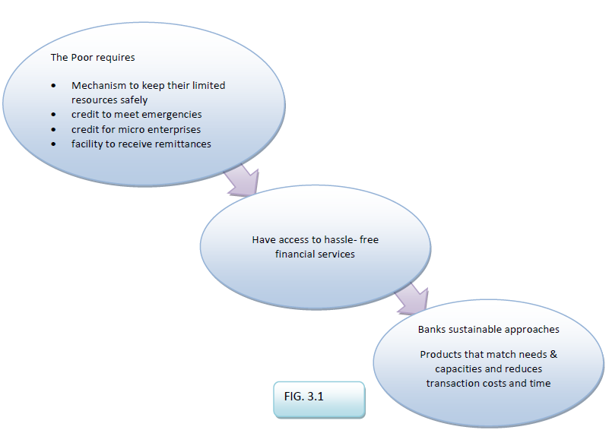

Slide 13
Genesis of Regional Rural Banks
The RRBs were owned by three entities with their respective shares as follows:
Central Government → 50%
State government → 15%
Sponsor bank → 35%
Regional Rural Banks were conceived as low cost institutions having a rural ethos, local feel and pro poor focus. Every bank was to be sponsored by a “Public Sector Bank”, however, they were planned as the self sustaining credit institution which were able to refinance their internal resources in themselves and were excepted from the statutory pre-emptions. http://www.gktoday.in/blog/regional-rural-banks/

Slide 14
"Technology can be a key business enabler in four areas: operational efficiency, customer management, product management, distribution and reach” –NR Narayan Murthy

Slide 15
CRAR
The CRAR is the capital needed for a bank measured in terms of the assets (mostly loans) disbursed by the banks. Higher the assets, higher should be the capital by the bank.
The capital adequacy ratio (CAR) is a measure of a bank's capital. It is expressed as a percentage of a bank's risk weighted credit exposures. Also known as "Capital to Risk Weighted Assets Ratio (CRAR)."
The banking regulator introduced the capital to risk weighted assets ratio or CRAR framework for RRBs in December 2007 and 22 out of 84 RRBs had the ratio below 1% at the end of the 2007-08 fiscal. Thirty three banks had CRAR below 7%.
RRBs to have CRAR of at least 7% as of 31 March 2011 and at least 9% from 31 March 2012 onwards.

Slide 16
MODERNISING RRB OPERATIONS
Technology applications in RRBs Specifically, the computerization can help the following processes; Automatic Ledger Posting and customer accounts management Customer Relations Management
- Extension of online
- remote access facility Participation in National Payment System for transfer of funds Participation in e-governance initiatives of State Govt.
Computer based integrated Data Base and MIS Online trading linkages to Money markets and other agencies Modules of House keeping ATMs, Kisan and other credit cards E-governance services

Slide 17
SOURCES OF RURAL FINANCE
Institutional Credit
Private Credit
Co-operative
Commercial
RBBs
Money Lenders
Landlords
Traders Commission Agents
Notes:
Money lender is often combined with the farming by the village money lender as they lend to farmer for both the productive and non productive purposes charging high rate of interest.
They enter larger than actually borrowed sums through false pretense by obtaining promissory and give no receipts for repayment and often deny such repayments.
Their main interest has been exploit the farmers and grab their lands.
Institutional credit has been introduced to stop such activities of the money lenders

Slide 18
TERM OF RURAL FINANCE
Funds needed by Indian farmers can be categorized into three types:
Short term loan - 12 to15 months
SHORT TERM LOAN are issued to the farmer for the purpose of cultivation or domestics expenses such buying seeds, manure and fodder for cattle, etc.
Medium term loan -3 to 5 years
MEDIUM TERM LOAN are given to farmer to purchase cattle, agriculture implement and to make improvement on land.
Long term loan -15 to 20 years
LONG TERM LOAN are given to the farmer to purchase land, pay of old debt and purchase useful machinery for long term usage. These loans are for comparative long period since the farmers can repay them gradually over a number of years.
Notes:
Depending upon the requirement and purpose, the funds needed by Indian farmers can be categorized into three types

Slide 19
GROUP-WISE DISTRIBUTION OF OFFICES OF COMMERCIAL BANKS - 2010

Slide 20
GROUP-WISE DEPOSITS OF Regional Rural Banks (Rs.in 000 crores)

Slide 21
BANK GROUP-WISE DEPOSITS (Rs.in 000 crores)

Slide 22
Rural banking faces twin challenges
Regulation
Distribution
Regulation with respect to banking has been designed for delivery in urban India.
Distribution requires more manpower to be deployed in rural area.
Rs 1-crore business in microfinance required 30 people in terms of manpower, the same volume of business in other portfolios requires only one person.

Slide 23
Delphi Study Approach :-
The Delphi study approach has been used to identify and understand the different scenarios that will emerge for rural retail banking in 2020.
It is a method for the “systematic solicitation and collation of judgments on a particular topic through a set of carefully designed sequential questionnaires interspersed with summarized information and feedback of opinions derived from earlier responses”
It being an iterative and expert based system, the Delphi study approach is regarded as a research technique especially suitable for complex issues.
For our study this was particularly relevant since we wished to understand how the rural retail banking industry will evolve over the next decade. Several experts in the field of retail banking, rural banking, rural finance and microfinance were approached through a web-tool and the final opinions of the various experts were studied and analyzed to reach our conclusion and recommendations.

Slide 24
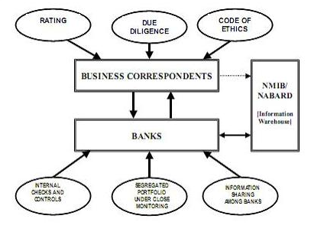

Slide 25
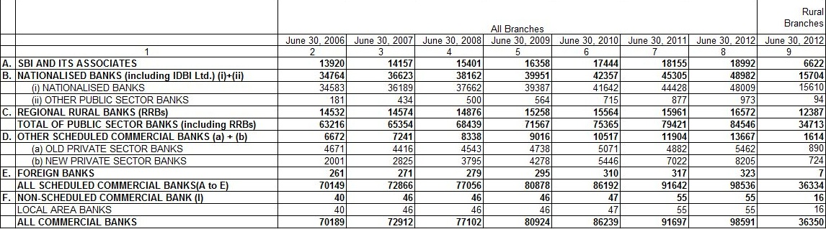
Branches expansion of Public Sector Banks and other commercial banks
Note: 1. 'Nationalised banks' includes IDBI Bank Ltd.
2. Population group classification is based on 2001 census. The population group 'Rural' includes centres with population of less than 10,000.
3. Data for 2006 to 2011 are revised and for 2012 are provisional.
4. Data on number of branches exclude administrative offices.

Slide 26
Factor influencing demand and supply in RRB
Supply Factors :-
Demand Factors :-
Person are un-bankable to bankers
Small loan amounts
Long distance for services/branches
High transaction cost
Lack of collateral
Information asymmetry
Human resource constraints
High transaction cost for client e.g. travel
Documentation
Lack of awareness
Lack of social capital
Non-availability of special products
Convenience of informal lending
Prior rejection by formal banking system

Slide 27
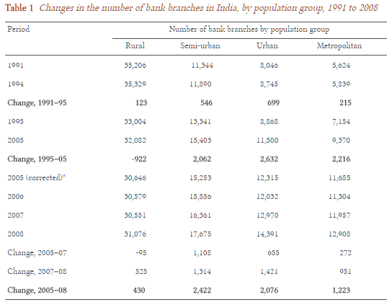

Slide 28
Market Opportunity
Money lender and informal financing are always synonymous.
Informal markets are less significant now than before, and have to face competition or at least accept benchmarking of formal credit.
Financing of consumption and at interest rates comparable to those prevailing in the rural informal debt markets.
The informal market is providing a range of financial products, which the formal banking system is not able to.
Studies have demonstrated that expansion of literacy and education tends to increase the access of rural folk to formal credit, reduce the informal transaction costs in dealings

Slide 29
Concerns regarding current approach
Non Performing Assets
Difference between the cost of resources and the commercial rates of interest of cooperative banks in the deregulated interest rate regime is on the high side.
Institutional credit is more likely to be available for well to do among the rural community.
Relatively backward regions have less access to institutional credit than others do.
Non-availability of timely credit and the cumbersome procedures for obtaining credit
For Government sponsored schemes, there has been overlap in accountability.
Notes:
The cooperative banks have different layers and many of them have significantly large non-performing assets (NPAs). Many cooperatives are undercapitalised. The public sector banking system also exhibits NPAs, and some of them have so far been provided with recapitalised funds. The RRBs also exhibit NPAs and these have been recapitalised from the Government of India so far, which would imply a total recapitalisation of double the amount provided by Government of India.

Slide 30
Concerns regarding current approach
Multiple financing - over financing and under financing.
Different agencies often fail to formulate and develop meaningful agriculture programs in given blocks and districts.
Different procedures and policies in the matter of providing loans and their recovery.
Problems in the recovery of loans lent to same person by different agencies.
Flow of formal credit to agriculturally developed regions and to relatively larger farmers leaving the backward regions and small farmers.
The transaction costs vary with type of credit agency involved, the type of borrower and farm-size.
Effective cost of borrowings for smaller loans tends to be relatively higher than for a larger loan.

Slide 31
Role of RBI in RURAL CREDIT
Providing timely and adequate credit through NABARD.
Scheduled commercial banks excluding foreign banks have been forced to supplement NABARDs efforts-through the stipulation that 40 % of net bank credit should go to the priority sector, out of which at least 18 % of net bank credit should flow to agriculture.
Besides, it is mandatory that any shortfall in fulfilling the 40 percent target or the 18 percent sub-target would have to go to the corpus Rural Infrastructure Development Fund(RIDF).
Recapitalization of Regional Rural Banks (RRBs) and setting up of local area banks(LABs).
Developing and strengthening cooperative credit structures.
Establishment of RRBs in 1975 By 1982, to consolidate the various arrangements made by the RBI to promote/ supervise institutions and channel credit to rural areas, NABARD was established.
Notes:
Though several efforts were made to increase the flow of institutional credit for agricultural and rural lending, there were mismatches in credit and production. Field studies conducted to determine the reason, revealed that it was due to absence of effective local level planning. It was felt that with the establishment of large network of branches, a system could be adopted to assign specific areas to each bank branch in which it can concentrate on focussed lending and contribute to the development of the area.

Slide 32
Services Required for Rural Sector
Loans
Savings
Risk Mitigation Products
Remittance
Pensions
Financial Counseling
Credit Cards
Insurance
Notes:
To enable them to raise their income levels and improve living

Slide 33
6 Major Problems faced by Regional Rural Banks of India
Haste and Lack of Co-ordination in Branch Expansion
Difficulties in Deposit Mobilisation.
Constraints in Deposit Mobilisation
Slow Progress in Lending Activity
Urban-Orientation of Staff
Procedural Rigidities

Slide 34
How technology and literacy affects rural banking
Atms
Net banking
M-cash (use of virtual money)
Credit card
Debit card

Slide 35
Benefits of Aadhaar Linked Bank Accounts:
Boost from PradhanMantriJandhan yojna
Linking your Aadhaar number with your Axis bank Account lets you:
Have a single financial address for government subsidies
Receive direct credit of LPG subsidy from Government into your account
Receive direct credit of other Govt subsidies like welfare funds, pensions, scholarships, MNREGA wages etc. into your account

Slide 36
Performance of RRBs during 2012-13(1 April 2012 – 31 March 2013)
The sources of funds of RRBs comprise of owned fund, deposits, borrowings from NABARD, Sponsor Banks and other sources including SIDBI and National Housing Bank.
The owned funds of RRBs comprising of share capital, share capital deposits received from the shareholders and the reserves stood at 19304 crore as on 31 March 2013.With growth of 17.26%.
Deposits of RRBs increased from 186336 crore to 211458 crore during the year registering growth rate of 13.48 %. There are Thirty three (33) RRBs having deposits of more than 3000 crore each.

Slide 37
Growth of RRBs:-
RRBs proved instrumental in achieving the target of inclusive and sustainable economic growth.
The number of RRBs' branches have increased to 16,170 during 2011-12 from 14,468 during 2000-01 i.e. an increase of 1.1 times.
The number of districts covered also increased to 620 during 2011-12 from 482 during 2000-01 i.e. an increase of 1.3 times.
The linear and compound growth rates of it account for 0.212% and 0.208% which indicates an insignificant growth of bank branches of Regional Rural Banks in India. However, there is a 65% increase in the Credit-Deposit ratio during the same period, which indicates the willingness of Target Group to invest in RRBs.

Slide 38
List of RRB’s functioning in country presently
http://financialservices.gov.in/banking/List%20of%20RRBs.pdf
There are many RRB’s operating in country.
Sponsored by :-
SBI
United Bank of India
Syndicate Bank
Central Bank of India
Andhra Bank
Dena Bank

Slide 39
Concluding Remarks:
.
Despite these problems, the RRBs have been trying their level best to achieve their social objectives. They have succeeded in projecting their image of ‘small man’s bank’. They are, in fact, development banks of the rural poor. They have been trying to fill regional and functional gaps in rural finance in our country
Although the growth rate of RRBs is very low, the Deposits and Credits are significantly high. Credit-Deposit ratio has increased over the period of time, leading to sufficient mobilization of funds in the regional areas.

Slide 40
Conclusion
Based on our study we have concluded that the following scenarios are the most probable in the year 2020 for the Indian rural retail banking industry:
Consumer awareness – with increased education among the consumers and greater availability of information, the consumer awareness will increase regarding the financial services and products that are present in the market and they will demand one-stop shop solutions for all their financial needs.
Consumer databases – the introduction of the UID project has led to the hope and an increasing probability of presence of extensive consumer databases in 2020. These databases will provide information about consumer credit history and financial transactions to enable the FIs to customize products suited to the consumers’ needs.
Capitalization of MFIs - there is a low probability that international banks would be the chosen medium of capitalization for the MFIs in 2020. They will be largely capitalized by the local Indian financial markets. This could be owing to the FDI regulations in the country as well as sufficient liquidity in the Indian financial markets.
Localized institutions – the FIs would work towards designing localized financial services that would serve to provide one-stop shop solutions and remove information asymmetry because of their local presence.
Mobile-based delivery model – the high penetration of mobile services in the country and advances in secure transfer mechanisms will see the rise of mobile phones as delivery platforms by 2020. This will be further augmented by the low costs associated with this delivery mechanism.

Slide 41
Project By:
Jay A Joshi (1401005)
Nirav Akbari (1401008)
Amee Bhuva (1401009)
Subhashi Dobariya (1401012)
Krima Doshi (1401035)
Rahul Rachh (1401057)
Jainil Vachhani (1401116)
Yash Turakhia (1401118)

