Slide 1
hi
i am ignatius

Slide 2
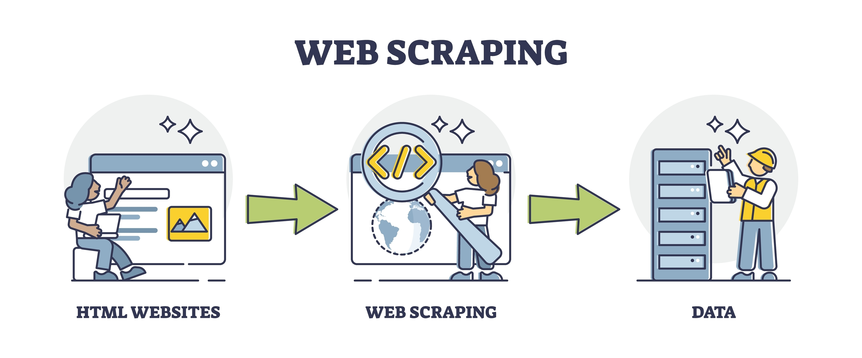
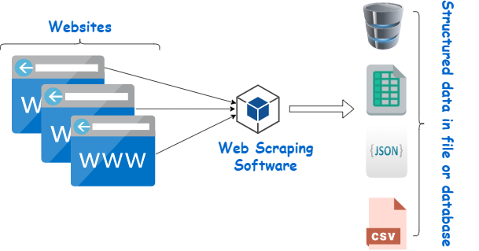
web scraping!

Slide 3

well what is a website!?!?!

Slide 4
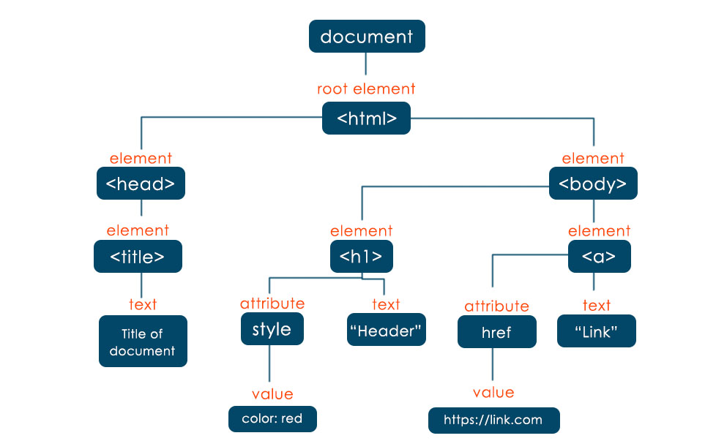
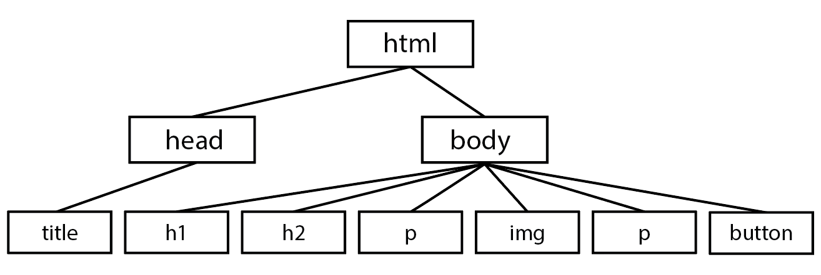
the dom

Slide 5
how can we retrieve data from the net?
Public APIs – mainly for devs
RSS Feeds / data dumps
some sites provide downloadable datasets
these are usually limited in what they offer
Scraping!
useful when no api available or data needs to be structured manually

Slide 6
public apis
https://friends.roblox.com//docs/index.html
in some cases, the the public apis are exhaustive enough!
Notes:
REMINDER LOOK AT FRIENDS API, EXPLAIN COOKIE AND HEADER STUFF

Slide 7
RSS feeds / data dumps
https://www.kaggle.com/datasets
Other mentions ~ news outlets like BBC, CNN ect…
The information you’re looking for is already bundled up nicely!
Notes:
REMINDER LOOK AT FRIENDS API, EXPLAIN COOKIE AND HEADER STUFF

Slide 8
so why scrape?
Data is everywhere! But not always accessible
APIs can be unavailable, restricted or costly!
Scraping allows for automation = less manual effort in data collection :D

Slide 9
what scraping tools are there?
BeautifulSoup (static)
Selenium (dynamic ++ scripts)
Notes:
https://beautiful-soup-4.readthedocs.io/en/latest/#

Slide 10
BeautifulSoup vs Selenium
Feat | Selenium | BeautifulSoup
Best for | Websites with JS-loaded content | Static HTML scraping (faster)
Speed | Slow (interacts with browser) | Fast (parses HTML in memory)
Handles JS? | Yes | No (reads only static HTML)
Handles dynamic pages? | Yes (clicking, scrolling, interacting) | No (only reads what is loaded)
Ease of use | Harder (need to find and interact /w elements) | Easier, just use .find() and .select() functions
Resource Usage | High (runs a full browser, uses CPU and RAM) | Low (just parses html, very lightweight)
Pagination | Can click “next” buttons easily | Needs url patterns (query param ect) or ajax handling
Risk of getting blocked (rip) | High, detectable as automation, needs proxies + headless mode | Low (mimics a regular request so is harder to detect)
File download/upload | Yes | No

Slide 11
well how can i use these?
demo 1 – extracting content from static web pages
(wikipedia)
https://en.wikipedia.org
https://github.com/Chary-x/ProsperScrapingWorkshop

Slide 12
well how can i use these?
demo 2 – extracting content from static web pages
(book scraping site)
https://books.toscrape.com/

Slide 13
well how can i use these?
demo 3 – interacting with elements
https://books.toscrape.com/

Slide 14
well how can i use these?
demo 4a – interacting with elements (combo)#
https://www.morganstanley.com/careers/career-opportunities-search?opportunity=sg

Slide 15
well how can i use these?
demo 4b – interacting with elements (just selenium)
https://www.morganstanley.com/careers/career-opportunities-search?opportunity=sg

Slide 16
thanks chat

