Slide 1
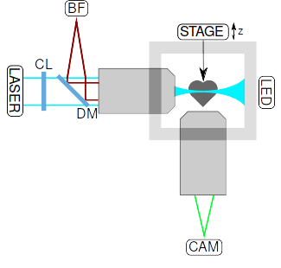
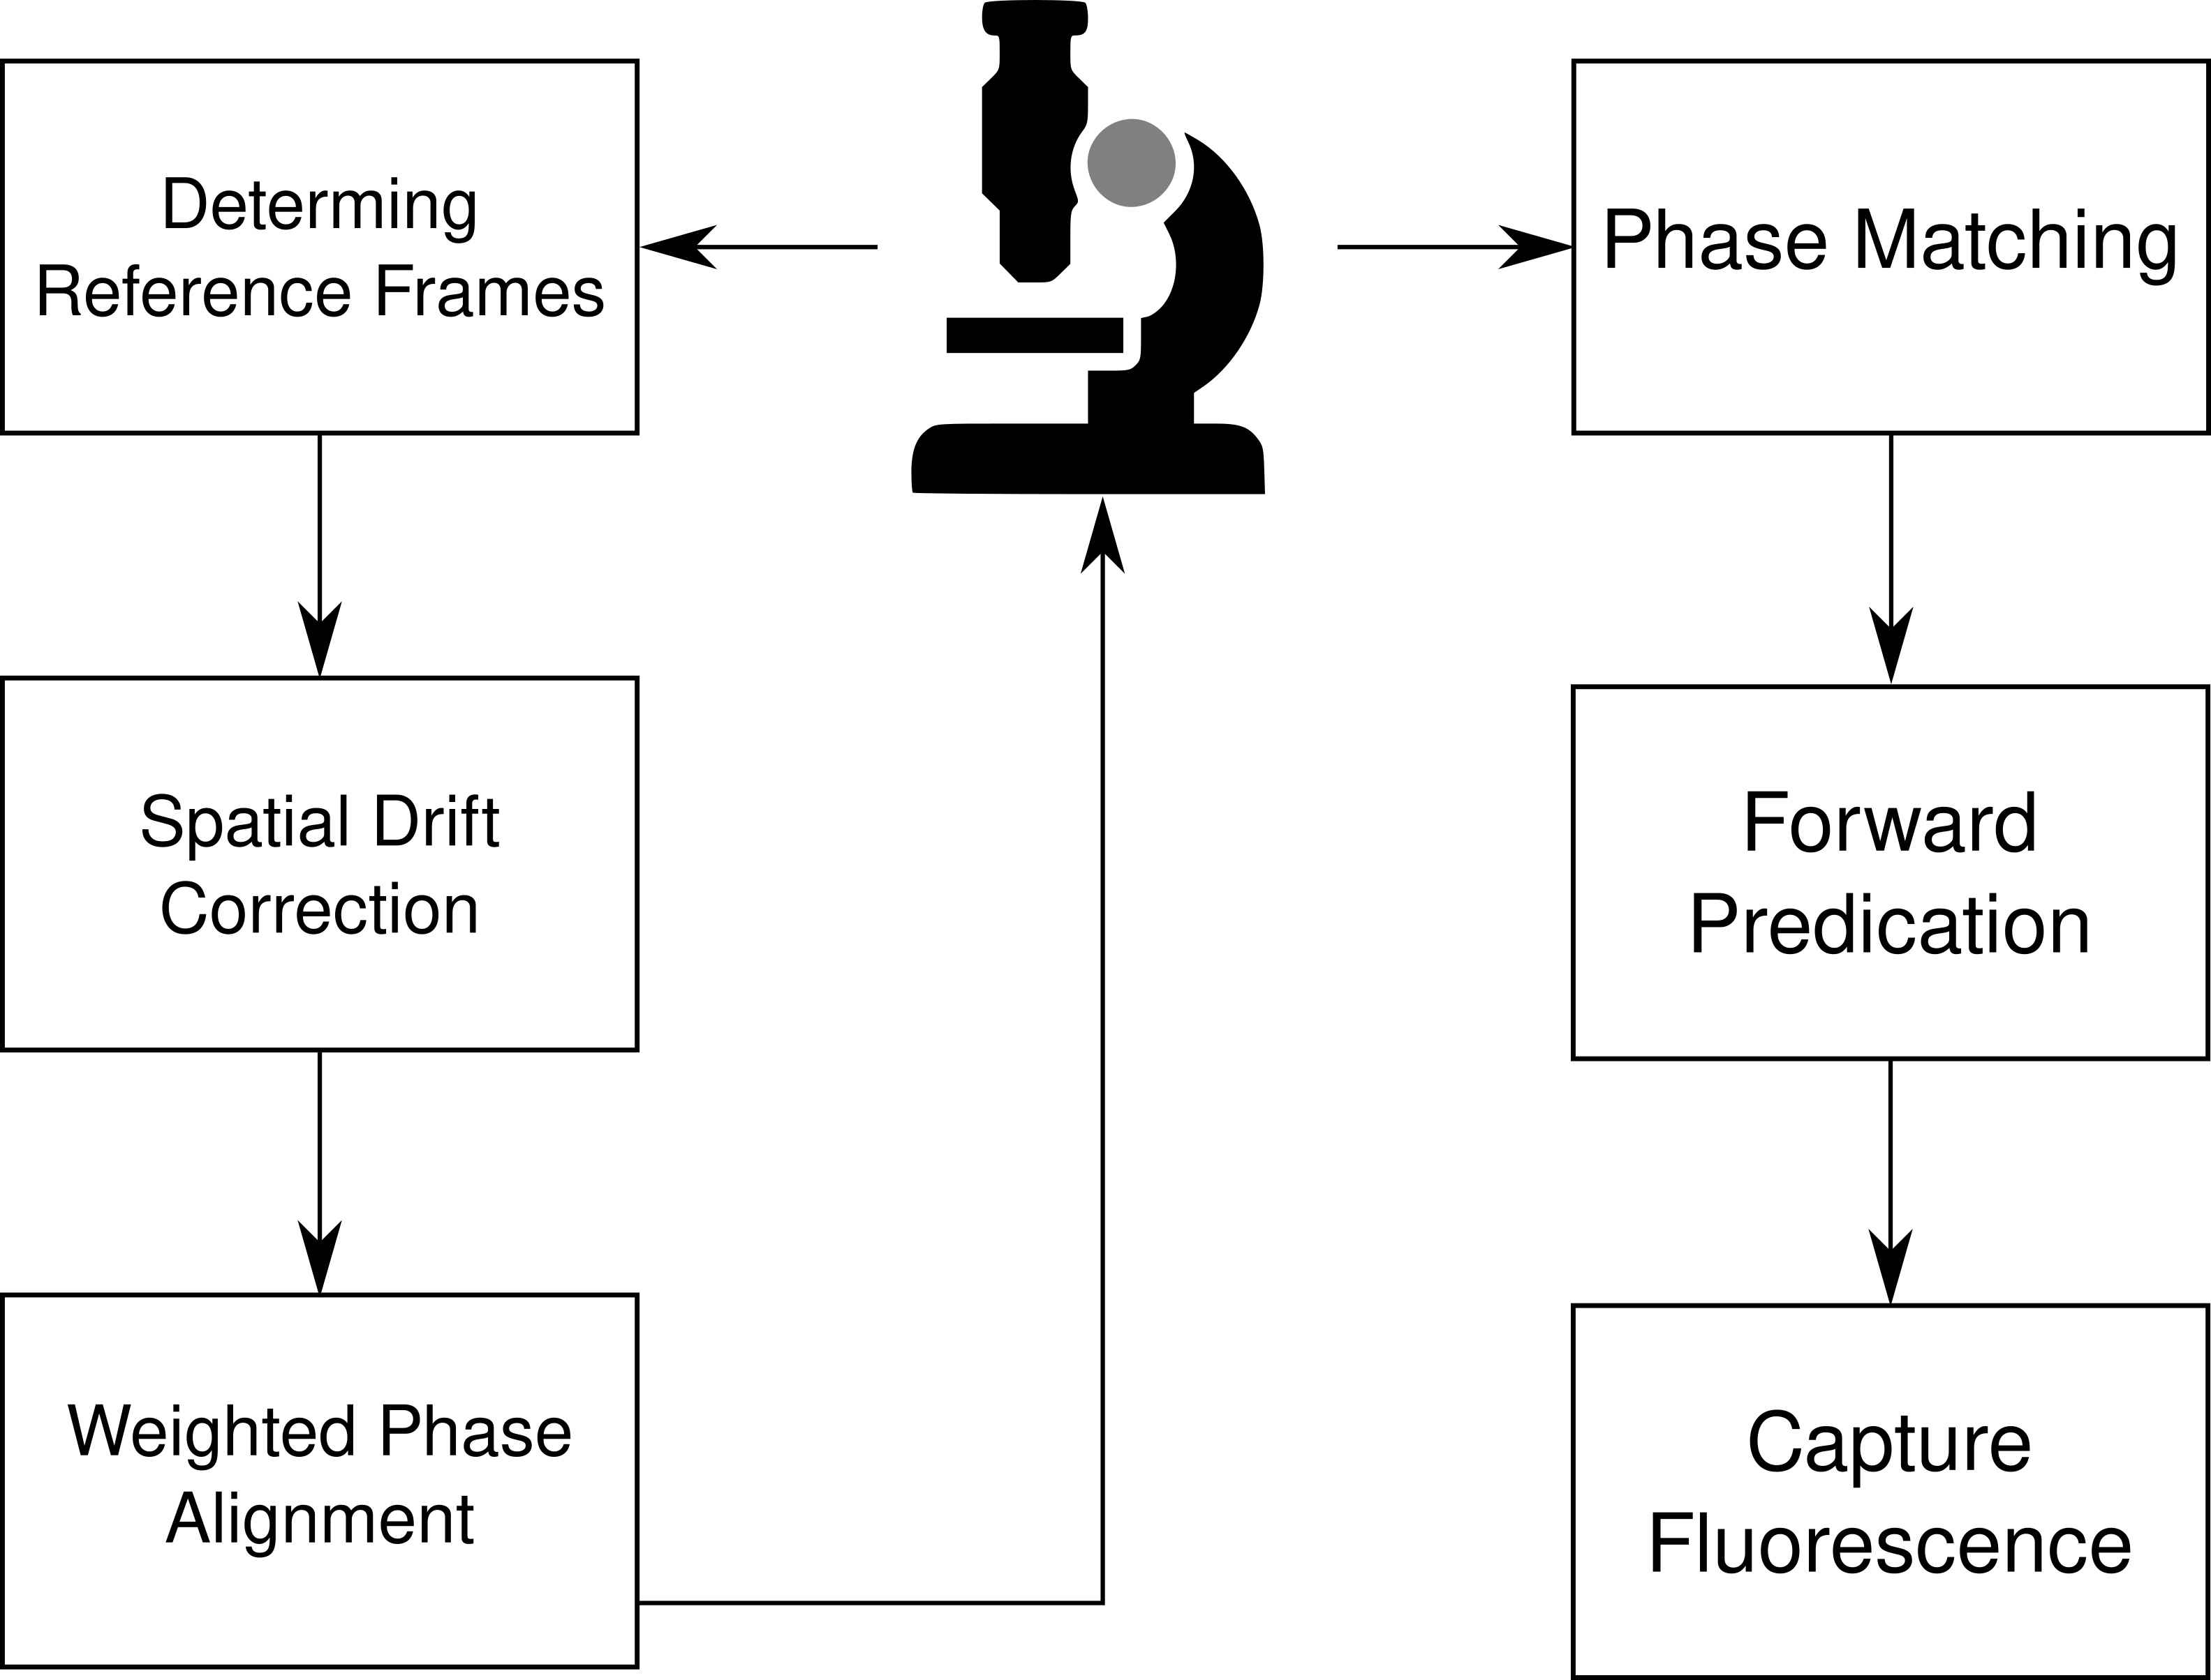
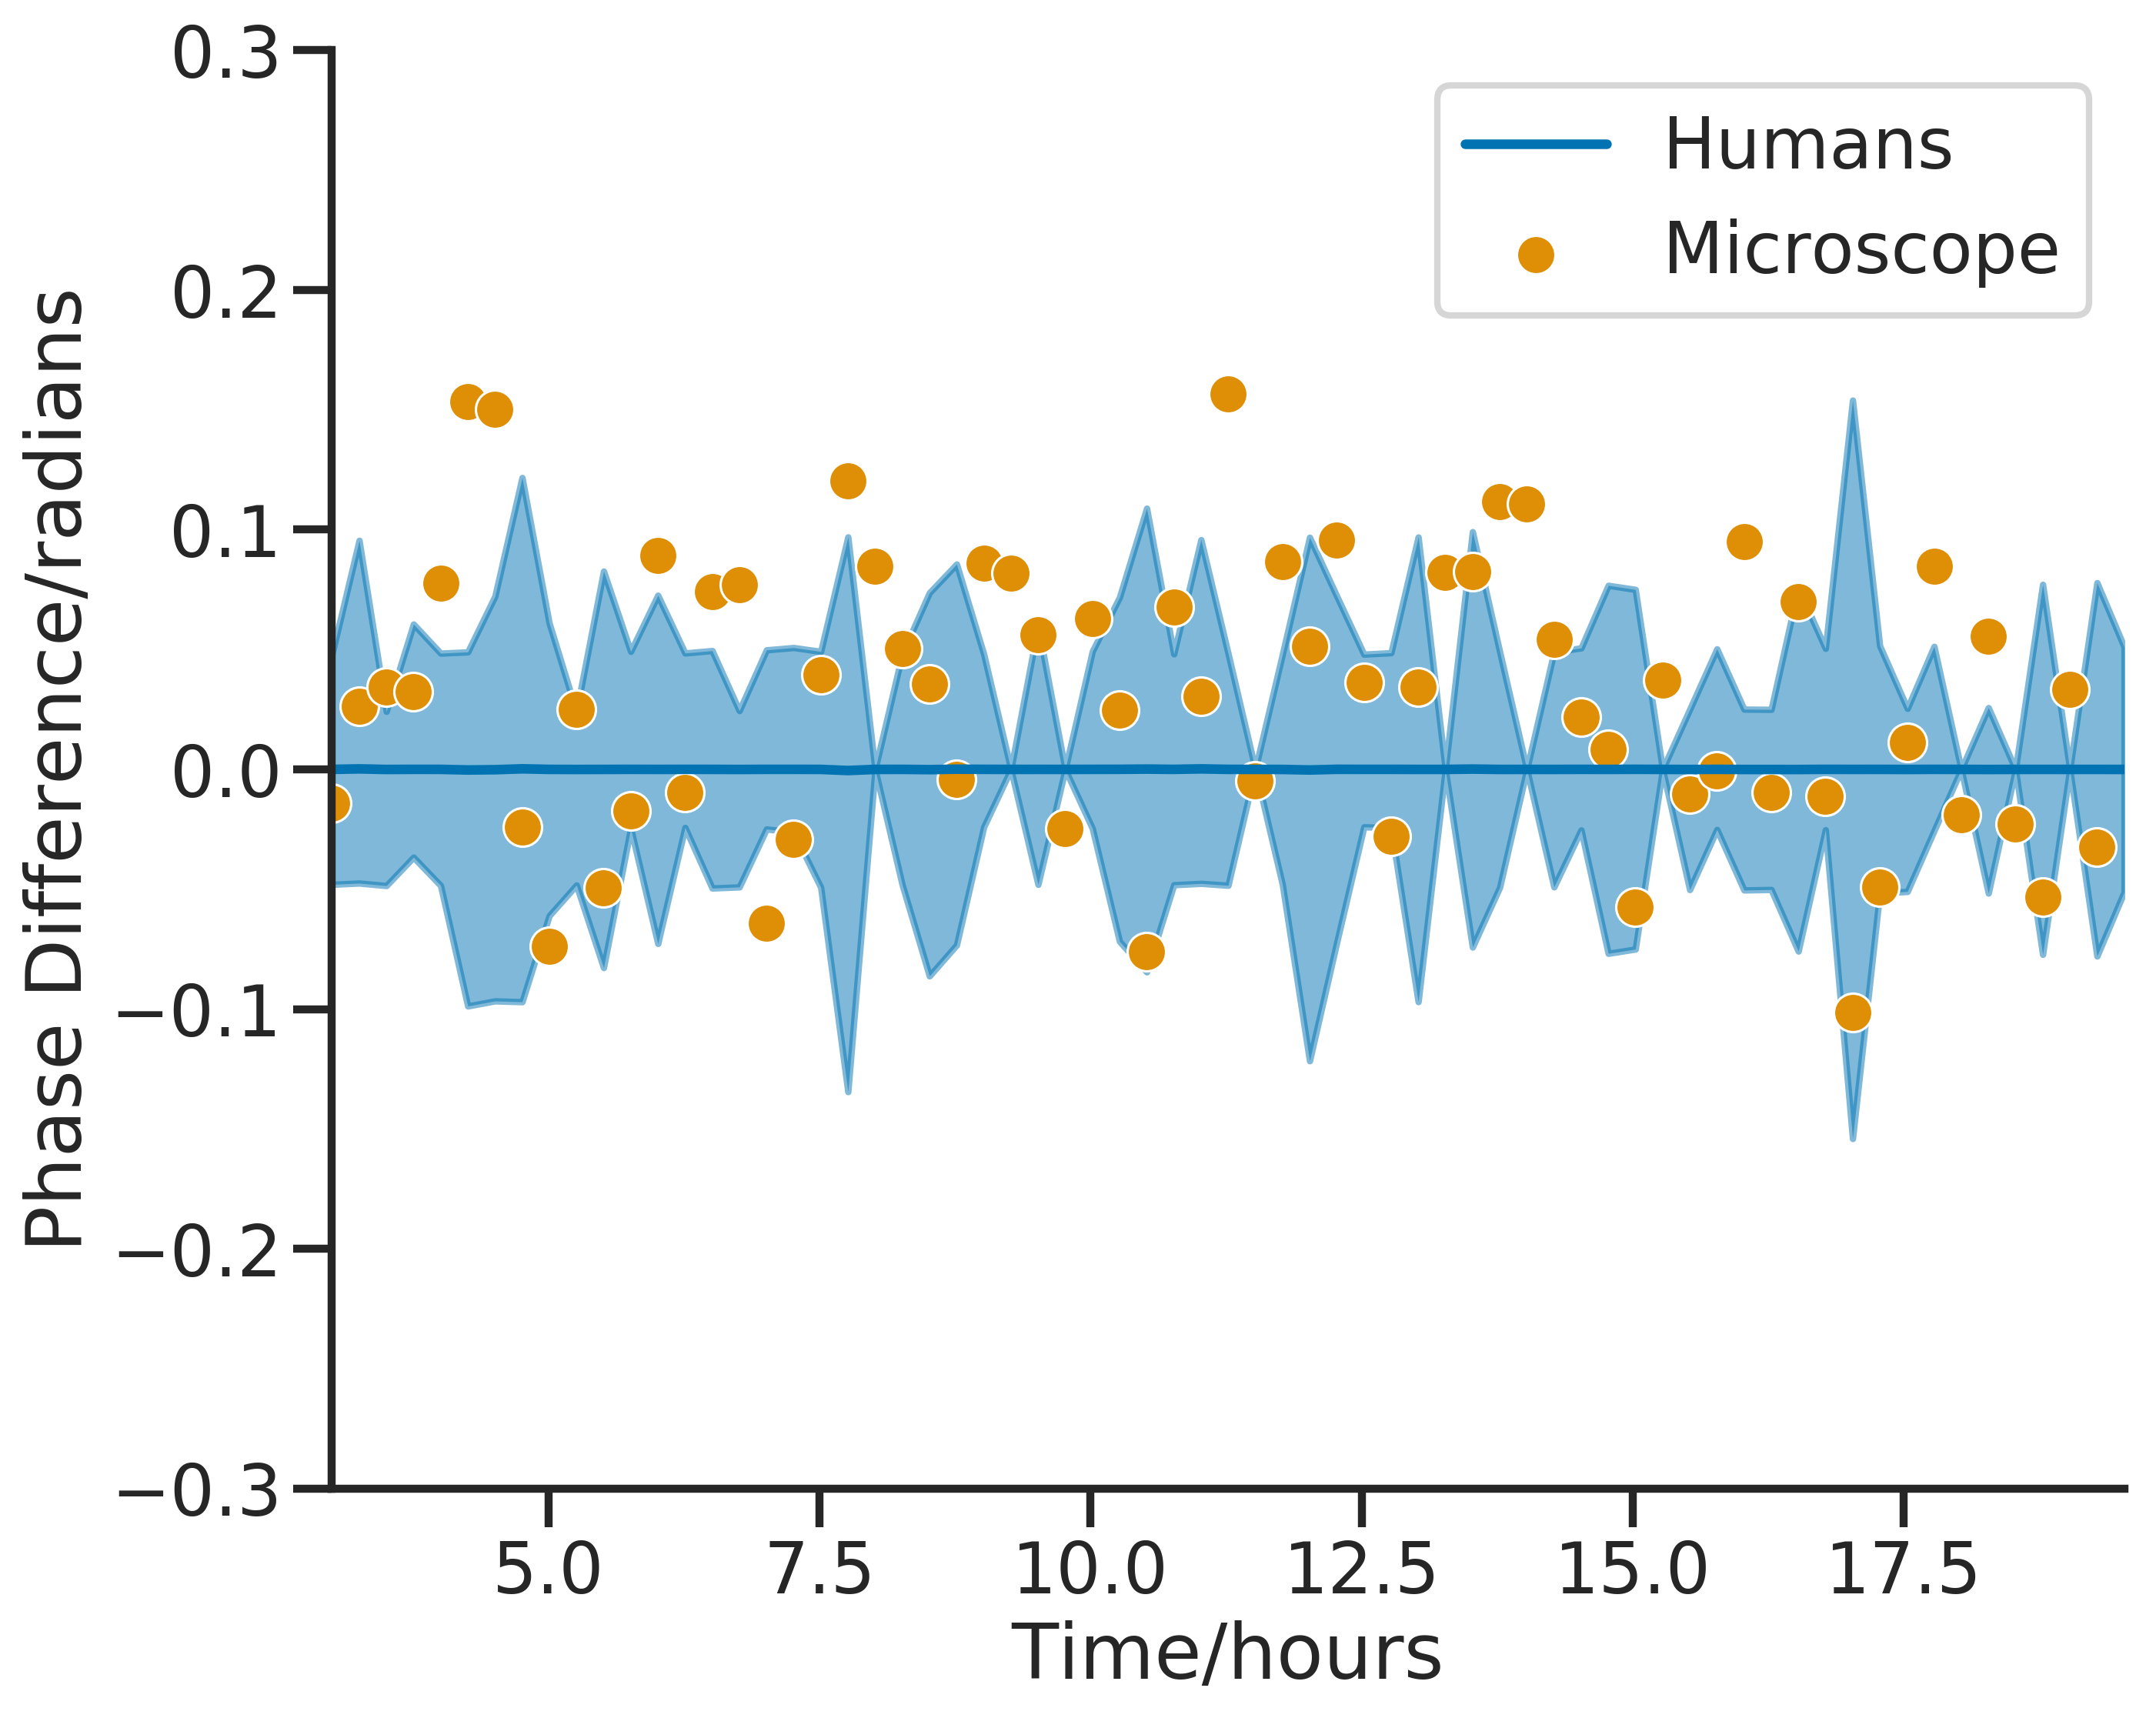
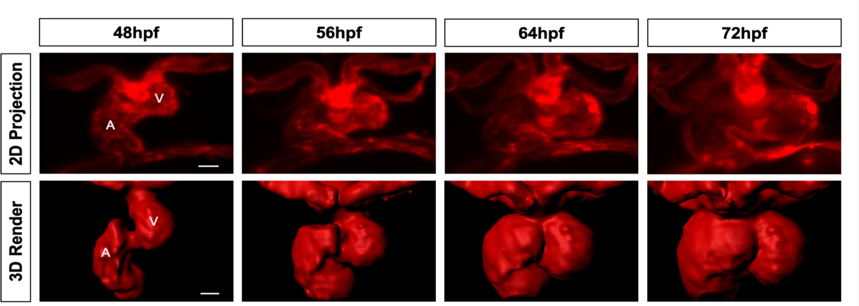
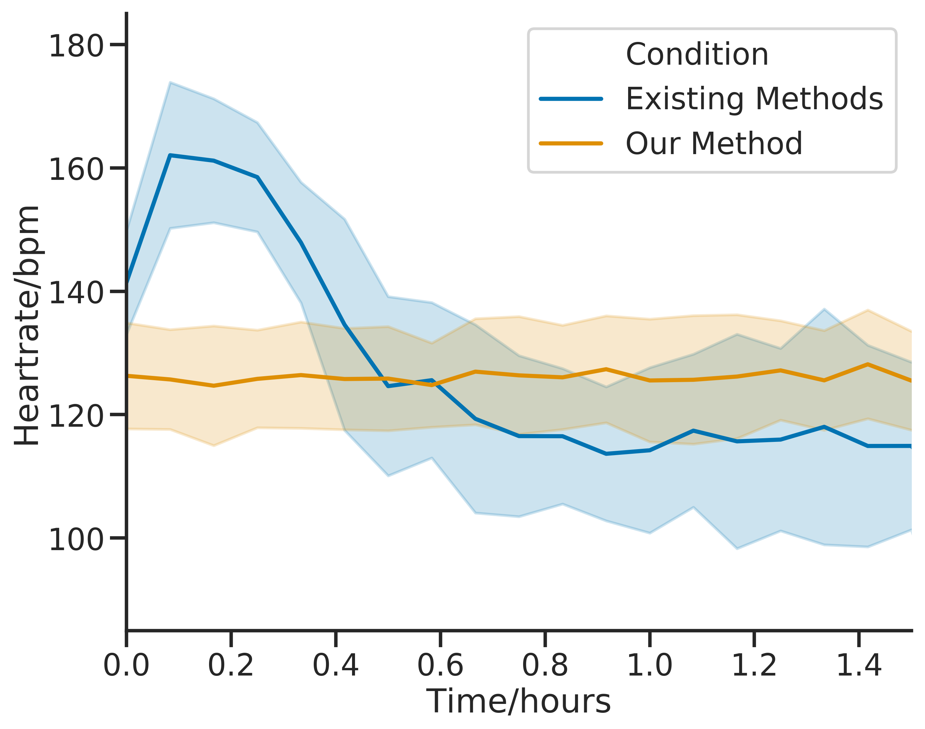
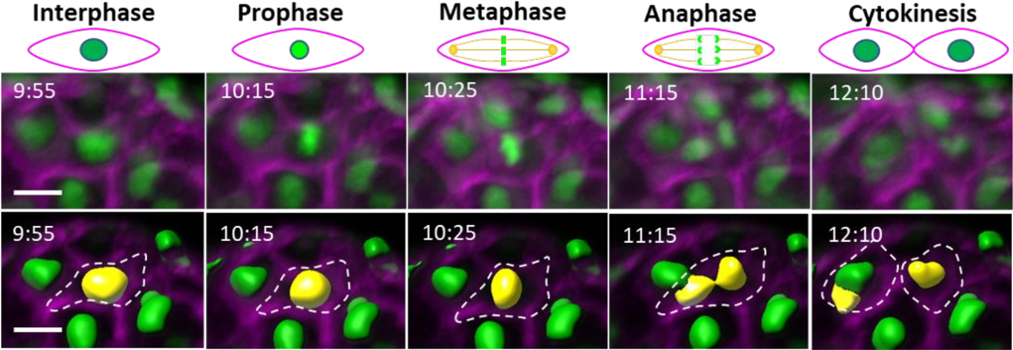



A Smart Microscope for In Vivo Day-Long 3D Time-lapse Imaging of the Beating Zebrafish Heart
Title:
Subtitle
Leeroy Jenkins, author2,
author3, author4
Chas Nelson, and Jonathan Taylor; University of Glasgow
A schematic of the light-sheet fluorescence microscope.
Finn Bruton, Aryan Baghbadrani, Charlotte Buckley, Carl Tucker,
Adriano Rossi, John Mullins, and Martin A. Denvir; University of Edinburgh
3D imaging of the heart is challenging:
  Constant, high-speed beating
  Shape and size changes during development
Existing methods have major drawbacks:
  Pausing heart with drugs affects physiology
  Retrospective gating causes phototoxic damage
We developed a smart microscope capable of:
  Virtual freezing of the heart without drugs
  Reduced phototoxic effects
  Provide phase-locked, day-long imaging with human-level precision
Smart-microscope Algorithm
Stable phase-locking over hours compared to humans
Day-long, 3D, Time-lapse Heart Imaging...
With this microscope we have:
Observed detailed 3D structure during periods of massive developmental changes (heart looping)
Tracked the 4D behaviour of macrophages and neutrophils during cardiac injury response
Witnessed never before seen cell division events that contradict the established literature of cardiac trabeculation
Zebrafish heart-rate response to imaging is stable during imaging
… with high spatial and temporal resolution.
Take a picture to download the full paper

