Slide 1
Intro to R and STATA for PLSC 306

Slide 2
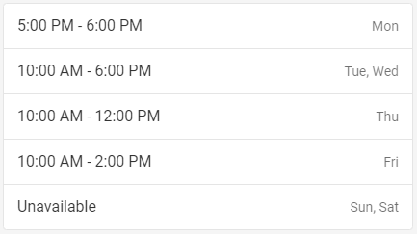
Introduction
YouCanBookMe: https://bloch-pennstate.youcanbook.me

Slide 3
Overview
Getting STATA and R (with R Studio) up and running
Package management and installation in R
Importing data
Exploring data
Tracking changes to data
Storing data and projects: Rule of three

Slide 4
R and Stata: What’s the difference?
R
Open source
More flexible and powerful, but steeper learning curve
Warnings tend to be more informative
Can hold many datasets at a time
Stata
Proprietary
Easy to learn and use, but has limited capabilities
Does not always warn if something is wrong with model specification
Can only hold one dataset at a time

Slide 5
Getting STATA and R (with R Studio) up and running
R Studio
R link: https://cran.r-project.org/mirrors.html
R Studio link: https://rstudio.com/products/rstudio/download/
File → New File → R Script
STATA
https://it.la.psu.edu/virtual-desktop-pilot

Slide 6
Package management and installation in R
In R Studio
Tools → Install Packages → Enter package name → Install
Import package:
library(package name)

Slide 7
Importing data: Common Data File Extensions
R: .rdata, .rda
STATA: .dta
SPSS: .sav, .sps, .spv, .spo
Genral: .csv, .xls, .xlsx, .txt, .json
.csv files can be open in excel
They can also be created from .xls or .xlsx file types in excel.

Slide 8
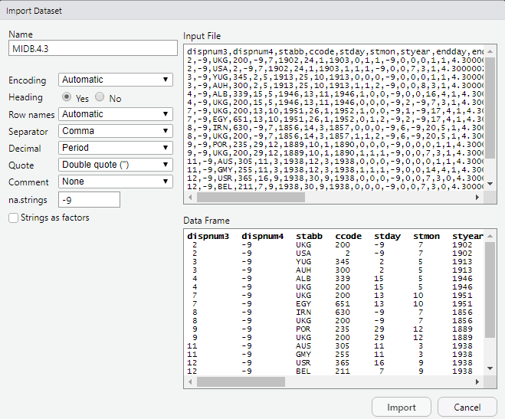
Importing Data: R Studio
File → Import Dataset → (select appropriate function based on file type)
Note: ‘From Text’ is usually either .txt or .csv with the specified delimiter
Change Name
Heading = Yes if data has variable headings
Copy and paste code from console into script when finished

Slide 9
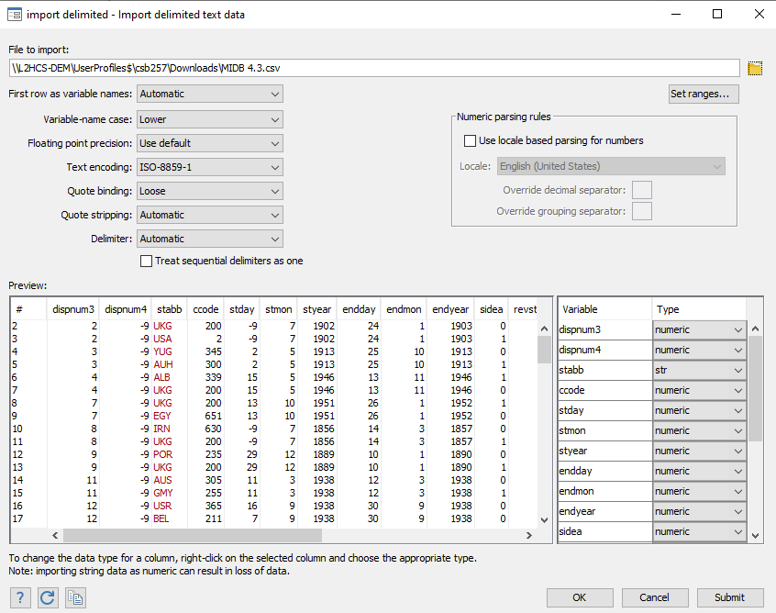

Importing Data: STATA
File → Import → (select appropriate function based on file type)
Copy and paste code into .do file when finished
Window → Do-File Editor → New Do-file editor
Or F9
Or

Slide 10
Exploring Data
Basic Indexing (in R)
Tabulate and Summarize (in Stata)
Subsetting by columns
Creating a new variable
Omit NA values
Task: Calculate the average duration of MIDs per country

Slide 11
Tracking changes to data
Any modifications to data should be tracked in .do file or .R script
Anytime you plan on deleting or changing a significant portion of a working script, you should start another version of that script
Do not overwrite original data
Significant changes to data should be exported under a different file name
Any small changes made in excel should still be tracked
In general, for purposes of replicability, everything you do should be tracked and there should be a document that explains how all your files relate to each other

Slide 12
Storing data and projects
Rule of three
Possible cloud storage options
Dropbox
Google Drive
Microsoft OneDrive
Box – this has unlimited storage per the university so it could be especially useful if you have a large project
Use a flash drive or external hard drive

