Slide 1
Beer Market Analysis 2018
Chase Henderson & Ben Spanswick
PROST!

Slide 2
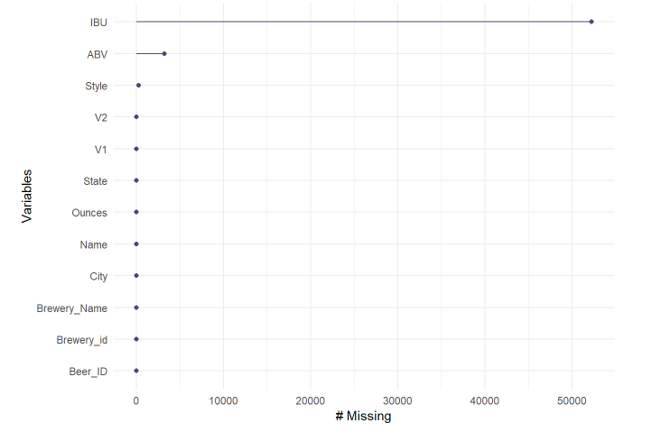
Data Overview
Represents 2410 unique craft beers
Represents 558 different Breweries
~42% of IBU values are missing
~3% of ABV values are missing
<1% of Style values are missing

Slide 3

Data Overview Cont.
Limitations:
- Brewery data based on single occurrences of unique breweries and/or headquarters.
- If a microbrewery has multiple breweries located in a state or within other states that information was not captured.
- Limited industry assessment.

Slide 4
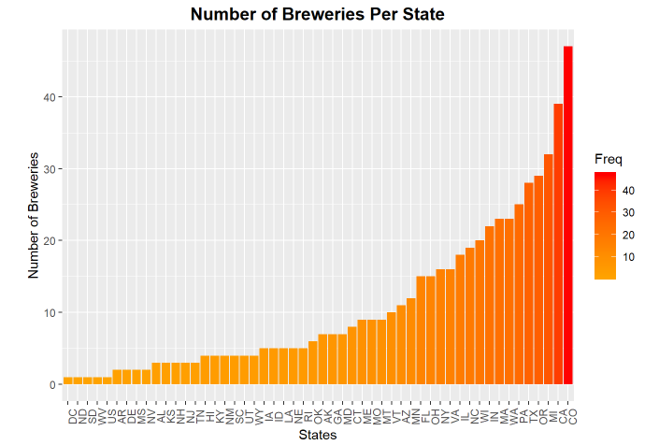
Where Are The Breweries?
Breweries are found in all 50 states and the District of Columbia.
Some states, including California and Michigan have over 30 breweries, Colorado has over 40!

Slide 5
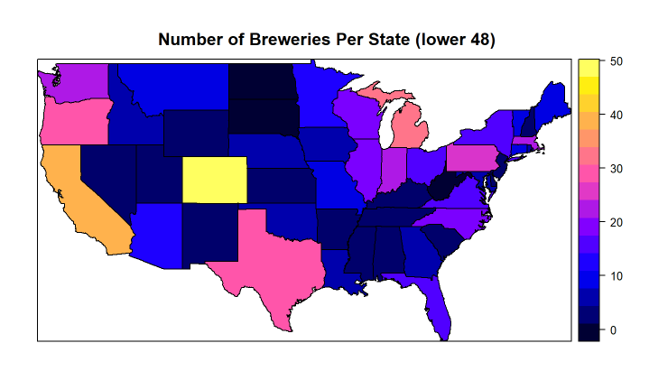
Where Are The Breweries of the continental United States?
This heat map displays distribution of unique microbreweries throughout the continental US.
Some states, including California and Colorado have over 2000 unique beers.

Slide 6
A Deeper Look
Is brewery per state an appropriate way to judge popularity of craft beer in a state?
Beer?

Slide 7
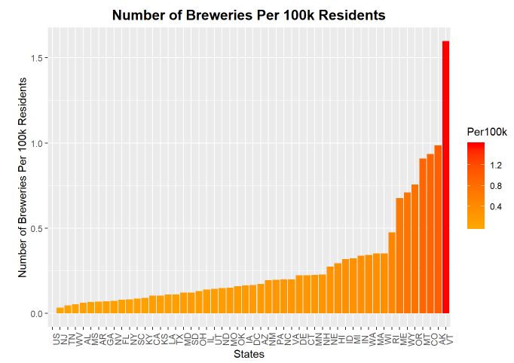
Breweries Per Capita
Not all States are created equal.
We expect California to have a lot of breweries because they are large and populous.
Lets take a look at number of breweries per 100K residents.
We paint a very different picture.
Some remain high (Colorado)
Some drop down (California)
Some move up (Vermont)

Slide 8
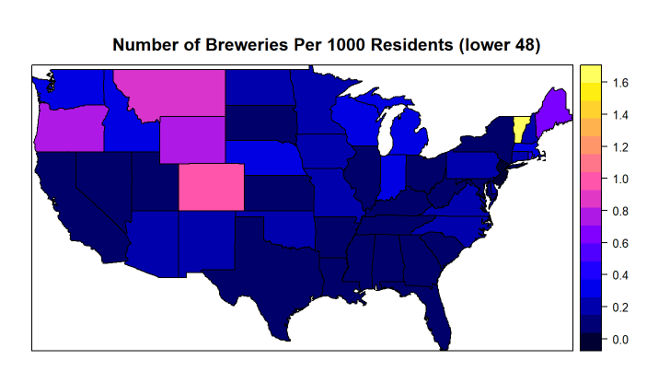
Breweries Per Capita
Do the darkened states suggest market opportunity?
Or market challenges?
- Total breweries in the state needs to be considered first.
What are additional factors that could have encouraged the brewery outliers?
- Distribution availability?
- More relaxed alcohol and business regulation?

Slide 9
What About Alcohol by Volume (ABV)?
ABV is an key measurement in strength of beer, lets see how that breaks down.
Beer?

Slide 10
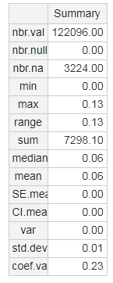

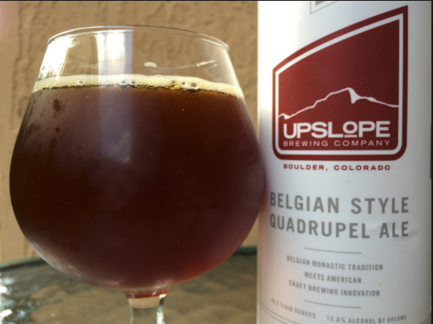
ABV Summary
By the numbers:
Lowest: 0.0 or 0%
Highest: 0.13 or 13%
Average (mean): 0.06 or 6%
On average, ABV for wine is 0.116 or 11.6%

Slide 11
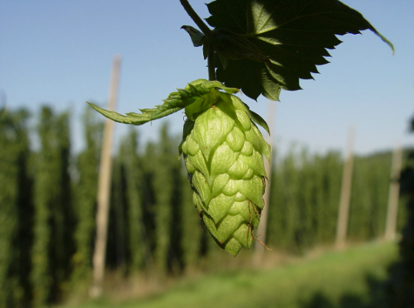
What About International Bitterness Units (IBU)?
IBU is an key measurement in bitterness of beer.
Quick facts:
- IBU is a measure of the parts per million of isohumulone found in beer.
- Isohumulone is the acid found in hops that gives beer its bitterness.

Slide 12
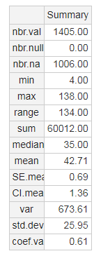

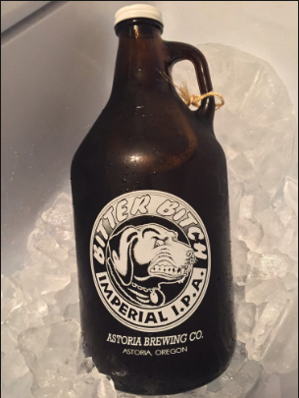
IBU Summary
By the numbers:
Lowest: 4 IBUs
Highest: 138 IBUs
Average (mean): ~43 IBUs

Slide 13
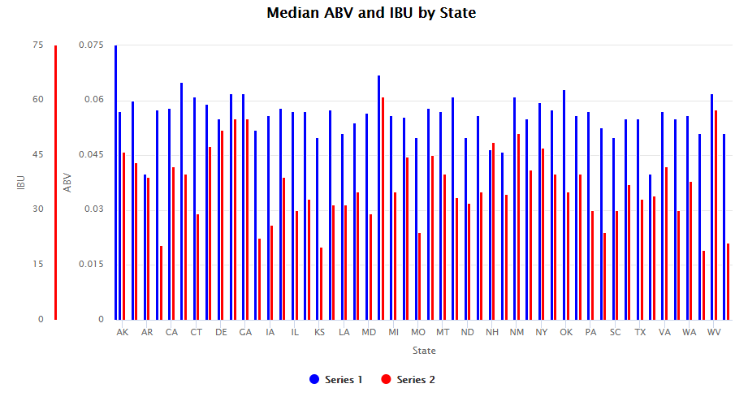
ABV and IBU Together?
As two important measures of the strength of beer, its important to know if there is any relationship between the two.

Slide 14
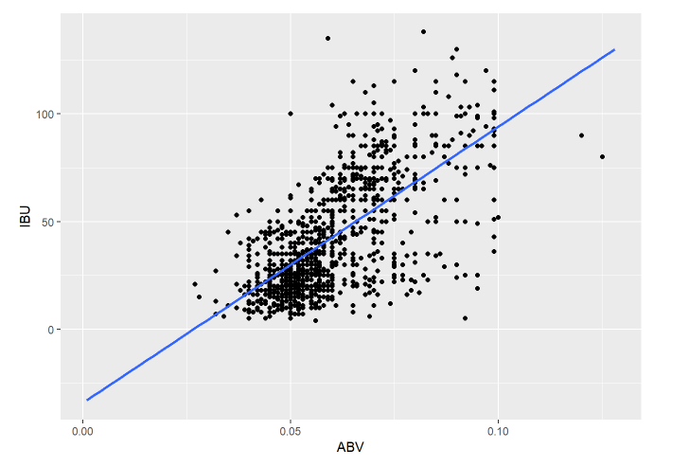
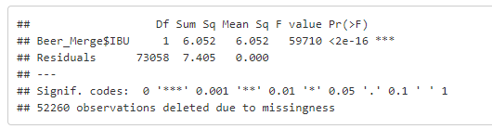
ABV and IBU
Hard to tell from the bar chart if there is any relationship.
Scatterplot is much more telling.
Fitting a regression line seems to indicate a relationship.
One-Way ANOVA to confirm (P < 0.001)

Slide 15
Photo Credit:
Slide 2: Ultimatepartyfoul.org
Slide 10: Daily Beer Review (http://www.dailybeerreview.com/2015/12/lee-hill-series-vol-5-belgian-style.html)
Slide 11: CC BY 2.5 File: Hopfendolde-mit-hopfengarten.jpg, Author: LuckyStarr
Slide 12: Yelp (https://www.yelp.com/biz_photos/astoria-brewing-astoria?select=tR3U9wtv-F9hAgX42jUaNA)
All Charts Original Productions by Chase Henderson and Ben Spanswick Analysis Co.

