Slide 1
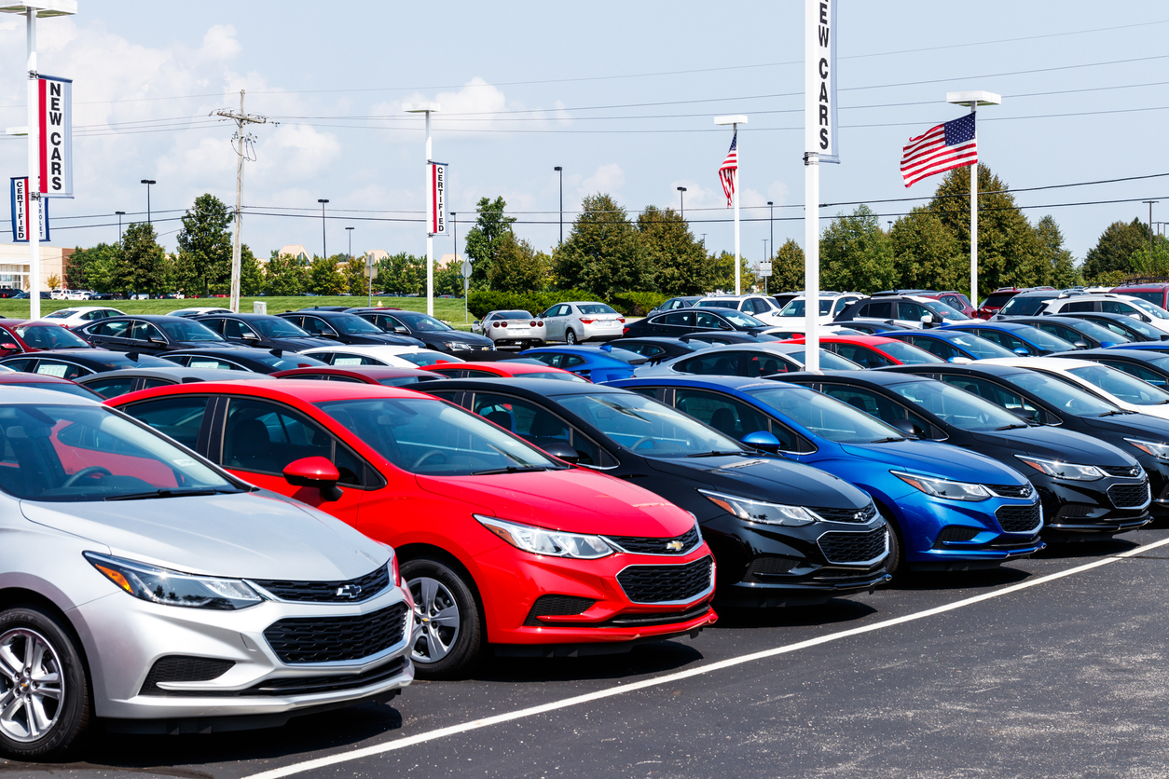
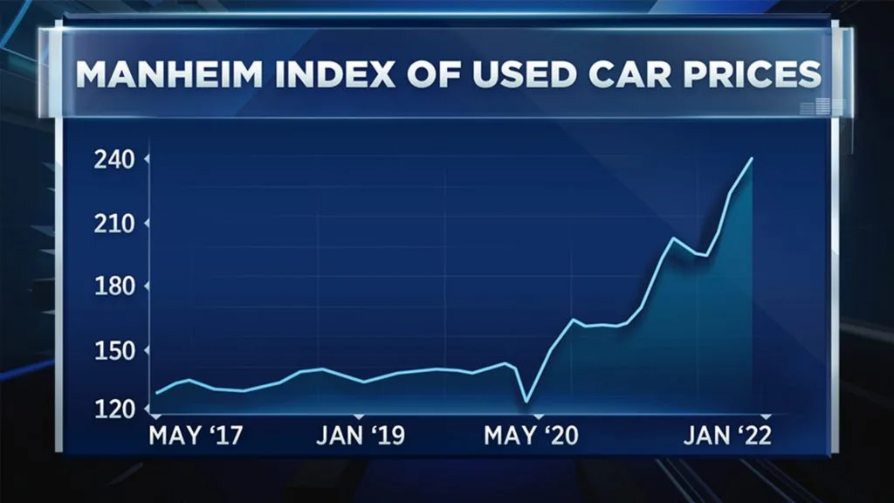

What Decides Resale Value for Vehicles in the UK?
Rick Chen, Chase Madson, Maria Manna & Jash Sompalli
Acme, Inc.
August 4th, 2022
Notes:
Speaker Notes
Context: New vehicle shortages (COVID, supply chain failures, semiconductor shortages have encouraged consumers to buy pre-owned. We want to capitalize on that.
Research Question: What decides resale value for vehicles in the UK?
Where did our data come from and how was it generated? 100,000 Used Car Dataset from Kaggle, compilation of 9 individual datasets; data gathered via scraping
https://www.copilotsearch.com/uploads/istock-1044328018.jpg
Other Image Options:
https://www.cnbc.com/2021/12/26/bubblicious-used-car-prices-rising-faster-than-bitcoin-jim-bianco-warns-.html
https://roadloans.com/wp-content/uploads/2018/03/072919-RL-Average-car-price-SEO-refresh_Graph_WP_1540x1000.jpg?w=1024

Slide 2
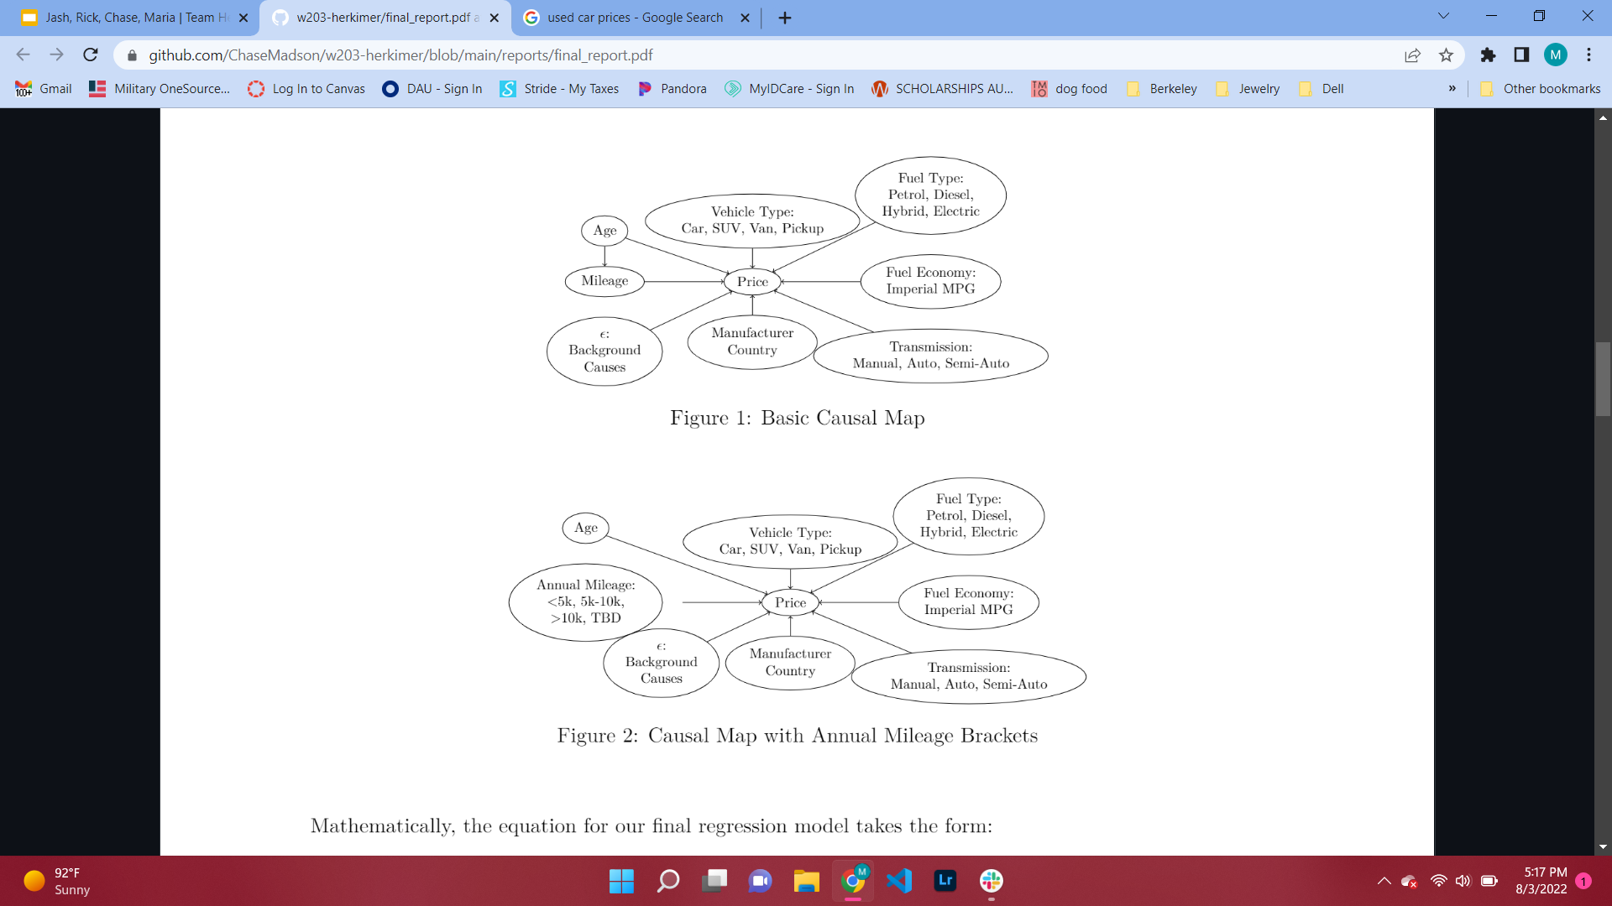
Basic Causal Map
Notes:
Data & Methodology Slide #½
Speaker Notes
What are our variables & why do they do a good job measuring our concept? Include units of observation.
Explain causal map… Age in years, mileage in Imperial miles, Price in pounds, fuel economy in Imperial MPG
What variables did we decide not to use, and why?
Removal of “other” category for transmission (9) and fuel type (247), decision not to use engine size due to data inaccuracies

Slide 3
Causal Map with Annual Mileage Brackets
Notes:
Data & Methodology Slide #2/2
Speaker Notes
Anomalies, censored scales, artifacts of binning
Mileage transformed to annual mileage (<1% observations dropped) and then binned into low, med, and high (rooted in insurance industry standards)
Decision to control the range of fuel economy (does this constitute a censored scale?)
Final regression model: should we display this? Who is our audience..?

Slide 4
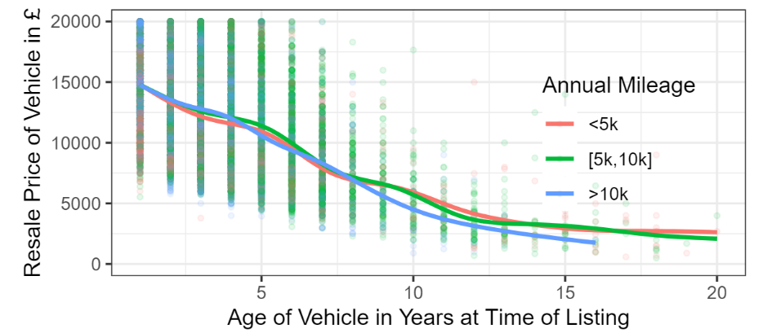
Results: Price Trends for Used Vehicles Based on Age and Use
Notes:
Results Slide #1/2
Speaker Notes
Thank you Rick. So after defining our causal theory mentioned above, we got our hands on the data that details the resale listings of around 100,000 vehicles in the UK. Here you see each of those vehicles plotted out with our outcome variable along the Y axis, the resale price in British pounds sterling. As you can see from our X-axis plotting the age of the vehicle and coloring to distinguish how heavily-driven that car was, there is a fairly intuitive trend for older cars to be worth less than newer ones, and heavily-driven cars diminish in value the fastest.
There’s quite a bit of variation leftover though, which makes sense. A car’s ownership history explains a lot about its resale value, but to get to a really useful model we must control for the baseline characteristics about the car - its fuel economy, whether its got a gas-powered or hybrid engine, is it a manual? So this motivates our model building process in next slide.

Slide 5
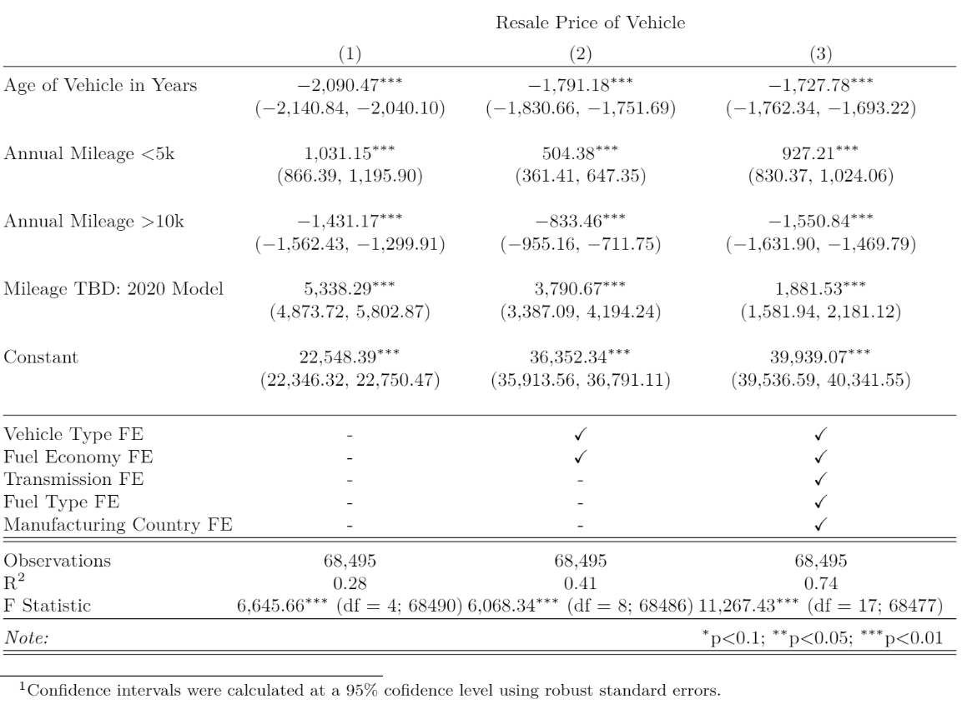
Results
Notes:
Results Slide #2/2
Speaker Notes
We landed on three models when trying to find one that adequately explains price.
We started out with no control variables and just our two explanatory variables of interest - how old is the car and how heavily-driven is it? This is the basic information a buyer might start with. This model says that, on average, every vehicle starts out at around £22.5k, and loses £2k pounds for every year since it was built. As a baseline, our model considered cars driven between 5k and 10k miles per year as the reference category, so that’s assumed by the constant. Lightly-driven cars that averaged less than 5000 miles per year were worth about £1k more on average than the baseline, while heavily-driven cars with over 10k miles per year were worth £1.4k less. We held aside a category for the cars that were the same year as the data collection, since we don’t yet know what their annual mileage would be and they’re obviously at peak value. As for the goodness-of-fit, we have a paltry R-squared 0.28 - I think we can do better.
Moving along to our second model, we add in two fixed effects to control for the type of vehicle (e.g., car, van, SUV) and fuel economy (i.e., the imperial mpg). These would be the next pieces of information a car buyer would want to know when evaluating a car for purchase. Including these variables grew our R-squared to 0.41, and each of the coefficients shrank towards zero - likely evidence of the mitigating effect of removing some omitted variable bias.
Finally, we land on our best model yet in the third column. Here we control for the fixed effects of transmission type, fuel type, and the country the car brand originates from. This represents the next level of information a car buyer would want to know. Here, our original coefficients from model 1 have each moved by a few hundred dollars but retain roughly the same magnitude and direction. Brand new cars have less of a premium, while the intercept nearly doubles. We end up with a satisfactory R-squared of 0.74. In all models, we observe statistical significance in the individual coefficients as well as the F-test for the models as a whole.
I will hand it over now to Jash to explain some of the limitations of this analysis.

Slide 6
Limitations
IID
Omitted Variable Bias
Costs associated with an asset not selling
Data Origin and Generalizability
Unique BLP Assumption
Reverse Causality
Outcome Variable on the Right Hand Side
Notes:
Limitations Slide #1/1
Speaker Notes
Review CLM assumptions
What problems would occur if the CLM assumptions were violated?
How did we respond to any violations?
OVB and direction of bias
1 Limitations of our model
1 * In order to run our model, the data it is being applied
2 to must be independent and identically distributed. It is possible
3 that there is some geographical clustering in our data
4 * Each manufacturer's country of origin is taken into account, but the
5 majority of the vehicles in the dataset come from germany
6 * This affects the generalizability of our model
7 * This model also does not take into account a couple important variables
8 when it comes to selling a car: how long the car has been on the lot,
9 and the cost of hosting a car on the lot for a period of time.
10 * Also, generalizing this model outside of the UK would be difficult as
11 there are differnt factors that must be taken into account. For example
12 the increased cost of parts for European cars outside of Europe
13 * As for Unique BLP, we observe some right skew in our metric variables, but
14 we believe that their variance s finite, so the model satisfies the unique
15 BLP assumption
16 * With this model, reverse causality is not a concern. You cannot use the
17 price of a used vehicle to determine all the specifications and usage of
18 that vehicle.
19 * To avoid having an outcome variable we crated an alternative variable to
20 represent the mileage of each vehicle over the years since it was
21 manufactured.
22 * Addressing omitted variable bias. We do not take into account the number of
23 collisions a vehicle has been in. Adding this variable would likely cause
24 our models slope to tilt away from zero.

Slide 7


Conclusion
Age: -£1,728
High Mileage: -£1,551
Low Mileage: +£927
Notes:
Speaker Notes
Briefly summarize the work
Review the research question
Discuss reasonable generalizations of the model based firmly within our analysis, and their limitations
https://www.hondaboardwalk.com/used-car-buying-checklist/
https://www.hybridbizadvisors.com/blog/5-ways-increase-your-gross-profit-margin/

