Slide 1
AddressBook – Level 2
Diagrams

Slide 2
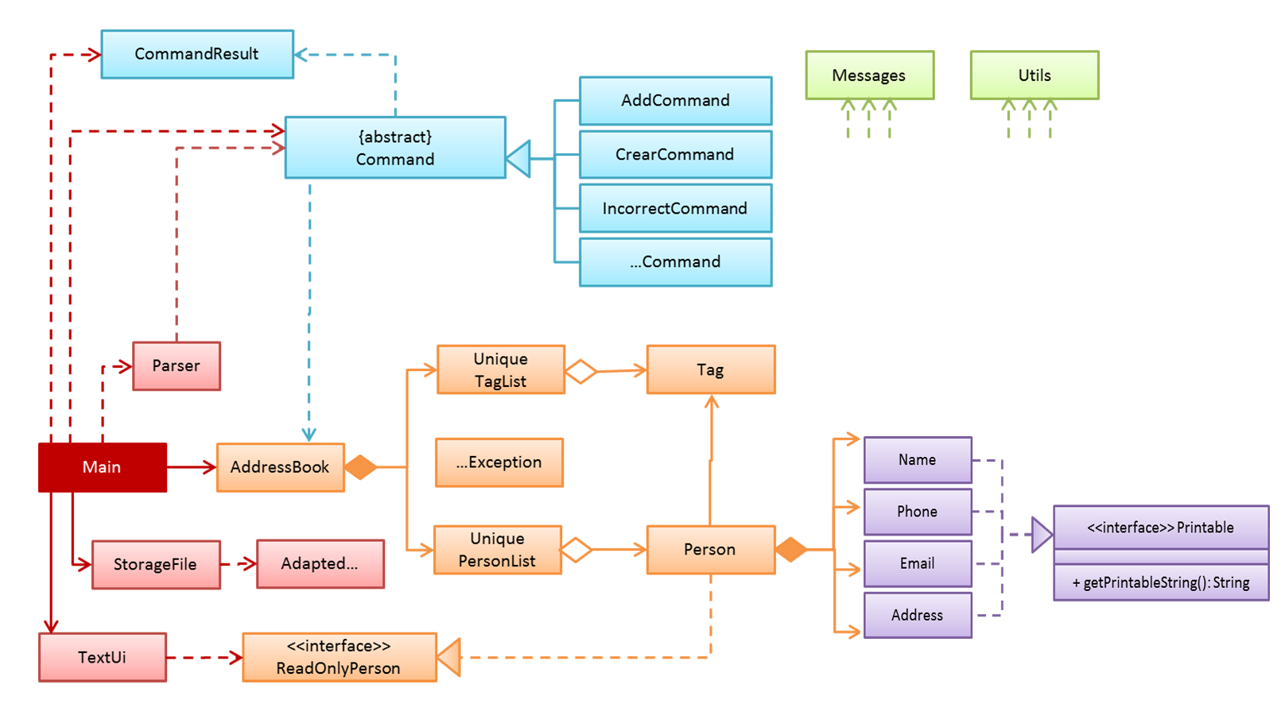

Slide 3
Contact
Block
Phone
Address
Email
Street
Address
Unit
Postal code

