Slide 1
Image Processing for Masked Stereolithography(MSLA) 3D Printing
By Chase Hughes

Slide 2
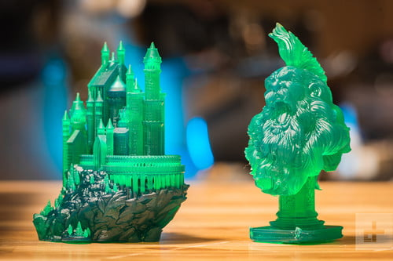
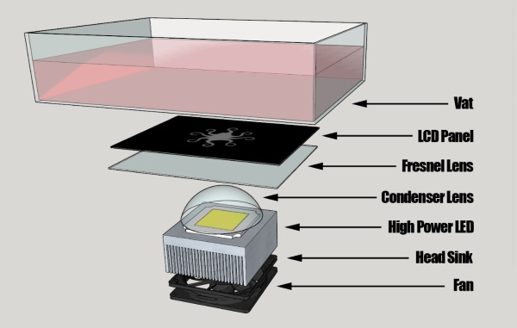
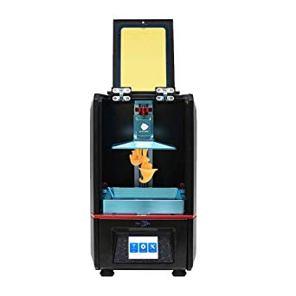
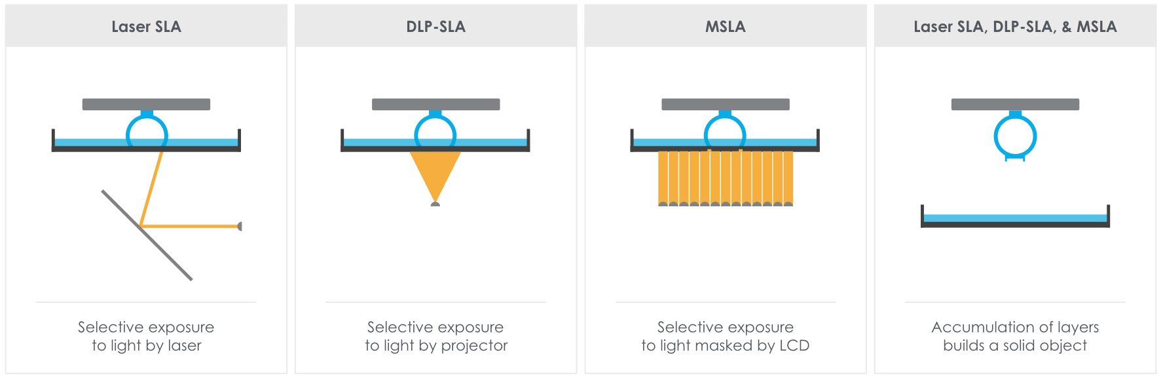
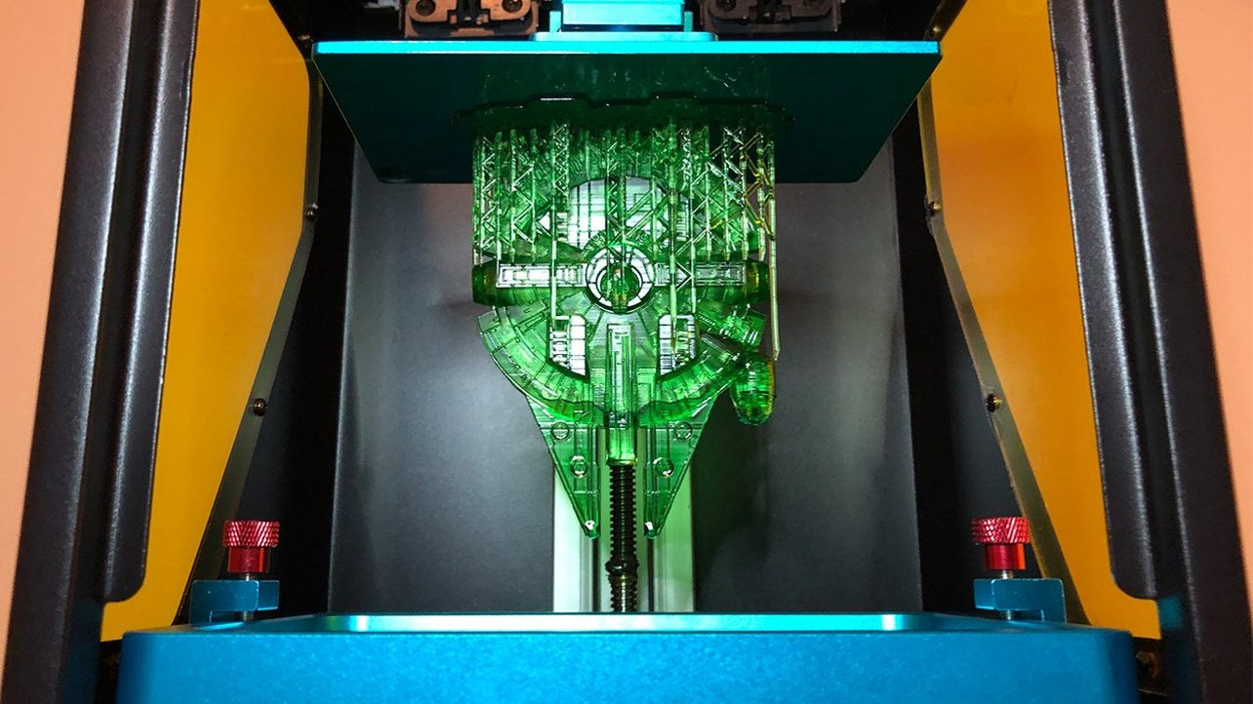
What is Masked Stereolithography(MSLA)

Slide 3
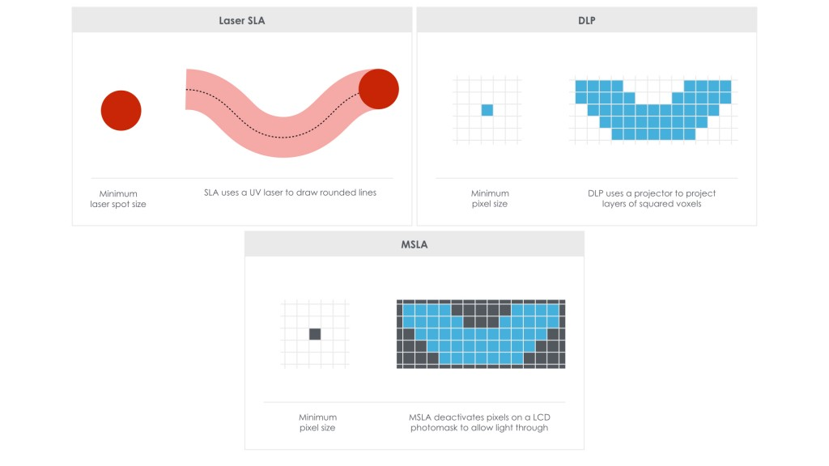
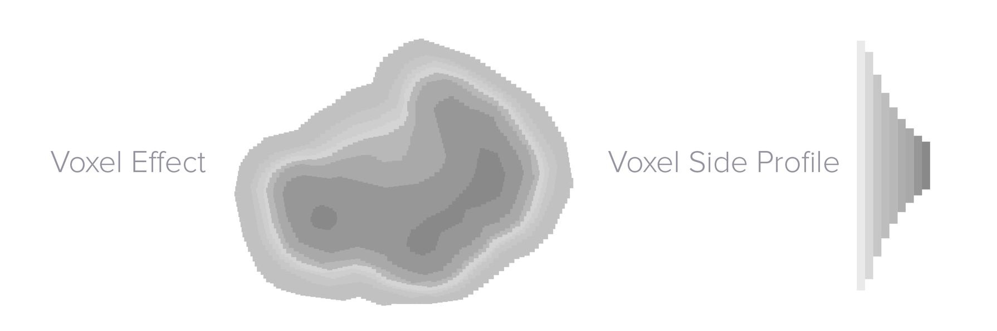
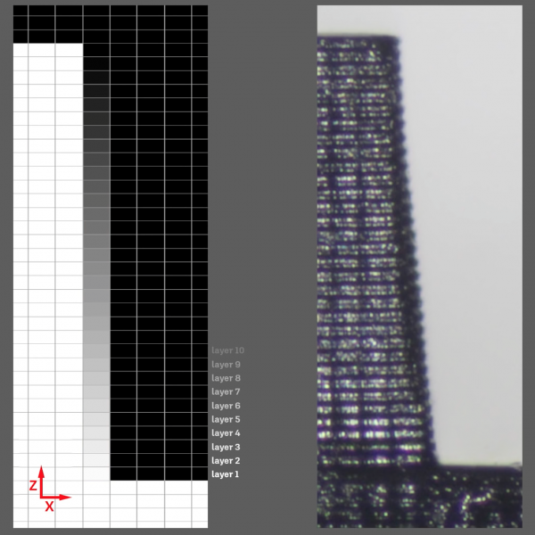
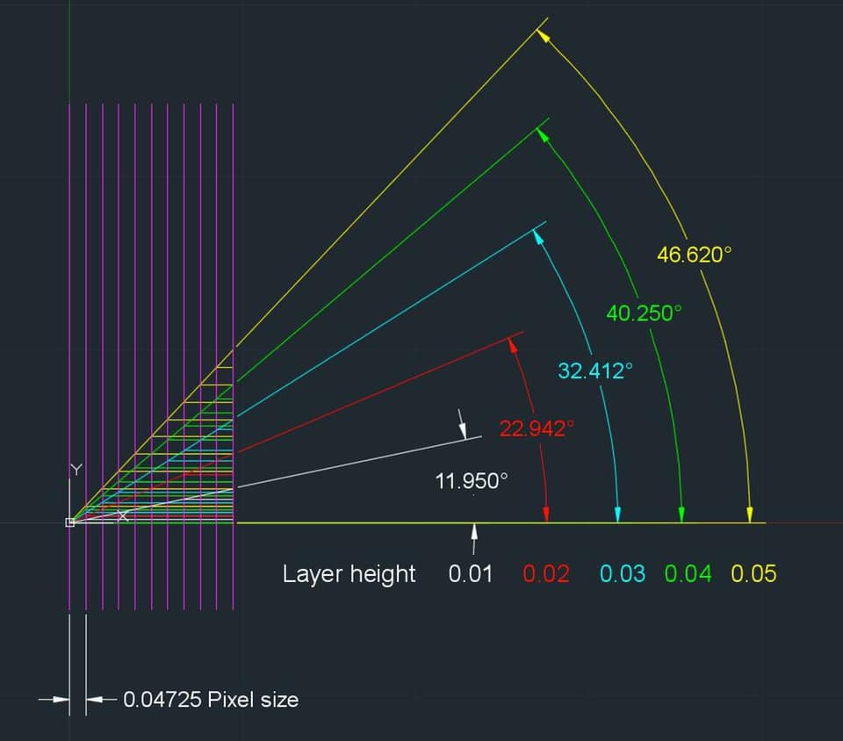

Slide 4


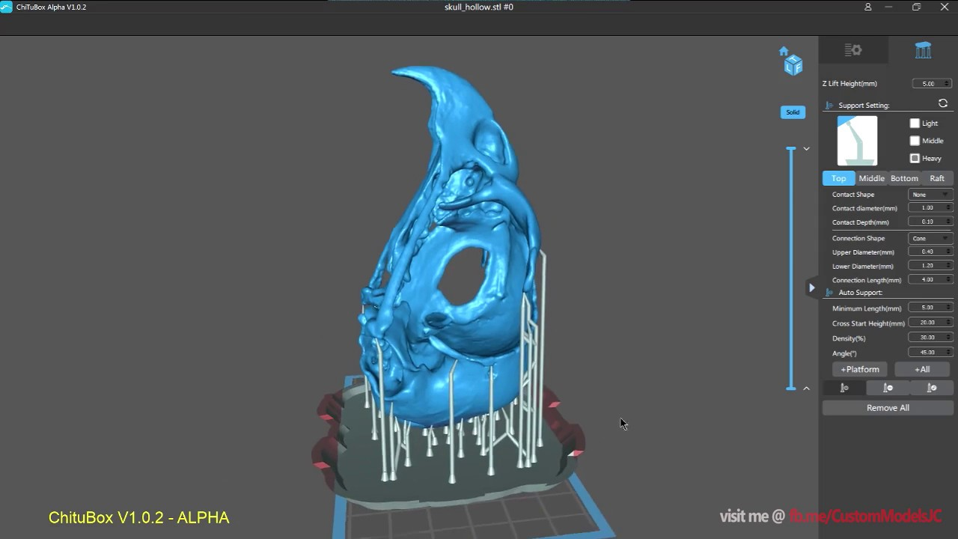

Previous Work
Chitubox-No AA
Chitubox- AA of 2

Slide 5
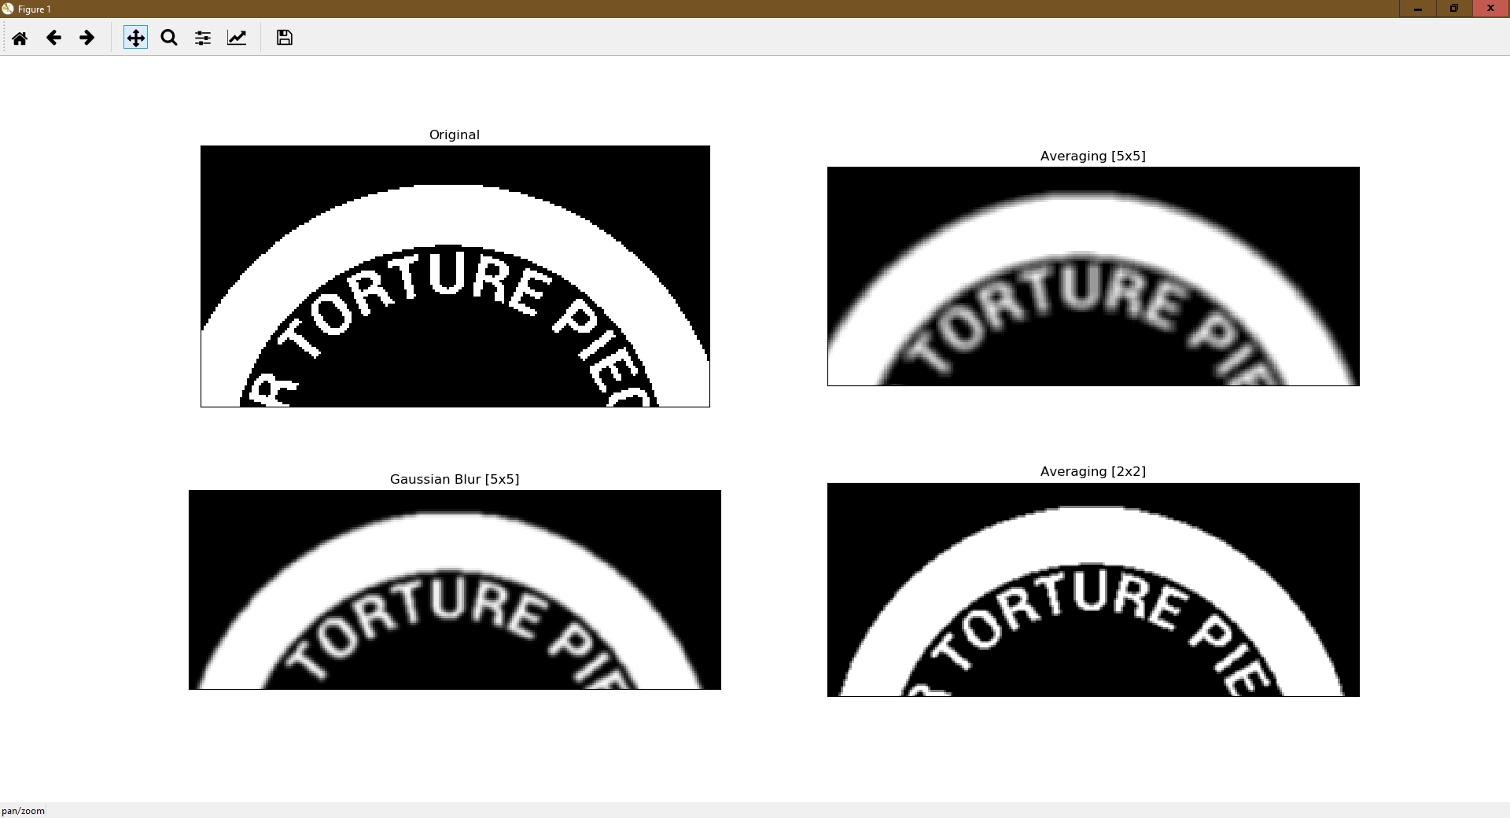
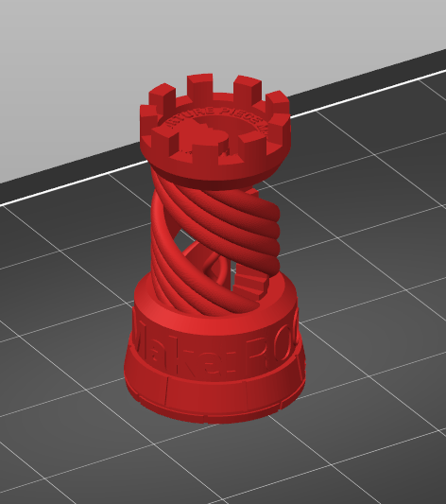
Experiment and results

Slide 6
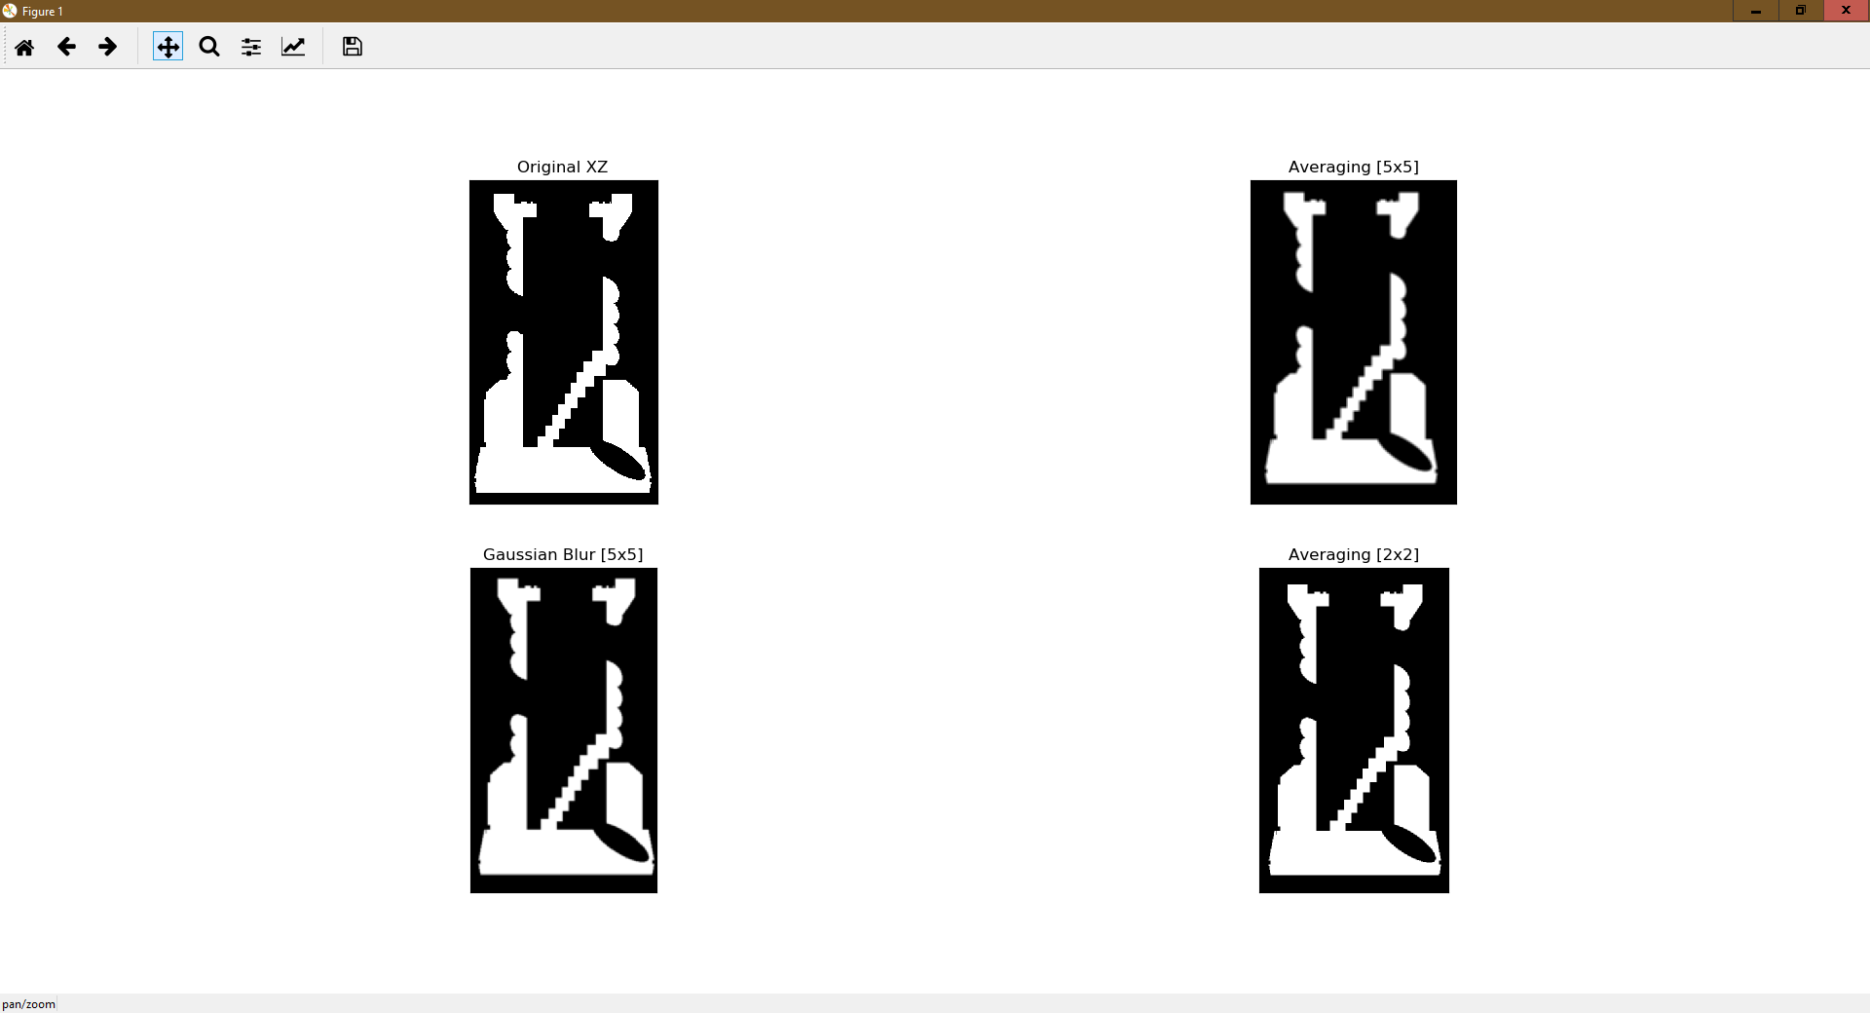
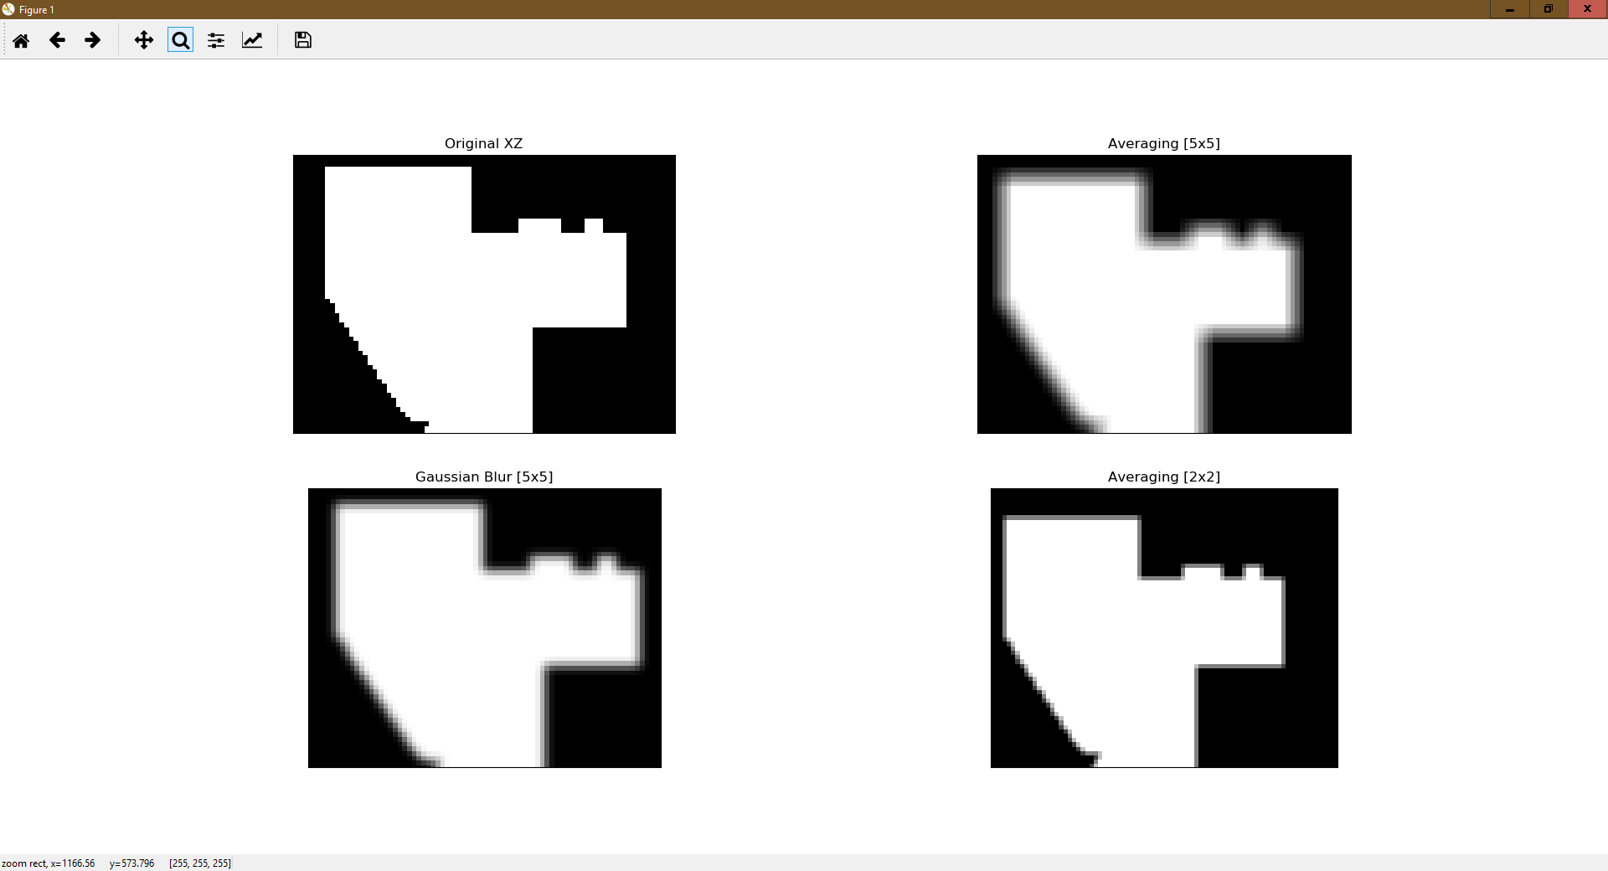

Slide 7
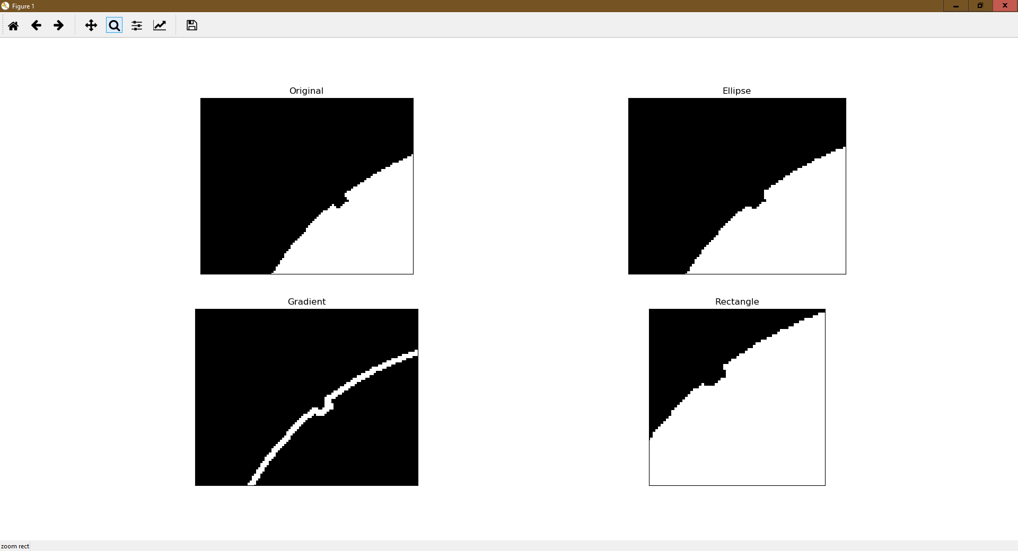
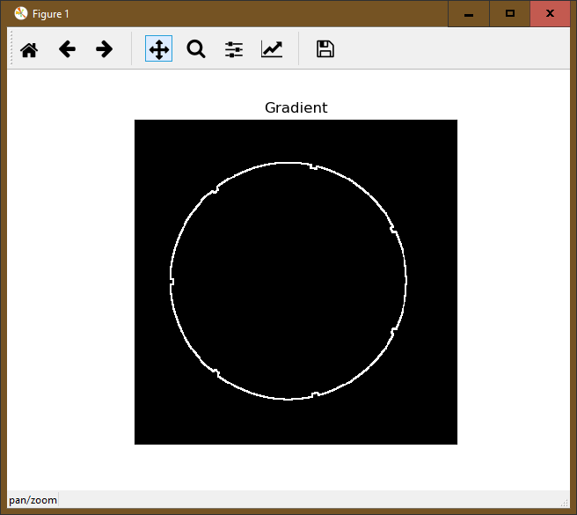
Morphology techniques

Slide 8
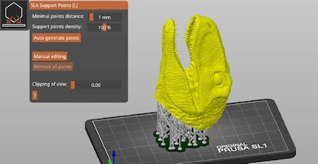
Future Work
---------------------------------------
---------------------------------------
---------------------------------------
---------------------------------------
G-code and Photon file export

Slide 9
Citations
https://github.com/3D-Printing-for-Microfluidics/OpenGL-STL-slicer.git
https://docs.opencv.org/
https://www.opengl.org/
https://github.com/Photonsters

