Slide 1
Olson Scenarios

Slide 2
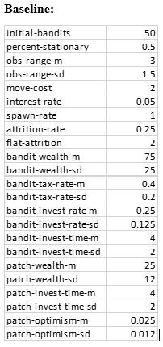
BASELINE
Results:
Most common result is that the roving bandits outperform the stationary bandits in the short term, but cannot maintain them for as long and eventually the stationary bandits outperform them through their investments maturing.
We see a dynamic where roving bandits face a bifurcation based on their tax rate. Roving bandits with lower taxes rates become stationary, turning orange. They usually come to outnumber the number of roving bandits and they can maintain their fitness by acting as a simple leader of their subjects. They tax them a small amount, but they don’t provide any public goods. But because they only tax a small amount their subjects are still incentivized to invest. The roving bandits that maintain their roving status are true roving bandits, they extract nearly the maximum taxes possible at rates above 90%.

Slide 3
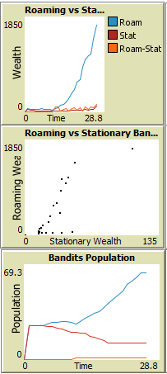
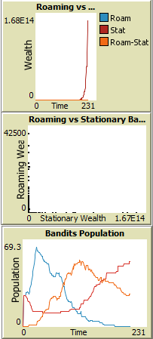
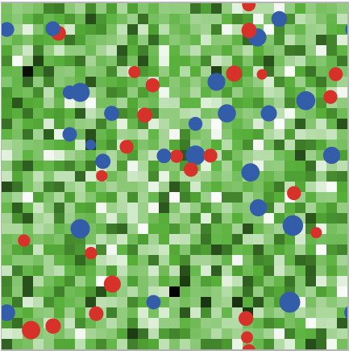
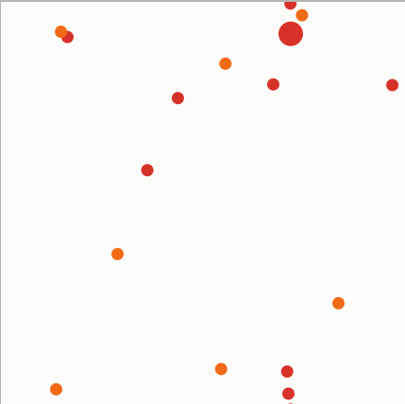
Baseline
25 200

Slide 4
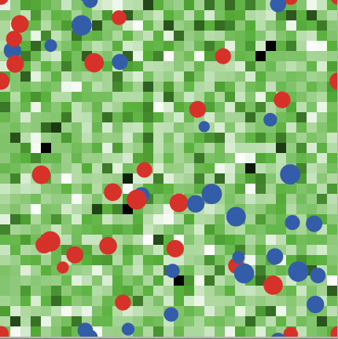
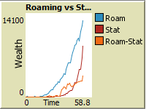
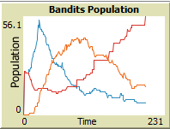

Baseline
25 200

Slide 5
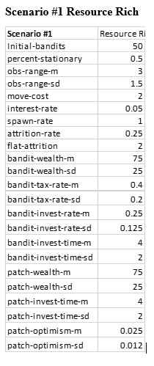
Scenario 1:
Results:
A: 8
B: 2
C: 2
D:
Roving bandits die out significantly more often in this scenario. Because the population booms more, they cannot sustain this increase population and die out, like wolf-sheep predation models.

Slide 6
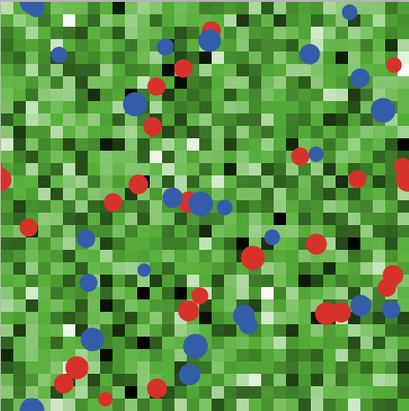
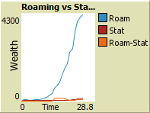
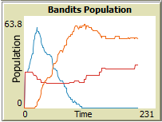

Scenario 1:
25 200

Slide 7
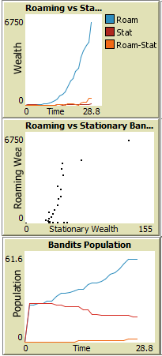
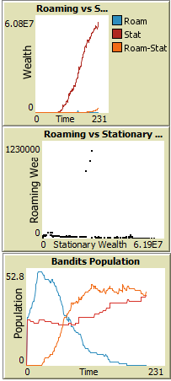
Scenario 1:
25 200

Slide 8
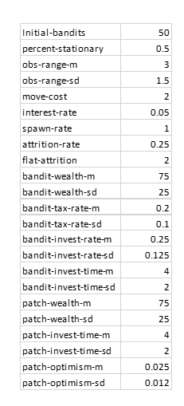
Scenario 2: More Resources, Low Taxes
Results:
Roving bandits die out quickly. While some of them die, most of them are simply rational agents who choose to become stationary as it is the dominant strategy. This result further emphasizes the equilibrium that is reached by roving bandits with low tax rates to survive and even thrive as roving-stationary bandits.
Stationary Bandits who can invest remain atop the model with the best ability to capture resources through its strategy of investing into their subjects. The mutual returns from investing in subjects in combination with subjects desire and ability to invest in themselves leads to a mutually advantageous outcome as both thrive. The Roving-Stationary bandits find a similar strategy, where they tax at a lower rate, but subjects are incentivized to invest in themselves and the autocrats benefit from this hands off approach.

Slide 9
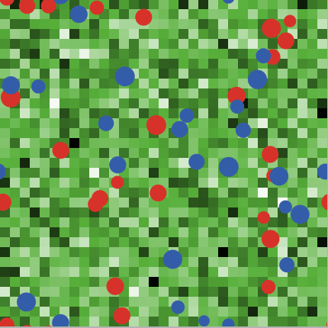
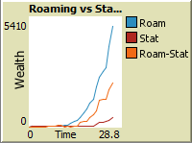
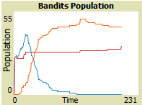

Scenario 2:
25 200

Slide 10
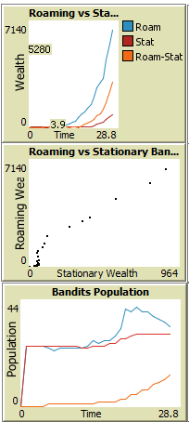
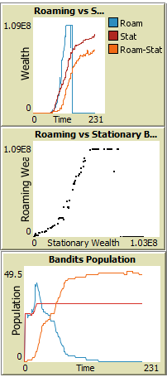
Scenario 2:
25 200

Slide 11
Scenario 3: More Resources, High Taxes
Results:
A: 3
B: 3
C:
D:
Stationary bandits with high tax rates quickly die out, but those with low-medium tax rates survive and thrive. Similar to the stationary bandits, the only time a roving-stationary bandit survives it will have a low tax rate and they can survive the scenario.
Roving bandits appear to be the dominant strategy as very few roving bandits transition into roving-stationary bandits. The population of roving bandits grows initially before becoming seamingly stable for a period of time before the population collapses. Roving bandits do not survive in this scenario.

Slide 12
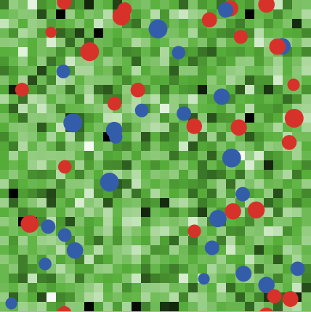
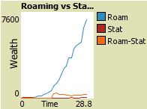
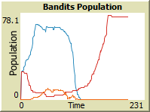

Scenario 3:
25 200

Slide 13

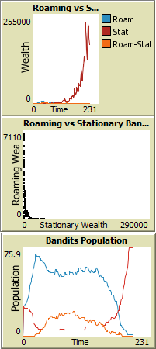
Scenario 3:
25 200

Slide 14
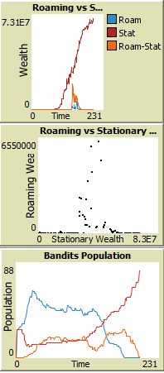
Scenario 3:
25 200

