Slide 1

Covert Channel
By Chase Ashby

Slide 2

Agenda
Introduction
How it works
Diagram Break Down
Sender Functionality
Receiver Functionality
Conclusion

Slide 3

About Me
Computer Science Student
Class of 2022
I Specialize in Web Development, Web Security, and Artificial Intelligence.
I have accepted a full-time position at Siemens Digital Industries post graduation.
For my project I have created a network based covert channel.

Slide 4
Surface View
A network based covert channel works via several components.
The sender component.
The receiver component.
Platform for transmitting data.
These components work by transmitting data from one network to another undetected by packaging it in with other information being transmitted across the network.

Slide 5
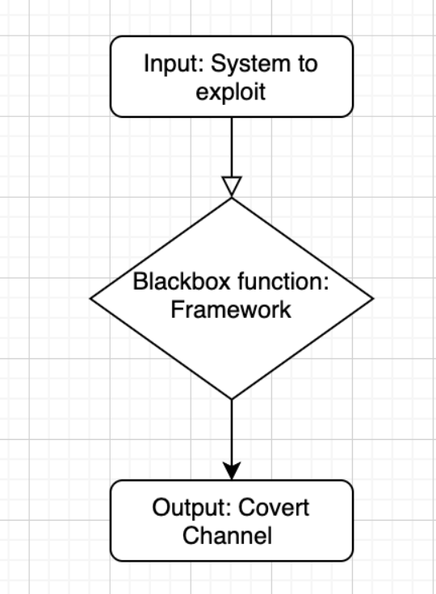
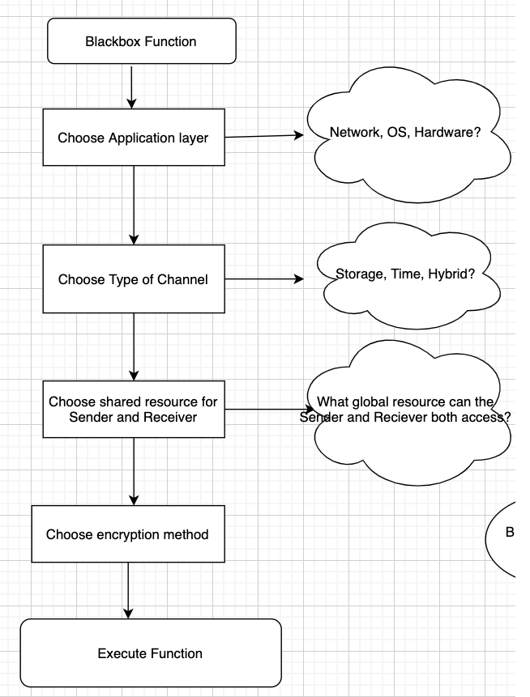
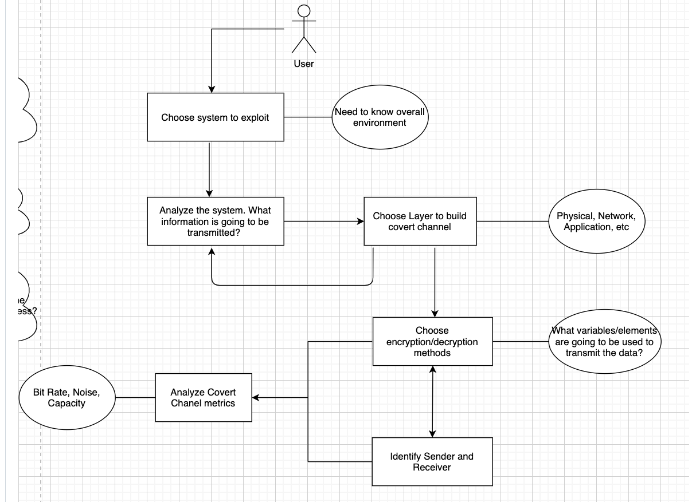
Diagrams

Slide 6
Sender Functionality
The sender is responsible for packaging the data and sending it across a network undetected by the user.
It does this by first reading in a message from a text file.
It then converts that message into bits and packages it one bit at a time to a TCP packet header.
It then sends out the packets one at a time.
This was done using python to read the message and open the server and port to be used for communication.

Slide 7
Receiver Functionality
The receiver function was also built using python libraries.
It works by opening the same server and port as the sender.
It then collects the bits from the TCP headers one at a time and stores them until all have been received.
Once all bits have been received the receiver outputs the binary version of the message.
It then converts the binary message back to plaintext and outputs the original message to the user of the receiver.

Slide 8
Results
The result of my project was a functioning covert channel with sender and receiver functionality that performed beyond my expectations. Once the project was completed I was able to transmit many different sizes of messages via a network undetected. When attempting to detect the messages being sent even knowing where to look I could rarely find any traces. All testing was done in a secure test environment as to protect the integrity of engineering ethics. It was a very fun project to work on and I was extremely happy with the results.

