Slide 1
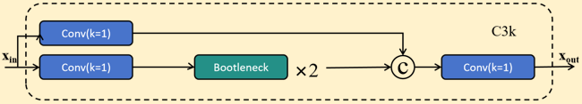
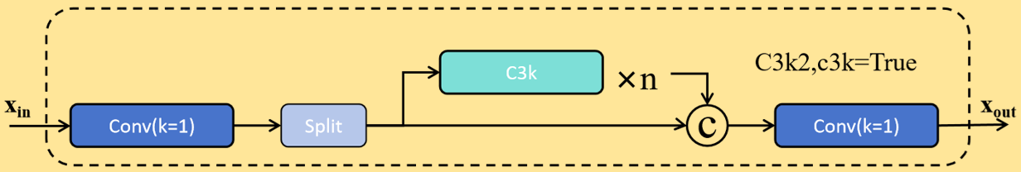
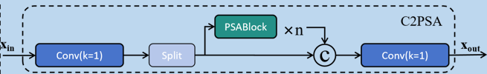
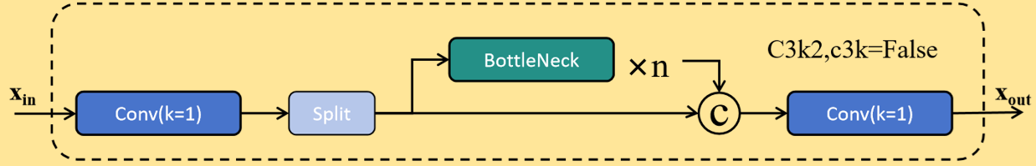
Input
640*640*3
YOLO11
Conv k=3 s=2
Conv k=3 s=2
C3k2
Conv k=3 s=2
C3k2
C3k2
Pose
Conv k=3 s=2
Concat
Conv k=3 s=2
C3k2
Upsample
Concat
Conv k=3 s=2
C3k2
C3k2
Pose
C3k2
Concat
Conv k=3 s=2
SPPF
Upsample
Concat
C2PSA
C3k2
Pose
Backbone
Neck
Head

Slide 2
Conv
Conv
Conv
Conv
Split
Bottleneck
C3k2
True/False
Bottleneck
False*
Conv
N
Bottleneck
True/False
Concat
add
Concat
C3k2
True*
Conv
Conv

Slide 3
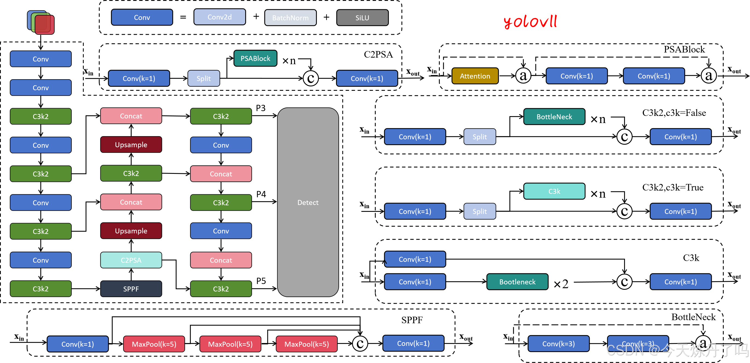

Slide 4
YOLOv8
Input
640*640*3
Conv k=3 s=2
Conv k=3 s=2
C2f
Conv k=3 s=2
C2f
Pose
C2f
Concat
Conv k=3 s=2
Conv k=3 s=2
Upsample
Concat
C2f
C2f
C2f
Pose
Conv k=3 s=2
Concat
Conv k=3 s=2
C2f
Upsample
Concat
SPPF
C2f
Pose
Backbone
Neck
Head

Slide 5
Input
640*640*3
YOLOv8
Conv k=3 s=2
SPPF
Conv k=3 s=2
Conv
k=3 s=2
Conv2d
k=1 s=1
Bbox.
Loss
C2f
CSPLayer_2Conv
Conv
k=3 s=2
Conv2d
k=1 s=1
Cls.
Loss
Conv k=3 s=2
Conv k=3 s=2
Concat
C2f
Concat
Conv
k=3 s=2
Conv2d
k=1 s=1
Bbox.
Loss
Upsample
Conv k=3 s=2
CSPLayer_2Conv
Conv
k=3 s=2
Conv2d
k=1 s=1
Cls.
Loss
C2f
CSPLayer_2Conv
Conv k=3 s=2
Conv k=3 s=2
Concat
C2f
Concat
Conv
k=3 s=2
Conv2d
k=1 s=1
Bbox.
Loss
Upsample
CSPLayer_2Conv
Conv
k=3 s=2
Conv2d
k=1 s=1
Cls.
Loss
SPPF
Backbone
Neck
head

Slide 6
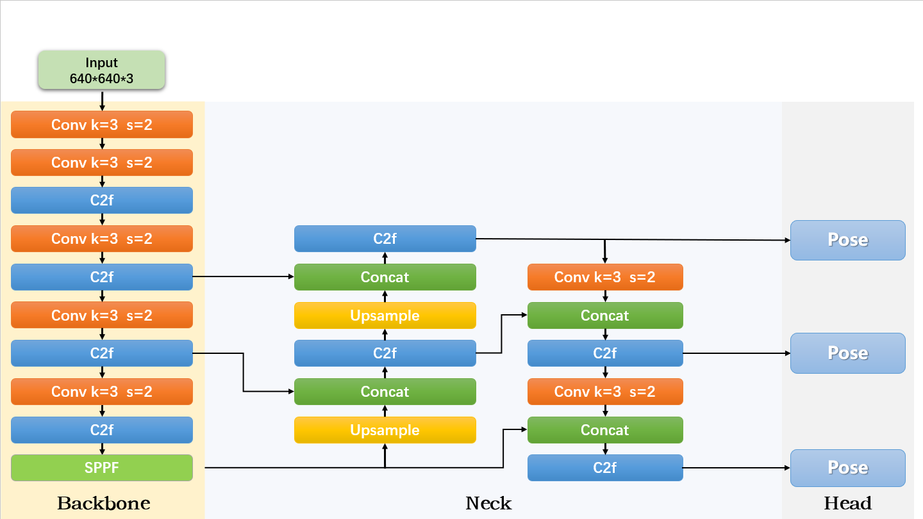
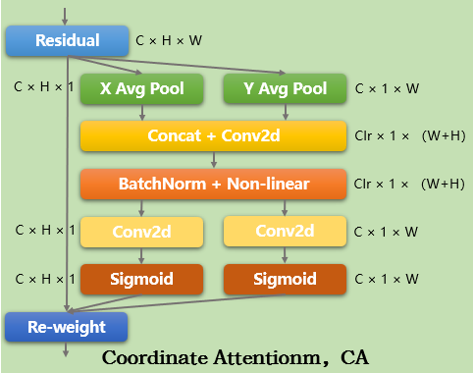
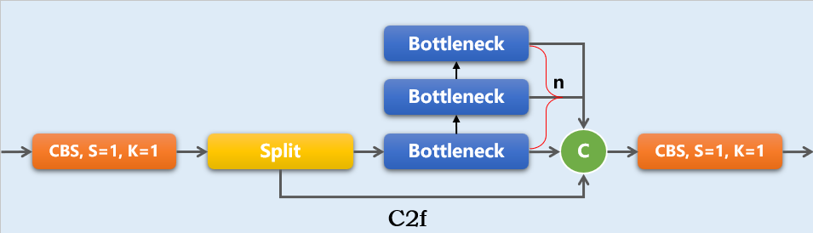
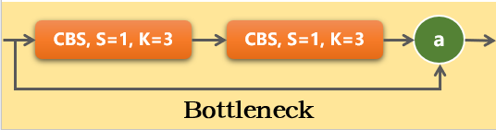
YOLOv8

Slide 7
YOLOv8+ca
Input
640*640*3
Conv k=3 s=2
Conv k=3 s=2
CoordAtt
Pose
C2f
Conv k=3 s=2
Conv k=3 s=2
C2f
Concat
C2f
Concat
C2f
Conv k=3 s=2
Upsample
CoordAtt
Pose
C2f
C2f
Conv k=3 s=2
Conv k=3 s=2
Concat
Concat
C2f
Upsample
C2f
SPPF
CoordAtt
Pose
Backbone
Neck
Head

Slide 8
YOLOv8
Bottleneck
Bottleneck
n
CBS, S=1, K=1
Split
Bottleneck
C
CBS, S=1, K=1
C2f
CBS, S=1, K=3
CBS, S=1, K=3
a
Residual
C × H × W
Bottleneck
C × H × 1
X Avg Pool
Y Avg Pool
C × 1 × W
Concat + Conv2d
Clr × 1 × （W+H）
BatchNorm + Non-linear
Clr × 1 × （W+H）
C × H × 1
Conv2d
Conv2d
C × 1 × W
C × H × 1
Sigmoid
Sigmoid
C × 1 × W
Re-weight
Coordinate Attentionm，CA

