Slide 1

Tic-Tac-Toe Kernel on a Raspberry Pi
Nicholas Franck, Eric Peasley, Chase Poland

Slide 2
Introduction
The goal of this project was to create a kernel for a Raspberry Pi 3 B+ that could play a simple game of Tic-Tac-Toe.
The Tic-Tac-Toe kernel uses Multi-threading, interrupt handler, and Spinlock to efficiently execute.
The Raspberry Pi takes input from keyboard through USB and displays the graphics onto a monitor through HDMI.

Slide 3

Setup
Used the Raspbian OS for booting
Replaced Raspbian Kernel with our own
Acquiring libraries for Kernel services

Slide 4
Kernel Design
System Start
Create kernel stack, interrupt stack and handler
Initialize USB ports
Initialize Screen
Stores display resolution
Store memory maps for IO devices and game state variables

Slide 5
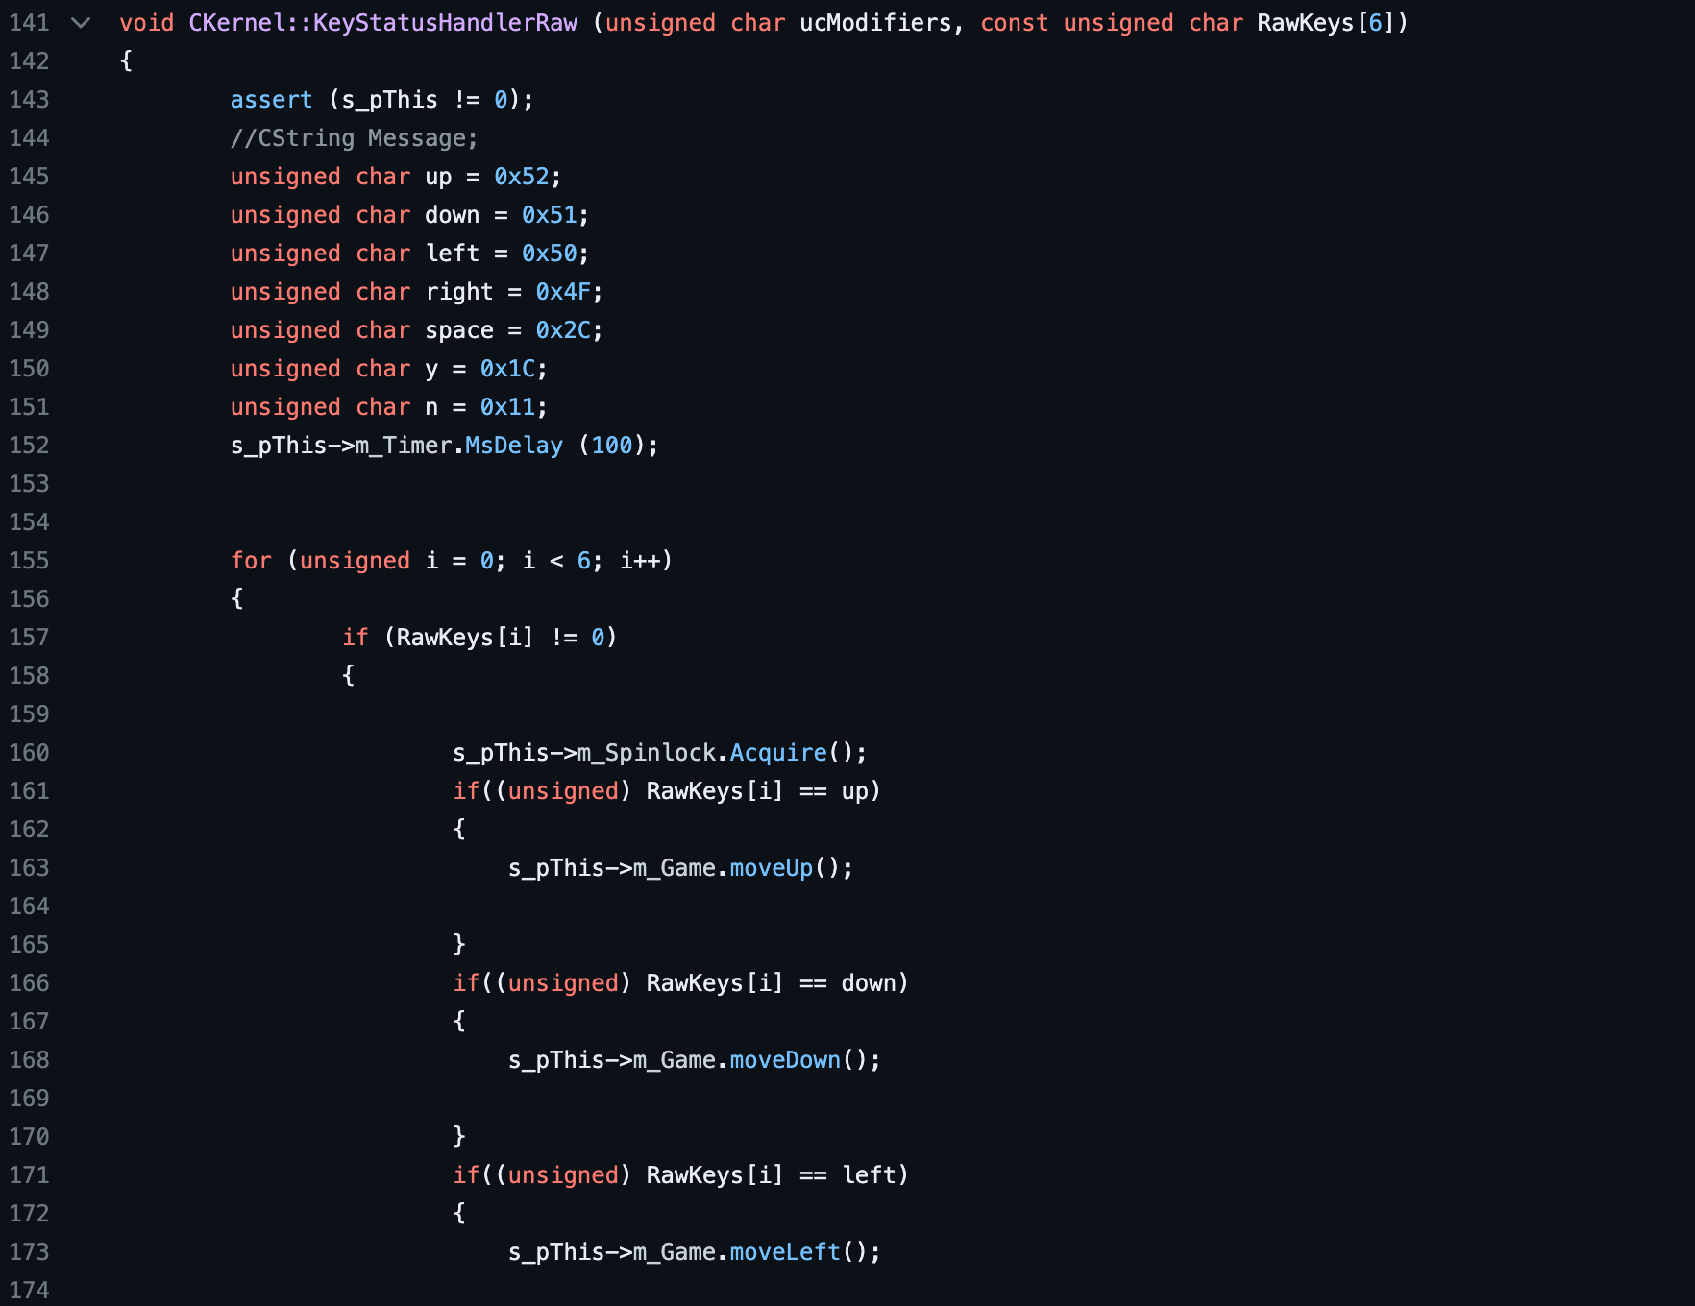
Keyboard Input
Check USB Device Type
If type is keyboard check
Create thread to handle inputs
Check input signal to map and translate

Slide 6
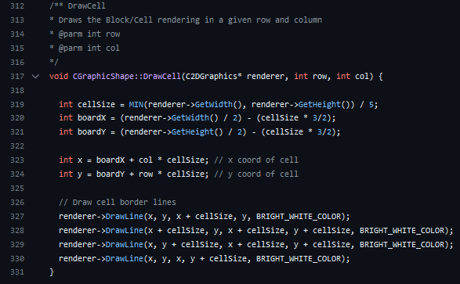
Graphic Display
Obtained Kernels Display
Rendered graphics according to the display's width/height
Had to build predefined functions for drawing lines, circles, and x's.
Had to create specific equations to calculate cell size.

Slide 7
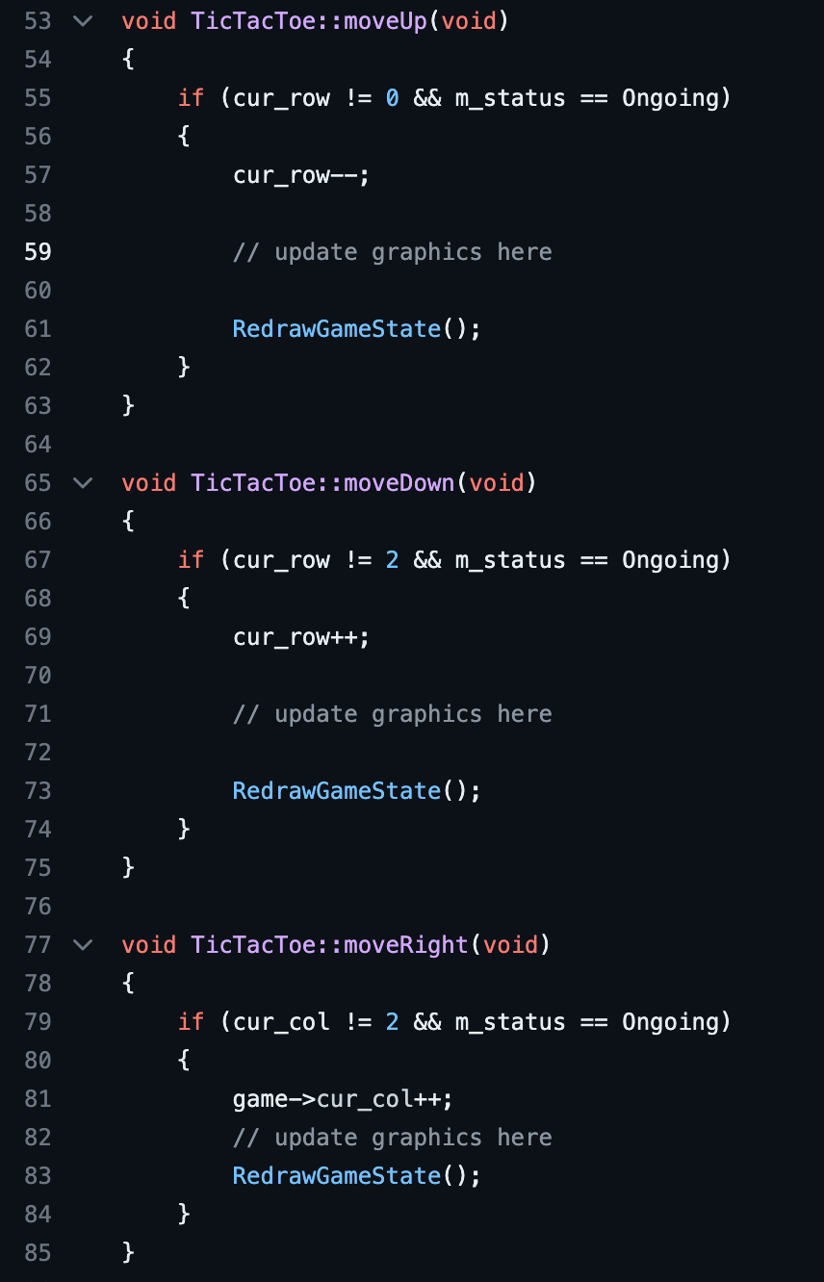
Game Logic
4 selection methods (up, down, left, right)
1 placement method
Checks for winners and keeps score
End of game handlers

Slide 8
Limitations
Only works for the one game
Only works with certain keyboards
Simple Kernel, not much functionality
No hardware performance indicators

Slide 9
Possible Improvements
Generalized to handle more than one game
Can handle many different input types
More dynamic graphics
Sound Effects

Slide 10
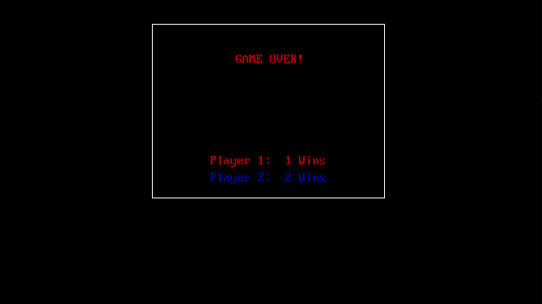
Q&A

