Slide 1

Video Analysis via Video Intelligence API
Group 9

Slide 2

Chathura Lakmal
(0422854)
Devanshi Patel
(0444549)
Team
Harshkumar
Vyas
(0424484)
Rupa
Chakrabarti
(0430308)
Jiazhou Ye
(0426609)
Notes:
Reference apple watch menu

Slide 3
Video Analysis via
Video Intelligence API
The Future is Now.
Pre-trained machine learning models in Video Intelligence API recognize many objects, places, and activities in recorded and streaming video. It has excellent quality out of the box, is efficient for typical use cases, and improves with new ideas.

Slide 4
Introduction
Why do we need to analyze videos?
CCTV
Overwhelming video content.
HD to 4K, low storage cost
Use machine learning.
Google already made a model
Notes:
Over the past decade, surveillance system needs have grown quickly. High-definition technology supports these growing rates. Application-oriented research on surveillance systems incorporating computer vision, machine learning, and image processing has garnered attention. This approach uses camera sensor data to automatically understand a video scene, detect, and forecast object interactions. The surveillance system began with tube cameras used to monitor or relay manufacturing activities in the 1940s. Close-Circuit Television (CCTV) was a delicate and expensive video surveillance technology where a security crew mounted cameras to monitor the scene from a visual display. The 2nd generation of surveillance systems, which are semi-self-loading, has grown because to digitalized CCTV and sophisticated computation systems. This innovative method benefits from digital video communication advances such data compression, consistent transmission, and bandwidth reduction.

Slide 5
Cloud vs. on-premises
Cost
Scalability
Accessibility
Maintenance
Reliability
Security
Deployment Speed

Slide 6




Objective
From the Video Intelligence API detect and track objects within CCTV footage or specific objects of interest.
Input Video
Data stored and Process
Outcome of the analyzed video

Slide 7
Data set
We have used publicly accessible video contents for testing purposes. video length less than 30 seconds.
Also we have used few sample drone videos from kaggle data set.

Slide 8
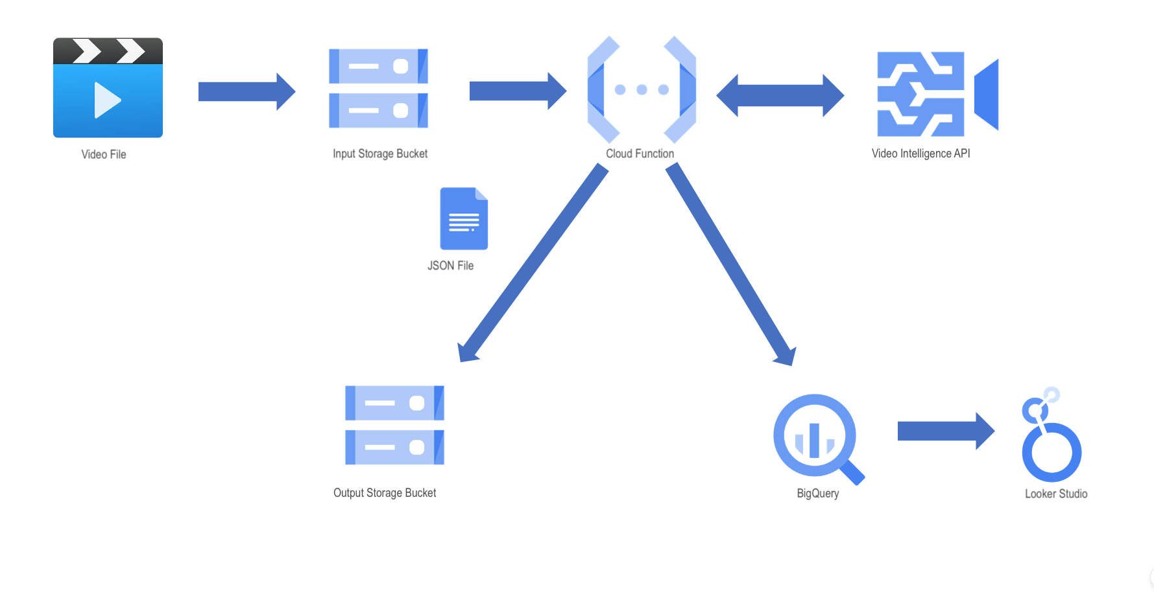
Architecture & Pipeline

Slide 9



Implementation
Create Google project
Enable API s
Create Cloud Buckets
Create BigQuery Dataset
Google Cloud Video Analysis Project

Slide 10



Implementation Cont..
Create Cloud Function
Set Permission for Service
Run the Project
Present data in Looker Studio
Google Cloud Video Analysis Project

Slide 11
Issues faced…
We had numerous errors writing the cloud function.
Big Query access permission issues,
Dependency library and connection challenges.
Timeouts occur with large videos.
Providing IAM console functions adequate rights resolve it.
The toughest issue was running the python code without errors, Fortunately, Google Cloud Logs helped us.
82%
Python Code and Setup Guide
Github Link: https://github.com/ChathuraP/Video-Analysis-via-GCP/tree/main

Slide 12
Future improvements
Generate accurate context
02
Large size videos will be supported
Alert users in real time using Pub/Sub
01
03
Notes:
Layout masih kurang

Slide 13
Conclusion
Event Detection
Used
as
Video Surveillance System
Traffic Management

Slide 14


Slide 15
