Slide 1
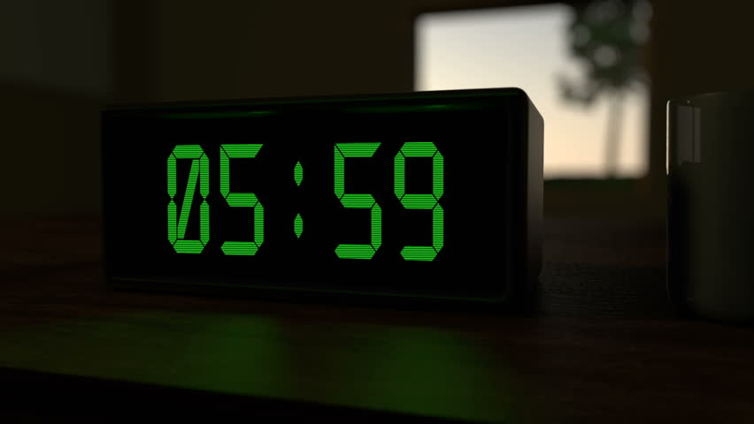
LAB PROJECT: SEMESTER 2
DIGITAL ALARM CLOCK
GROUP 22

Slide 2
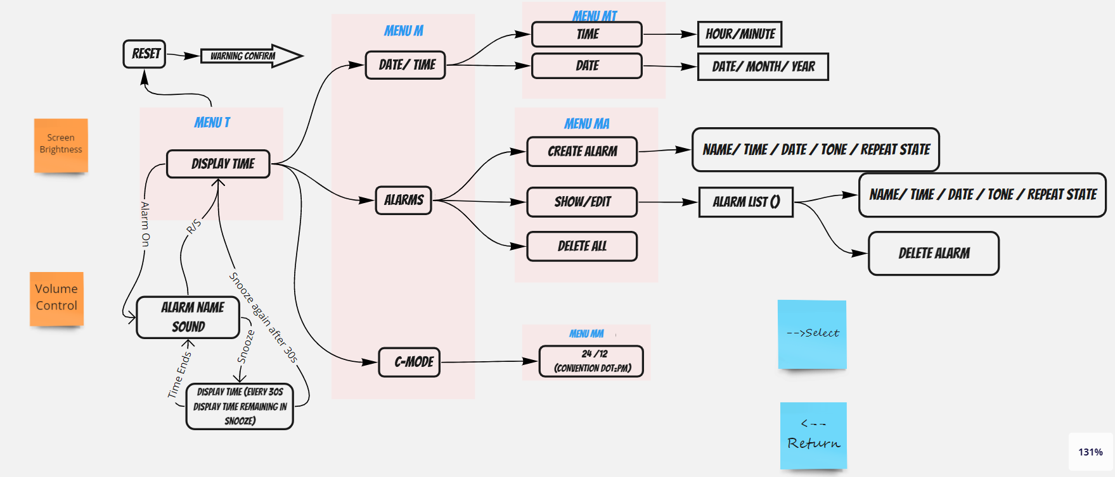
CLOCK FUNCTIONAL FEATURES
Repeat state
handling

Slide 3
CLOCK OPERATIONAL FEATURES
Buttons
Visible Buttons
Select.
Return.
Next .
Previous. Big button on the Top
Snooze. Hidden Button
Reset.
Screen Brightness adjustment.
Alarm volume adjustment.
Reset the clock completely.
Key Operation Indication.
Continuous scrolling within options.

Slide 4
WORK SHARING
Micro product code modification and main code : Sajeepan (190539T)
Algorithm development and main code : Sanjith (190562G)
PCB Design : Chathushka (190557V)
Enclosure Design : Ushan (190543B)

Slide 5
DEMOSTRATION FLOW
Stimulation of alarm clock functionalities : Sajeepan
Algorithm and problem handling demo : Sanjith
PCB features : Chathuska
Enclosure features : Ushan

Slide 6
Here we haven’t included the things we discussed during micro-product…
Lets Begin with Stimulation…..
Over to you Sajeepan….
HOPE YOU LIKE OUR DEMOSTRATION….

