Slide 1
FindIt: Lost and Found Application
A Streamlined Lost and Found Management System
Connecting people with their lost belongings.

Slide 2
Introduction & Overview
Objective: Provide a digital platform to easily report, search for, and claim lost and found items.
Problem Solved: Traditional lost and found processes are disorganized and localized.
Solution: A centralized mobile application accessible anywhere, bringing together users who lost items with those who found them.
Core Platform: Android App powered by Firebase and Cloudinary.

Slide 3
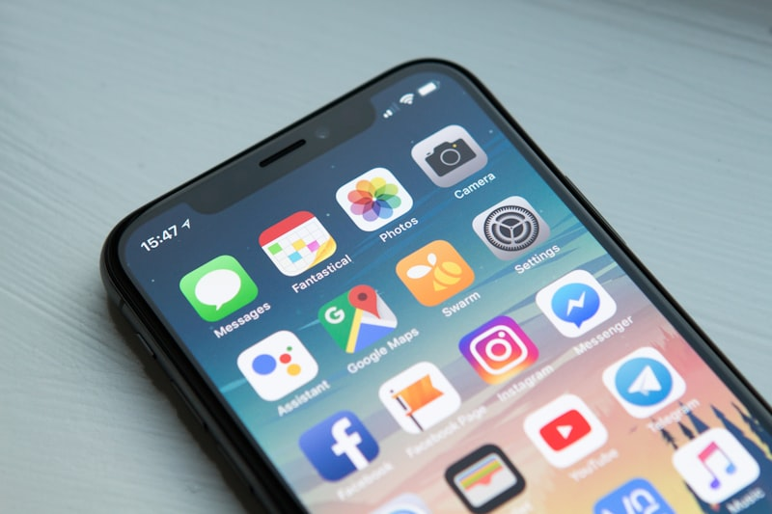
System Architecture & Technologies
Frontend: Android (Java/Kotlin) providing an intuitive native user interface.
Backend/Database: Firebase Firestore for real-time, scalable data synchronization.
Image Hosting: Cloudinary integration for robust handling of item images and proof of ownership.
Architecture: Asynchronous data layer for seamless non-blocking operations.

Slide 4
Part 1: User Profile & Item Management
Authentication: Secure user registration and login system.
Profile: Manage personal details and contact information.
Reporting: Users can report items they have lost or items they have found.
Details: Upload images (via Cloudinary), add descriptions, location details, and categorization.
Tracking: Users can track the status of the items they have reported.

Slide 5
Part 2: Item Viewing and Search
Home Feed: Centralized feed displaying all recently lost and found items.
Detailed View: Click on any item to view full descriptions, high-quality images, and context.
Search Capabilities: Search by keywords (e.g., 'iPhone', 'Keys').
Filtering: Filter listings by category, date, and status (Lost vs. Found).

Slide 6
Part 3: Claims and Notifications
Initiation: Users who recognize their lost item can initiate a claim directly from the item's page.
Proof of Ownership: Users upload verification images when submitting a claim.
Alerts: Users receive updates on their claim status (Pending, Verified, Rejected).
Communication: System bridges the gap between the claimant and the administration securely.

Slide 7
Part 4: Admin and Reports
Admin Dashboard: Admins have a dedicated panel to oversee all platform activity.
Claim Verification: Admins review submitted claims and the attached proof of ownership images.
'Mark Recovered': Admins can finalize the process by marking an item as 'RECOVERED'.
System Reports: Generate insights on app usage, total items recovered, and active user metrics.

Slide 8
Future Enhancements & Roadmap
Implement push notifications for real-time match alerts.
Integrate location-based matching using Maps API (e.g., Google Maps).
Add an in-app messaging system for direct user-to-user communication after a claim is verified.

Slide 9
Q&A
Thank You!
Questions and feedback are welcome.

