Slide 1
FindIt
The Next-Generation Lost and Found Platform

Slide 2
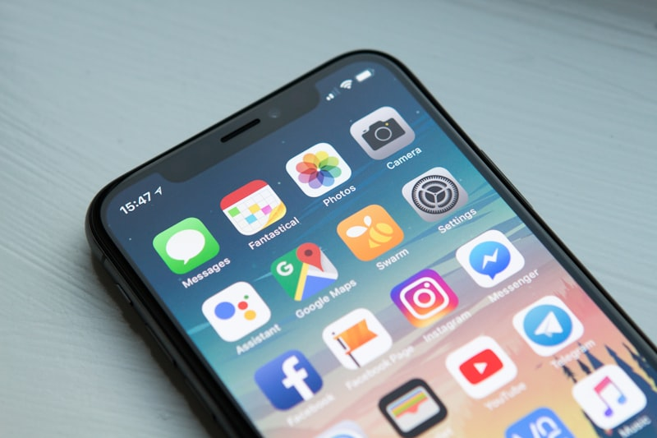
Introduction & Overview
Target: Revolutionize how people recover lost items using a modern digital interface.
Problem: Currently, finding a lost item relies on luck, disorganized physical bins, or scattered social media posts.
Solution: A centralized, elegant Android Application that intelligently bridges the gap between those who lost items and those who found them.
Core Stack: Native Android powered by Firebase realtime architecture and Cloudinary.

Slide 3
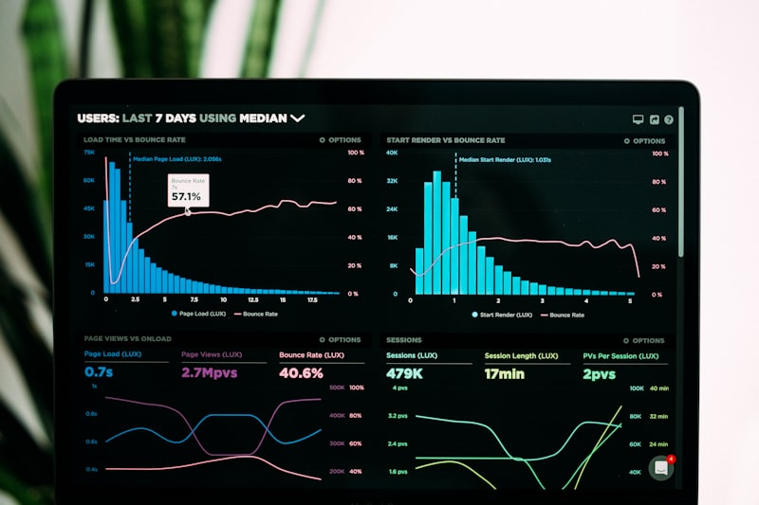
System Architecture
Frontend: Crafted with Java/Kotlin focusing on fluid UX and Material Design principles.
Backend/DB: Firebase Firestore integration for low-latency, real-time data syncing across all users.
Media Layer: Cloudinary handles high-res image uploads securely without bogging down the database.
Operations: Fully asynchronous architecture preventing UI locks and providing instantly responsive feedback.

Slide 4
Part 1: User & Item Hub
Authentication: Frictionless and secure user registration and login.
Comprehensive Profiling: Keep user data and contact paths cleanly organized.
Rich Item Reporting: When reporting an item, users add high-res photos, location tags, and detailed descriptors.
Status Tracking: Users can follow their reported item through a beautiful, timeline-style tracking UI.

Slide 5
Part 2: Discovery & Search
Global Feed: A unified, infinitely scrolling feed of all active items in the ecosystem.
Item Deep-Dive: Tapping an item yields a full-screen, detailed card with zoomable photos.
Smart Search: Instantly filter items by keywords (e.g., 'Keys', 'Backpack').
Categorization: Rapidly drill down by specific status (Lost/Found) or semantic category.

Slide 6

Part 3: Claims & Notification
Direct Claiming: Found your item? Initiate a direct claim seamlessly from the item's view.
Ownership Proof: Securely upload private verification images that only admins can see.
Real-time Alerts: Instant notifications when a claim state changes (Pending -> Verified).
Secure Channels: The platform mediates communication, ensuring privacy and trust for both parties.

Slide 7
Part 4: Admin Authority
Command Center: A dedicated dashboard giving administrators a 10,000-foot view of the platform.
Verification Hub: Admins can side-by-side compare the original listing with the claimant's proof.
One-Tap Closure: Securely finalize a case by marking the item 'RECOVERED', hiding it from the public feed.
Analytics: Exportable insights on app performance and success rates.

Slide 8

Future Roadmap
Push Notifications: Implement FCM for instant matching alerts and pings.
Geolocation: Integrate Google Maps API to let users browse items on an interactive map.
Encrypted Chat: A secure in-app messaging feature unlocking once an admin approves a match.

Slide 9
Q&A
Thank You. Questions are welcomed.

