Slide 1
DONORINTERVAL / EC8204
THE PROBLEM
One shared timeline.
Safer donation scheduling.
Blockchain-Based Blood Donation Interval Registry
Participating blood banks need to see recent recorded donations before adding a new one.
Group [XX] • [Member 1] • [Member 2] • [Member 3]
GROUP [XX] • EDUCATIONAL PROTOTYPE
01 / 05

Slide 2
DONORINTERVAL / EC8204
HOW IT WORKS
Authorized banks write. Anyone with the code can check.
BANK A
SMART CONTRACT
BANK B
Records a donation using a fictional donor code hash.
→
Checks the interval, stores a timestamp, emits an audit event.
←
Reads the same history and cannot record an early second donation.
OFF-CHAIN: real identity, blood group, screening, and the donor-code mapping
GROUP [XX] • EDUCATIONAL PROTOTYPE
02 / 05

Slide 3
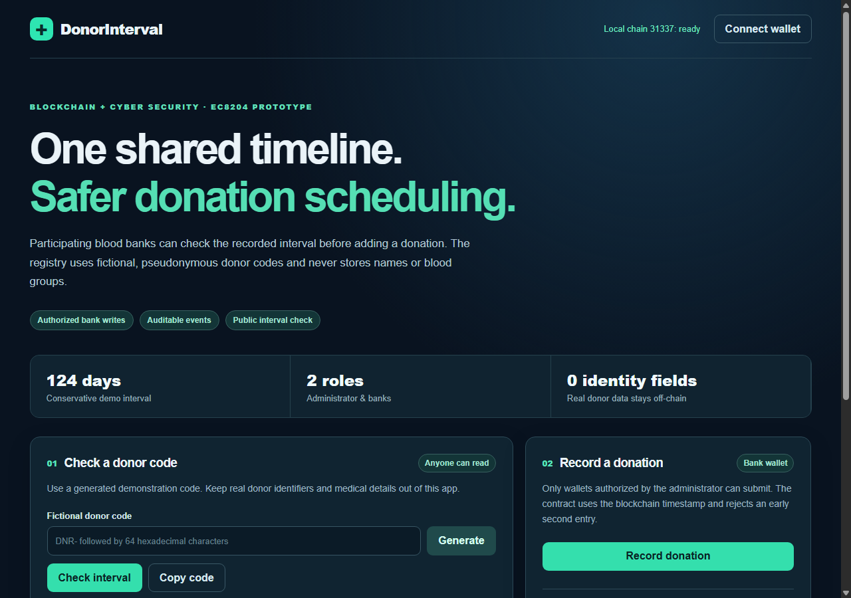
DONORINTERVAL / EC8204
LIVE DEMONSTRATION
One code. Two banks. A rejected early record.
01
Generate
Use a random fictional donor code.
02
Record
Bank A writes the first timestamp.
03
Check
Bank B sees the shared history.
04
Reject
The contract blocks another record too soon.
124-day fixed interval is a conservative demonstration approximation, not a clinical decision.
GROUP [XX] • EDUCATIONAL PROTOTYPE
03 / 05

Slide 4
DONORINTERVAL / EC8204
IMPLEMENTATION & TESTS
Tested security behavior
✓
First donation and timestamp
8
✓
Early second donation blocked across banks
automated tests passing
✓
Later donation accepted after simulated time
✓
Unauthorized or revoked bank blocked
✓
Independent donor histories and invalid inputs
Solidity smart contract • Hardhat local chain • MetaMask + ethers web app
GROUP [XX] • EDUCATIONAL PROTOTYPE
04 / 05

Slide 5
DONORINTERVAL / EC8204
SECURITY & LIMITS
What the registry proves — and what it cannot
PROVES
DOES NOT PROVE
Which authorized wallet submitted a pseudonymous record, when it was submitted, and whether the recorded interval has passed.
A donor's medical eligibility, real identity, or donations outside participating banks. A disclosed code also links public records.
A shared audit trail supports coordination; clinical staff retain the final decision.
GROUP [XX] • EDUCATIONAL PROTOTYPE
05 / 05

