Slide 1
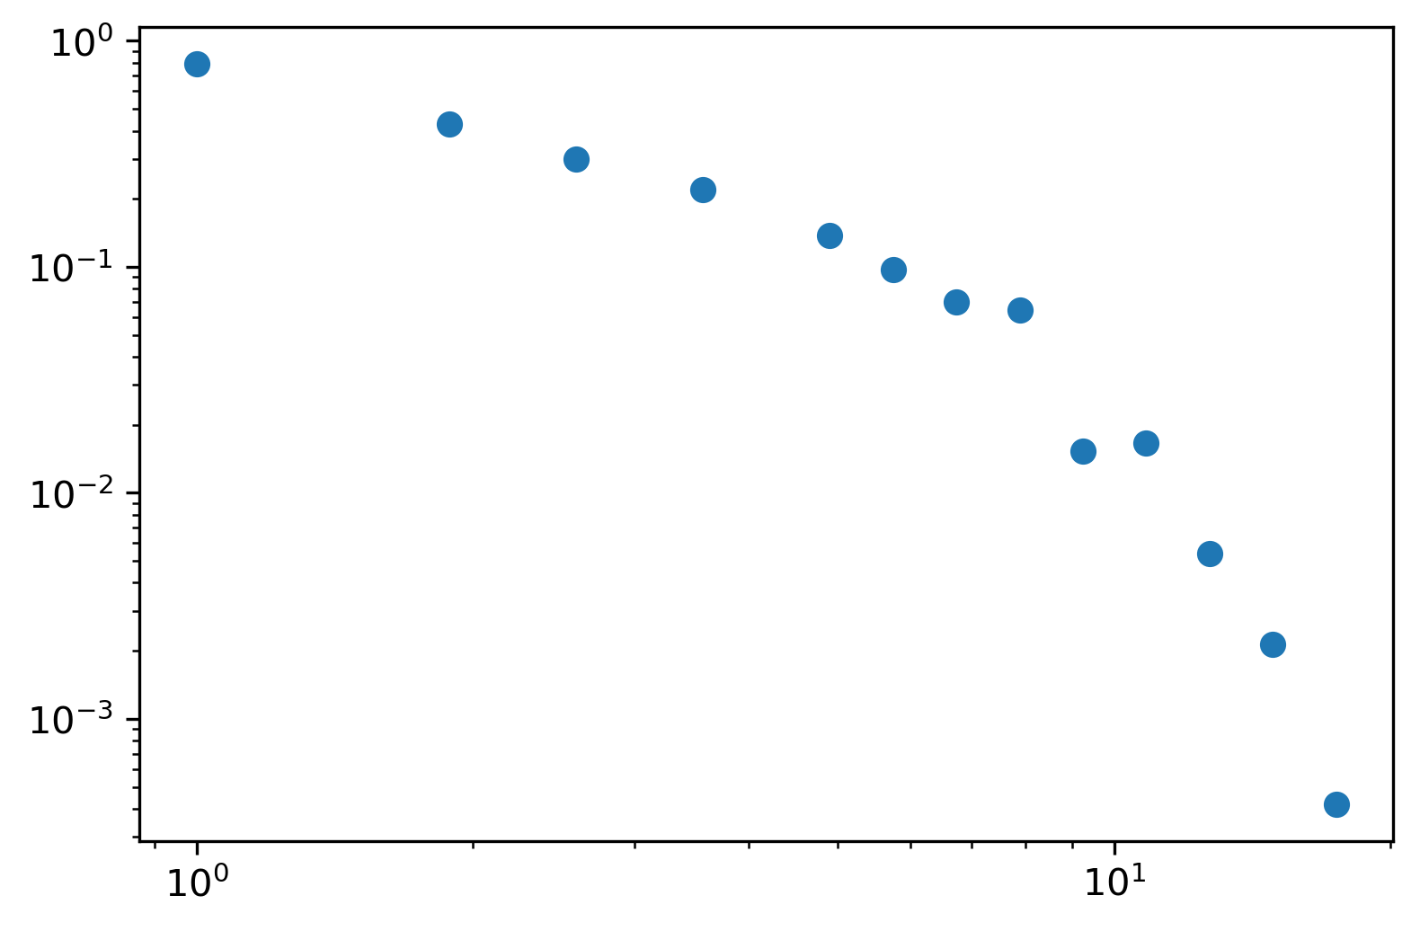
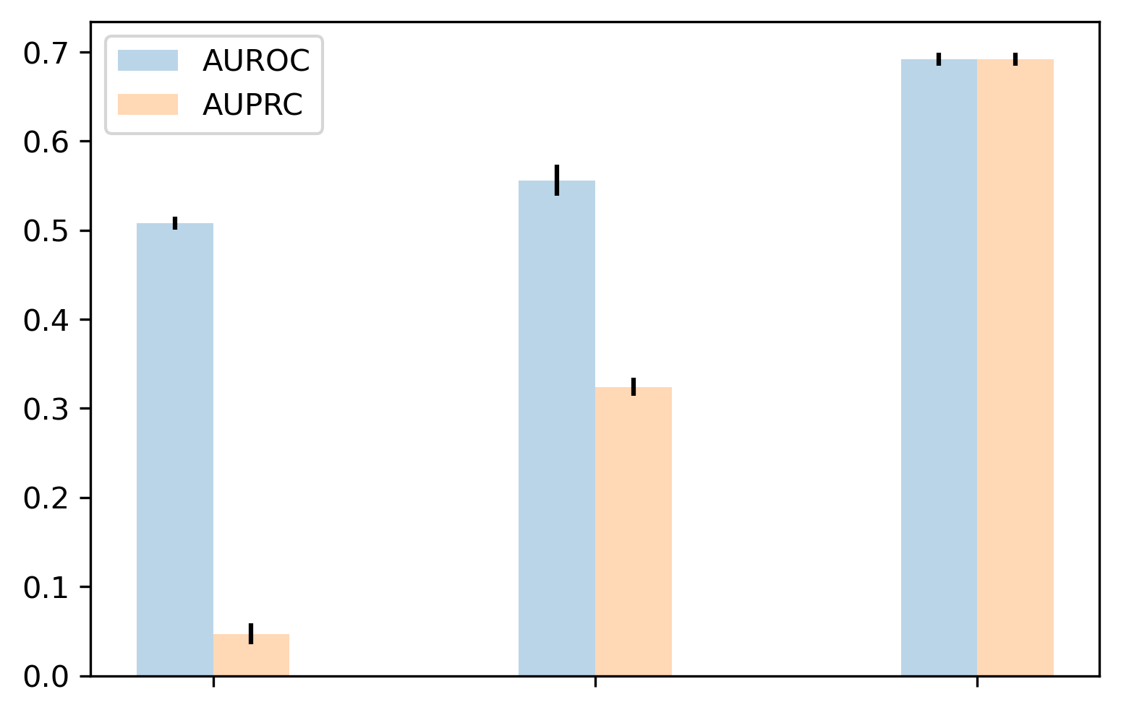
A
B
E
|N_{w}(u)| = 4
PDF
u
u
v
v
y
|N_{w}(v)| = 1
y
|N_{w}(y)| = 1
C
D
Degree
F
u
|N_{w}(u)| = 4
v
|N_{w}(v)| = 1
Performance
a
b
a
|N_{w}(a)| = 0
|N_{w}(a)| = 0
|N_{w}(b)| = 0
|N_{w}(x)| = 0
|N_{w}(x)| = 1
|N_{w}(x)| > 1

