Slide 1
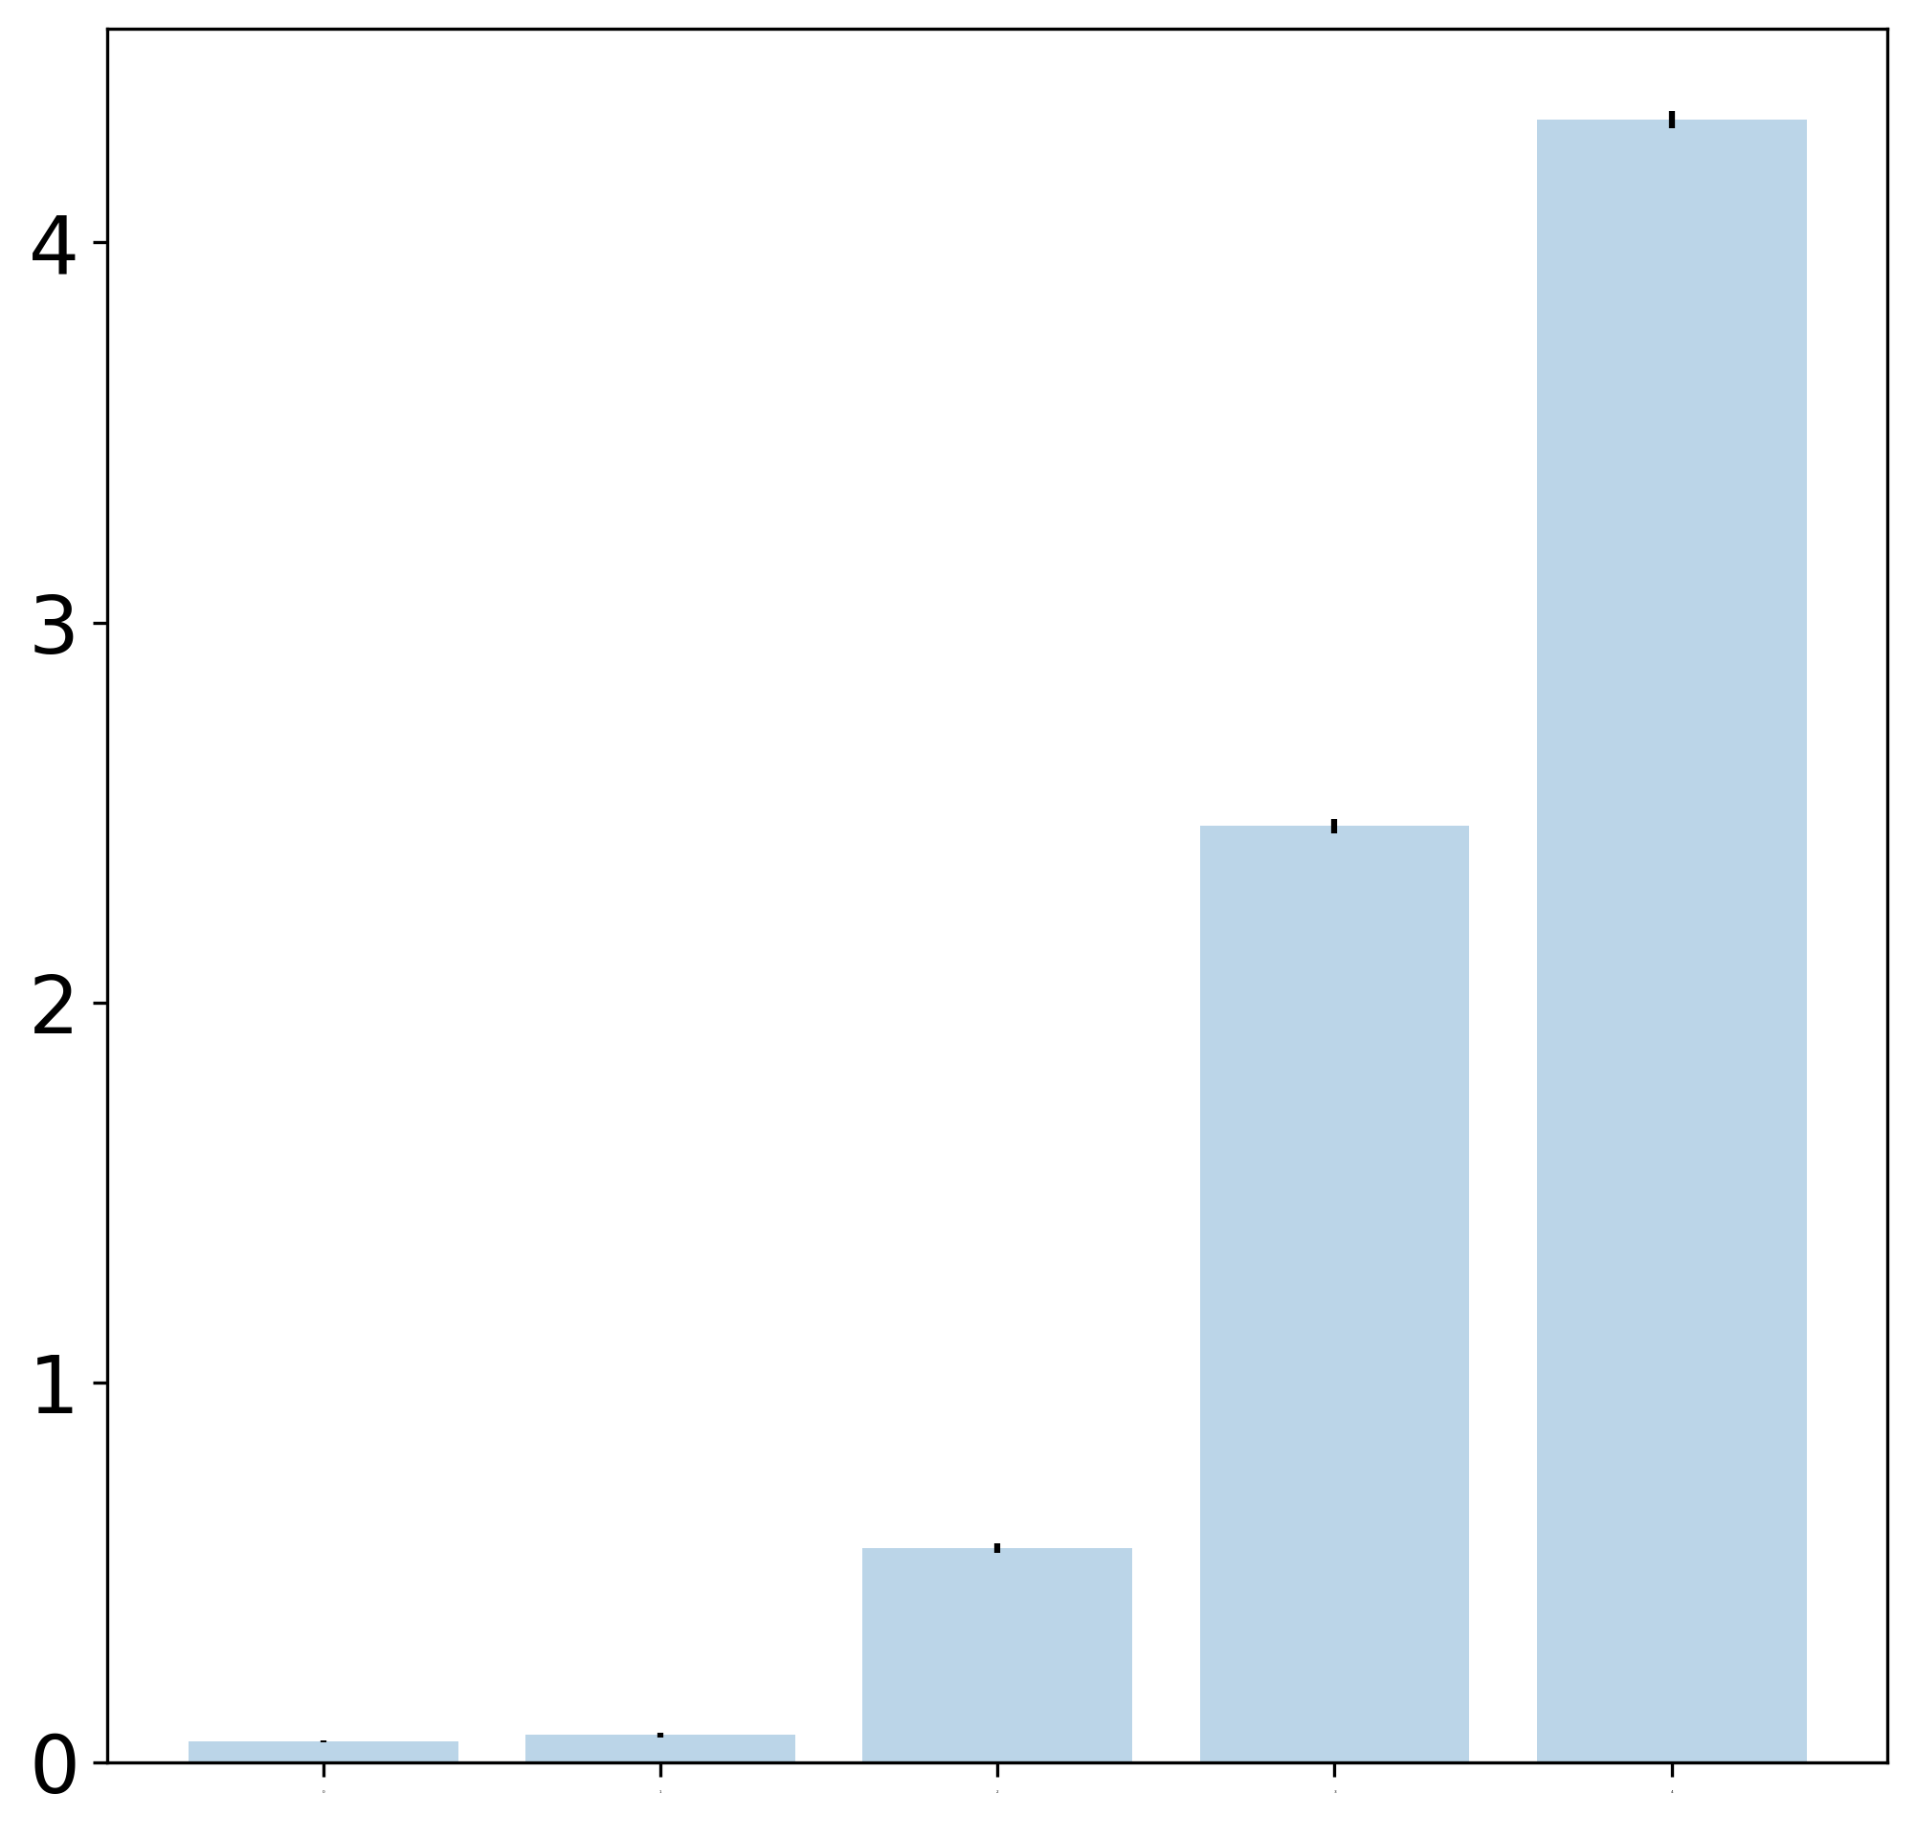
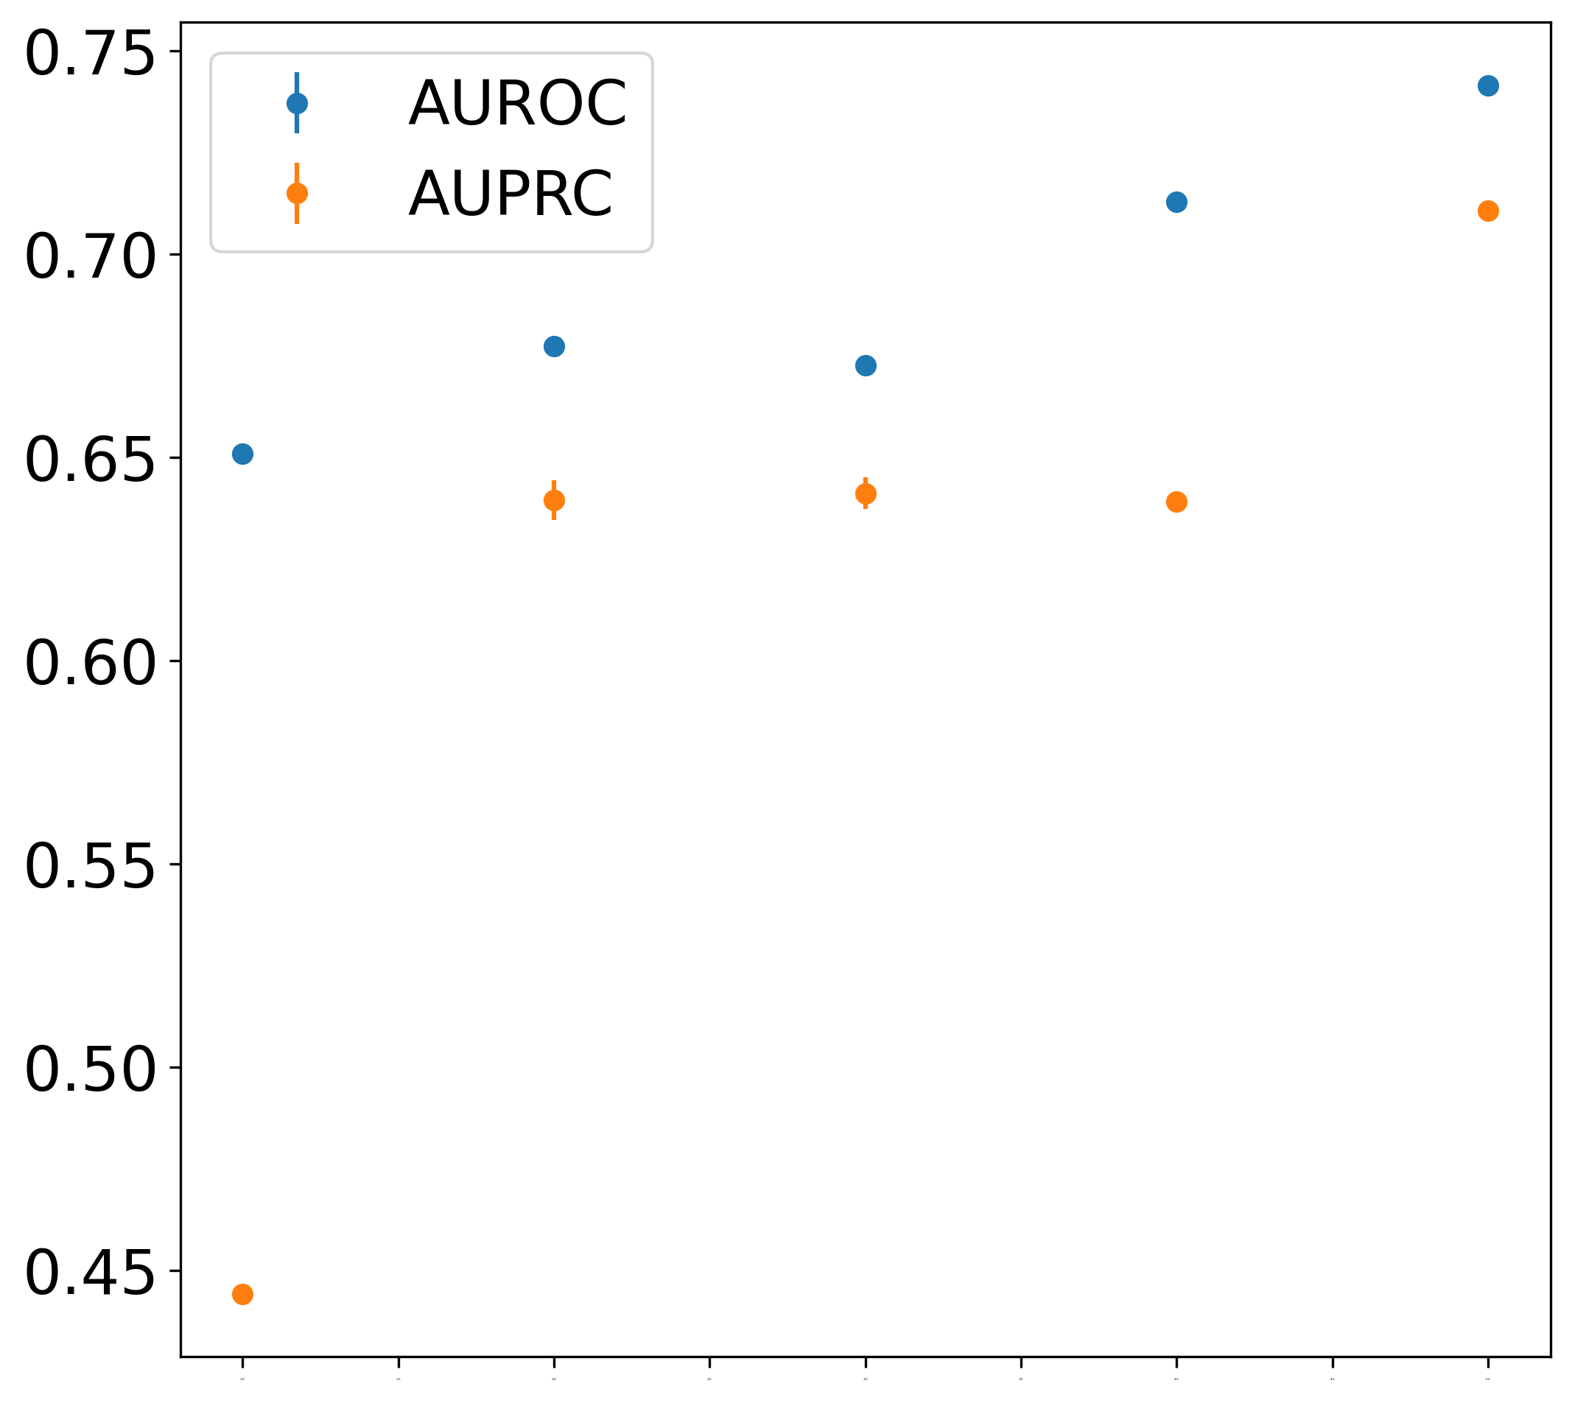
Feature Importance
Performance
BC
BC+NN
BC+NN+CC
BC+NN+CC+Δ
BC+NN+CC+Δ+k
BC: Betweenness Centrality
NN: Nearest Neighbor Degree
CC: Clustering Coefficient
Δ: Triangle Count
K: Degree of a Node

