Slide 1
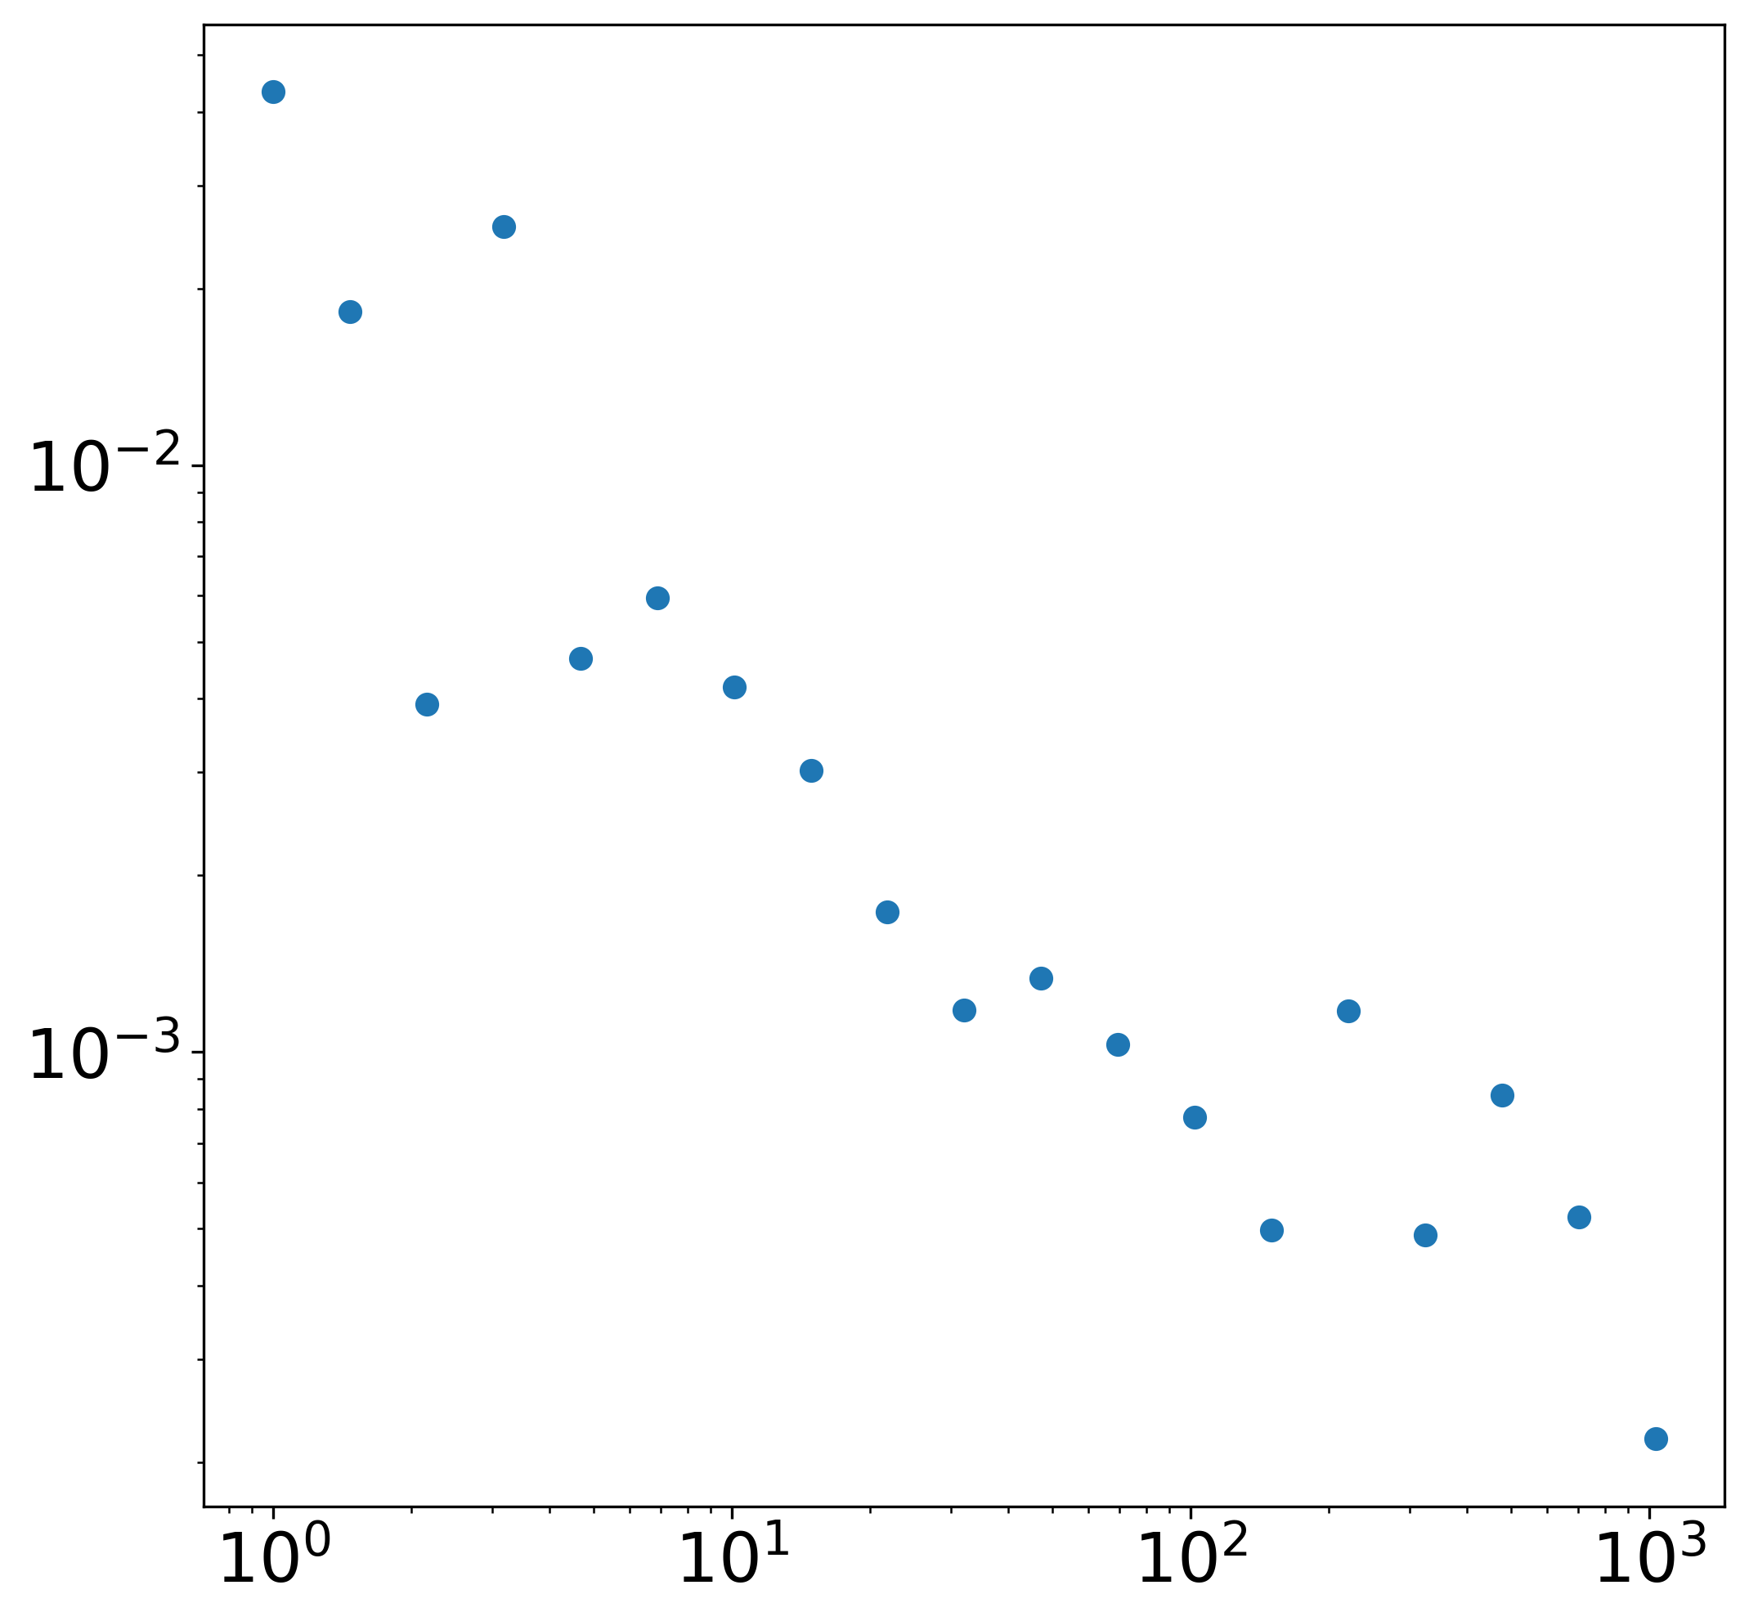
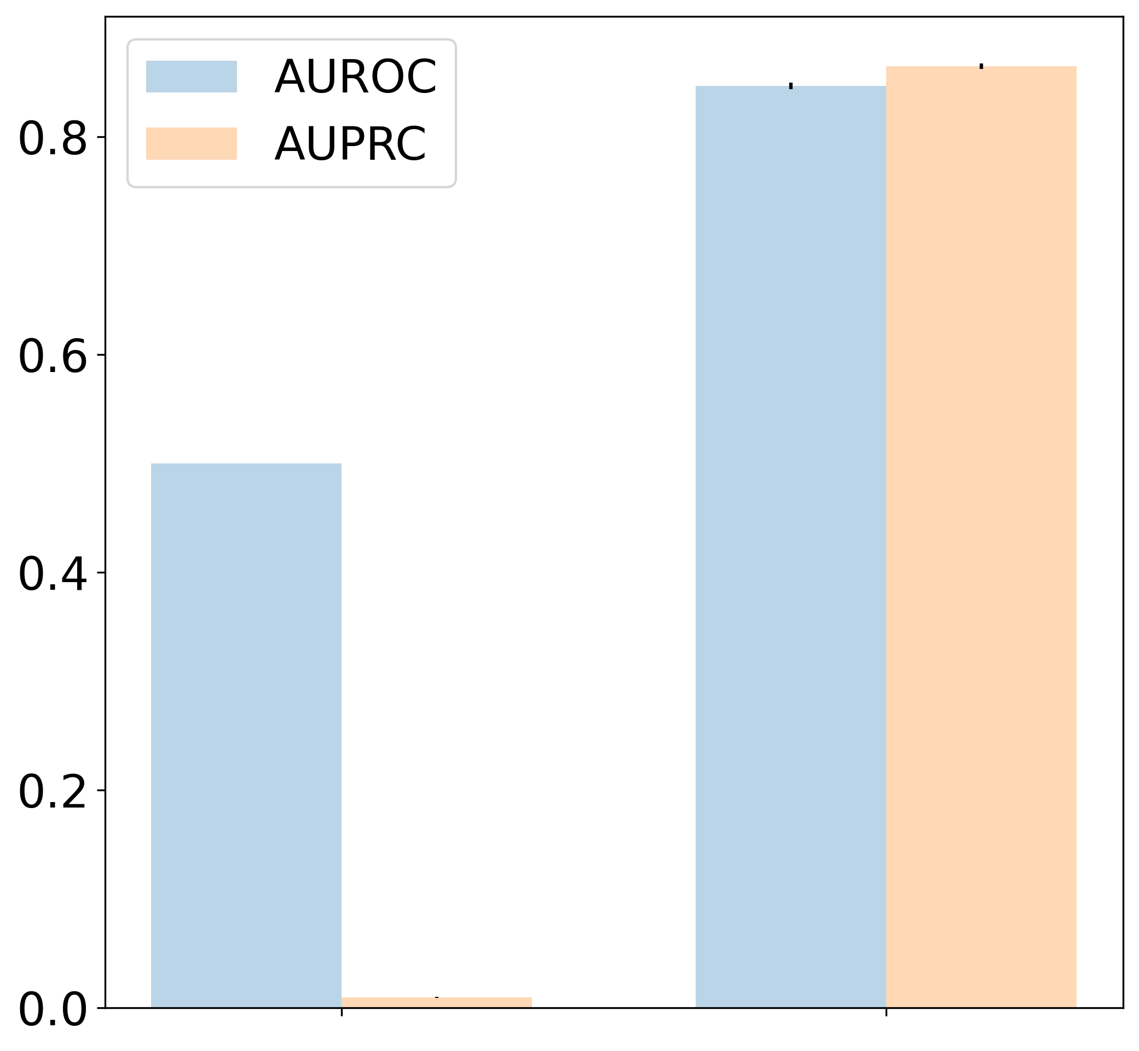
k ≥ 100
High Degree Nodes
PDF
k < 100
Low Degree Nodes
Degree
Performance
Low Degree
High Degree

