Slide 1
CINEBOOK PRO
An Integrated Multi-Language Movie Ticketing & Security Architecture
Internship Project Presentation • Department of Cyber Security
Submitted by
Kolluri Chaturvedhi Narsimha • 24EG109A28 Anurag University, Hyderabad

Slide 2
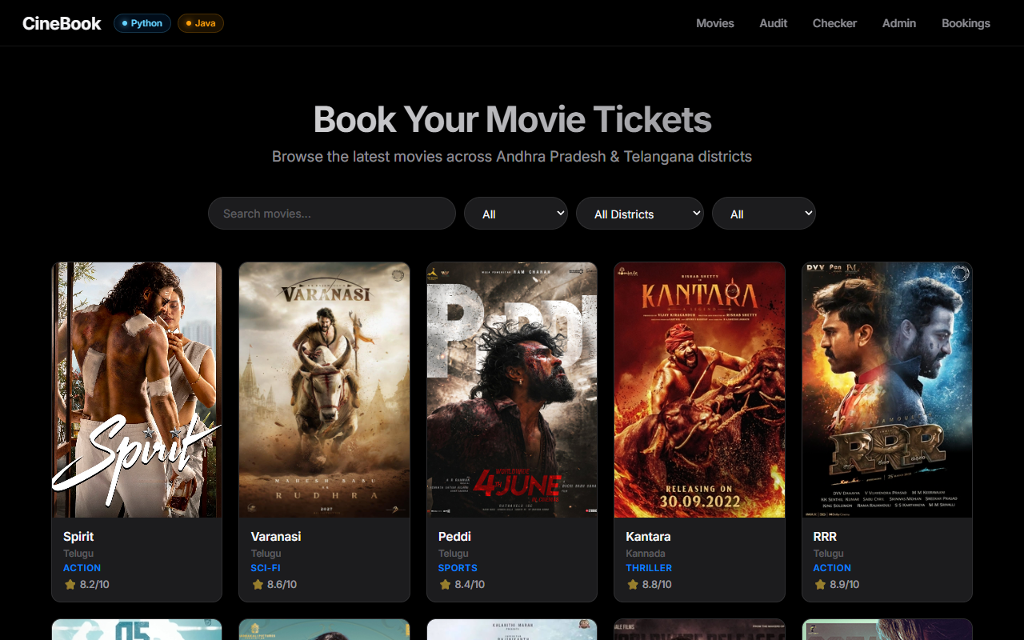
OVERVIEW
Project Overview & Technology Stack
Four distinct technology layers orchestrated into a unified cinema ticketing platform.
TECHNOLOGY DETAILS
• React (Host SPA) Manages global state via Context API, hash-change routing, and interactive 3D seat animations with frosted-glass UI panels.
• Vue.js (Widgets) Micro-containers mounted inside React DOM refs for modular card checkout forms and password audit consoles.
• Java (Security) Luhn's card validation, private-field OOP encapsulation, ArrayList memory tracking, BufferedWriter logging, and synchronized thread locks.
• Python (Auditor) Password audit layer deriving concrete rules from an abstract base class. CLI console emulator with Matplotlib stats.
• AI & Prompt Engineering Utilized AI prompts for code debugging, architecture design optimization, and automated documentation generation.

Slide 3
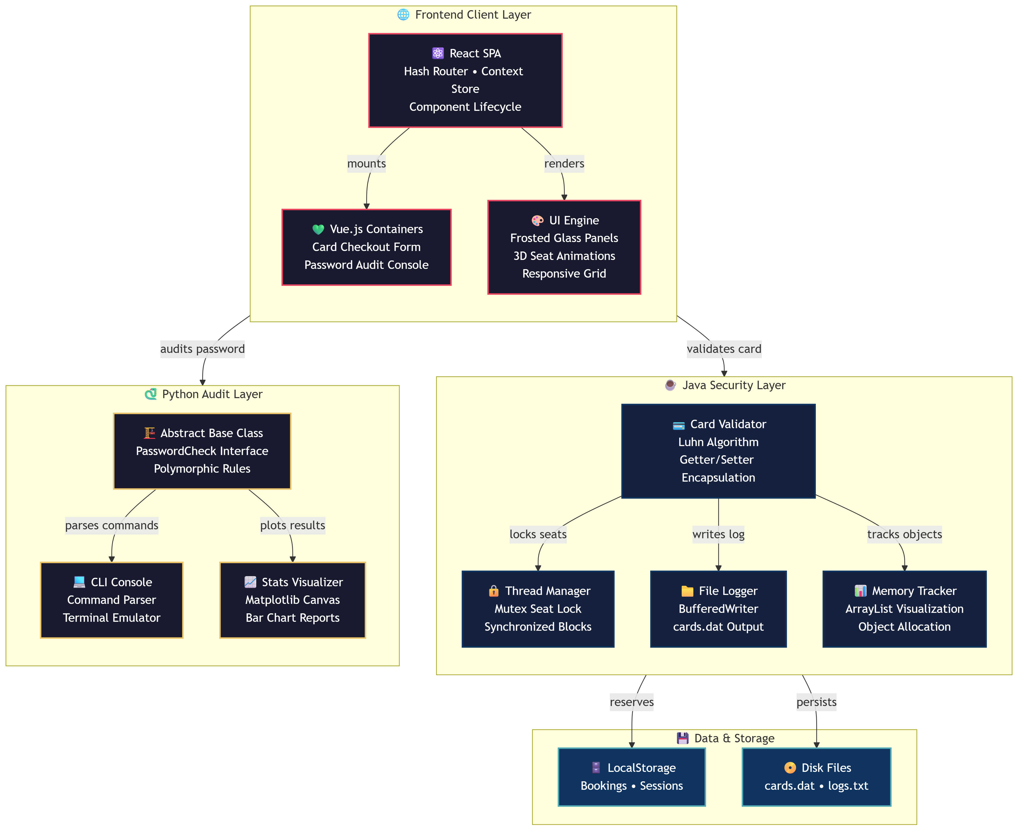
ARCHITECTURE
System Component Architecture
COMPONENT LAYERS
• Frontend Client Layer React SPA with hash routing and context store. Vue containers mounted dynamically for checkout and audit widgets.
• Java Security Layer OOP encapsulation with Luhn's checksum validation, ArrayList object tracking, BufferedWriter disk logging, and mutex seat locks.
• Python Audit Layer Abstract PasswordCheck base class with polymorphic rule derivation. CLI parser and Matplotlib canvas charts.
• Data & Storage Browser LocalStorage for bookings and sessions. Java file I/O writes card validation logs to cards.dat on disk.
Fig 2.1 — CineBook Multi-Language Component Architecture

Slide 4
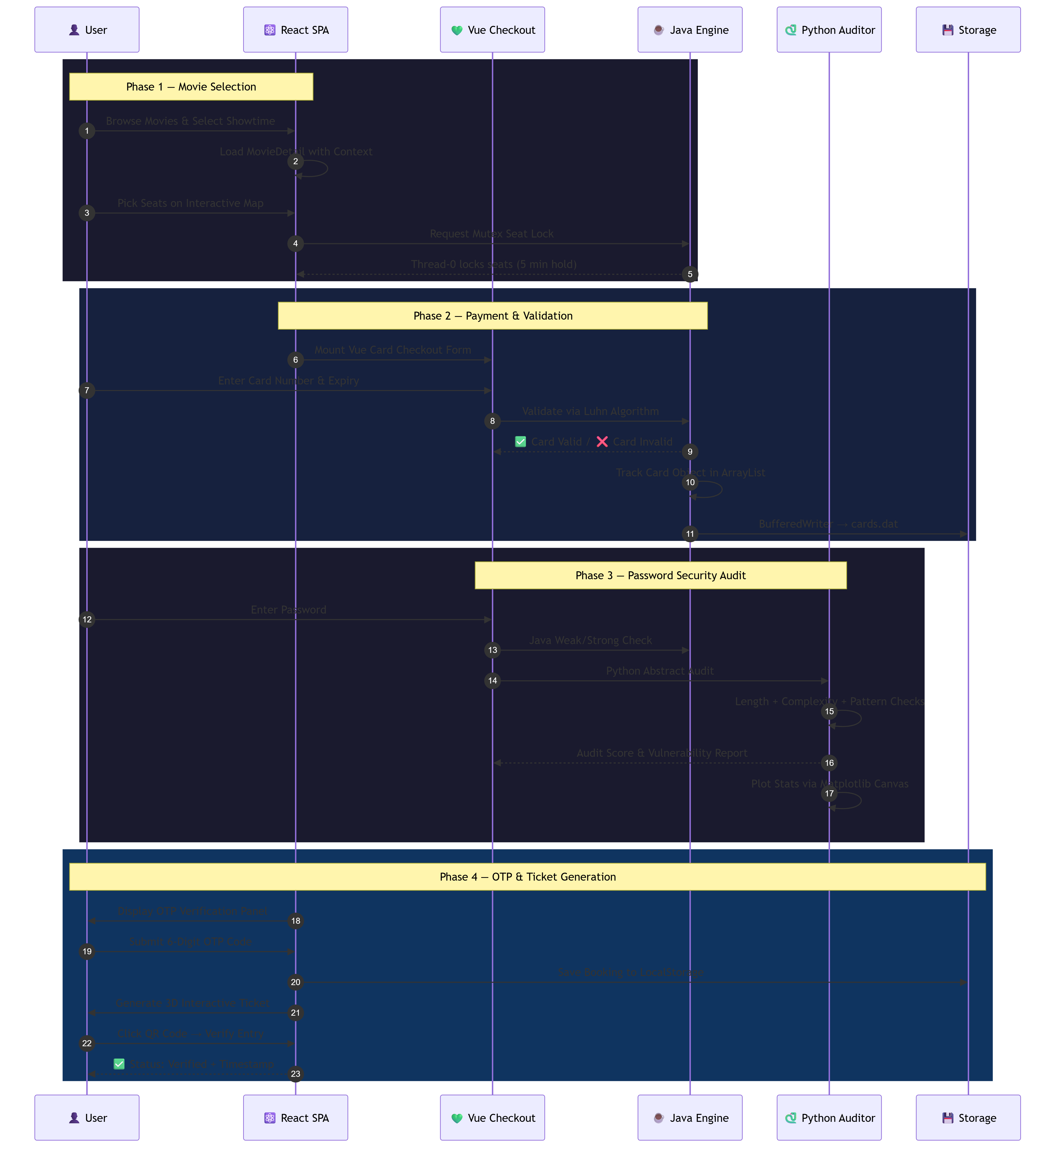
ARCHITECTURE
End-to-End Booking Sequence Flow
TRANSACTION PHASES
• Phase 1 — Seat Lock Thread-0 acquires a synchronized mutex, locking selected seat coordinates for 5 minutes to prevent double-bookings.
• Phase 2 — Card Validation Vue checkout collects card details. Luhn's mod-10 checksum validates digits. Valid cards tracked in ArrayList and logged to disk.
• Phase 3 — Security Audit Dual validation: Java Weak/Strong classification + Python abstract auditor running LengthCheck, ComplexityCheck, PatternCheck rules.
• Phase 4 — Ticket Issue 6-digit OTP verification → booking saved to LocalStorage → 3D parallax ticket with SVG QR code and scan verification generated.
Fig 2.2 — End-to-End Booking Validation & Security Flow

Slide 5
CODE WALKTHROUGH
React & Vue Interoperability
HOW IT WORKS
• React DOM Wrapper A ref-backed container div is rendered by React, holding the mount point for Vue instances.
• Vue Lifecycle Inside useEffect, createApp() initializes the Vue widget and mounts it. On cleanup, app.unmount() frees memory.
• State Bridge Custom browser events (dispatchEvent) synchronize seat counts and invoice data across frameworks.
// React component mounting a Vue widget const VueWrapper = () => { const containerRef = useRef(null); useEffect(() => { // Create and mount Vue app instance const app = createApp(CardCheckout); app.mount(containerRef.current); return () => { app.unmount(); // Cleanup on unmount }; }, []); return <div ref={containerRef} />; };

Slide 6
CODE WALKTHROUGH
Java Security Engine
// Luhn Algorithm — Card Validation public boolean checkLuhn(String cardNo) { int nDigits = cardNo.length(); int nSum = 0; boolean isSecond = false; for (int i = nDigits - 1; i >= 0; i--) { int d = cardNo.charAt(i) - '0'; if (isSecond) d = d * 2; nSum += d / 10; nSum += d % 10; isSecond = !isSecond; } return (nSum % 10 == 0); }
CORE JAVA CONCEPTS
• Luhn Check Algorithm Executes mod-10 double-every-second digit sum validations on inputs to prevent fake or invalid card numbers.
• OOP Encapsulation Strictly keeps attributes private, accessing them via clean getter/setter objects to block arbitrary edits.
• ArrayList Tracking Stores validated Card instances to memory dynamically, mapping object heap locations to console logs.
• BufferedWriter I/O Streams transaction logs out to cards.dat on disk using Java's file output stream, securing records permanently.
• Thread Synchronization Synchronized blocks on Thread-0 acquire mutex locks on seat coordinates, preventing concurrent double-bookings.

Slide 7
CODE WALKTHROUGH
Python Audit Layer
AUDIT ARCHITECTURE
• Abstract Base Class PasswordCheck defines an abstract validate() method. Concrete subclasses override it with specific checking rules.
• Regex Pattern Scanning Regular expressions detect repeated sequences, missing character classes (uppercase, digits, specials), and dictionary words.
• Matplotlib Visualization Audit scores compiled into a bar chart rendered as PNG, embedded into the app's HTML5 canvas for dashboard display.
from abc import ABC, abstractmethod class PasswordCheck(ABC): @abstractmethod def validate(self, pwd: str) -> bool: pass class LengthCheck(PasswordCheck): def validate(self, pwd: str) -> bool: return len(pwd) >= 8 class ComplexityCheck(PasswordCheck): def validate(self, pwd: str) -> bool: return bool( re.search(r'[A-Z]', pwd) and re.search(r'[0-9]', pwd) and re.search(r'[!@#$%]', pwd) )

Slide 8
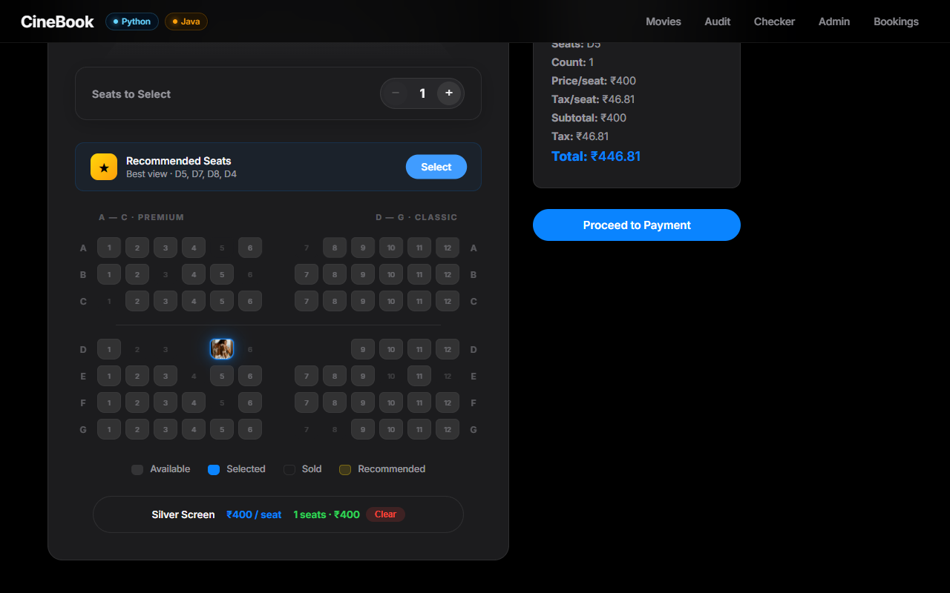
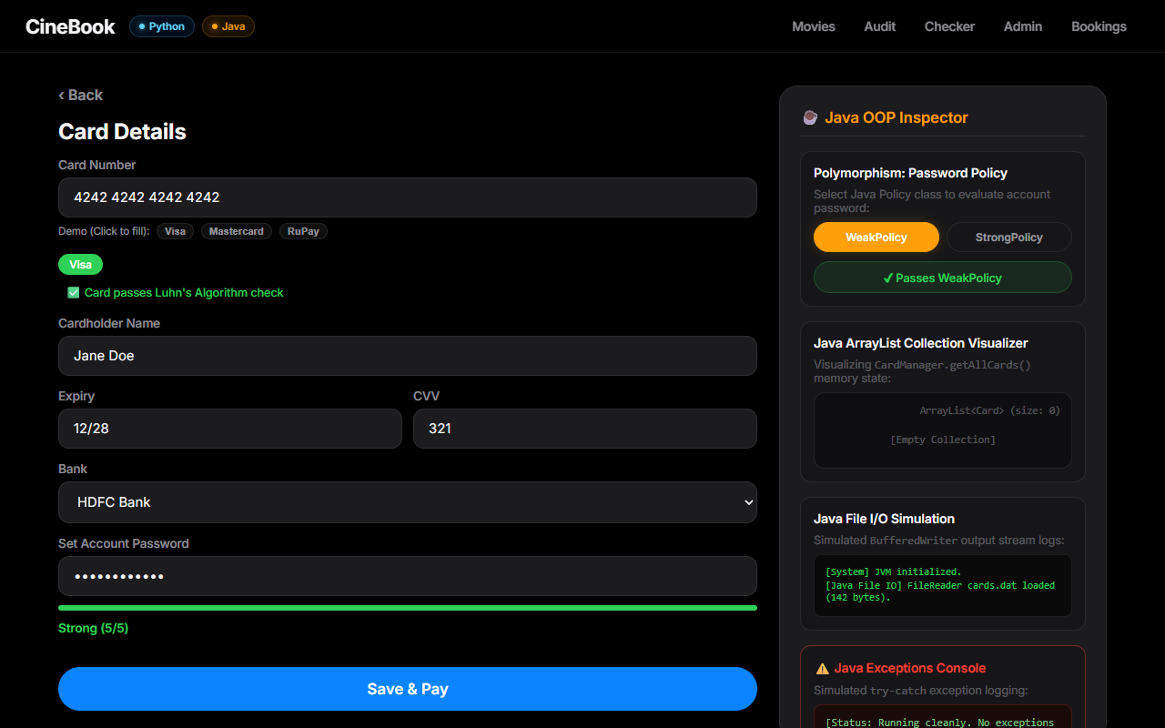
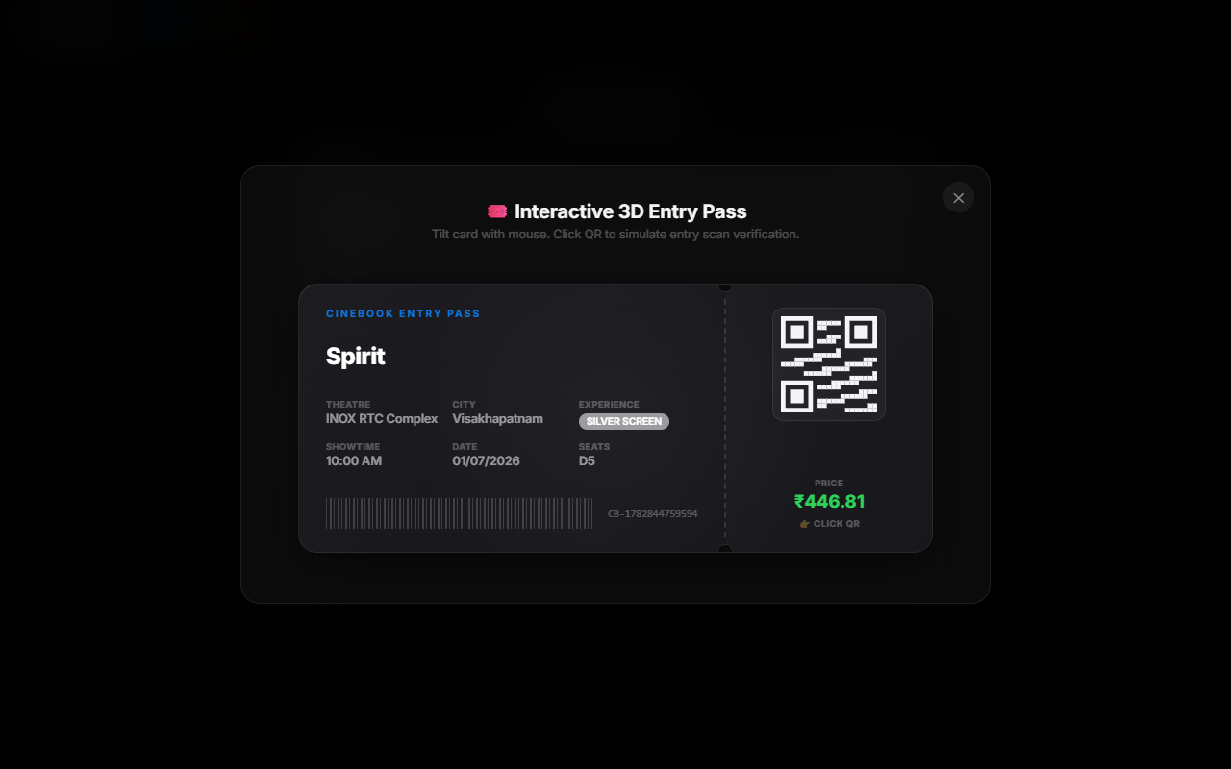
LIVE DEMO
Application Interface & Features
FEATURE HIGHLIGHTS
• Home Screen Frosted-glass movie cards with responsive grid layout, genre badges, ratings, and Apple HIG-inspired visual design.
• 3D Curved Seating Map Interactive seat grid with quantity stepper sync, recommended seat algorithm, and 3D flip animations on selection.
• Vue Card Checkout Real-time Luhn validation, auto-formatting, demo presets (Visa/Mastercard/RuPay), and dual password audit.
• Parallax 3D Ticket Mouse-tracking perspective tilt, notched stub design, embedded SVG QR code, and click-to-verify scan animation.

Slide 9
ENGINEERING
Technical Challenges & Solutions
ENGINEERING MITIGATIONS
• Double-Booking Race Condition Challenge: Simultaneous booking attempts caused seat overlap conflicts. | Solution: Java synchronized blocks with Thread-0 mutex locks hold seats for 5 minutes, blocking concurrent access.
• React-Vue DOM Collision Challenge: Independent reactive frameworks caused lifecycle conflicts when mounted side-by-side. | Solution: Managed mount/unmount via React useRef + useEffect. Vue apps cleaned up on component destroy.
• Exception Propagation Challenge: Deep validation errors in Java/Python layers failed to surface in the frontend UI. | Solution: Structured custom exceptions with stack trace logging to sidebar console for real-time debugging.
• Multi-Language Integration Challenge: Coordinating data flow across React, Vue, Java, and Python required careful interface design. | Solution: Custom browser events bridge state between frameworks; standardized JSON payloads for cross-language communication.

Slide 10
Thank You
Questions about the hybrid architecture, security modules, code integration, or prompt engineering workflow?
Kolluri Chaturvedhi Narsimha • 24EG109A28 • github.com/Chatur7x/CineProo

