Slide 1
CINEBOOK PRO
A Hybrid Multi-Language Movie Ticketing & Security Architecture
Internship Project Presentation | Department of Cyber Security
Submitted by:
Kolluri Chaturvedhi Narsimha HTNo: 24EG109A28 Anurag University

Slide 2
CINEBOOK PRO
Project Overview & Technology Stack
SYSTEM CONCEPT
CineBook Pro is designed to demonstrate multi-framework web orchestration coupled with native backend validation workflows. It mounts independent frontend frameworks side-by-side while utilizing robust multi-language backends to validate core ticketing details.
KEY ATTRIBUTES
• React-Vue frontend interoperability.
• Java-based security & memory visualization.
• Python password strength classification.
• AI-assisted prompt engineering development.
TECHNOLOGY DETAILS
React (Host SPA) — Manages global state, routing, and interactive ticket stubs.
Vue.js (Widgets) — Encapsulates modular UI cards and password audit screens.
Java (Security Engine) — Executes Luhn validations, logs file operations, and runs thread locks.
Python (Auditor) — Runs structural validations and generates statistical plots.
Prompt Engineering — Utilized AI prompts to debug code and optimize database locking.

Slide 3
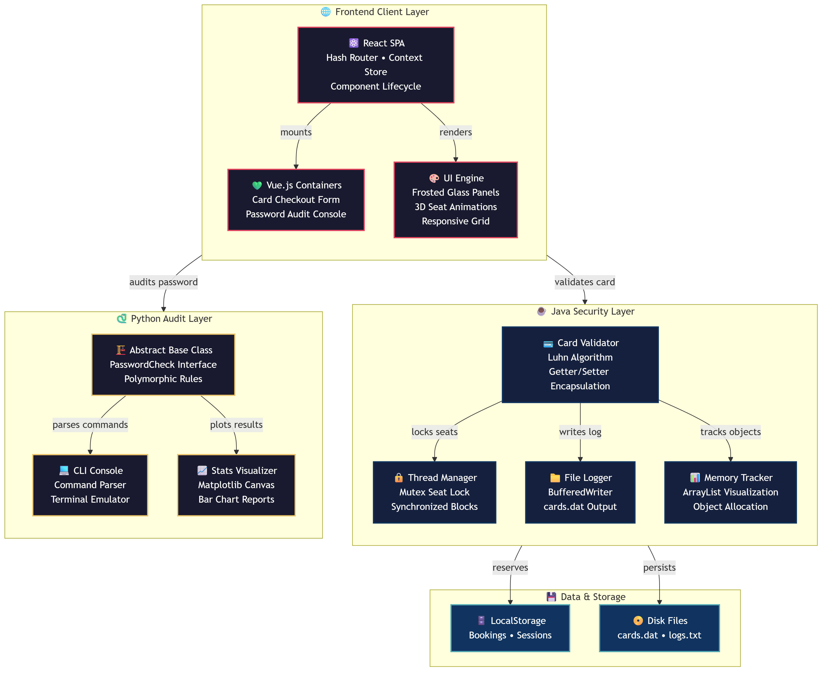
CINEBOOK PRO
System Component Architecture
COMPONENT ARCHITECTURE
• React Host & Vue Containers The React host utilizes hash routing and context managers while dynamically mounting Vue checkout widgets in the container DOM.
• Java Security Middleware Implements Private encasing, card verification through Luhn's algorithm, transaction serialization via BufferedWriter, and concurrency checks.
• Python Auditor & Terminal Console Derived password checking strategies from abstract parents, displaying evaluation stats on a dynamic Matplotlib chart.
• File I/O & Storage Layer Tracks local session variables inside LocalStorage and stores credit details securely to disk in cards.dat.

Slide 4
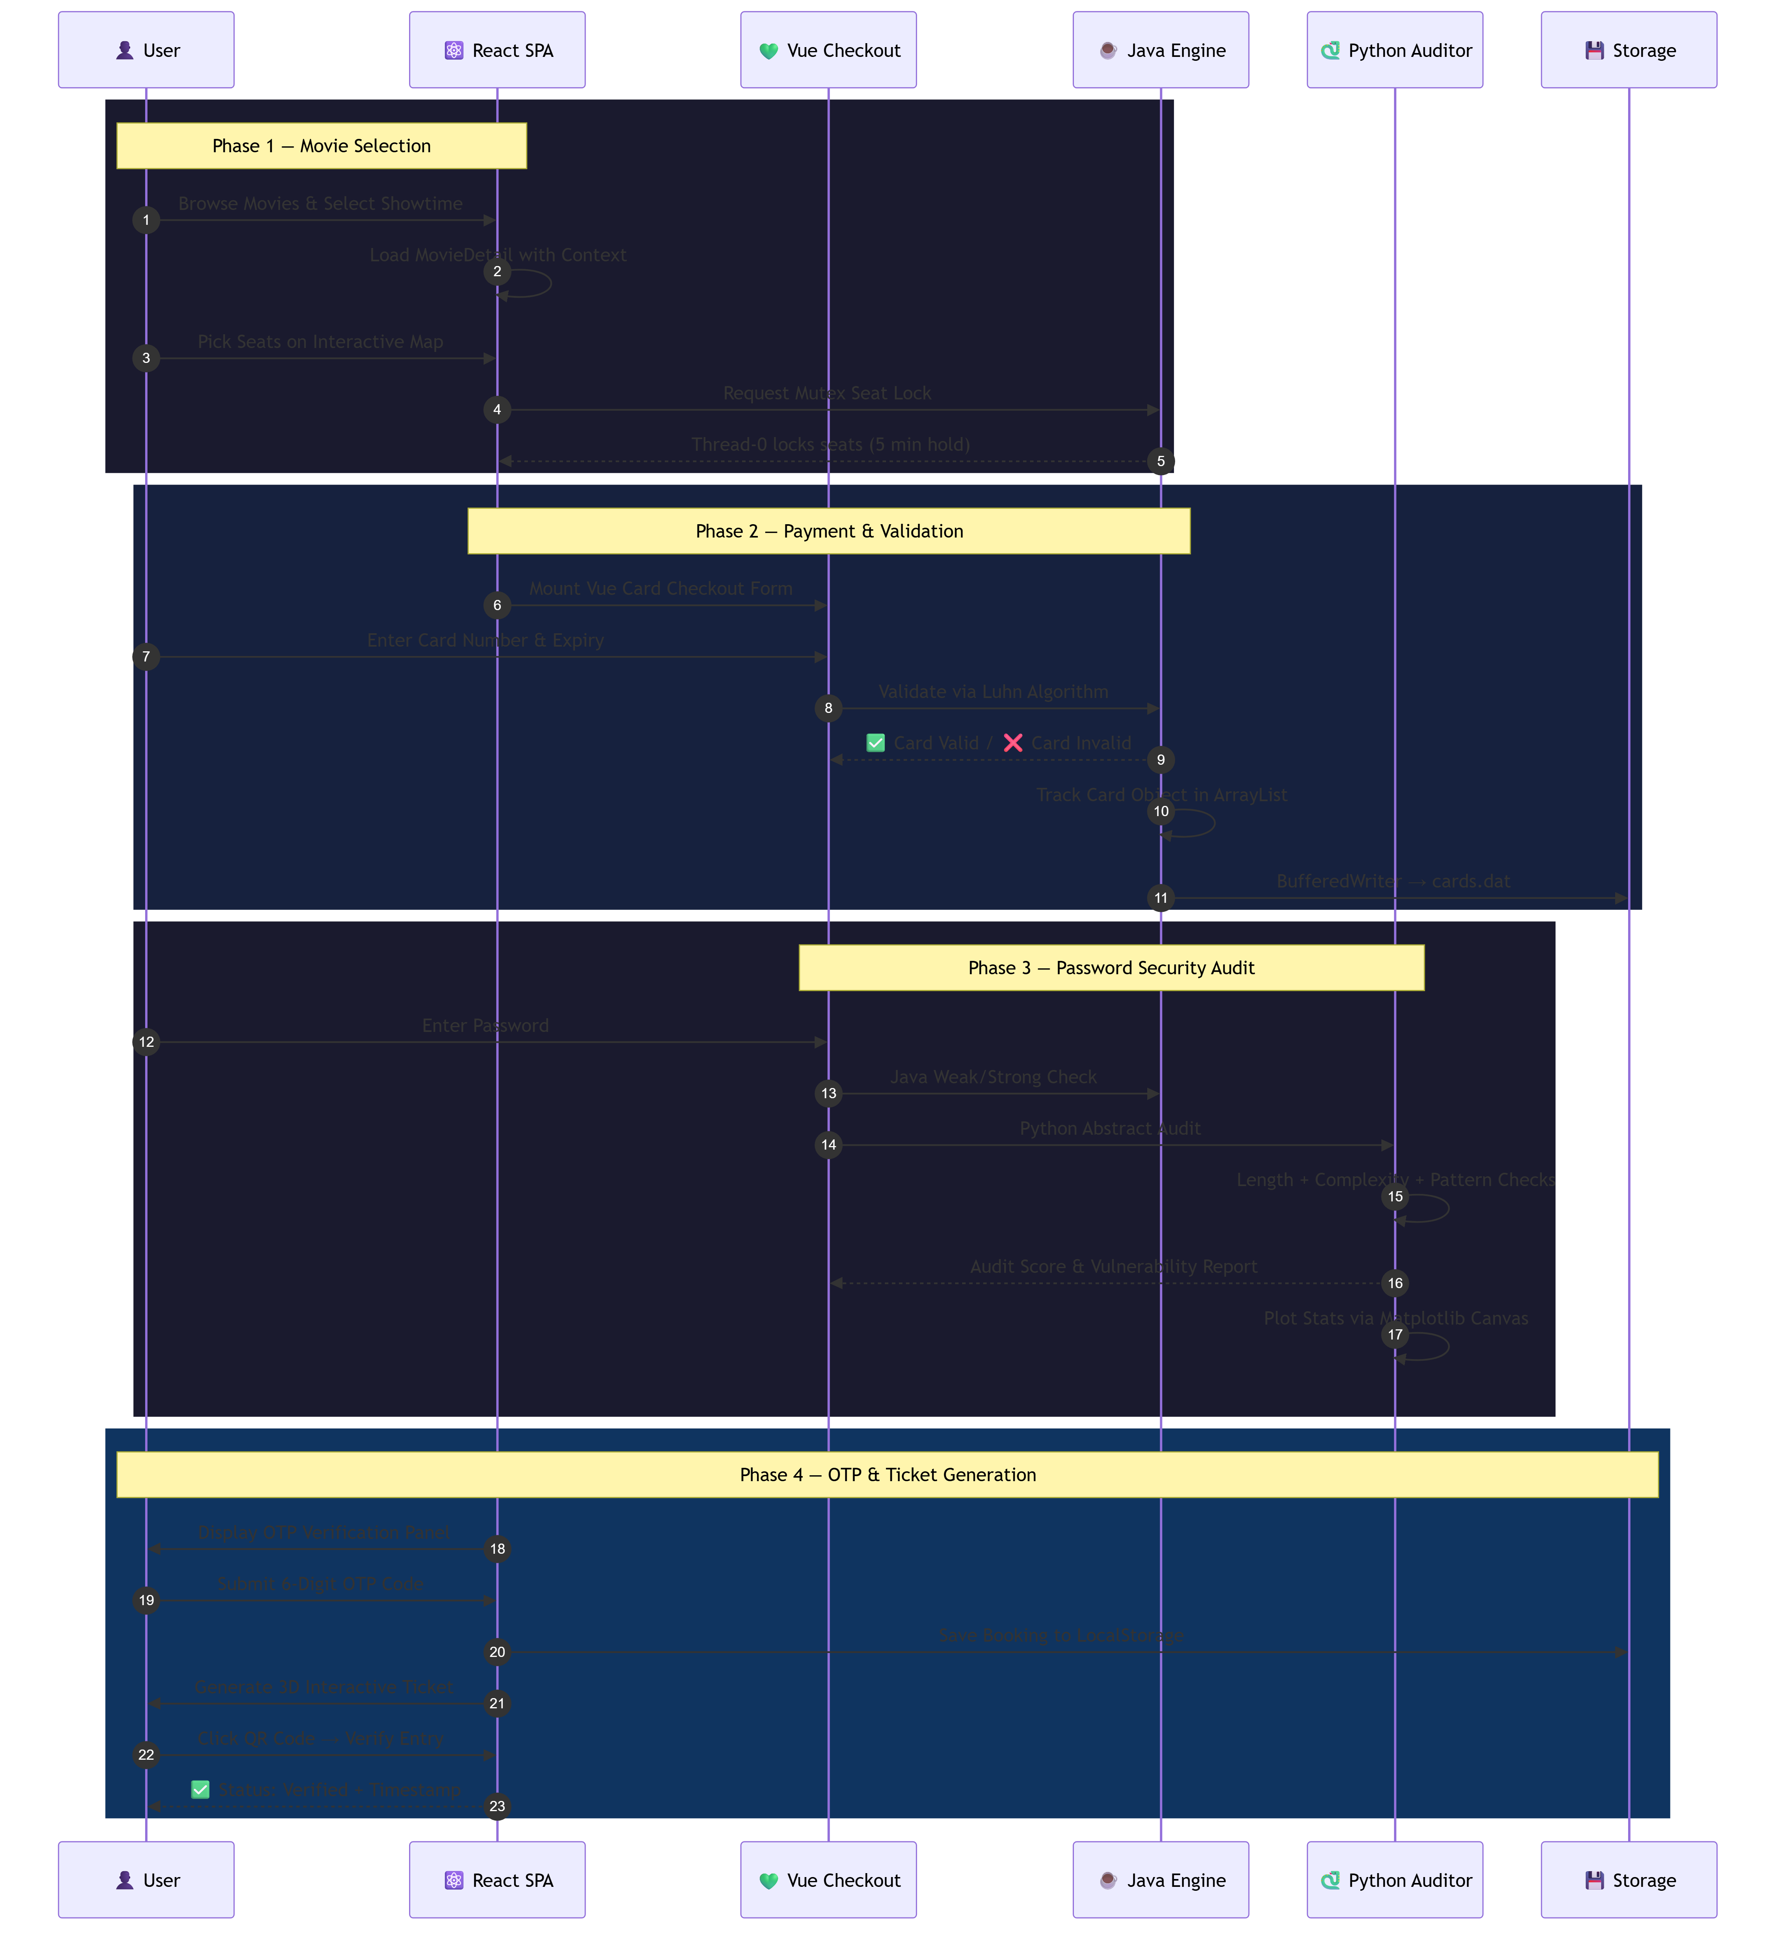
CINEBOOK PRO
End-to-End Booking Sequence Flow
TRANSACTIONAL PHASES
• Phase 1: Seating Lock A synchronized block launches Thread-0 on showtime selection, locking the coordinates for 5 minutes to avoid conflicts.
• Phase 2: Card Verification The Luhn validation checksum checks bank card details, recording verified structures to disk via BufferedWriter.
• Phase 3: Security Audit Validates password strengths. Java tracks simple length restrictions while Python computes entropy and displays charts.
• Phase 4: Ticket Issue Generates interactive 3D ticket stubs with embedded SVG QR codes, triggering validation confirmations on click.

Slide 5
CINEBOOK PRO
Technical Focus: React & Vue Interoperability
INTEROPERABILITY DETAILS
• React DOM Wrapper React coordinates the global session state and mounts a wrapper div container. It manages component visibility and transitions.
• Vue Widget Mounts Inside React's lifecycle hooks, custom Vue apps are initialized and mounted to the ref wrappers. On unmounting, state cleanup is performed.
• State Synchronization Data is bridged using custom browser event listeners, synchronizing updates in seat counts and invoices between React and Vue components.
REACT LIFECYCLE MOUNTING CODE
// React component mounting Vue app const VueWrapper = () => { const containerRef = useRef(null); useEffect(() => { // Create and mount Vue widget instance const app = createApp(CardCheckout); app.mount(containerRef.current); return () => { app.unmount(); // Unmount on clean up }; }, []); return <div ref={containerRef} />; };

Slide 6
CINEBOOK PRO
Technical Focus: Java Security Layer
LUHN ALGORITHM CARD CHECK
public boolean checkLuhn(String cardNo) { int nDigits = cardNo.length(); int nSum = 0; boolean isSecond = false; for (int i = nDigits - 1; i >= 0; i--) { int d = cardNo.charAt(i) - '0'; if (isSecond == true) d = d * 2; nSum += d / 10; nSum += d % 10; isSecond = !isSecond; } return (nSum % 10 == 0); }
CORE JAVA IMPL
• Luhn Check Algorithm Executes mod-10 double-every-second digit sum validations on inputs to prevent fake/invalid card numbers.
• OOP Encapsulation Pattern Strictly keeps attributes private, accessing them via clean getter/setter objects to block arbitrary edits.
• ArrayList Allocation Stores validated instances to memory dynamically, mapping object heap locations to logs.
• File System Logging Streams logs out to cards.dat on disk using Java's BufferedWriter class, securing records.

Slide 7
CINEBOOK PRO
Technical Focus: Python Audit Layer
AUDIT SPECIFICATION
• Polymorphic Abstract Structure Utilizes abstract classes defining baseline check functions. Concrete sub-classes overwrite checking parameters.
• Entropy & Pattern Scanning Applies regular expressions to scan passwords for repeated sequences, length rules, and character sets.
• Matplotlib Graph Generation Saves audit results and vulnerability scores as a bar chart, saving a PNG which is rendered in the app's HTML canvas.
ABSTRACT AUDITING ENGINE
from abc import ABC, abstractmethod class PasswordCheck(ABC): @abstractmethod def validate(self, pwd: str) -> bool: pass class LengthCheck(PasswordCheck): def validate(self, pwd: str) -> bool: return len(pwd) >= 8 class ComplexityCheck(PasswordCheck): def validate(self, pwd: str) -> bool: # RegEx checks for lower/upper/digit/special return bool(re.search(r'[A-Z]', pwd))

Slide 8
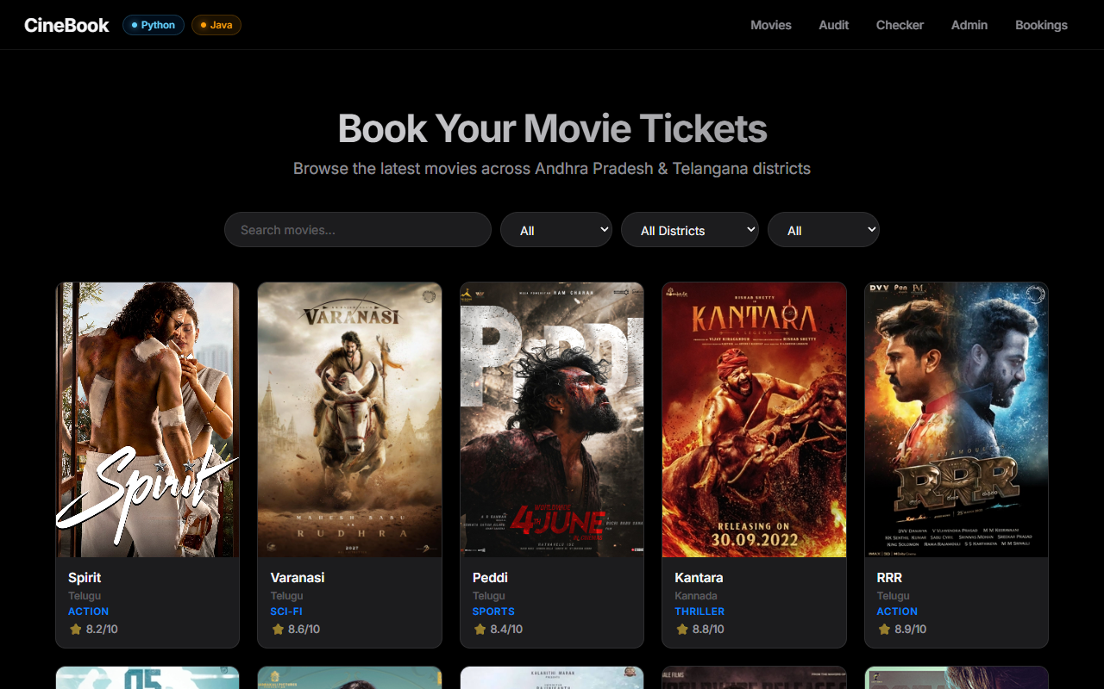
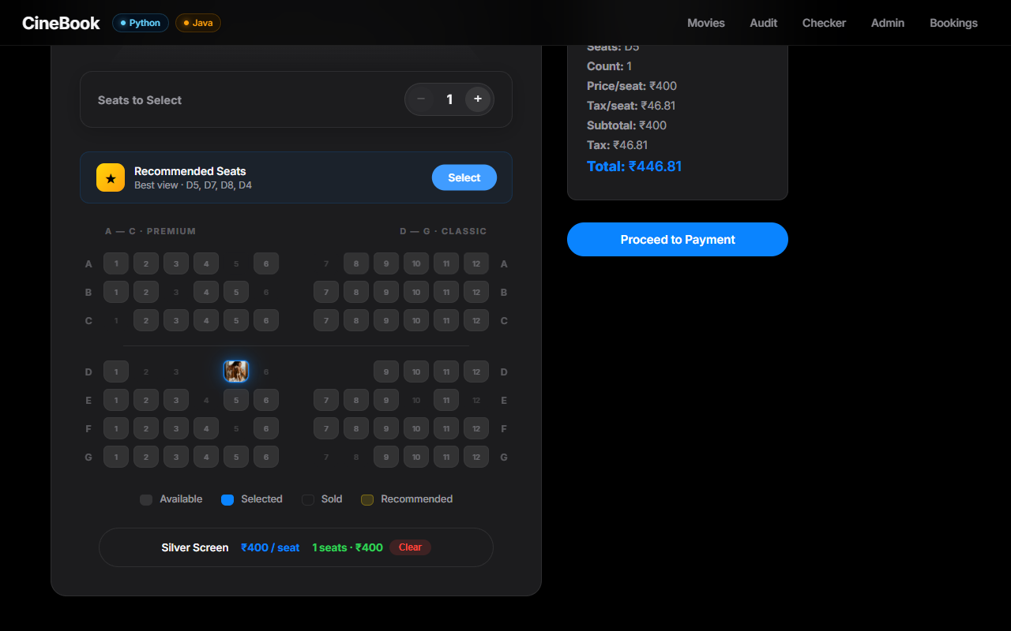
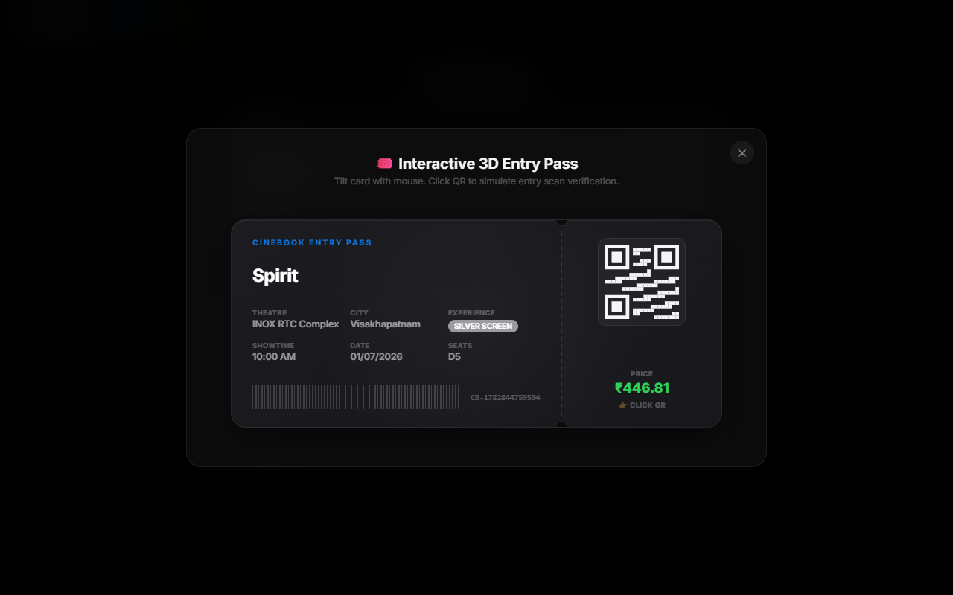
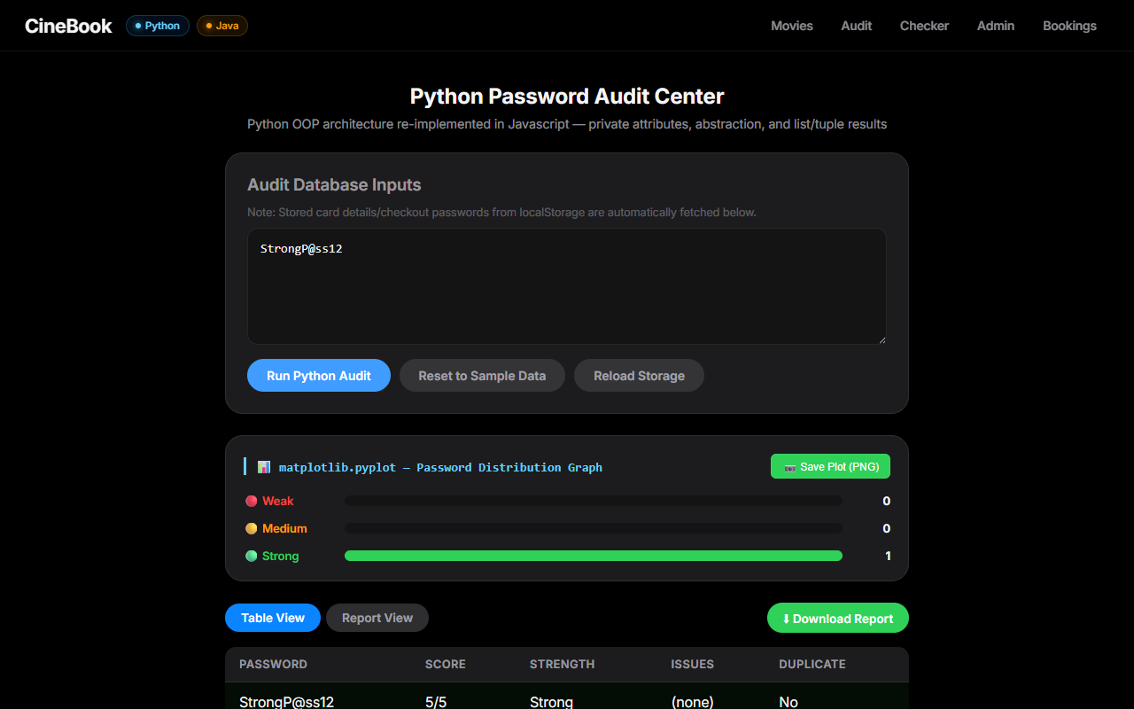
CINEBOOK PRO
Application Features & Interface Designs
CORE USER CAPABILITIES
• Home & Showtime Selector Frosted glass visual layouts dynamically loading show details. Responsive grids align items smoothly.
• 3D Curved Seating Map Interactive seats mapped to custom hooks. Visualizes selected seats, recommended paths, and price categories.
• Parallax 3D Ticket Modal Features responsive card tilts. Users can hover to examine validation details and click to verify QR passes.
• Password Auditing Dashboard Simulates server security terminal overlays. Computes entropy levels and compiles charts of weak parameters.

Slide 9
CINEBOOK PRO
Technical Challenges & Engineering Mitigations
ENGINEERING MITIGATIONS
• Double-Booking Race Condition Challenge: Simultaneous booking attempts by multiple user contexts created double-booking conflicts. Mitigation: Implemented Mutex seating locks. Thread-0 acquires validation limits via Java synchronized blocks, preventing multi-user overlaps.
• React-Vue Interoperability Challenge: Mounting independent reactive frameworks side-by-side inside DOM trees produced component lifecycle collisions. Mitigation: Managed DOM wrappers with React useRef and loaded Vue apps inside useEffect hooks. Cleaned memory caches on component unmounting.
• Validation Exception Propagation Challenge: Formatting errors in deep class libraries failed to notify frontend layers. Mitigation: Structured custom exceptions that trace errors to sideboards, displaying error logs directly in client consoles.

Slide 10
CINEBOOK PRO
Conclusion & Learnings
CORE INTERNSHIP LEARNINGS
• Software Engineering Design Learned how to split responsibilities across independent, specialized layers (Web UI, Security logic, and Auditor modules).
• Cross-Framework Integration Gained deep understanding of DOM lifecycles by mounting, bridging, and cleaning memory parameters between React and Vue.
• Robust OOP & Concurrency Gained practical experience using Java synchronized locks, encapsulation patterns, custom exception structures, and list serialization.
• AI-Assisted Prompting Flow Learned to leverage prompt engineering techniques to draft mock parameters, speed up debugging, and format logs.
QUESTIONS & ANSWERS
Thank You.
Feel free to ask any technical questions regarding the hybrid architecture, card check validations, password auditing algorithms, or prompt engineering methods.

