Slide 1
Daily Journal
https://daily-journal-ofpt.onrender.com/journal

Slide 2
Front-End Technologies Used
HTML- Hyper-Text-Markup-Language is used for structuring web pages over the internet. HTML is the language in which most websites are written. HTML is used to create pages and make them functional.
CSS - Cascading-Style-Sheet is a styling language used to style and basically define how the content will appear on the website.
Javascript - JavaScript is a scripting or programming language which is now used extensively to design modern web applications and website, it allows the developer to write application which modify themselves according to each user and its data, this made web applications much more accessible and suitable for many purposes. Many Frameworks of JavaScript such as React, Node, Next etc. are used for different type of requirements and developments.

Slide 3
BACKEND Technologies Used
MongoDB: MongoDB is a source-available cross-platform document-oriented database program developed by Alfons Kemper. Classified as a NoSQL database program, MongoDB uses JSON-like documents with optional schemas. MongoDB is developed by MongoDB Inc. and licensed under the Server Side Public License (SSPL) which is deemed non-free by several distributions. MongoDB is a member of the MACH Alliance.
ExpressJS: Express.js, or simply Express, is a back-end web application framework for building RESTful APIs with Node.js, released as free and open-source software under the MIT License. It is designed for building web applications and APIs. It has been called the de facto standard server framework for Node.js.
Node: Node.js is a cross-platform, open-source server environment that can run on Windows, Linux, Unix, macOS, and more. Node.js is a back-end JavaScript runtime environment, runs on the V8 JavaScript Engine, and executes JavaScript code outside a web browser.
Google Firebase: Firebase is an app development platform that helps you build and grow apps and games users love. Backed by Google and trusted by millions of businesses around the world. Firebase provides detailed documentation and cross-platform SDKs to help you build and ship apps on Android, iOS, the web, C++, and Unity.

Slide 4
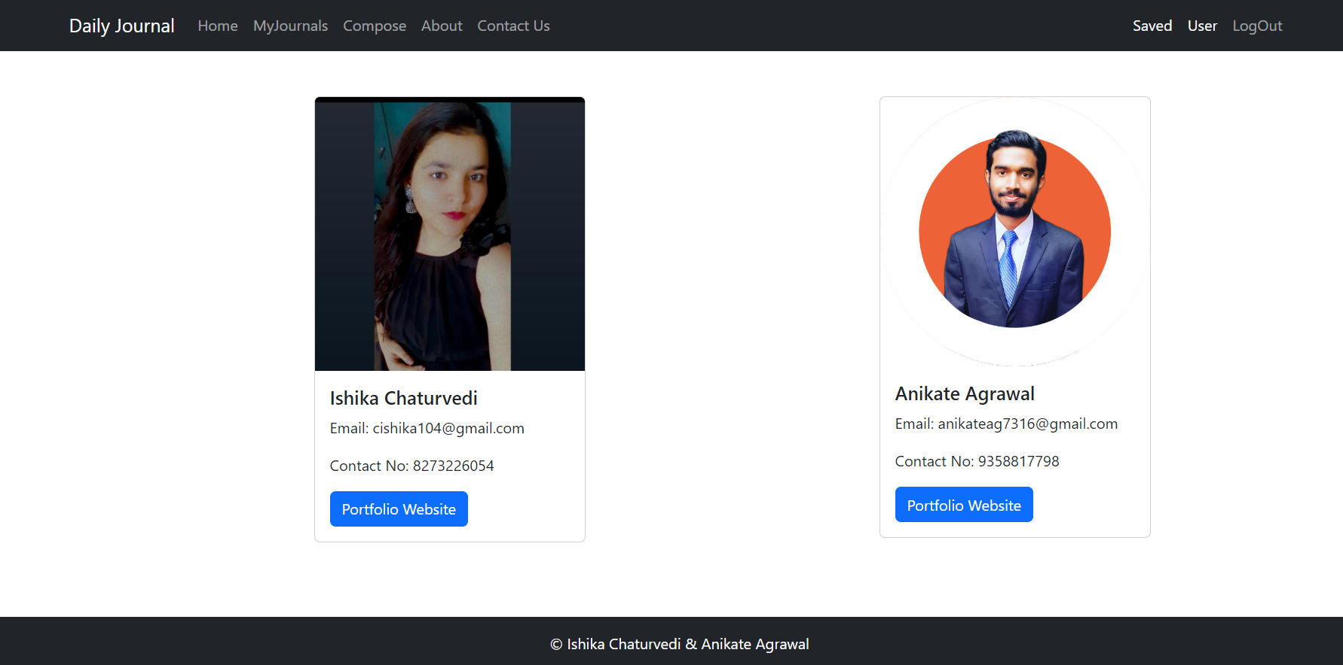
TEam

Slide 5
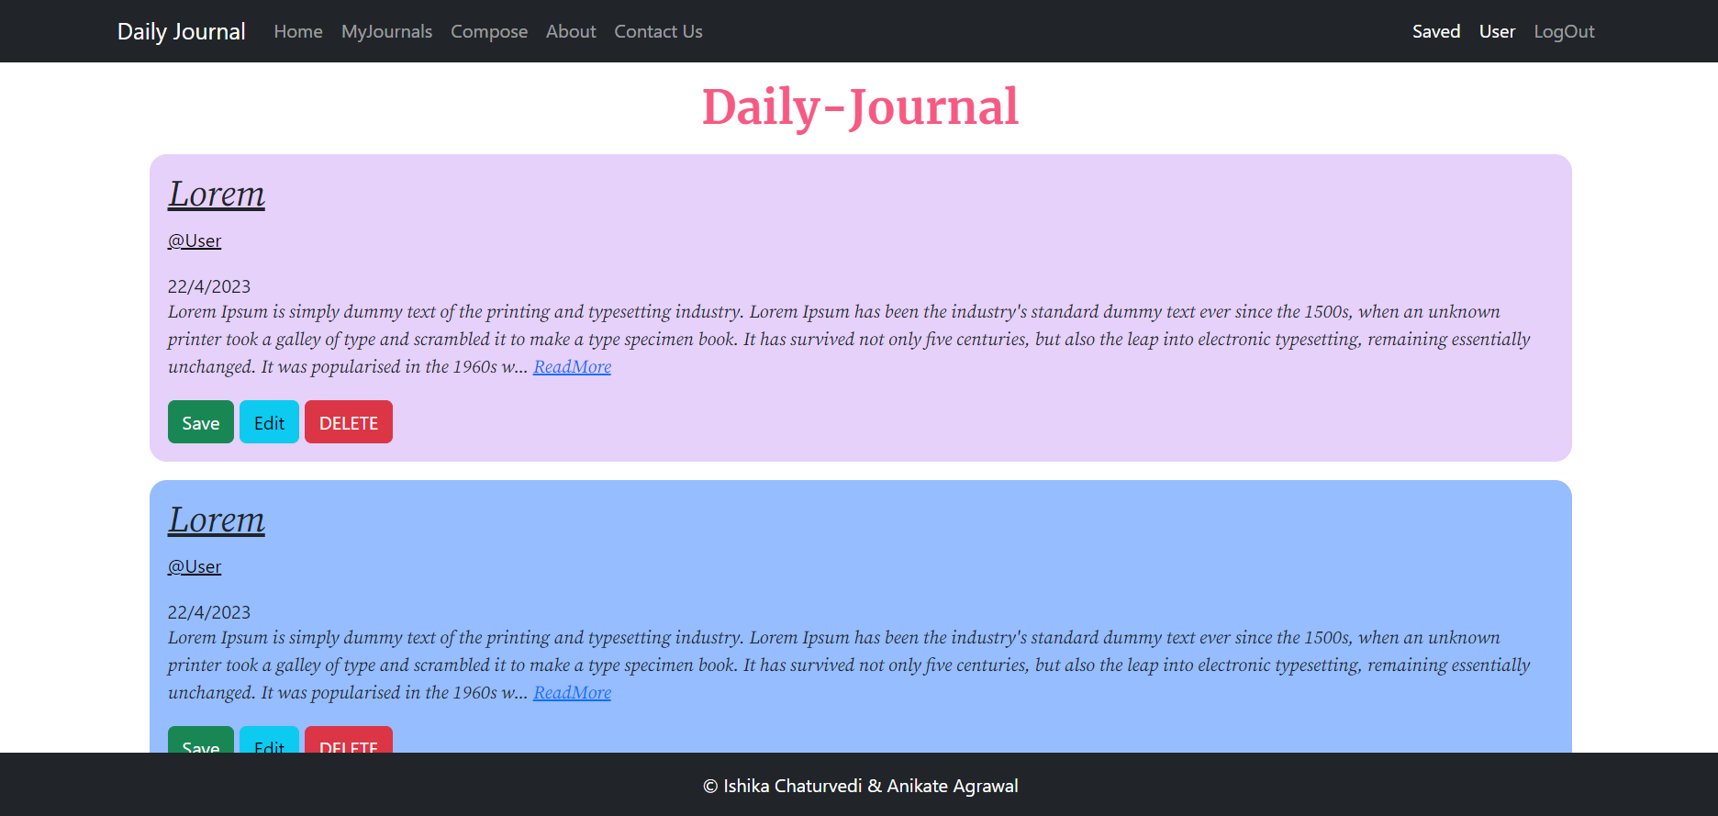
Home Page

Slide 6
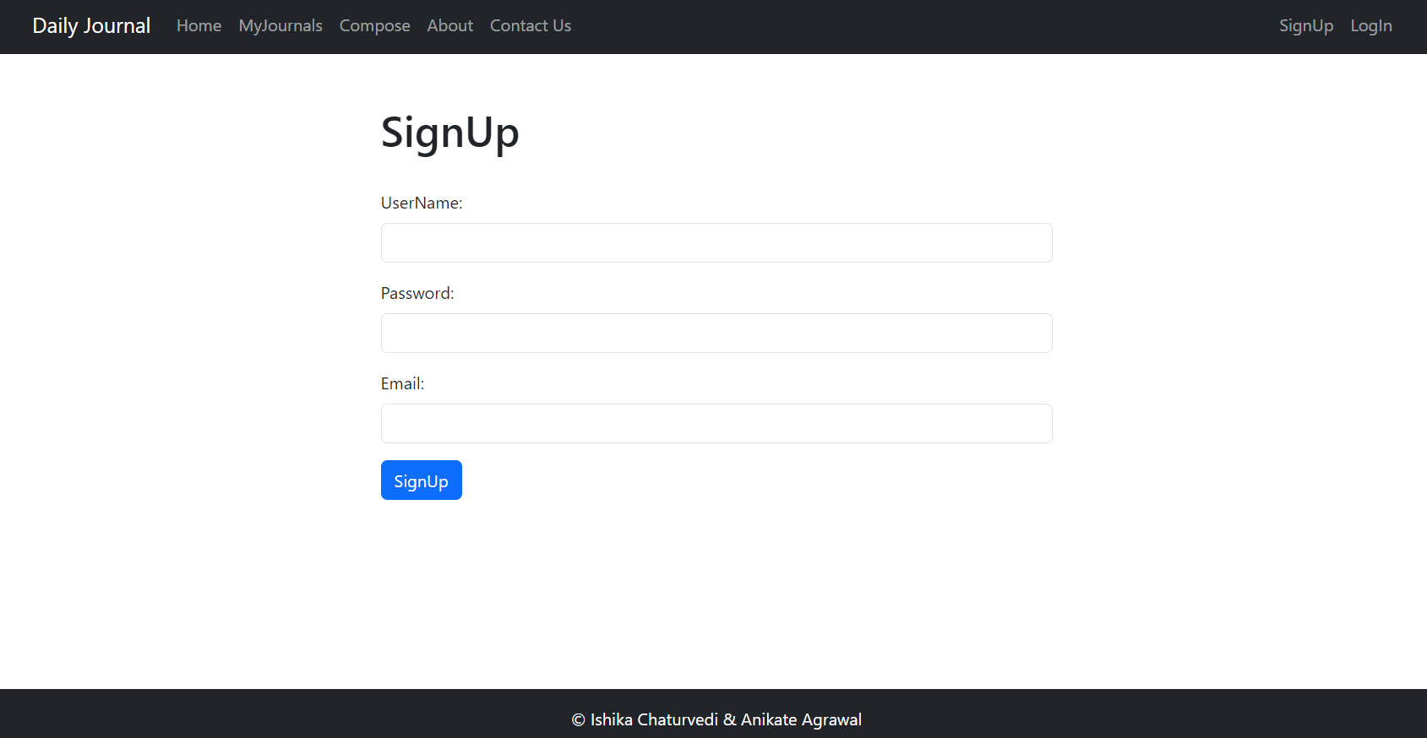
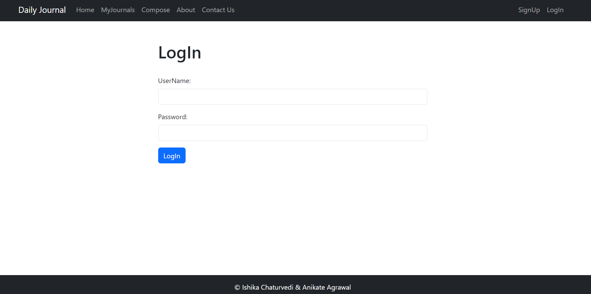
Authentication

Slide 7
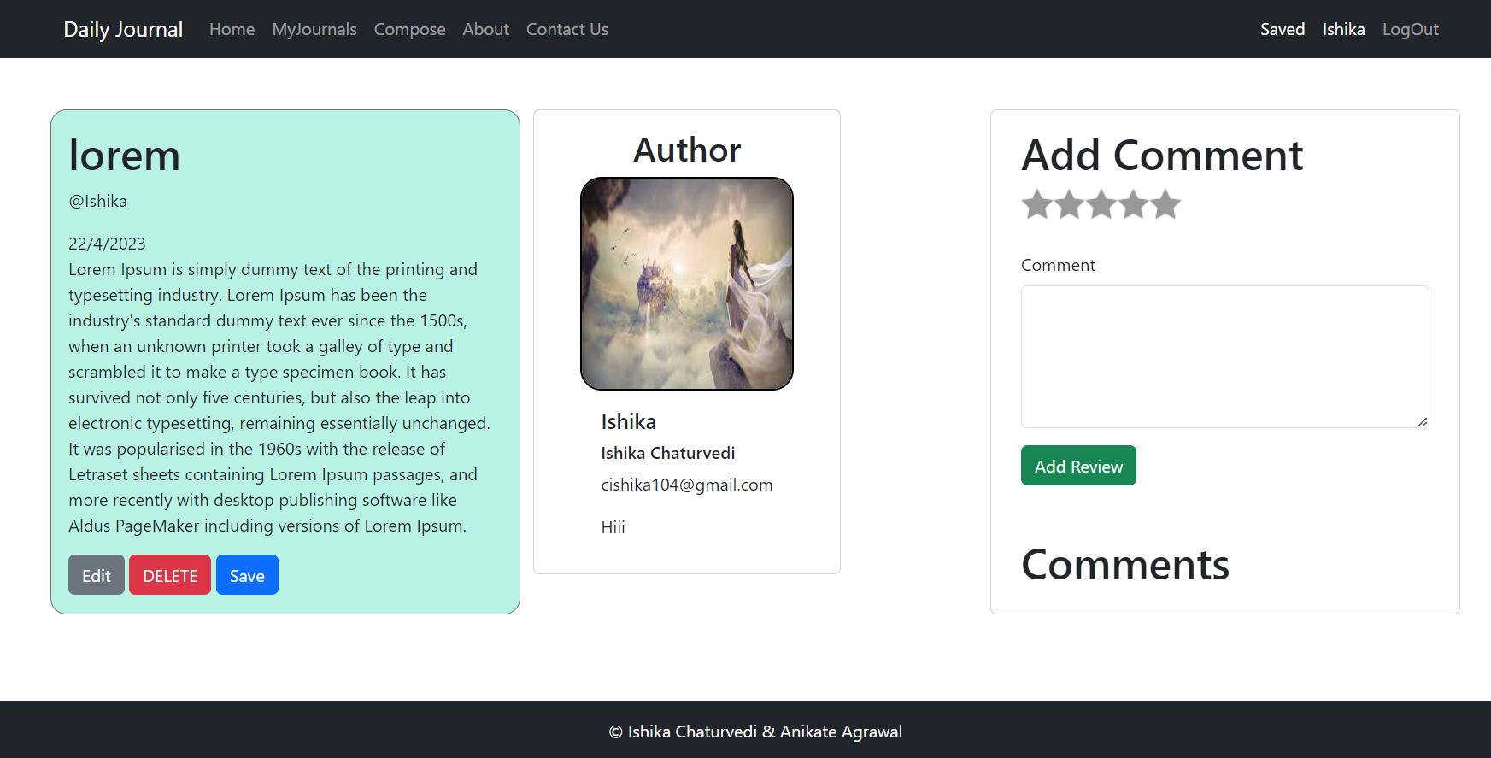
Read more page

Slide 8
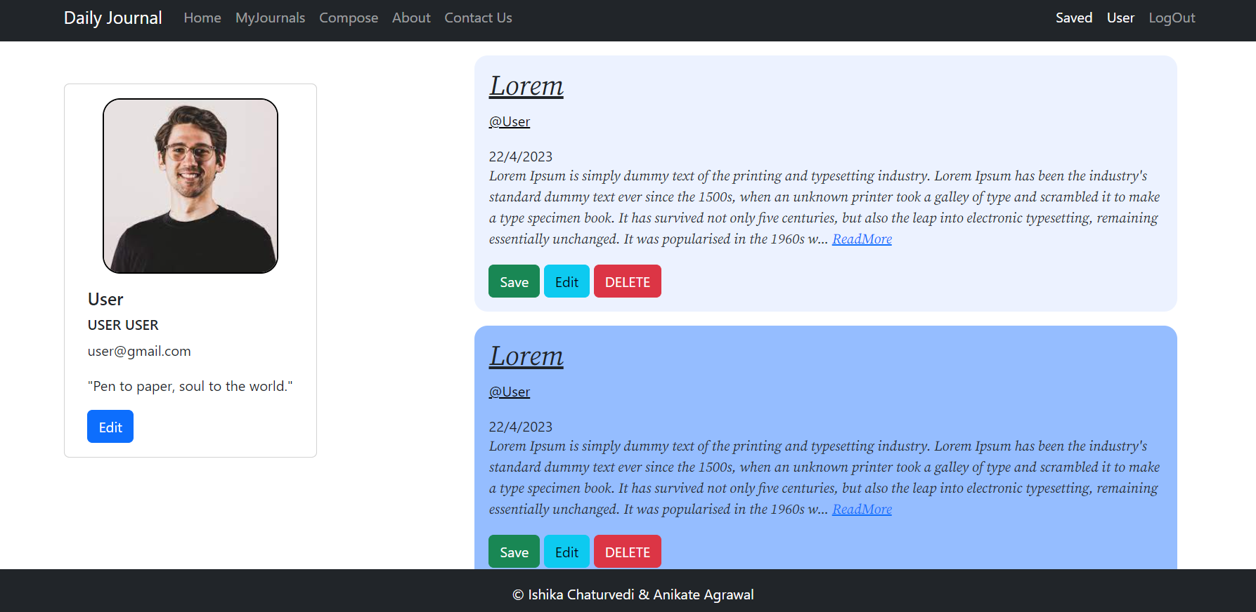
Edit Profile

Slide 9
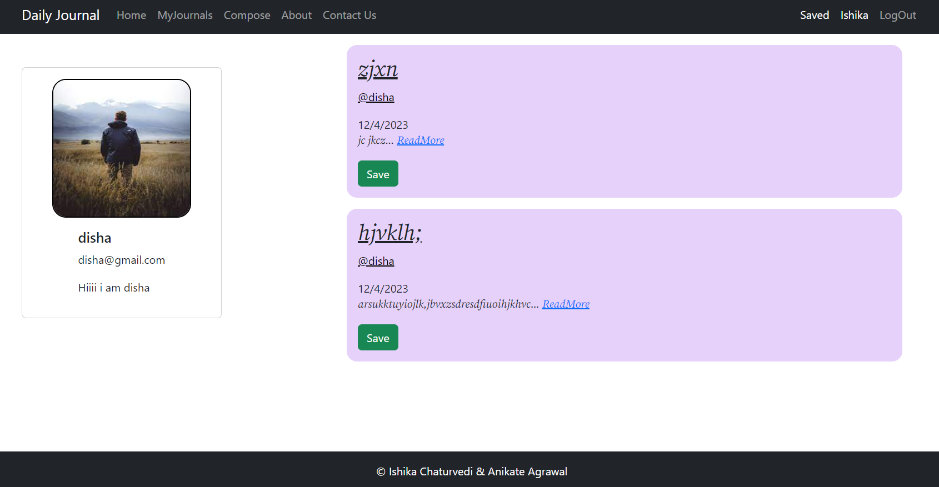
Author profile

Slide 10
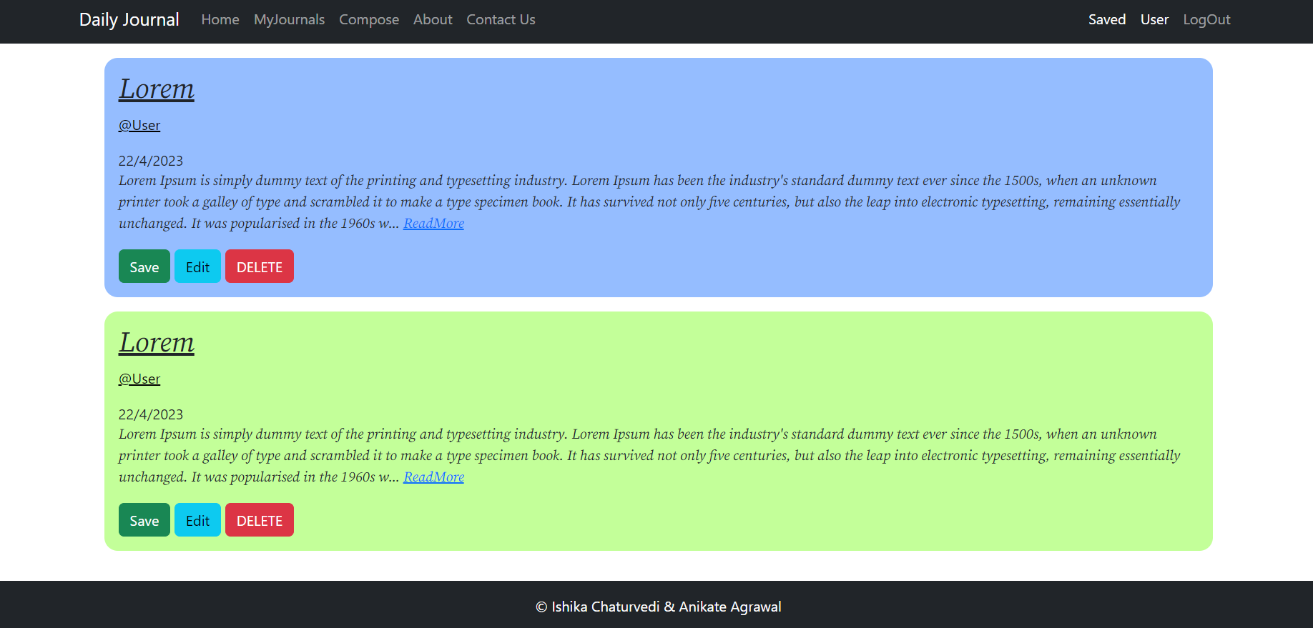
My Journal Page

Slide 11
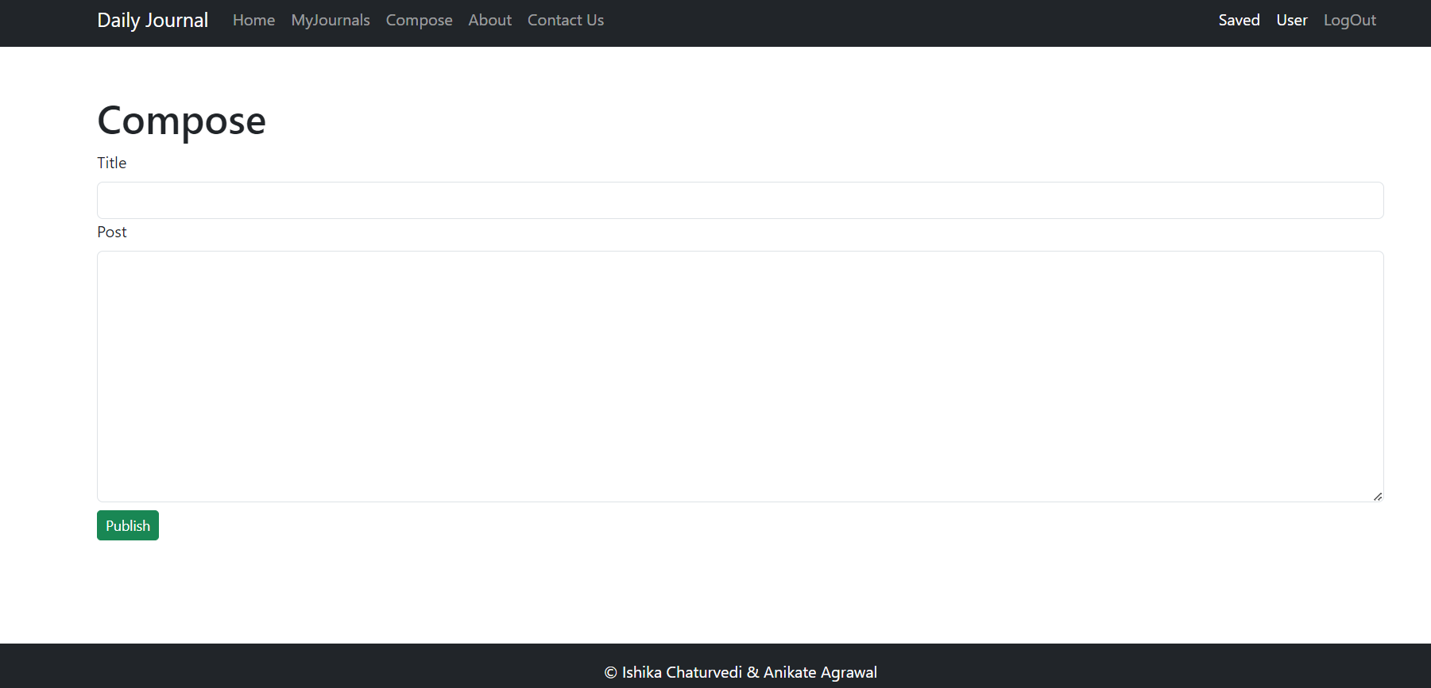
cOMPOSE

Slide 12
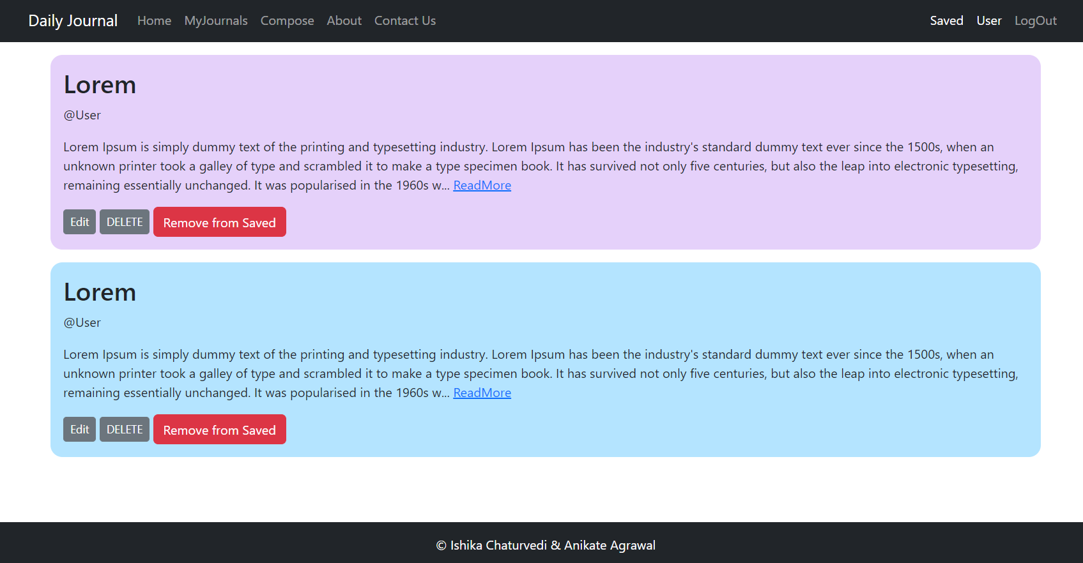
Saved Journals

Slide 13
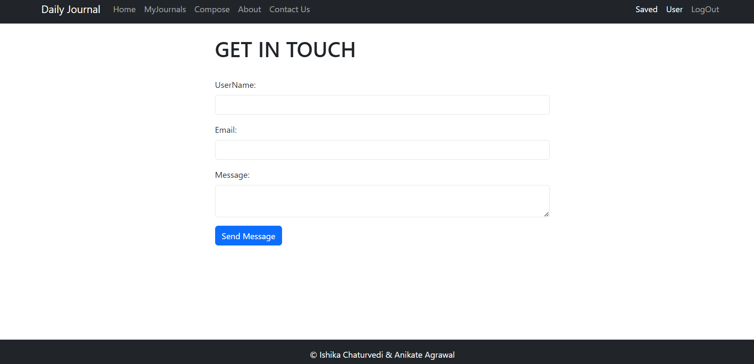
CONTACT uS

Slide 14

Logout

Slide 15
Thank You

