Slide 1
Major Project
Health Care System
(G-113)

Slide 2
Team Members
Anikate Agrawal (201500088)
Ishika Chaturvedi (201500306)
Anuj Verma (201500122)
Pop Singh (201500475)

Slide 3
Why do we need a health care system?
Long lines at reception
Long waits for lab results
High levels of medical appointment fees
Expansion of epidemic and viral diseases due to hospital overcrowding

Slide 4
Purpose of Health Care System:
Consumer education
Disease management
Clinical decision support
Physician-consumer communication
Administrative efficiencies

Slide 5
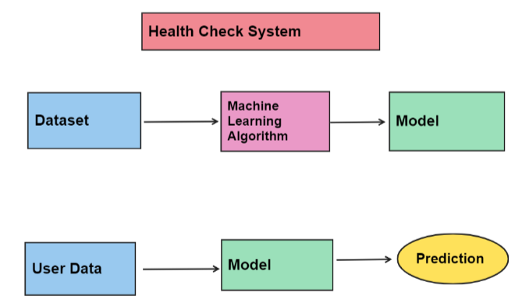
System Design

Slide 6
Machine Learning Algorithm
Decision Tree Classifier (For initial phase)
For Future implementation
KNN
SVM
Naïve Bayes

Slide 7
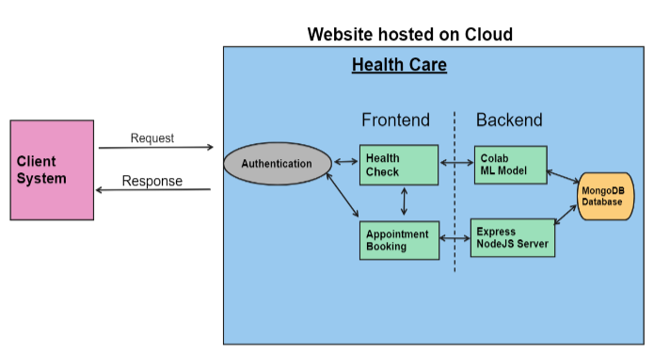

Slide 8
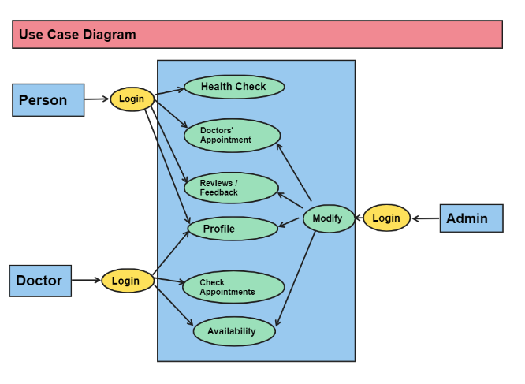

Slide 9
Reference Research Journals
Disease Prediction using Machine Learning Algorithms(https://ieeexplore.ieee.org/document/9154130)
Human Disease Prediction using Machine Learning Techniques and Real-life Parameters(https://www.ije.ir/article_169090_5525e34b7bd485c6f9f9cc710f62522f.pdf)
Disease Prediction From Various Symptoms Using Machine Learning(https://papers.ssrn.com/sol3/papers.cfm?abstract_id=3661426)

Slide 10
Thank You

