Slide 1
English-German-dictionary

Slide 2
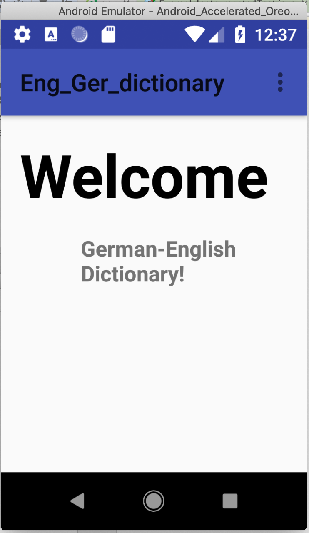
Homepage of English-German dictionary app.

Slide 3
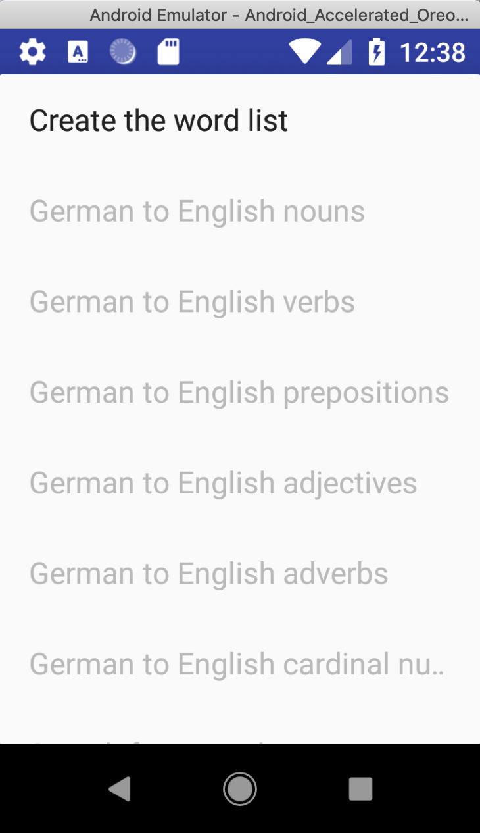
Creating the list of English-German vocabulary.

Slide 4
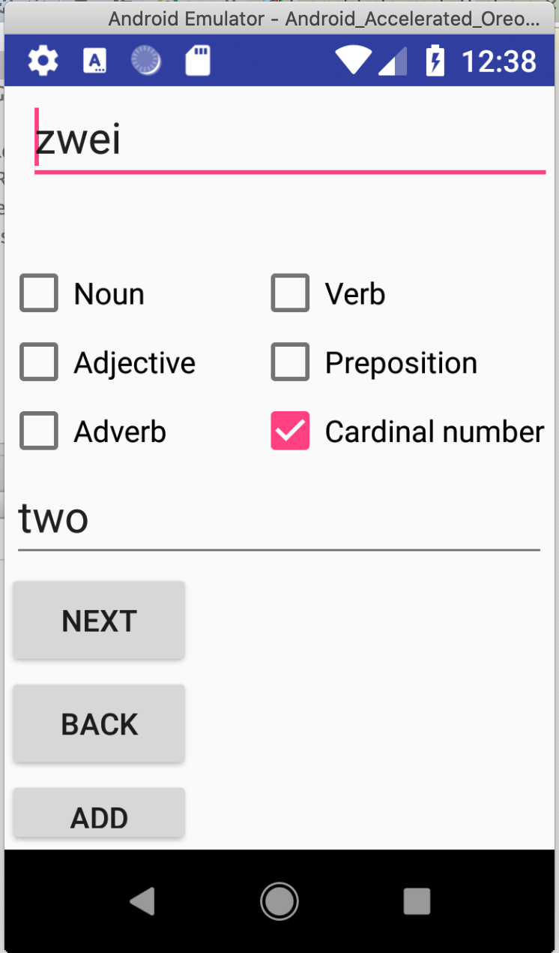
Creating words and its parts of speech.

Slide 5
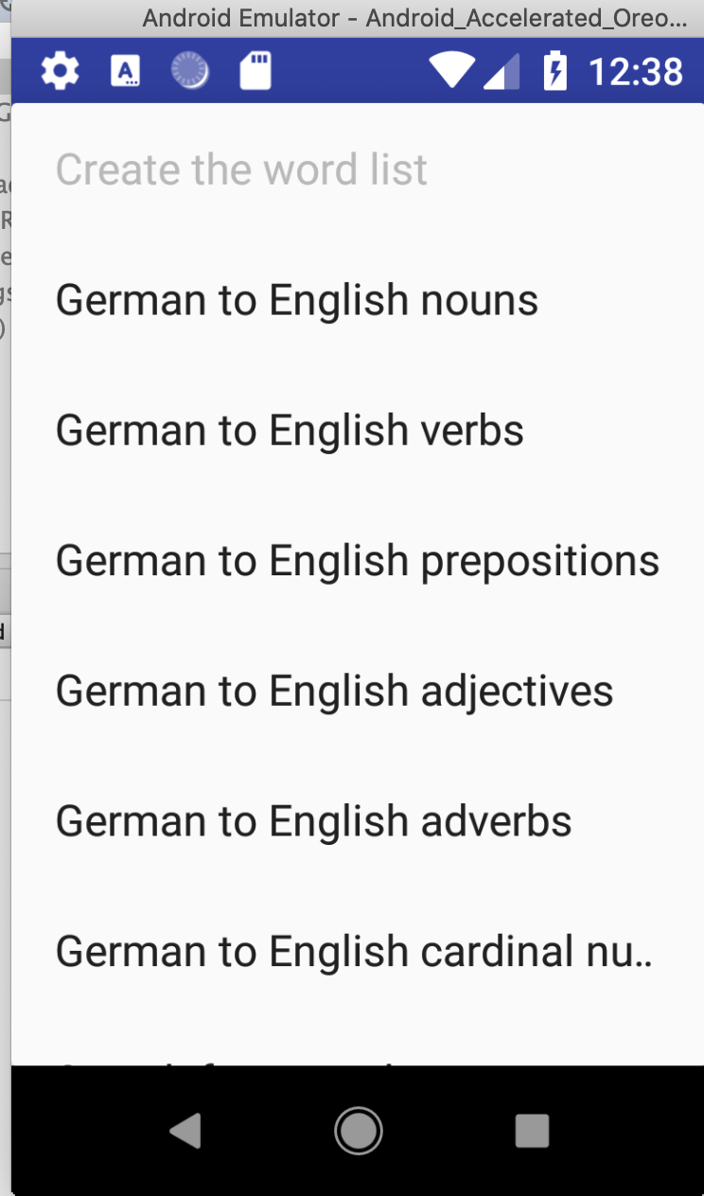
Dropdown list including category of words and English meanings, search engine and exit option.

