Slide 1
Pizza 1

Slide 2
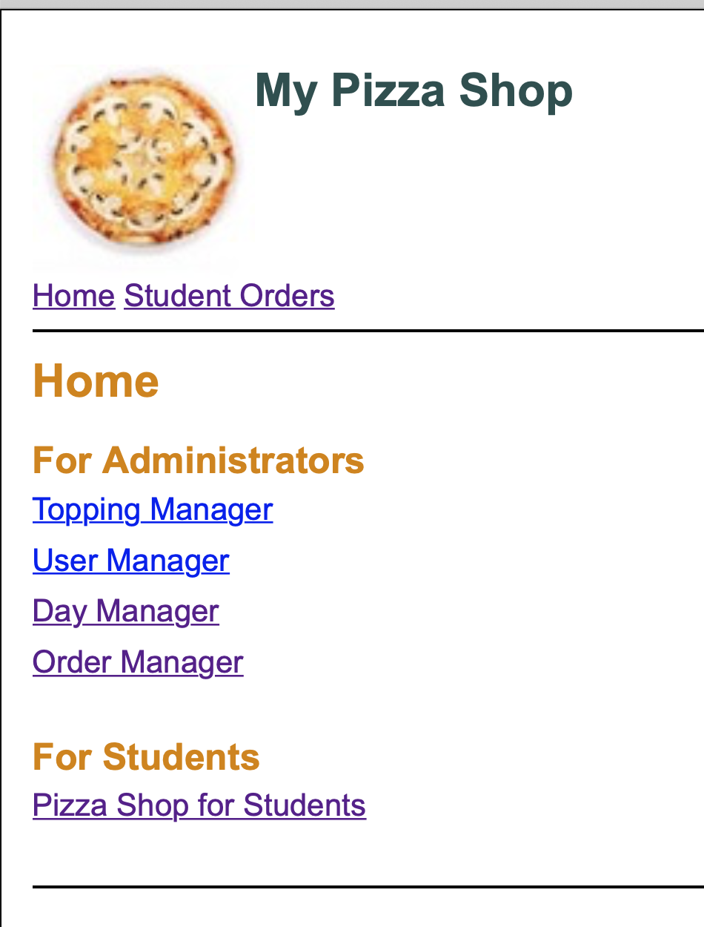
The homepage of Pizza order

Slide 3
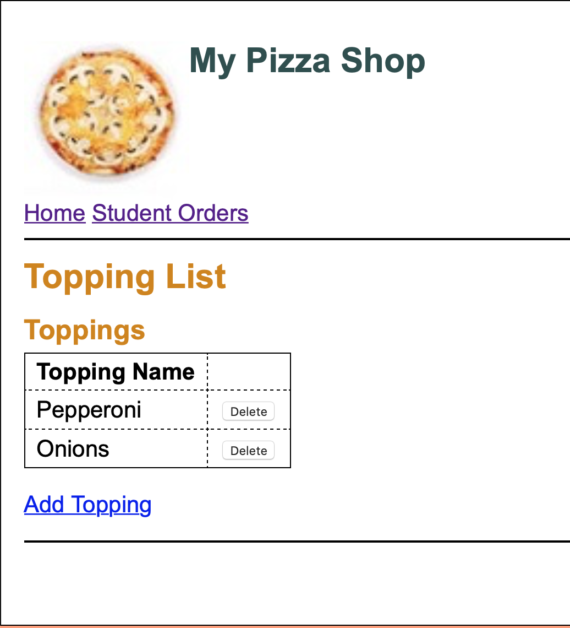
Toppings with delete and add toppings option.

Slide 4
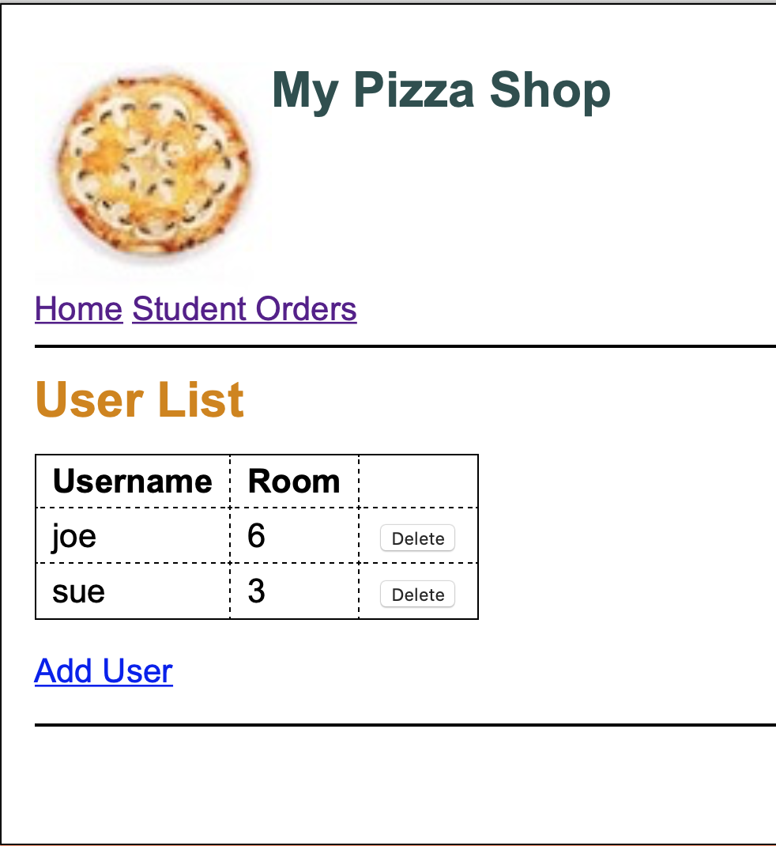
Users page with delete current users and add new users option.

Slide 5
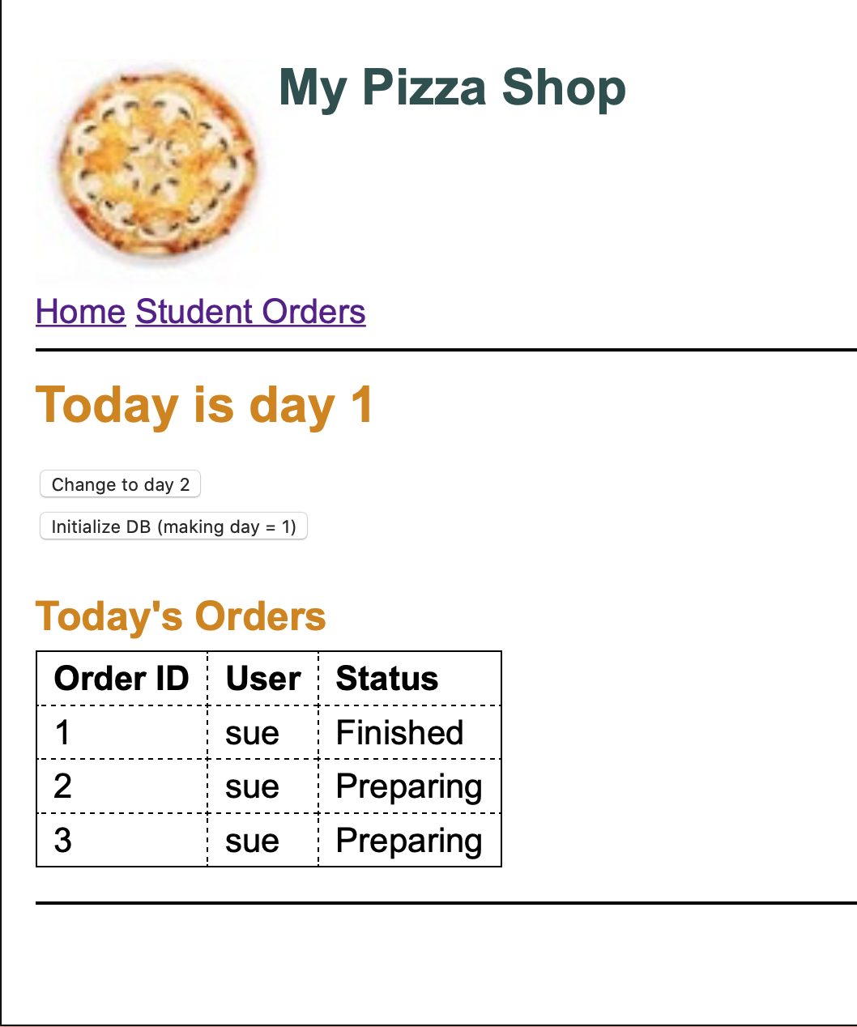
Day page. Reset day back to day 1 or advance in the next day (All orders will be marked Finished in current day)

Slide 6
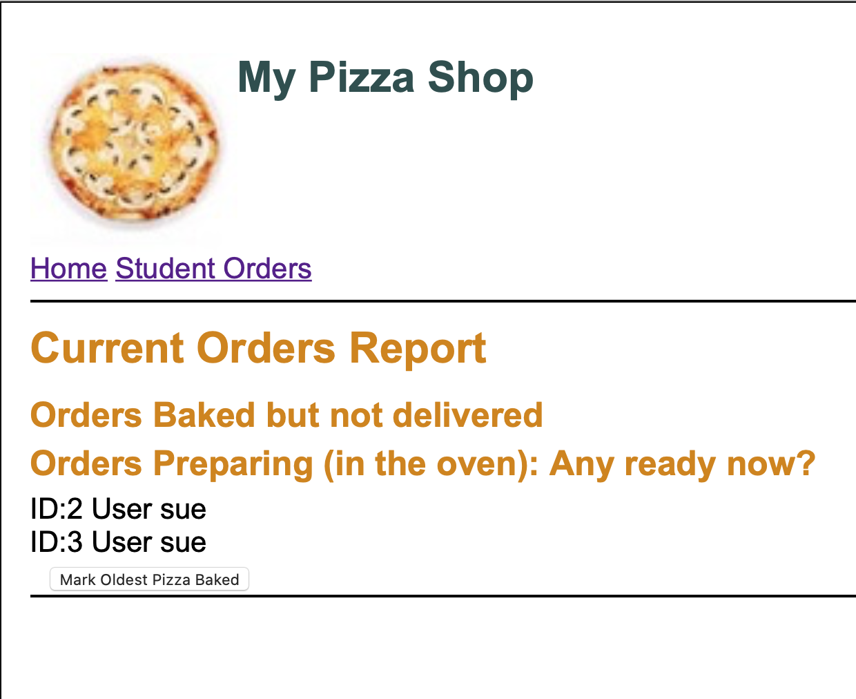
Admin can keep track the completeness of orders from user.

Slide 7
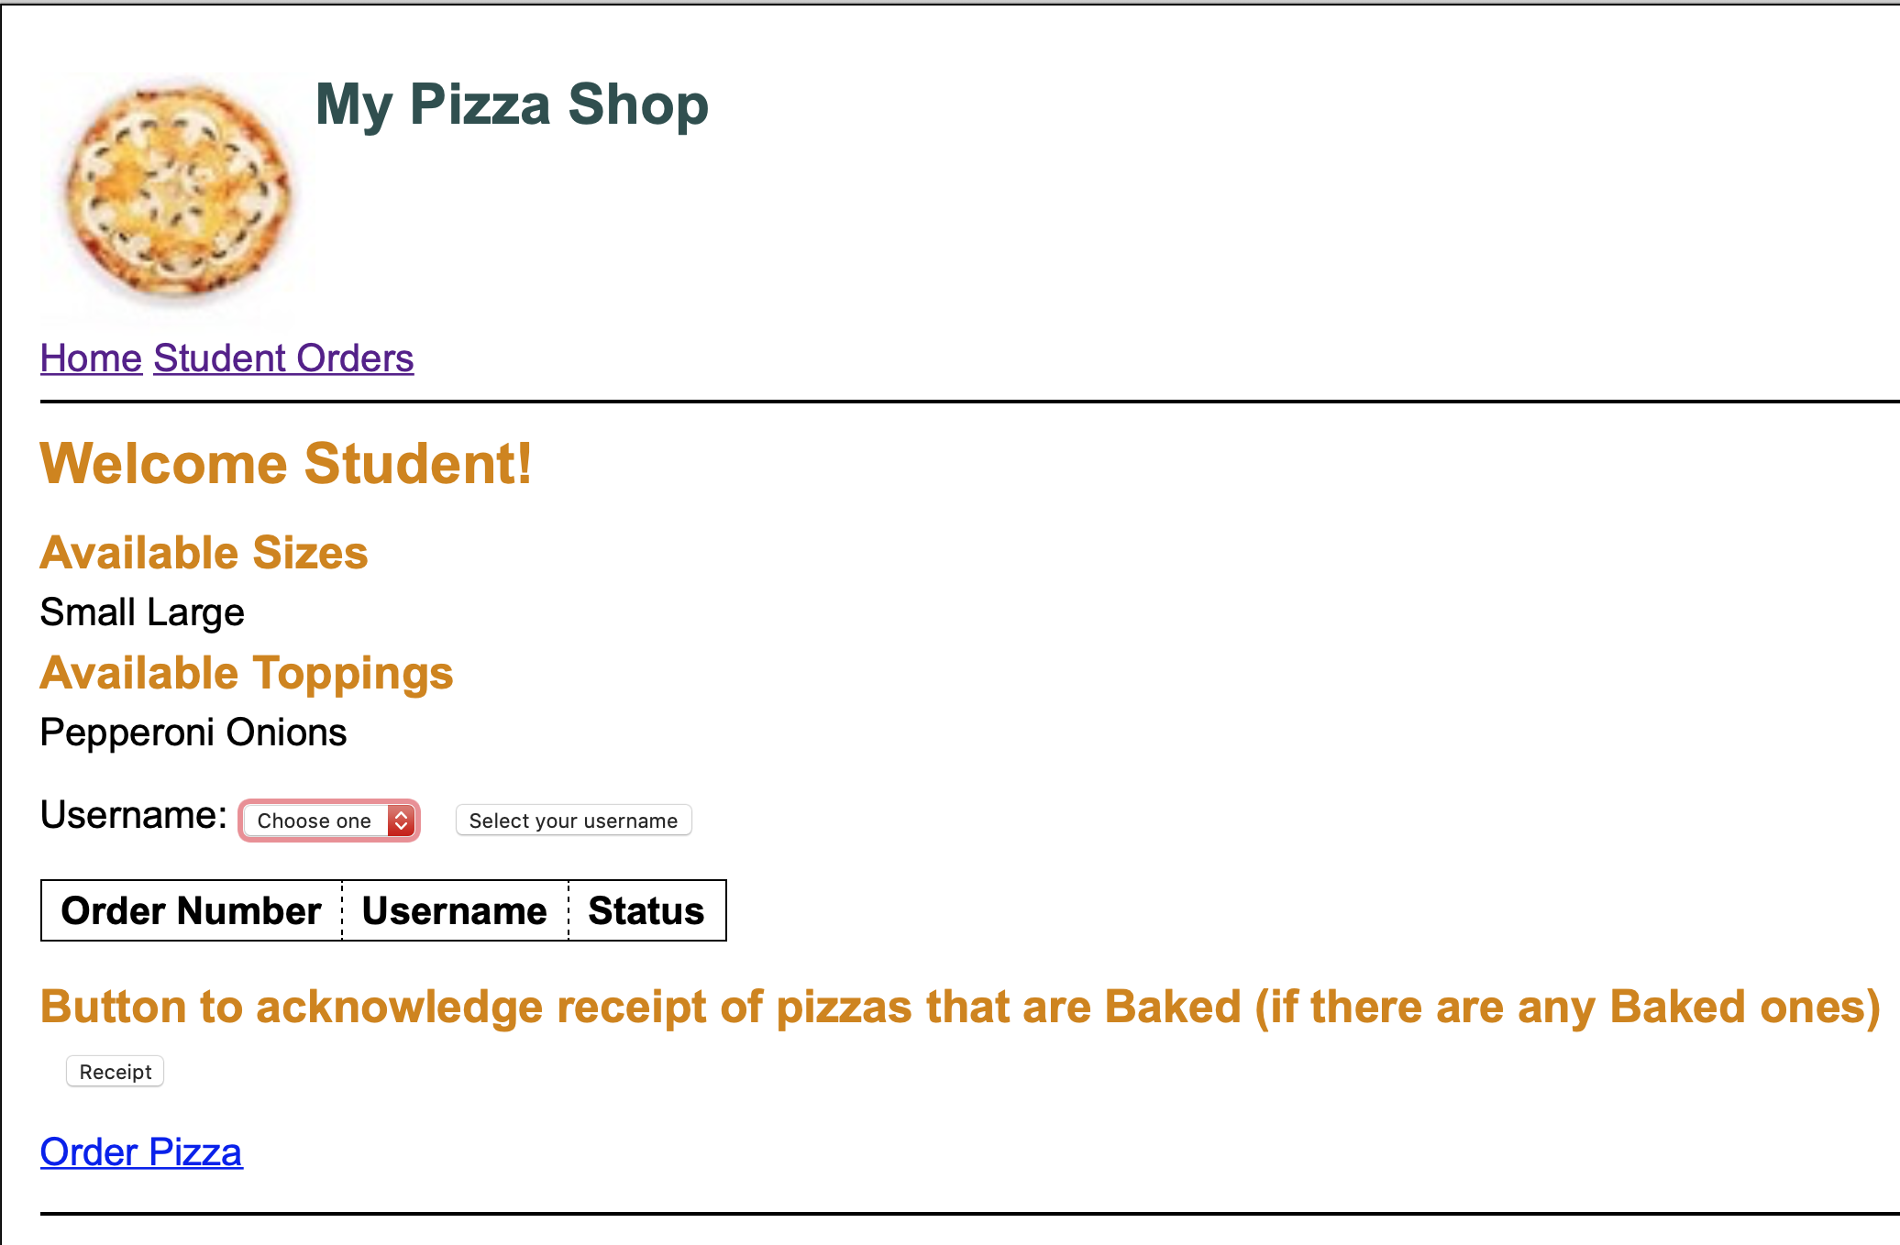
User's pizza ordered page.

Slide 8
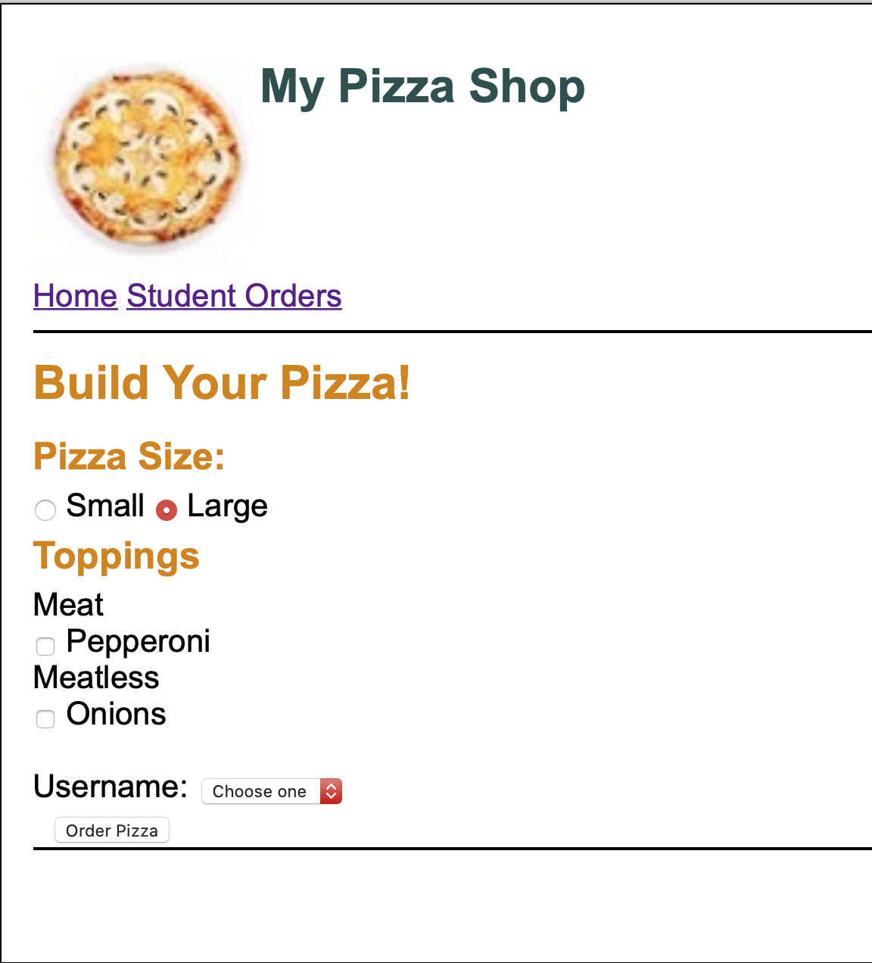
Order page. User can choose their preferred toppings and the size of the pizza.

