Slide 1
Pizza2 (Client side only for user, Admind side will be treated as server side)

Slide 2
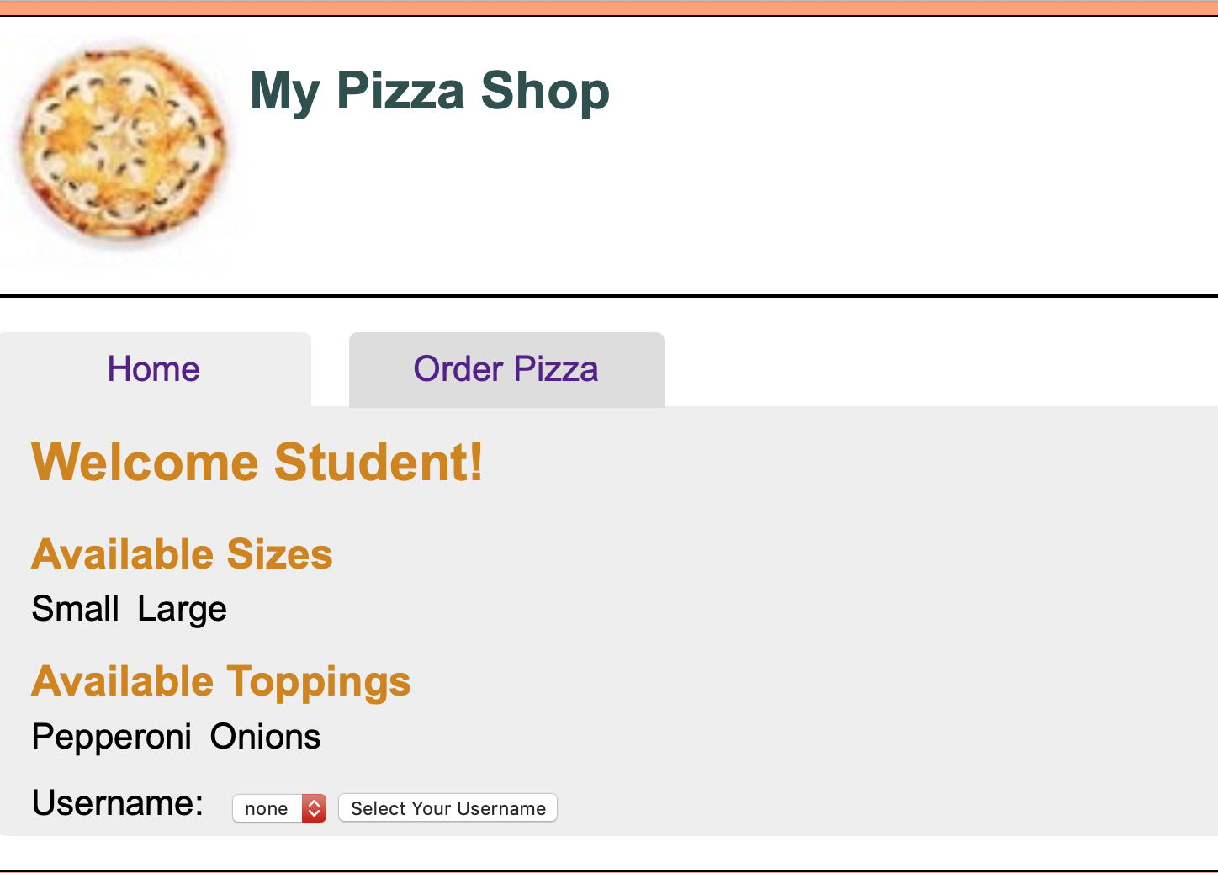
Pizza ordered page.

Slide 3
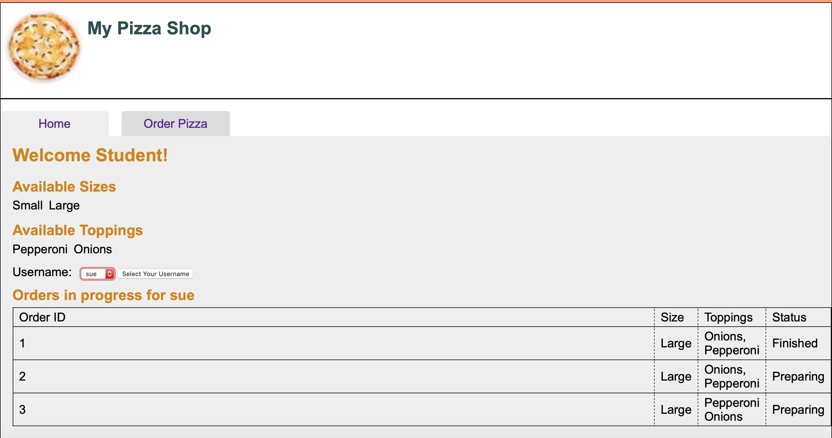
Home tab: Display the order of chosen user.

Slide 4
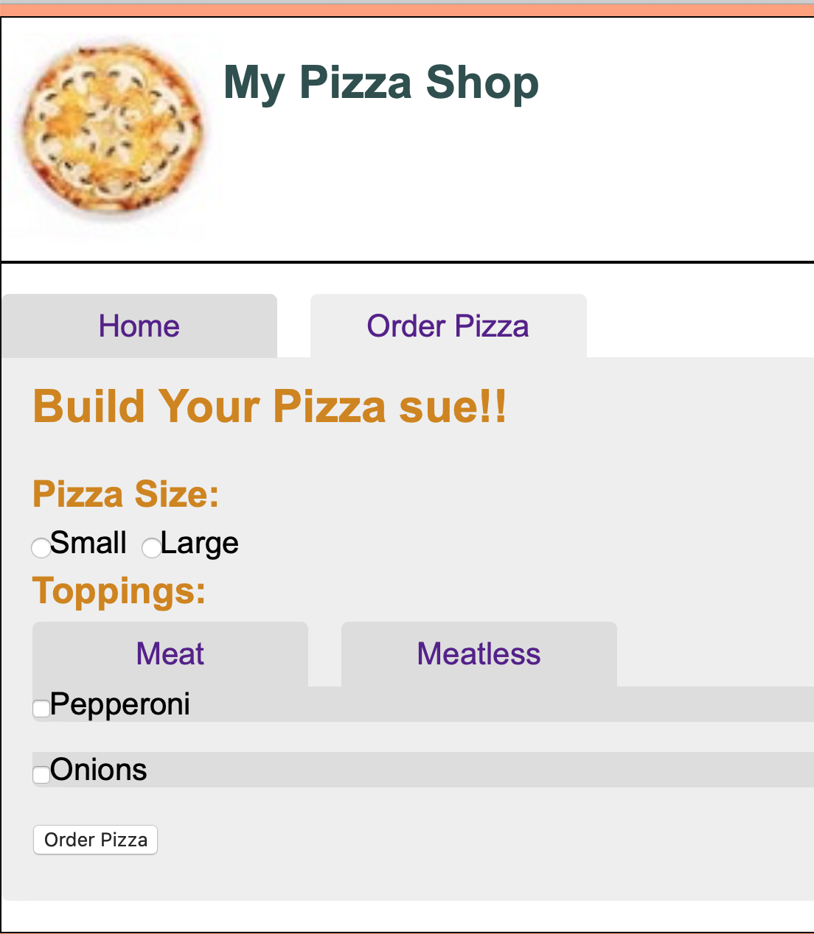
Order Pizza tab: with toppings, sizes available

