Slide 1
Web and HTTP
First, a quick review…
web page consists of objects, each of which can be stored on different Web servers
object can be HTML file, JPEG image, Java applet, audio file,…
web page consists of base HTML-file which includes several referenced objects, each addressable by a URL, e.g.,
www.someschool.edu/someDept/pic.gif
host name
path name

Slide 2


HTTP overview
HTTP: hypertext transfer protocol
Web’s application-layer protocol
client/server model:
  client: browser that requests, receives, (using HTTP protocol) and “displays” Web objects
  server: Web server sends (using HTTP protocol) objects in response to requests
HTTP request
PC running
Firefox browser
HTTP response
HTTP request
server running
Apache Web
server
HTTP response
iPhone running
Safari browser

Slide 3
HTTP overview (continued)
HTTP uses TCP:
client initiates TCP connection (creates socket) to server, port 80
server accepts TCP connection from client
HTTP messages (application-layer protocol messages) exchanged between browser (HTTP client) and Web server (HTTP server)
TCP connection closed
HTTP is “stateless”
server maintains no information about past client requests
aside
protocols that maintain “state” are complex!
past history (state) must be maintained
if server/client crashes, their views of “state” may be inconsistent, must be reconciled

Slide 4
HTTP is “stateless”
Scenario: You visit an online store, and you want to add two items to your shopping cart.
  First Request:
    You add Item A to your cart by sending an HTTP request to the server.
    The server processes the request and responds, confirming that Item A has been added.
  However, HTTP is stateless, so the server doesn't remember this action after responding. It doesn't keep track of your cart.
  2. Second Request:
    Now, you add Item B to your cart with a new HTTP request.
    Since HTTP is stateless, the server has no memory of your previous request (adding Item A). If the application didn’t use something like cookies or sessions, the server would have no idea that Item A was already added, and it would only know about Item B.
  Without special mechanisms, the server doesn't automatically know about your entire cart because it doesn’t maintain a memory between requests.

Slide 5
HTTP connections: two types
Non-persistent HTTP
TCP connection opened
at most one object sent over TCP connection
TCP connection closed
downloading multiple objects required multiple connections
Persistent HTTP
TCP connection opened to a server
multiple objects can be sent over single TCP connection between client, and that server
TCP connection closed

Slide 6
Non-persistent HTTP: example
User enters URL:
www.someSchool.edu/someDepartment/home.index
(containing text, references to 10 jpeg images)
1a. HTTP client initiates TCP connection to HTTP server (process) at www.someSchool.edu on port 80
1b. HTTP server at host www.someSchool.edu waiting for TCP connection at port 80 “accepts” connection, notifying client
2. HTTP client sends HTTP request message (containing URL) into TCP connection socket. Message indicates that client wants object someDepartment/home.index
3. HTTP server receives request message, forms response message containing requested object, and sends message into its socket
time

Slide 7
Non-persistent HTTP: example (cont.)
User enters URL:
www.someSchool.edu/someDepartment/home.index
(containing text, references to 10 jpeg images)
4. HTTP server closes TCP connection.
5. HTTP client receives response message containing html file, displays html. Parsing html file, finds 10 referenced jpeg objects
6. Steps 1-5 repeated for each of 10 jpeg objects
time

Slide 8
Non-persistent HTTP: response time
RTT (definition): time for a small packet to travel from client to server and back
HTTP response time (per object):
one RTT to initiate TCP connection
one RTT for HTTP request and first few bytes of HTTP response to return
object/file transmission time
initiate TCP
connection
RTT
request file
RTT
time to
transmit
file
file received
time
time
Non-persistent HTTP response time = 2RTT+ file transmission time

Slide 9
Persistent HTTP (HTTP 1.1)
Non-persistent HTTP issues:
requires 2 RTTs per object
OS overhead for each TCP connection
browsers often open multiple parallel TCP connections to fetch referenced objects in parallel
Persistent HTTP (HTTP1.1):
server leaves connection open after sending response
subsequent HTTP messages between same client/server sent over open connection
client sends requests as soon as it encounters a referenced object
as little as one RTT for all the referenced objects (cutting response time in half)

Slide 10
Exercise 1: Non-Persistent HTTP
Assume:
  RTT between the client and the server: 100 ms
  Time to transmit an object: 10 ms
  Webpage consists of: 1 HTML file and 3 objects (e.g., images or CSS files).
Question: Calculate the total time to retrieve the webpage using non-persistent HTTP.

Slide 11
Response Time for the HTML file
TCP Handshake:
  Before sending the HTTP request, the TCP 3-way handshake needs to be completed to establish a connection.
    This involves 1 RTT (Round-Trip Time):
      Client sends a SYN packet to the server.
      Server responds with a SYN-ACK.
      Client sends an ACK to the server.
Response Time for the HTML file:
  TCP Connection Setup (3-way handshake) = 1 RTT = 100 ms
  Request and Response for HTML = 1 RTT = 100 ms
  Transmission time for HTML file = 10 ms
Total time to retrieve the HTML file = 1 RTT (TCP handshake) + 1 RTT (HTTP request and response) + transmission time = 100 + 100 + 10 = 210 ms

Slide 12
Response Time for each additional object (non-persistent connection)
For each object (requires a new TCP connection):
  TCP Connection Setup = 1 RTT = 100 ms
  Request and Response for Object = 1 RTT = 100 ms
  Transmission time for each object = 10 ms
Total time to retrieve each object = 1 RTT (TCP handshake) + 1 RTT (HTTP request and response) + transmission time = 100 + 100 + 10 = 210 ms

Slide 13
Total Response Time for the Entire Webpage
Time for the HTML file = 210 ms
Time for each of the 3 objects = 210 ms × 3 = 630 ms
Total time for webpage loading = 210 ms (HTML) + 630 ms (for 3 objects) = 840 ms

Slide 14
Steps involved in Persistent HTTP
Response Time for the HTML file:
  TCP Connection Setup (3-way handshake) = 1 RTT = 100 ms
  Request and Response for HTML = 1 RTT = 100 ms
  Transmission time for HTML file = 10 ms
Total time for the HTML file = 1 RTT (TCP handshake) + 1 RTT (HTTP request/response) + transmission time = 100 + 100 + 10 = 210 ms

Slide 15
Response Time for each additional object (over persistent connection)
For each additional object (since the TCP connection is already established):
  Request and Response for Object = 1 RTT = 100 ms
  Transmission time for each object = 10 ms
Total time for each object = 100 + 10 = 110 ms

Slide 16
Total Response Time for the Entire Webpage
Time for the HTML file = 210 ms
Time for each of the 3 objects = 110 ms × 3 = 330 ms
Total time for webpage loading = 210 ms (HTML) + 330 ms (for 3 objects) = 540 ms

Slide 17
Comparison of Non-Persistent vs. Persistent HTTP:
Non-Persistent HTTP: 840 ms
Persistent HTTP: 540 ms
Persistent HTTP saves 300 ms in this example because it avoids repeated TCP connection setups for each object. The key benefit of persistent HTTP is that it reduces the need for multiple RTTs by reusing the same TCP connection for multiple requests.

Slide 18
HTTP request message
two types of HTTP messages: request, response
HTTP request message:
  ASCII (human-readable format)
carriage return character
request line (GET, POST,
HEAD commands)
line-feed character
GET /index.html HTTP/1.1\r\n
Host: www-net.cs.umass.edu\r\n
User-Agent: Mozilla/5.0 (Macintosh; Intel Mac OS X 10.15; rv:80.0) Gecko/20100101 Firefox/80.0 \r\n
Accept: text/html,application/xhtml+xml\r\n
Accept-Language: en-us,en;q=0.5\r\n
Accept-Encoding: gzip,deflate\r\n
Connection: keep-alive\r\n
\r\n
header
lines
carriage return, line feed at start of line indicates end of header lines
* Check out the online interactive exercises for more examples: http://gaia.cs.umass.edu/kurose_ross/interactive/

Slide 19
HTTP request message: general format
method
sp
URL
sp
version
cr
lf
request
line
header field name
value
cr
lf
~
~
header
lines
~
~
header field name
value
cr
lf
cr
lf
~
entity body
~
body
~
~

Slide 20
Other HTTP request messages
POST method:
web page often includes form input
user input sent from client to server in entity body of HTTP POST request message
HEAD method:
requests headers (only) that would be returned if specified URL were requested with an HTTP GET method.
PUT method:
uploads new file (object) to server
completely replaces file that exists at specified URL with content in entity body of POST HTTP request message
GET method (for sending data to server):
include user data in URL field of HTTP GET request message (following a ‘?’):
www.somesite.com/animalsearch?monkeys&banana

Slide 21
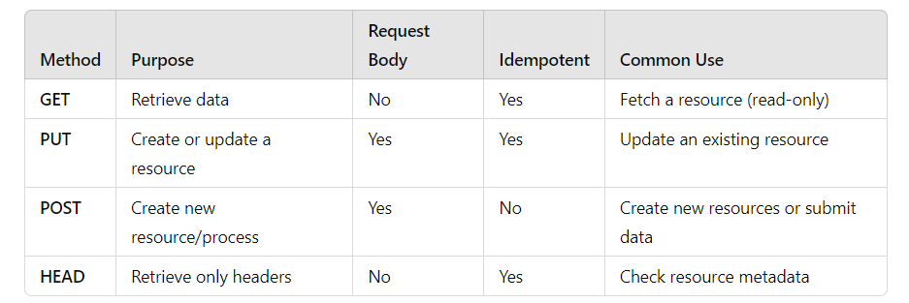
Key Differences

Slide 22
Idempotent
In HTTP, idempotent refers to a property of certain methods where making multiple identical requests has the same effect as making a single request.
In other words, no matter how many times the request is repeated, the final outcome or the state of the resource on the server remains the same, with no additional side effects.

Slide 23
Idempotent Methods in HTTP
GET: The GET method is idempotent. When you request a resource using GET, whether you make the request once or multiple times, the response will be the same, and the state of the server will not be modified.
  Example: GET /user/123 will always return the same user information (if unchanged) without altering the state of that user on the server.

Slide 24
Non-Idempotent Methods in HTTP
POST: The POST method is not idempotent. Repeating a POST request may create multiple resources or have different side effects, making the outcome different with each request.
  Example: POST /user to create a new user. Each time the POST request is sent, a new user is created, leading to different results (new user IDs, for example).

Slide 25
Why Idempotence Matters
Idempotence is important for ensuring stability and safety in network communications. If a request fails (due to timeouts, connection issues), it might be automatically retried. With idempotent methods, retrying the same request won't cause unintended side effects or change the outcome.
Systems like distributed servers and load balancers often rely on idempotence to perform tasks like balancing traffic or retrying requests efficiently without causing issues on the server.

Slide 26
HTTP response message
status line (protocol
status code status phrase)
HTTP/1.1 200 OK
Date: Tue, 08 Sep 2020 00:53:20 GMT
Server: Apache/2.4.6 (CentOS) OpenSSL/1.0.2k-fips PHP/7.4.9 mod_perl/2.0.11 Perl/v5.16.3
Last-Modified: Tue, 01 Mar 2016 18:57:50 GMT
ETag: "a5b-52d015789ee9e"
Accept-Ranges: bytes
Content-Length: 2651
Content-Type: text/html; charset=UTF-8
\r\n
data data data data data ...
header
lines
data, e.g., requested
HTML file
* Check out the online interactive exercises for more examples: http://gaia.cs.umass.edu/kurose_ross/interactive/

Slide 27
HTTP response status codes
status code appears in 1st line in server-to-client response message.
some sample codes:
200 OK
  request succeeded, requested object later in this message
301 Moved Permanently
  requested object moved, new location specified later in this message (in Location: field)
400 Bad Request
  request msg not understood by server
404 Not Found
  requested document not found on this server
505 HTTP Version Not Supported

Slide 28
Trying out HTTP (client side) for yourself
1. netcat to your favorite Web server:
% nc -c -v gaia.cs.umass.edu 80 (for Mac)
>ncat –C gaia.cs.umass.edu 80 (for Windows)
opens TCP connection to port 80 (default HTTP server port) at gaia.cs.umass.edu.
anything typed in will be sent to port 80 at gaia.cs.umass.edu
2. type in a GET HTTP request:
GET /kurose_ross/interactive/index.php HTTP/1.1
Host: gaia.cs.umass.edu
by typing this in (hit carriage return twice), you send this minimal (but complete) GET request to HTTP server
3. look at response message sent by HTTP server!
(or use Wireshark to look at captured HTTP request/response)
Notes:
nc -v gaia.cs.umass.edu 80
In Linux

Slide 29

Maintaining user/server state: cookies
Recall: HTTP GET/response interaction is stateless
no notion of multi-step exchanges of HTTP messages to complete a Web “transaction”
  no need for client/server to track “state” of multi-step exchange
  all HTTP requests are independent of each other
  no need for client/server to “recover” from a partially-completed-but-never-completely-completed transaction
a stateful protocol: client makes two changes to X, or none at all
X
lock data record X
X
OK
update X X’
X’
OK
t’
update X X’’
OK
X’’
unlock X
OK
X’’
time
time
Q: what happens if network connection or client crashes at t’ ?
Notes:
t’

Slide 30
What happens if network connection or client crashes at t’ ?
Data Integrity Issues: The record might become corrupted if the server has partially updated the data. For example, if X was supposed to become X′′but due to the crash, only some changes are reflected in the database, this can lead to inconsistent states.
Lock Release: If the client crashes while holding a lock, the lock may not be released properly.

Slide 31
Maintaining user/server state: cookies
Web sites and client browser use cookies to maintain some state between transactions
four components:
  1) cookie header line of HTTP response message
  2) cookie header line in next HTTP request message
  3) cookie file kept on user’s host, managed by user’s browser
  4) back-end database at Web site
Example:
Susan uses browser on laptop, visits specific e-commerce site for first time
when initial HTTP requests arrives at site, site creates:
  unique ID (aka “cookie”)
  entry in backend database for ID
subsequent HTTP requests from Susan to this site will contain cookie ID value, allowing site to “identify” Susan
Notes:
t’

Slide 32
Maintaining user/server state: cookies
client
Amazon server
ebay 8734
usual HTTP request msg
Amazon server
creates ID
1678 for user
cookie file
usual HTTP response
set-cookie: 1678
backend
database
create
entry
ebay 8734
amazon 1678
usual HTTP request msg
cookie: 1678
cookie-
specific
action
access
usual HTTP response msg
one week later:
access
ebay 8734
amazon 1678
usual HTTP request msg
cookie: 1678
cookie-
specific
action
usual HTTP response msg
time
time
Notes:
t’

Slide 33
HTTP cookies: comments
aside
What cookies can be used for:
authorization
shopping carts
recommendations
user session state (Web e-mail)
cookies and privacy:
cookies permit sites to learn a lot about you on their site.
third party persistent cookies (tracking cookies) allow common identity (cookie value) to be tracked across multiple web sites
Challenge: How to keep state?
at protocol endpoints: maintain state at sender/receiver over multiple transactions
in messages: cookies in HTTP messages carry state
Notes:
t’

Slide 34
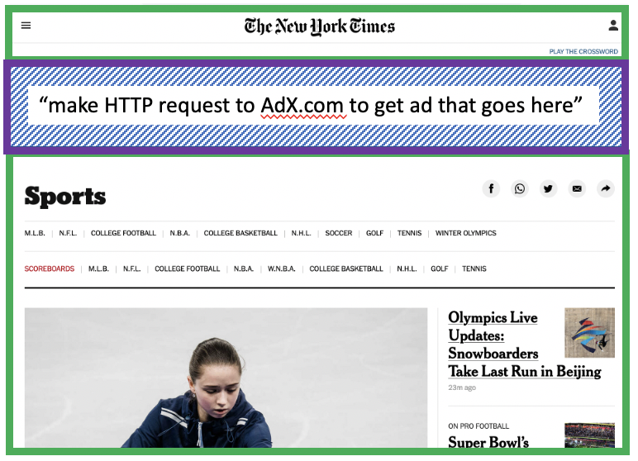



Example: displaying a NY Times web page
1
GET base html file from nytimes.com
2
fetch ad from AdX.com
nytimes.com
4
5
HTTP GET
1
2
HTTP reply
7
display composed page
3
4
6
5
NY times page with embedded ad displayed
AdX.com

Slide 35
Cookies: tracking a user’s browsing behavior
1634: sports, 2/15/22
nytimes.com (sports)
“first party” cookie – from website you chose to visit (provides base html file)
HTTP
GET
HTTP reply
Set cookie: 1634
HTTP GET
Referrer: NY Times Sports
4
5
7493: NY Times sports, 2/15/22
“third party” cookie – from website you did not choose to visit
HTTP reply
NY Times: 1634
Set cookie: 7493
AdX.com
AdX: 7493

Slide 36
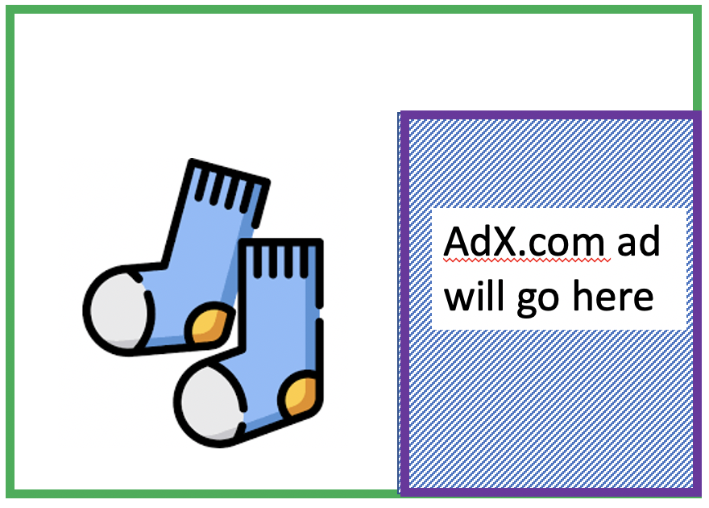
Cookies: tracking a user’s browsing behavior
1634: sports, 2/15/22
nytimes.com
AdX:
tracks my web browsing over sites with AdX ads
can return targeted ads based on browsing history
socks.com
HTTP reply
2
HTTP GET
1
HTTP GET
Referrer: socks.com, cookie: 7493
4
7493: NY Times sports, 2/15/22
5
7493: socks.com, 2/16/22
HTTP reply
NY Times: 1634
Set cookie: 7493
AdX.com
AdX: 7493

Slide 37

Cookies: tracking a user’s browsing behavior (one day later)
1634: sports, 2/15/22
1634: arts, 2/17/22
nytimes.com (arts)
socks.com
HTTP
GET
HTTP reply
cookie: 1634
Set cookie: 1634
HTTP GET
Referrer: nytimes.com, cookie: 7493
4
7493: NY Times sports, 2/15/22
5
7493: socks.com, 2/16/22
HTTP reply
7493: NY Times arts, 2/15/22
NY Times: 1634
Set cookie: 7493
AdX.com
AdX: 7493
Returned ad for socks!

Slide 38
Cookies: tracking a user’s browsing behavior
Cookies can be used to:
track user behavior on a given website (first party cookies)
track user behavior across multiple websites (third party cookies) without user ever choosing to visit tracker site (!)
tracking may be invisible to user:
  rather than displayed ad triggering HTTP GET to tracker, could be an invisible link
third party tracking via cookies:
disabled by default in Firefox, Safari browsers
to be disabled in Chrome browser in 2023

Slide 39


GDPR (EU General Data Protection Regulation) and cookies
“Natural persons may be associated with online identifiers […] such as internet protocol addresses, cookie identifiers or other identifiers […].
This may leave traces which, in particular when combined with unique identifiers and other information received by the servers, may be used to create profiles of the natural persons and identify them.”
GDPR, recital 30 (May 2018)
when cookies can identify an individual, cookies are considered personal data, subject to GDPR personal data regulations
User has explicit control over whether or not cookies are allowed

Slide 40

Web caches
Goal: satisfy client requests without involving origin server
user configures browser to point to a (local) Web cache
browser sends all HTTP requests to cache
  if object in cache: cache returns object to client
  else cache requests object from origin server, caches received object, then returns object to client
Web
cache
HTTP request
HTTP request
client
HTTP response
HTTP response
origin
server
HTTP request
HTTP response
client
Notes:
t’

Slide 41


Web caches (aka proxy servers)
Web cache acts as both client and server
  server for original requesting client
  client to origin server
Why Web caching?
reduce response time for client request
  cache is closer to client
reduce traffic on an institution’s access link
Internet is dense with caches
  enables “poor” content providers to more effectively deliver content
server tells cache about object’s allowable caching in response header:
Notes:
re: poor content providers – like in real-estate, location is everything. servers want to be close to clients.

Slide 42
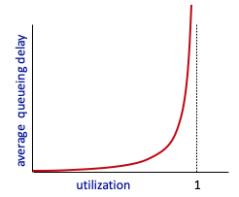


Caching example
Scenario:
access link rate: 1.54 Mbps
RTT from institutional router to server: 2 sec
web object size: 100K bits
average request rate from browsers to origin servers: 15/sec
  avg data rate to browsers: 1.50 Mbps
origin
servers
public
Internet
1.54 Mbps
access link
Performance:
access link utilization = .97
LAN utilization: .0015
end-end delay = Internet delay +
access link delay + LAN delay
= 2 sec + minutes + usecs
problem: large queueing delays at high utilization!
institutional
network
1 Gbps LAN
Notes:
explain why minutes (recall earlier delay versus arrival rate curve from Chapter 1)

Slide 43
Option 1: buy a faster access link
Scenario:
access link rate: 1.54 Mbps
RTT from institutional router to server: 2 sec
web object size: 100K bits
average request rate from browsers to origin servers: 15/sec
  avg data rate to browsers: 1.50 Mbps
154 Mbps
origin
servers
public
Internet
154 Mbps
1.54 Mbps
access link
Performance:
access link utilization = .97
LAN utilization: .0015
end-end delay = Internet delay +
access link delay + LAN delay
= 2 sec + minutes + usecs
.0097
institutional
network
1 Gbps LAN
Cost: faster access link (expensive!)
msecs
Notes:
t’

Slide 44
Option 2: install a web cache
Scenario:
access link rate: 1.54 Mbps
RTT from institutional router to server: 2 sec
web object size: 100K bits
average request rate from browsers to origin servers: 15/sec
  avg data rate to browsers: 1.50 Mbps
origin
servers
public
Internet
1.54 Mbps
access link
Cost: web cache (cheap!)
institutional
network
Performance:
LAN utilization: .?
access link utilization = ?
average end-end delay = ?
1 Gbps LAN
How to compute link
utilization, delay?
local web cache
Notes:
t’

Slide 45
Calculating access link utilization, end-end delay with cache:
suppose cache hit rate is 0.4:
40% requests served by cache, with low (msec) delay
origin
servers
public
Internet
60% requests satisfied at origin
  rate to browsers over access link
  = 0.6 * 1.50 Mbps = .9 Mbps
  access link utilization = 0.9/1.54 = .58 means low (msec) queueing delay at access link
1.54 Mbps
access link
institutional
network
average end-end delay:
  = 0.6 * (delay from origin servers)
  + 0.4 * (delay when satisfied at cache)
  = 0.6 (2.01) + 0.4 (~msecs) = ~ 1.2 secs
1 Gbps LAN
local web cache
lower average end-end delay than with 154 Mbps link (and cheaper too!)
Notes:
t’

Slide 46
Browser caching: Conditional GET
client
server
Goal: don’t send object if browser has up-to-date cached version
  no object transmission delay (or use of network resources)
client: specify date of browser-cached copy in HTTP request
  If-modified-since: <date>
server: response contains no object if browser-cached copy is up-to-date:
  HTTP/1.0 304 Not Modified
HTTP request msg
If-modified-since: <date>
object
not
modified
before
<date>
HTTP response
HTTP/1.0
304 Not Modified
HTTP request msg
If-modified-since: <date>
object
modified
after
<date>
HTTP response
HTTP/1.0 200 OK
<data>
Notes:
t’

Slide 47
HTTP/2
Key goal: decreased delay in multi-object HTTP requests
HTTP1.1: introduced multiple, pipelined GETs over single TCP connection
server responds in-order (FCFS: first-come-first-served scheduling) to GET requests
with FCFS, small object may have to wait for transmission (head-of-line (HOL) blocking) behind large object(s)
loss recovery (retransmitting lost TCP segments) stalls object transmission
Notes:
t’

Slide 48
HTTP/2
Key goal: decreased delay in multi-object HTTP requests
HTTP/2: [RFC 7540, 2015] increased flexibility at server in sending objects to client:
methods, status codes, most header fields unchanged from HTTP 1.1
transmission order of requested objects based on client-specified object priority (not necessarily FCFS)
push unrequested objects to client
divide objects into frames, schedule frames to mitigate HOL blocking
Notes:
t’

Slide 49
HTTP/2: mitigating HOL blocking
HTTP 1.1: client requests 1 large object (e.g., video file) and 3 smaller objects
server
GET O₄
GET O₃
GET O₂
GET O₁
object data requested
client
O₁
O₂
O₁
O₃
O₂
O₃
O₄
O₄
objects delivered in order requested: O₂, O₃, O₄ wait behind O₁
Notes:
t’

Slide 50
HTTP/2: mitigating HOL blocking
HTTP/2: objects divided into frames, frame transmission interleaved
server
GET O₄
GET O₃
GET O₂
GET O₁
object data requested
client
O₂
O₄
O₃
O₁
O₂
O₃
O₄
O₁
O₂, O₃, O₄ delivered quickly, O₁ slightly delayed
Notes:
shortest job first: decreased average delay!

Slide 51
HTTP/2 to HTTP/3
HTTP/2 over single TCP connection means:
recovery from packet loss still stalls all object transmissions
  as in HTTP 1.1, browsers have incentive to open multiple parallel TCP connections to reduce stalling, increase overall throughput
no security over vanilla TCP connection
HTTP/3: adds security, per object error- and congestion-control (more pipelining) over UDP
  more on HTTP/3 in transport layer
Notes:
t’

Slide 52

Application layer: overview
P2P applications
video streaming and content distribution networks
socket programming with UDP and TCP
Principles of network applications
Web and HTTP
E-mail, SMTP, IMAP
The Domain Name System DNS

Slide 53
E-mail
user
agent
Three major components:
user agents
mail servers
simple mail transfer protocol: SMTP
User Agent
a.k.a. “mail reader”
composing, editing, reading mail messages
e.g., Outlook, iPhone mail client
outgoing, incoming messages stored on server
mail
server
user
agent
SMTP
mail
server
user
agent
SMTP
SMTP
user
agent
mail
server
user
agent
user
agent
outgoing
message queue
user mailbox

Slide 54
E-mail: mail servers
user
agent
mail servers:
mailbox contains incoming messages for user
message queue of outgoing (to be sent) mail messages
SMTP protocol between mail servers to send email messages
client: sending mail server
“server”: receiving mail server
mail
server
user
agent
SMTP
mail
server
user
agent
SMTP
SMTP
user
agent
mail
server
user
agent
user
agent
outgoing
message queue
user mailbox

Slide 55
SMTP RFC (5321)
“client”
SMTP server
“server”
SMTP server
uses TCP to reliably transfer email message from client (mail server initiating connection) to server, port 25
  direct transfer: sending server (acting like client) to receiving server
three phases of transfer
  SMTP handshaking (greeting)
  SMTP transfer of messages
  SMTP closure
command/response interaction (like HTTP)
  commands: ASCII text
  response: status code and phrase
initiate TCP
connection
RTT
TCP connection
initiated
Service ready
220
SMTP handshaking
HELO
250 Hello
SMTP transfers
time

Slide 56


Scenario: Alice sends e-mail to Bob
1) Alice uses UA to compose e-mail message “to” bob@someschool.edu
4) SMTP client sends Alice’s message over the TCP connection
2) Alice’s UA sends message to her mail server using SMTP; message placed in message queue
5) Bob’s mail server places the message in Bob’s mailbox
3) client side of SMTP at mail server opens TCP connection with Bob’s mail server
6) Bob invokes his user agent to read message
user
agent
mail
server
user
agent
1
mail
server
2
3
6
4
Alice’s mail server
5
Bob’s mail server

Slide 57
Sample SMTP interaction
220 <domain> Service ready
S: 220 hamburger.edu
C: HELO crepes.fr
S: 250 Hello crepes.fr, pleased to meet you
C: MAIL FROM: <alice@crepes.fr>
S: 250 alice@crepes.fr... Sender ok
C: RCPT TO: <bob@hamburger.edu>
S: 250 bob@hamburger.edu ... Recipient ok
C: DATA
S: 354 Enter mail, end with "." on a line by itself
C: Do you like ketchup?
C: How about pickles?
C: .
S: 250 Message accepted for delivery
C: QUIT
S: 221 hamburger.edu closing connection
Notes:
250 Requested mail action okay, completed
The SMTP HELO clause is the stage of the SMTP protocol where a SMTP server introduce them selves to each other

Slide 58
SMTP: observations
comparison with HTTP:
HTTP: client pull
SMTP: client push
both have ASCII command/response interaction, status codes
HTTP: each object encapsulated in its own response message
SMTP: multiple objects sent in multipart message
SMTP uses persistent connections
SMTP requires message (header & body) to be in 7-bit ASCII
SMTP server uses CRLF.CRLF to determine end of message

Slide 59
Mail message format
SMTP: protocol for exchanging e-mail messages, defined in RFC 5321 (like RFC 7231 defines HTTP)
RFC 2822 defines syntax for e-mail message itself (like HTML defines syntax for web documents)
header lines, e.g.,
  To:
  From:
  Subject:
  these lines, within the body of the email message area different from SMTP MAIL FROM:, RCPT TO: commands!
Body: the “message” , ASCII characters only
header
blank
line
body

Slide 60
Retrieving email: mail access protocols
user
agent
e-mail access
protocol
user
agent
SMTP
SMTP
(e.g., IMAP, HTTP)
sender’s e-mail
server
receiver’s e-mail
server
SMTP: delivery/storage of e-mail messages to receiver’s server
mail access protocol: retrieval from server
  IMAP: Internet Mail Access Protocol [RFC 3501]: messages stored on server, IMAP provides retrieval, deletion, folders of stored messages on server
HTTP: gmail, Hotmail, Yahoo!Mail, etc. provides web-based interface on top of STMP (to send), IMAP (or POP) to retrieve e-mail messages

Slide 61
Application Layer: Overview
P2P applications
video streaming and content distribution networks
socket programming with UDP and TCP
Principles of network applications
Web and HTTP
E-mail, SMTP, IMAP
The Domain Name System DNS

Slide 62
DNS: Domain Name System
people: many identifiers:
  SSN, name, passport #
Internet hosts, routers:
  IP address (32 bit) - used for addressing datagrams
  “name”, e.g., cs.umass.edu - used by humans
Q: how to map between IP address and name, and vice versa ?
Domain Name System (DNS):
distributed database implemented in hierarchy of many name servers
application-layer protocol: hosts, DNS servers communicate to resolve names (address/name translation)
  note: core Internet function, implemented as application-layer protocol
  complexity at network’s “edge”

Slide 63
DNS: services, structure
DNS services:
hostname-to-IP-address translation
host aliasing
  canonical, alias names
mail server aliasing
load distribution
  replicated Web servers: many IP addresses correspond to one name
Q: Why not centralize DNS?
single point of failure
traffic volume
distant centralized database
maintenance
A: doesn‘t scale!
Comcast DNS servers alone: 600B DNS queries/day
Akamai DNS servers alone: 2.2T DNS queries/day

Slide 64
Host aliasing
Host aliasing in DNS (Domain Name System) is typically achieved using CNAME (Canonical Name) records.
This allows one domain name to be an alias for another, meaning that one domain points to the canonical (true) name or another domain, rather than an IP address directly.

Slide 65
How Host Aliasing Works
CNAME Record: A CNAME record is used to map an alias (or alternative name) to a true or canonical domain name.
  Example: Suppose you have two domain names, example.com (canonical name) and www.example.com (alias). The CNAME record for www.example.com could point to example.com, meaning www.example.com is an alias for example.com.

Slide 66
Benefits of Host Aliasing
Flexibility: If the canonical domain's IP changes, you only need to update the DNS record for the canonical domain. All aliases (CNAMEs) will automatically resolve to the new IP.
Ease of Management: It's easier to manage multiple domain names or subdomains pointing to the same service (like a website or application) by using a single canonical name.
Load Distribution: CNAMEs can be used with load balancers or content delivery networks (CDNs) to distribute traffic across multiple servers.

Slide 67

Example
Let’s say you have:
  www.example.com (the alias)
  server1.example.com (the canonical name)
If you set a CNAME record like this:
When someone accesses www.example.com, DNS will resolve it to server1.example.com, and then it resolves server1.example.com to its actual IP address (e.g., 192.0.2.1

Slide 68

Thinking about the DNS
humongous distributed database:
~ billion records, each simple
handles many trillions of queries/day:
many more reads than writes
performance matters: almost every Internet transaction interacts with DNS - msecs count!
organizationally, physically decentralized:
millions of different organizations responsible for their records
“bulletproof”: reliability, security
Notes:
Humongous: khổng lồ
Trillions: hàng nghìn tỉ

Slide 69
DNS: a distributed, hierarchical database
Root DNS Servers
Root
…
…
.com DNS servers
.org DNS servers
.edu DNS servers
Top Level Domain
…
…
…
…
yahoo.com
DNS servers
amazon.com
DNS servers
pbs.org
DNS servers
nyu.edu
DNS servers
umass.edu
DNS servers
Authoritative
Client wants IP address for www.amazon.com; 1st approximation:
client queries root server to find .com DNS server
client queries .com DNS server to get amazon.com DNS server
client queries amazon.com DNS server to get IP address for www.amazon.com
Notes:
Authoritative: có thẩm quyền

Slide 70
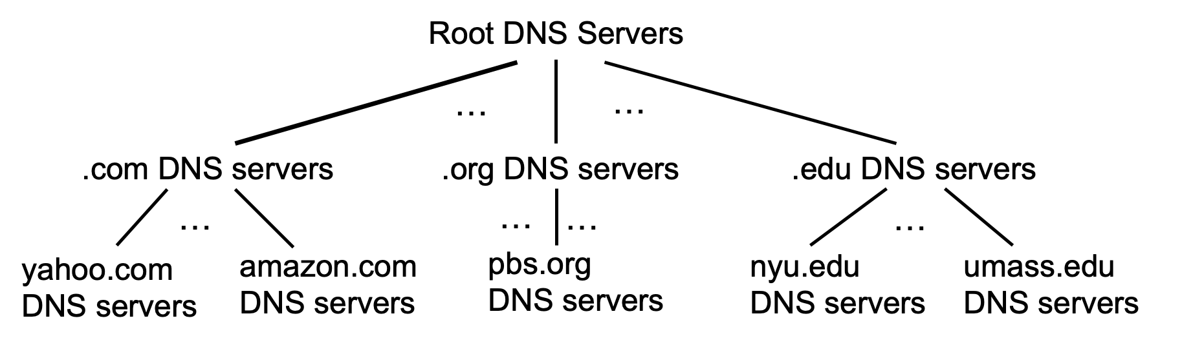
DNS: root name servers
official, contact-of-last-resort by name servers that can not resolve name

Slide 71
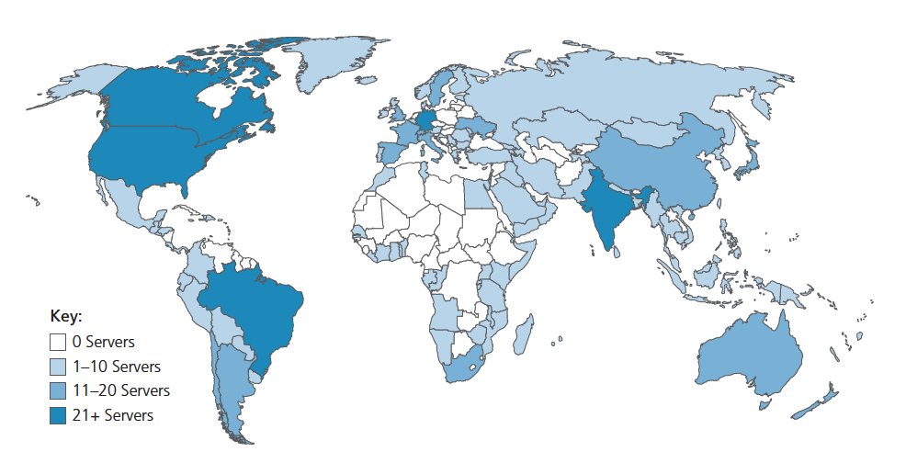
DNS: root name servers
official, contact-of-last-resort by name servers that can not resolve name
incredibly important Internet function
  Internet couldn’t function without it!
  DNSSEC – provides security (authentication, message integrity)
ICANN (Internet Corporation for Assigned Names and Numbers) manages root DNS domain
13 logical root name “servers” worldwide each “server” replicated many times (~200 servers in US)

Slide 72
Top-Level Domain, and authoritative servers
Top-Level Domain (TLD) servers:
  responsible for .com, .org, .net, .edu, .aero, .jobs, .museums, and all top-level country domains, e.g.: .cn, .uk, .fr, .ca, .jp
  Network Solutions: authoritative registry for .com, .net TLD
  Educause: .edu TLD
authoritative DNS servers:
  organization’s own DNS server(s), providing authoritative hostname to IP mappings for organization’s named hosts
  can be maintained by organization or service provider

Slide 73
Local DNS name servers
when host makes DNS query, it is sent to its local DNS server
  Local DNS server returns reply, answering:
    from its local cache of recent name-to-address translation pairs (possibly out of date!)
    forwarding request into DNS hierarchy for resolution
  each ISP has local DNS name server; to find yours:
    MacOS: % scutil --dns
    Windows: >ipconfig /all
local DNS server doesn’t strictly belong to hierarchy

Slide 74
DNS name resolution: iterated query
root DNS server
Example: host at engineering.nyu.edu wants IP address for gaia.cs.umass.edu
2
3
TLD DNS server
Iterated query:
contacted server replies with name of server to contact
“I don’t know this name, but ask this server”
1
4
8
5
requesting host at
engineering.nyu.edu
local DNS server
dns.nyu.edu
gaia.cs.umass.edu
7
6
authoritative DNS server
dns.cs.umass.edu
Notes:
Iterated: lặp lại

Slide 75
DNS name resolution: recursive query
root DNS server
Example: host at engineering.nyu.edu wants IP address for gaia.cs.umass.edu
2
3
7
6
Recursive query:
puts burden of name resolution on contacted name server
heavy load at upper levels of hierarchy?
1
TLD DNS server
8
requesting host at
engineering.nyu.edu
local DNS server
dns.nyu.edu
5
4
gaia.cs.umass.edu
authoritative DNS server
dns.cs.umass.edu

Slide 76
Caching DNS Information
once (any) name server learns mapping, it caches mapping, and immediately returns a cached mapping in response to a query
  caching improves response time
  cache entries timeout (disappear) after some time (TTL)
  TLD servers typically cached in local name servers
cached entries may be out-of-date
  if named host changes IP address, may not be known Internet-wide until all TTLs expire!
  best-effort name-to-address translation!

Slide 77
DNS records
DNS: distributed database storing resource records (RR)
RR format: (name, value, type, ttl)
type=A
  name is hostname
  value is IP address
type=CNAME
  name is alias name for some “canonical” (the real) name
  www.ibm.com is really servereast.backup2.ibm.com
  value is canonical name
type=NS
  name is domain (e.g., foo.com)
  value is hostname of authoritative name server for this domain
type=MX
  value is name of SMTP mail server associated with name

Slide 78
DNS protocol messages
DNS query and reply messages, both have same format:
2 bytes
2 bytes
message header:
identification: 16 bit # for query, reply to query uses same #
flags:
  query or reply
  recursion desired
  recursion available
  reply is authoritative
identification
flags
# questions
# answer RRs
# authority RRs
# additional RRs
questions (variable # of questions)
answers (variable # of RRs)
authority (variable # of RRs)
additional info (variable # of RRs)

Slide 79
DNS protocol messages
DNS query and reply messages, both have same format:
2 bytes
2 bytes
identification
flags
# questions
# answer RRs
# authority RRs
# additional RRs
name, type fields for a query
questions (variable # of questions)
RRs in response to query
answers (variable # of RRs)
records for authoritative servers
authority (variable # of RRs)
additional “ helpful” info that may be used
additional info (variable # of RRs)

Slide 80
Getting your info into the DNS
example: new startup “Network Utopia”
register name networkuptopia.com at DNS registrar (e.g., Network Solutions)
  provide names, IP addresses of authoritative name server (primary and secondary)
  registrar inserts NS, A RRs into .com TLD server:
  (networkutopia.com, dns1.networkutopia.com, NS)
  (dns1.networkutopia.com, 212.212.212.1, A)
create authoritative server locally with IP address 212.212.212.1
  type A record for www.networkuptopia.com
  type MX record for networkutopia.com

Slide 81
DNS security
DDoS attacks
bombard root servers with traffic
  not successful to date
  traffic filtering
  local DNS servers cache IPs of TLD servers, allowing root server bypass
bombard TLD servers
  potentially more dangerous
Spoofing attacks
intercept DNS queries, returning bogus replies
  DNS cache poisoning
  RFC 4033: DNSSEC authentication services

