Slide 1
Introduction to awk
Arun Vishwanathan
Nevis Networks Pvt. Ltd.

Slide 2
Agenda
What is awk ??
awk versions
A few basic things about AWK
Program Structure in awk.
A simple example.
Running awk programs.
Advanced awk features.
Awk examples.
Advantages of AWK.
awk References.

Slide 3
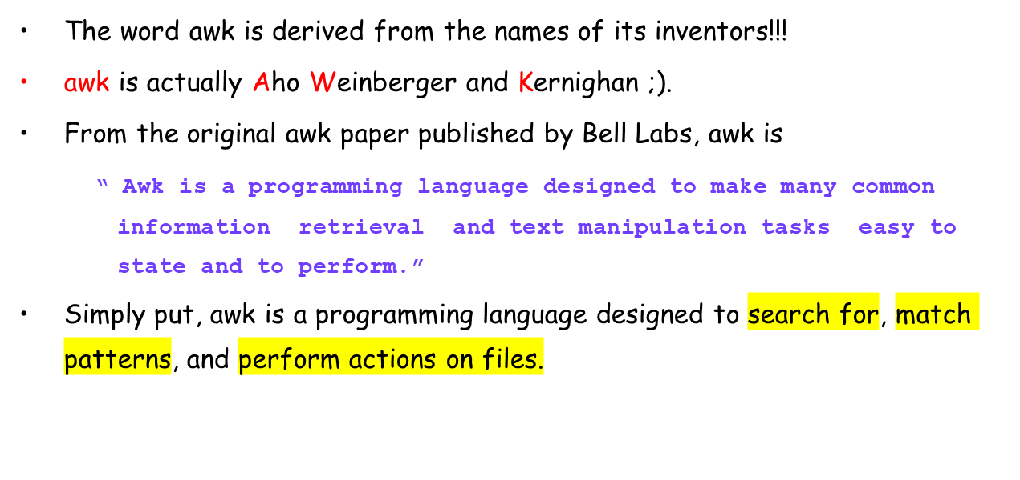
What is awk ??

Slide 4
awk Versions
awk – Original Bell Labs awk (Version 7 UNIX, around 1978) + latest POSIX
awk.
nawk – New awk (released with SVR4 around 1989)
gawk – GNU implementation of awk standard.
mawk – Michael’s awk.
……… and the list goes on.
All these are basically same except for some minor differences in features
provided. This presentation will assume the widely used POSIX awk (also
called “awk”).

Slide 5
A few basic things about awk
awk reads from a file or from its standard input, and outputs to its standard output.
awk recognizes the concepts of "file“99 , "record" and "field".
A file consists of records, which by default are the lines of the file. One line becomes one record.
awk operates on one record at a time.
A record consists of fields, which by default are separated by any number of spaces or tabs.
Field number 1 is accessed with $1, field 2 with $2, and so forth. $0 refers to the whole record.

Slide 6
Program Structure in Awk
An awk program is a sequence of statements of the form:
  pattern { action }
  pattern { action }
  ...
pattern in front of an action acts as a selector that determines whether the action is to be executed.
Patterns can be : regular expressions, arithmetic relational expressions, string-valued expressions, and arbitrary boolean combinations of these.

Slide 7
Program Structure in awk (cont..)
action is a sequence of action statements terminated by newlines or semicolons.
These action statements can be used to do a variety of bookkeeping and string manipulating tasks.
awk programs can either be written in a file or they can be written on the command line itself.

Slide 8
A simple example
Problem : Get the userid of user “arun” from the /etc/passwd file.
Suppose /etc/passwd file contains the following entries
arun:x:504:504::/home/arun:/bin/bash
try:x:500:500::/home/try:/bin/bash
optima:x:501:501::/home/optima:/bin/bash
optimal:x:502:502::/home/optimal:/bin/bash
awk will see this file as follows
  1 line = 1 record (by default) so in total there are 4 records in the file.
  1 record = 7 fields separated by “:” (Not by default)
  Note : Default field separator is space.

Slide 9
A simple example (cont..)
$ awk –F”:” ‘/arun/ {print $1 “ “ $3}’ /etc/passwd
Awk
executable
Field
Separator
Action to
perform on line
If pattern matches
pattern
to search
The file
to operate
upon

Slide 10
A simple example (cont..)
The output of the above command will be
[root@tux root]# awk -F":" ‘/arun/ {print $1 " " $3}’ /etc/passwd
arun 504
[root@tux root]#
Another way to write the command is
[root@tux root]# awk ‘BEGIN { FS=“:” } /arun/ {print $1 " " $3}’ /etc/passwd
arun 504
[root@tux root]#

Slide 11
Running awk programs
There are four ways in which we can run awk programs
One-shot: Running a short throw-away awk program.
$ awk 'program' input-file1 input-file2
... where program consists of a series of patterns and actions.
Read Terminal: Using no input files (input from terminal instead).
$ awk 'program' <ENTER>
<input lines>
<input lines>
ctrl-d
Long: Putting permanent awk programs in files.
$ awk -f source-file input-file1 input-file2 ...

Slide 12
Running awk programs (cont..)
Executable Scripts: Making self-contained awk programs.
(eg) : Write a script named hello with the following contents
#! /bin/awk -f
# a sample awk program
/foo/ { print $1}
Execute the following command
$ chmod +x hello
To run this script simply type
$ ./hello file.txt

Slide 13
Advanced awk features
Awk borrows a lot from the C language.
The if loop, for loop and while loop have the same constructs as in C.
Awk’s variables are stored internally as strings.
eg. x = “1.01”
x = x + 1
print x
The above will print the value 2.01
Comparison operators in awk are : "==", "<", ">", "<=", ">=", "!=“, "~" and "!~“.
“~” and “!~” operators mean "matches" and "does not match".

Slide 14
Advanced awk features (cont..)
Common Arithmetic operators in awk are : “+", “-", “/", “*“;
“^” is the exponentiation operator.
“%” is the modulo operator
All the C operators like “++”, “--”, “+=“, “-=”, “/=“ etc. are also valid.
The awk language has one-dimensional arrays for storing groups of related strings or numbers.
Arrays in awk are associative. This means that each array is a collection of pairs: an index, and its corresponding array element value.
(eg) : Element 1 value 2
Element 2 value “foo”
Element “cat” value “chicken”

Slide 15
Awk Examples
$ awk '{ print $0 }' /etc/passwd
Prints all the lines in /etc/passwd
$ awk -F":" '{ print "username: " $1 "\t\tuid:" $3" }' /etc/passwd
Prints the 1st and 3rd fields of each line in /etc/passwd. The fields are separated by “:”
$ awk –f script1.awk /etc/passwd
script1.awk
BEGIN{ x=0 }# The BEGIN block is executed before processing the file
/^$/ { x=x+1 } # For every null line increment the count
END { print "I found " x " blank lines. :)" } #Executed at the end
The above script calculates the number of null lines. Note that BEGIN and END are
special patterns.

Slide 16
Awk examples (cont..)
$ awk 'BEGIN { RS = "/" } ; { print $0 }' file1.txt
RS is the record separator (default is \n). In this example the RS is modified to “/”
and then the file is processed. So awk will distinguish between records by “/”
character.
$ awk '$1 ~ /foo/ { print $0 }' file.txt
The pattern will print out all records from file file.txt whose first fields contain the
string “foo”.
$ awk '{ print $(2*2) }' file.txt
In the above example the field number is an expression. So awk will print the 4th fields
of all the records.

Slide 17
Awk examples (cont..)
$ awk '{ $3 = $2 - 10; print $2, $3 }' inventory-shipped
This example will subtract the second field of each record by 10 and store
it in the third field.
$ awk 'BEGIN { FS = "," } ; { print $2 }' file.txt
FS is the field separator in awk. In the above example we are asking awk to
separate the fields by “,” instead of default “ “.
$ awk 'BEGIN { OFS = ";"; ORS = "\n\n" }
{ print $1, $2 }' file1.txt
OFS is the Output field Separator, ORS is Output record separator. This
prints the first and second fields of each input record separated by a
semicolon, with a blank line added after each line.

Slide 18
Awk examples (cont..)
Consider that we have the following input in a file called grades
john 85 92 78 94 88
andrea 89 90 75 90 86
jasper 84 88 80 92 84
The following awk script grades.awk will find the average
# average five grades
{ total = $2 + $3 + $4 + $5 + $6
avg = total / 5
print $1, avg }
$ awk –f grades.awk grades

Slide 19
Awk examples (cont..)
$ awk 'BEGIN { OFMT = "%d" # print numbers as integers
print 17.23 }‘
This will print 17. OFMT is the output format specifier.
$ awk –f mailerr.awk
{ report = "mail bug-system"
print "Awk script failed:", $0 | report
print "at record number", FNR, "of", FILENAME | report
close(report)
}
This script opens a pipe to the mail command and prints output into the pipe.
When the pipe is closed the mail is sent. Awk assumes that whatever comes
after the “|” symbol is a command and creates a process for it.

Slide 20
awk '{ if (NF > max) max = NF }

Slide 21
Advantages of Awk
awk is an interpreted language so you can avoid the usually lengthy edit-compile-test-debug cycle of software development .
Can be used for rapid prototyping.
The awk language is very useful for producing reports from large amounts of raw data, such as summarizing information from the output of other utility programs like ls.

Slide 22
awk references
The GNU Awk manual
Awk -- A Pattern Scanning and Processing Language (Original AWK paper)
http://www-106.ibm.com/developerworks/library/l-awk1.html
http://www-106.ibm.com/developerworks/library/l-awk2.html
http://www-106.ibm.com/developerworks/library/l-awk3.html
Sed and Awk 2nd Edition (O’reilly)

