Slide 1


Project Stage – II (417527)
Bhujbal Knowledge City
Institute of Engineering
Semester-II, A.Y.-2025-26
Project Presentation For Evaluation –I
Smart Street Light Monitoring and Fault Detection System
:: Presented By ::
Rushikesh Desale
Lokesh Bhadane
Parth Chaudhari
:: Under the Guidance of ::
Prof. Nitin Dhamale
:: Domain ::
IOT

Slide 2
Contents
Bhujbal Knowledge City
Institute of Engineering
1.Abstract
2.Literature survey
3.Problem Statement
4.Proposed System
5.Algorithm,Technical Concept
6.Relevant mathematical model associated with the project
7.Hardware/Software Requirement
8.Risk Analysis(technical risks,Operational risks, schedule risks,business risks )
9.Project Goals
10.Project Modules
11.structural diagrams (class, Object, etc)
12.UML Diagrams
13.DFD Diagram
14.software Development Process model used
15.State transition Diagram.
16.Project ModulesDesign
17.Project Module Coding
18.Test Cases
19.Results
20.Future Scope
21.Conclusion
22.References

Slide 3

Bhujbal Knowledge City
Institute of Engineering
Abstract
Street lights are an essential source of light for people, especially along walkways and streets during dark hours. In conventional systems, identifying faulty bulbs and managing energy-saving operations requires human effort and consumes time. Moreover, street lights often remain switched on at full brightness throughout the night, even when vehicle movement is low, leading to energy wastage. To address these issues, a Smart Streetlight System using IoT is proposed. This system can automatically detect faulty streetlights, send their location details to web application, and enable systematic switching along with progressive dimming based on vehicle movement. The proposed system ensures quick maintenance, reduced human intervention, and significant energy savings.
Keywords: Fault Detection, Smart Streetlight, IoT, Automation

Slide 4
Bhujbal Knowledge City
Institute of Engineering
Problem Statement
Conventional streetlights waste energy by staying ON at full brightness all night and require manual fault detection, causing delays in maintenance. There is a need for an automated IoT-based system that enables real-time fault detection, adaptive lighting control, and centralized monitoring through a web application.

Slide 5
SSSystem Architecture
Bhujbal Knowledge City
Institute of Engineering
Street Light Sensors (LDR, PIR, Current, Voltage, Temperature, Vibration)
ESP8266 Microcontroller
Sensor Data Preprocessing & Threshold Checking
Fault Detection (OFF, DIM, FLICKERING, Overheating, Pole Damage)
Data Transmission (Wi-Fi / MQTT / HTTP)
Cloud Server (Firebase / Flask)
Real-Time Data & Fault Database
Fault Classification & Status Update (ON, OFF, DIM, LOW/HIGH LIGHT)
Web Dashboard (Real-Time Monitoring)
Admin Control (ON/OFF, Dimming)
Maintenance Alerts (Dashboard / Telegram)

Slide 6
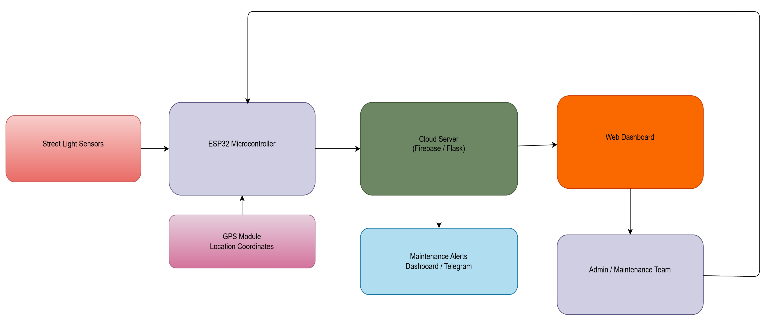
Bhujbal Knowledge City
Institute of Engineering

Slide 7
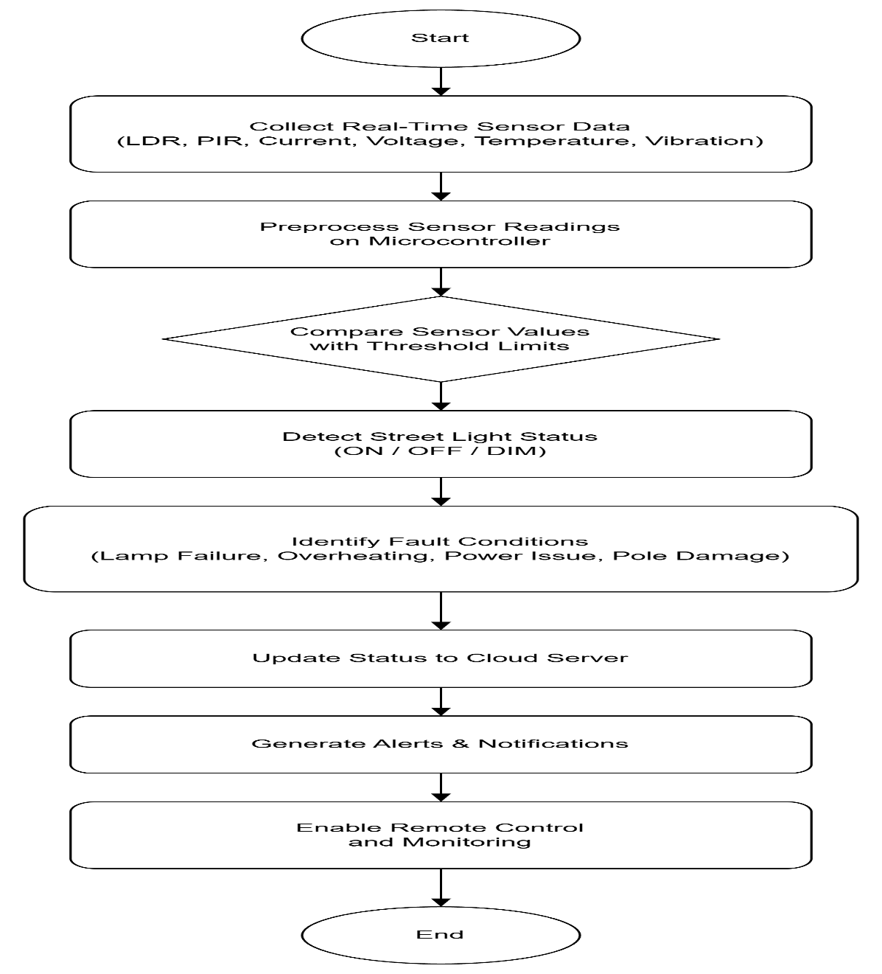
Algorithm
Bhujbal Knowledge City
Institute of Engineering
Algorithm Used
Rule-Based Decision Algorithm
Steps:
Preprocess sensor readings on the microcontroller
Compare sensor values with predefined threshold limits
Detect street light status (ON / OFF / DIM)
Identify fault conditions (lamp failure, overheating, power issue, pole damage)
Update status to cloud server.

Slide 8
Algorithm
Bhujbal Knowledge City
Institute of Engineering
6. Update status to cloud server
7. Generate alerts and notifications
8. Enable remote control and monitoring
Reason for selection: Simple implementation, fast decision-making, real-time operation, threshold-based fault detection, low computational resources, IoT suitability

Slide 9
Bhujbal Knowledge City
Institute of Engineering
Relevant mathematical model associated with the project
1. LDR Sensing Model
𝑅_{𝑓}
^{𝑉}𝑜𝑢𝑡 ^{= 𝑉}𝑐𝑐 ⋅
𝑅 + 𝑅
𝑓 𝐿𝐷𝑅
^{𝑉}𝑐𝑐
^{𝑅}𝐿𝐷𝑅 ^{= 𝑅}𝑓
− 1
^{𝑉}𝑜𝑢𝑡
→Converts LDR voltage into light intensity (lux) for automatic ON/OFF control.
2. Fault detection logic (two-LDR scheme)
Let 𝑆_{𝑎} =ambient LDR reading, 𝑆_{𝓁} =lamp-facing LDR reading (measures lamp output).
Use thresholds 𝑇_{𝑎} ambient, 𝑇_{𝓁} lamp light, Fault detection rule:
FAULT ⟺ (𝑆_{𝑎} < 𝑇_{𝑎}) ∧ (𝑆_{𝓁} < 𝑇_{𝓁})
Interpretation: it is night, but lamp output is below expected level → likely fault.
Add time confirmation 𝑡_{𝑐𝑜𝑛𝑓𝑖𝑟𝑚} :require the condition to persist for 𝑡_{𝑐𝑜𝑛𝑓𝑖𝑟𝑚}seconds to avoid false alarms:
FAULT if condition holds for 𝑡 ≥ 𝑡_{𝑐𝑜𝑛𝑓𝑖𝑟𝑚}.

Slide 10
Bhujbal Knowledge City
Institute of Engineering
Hardware/Software Requirement
Hardware Requirements
Control Units
ESP8266 Development Board
Sensors
PIR sensor – motion detection
LDR – ambient light and faulty lamp detection
RELAY – 3 Modules

Slide 11
Bhujbal Knowledge City
Institute of Engineering
Software Requirement & Specification (SRS)
Software Requirements
Embedded Development
Arduino IDE / PlatformIO (for programming ESP8266)
Telegram Bot Development
Bot Framework: Python (python-telegram-bot)
API Integration: MQTT bridge to fetch sensor data and send alerts from IoT nodes

Slide 12
Bhujbal Knowledge City
Institute of Engineering
Risk Analysis
Sensor Failure: Sensors like LDR, PIR, vibration, or temperature sensors may fail, causing streetlights to malfunction or faults to go undetected. This can be mitigated by using high-quality sensors, adding redundancy, and performing regular calibration.
Network Failure: Loss of Wi-Fi connectivity can interrupt real-time monitoring and alert delivery. Local fallback
logic, data buffering, and auto-reconnect mechanisms help reduce this risk.
Power Failure / Electrical Fluctuations: Streetlights and sensors may stop functioning due to power outages or voltage fluctuations. Surge protection and backup power systems are recommended.

Slide 13
Bhujbal Knowledge City
Institute of Engineering
Project Goals
To automatically control street lights using LDR (day/night detection) .
To implement adaptive dimming based on traffic or motion .
To reduce energy consumption by adjusting brightness levels .
To detect faults (light failure, abnormal behavior) .
To send real-time data via Wi-Fi .
To enable remote monitoring using dashboard/app .
To improve road safety with proper illumination .

Slide 14
Bhujbal Knowledge City
Institute of Engineering
Project Modules
Sensor Module (Sensing) :
Purpose: measure ambient light and lamp output.
Components: LDR , optional PIR for motion detection.
Microcontroller / Control Unit :
Purpose: read sensors, run detection logic, control dimming, and manage comms.
Components: ESP8266

Slide 15







Bhujbal Knowledge City
Institute of Engineering
Structural Diagrams
Sensor Unit
Analog/Digital signals
Controller Unit
PWM Control & Feedback
Wi-Fi/MQTT
Power & Driver
Communication Module
Power Supply &LDR Feedback
Internet Data
Cloud Platform
Street Light
API Calls
User Dashboard
19

Slide 16
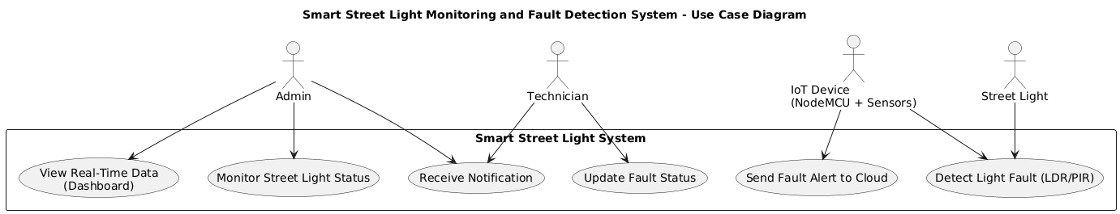
Bhujbal Knowledge City
Institute of Engineering
UML Diagrams
26

Slide 17
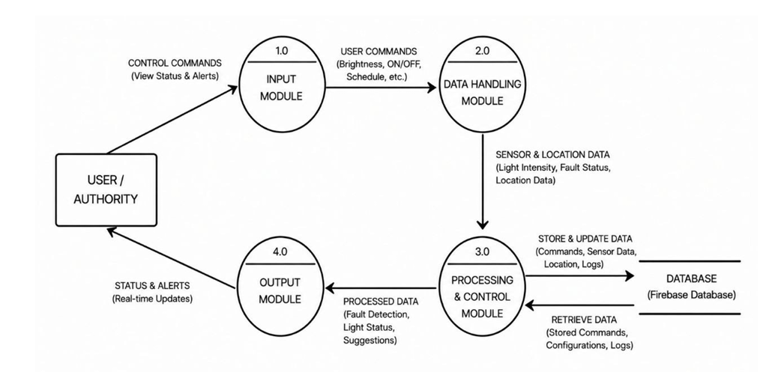
Bhujbal Knowledge City
Institute of Engineering
DFD Diagram
21

Slide 18
Software Development Process Model Used Process model used
Bhujbal Knowledge City
Institute of Engineering
Process Model Used: Incremental Development Model
Reason for Selection:
System is developed module by module (sensors, fault detection, cloud, dashboard)
Each module is designed, implemented, and tested separately
Easy to add new features like predictive maintenance later
Suitable for IoT + real-time systems
Reduces risk and allows early working prototype

Slide 19
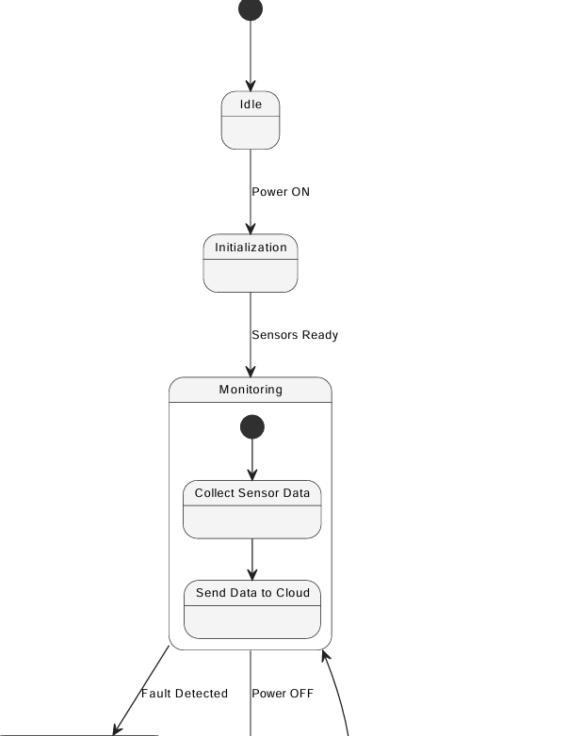
State Transition Diagram used
Bhujbal Knowledge City
Institute of Engineering

Slide 20
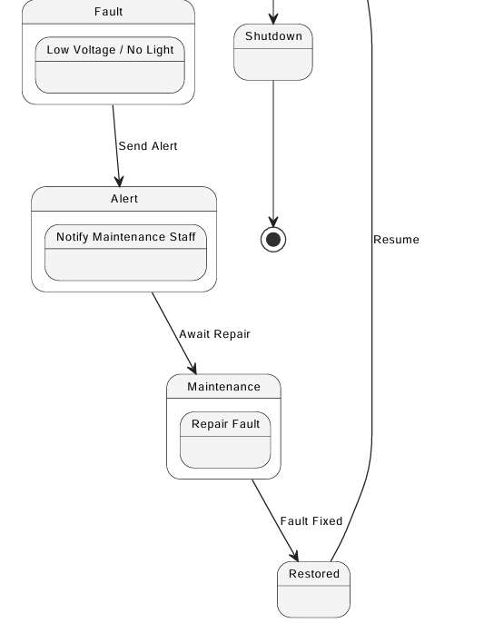
State Transition Diagram used
Bhujbal Knowledge City
Institute of Engineering

Slide 21
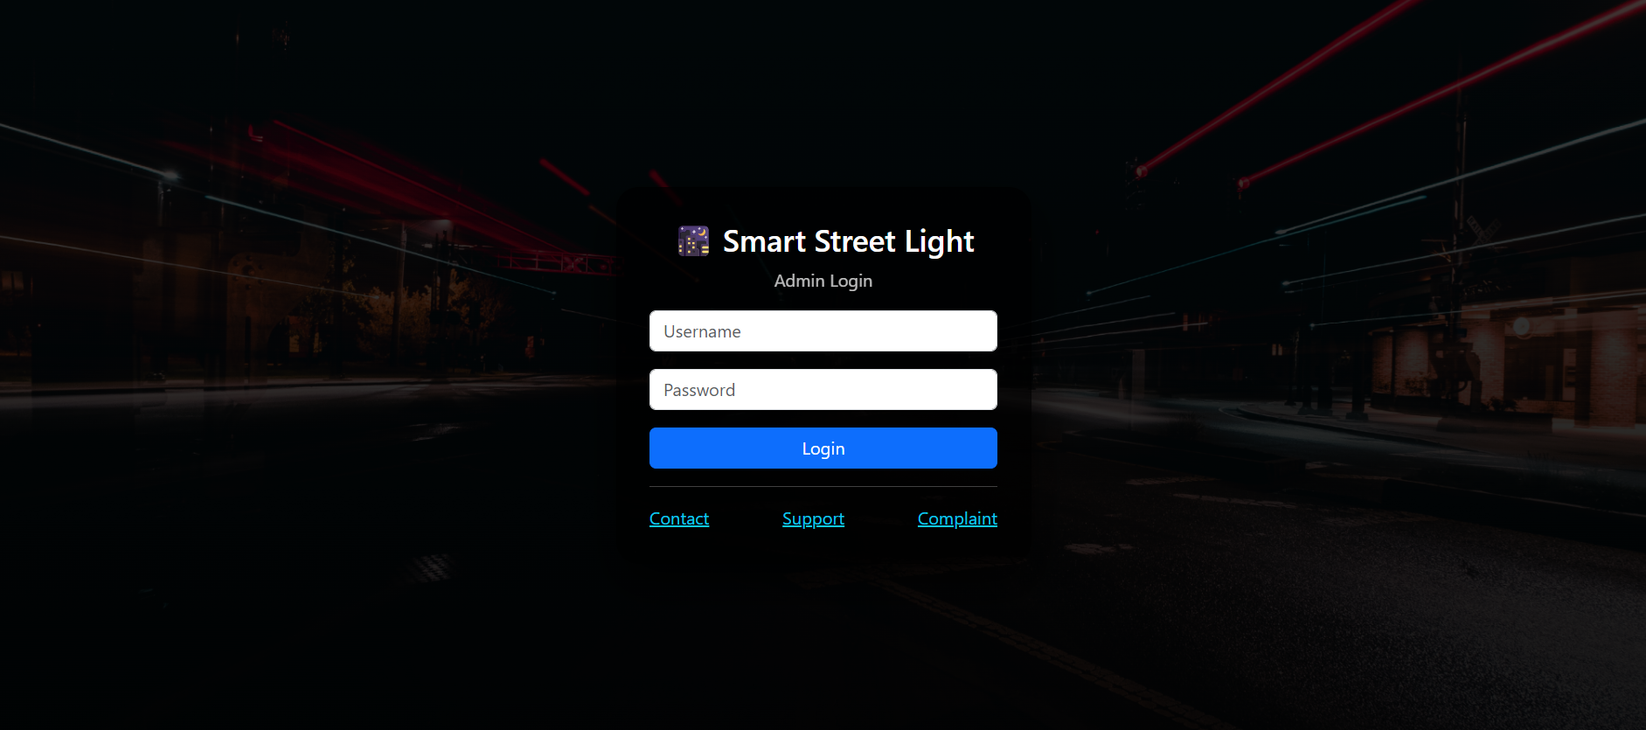
Project Modules DesignModules Design
Bhujbal Knowledge City
Institute of Engineering
Frontend (Streamlit Interface)
Admin login interface
Centralized monitoring dashboard
Total lights, lights ON, faulty lights, system status display
Individual street light status cards (ON/OFF, motion detection)
Day/Night mode indicator
Public login interface
Public services panel (Contact, Support, Raise Complaint, Logout)
Real-time status updates
Responsive and user-friendly dark theme UI

Slide 22
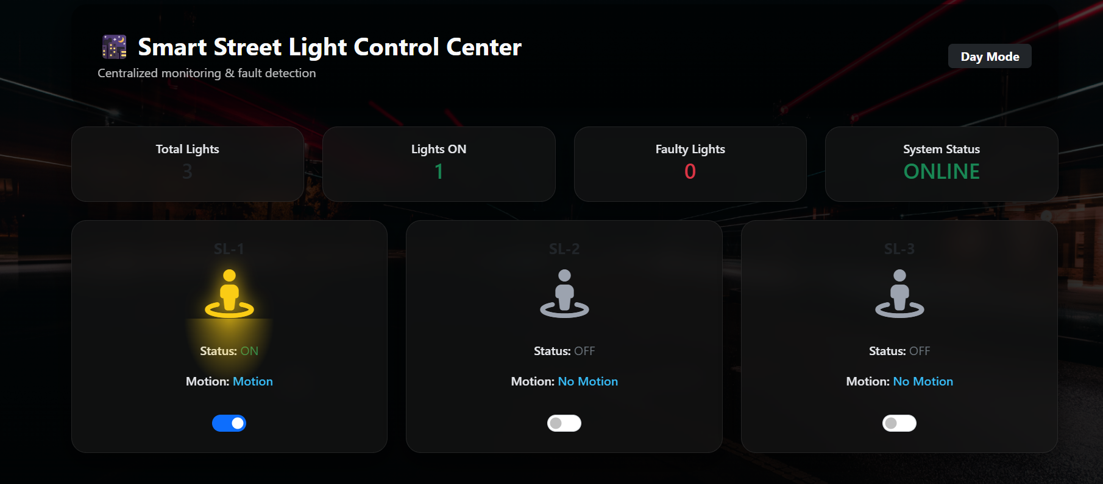


Bhujbal Knowledge City
Institute of Engineering

Slide 23
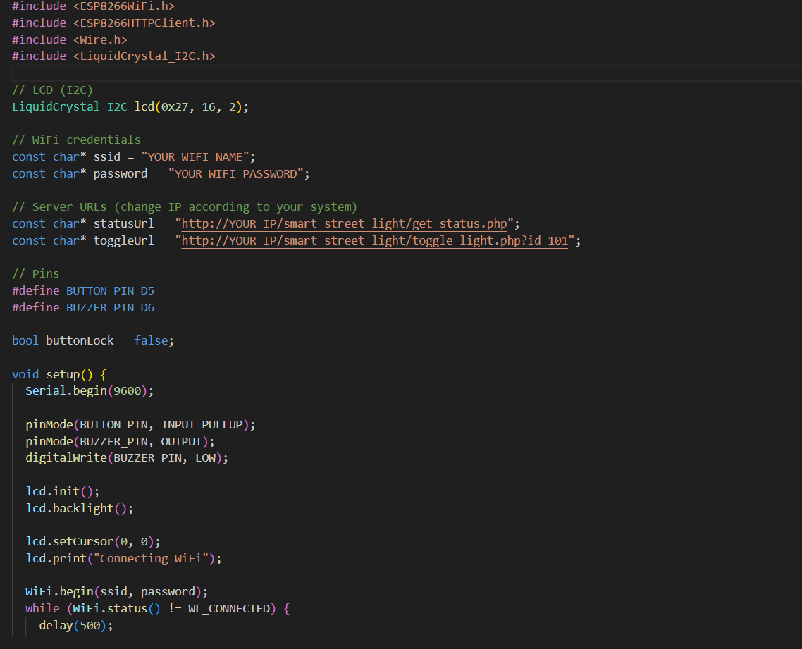
Bhujbal Knowledge City
Institute of Engineering
Backend Implementation
ESP8266 Wi-Fi based microcontroller
Wi-Fi connectivity for server communication
Fetches street light status from backend server
Displays ON / OFF / FAULT status on LCD
Sends toggle command to server on button press
Local alert generation for fault conditions
Serial monitoring for debugging and logs

Slide 24


Bhujbal Knowledge City
Institute of Engineering

Slide 25
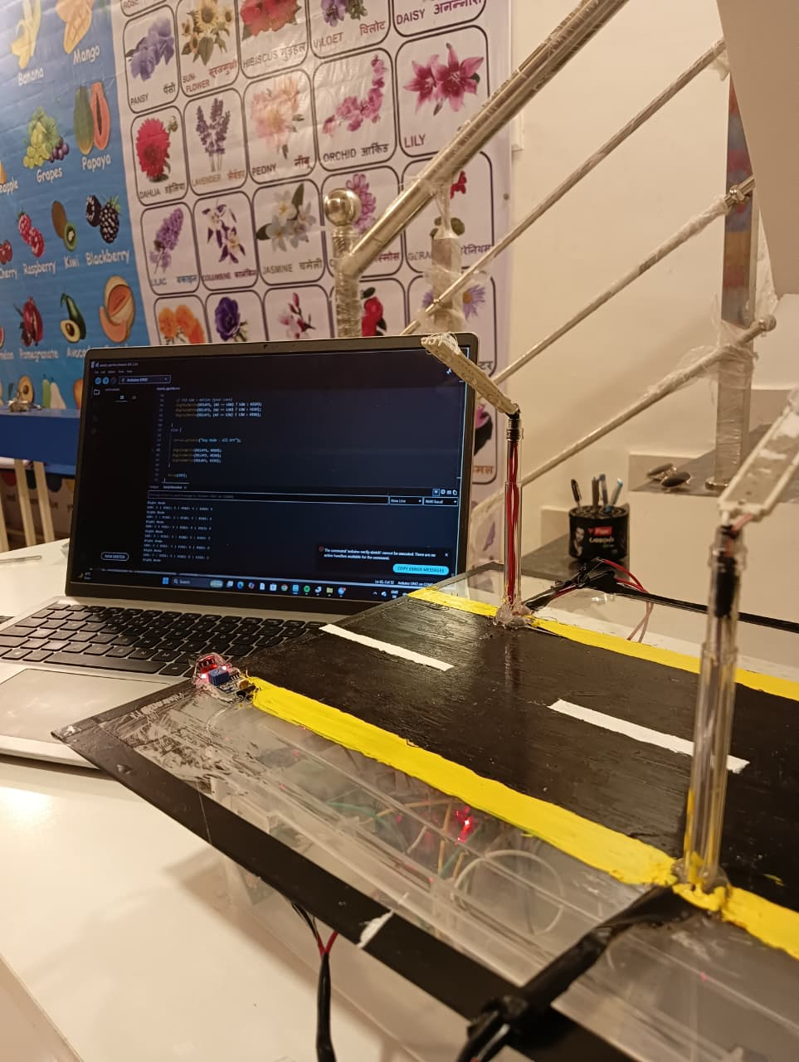
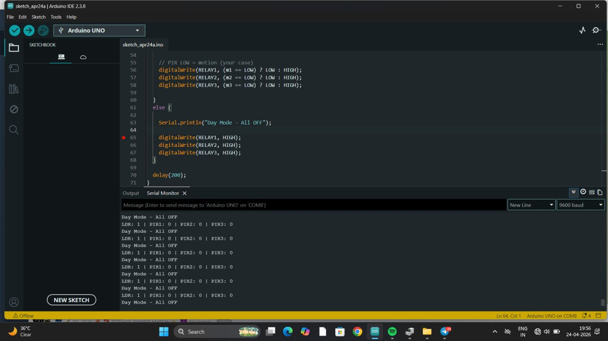
Bhujbal Knowledge City
Institute of Engineering
Test Case
Test Case 1 : when there is no activity on road Street Lights are off.

Slide 26
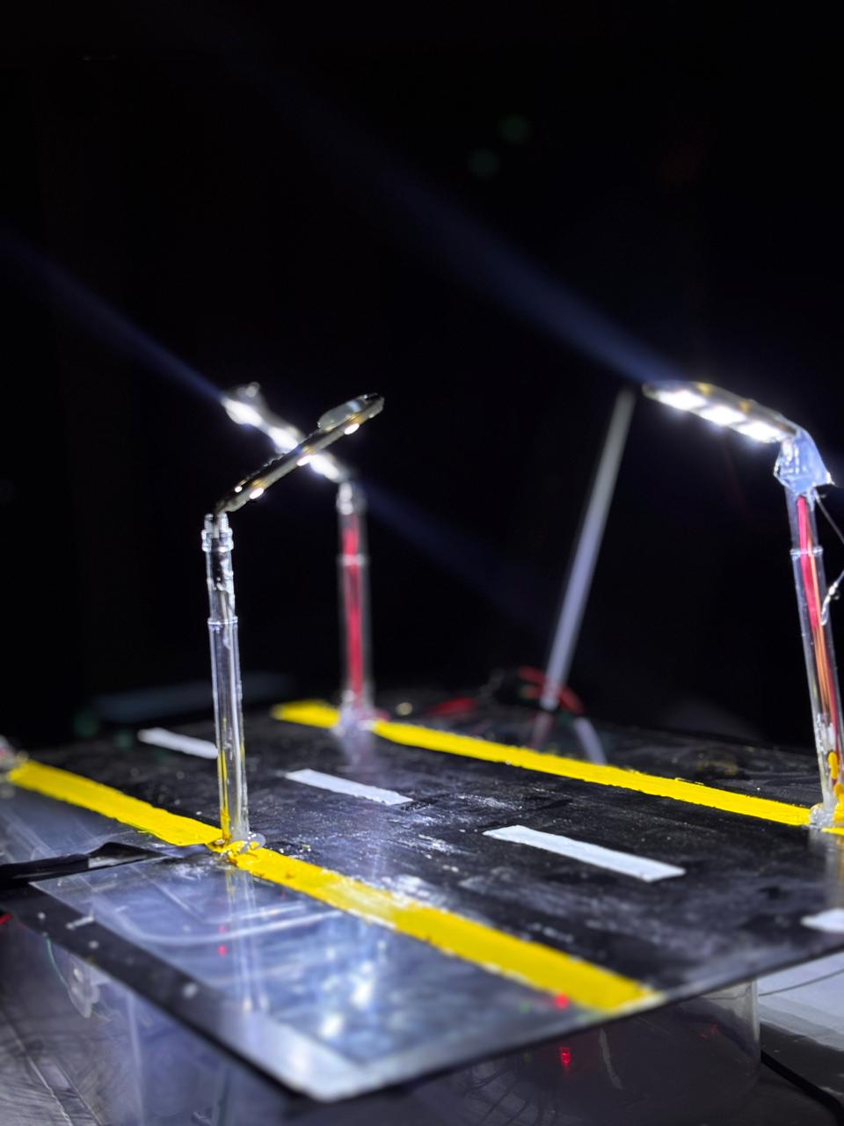
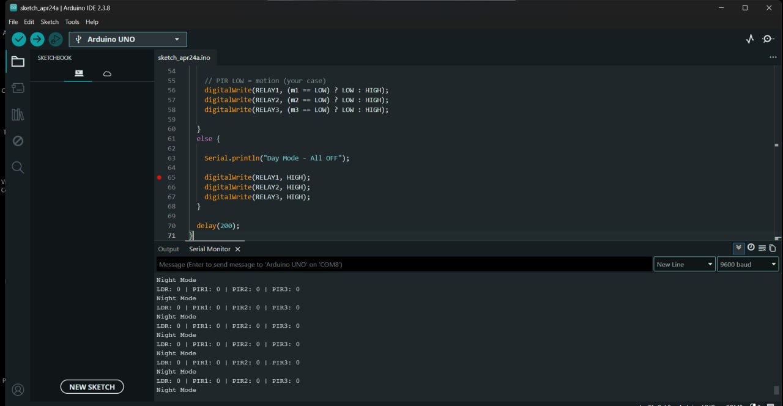
Bhujbal Knowledge City
Institute of Engineering
Test Case
Test Case 2 : When there is activity detected on road at night Street Lights are ON .

Slide 27
Bhujbal Knowledge City
Institute of Engineering
Future Scope
Integration of Machine Learning for Predictive Maintenance
In future iterations, historical sensor data (temperature, current, vibration, and brightness) can be used to train predictive models. This will allow the system to forecast potential light or circuit failures before they occur, minimizing downtime and maintenance costs.
B. Edge AI for Local Decision-Making
Implementing lightweight AI models directly on ESP32 microcontrollers can enable real-time, on-device fault classification and adaptive brightness control without constant cloud dependency.
C. Scalability and Cloud Analytics
Future development could focus on building a large-scale cloud platform for multi-city deployment, allowing central monitoring, energy analytics, and AI-based optimization.

Slide 28
Bhujbal Knowledge City
Institute of Engineering
Conclusion
The proposed Smart Street Light Monitoring and Fault Detection System successfully demonstrates the integration of IoT technology to enhance the efficiency, reliability, and automation of conventional streetlight systems. By utilizing sensors such as LDR, PIR, vibration, temperature, and current sensors, combined with an ESP32 microcontroller and cloud-based monitoring, the system ensures intelligent illumination control and real-time fault detection. The developed prototype minimizes energy wastage by dynamically adjusting the brightness of streetlights based on environmental light levels and human or vehicle movement. Additionally, the inclusion of fault detection and alert mechanisms through platforms like Firebase and Telegram bot enables faster maintenance response and reduces manual inspection requirements.This system not only supports the goal of sustainable urban development but also demonstrates the potential for smart infrastructure deployment in smart cities.

Slide 29
Bhujbal Knowledge City
Institute of Engineering
References
1. L. J. Varghese, P. SR, R. M., and R. P. E., “Energy-Efficient Smart Street Lighting with Fault Detection and Real-Time Monitoring,” in Proc. 2025 Int. Conf. Inventive Computation Technologies (ICICT), pp. 1–7, 2025,
doi: 10.1109/ICICT64420.2025.11004986.
2. S. Selvam, S. Manivannan, T. Saravanan, and R. G., “Street Light Fault Detection and Control System – Urban Glow,”
Int. J. Eng. Res. Electron. Commun. Eng. (IJERECE), vol. 11, Jul. 2024.
3. S. K. Saravanaraaj, P. Kavitha, N. Vishal, Y. Sukhi, G. S. Sriram, and Y. Jeyashree, “PV Based Sensors for Smart Street Light Fault Detection and Tracking,” in Proc. 2025 5th Int. Conf. Expert Clouds and Applications (ICOECA), 2025.

Slide 30
Bhujbal Knowledge City
Institute of Engineering
References
4. S. C. Suseendran, N. K. B and M. S. Bennet Praba (2018), "Smart Street Lighting System," in Proc. Int. Conf. Communication and Electronics Systems (ICCES), pp. 630-634, doi: 10.1109/ICCES.2018.8782454.
5. S. M. Kumthekar, T. A. Khot, A. K. Lande, P. B. Pawar, and R. S. Dalvi ,(Apr. 2024), “IoT Based Street Light Fault
Detection and Location Tracking,” Int. J. Res. Appl. Sci. Eng. Technol. (IJRASET), vol. 12, no. IV.
6. M. Kanthi and D. Ravilla, “Smart Streetlight System using Mobile Applications ,(Feb , 24 . 2024): Secured Fault Detection and Diagnosis with Optimal,” Wireless Networks, Springer, Online, doi: 10.1007/s11276-023-03210-5.
7. A. Almeida, B. Silva, and A. Pinto, “IoT-Enabled Smart Street Lighting System for Urban Energy Efficiency,” IEEE Access, Online, 2023, doi: 10.1109/ACCESS.2023.3278912.
8. R. Kumar and V. Reddy, “Smart Street Light Monitoring Using ESP32 and Cloud-Based Analytics,” Int. J. Eng. Adv. Technol. (IJEAT), Online, 2022.

Slide 31
Bhujbal Knowledge City
Institute of Engineering
References
9. M. A. Hossain et al., “A Cloud-Integrated IoT Framework for Automatic Fault Detection in Street Lighting,” Sensors, Online, 2023, doi: 10.3390/s23042011.
10. W. Zhang and L. Wang, “Energy-Efficient Street Lighting System Based on Wireless Sensor Networks,” Wireless Networks, Springer, Online, 2022, doi: 10.1007/s12652-021-03375-3.
11. Y. Chen, H. Li, and M. Zhao, “Fault Detection and Prediction in Smart Street Lighting Using Edge Computing,” IEEE Internet of Things Journal, Online, 2023, doi: 10.1109/JIOT.2023.3245671.
12. G. Sagar and A. Rao, “Automatic Street Light Control and Fault Monitoring Using IoT,” Int. J. Sci. Technol. Res. (IJSTR), Online, 2021.
13. P. Sharma and H. Bedi, “Smart Lighting System with PIR and LDR Sensors Using IoT,” Int. J. Electron. Telecommun., Online, 2023, doi: 10.24425/ijet.2023.144347.
14. R. Souza et al., “Design and Deployment of Smart Street Lighting Based on LoRaWAN,” IEEE Sensors Journal, Online, 2022, doi: 10.1109/JSEN.2022.3159876.

Slide 32

Bhujbal Knowledge City
Institute of Engineering

