Slide 1
ZIDIO – Business Consulting & Software Development
Project Title
Project FORESIGHT
Demand & Inventory Intelligence
Presented By:
Utkarsh Yogesh Chaudhari

Slide 2
Presentation Outline
Executive Summary
Business Problem
Data& Solution
Demand Forecasting
Model Performance
Inventory Risk Intelligence
Risk Scoring screenshot.
Decisioning & Recommended Actions
Financial Impact
Dashboard & Deployment
Dashboard screenshot
Recommendations
Limitations & Next Steps
Conclusion

Slide 3

Key Business Output
Executive Summary
Business Impact
Identify products at risk of stockout before inventory is exhausted.
Identify overstocked products that may require markdown or clearance.
Prioritize inventory decisions using forecast demand and current inventory position.
Quantify potential Sales at Risk and Capital Locked in rupees.
Provide actionable recommendations through an interactive planning dashboard.
Best forecasting model: LightGBM
Seasonal Naive WAPE: 12.17%
LightGBM WAPE: 8.11%
Improvement over baseline: 33.39%
Demand Forecast
Risk Detection
Impact
Business Action

Slide 4
KEY BUSINESS IMPACT
NOT YET QUANTIFIED
SALES AT RISK
Potential revenue exposed
to stockout conditions
NOT YET QUANTIFIED
CAPITAL LOCKED
Estimated value of excess
inventory at risk
33.39%
FORECAST IMPROVEMENT
vs Seasonal Naive baseline
KEY RECOMMENDED ACTIONS
Reorder high stockout-risk SKUs
Markdown / clear high-overstock SKUs
Monitor volatile SKUs closely
Prioritize decisions by financial impact

Slide 5

NorthBay Living currently faces two major inventory problems:
Business Problem
Stockout
Overstock
High-demand products can run out of stock.
Lost sales and customer dissatisfaction.
Planning teams need early warning before stock reaches critical levels.
Slow-moving products remain in inventory.
Cash becomes locked in unsold inventory.
Products may eventually require markdowns.

Slide 6

Business Need
A single system that answers:
What will we sell?
Which products are at risk?
What should we reorder?
What should we clear or markdown?
Which products require no immediate action?

Slide 7
Data & Solution
Data Sources :-
sales_daily.csv
sku_master.csv
calendar.csv
inventory_snapshots.csv
Data Coverage :-
200 SKUs
105 weeks of historical data
Daily sales and periodic inventory information
Solution Flow :-
Raw Data
Data Cleaning & Validation
Feature Engineering
Demand Forecasting
Risk Scoring
Business Impact Calculation
Dashboard & API

Slide 8
Objective
Demand Forecasting
Generate weekly SKU-level demand forecasts.
Forecasting Approach :-
Seasonal Naive baseline
Feature engineering using:
Lag features
Rolling statistics
Calendar/seasonality features
Promotion signals
Machine-learning forecasting models
Rolling-origin backtesting
Models Evaluated :-
Seasonal Naïve
XGBoost
LightGBM
Selected Model
LightGBM
The model was selected because it achieved the lowest WAPE among the evaluated approaches.

Slide 9
Model Performance
12.17% Seasonal Naive
8.11%
LightGBM
33.39%
IMPROVEMENT vs BASELINE
Model | WAPE
Seasonal Naive Baseline | 12.17%
XGBoost | 8.53%
LightGBM | 8.11%
Key Result
LightGBM reduced WAPE from 12.17% to 8.11%,achieving a 33.39% improvement over the Seasonal Naive baseline.
Improvement over Seasonal Naive: 33.39%
This demonstrates that the selected forecasting approach provides a measurable improvement over the required baseline.
Validation Approach
Rolling-origin cross-validation
Time-aware evaluation
Seasonal Naive baseline comparison
No random train/test split for time-series evaluation

Slide 10
The system converts forecast demand and inventory position into actionable risk categories.
Inventory Risk Intelligence
Stockout Risk
Overstock Risk
Compares:
Forecast Demand during Lead Time
With
On-hand + On-order Inventory
If projected inventory becomes insufficient, the SKU is identified as a potential stockout risk.
Compares:
Current On-hand Inventory
With
Expected Future Demand
If inventory is substantially higher than expected demand,
the SKU is identified as overstock risk.

Slide 11
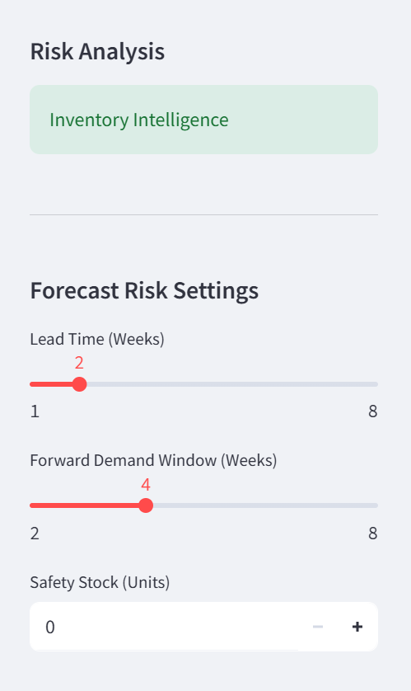
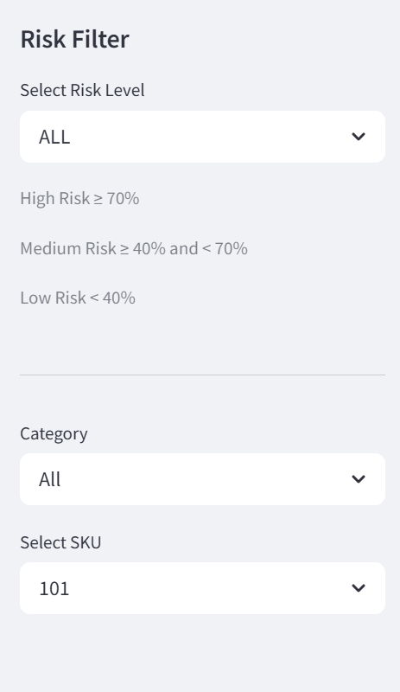
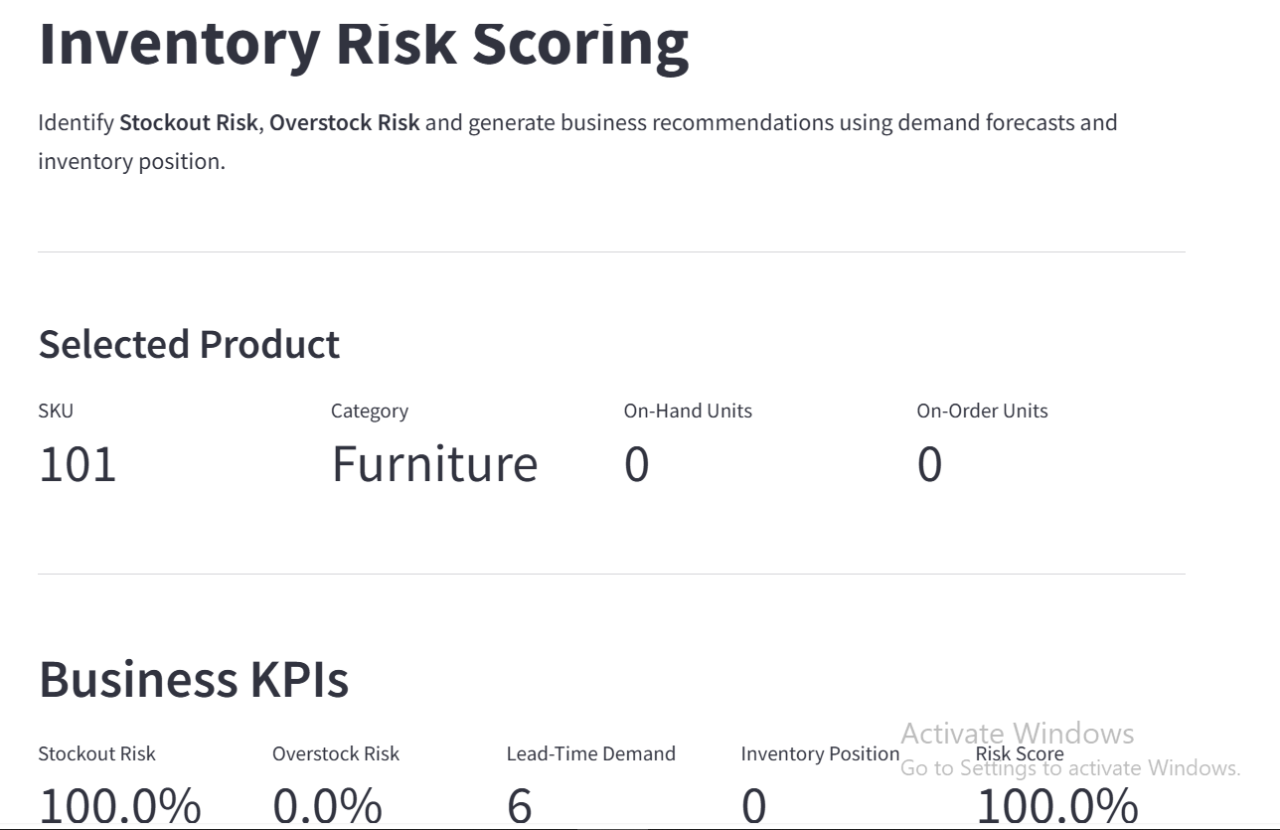
Risk Scoring screenshot.

Slide 12
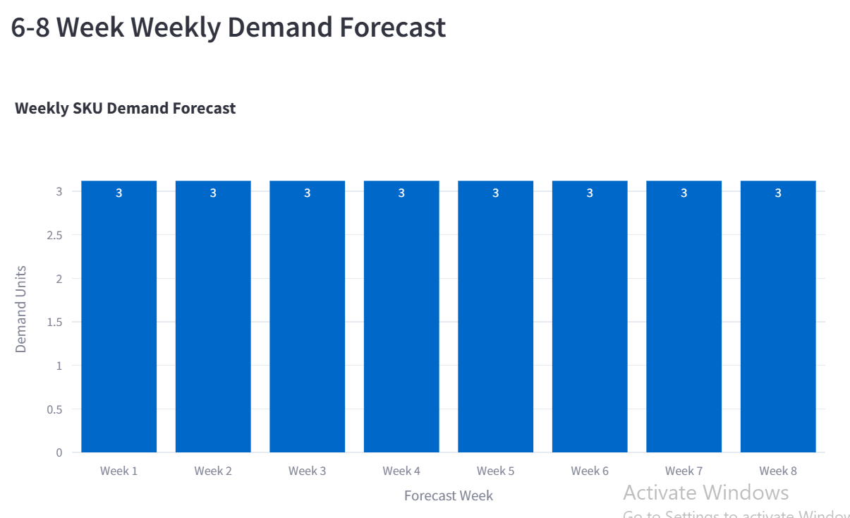
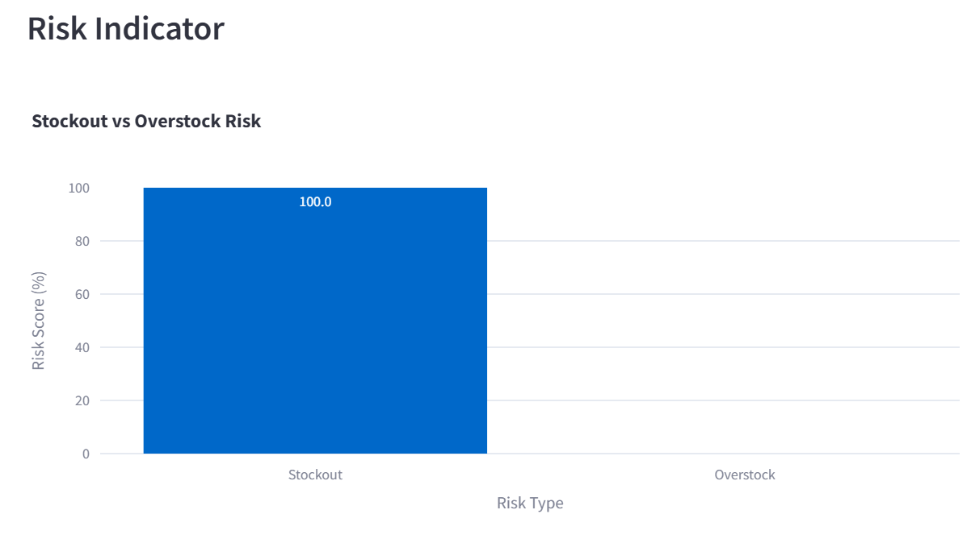
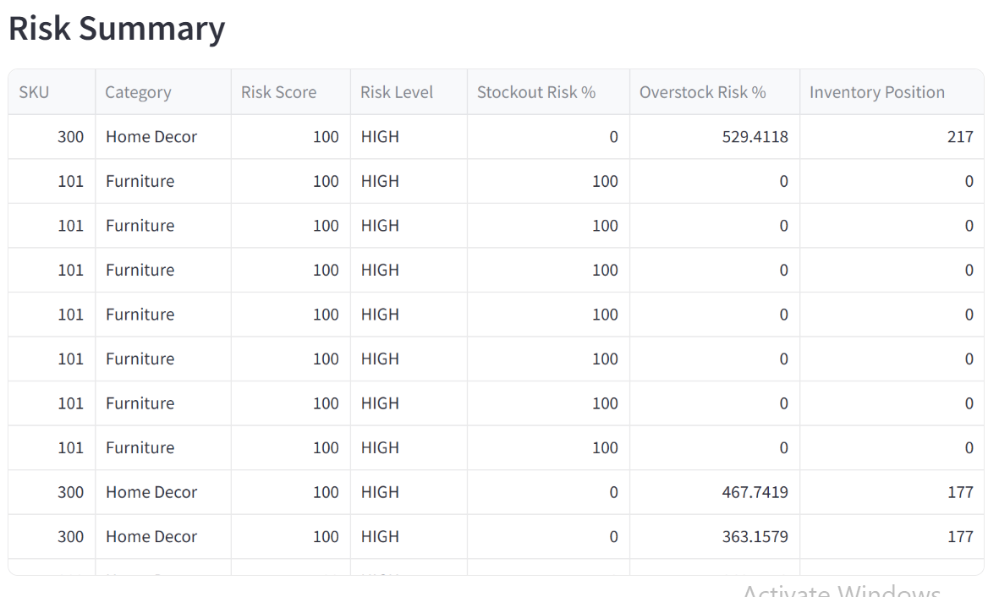
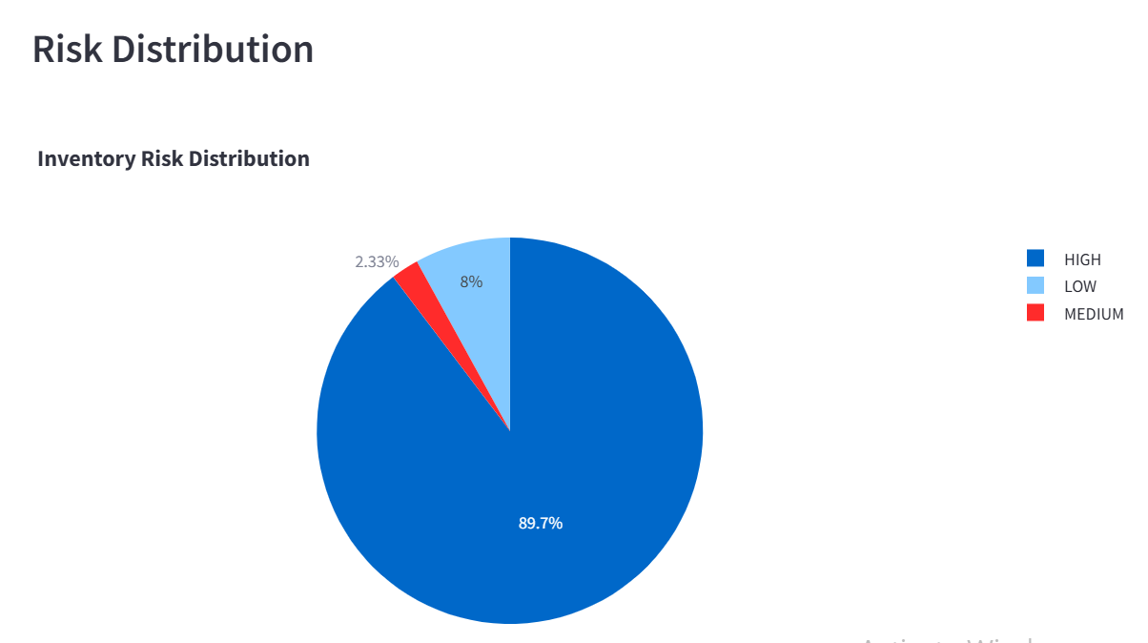

Slide 13
Decisioning & Recommended Actions
Risk Category | Business Meaning | Recommended Action
Reorder Now | High stockout risk | Replenish inventory
Markdown / Clear | High overstock risk | Promote, discount or clear
Watch / Volatile | High stockout and overstock risk | Investigate manually
Healthy | Low risk | No immediate action
The decisioning layer helps the operations team prioritize SKUs instead of reviewing hundreds of products individually.

Slide 14

Financial Impact
The system translates inventory risks into business impact.
Sales at Risk
Estimated revenue potentially affected by stockout conditions.
Capital Locked
Estimated value of excess inventory that may remain unsold.
Business Value
Stockout prevention
Protect potential revenue
Reduce lost-sales exposure
Improve product availability
Overstock reduction
Release working capital
Reduce markdown exposure
Improve inventory efficiency
Priority
Focus first on SKUs with the highest financial impact and highest risk.

Slide 15
Dashboard & Deployment
Planning Dashboard
The Streamlit dashboard provides:
SKU-level demand forecast
Actual vs forecast comparison
Forecast accuracy metrics
Stockout risk
Overstock risk
Reorder priority
Markdown / clearance priority
Decisioning view
Business impact metrics
Scoring Service
FastAPI provides a scoring interface for SKU-level prediction and risk assessment.
Deployment
Streamlit dashboard
Public scoring API
Swagger/OpenAPI interface
The system is designed so that business users can access the outputs without directly interacting with the underlying Python code.

Slide 16
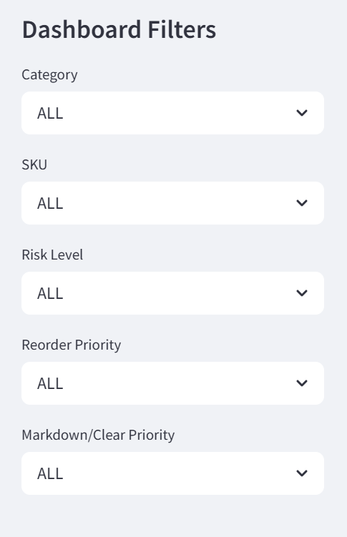
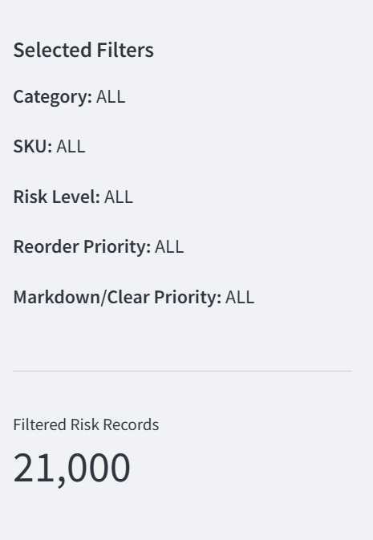
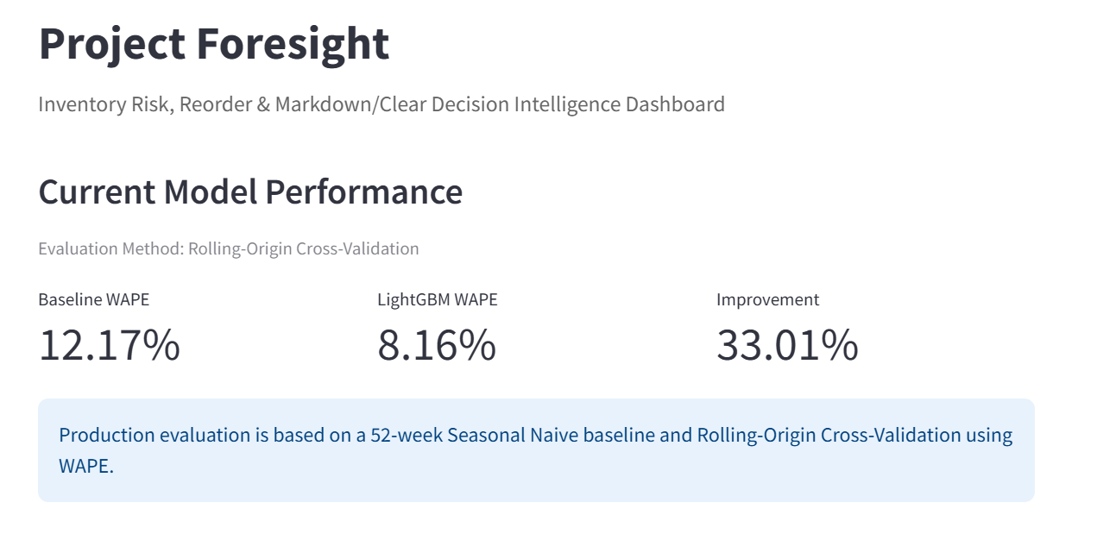
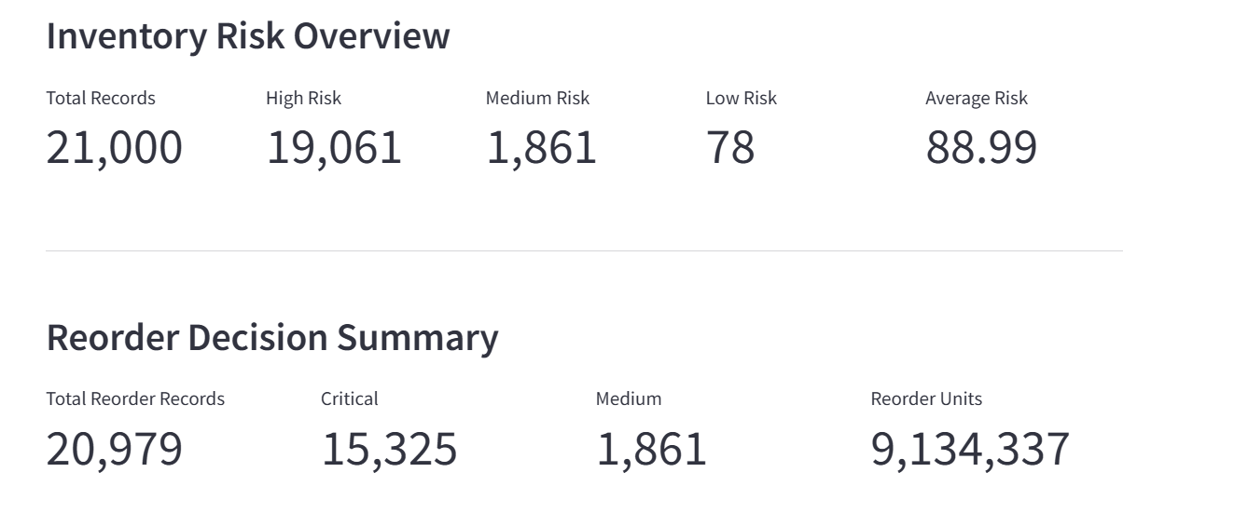
Dashboard screenshot

Slide 17
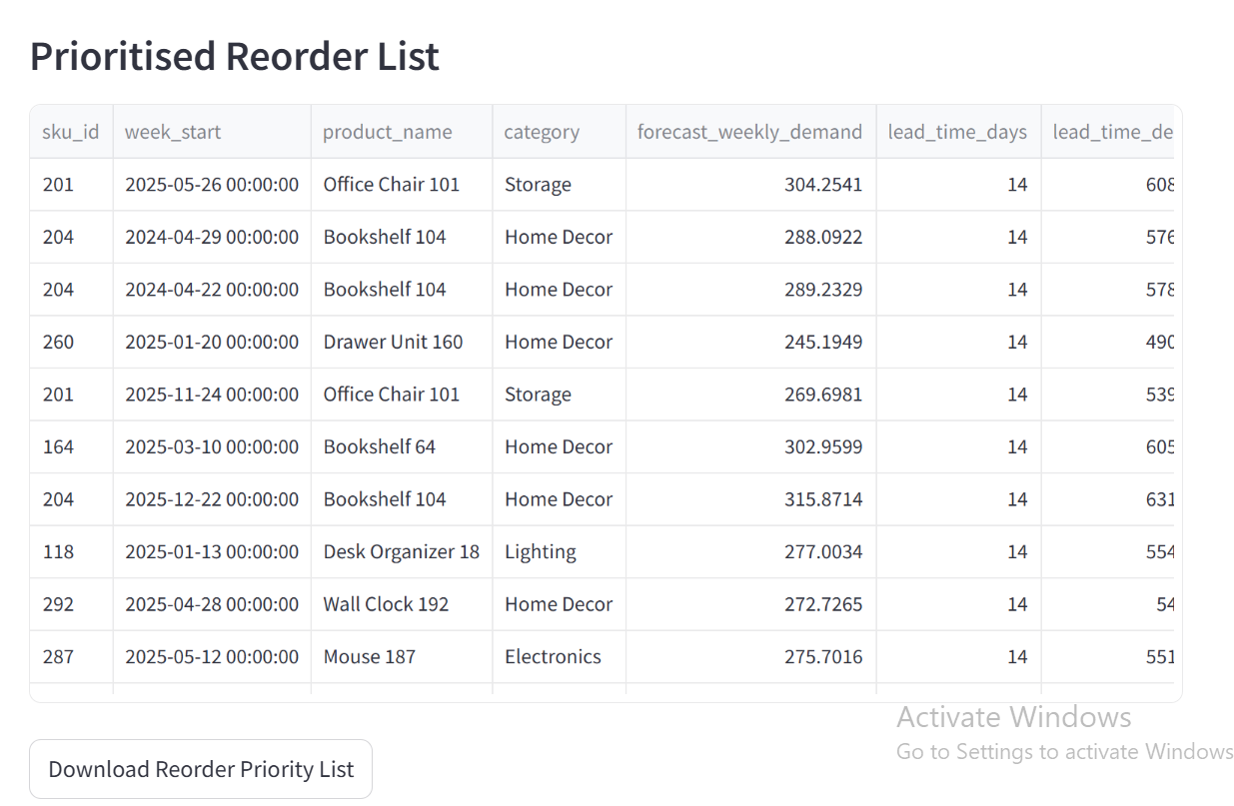
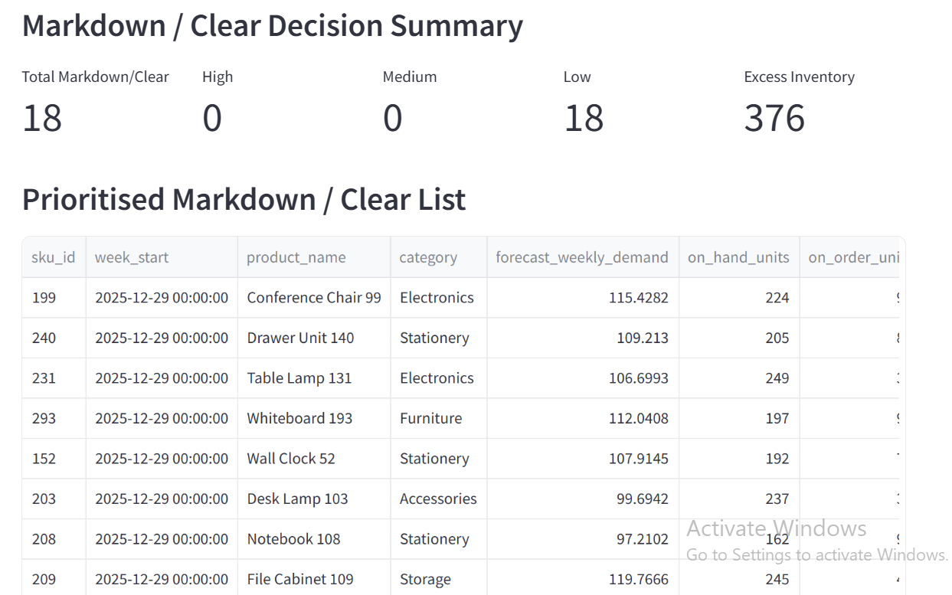
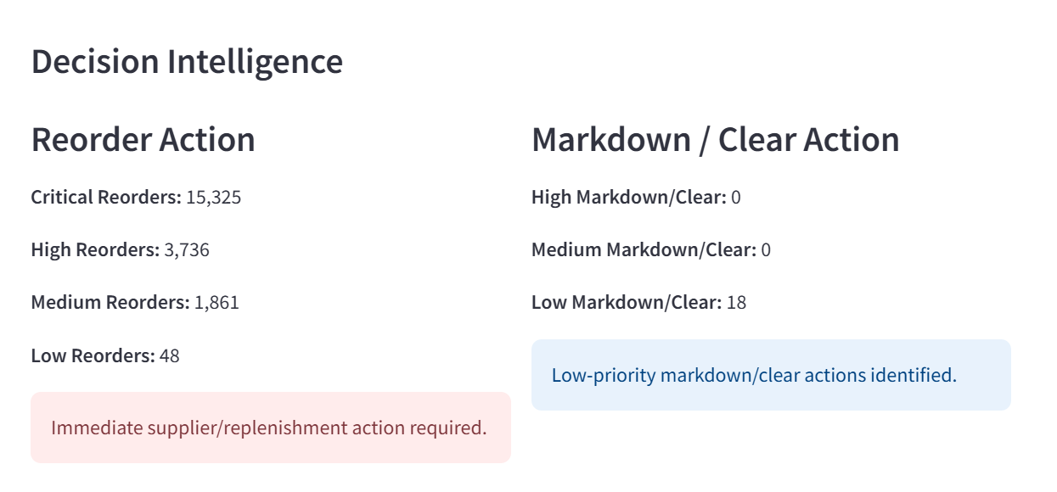

Slide 18
Recommendations
Recommended Actions
Prioritize high-risk stockout SKUs for replenishment.
Review high-overstock SKUs for markdown or clearance.
Monitor volatile SKUs more frequently.
Use forecast accuracy and inventory risk together for planning.
Refresh the pipeline regularly with updated sales and inventory data.

Slide 19
Limitations & Next Steps
Limitations
Future Scope
Forecast quality depends on the quality and history of the provided data.
New or low-history SKUs may have less reliable forecasts.
Promotions can create unusual demand patterns.
Forecasts are estimates and should support—not replace—business decisions.
Supplier and real-world operational constraints are outside the current scope.
Prediction intervals and forecast confidence.
What-if inventory scenarios.
Forecast explainability.
Model monitoring.
Additional demand drivers.
Automated periodic reporting.

Slide 20

Conclusion
PROJECT FORESIGHT provides an end-to-end solution for demand forecasting and inventory intelligence. It uses historical sales, product, calendar, and inventory data to generate SKU-level demand forecasts. The system identifies stockout and overstock risks and converts them into clear business actions. It also quantifies potential Sales at Risk and Capital Locked to support better financial decisions. The Streamlit dashboard and FastAPI service make the insights accessible and actionable for business users. Overall, PROJECT FORESIGHT helps the operations team make more informed, data-driven inventory decisions.

Slide 21
Thank You !

