Slide 1
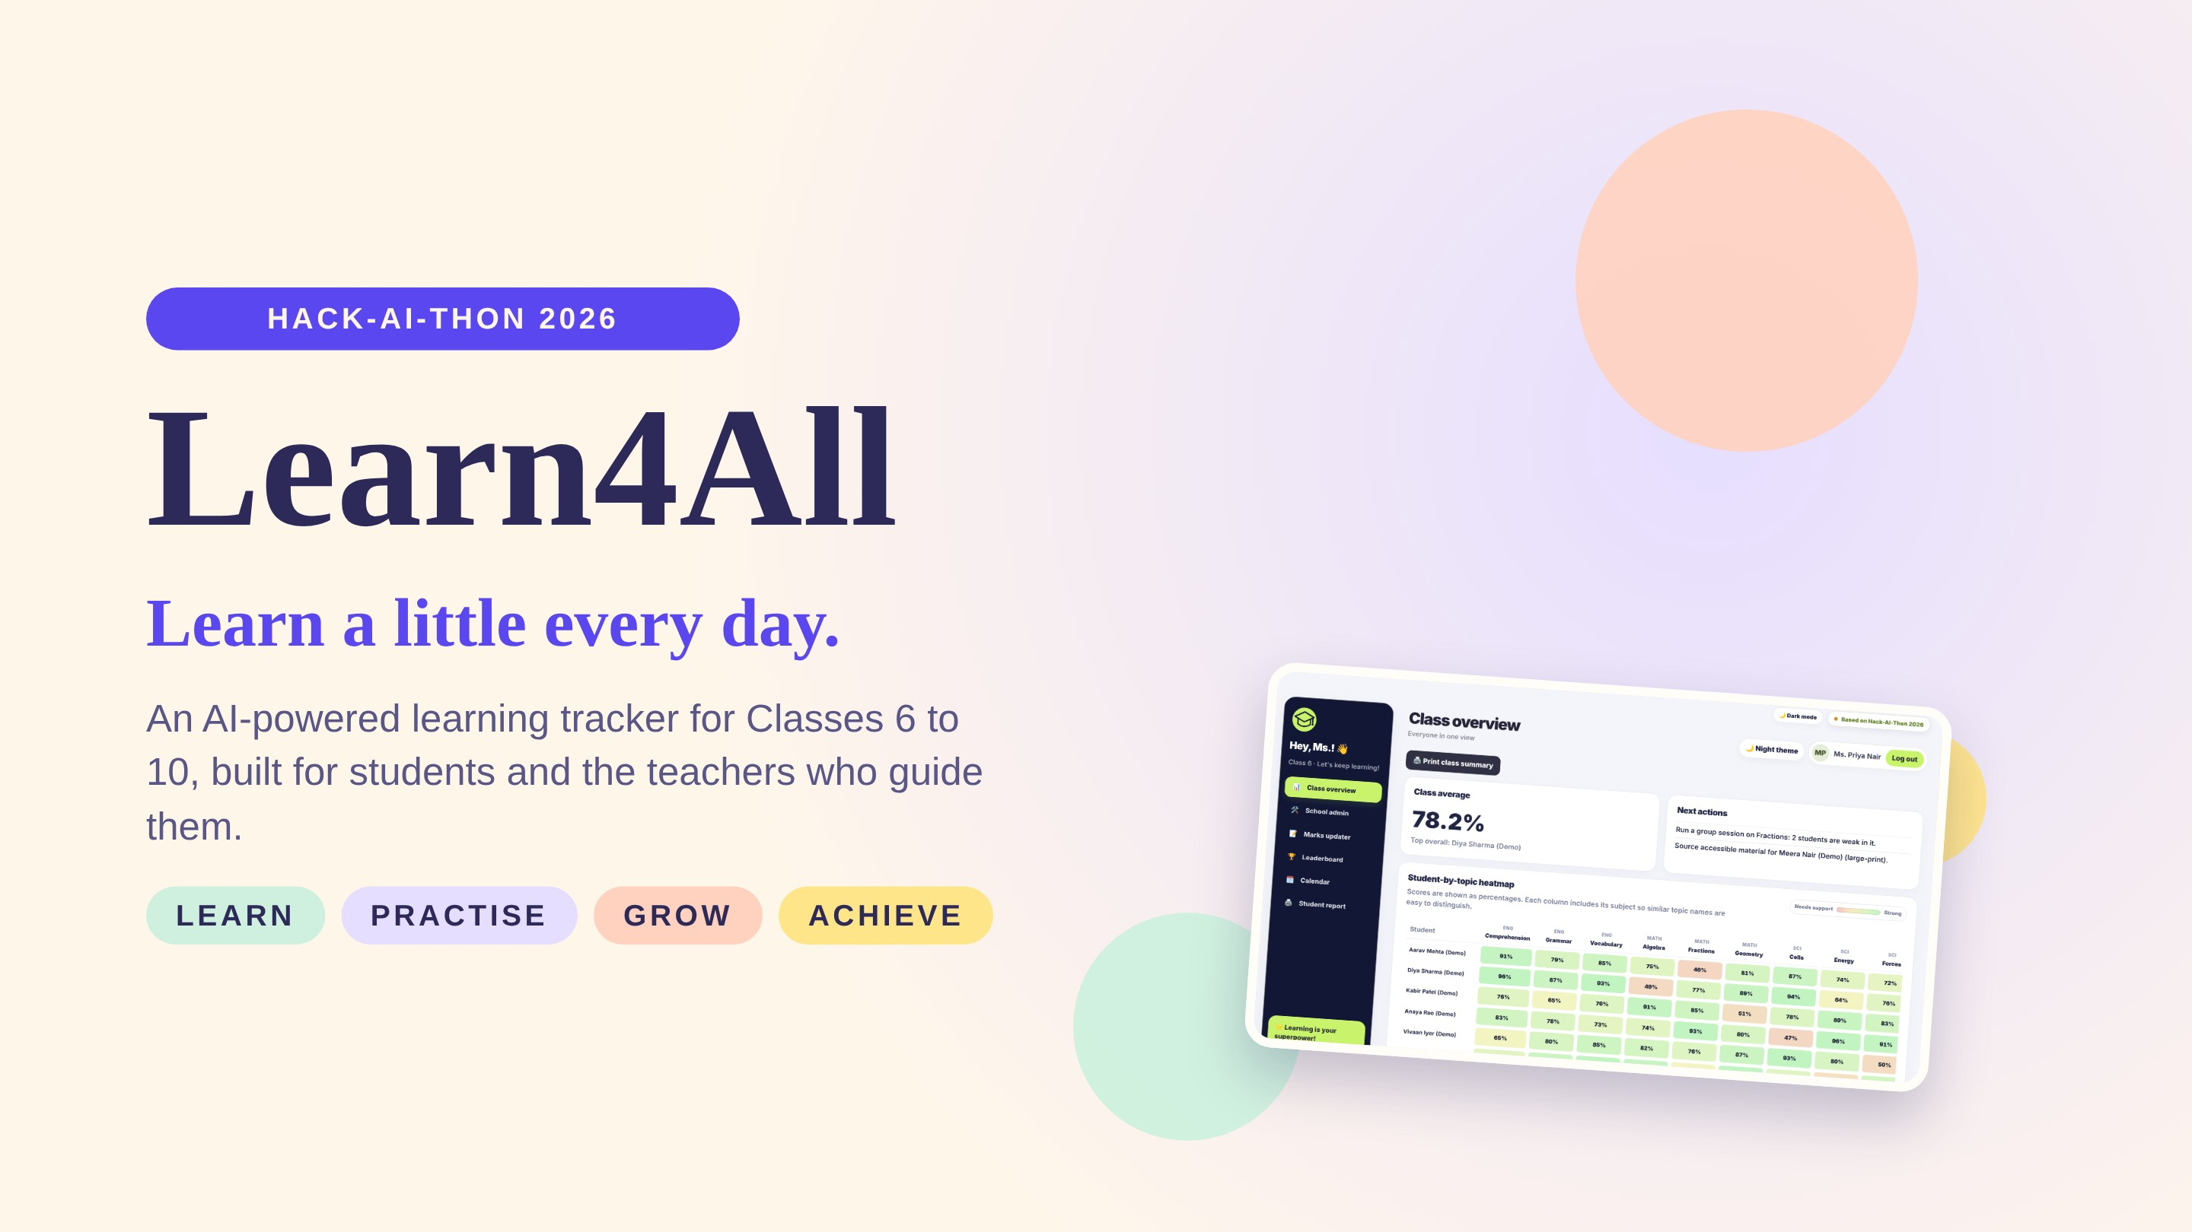
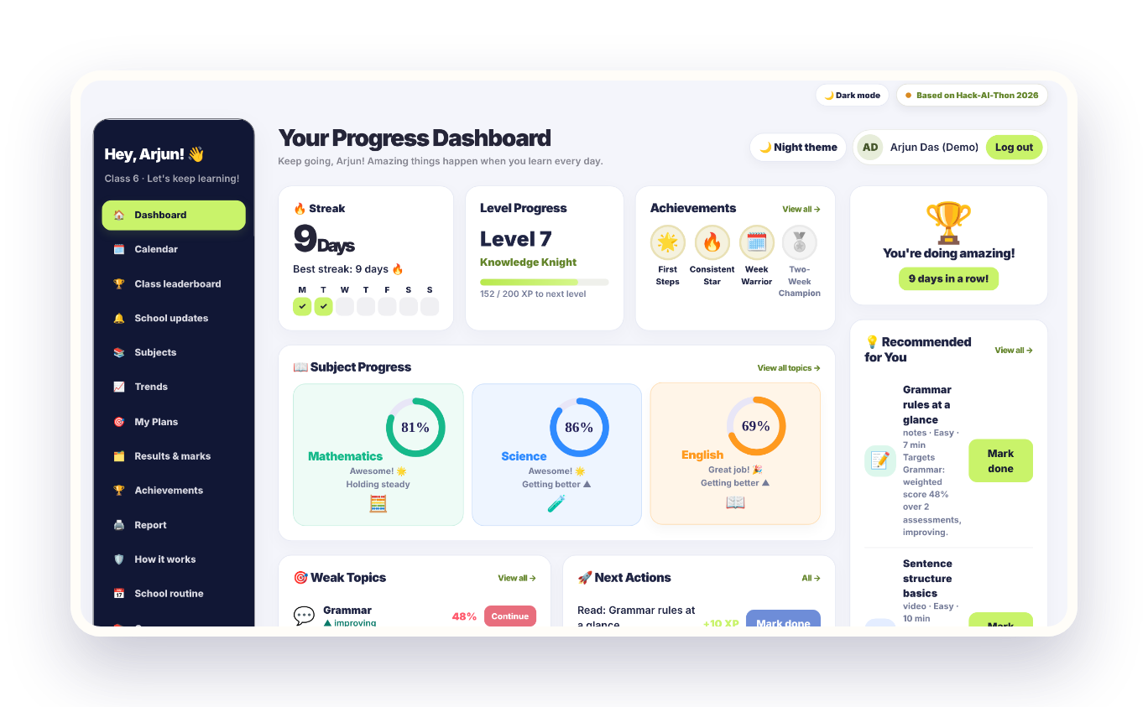
Notes:
Open with the tagline. Learn4All (code name LearnTrack) was built for Hack-AI-Thon 2026. Every screenshot in this deck is the real running app with fictional demo students.

Slide 2
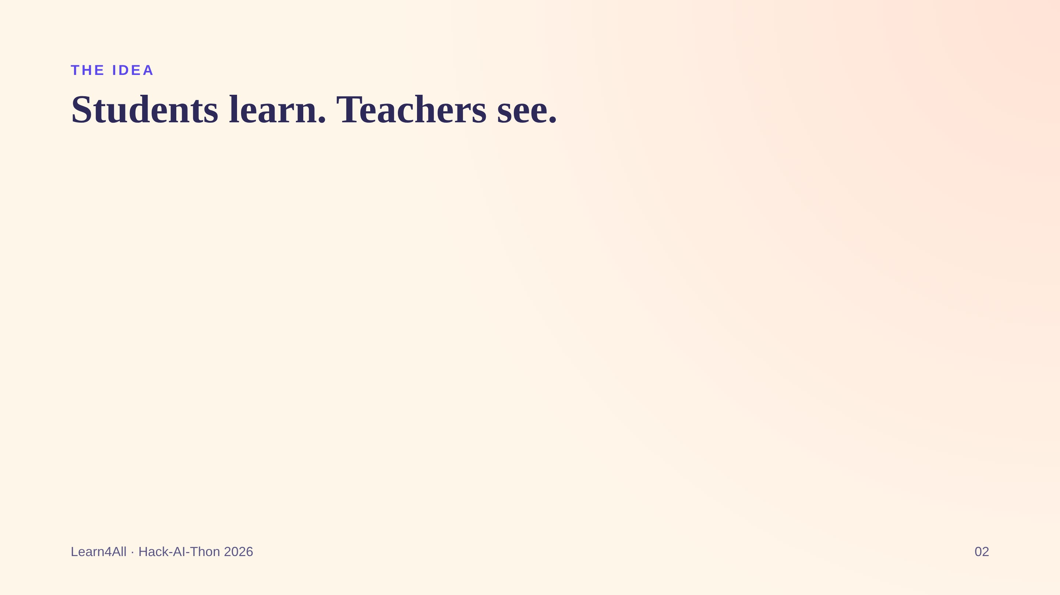
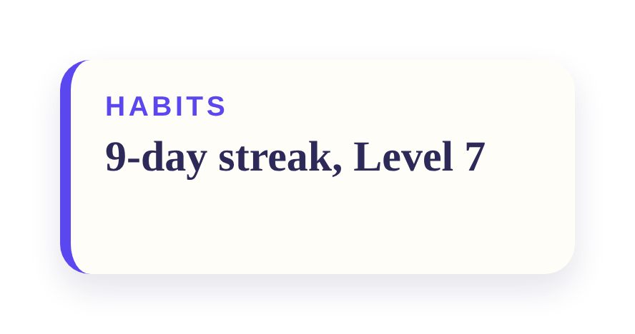
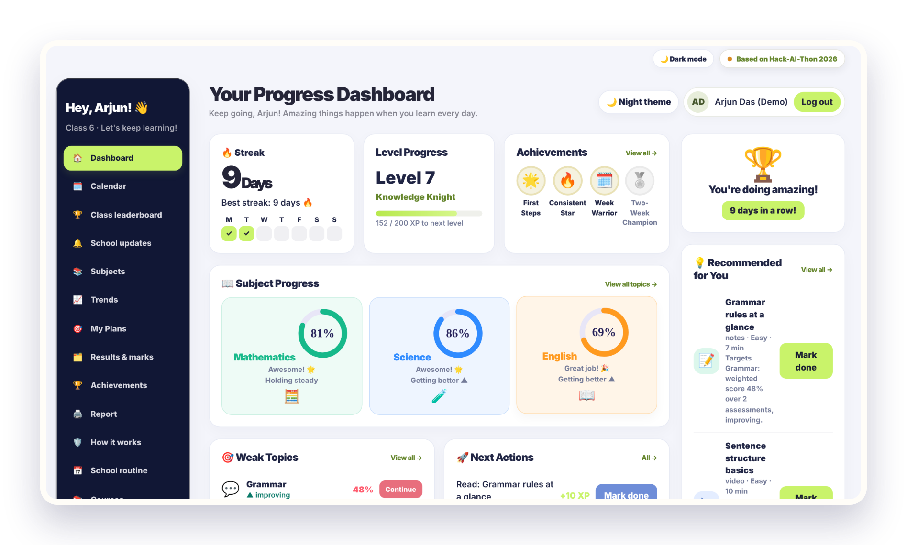
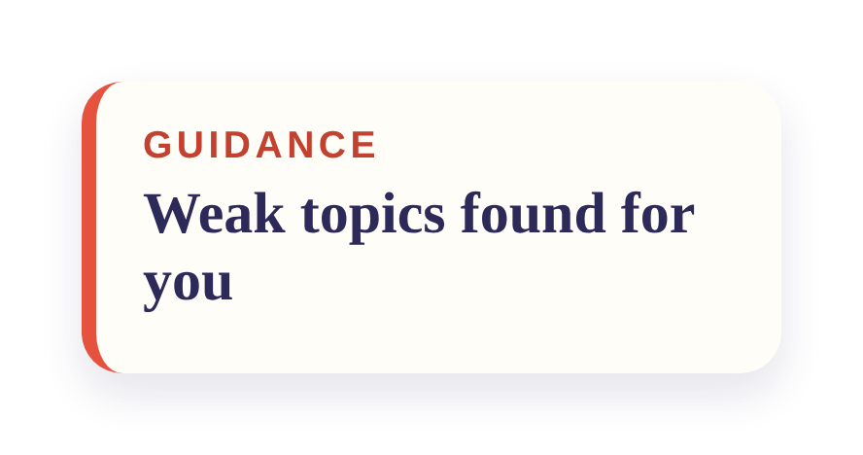
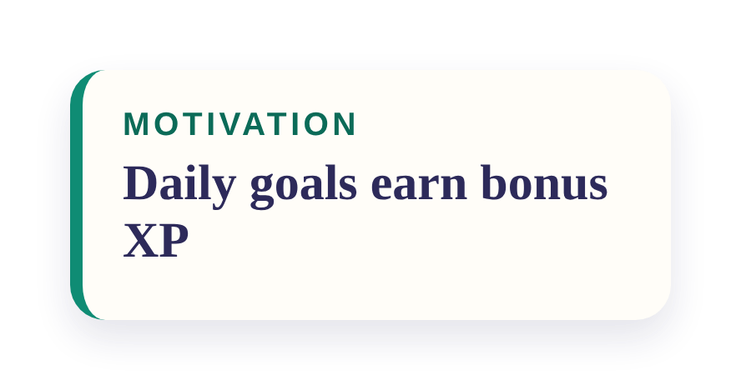
Notes:
One app, two views. The student sees streaks, levels, weak topics and what to do next. The teacher sees the whole class at a glance. This dashboard is the real app showing a fictional demo student.

Slide 3

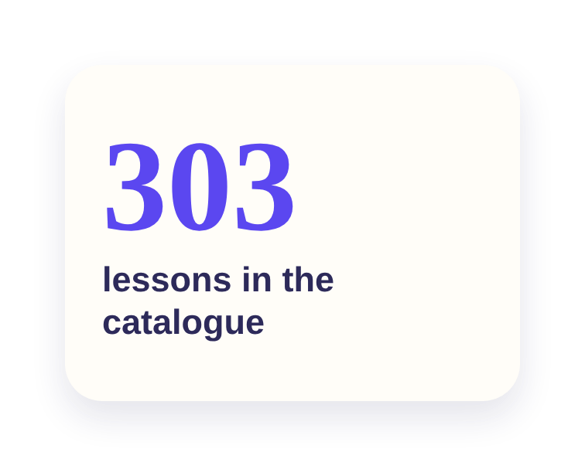
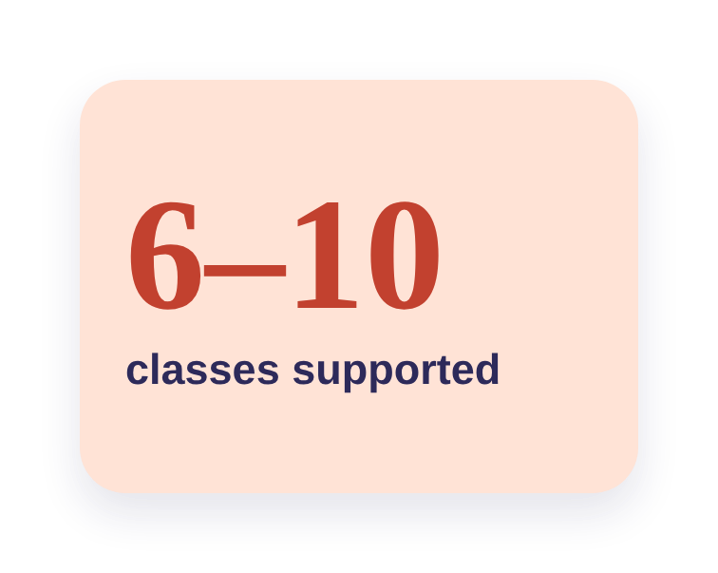
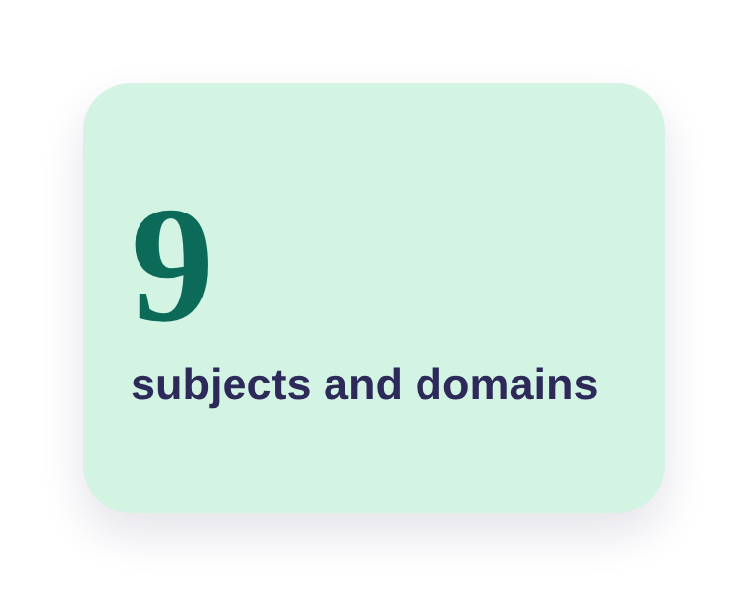
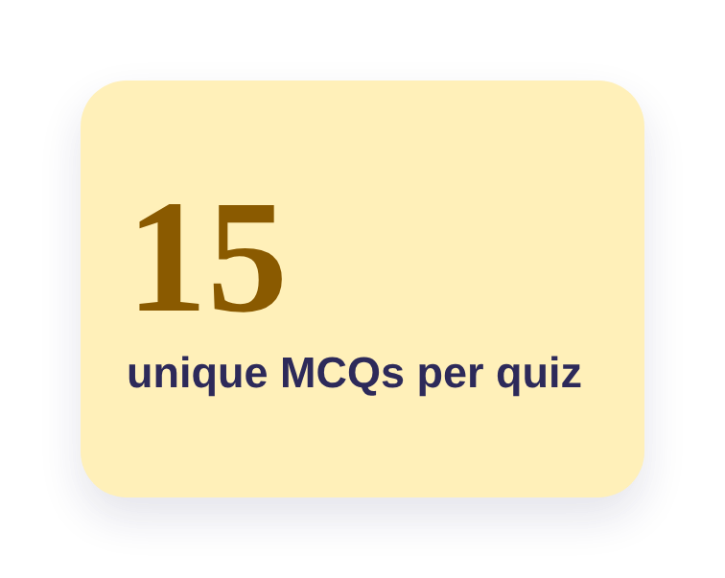
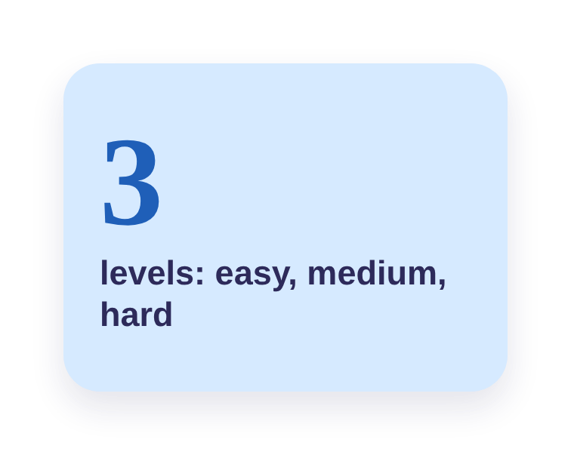
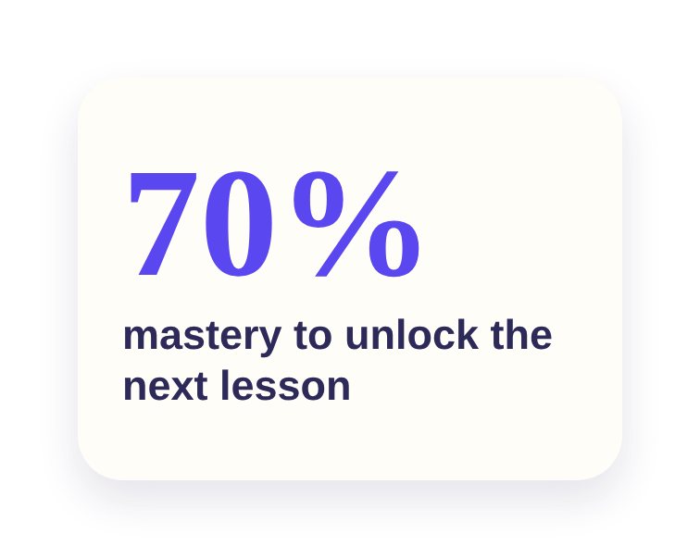
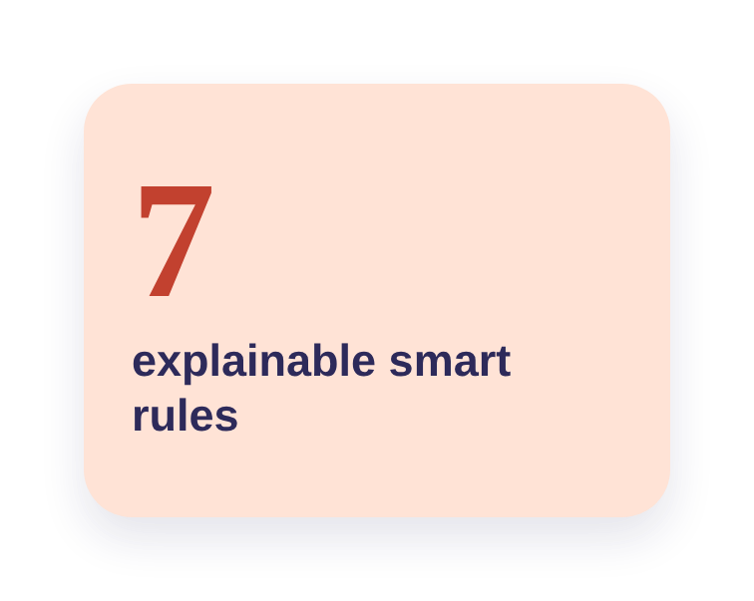
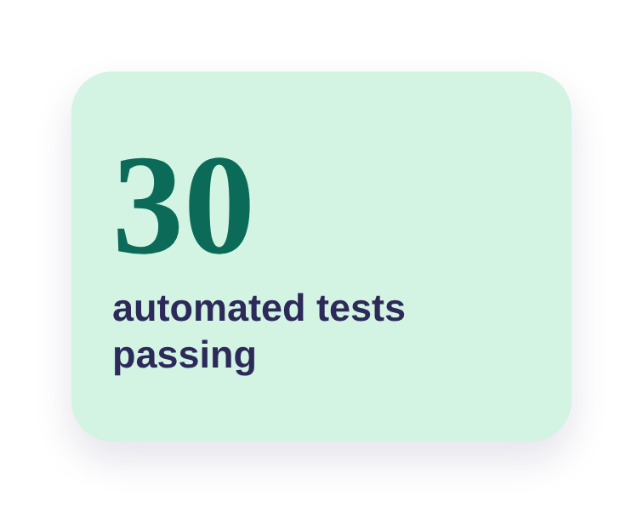
Notes:
Figures come straight from the project files: 303 catalogue lessons, 15 unique questions per quiz, 7 recommendation rules and 30 passing automated tests.

Slide 4
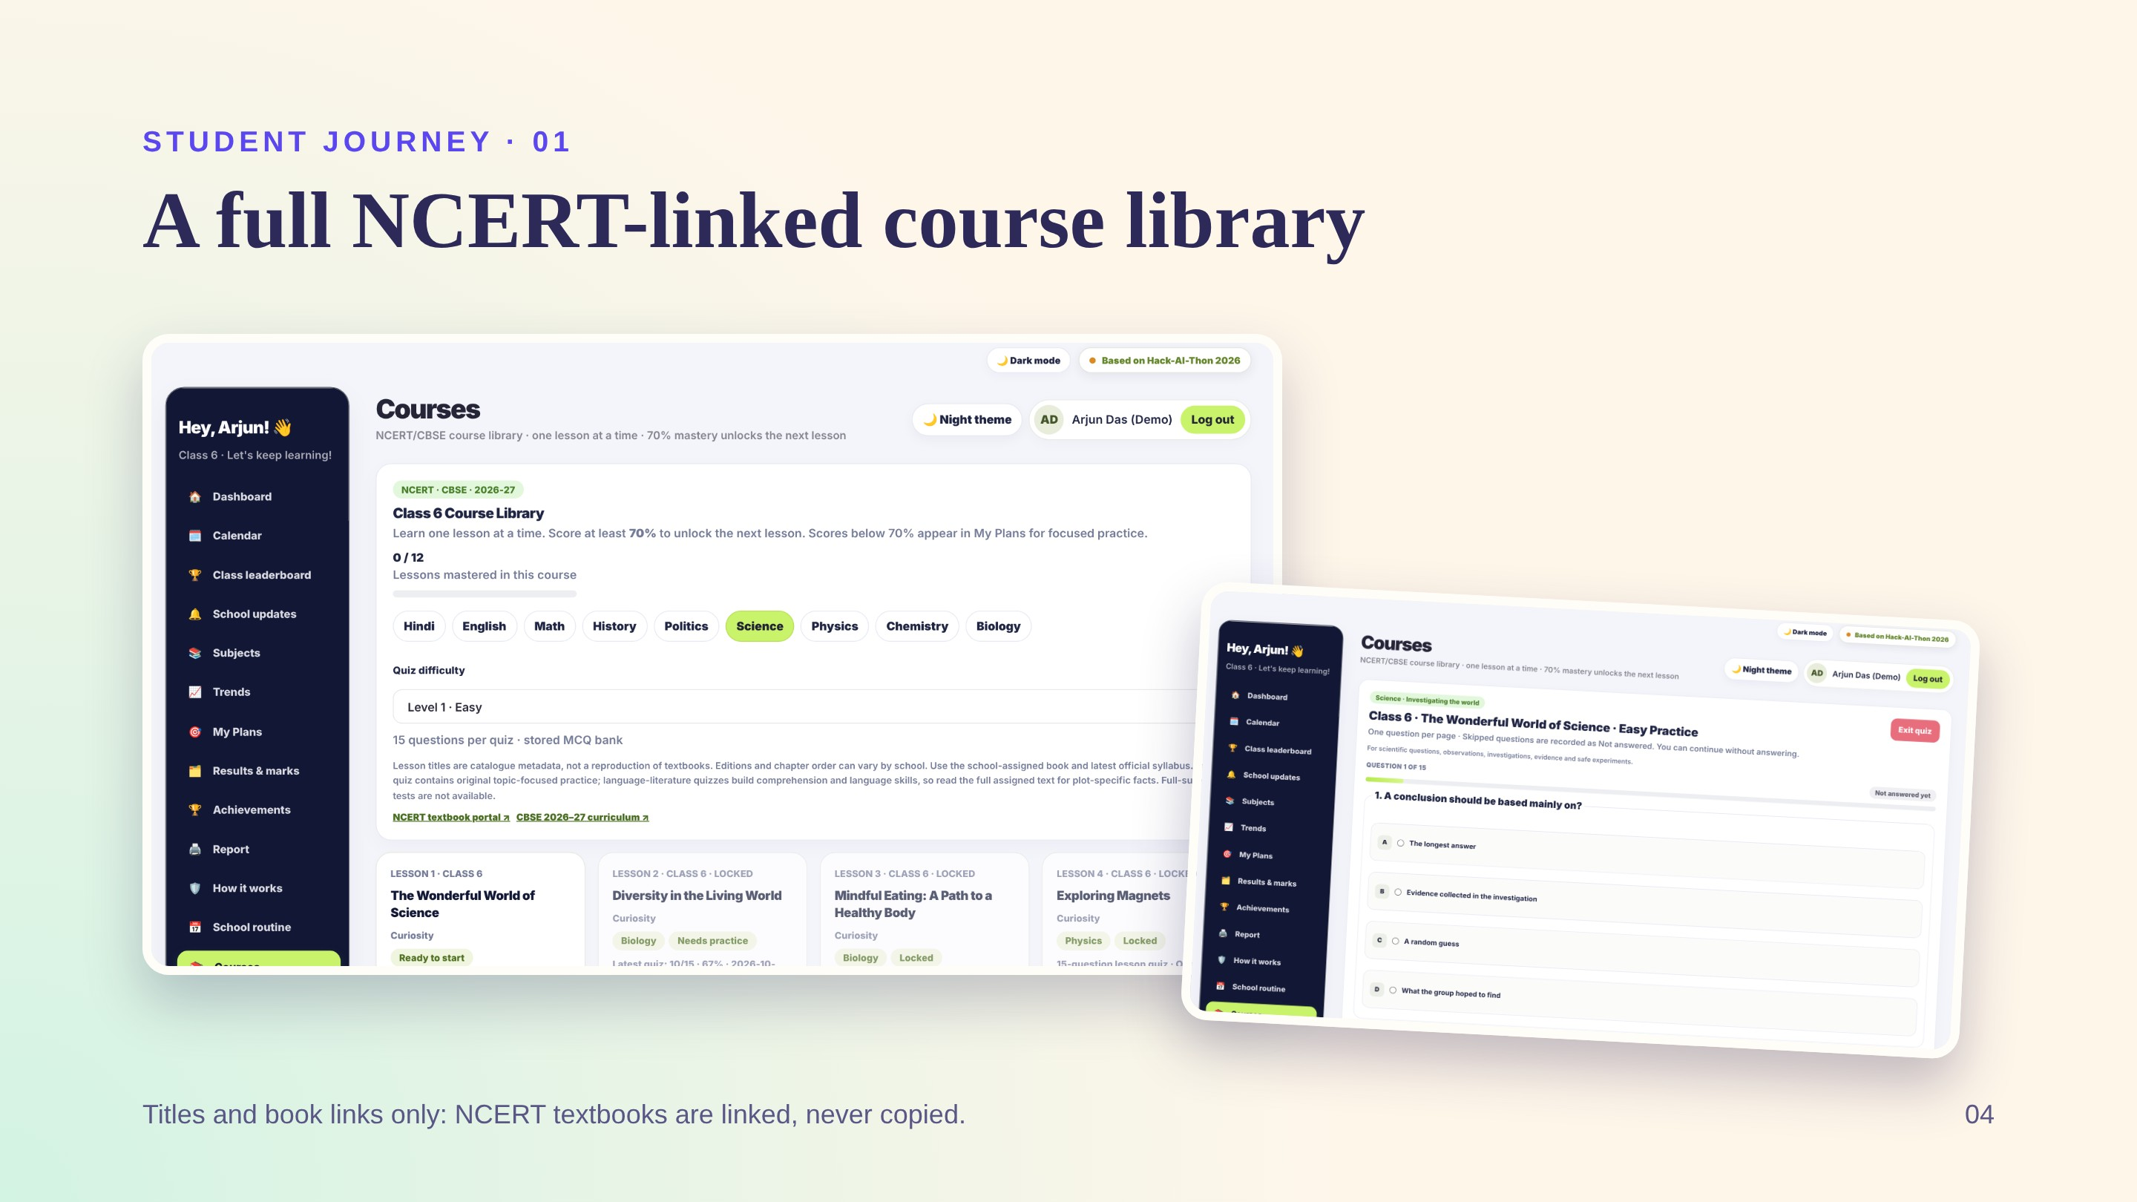
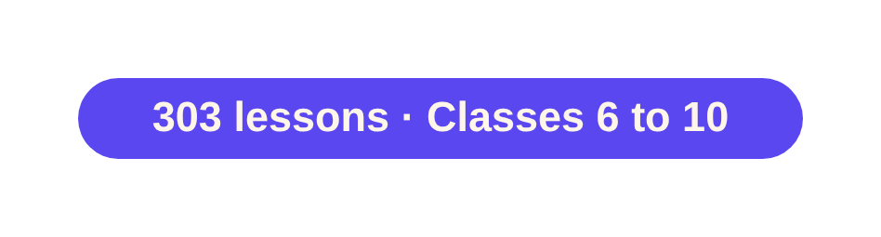
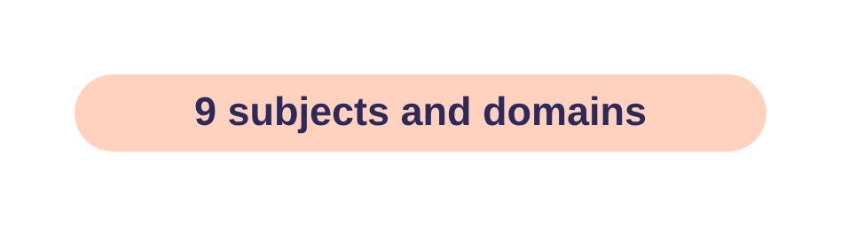
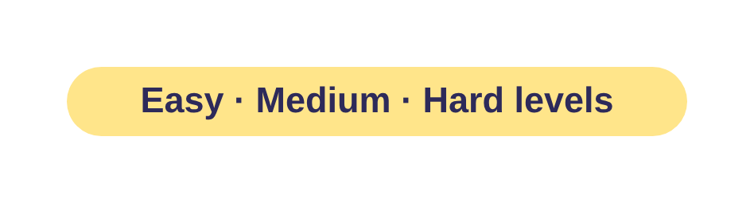
Notes:
Each class has its own lesson sequence. Students pick a subject chip, choose a difficulty level and start a 15-question quiz, one question per page. Questions are original practice material, not the NCERT question bank.

Slide 5
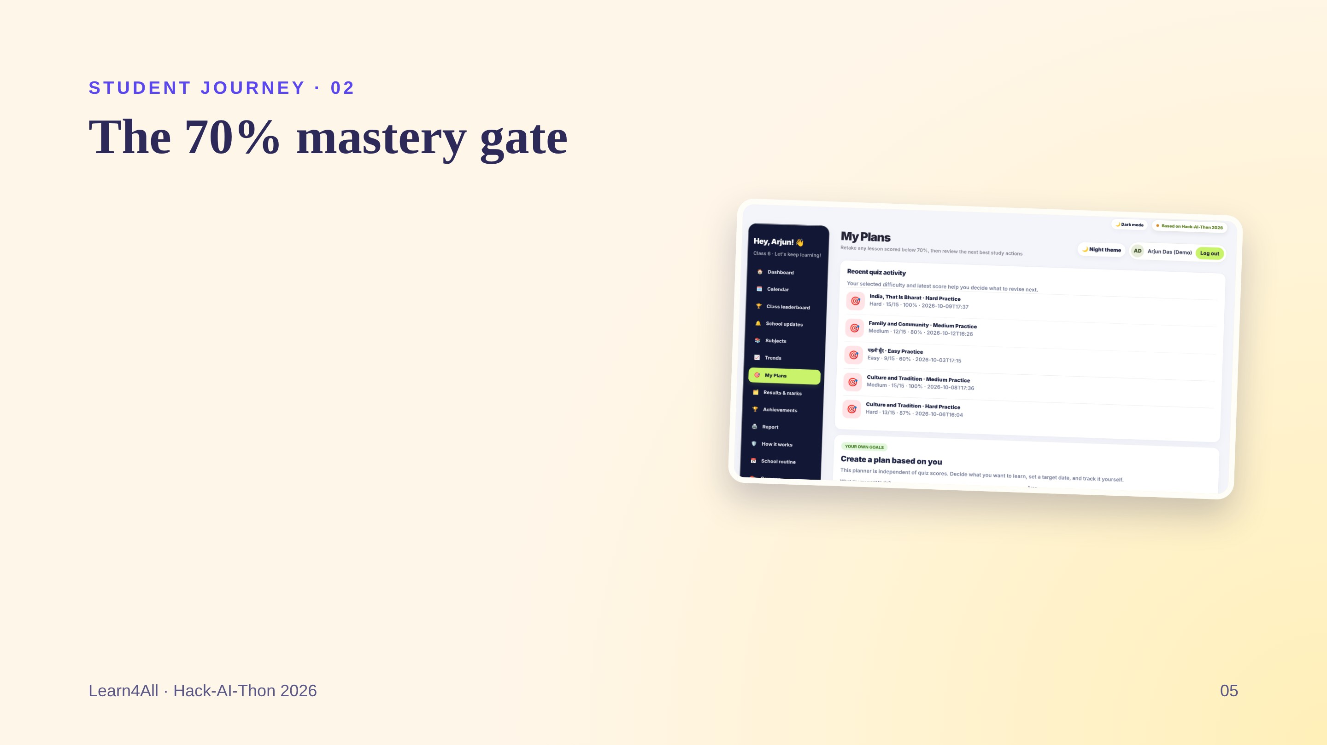
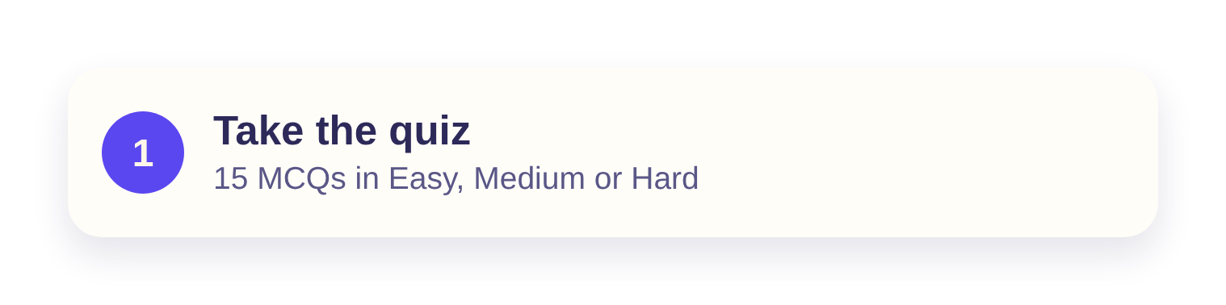
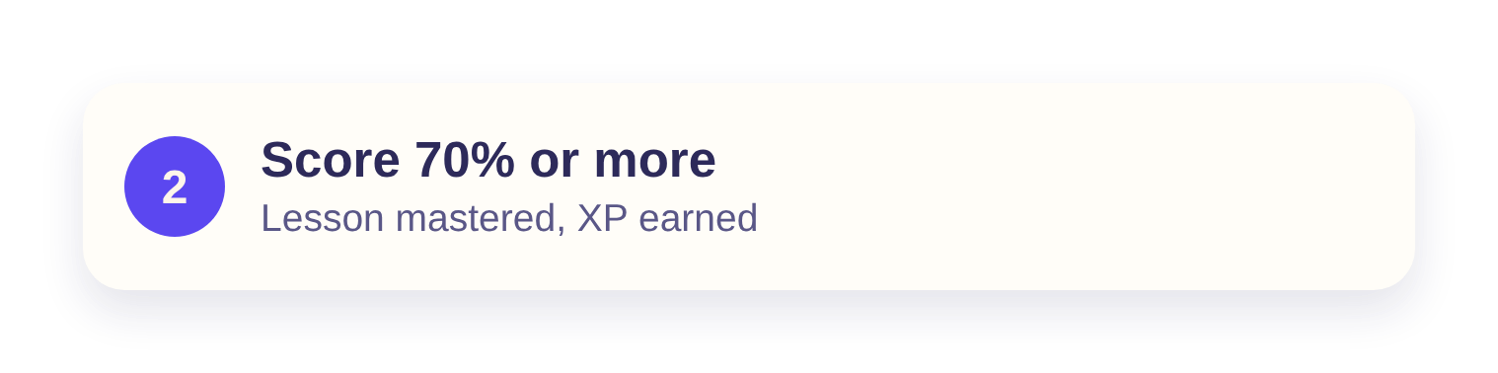
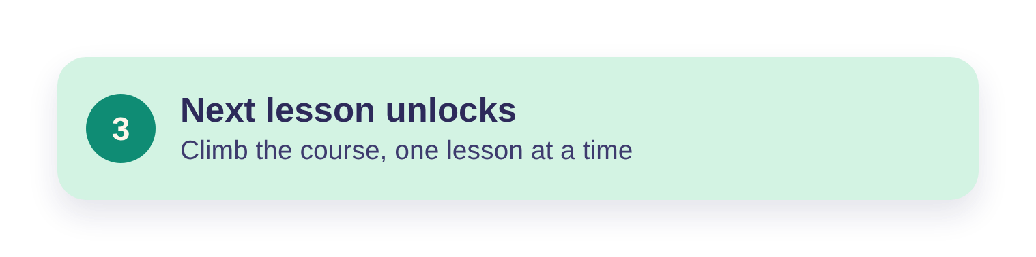
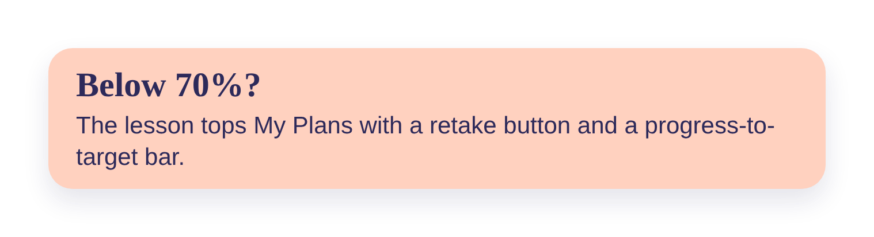
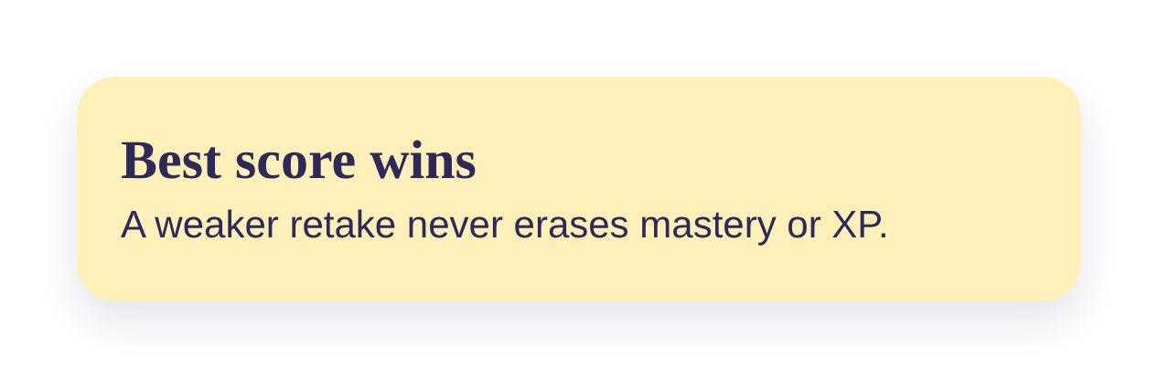
Notes:
Mastery and XP are separate. 70% unlocks the next lesson. XP equals the best score percentage, so low scores never cost points. Every attempt is saved but only the best counts. The My Plans screen shows recent quizzes with their levels.

Slide 6
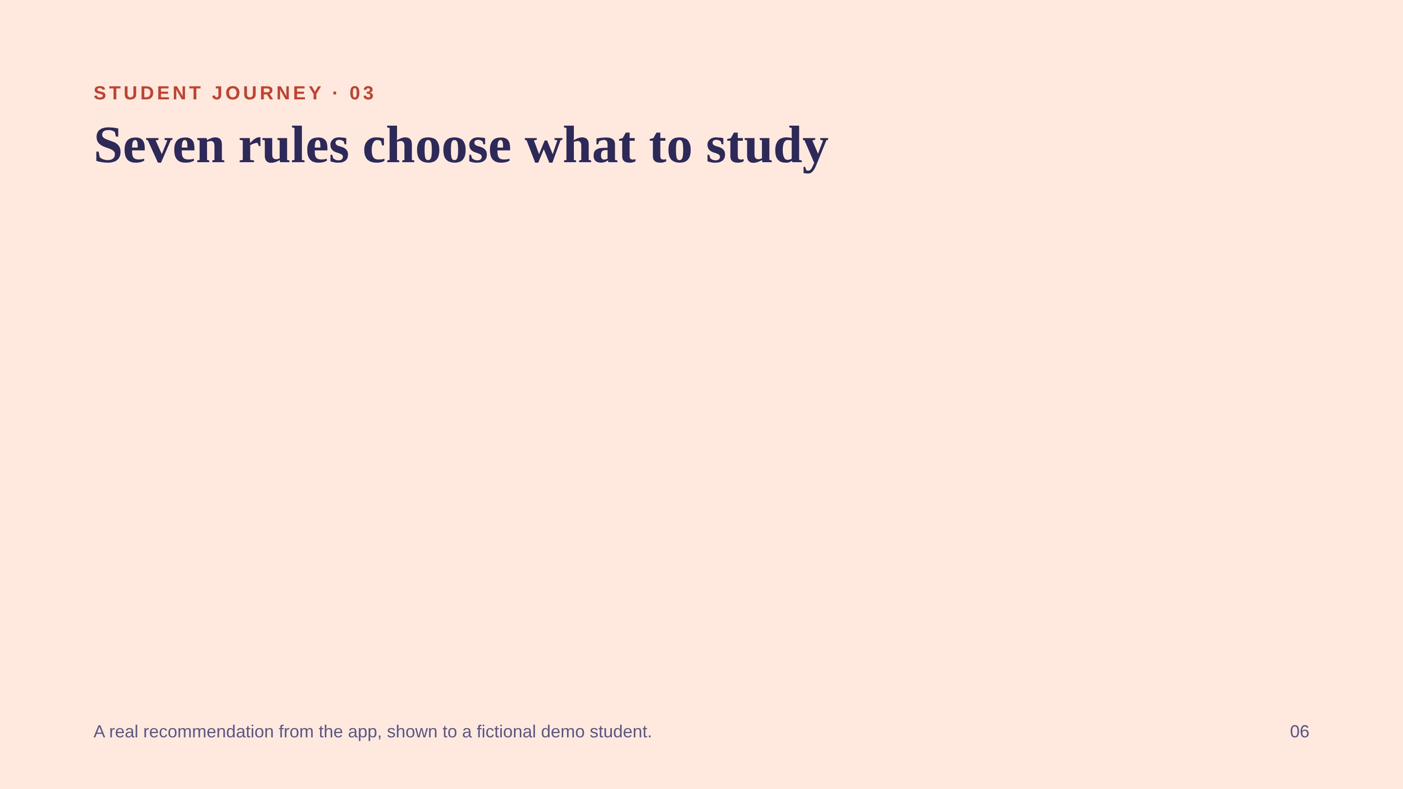
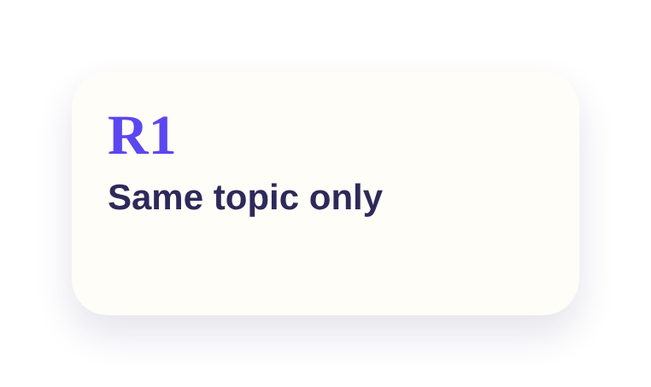
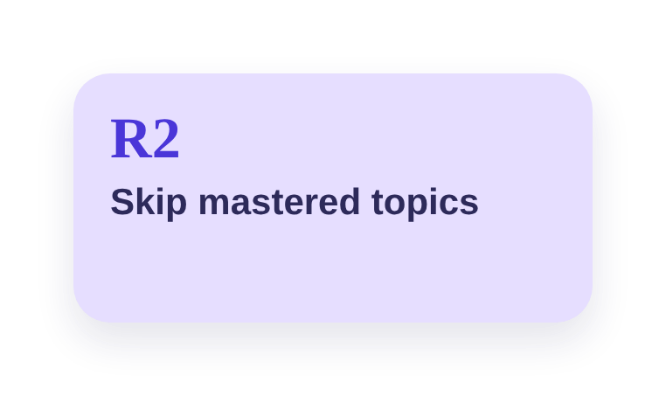
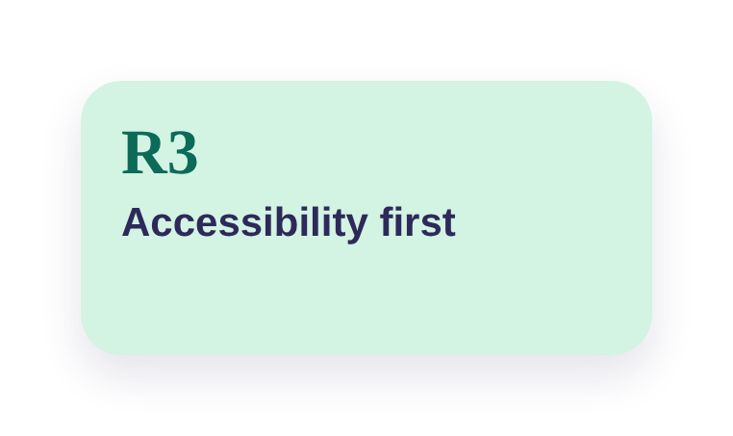
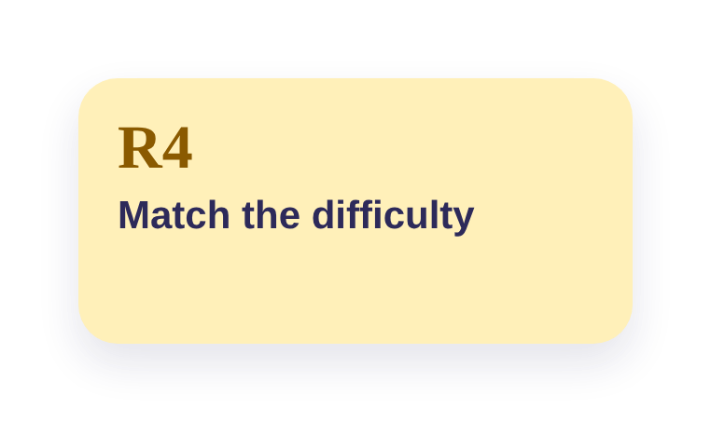
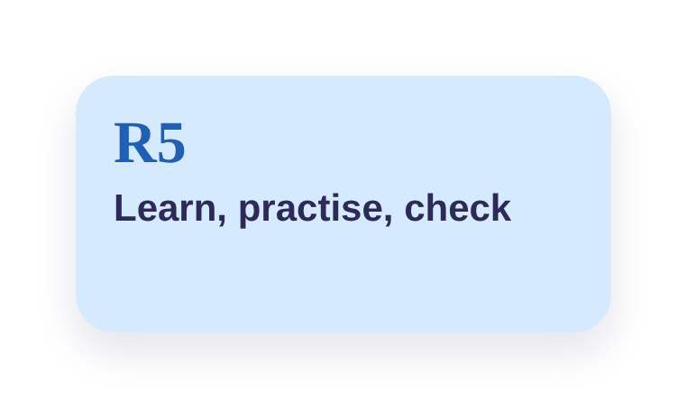
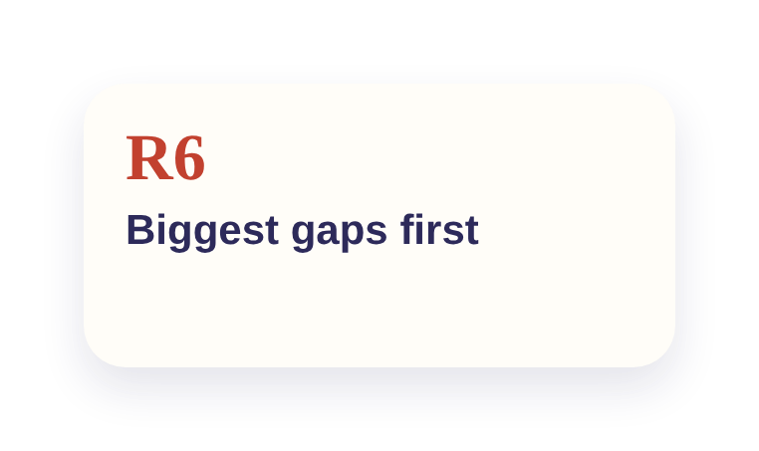
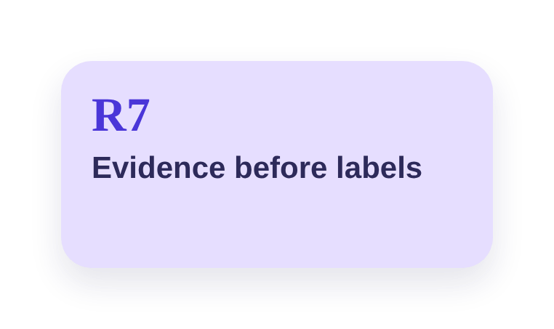
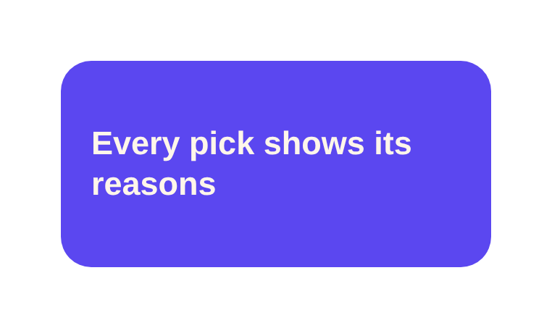
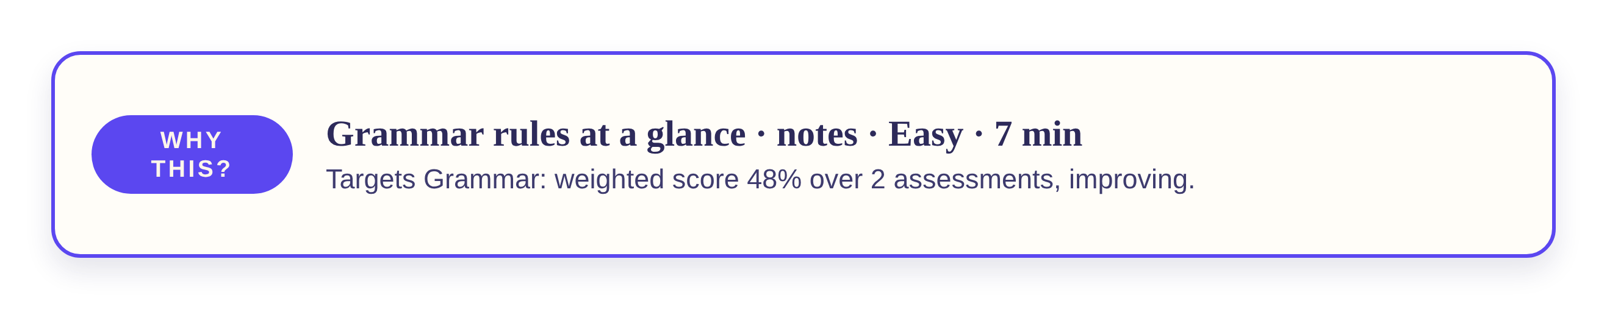
Notes:
This is the rule-based engine. R1 to R4 filter resources, R5 and R6 order them, and R7 stops us labelling a student weak without enough evidence. Because each rule can explain itself, every recommendation comes with a reason.

Slide 7
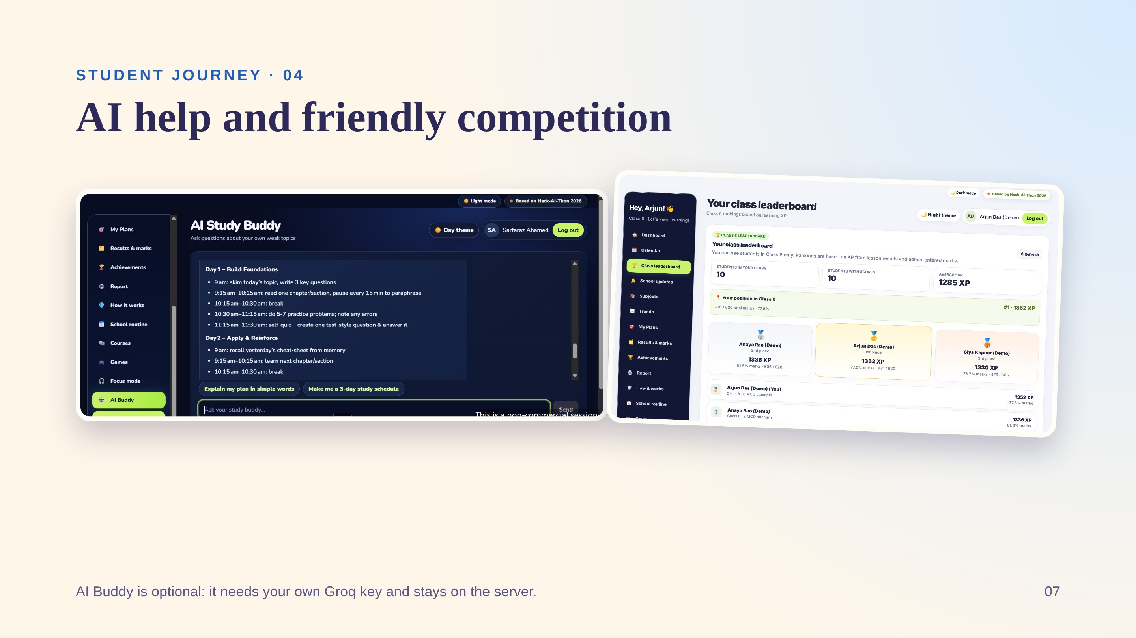
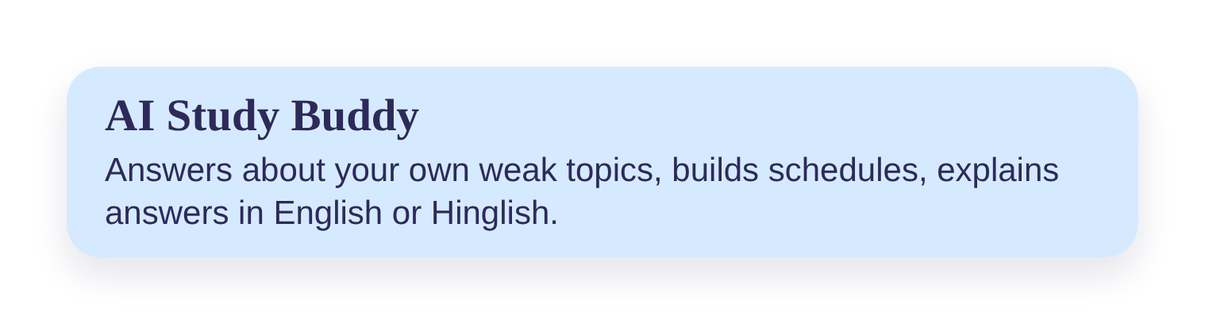
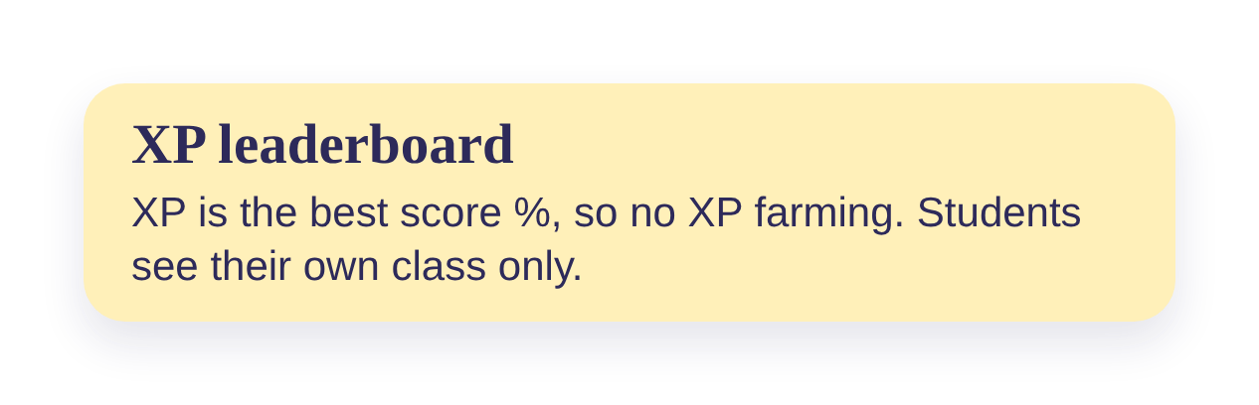
Notes:
The AI Buddy runs through Groq on the server, so the API key never reaches the browser. Without a key the rest of the app still works. The leaderboard shows the real ranked demo class; the server ignores any attempt by a student to view another class.

Slide 8
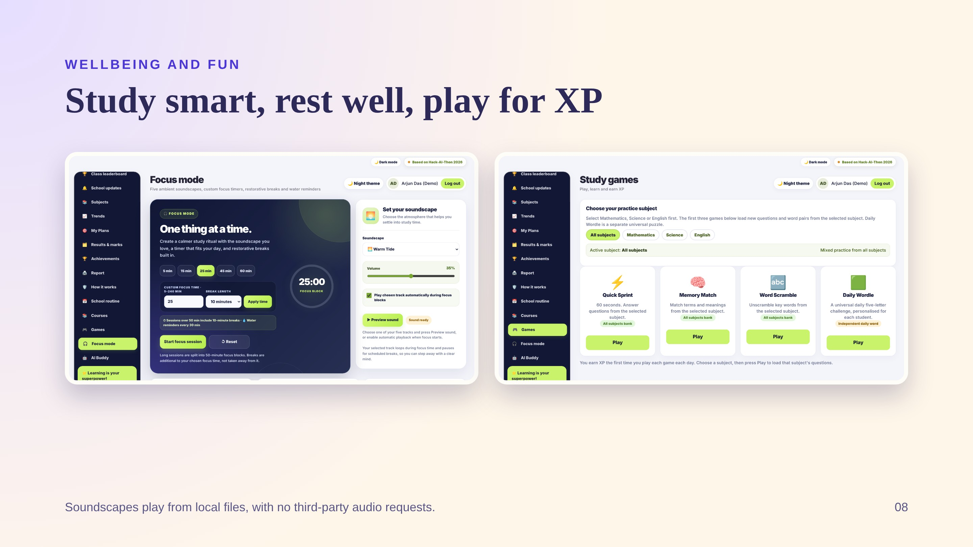
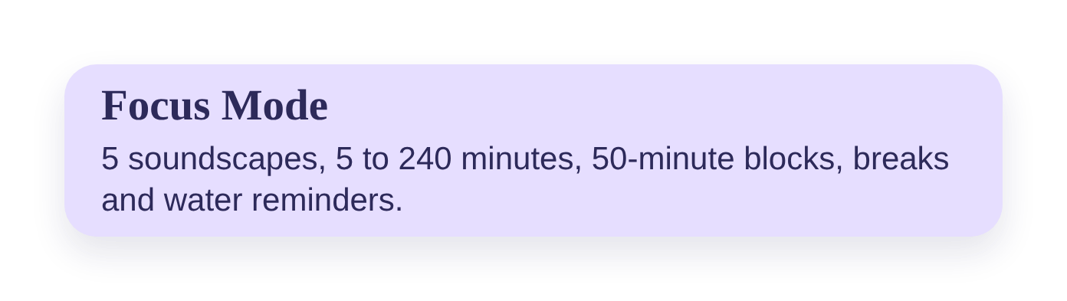
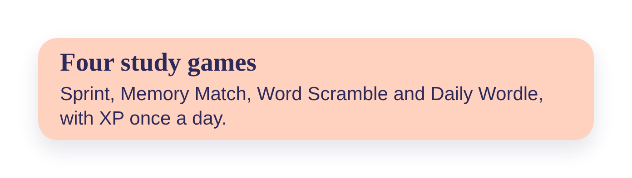
Notes:
Focus Mode splits long sessions into 50-minute blocks with 10 or 15 minute breaks and reminds students to drink water. XP is capped at three sessions a day. Games load questions from the chosen subject; Daily Wordle gives every student a private word.

Slide 9
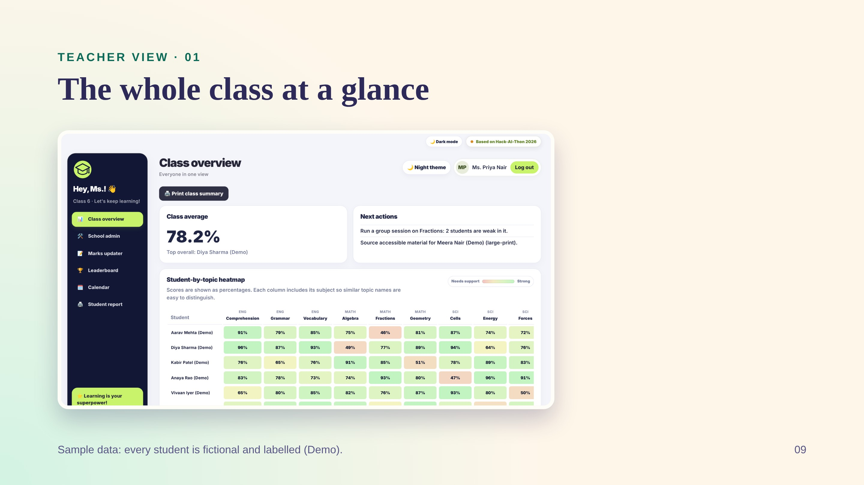
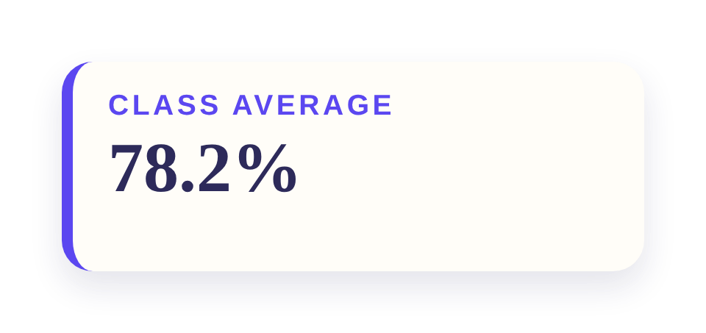
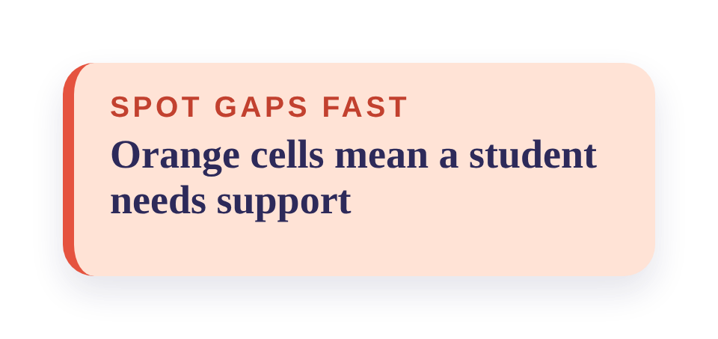
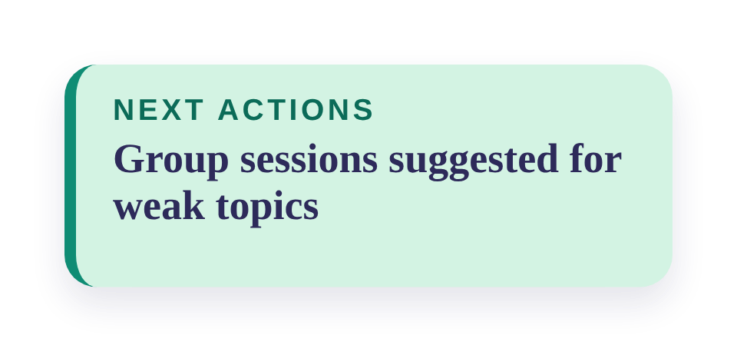
Notes:
Read across a row to see one student, down a column to see which topic the class struggles with. The heatmap has clear subject labels, high-contrast percentages, a legend and sticky student names while it scrolls.

Slide 10
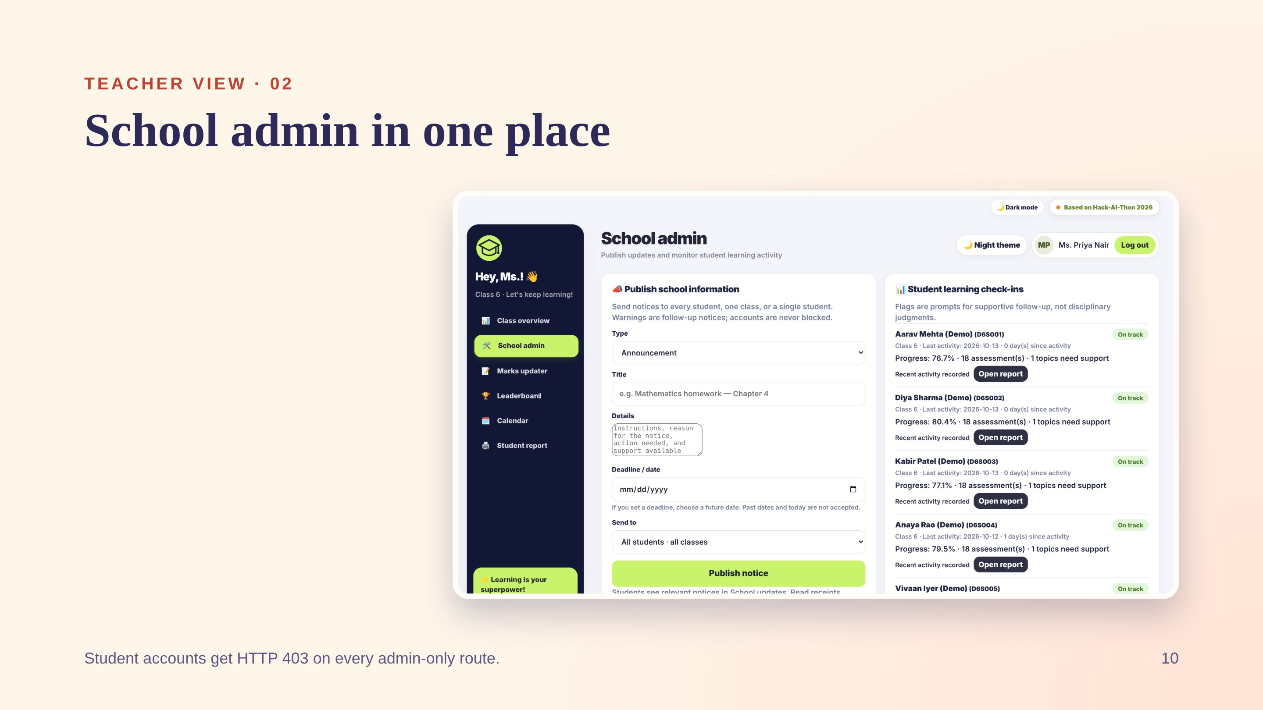
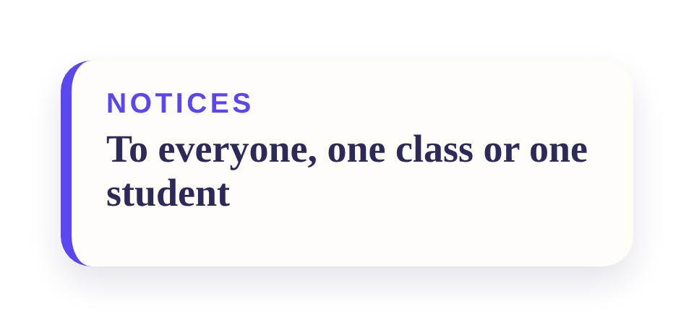
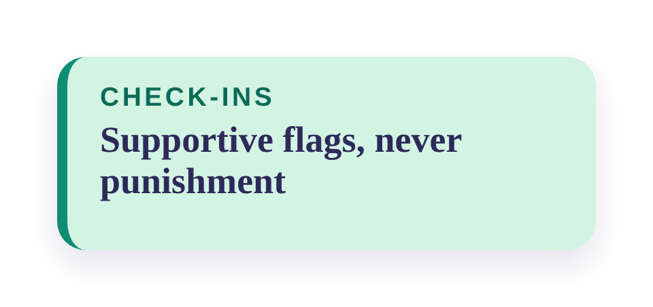
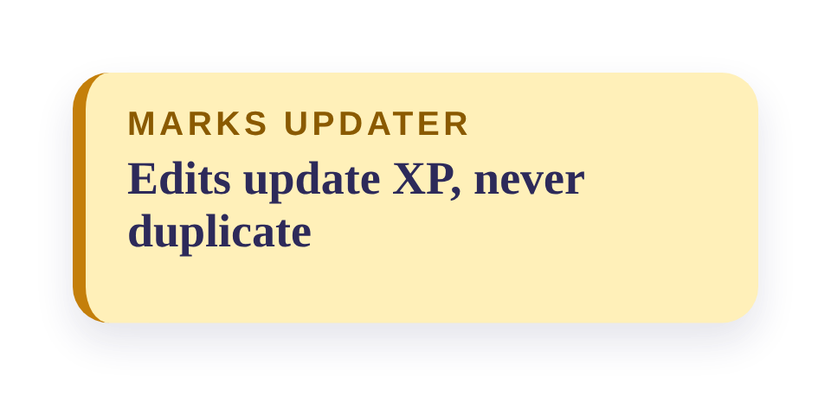
Notes:
Publish homework, exam or warning notices, then watch read receipts. Check-ins show each learner's progress and last activity so teachers can follow up kindly. Printable reports show trends, strong and weak topics and the recommended plan.

Slide 11
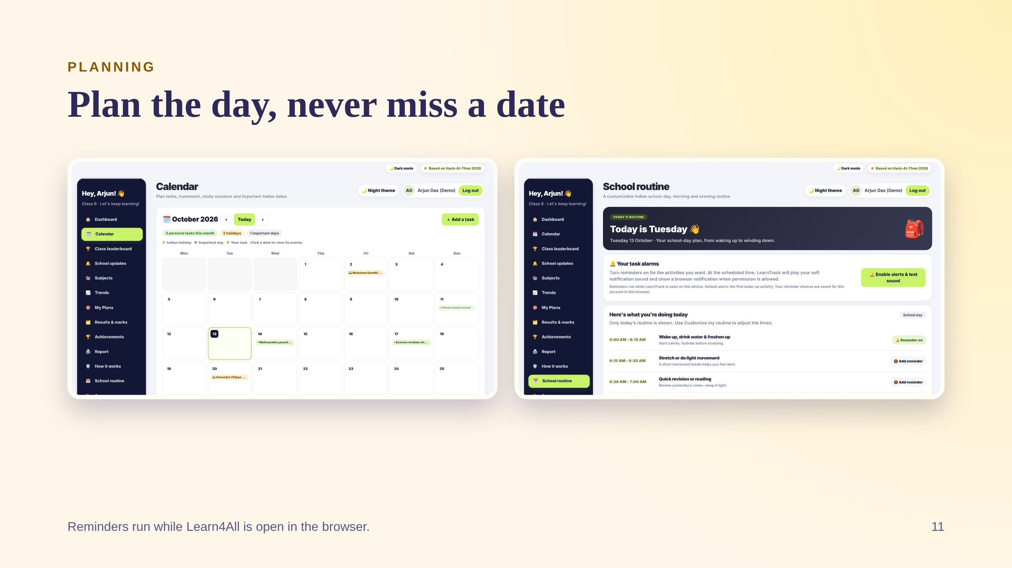


Notes:
Be upfront that alarms are in-page: the browser tab must be open. Holiday dates come from official Government of India sources, and state or school holidays can differ.

Slide 12







Notes:
Our edge is not one feature. It is that mastery gating, explainable recommendations, teacher visibility, wellbeing and accessibility all live in one small, private app made for Indian classrooms.

Slide 13








Notes:
The headline: Learn4All now ships with a repeat-safe demo dataset, so judges can log in as the admin or any of 10 fictional Class 6 students and see populated marks, trends and recommendations at once.

Slide 14







Notes:
The Next column is our honest to-do list from the project's own audit: password recovery is demo-only, the question banks need teacher review, and the live Groq call was only tested with mocks.

Slide 15









Notes:
Credit first to Aaditya Sorout and Syed Sarfaraz Ahamed, who wrote the whole codebase. Then Pramveer Kumar for the foundation code and ideas, and Sarah for the research. Thank Mohamed Aathif, Mohamed Rayan M, Sriyansh Sai Mohanty and M. Vetri Selvan M by name.

Slide 16

Notes:
Close with the tagline, thank the judges and invite questions. Offer a live demo with the teacher login and a demo student.

