Slide 1

Project : Geo fencing based Attendance System
Guided By:-
Gunjan sir
Submitted by:-
Ajay Kr. Sharma
Abhinav Chauhan
Sahil Mathur

Slide 2
GEOX

Slide 3
Problem Statement
Manual creation of database of students.
Lots of paper work.
Checking the attendance of each student manually
Time Consuming.
Students can check their attendance only by visiting the registration office
.

Slide 4
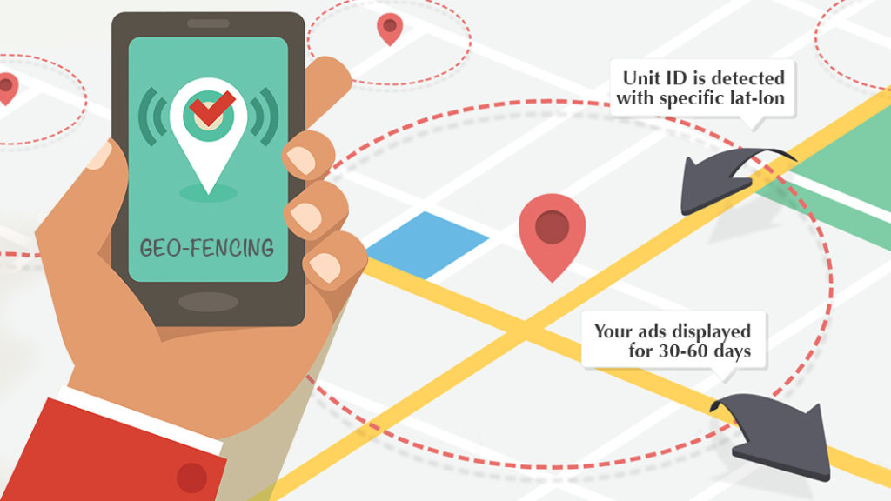
Literature Survey
Geo-fencing is a feature in a software program that uses the global positioning system (GPS) to define geographical boundaries.
Geo-fencing allow an administrator to set up triggers so when a device enters (or exits) the boundaries defined by the administrator, an alert is issued.

Slide 5
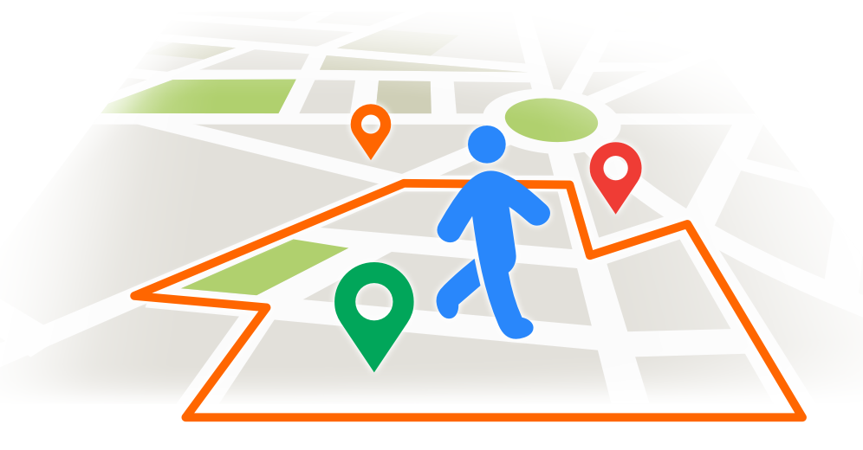
What is GEOX?
GEOX is basically an automated attendance system that is being created to ease the paperwork and maintain a attendance database of the student in institutes. We are using geofence as the main pillar to fix this problem and a database mongoDB for storing students information.

Slide 6
References
https://fencer.io/
https://developers.google.com/maps/documentation/javascript/tutorial
https://whatis.techtarget.com/definition/geofencing

Slide 7
Solution
Automated attendance system for the users.
Students can check their attendance on day to day basis
Time Saving.
Easy user interface
Discrete login page for admin and students
Push notification when the user enters the cdac.
Reduced operational time.

Slide 8
Target Audience
Institutes.
Online retailers.
Billing and Tracking.
Traffic management authority.

Slide 9
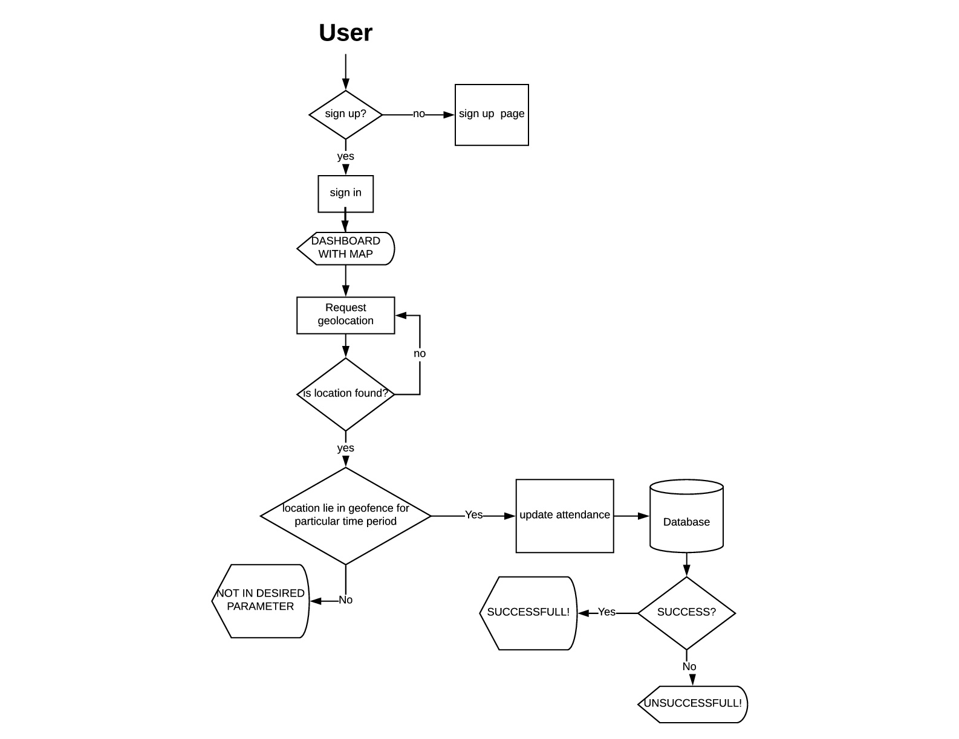
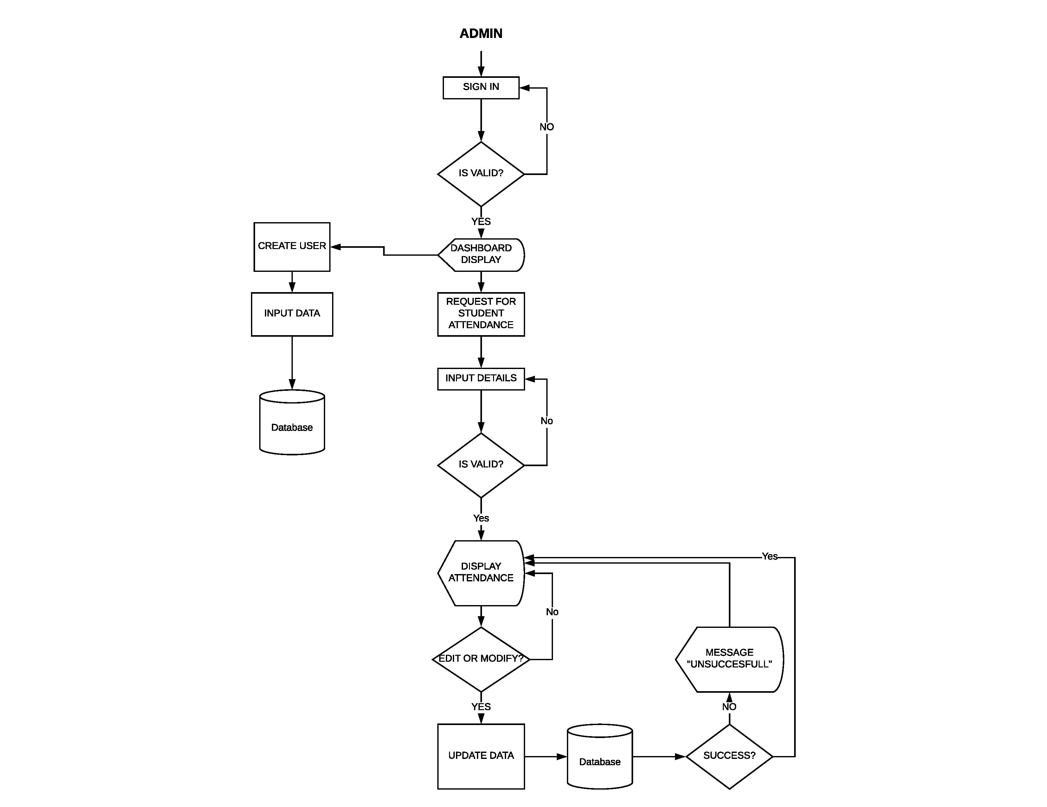
Flow Chart

Slide 10
Flow Chart

Slide 11
Future Scope
Real time monitoring of users by admin.
Advertisement and marketing by push notification when the user enters the geofence.
Traffic monitoring.

