Slide 1

MC-CDMA SYSTEM SIMULATION
Multi-Carrier CDMA System Simulation
Using OFDM
Rajesh Chauhan
Indian Institute of Technology, Kharagpur

Slide 2




MOTIVATION
Problem Statement
Designing a wireless link that stays reliable as more users share the
same spectrum under hostile, fading channel conditions.
Multi-user communication
Channel fading
Many users must share the same wideband channel without destructive interference.
Multipath propagation causes Rayleigh fading that randomly attenuates the signal.
Noise mitigation
Reliable data transmission
Additive white Gaussian noise corrupts the received signal and must be combated.
Coding, spreading, and equalization must combine to guarantee low error rates.
MC-CDMA • OFDM SIMULATION
02

Slide 3
ARCHITECTURE
System Overview
End-to-end signal path from raw information bits to the receiver.
Information
Bits
FEC
QPSK
Walsh
Spreading
OFDM
Channel
Receiver
Bits are protected with forward error correction, modulated onto QPSK symbols, spread with Walsh codes for multiple access, carried on OFDM subcarriers across the wireless channel, then reversed at the receiver.
MC-CDMA • OFDM SIMULATION
03

Slide 4
ARCHITECTURE
Frame Structure
Layout of a single transmitted frame, segment by segment.
AGC
Barker Sync
Training Sequence
OFDM Payload
Guard Interval
One MC-CDMA Frame
AGC normalizes signal power before Barker-sequence detection achieves coarse synchronization. A training sequence enables channel estimation, the OFDM payload carries user data, and a guard interval absorbs multipath delay spread.
MC-CDMA • OFDM SIMULATION
04

Slide 5






ARCHITECTURE
Transmitter Architecture
01
02
03
Random Bit Generation
Convolutional Coding
QPSK Modulation
04
05
06
Walsh Spreading
OFDM Modulation
Cyclic Prefix Addition
MC-CDMA • OFDM SIMULATION
05

Slide 6






ARCHITECTURE
Receiver Architecture
01
02
03
AGC
Synchronization
MMSE Channel Estimation
04
05
06
FFT
Despreading
Viterbi Decoding
MC-CDMA • OFDM SIMULATION
06

Slide 7


CHANNEL MODEL
Modeling the Wireless Channel
Rayleigh Fading
AWGN Channel
Models multipath propagation in a non-line-of-sight environment, causing the received signal envelope to fluctuate randomly over time and frequency.
Adds white Gaussian-distributed thermal noise to the signal, representing the random background interference present in every real receiver.
MC-CDMA • OFDM SIMULATION
07

Slide 8
EVALUATION
Performance Metrics
Three complementary error rates quantify link quality at every layer.
BER
SER
FER
Bit Error Rate
Symbol Error Rate
Frame Error Rate
Fraction of individual bits received in error after decoding — the finest-grained measure of link quality.
Fraction of QPSK symbols decoded incorrectly, reflecting errors before bit-level mapping.
Fraction of entire frames containing at least one error — the strictest, most application-relevant metric.
MC-CDMA • OFDM SIMULATION
08

Slide 9
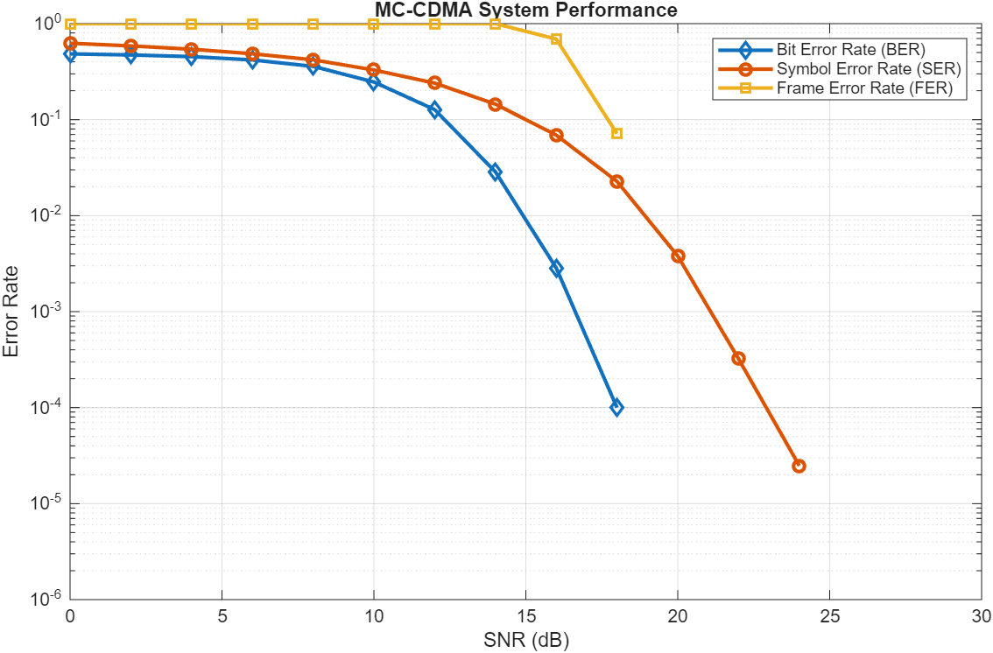
RESULTS
Error Rate vs. SNR
Reading the curves
BER falls fastest, dropping to 1e-4 by 18 dB SNR.
SER stays consistently above BER, since one symbol error can stem from a single bit flip.
FER remains near 1 until SNR climbs past ~14 dB, then collapses sharply.
All three confirm a classic waterfall region — the system transitions quickly from unreliable to highly reliable.
MC-CDMA • OFDM SIMULATION
09

Slide 10
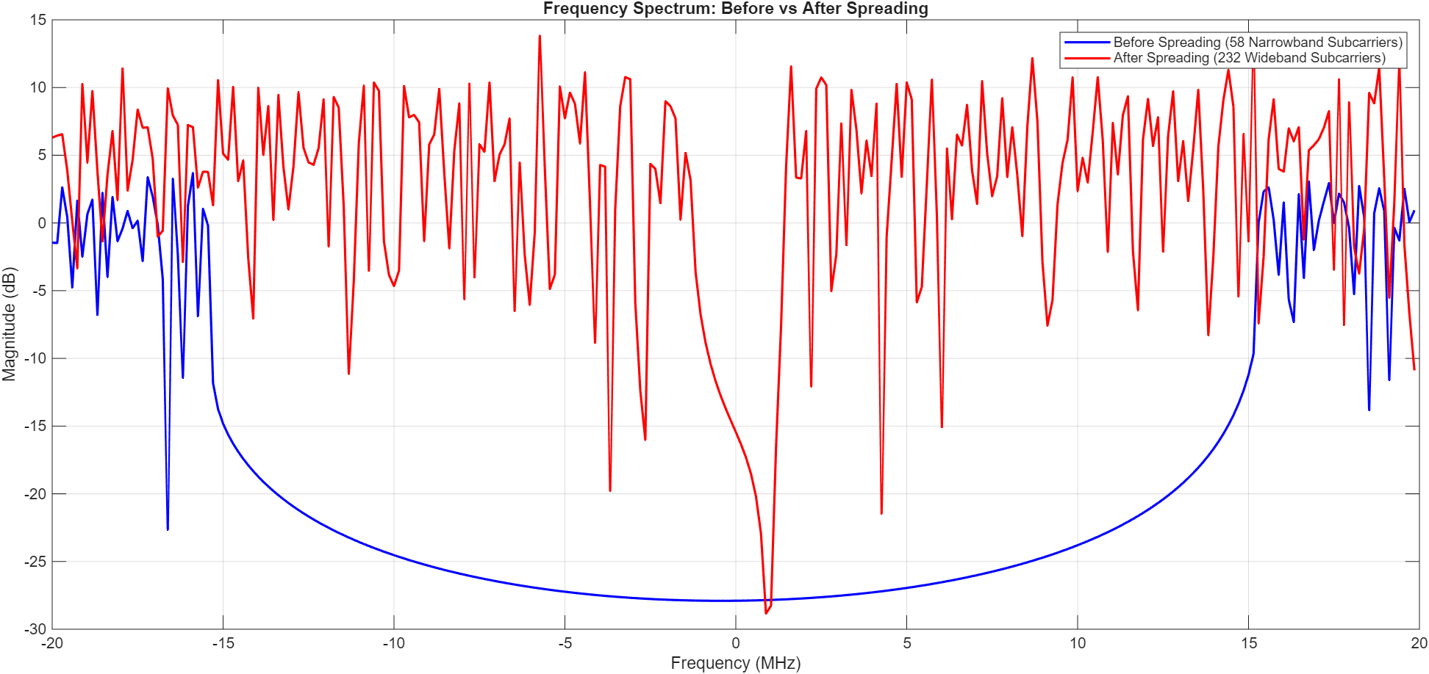
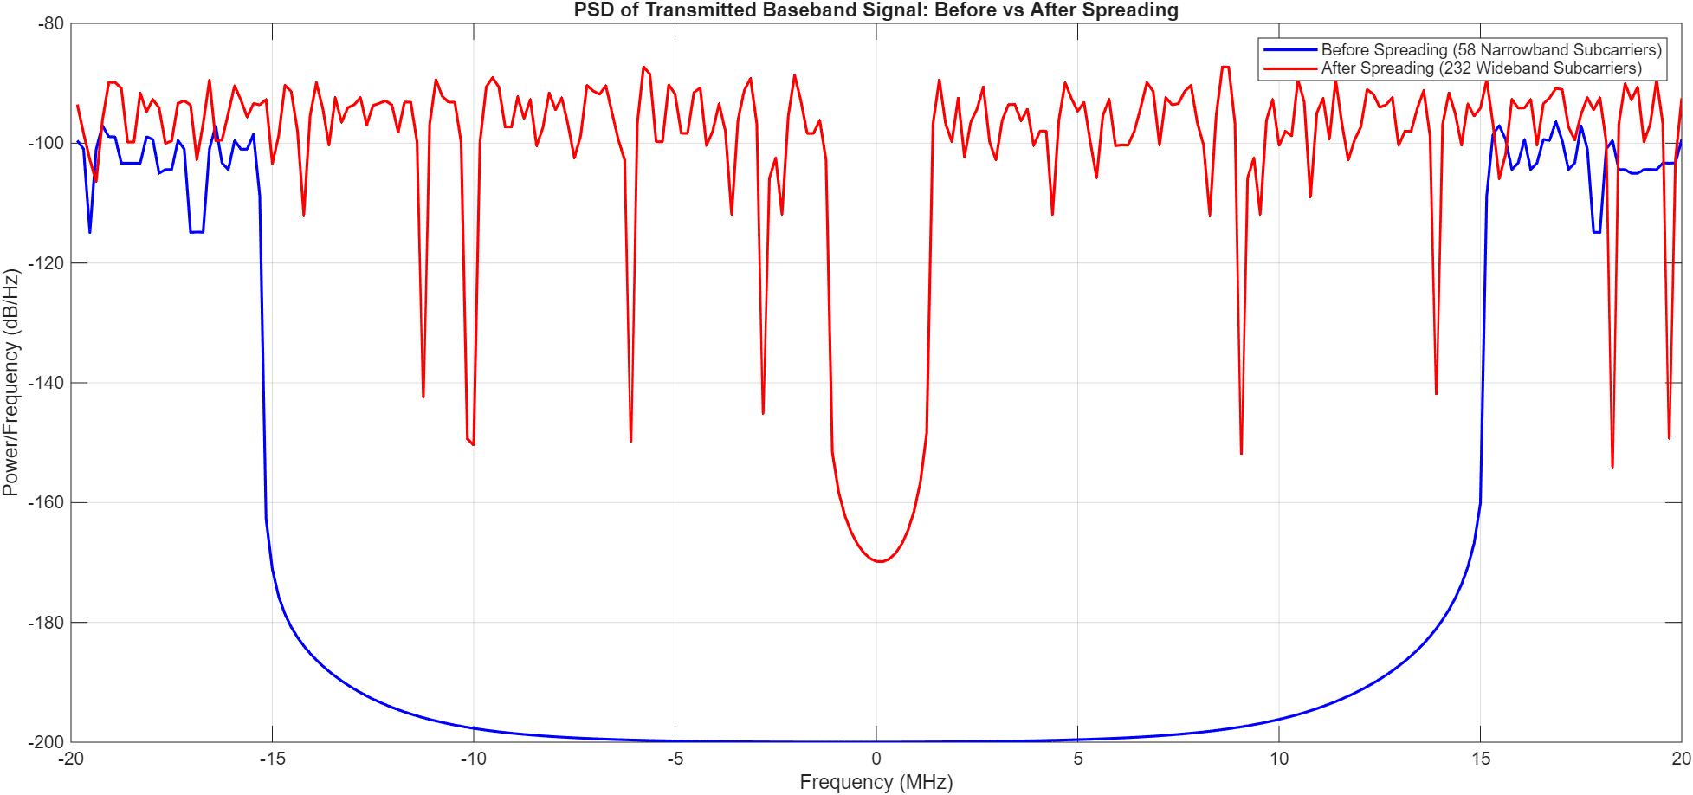
RESULTS
Spectral Analysis: Before vs. After Spreading
Walsh spreading widens each narrowband subcarrier into a wideband signal, trading peak power for processing gain.
Frequency Spectrum
Power Spectral Density
Spreading raises the noise floor between subcarriers by roughly 70 dB/Hz, distributing energy across a much wider band for processing-gain resilience.
MC-CDMA • OFDM SIMULATION
10

Slide 11



TOOLKIT
Technologies Used
MATLAB
DSP
OFDM
MC-CDMA
FEC
Wireless Comm.
MC-CDMA • OFDM SIMULATION
11

Slide 12




IMPACT
Applications
4G / 5G Systems
Research
Multi-carrier spreading techniques underpin modern cellular waveform design.
A flexible testbed for studying spreading codes, channel estimation, and coding gains.
Education
Wireless Comm. Design
Hands-on illustration of OFDM and CDMA concepts taught in communications courses.
A reference architecture for prototyping and benchmarking new transceiver designs.
MC-CDMA • OFDM SIMULATION
12

Slide 13
Thank You
Rajesh Chauhan
Indian Institute of Technology, Kharagpur

