Slide 1

Weather Impact on US Public Transportation
A project report on how weather affects transit systems in Boston, Chicago, and New York.
Creators:
25070149004 - BVS Supriya
25070149006 - Jay Chauhan
25070149014 - Malhar Shinde
Faculty Guides:
Dr. Nilkanth Deshpande
Dr. Shrikrishna Kolhar

Slide 2




Executive Summary
Key Finding
Coverage
Snowy weather causes 114% more delays than clear conditions.
Boston, Chicago, New York.
Data Analyzed
364,038 records across 429 routes over 731 days.

Slide 3

Project Overview
Problem Statement
Objectives
Quantify weather impact
US public transportation systems lose millions annually due to weather-related delays. Transit agencies lack quantitative data to:
Identify disruptive conditions
Compare city resilience
Build monitoring pipeline
Deliver actionable insights
Predict disruptions
Allocate resources efficiently
Justify infrastructure investments
Communicate expectations to passengers

Slide 4


Data Collection & Processing
1
2
Weather Data
Transit Data
Visual Crossing Weather API: Daily observations for 3 cities over 731 days.
GTFS feeds: 143 routes each for MBTA, CTA, MTA (429 total).
3
ETL Process
Extract, Transform, Load into PostgreSQL, including cleaning and merging data.

Slide 5


Pipeline Execution Flow
Airflow Scheduler
Trigger US Cities DAG
Step 1: Fetch Weather Data
(Every 5 minutes)
API Call to Visual Crossing
Fetch data for 3 cities
Save to weather_data.csv
Step 2: Fetch Transit Data
Fetching Transit Data (GTFS)
Correlate with weather patterns
Save to transit_data.csv
Step 4: Run Analysis
Step 3: Process Data
DAG Complete
Query weather_db
Calculate correlations
Generate insights
Log results
Load CSV files
Merge datasets
Clean and validate
Insert into PostgreSQL

Slide 6
Analysis Results: Overall Impact
Weather Condition
Avg Delay
% of Total
Impact vs Clear
Snowy
2.14 min
15.6%
+114.0%
Rainy
1.40 min
30.0%
+40.0%
Windy
1.06 min
10.8%
+6.0%
Clear
1.00 min
43.6%
Baseline
Snow causes more than double the delays, while rain increases delays by 40%.

Slide 7

City-Specific & Seasonal Patterns
City Analysis
Seasonal Patterns
Boston (MBTA): Avg Delay 1.30 min, significant snow delays.
Winter: 1.45 min avg delay, 23% more than summer.
Chicago (CTA): Avg Delay 1.31 min (highest), most severe winter impact.
Summer: Most reliable service.
New York (MTA): Avg Delay 1.30 min, similar snow impact.
Snowfall is the strongest predictor of delays (correlation 0.45).
All cities show similar weather resilience patterns, with Chicago experiencing the highest overall delays.

Slide 8





Technical Implementation
Data Processing
Python, Pandas, NumPy, SciPy for analysis.
Database
PostgreSQL 13 with SQLAlchemy.
Orchestration
Apache Airflow 2.7.0, Docker for automated scheduling.
Visualization
Matplotlib, Seaborn, Jupyter, Power BI for dashboards.

Slide 9
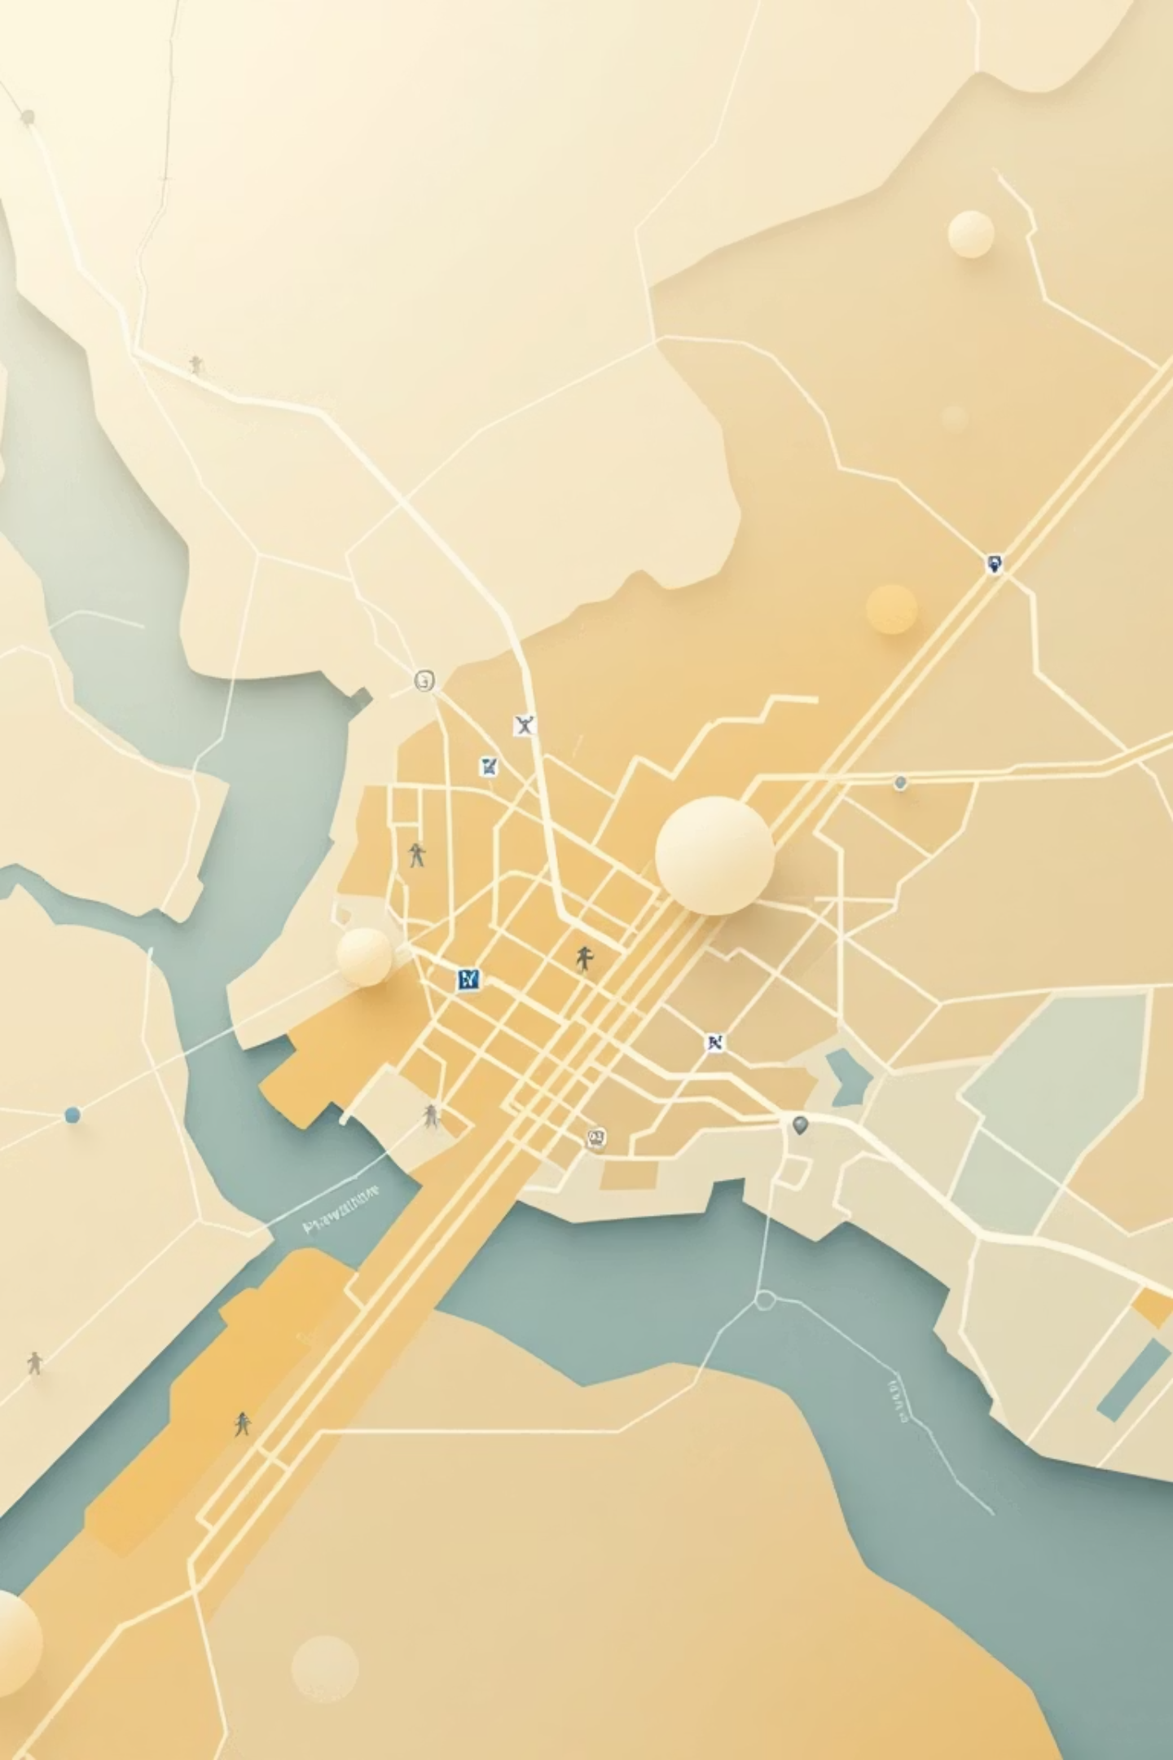
Key Insights & Recommendations
Operational
Strategic
Snow Events: Deploy 25-30% more vehicles, pre-position crews, add 15-20 min buffer.
Infrastructure: Prioritize Chicago (heated shelters), Boston (drainage), study NYC resilience.
Communication
Proactive Alerts: Mobile app integration for weather-based delay predictions.

Slide 10

Business Value & ROI
$700K
10
20%
Annual Savings
On-Time Performance
Satisfaction
Potential savings up to $1.95M across 3 cities.
Points improvement in on-time performance.
Increase in passenger satisfaction.
This project transforms reactive crisis management into proactive strategic planning, with significant financial and service quality benefits.

Slide 11

Conclusion & Future Enhancements
Summary
Future Enhancements
Quantified weather impact (snow = 114% more delays).
Short-Term: Add more cities, real-time weather API, ML predictions.
Analyzed 364,038 records across 3 cities.
Built production-ready automated pipeline.
Long-Term: Predictive maintenance, dynamic route optimization, climate impact.
Delivered actionable insights and dashboards.

