Slide 1
AWS Cloud Architecting
ITC 6480
Team 1
Members: Neha Madaram
Nandini Ghosh
Nirmit Dwa

Slide 2
Agenda
Introduction
Executive Summary
Requirements and Assumptions
Architecture
Network and Security
Scalability, HA and business Continuity
Monitoring and Auditing
Next Steps and Conclusion

Slide 3
Introduction
Problem Statement
Understanding the current environment of a Medical Company and exploring various AWS services and abiding by efficient design principles recommended by AWS and help the company in launching a highly scalable and available cloud infrastructure.
Solution
Recommending the implementation of AWS cloud solution for the medical company which is reliable, secure, highly available, cost optimized with high performance.

Slide 4
Executive Summary
Analyzed the current architecture deployed in a server hosting company.
Primary objective: Architecting a highly available, resilient, and adaptive cloud infrastructure for a medical company with adequate Security and Compliance Standards.
Provision monitoring, auditing and Accountability.
Suggested AWS services to make the diagnosis assistance application of the medical company highly available across all regions in APAC, US and Europe.

Slide 5
Requirements and Assumptions
To build an architecture that matches the current architecture with the ability to handle double the number of servers.
The architecture as shown in the diagram in the next slide reflects a generalized case for a particular region. It is assumed that AWS organizations are formed when the same architecture is implemented across several regions.
The environment deals with highly critical Personal Identifiable Information and Protected health information. Hence, security is not compromised for cost optimization. However, the costs are optimized on less critical services.

Slide 6
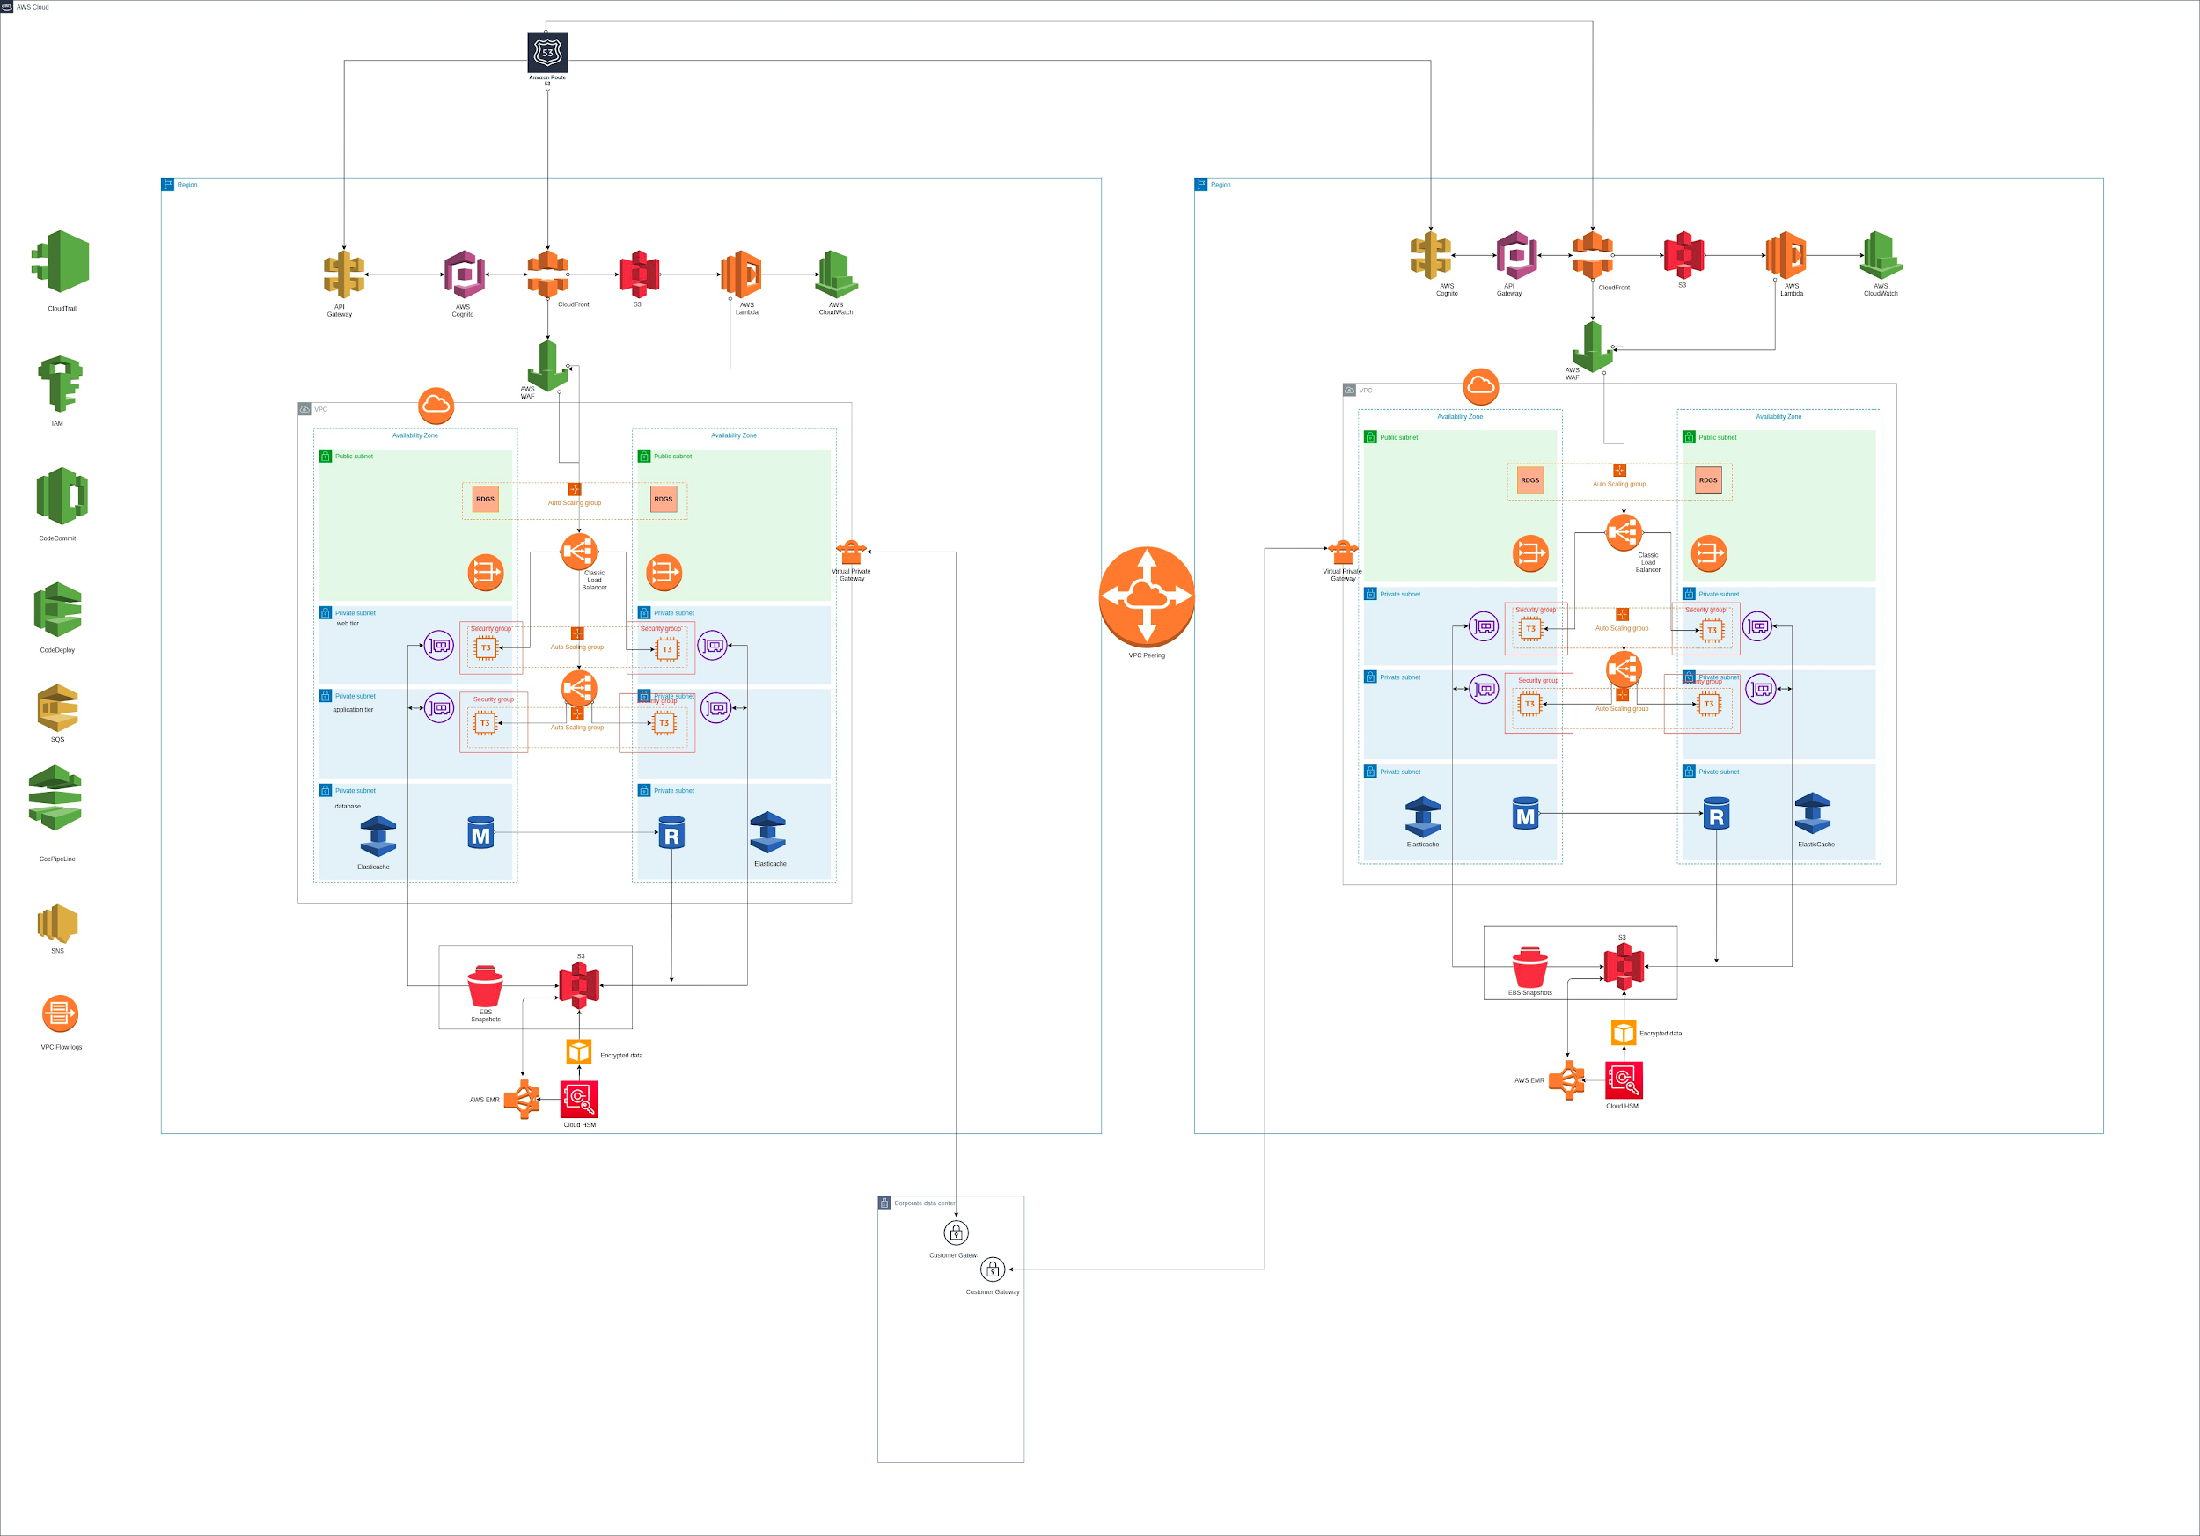
Architecture

Slide 7
Network and Security
AWS WAF for blocking malicious traffic.
IAM policies: For groups’ and user’s access control.
Security groups: Resource based policy for EC2 instances.
Network ACL for inbound and outbound traffic in subnet.
RDGW (Remote Desktop Gateway) for secure access to configure servers.
Security tokens in Amazon Cognito ( Cognito tracks everything).

Slide 8
Network and Security
Bucket policies: To restrict unauthorized access.
VPC endpoints to buckets: To access bucket in the private subnet.
AWS Key Management Services: To facilitate server-side and client-side encryption.
API gateway by AWS: To make programmatic system calls.
VPC Flow Logs and Cloudwatch for security auditing using log analysis.
Secure VPN connection between Cloud and On-Premise infrastructure.

Slide 9
Scalability, HA and Business Continuity
The medical company runs on standard SQL server in the current environment.
Best practice on AWS for applications with MySQL recommends to implement two AZs to support active/passive availability.
Cloud watch metrics to autoscale MySQL RDS storage if the free space is less than 10% of allocated Storage.
Latency Based Routing using Route 53 for a global highly available Multi Region infrastructure.
AWS EMR - to further analyze clustered information for business continuity.

Slide 10
Scalability, HA and Business Continuity
Choosing the classic load balancer for proper load distribution in two AZs.
Primary RDS and Replicated RDS.
Elastic Cache for reducing time for read process from RDS.
Auto-scaling groups for Web Server and App server.
PoP( Point of Presence in AWS):
For AWS Cloudfront to deliver content to end users at high speeds.
To run Lambda functions with the lowest possible latency.

Slide 11
Monitoring and Auditing
Some of the services/ instances that fulfill these functionalities are listed in the following:
Monitoring network traffic through VPC flow logs across regions.
Fetching both logical and visual metrics of the information logged using CloudWatch.
CloudWatch and Cloudtrail integration for tracking events.
SNS notifications for Administrative changes and when expense exceeds monthly budget.
Implementing AWS GameDays to review the cloud solution.

Slide 12
Next steps and Conclusion
Detailed study of several AWS services pertaining to various tiers of the cloud environment while sketching the architect for the medical company.
Collecting data-clusters from AWS EMR which uses Hadoop framework to process large sets of information.
After visualizing AWS GameDay results, enhancements are adapted accordingly.

Slide 13
Questions?

