Slide 1
Credit Risk
Intelligence Platform
AI-Powered Credit Risk Assessment & Financial Document Analysis
Akash Chaurasiya
Ashu Sharma
🌐 creditriskplatform.azurewebsites.net
Notes:
Title slide. Introduce the team and the platform. Mention it is live on Azure.

Slide 2
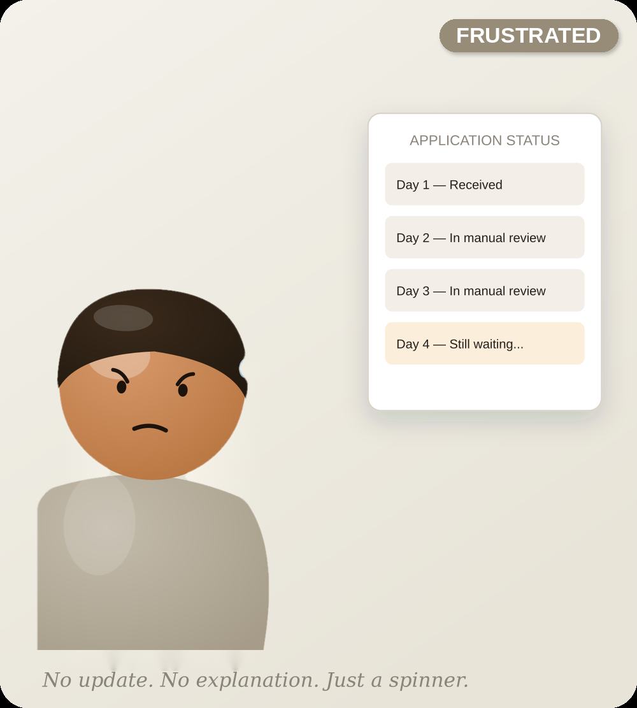
THE OLD WAY
THE APPLICATION
Rohan asked for a loan. Then he waited four days.
Rohan owns a small electronics shop. A big festival is coming, and he needs a loan to buy new products to sell before demand goes up. He applies for the loan, feeling hopeful. But one day turns into four. No one tells him what is happening. He has no idea if he will get the loan or not.
THE OLD WAY
Rohan's Story

Slide 3
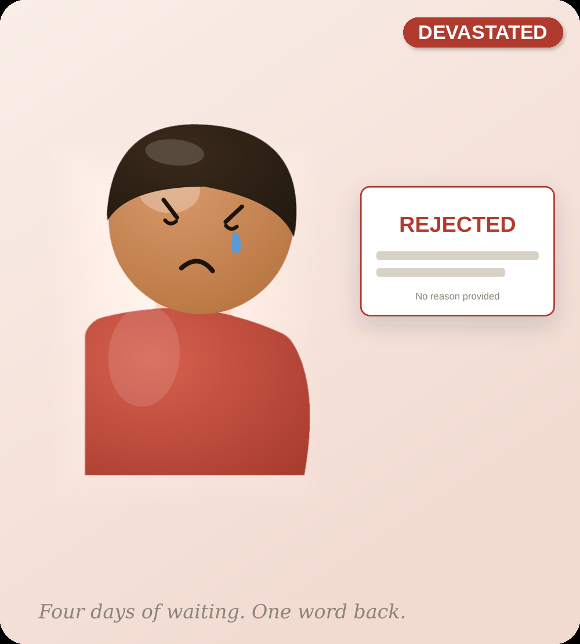
WHERE IT BROKE
THE ANSWER HE GOT
Loan Application Rejected — No Reason Given by the Bank
After four days of waiting, the answer is just one word: rejected. No one tells him why, and no one tells him what to fix. The festival does not wait for anyone. Rohan cannot buy new stock in time, and he loses more than a loan — he loses his best sales season of the year.
WHERE IT BROKE
Rohan's Story

Slide 4
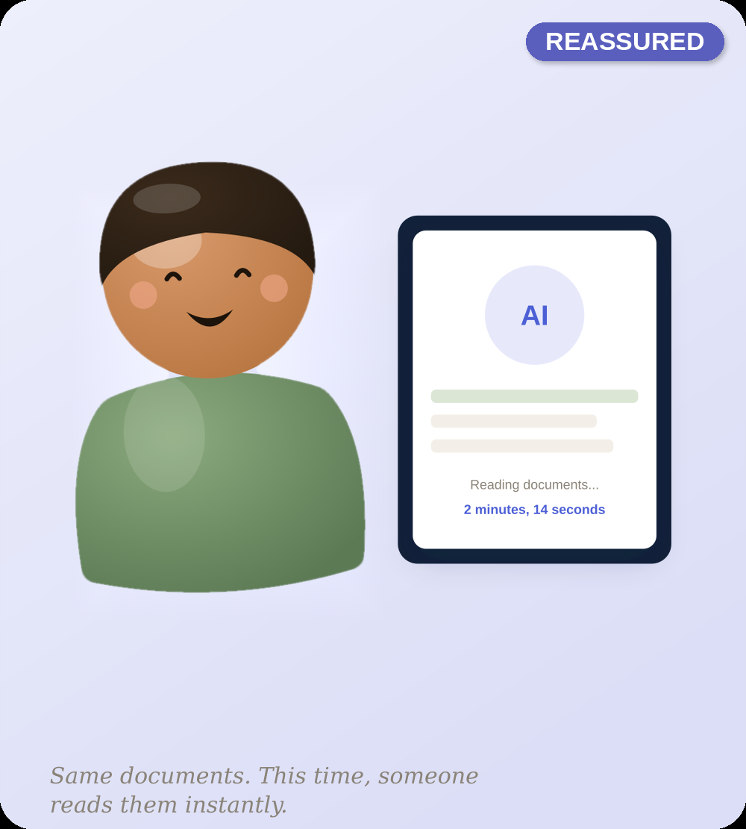
THE NEW WAY
THE TURNING POINT
The same documents. This time, read in minutes.
This time, before he applies again, Rohan uploads his documents to the Credit Risk Intelligence Platform recommended by his friend. In minutes, it shows him exactly why he was rejected — and what he needs to fix. He fixes it, then applies again, feeling sure this time.
THE NEW WAY
Rohan's Story

Slide 5

THE NEW WAY
THE NEW NORMAL
Approved. And this time, he knows why.
Rohan gets his inventory in time for the festival. The bank keeps a happy customer instead of losing one. Same papers, read the right way this time — by the bank and by Rohan. Rohan is just one person. But this platform is built to give every person a clear answer, not just a yes or no.
THE NEW WAY
Rohan's Story

Slide 6
IN ONE SENTENCE
A loan decision that used to take days
and still felt unfair now takes minutes —
and finally explains itself.
Rohan's story is one applicant. The platform behind it — built on real documents, real risk scoring, and a mandatory human sign-off — is built to give every applicant an answer, not just a stamp.
Credit Risk Intelligence Platform · Ashu Sharma & Akash Chaurasiya
Close
Rohan's Story

Slide 7
OVERVIEW
Why We Built It — And What We Built
THE PROBLEM
OUR SOLUTION
📄
Manual Review
An AI platform that extracts key financial data from uploaded PDFs, generates explainable credit risk scores, and gives AI-powered loan recommendations — for both individual customers and financial institutions.
Officers read 50-100 page PDFs by hand — 3-5 days per application.
❌
Human Error
Same applicant gets different risk ratings from different officers.
•
Automatic PDF data extraction
⏰
Slow Decisions
•
Explainable risk scores, not black-box numbers
Customers wait weeks while documents sit in a processing queue.
•
Safer loan amounts, better rates, next steps
💰
Revenue Loss
•
Full CI/CD deploy pipeline on Azure
Banks lose creditworthy customers to faster competitors.
Streamlit
LangChain
Pinecone
Docker
Azure
LangSmith
OpenAI
Notes:
Explain the manual bottleneck. Banks receive hundreds of loan applications. Human review is slow and inconsistent.

Slide 8
ARCHITECTURE
System Architecture
UI Layer
Orchestrator
AI / LLM
Data Layer
Cloud
Streamlit Web App
Chat Agent
OpenAI → Groq → Gemini
Pinecone Vector DB
Azure App Service
Auth (JWT + bcrypt)
Document Agent
3-tier fallback chain
BM25 Hybrid Search
GitHub Actions CI/CD
Customer + Institution Views
Retrieval Agent
LangSmith tracing
SQLite User Auth
← User uploads PDF → Chunks → Vectors → LLM → Risk Score + Recommendations →
Notes:
Show the five layers. PDF comes in at the top, risk decision comes out at the bottom.

Slide 9
FEATURES
Everything Inside The Platform
🔐
Secure Login
📤
Upload PDFs
📊
Risk Analysis
JWT + bcrypt auth
Salary slips, statements, ITR
AI credit score + red flags
💡
AI Recommendations
💬
AI Chat
🏙️
Retirement Planner
Urgency-sorted action plan
Ask about your own documents
40-city cost of living
👤 CUSTOMER SEES
🏦 BANK OFFICER SEES
•
Personal risk score (0-100)
•
NPA risk & CRAR indicators
•
Loan approval probability
•
Fraud detection flags
•
Safe borrowing amount
•
Applicant financial summary
•
Recommended banks & rates
•
Loan approve / reject decision
•
Debt-to-income ratio (DTI)
•
Capital adequacy assessment
•
Improvement action plan
•
Structured executive report
Notes:
Show the customer journey from login to recommendations. Mention loan gating feature.

Slide 10


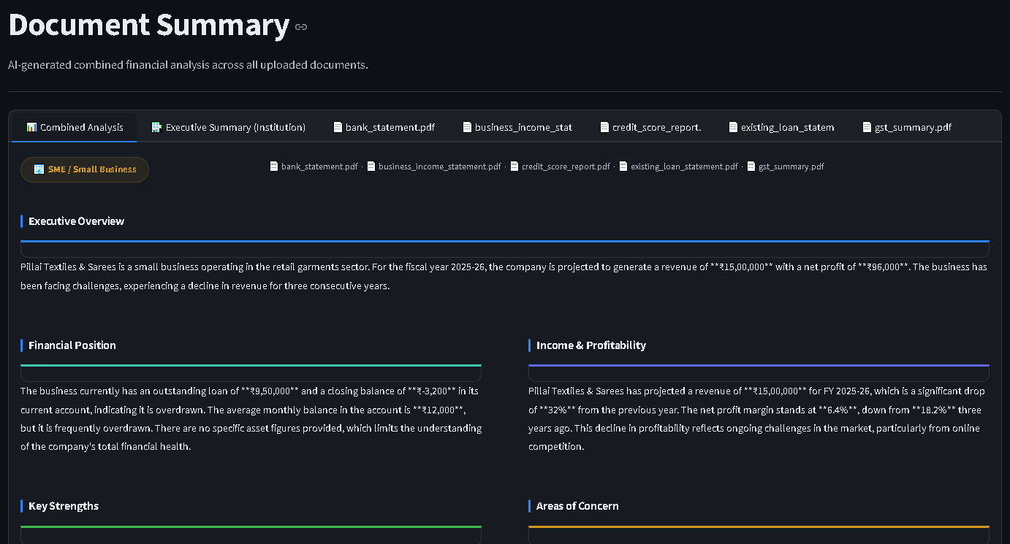
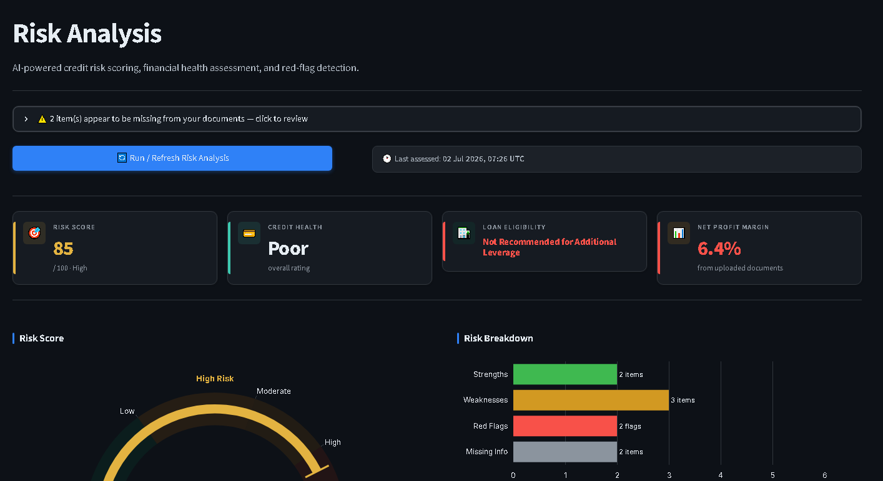

CORE FEATURE
Understanding the documents, then scoring the risk
Document Summary
Risk Analysis
The AI reads every uploaded PDF and pulls out the numbers that actually matter — income, expenses, existing loans, balances — and lays them out in plain language instead of raw pages.
From that summary, the app calculates a credit risk score out of 100, and explains it — what's working in the applicant's favor, what the red flags are, and how much of their income already goes toward debt.
Document Summary Screen
Risk Analysis Screen
Paste your screenshot here
Paste your screenshot here
Credit Risk Intelligence Platform
07

Slide 11
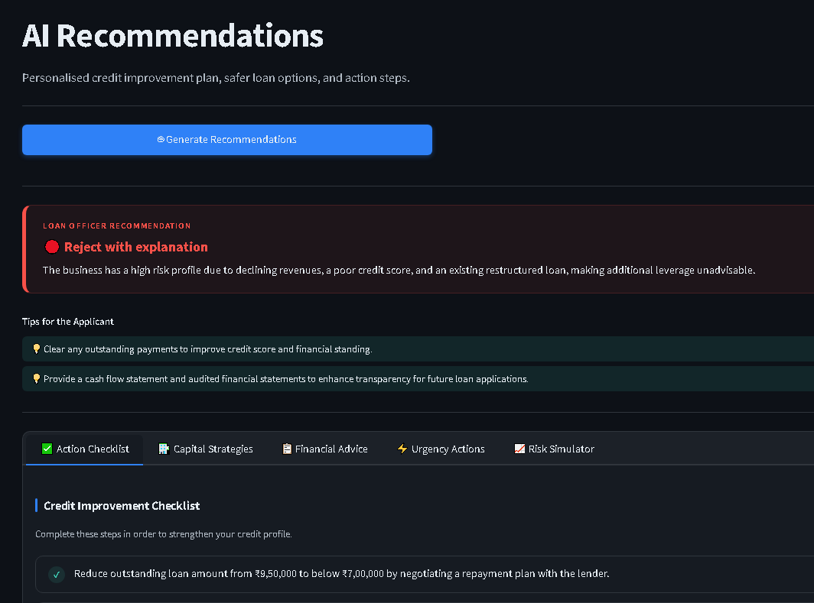
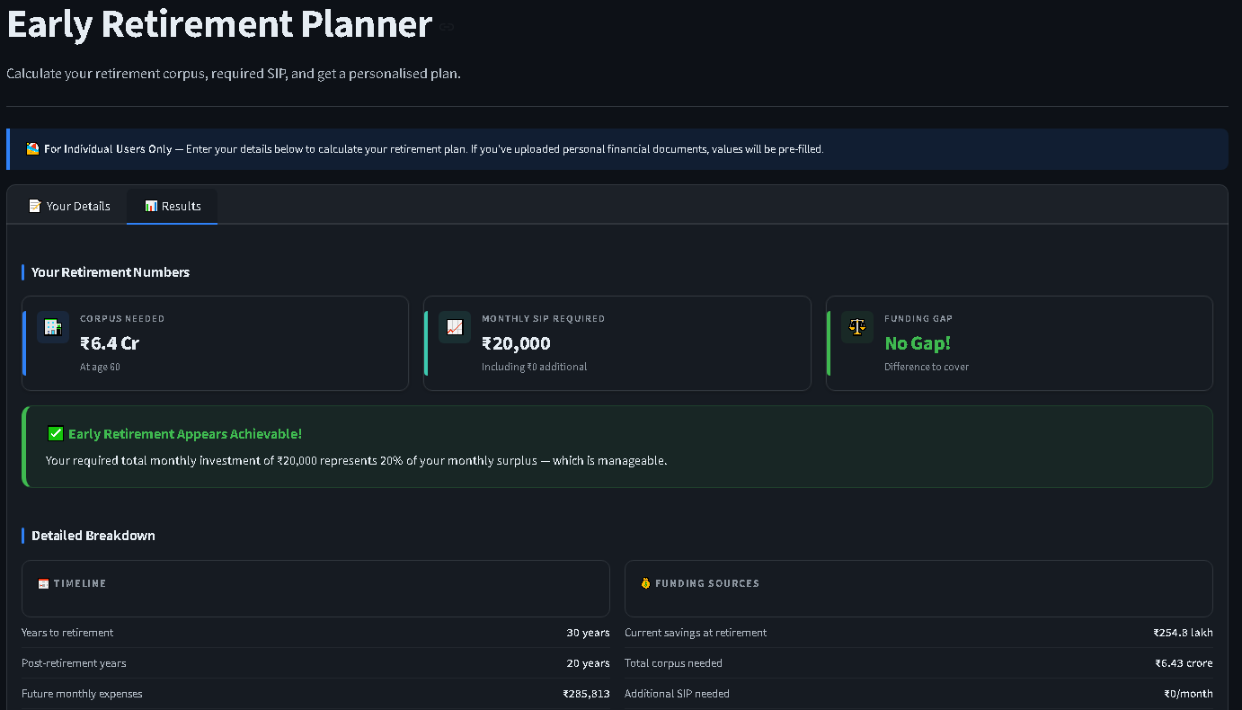
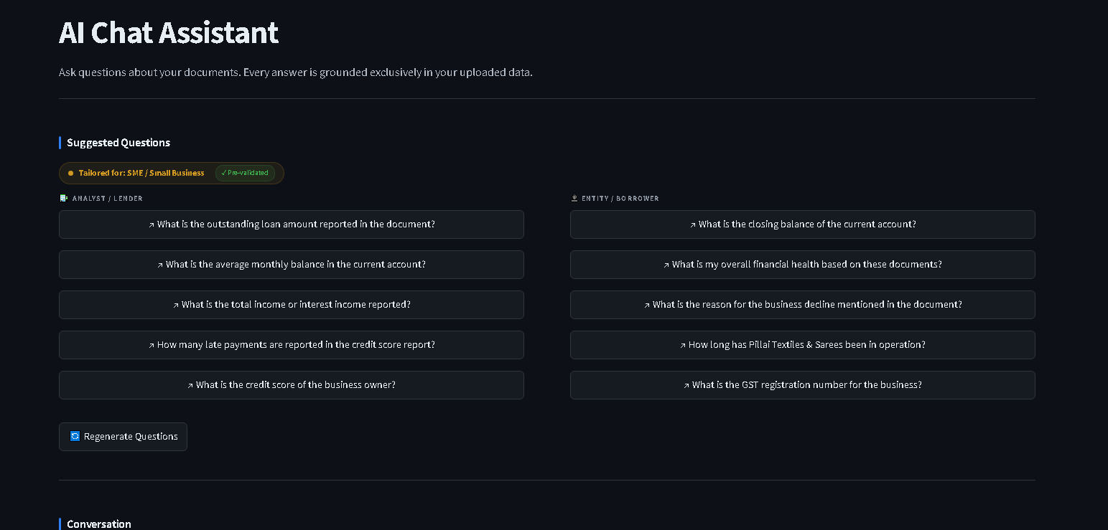
CORE FEATURES
Recommendations · Retirement · Chat
🎯 AI Recommendations
🏙️ Retirement Planner
💬 AI Chat
Personalised action plan from your risk profile.
City-aware corpus calculator, 40 Indian cities.
Ask questions about your own documents.
•
Approve / Review / Reject with reasons
•
Retirement corpus required
•
Answers grounded only in your documents
•
Alternative financing suggestions
•
Monthly SIP needed to close the gap
•
Hybrid BM25 + vector retrieval
•
Steps to improve approval odds
•
Feasibility check vs income
•
Year-aware re-ranking prevents mixups

Slide 12
HOW IT WORKS
The RAG Pipeline
1
2
3
4
5
Upload PDF
Extract Text
Chunk + Embed
Store Vectors
Retrieve
User uploads financial documents
PyMuPDF extracts content by page
Split into chunks, create vectors
Indexed in Pinecone cloud DB
BM25 + vector hybrid search
6
7
8
9
Re-rank
LLM Call
Validate
Display
Year-aware re-ranking removes stale data
OpenAI → Groq → Gemini fallback chain
DeepEval + RAGAS hallucination check
Risk score, recommendations, chat answer
Notes:
Walk through the 9-step pipeline. Emphasise the hybrid search and year-aware re-ranking as the key innovation for reducing hallucination.

Slide 13
AI QUALITY
Evaluation & Testing Coverage
DeepEval — Hallucination Detection
RAGAS — Faithfulness & Relevancy
0.22
0.88
avg. score, bad profile (under 0.5 = pass)
avg. faithfulness score
96 Unit Tests — Every Module Covered
13
test_auth.py
16
test_loan_workflow.py
19
test_entity_aware_fixes.py
14
test_reranker.py
13
test_city_and_validator.py
4
test_retirement_calc.py
5
test_sampling.py
6
test_schemas.py
All 96 tests run automatically in GitHub Actions on every push — in 6 seconds, no API keys required.
Load Testing — 20 Concurrent Users × 3 Questions Each
60
Total Requests
0%
Failure Rate
5.78s
Avg Response
1.79/s
Throughput
60/60 requests succeeded (0% failure) — p95: 11.05s, max: 21.12s — tests/Load/load_test_orchestrator.py
Notes:
62% reduction in hallucination. Explain that DeepEval gives us proof the AI is not making things up.

Slide 14
AI TOOLING
Built With Kiro AI
We used Kiro AI (agentic IDE) to design and build the Retirement Planner feature, following a strict spec-driven planning process before writing code.
Spec-First, Not "Vibe Coded"
User Prompt: "Build a retirement planner with city-wise cost of living"
Forcing a planning phase (requirements -> design -> tasks) before coding ensured the inflation-adjusted retirement-corpus formula matched the exact financial logic needed — not a rough approximation.
Kiro Spec-Driven Planning
requirements.md
design.md
tasks.md
Validated Before Shipping
4 dedicated unit tests (test_retirement_calc.py) verify the SIP and corpus math — including edge cases like zero current savings — before the feature ever reached the UI.
Implementation city_data.py
Validation test_retirement_calc.py
Credit Risk Intelligence Platform — Technical Deep-Dive

Slide 15
DEVOPS
CI/CD, Observability & Cloud Deployment
Automated CI/CD Pipeline
git push
96 tests
Docker build
Push to ACR
Deploy
Live on Azure
LangSmith — Full Request Tracing
auth.login_attempt
document_processing
run_risk_analysis
retrieval_agent.retrieve
chat_agent.answer_question
Live on Azure App Service
📦
⚙️
🌐
🔑
Container Registry
App Service Plan
Web App
Environment Vars
creditriskakash7272.azurecr.io
B2 — 2 CPU, 3.5GB RAM
creditriskplatform.azurewebsites.net
13 secure settings, never baked into image
Notes:
Two workflows run on every push. main.yml is the quality gate. The Azure workflow only runs if tests pass.

Slide 16
WRAP-UP
The Codebase & Credits
With gratitude — built end-to-end by a 2-person team over 5 days with guidance from our trainer Rajat Garg throughout the training sessions.
!
BY THE NUMBERS
OPEN SOURCE WE BUILT ON
✓
11,625 total lines of code (Python + docs/config)
✓
10,491 Python lines across 77 files
AI
AI / Backend
✓
src/ backend: 4,696 lines · ui/: 3,660 lines
Streamlit · LangChain · OpenAI · Groq · Gemini · FAISS / Pinecone · rank_bm25 · PyMuPDF / pypdf · bcrypt · PyJWT
✓
tests/: 1,270 lines · 96 unit tests passing
✓
3 LLM providers with automatic fallback
40 Indian cities in the retirement planner
UI
UI / Quality / Ops
✓
✓
6 fictional test profiles for reproducible demos
Plotly · pytest · RAGAS · DeepEval · Docker · GitHub Actions · LangSmith · Azure App Service
Credit Risk Intelligence Platform — Akash Chaurasiya · Ashu Sharma

Slide 17
LESSONS
Challenges We Solved & What We Learned
HARDEST PROBLEMS
WHAT WORKED
Hallucination in RAG
•
Hybrid search dramatically cut hallucination
✅ Hybrid BM25 + vector search with year-aware re-ranking. 0.58 → 0.22.
•
LangSmith tracing made debugging fast
Python 3.11 vs Docker
•
Pydantic settings caught config errors early
✅ SyntaxError only in Docker's Python 3.11 — fixed, now tested inside Docker pre-deploy.
•
96 tests caught Docker/Python issues pre-deploy
Azure CI/CD permissions
WHAT WE'D DO DIFFERENTLY
✅ No Owner role for a service principal — used Deployment Center + system identity instead.
•
Use managed auth (Supabase/Auth0) from day one
LLM provider reliability
•
Pin all package versions from the start
✅ Gemini deprecations, OpenAI 401s, Groq limits — solved with a 3-tier fallback chain.
•
Set up LangSmith tracing from day one
•
Add a background job queue for large PDFs
Notes:
Pick the hardest one and explain it in depth. The hallucination problem is the most impressive technically.

Slide 18
GUIDELINES · IN PRACTICE
How Our Project Followed Coding Guidelines
Every coding principle mapped to what we actually built and shipped on the Credit Risk Intelligence Platform.
✎
Naming Conventions
🔀
Code Reviews
Modules named by responsibility — test_auth.py, test_loan_workflow.py, test_reranker.py, retrieval_agent, chat_agent — consistent across the codebase.
Every push is gated: GitHub Actions runs all 96 tests automatically before code can move forward — no merge without a passing check.
📄
Documentation
🛡
Security & Compliance
LangSmith traces every step by name (auth.login_attempt, document_processing, run_risk_analysis) — intent is visible, not just code.
JWT + bcrypt authentication; 13 secure environment settings kept out of the Docker image, never baked into the build.
✔
Testing Standards
📦
Version Control
96 unit tests across every module, plus DeepEval (0.22 hallucination score) and RAGAS (0.88 faithfulness) — all run in CI in 6 seconds.
Trunk-based flow: git push → tests → Docker build → push to ACR → deploy — a clean, atomic, automated pipeline to Azure.

Slide 19
SUBMITTED
Thank You
Questions & Answers
🌐 Live App
creditriskplatform.azurewebsites.net
💻 GitHub
github.com/Chaurasiyakash0136/Training-2026
🔍 LangSmith
smith.langchain.com → credit-risk-platform
🏷️ Version
git tag v1.0 — main branch
Akash Chaurasiya · Ashu Sharma
Notes:
Thank the audience. Offer to show the live app and LangSmith traces. Invite questions.

