Slide 1

MODULE 2 · STATISTICS & PROBABILITY · TOPIC 2.8
Hypothesis
Testing
Day 28 — is this difference real, or is it the √n noise we measured yesterday?
Boston University
1
4
3
Formula, built from yesterday's SE
Ways people misread a p-value
Habits that quietly break it
Prepared & presented by Srinivasa Sai Chava
Notes:
Day 28. The machinery here is small - it is yesterday's standard error with a decision rule bolted on. Almost the whole session is about how the decision rule gets misused, because that is where the damage happens.

Slide 2
WHY THIS SESSION
The maths is small. The misuse is enormous.
The whole formula
And the reason it needs two hours
t = (what we saw − what we expected) / SE
This is the single most misused tool in applied statistics. Entire research literatures have been built on p-values that did not mean what their authors thought.
The formula takes ten minutes. Knowing when it lies to you takes the rest.
That is it. The SE is yesterday's σ/√n. You already have every piece; today just adds a decision rule on top.
Four claims today, in order of how much they will bother you
1
A p-value is NOT the probability that your hypothesis is wrong
2
p = 0.049 and p = 0.051 differ by 0.017 in the test statistic
3
Two ordinary research habits triple your false positive rate
4
In some fields, most “significant” findings are false
Slides by Srinivasa Sai Chava
Notes:
Claim 4 is deliberately provocative and it is arithmetic, not opinion - slide on the base rate proves it. Promise all four up front.

Slide 3
WARM-UP · 5 MINUTES
Four questions from Day 27
1
What is the standard error?
→ σ/√n — how far a sample mean lands from the truth.
2
σ or SE: which describes people?
→ σ. SE describes how well you measured the average.
3
Does the CLT make your data normal?
→ No. It never did. It is about the MEAN.
4
Name one way the CLT fails.
→ Infinite variance, or dependent observations.
Everything today is built on that first answer. A hypothesis test asks one question: is the gap I observed large compared with the SE — the noise I already know how to compute?
Slides by Srinivasa Sai Chava
Notes:
Make the continuity explicit. Students who see a test as a new thing to memorise struggle; students who see it as SE plus a rule do not.

Slide 4
SESSION PLAN
How today's two hours are structured
The logic and the formula
15 min
What a p-value is
20 min
1
2
Assume nothing, measure surprise
And the four things it is not
Choosing the right test
20 min
The two errors, and power
15 min
3
4
Welch, paired, and t vs z
Why “not significant” says little
How it goes wrong
20 min
Practice notebook
30 min
5
6
Multiplicity, p-hacking, base rates
You code, I walk around
Sections 2 and 5 are the ones that matter. Most courses teach section 1 and stop, which is how the misuse gets passed on.
Slides by Srinivasa Sai Chava
Notes:
Be explicit that the critical-thinking half is the point, not an aside.

Slide 5
1
The Logic
The null hypothesis
The formula
A worked test
Assume nothing, then measure surprise · 15 minutes
Slides by Srinivasa Sai Chava

Slide 6
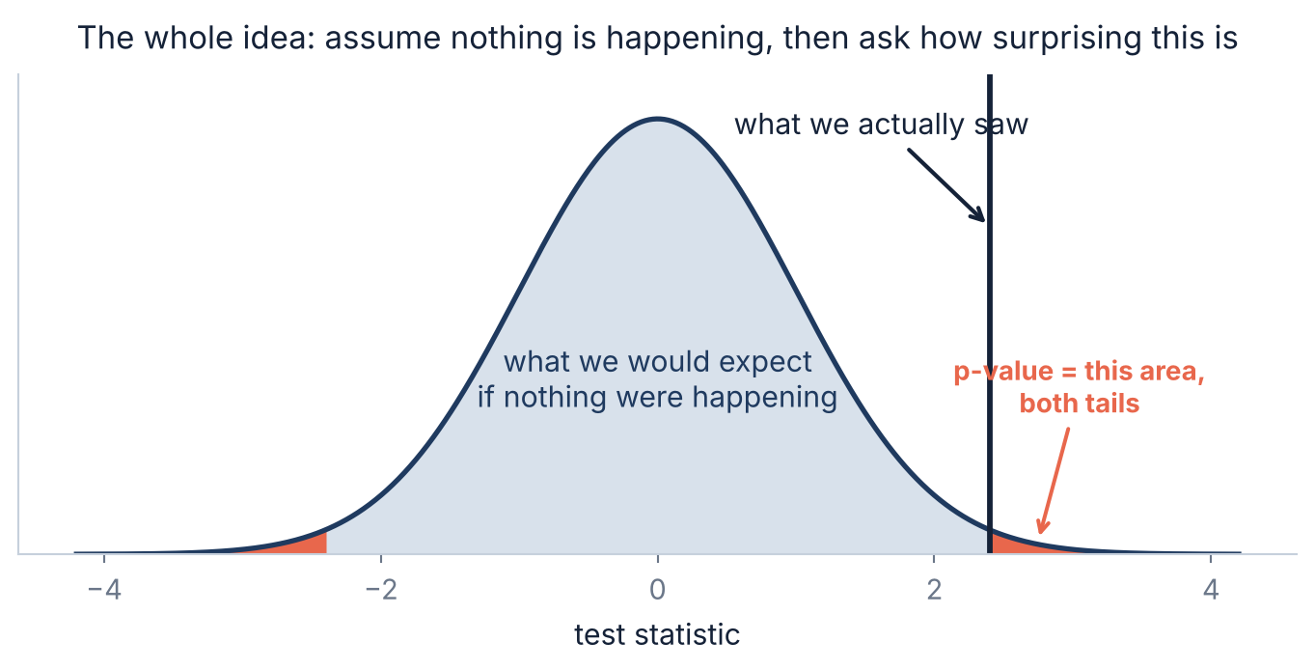
1.1 · THE LOGIC
The whole idea, in one picture
Read it as a proof by contradiction, run on probabilities rather than logic: assume nothing is happening, work out what the data would look like under that assumption, and see whether what you actually got is a comfortable fit or an awkward one.
Slides by Srinivasa Sai Chava
Notes:
The courtroom analogy also works: presumed innocent, and we ask whether the evidence is hard to explain under that presumption. But do not overwork it - a verdict of not guilty is not a finding of innocence, which is exactly the point about p > 0.05.

Slide 7
1.2 · THE MACHINERY
The formula is yesterday's standard error, rearranged
t = (what we saw − what we would expect) / SE
“how many standard errors away from boring is this?”
1
State the null
The boring version of the world: no difference, no effect, nothing happening.
2
Compute the statistic
The gap, divided by the SE you learned to compute yesterday.
3
Find the p-value
How often a world with no effect produces a gap at least this big.
4
Decide — and report more
The decision is the least interesting output. Report the effect and its interval too.
Slides by Srinivasa Sai Chava
Notes:
Step 4's phrasing is deliberate. The decision is the part everyone reports and the part that carries the least information.

Slide 8
1.3 · A FULL EXAMPLE
Worked through: did the training course help?
PAIRED, not two-sample
# 60 employees, productivity scored before and after a course.
# Each person is measured twice, so the test is PAIRED.
change = after - before
# --- 1. the null: the course does nothing, so mean change = 0
# --- 2. the statistic
mean_d = change.mean() # +2.587
sd_d = change.std(ddof=1) # 5.978
se = sd_d / np.sqrt(60) # 0.772
t = mean_d / se # +3.353
# --- 3. the p-value
stats.ttest_rel(after, before)
# t = 3.353, df = 59, p = 0.0014
# --- 4. and the part that actually matters
stats.t.interval(.95, 59, mean_d, se) # (+1.04, +4.13)
cohen_d = mean_d / sd_d # 0.43
same people measured twice
t = 3.35
3.35 standard errors from zero
p = 0.0014
rare, if the course did nothing
CI: +1.0 to +4.1 points
the useful output
d = 0.43
a modest, real-world effect
Report all three
p alone says almost nothing
Say it in words: “the course raised scores by about 2.6 points, and we are confident the true gain is between 1 and 4.”
Slides by Srinivasa Sai Chava
Notes:
Note that the sentence in the green card contains no p-value at all, and is more informative than one. That is the habit to build.

Slide 9
2
What a p-value Is
Uniform under the null
The four misreadings
The threshold is arbitrary
And the four things it is not · 20 minutes
Slides by Srinivasa Sai Chava

Slide 10
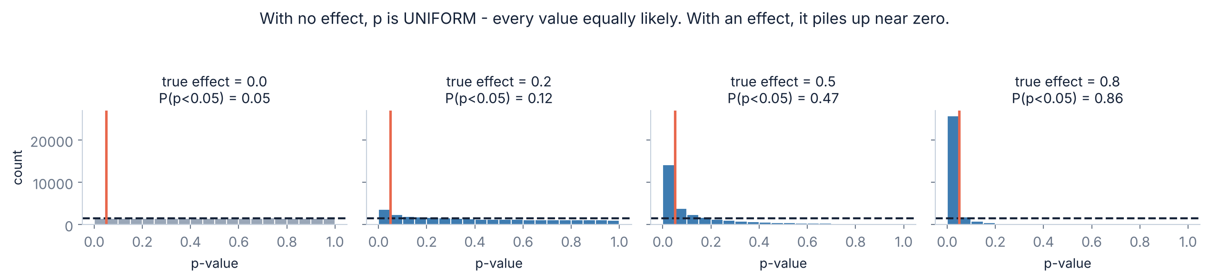
2.1 · THE DEFINITION
What a p-value does when nothing is happening
Left panel: no effect at all
Right panels: a real effect
The p-values are UNIFORM — 0.03 is exactly as likely as 0.97. That is Day 26's flat line, and it is the definition working: 5% of the time, a world with nothing in it hands you p < 0.05.
The distribution tips towards zero. A small p-value is evidence precisely because it is rare under the null — not because small numbers are meaningful in themselves.
Slides by Srinivasa Sai Chava
Notes:
The uniform-under-the-null fact is the single cleanest definition of a p-value and it ties straight back to Day 26. Most students have never seen it.

Slide 11
2.2 · THE MISREADINGS
⚠ Four things a p-value is not
✗ “p = 0.03, so there is a 3% chance the null is true”
It is the other way round. p assumes the null IS true and asks how odd the data is. It cannot tell you the chance of the null.
✗ “p = 0.03, so there is a 97% chance the effect is real”
No. That depends on how plausible the effect was beforehand — section 5 puts a number on it.
✗ “p = 0.20, so there is no effect”
No. It means you did not find one, which may only mean your study was small. Absence of evidence.
✗ “p = 0.001, so the effect is large and important”
No. With enough data a meaningless difference gets a tiny p. Significance is about detectability, not size.
✓ What it IS: if nothing were happening, how often would I see data at least this extreme? That sentence, and nothing more.
Slides by Srinivasa Sai Chava
Notes:
Make them say the correct sentence out loud. It is long and awkward, and that awkwardness is exactly why people substitute the wrong short ones.

Slide 12
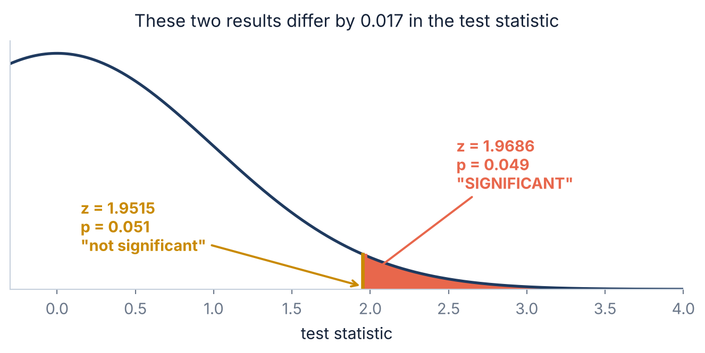
2.3 · THE THRESHOLD
⚠ There is nothing magic about 0.05
Two results, one career
p = 0.049 gets published and called a discovery. p = 0.051 gets a shrug and a file drawer.
The underlying test statistics are 1.9686 and 1.9515 — a difference of 0.017.
Where 0.05 came from
Ronald Fisher suggested it in 1925 as a convenient rule of thumb, roughly two standard errors. He explicitly intended it as a starting point, not a law.
Particle physics uses 0.0000003. The number should follow from the cost of being wrong.
The practical habit: report the actual p-value, not “p < 0.05”. A reader can then judge 0.049 and 0.004 differently — which they should, because they are different.
Slides by Srinivasa Sai Chava
Notes:
The 0.017 figure is the one that lands. It makes the arbitrariness concrete rather than philosophical.

Slide 13
3
Choosing the Test
Which test
Welch vs Student
Paired vs unpaired
t vs z
Three choices that change the answer · 20 minutes
Slides by Srinivasa Sai Chava

Slide 14
3.1 · CHOOSING
Which test, in one table
Your question | The test | scipy
Is this mean different from a target? | one-sample t | ttest_1samp(x, mu0)
Are these two groups different? | Welch's t | ttest_ind(a, b, equal_var=False)
Same people, before and after? | paired t | ttest_rel(after, before)
Are these two proportions different? | two-proportion z | proportions_ztest
More than two groups? | ANOVA, then adjust | f_oneway
Counts in categories? | chi-square | chi2_contingency
Data badly non-normal, small n? | permutation test | permutation_test
The next three slides are the three choices in this table that most often get made wrong — and in each case the wrong choice runs without error and returns a confident number.
Slides by Srinivasa Sai Chava
Notes:
The permutation-test row is worth a sentence: it needs no distributional assumption at all, and modern computers make it cheap.

Slide 15
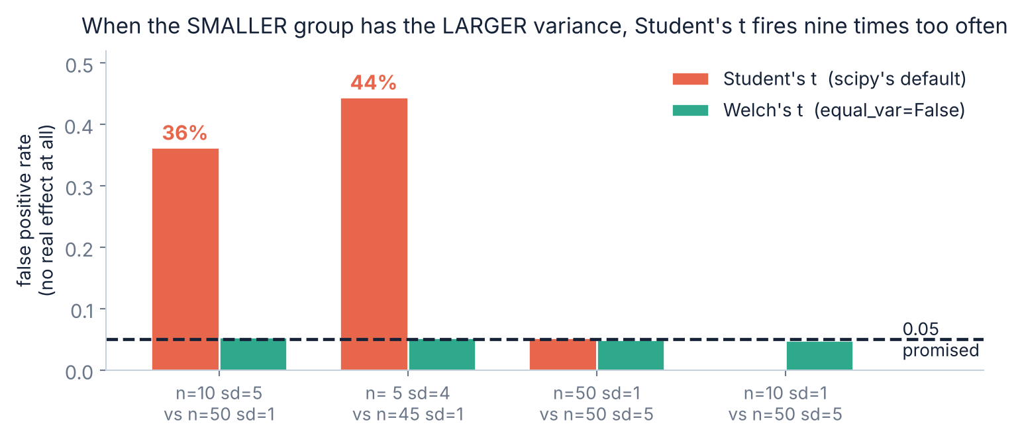
3.2 · WELCH
⚠ scipy's default two-sample test is the wrong one
44% instead of 5%
Student's t assumes both groups have the same variance. When the SMALLER group has the LARGER variance, that assumption fails badly and the test fires nine times too often — on data with no effect whatsoever.
The fix is one argument
stats.ttest_ind(
a, b,
equal_var=False)
scipy's equal_var argument still defaults to True, so the dangerous version is the one you get by typing the obvious thing. Use Welch unless you have a specific reason not to — there is essentially no downside.
Welch holds at 5% in every case above, and costs almost nothing when the variances do match.
Slides by Srinivasa Sai Chava
Notes:
Have them check the default themselves in the notebook. A default they can verify is more memorable than one they are told about.

Slide 16
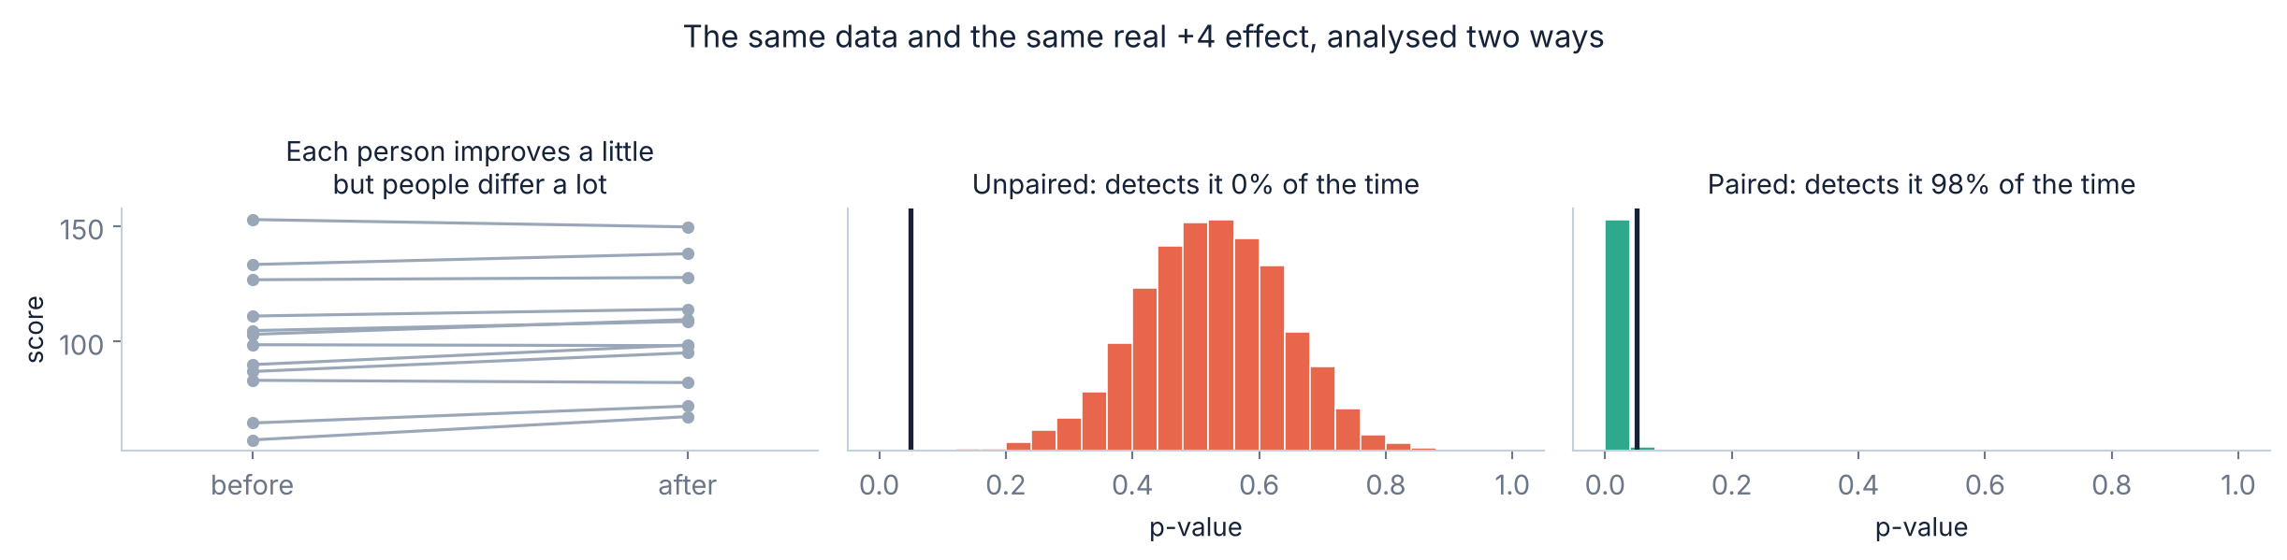
3.3 · PAIRED DATA
Pairing can be the difference between 0% and 98%
Why the unpaired test fails here
What pairing does
People differ by about 20 points; the effect is 4. An unpaired test has to see that 4-point signal through 20 points of between-person noise, and it cannot.
It subtracts each person from themselves. The between-person variation cancels completely, and all that is left is the change — which is exactly what you wanted to measure.
Slides by Srinivasa Sai Chava
Notes:
This is the largest single gain available from a design choice anywhere in the module. If the data is paired, pairing it is free power.

Slide 17
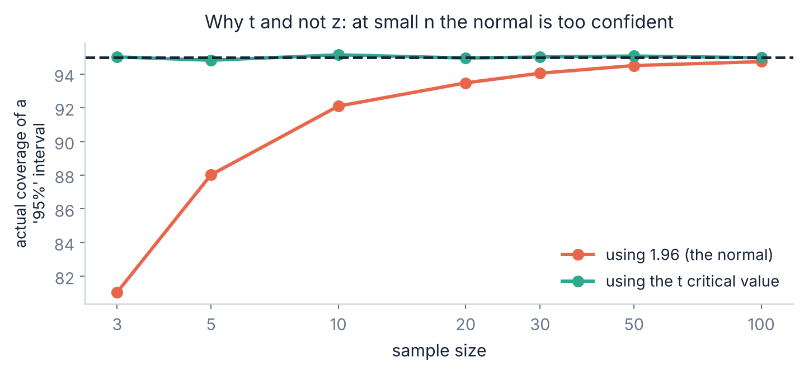
3.4 · t VS z
Why t and not z, and when it stops mattering
One extra source of error
When you use 1.96 you are pretending you know σ. You do not — you estimated it from the same small sample, and that estimate is itself uncertain.
The t distribution has heavier tails to pay for that.
How much it matters
n | using z | using t
3 | 81% | 95%
10 | 92% | 95%
30 | 94% | 95%
100 | 95% | 95%
Past about n = 100 the two agree to the third decimal, which is why nobody worries about it in large studies. Below n = 20 it is the difference between a 95% interval and a 92% one — and scipy's t functions handle it for you anyway.
Slides by Srinivasa Sai Chava
Notes:
Reassure them: if they use ttest_* and t.interval, this is already handled. The slide is so they know why the function exists.

Slide 18
4
The Two Errors
Type I and Type II
Power
Absence of evidence
And why a null result says so little · 15 minutes
Slides by Srinivasa Sai Chava

Slide 19
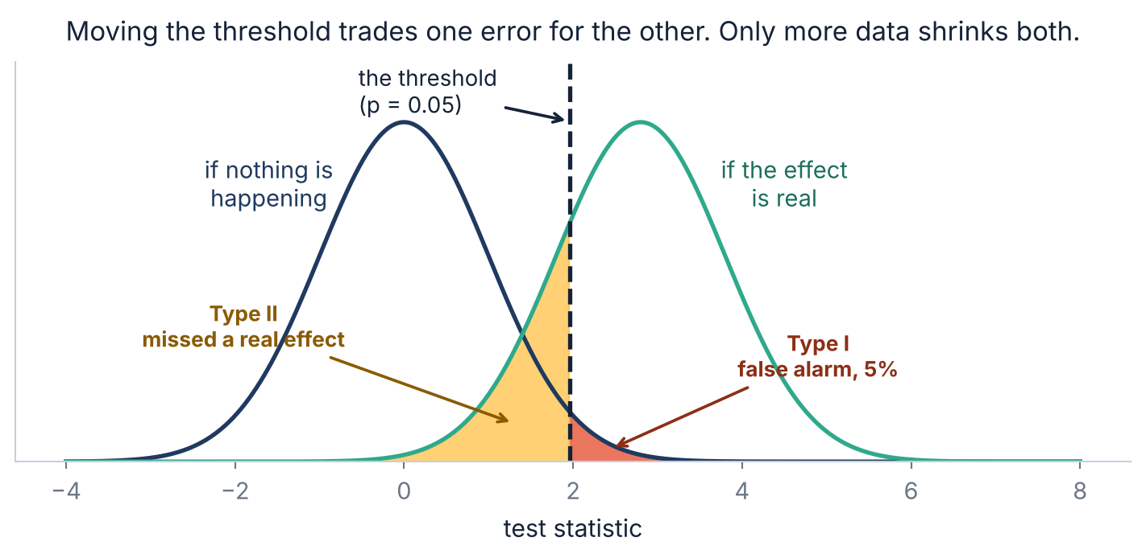
4.1 · TYPE I AND II
Two ways to be wrong, and they trade against each other
Type I — a false alarm
Type II — a miss
You declare an effect that is not there. You control this directly: it is α, the 5%.
A real effect goes undetected. You almost never control this, and almost nobody reports it.
Slides by Srinivasa Sai Chava
Notes:
The asymmetry is the point. Everyone can tell you alpha is 0.05; almost nobody can tell you their study's power.

Slide 20
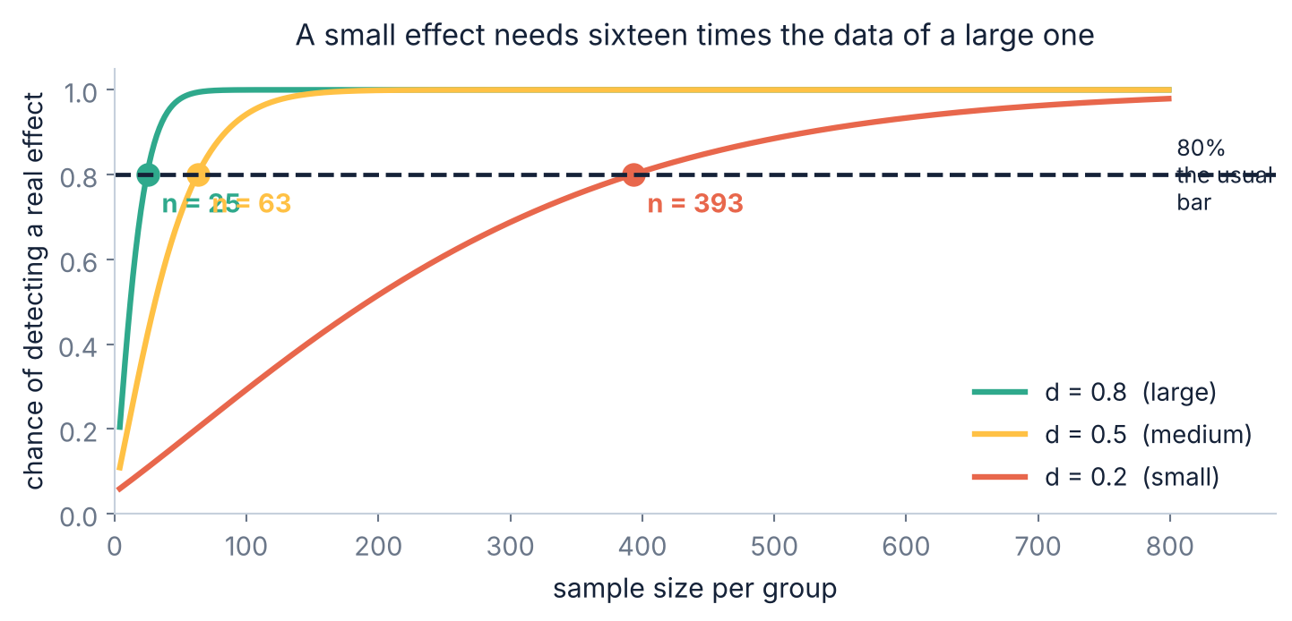
4.2 · POWER
Power: the chance of noticing an effect that is really there
What the numbers mean
Cohen's d is the gap measured in standard deviations. 0.2 is small, 0.5 medium, 0.8 large.
For 80% power you need 25 per group at d = 0.8, 63 at d = 0.5, and 393 at d = 0.2.
Halve the effect, quadruple the n
25 → 63 → 393 as d goes 0.8 → 0.5 → 0.2. It is the same √n law as yesterday, seen from the other side: small effects are expensive to find.
Do this calculation BEFORE you collect data, not after. Afterwards it only tells you what you already know — that you did not find anything.
Slides by Srinivasa Sai Chava
Notes:
Post-hoc power computed from the observed effect is circular and widely criticised. Power analysis belongs at the design stage.

Slide 21
4.3 · NULL RESULTS
⚠ “Not significant” does not mean “no effect”
What a null result actually says
What to report instead
“We did not find an effect.” That is compatible with two completely different worlds:
· there is no effect, or
· there is one and our study was too small to see it.
The p-value alone cannot tell you which.
The confidence interval, which separates the two cases immediately:
· CI of −0.2 to +0.3 — any real effect is tiny. Informative.
· CI of −8 to +11 — you learned nothing at all. Also informative, and honest.
Same p-value. Completely different conclusions.
Why this matters beyond your own analysis
Journals have historically been reluctant to publish null results, so the studies that found nothing stay in the drawer while the ones that got lucky appear in print. The published record then looks far more certain than the evidence is. Reporting intervals rather than verdicts is the individual-level fix.
Slides by Srinivasa Sai Chava
Notes:
The two-CI contrast is the most useful single idea on this slide. Same verdict, opposite amounts of information.

Slide 22
5
How It Goes Wrong
Many comparisons
p-hacking
The base rate
Significant but trivial
Three ways, none of which feel like cheating · 20 minutes
Slides by Srinivasa Sai Chava

Slide 23
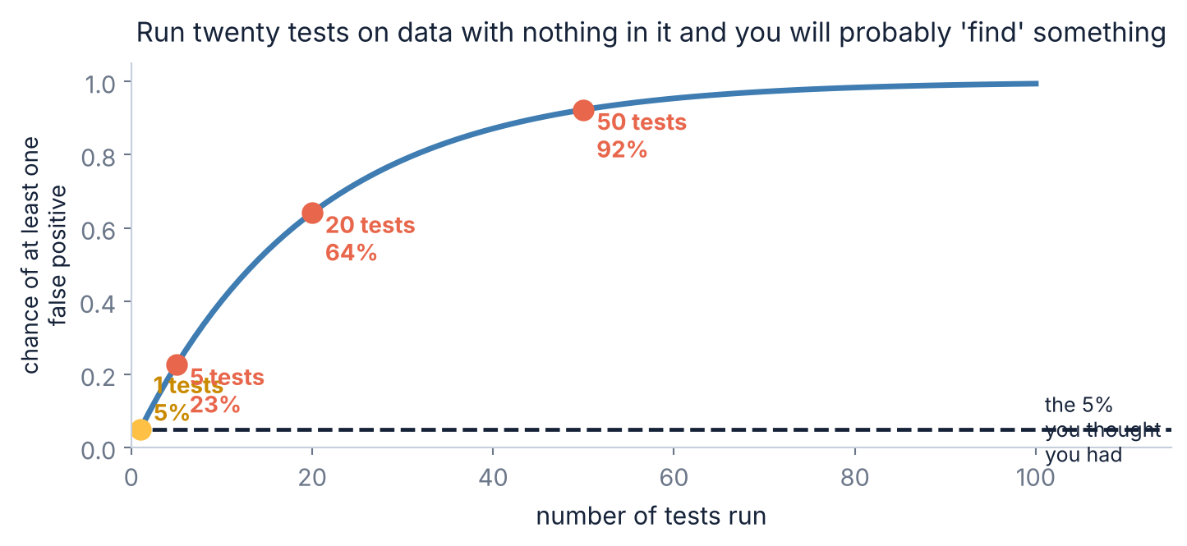
5.1 · MULTIPLICITY
Run enough tests and something will always turn up
Twenty tests, nothing real
1 − 0.95²⁰ = 64%. On pure noise, you will find a “significant” result about two times in three, and on average exactly one.
This is not a subtle statistical issue. It is arithmetic.
The fixes
· Bonferroni: use 0.05/k. Simple, and strict.
· Benjamini–Hochberg: controls the false discovery rate. Less strict, usual choice for many tests.
· Best of all: decide which test matters before you look.
Where this bites in practice: testing ten metrics in an A/B test, comparing every pair of groups, or scanning a wide dataframe for “interesting” correlations. All three are routine.
Slides by Srinivasa Sai Chava
Notes:
The dataframe-scanning example is the one students will actually do. A 20-column correlation matrix is 190 tests.

Slide 24
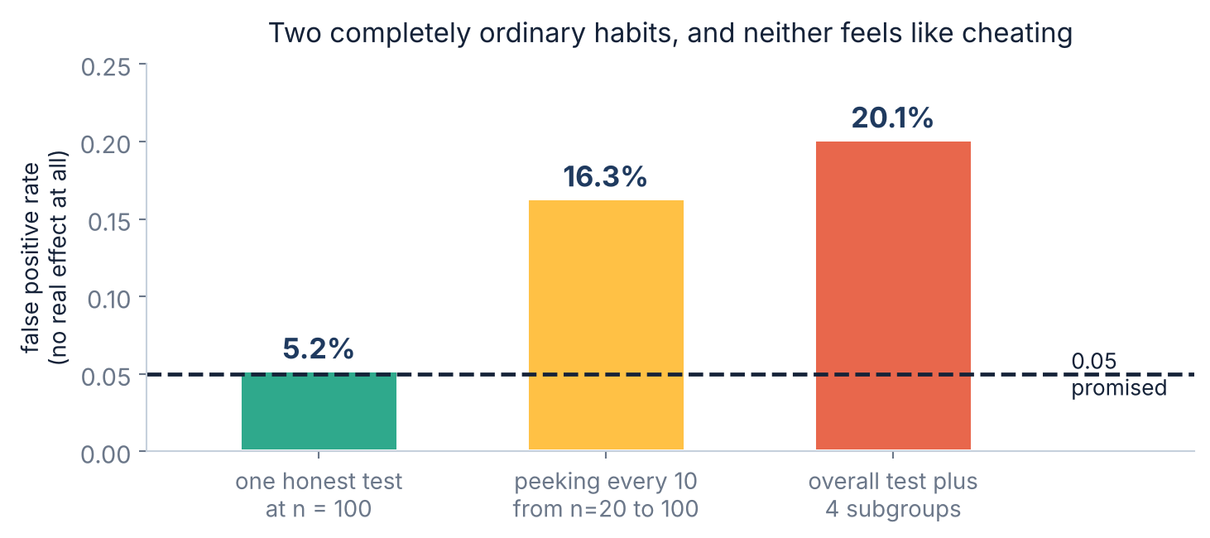
5.2 · p-HACKING
⚠ Two habits that feel completely reasonable
Neither feels like cheating
“Let's check whether it's significant yet before spending more budget.”
“It didn't work overall — but does it work for new users?”
Both are sensible-sounding sentences. Both triple or quadruple your false positive rate.
Why it happens
Every extra look is an extra chance for noise to cross the line. You are running many tests — you are just not counting them.
The fix: write down the analysis before you see the data, and count every test you run.
You will see this live in the practice notebook: a real +2.6 effect where the p-value goes 0.21 at n=10, then 0.041 at n=15, then back to 0.12 at n=25. Stopping at the good moment is the trap.
Slides by Srinivasa Sai Chava
Notes:
The real-data peeking sequence is the most persuasive thing in the session, because the effect genuinely exists and the p-value still wanders across the threshold twice.

Slide 25
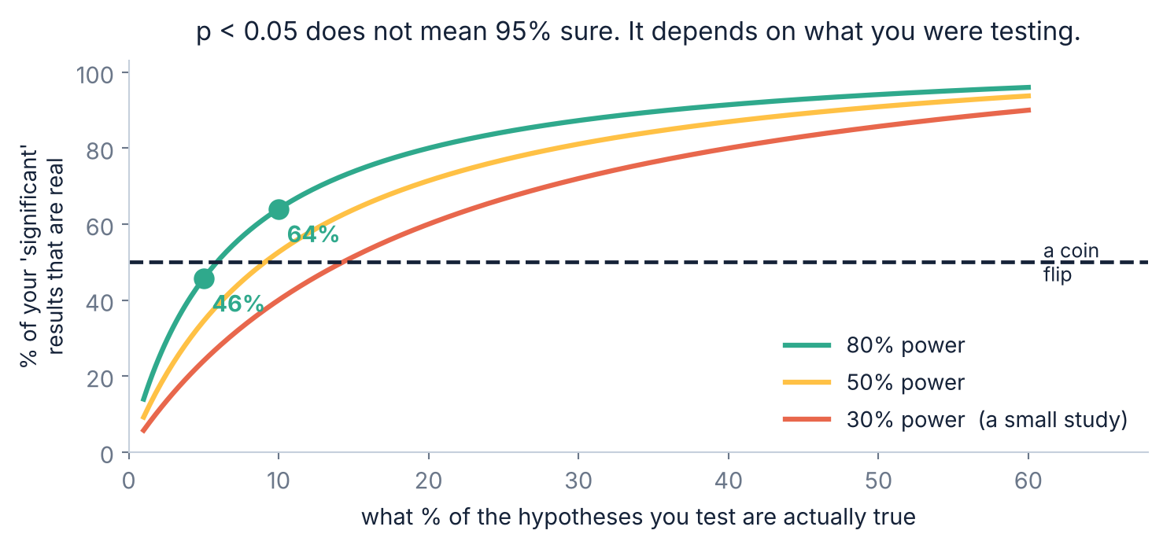
5.3 · THE BASE RATE
⚠ p < 0.05 does not mean 95% sure
The arithmetic
Test 1,000 hypotheses of which 100 are true, with 80% power:
· 80 true findings
· 45 false alarms (5% of 900)
So 45 of your 125 “discoveries” — more than a third — are wrong.
What moves the number
· Testing plausible hypotheses, not fishing
· Higher power — bigger studies
· A stricter threshold where the cost of a false alarm is high
None of these is about the p-value itself.
If only 5% of what you test is real — which is optimistic for exploratory work — then fewer than half your significant results are. The p-value cannot see this, because it never asked how plausible your hypothesis was.
Slides by Srinivasa Sai Chava
Notes:
This is the deepest point of the session and it is pure arithmetic. It explains the replication crisis better than any accusation of misconduct does.

Slide 26
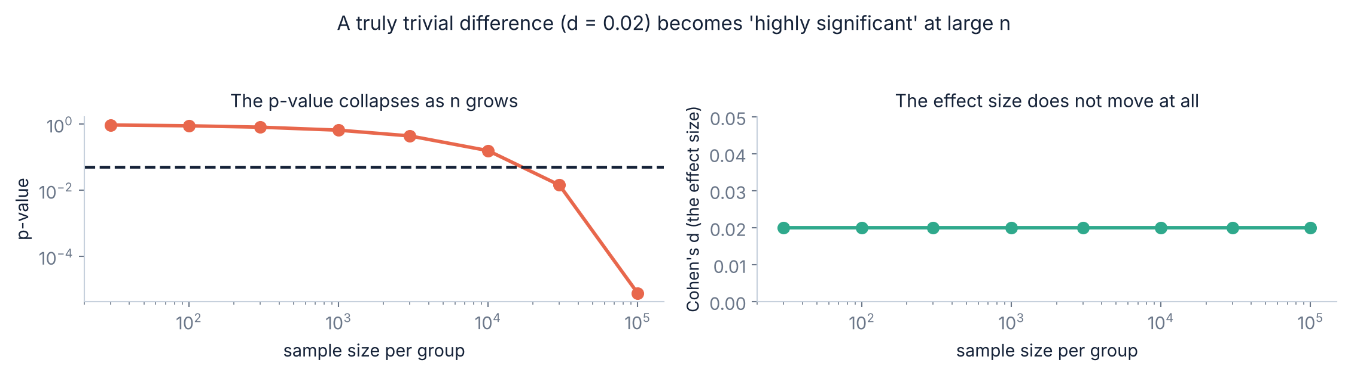
5.4 · EFFECT SIZE
⚠ Significant means detectable, not important
Any difference becomes significant
The effect size does not care about n
A difference of d = 0.02 — utterly trivial — reaches p < 0.001 once n is large enough. No difference is exactly zero, so with enough data everything is “significant”.
Cohen's d is flat across the whole right-hand panel. It measures the thing you actually wanted to know, and it is the number to lead with.
Slides by Srinivasa Sai Chava
Notes:
With a few million users, an A/B test will find every change significant. The question then becomes whether the effect is worth shipping, which p cannot answer.

Slide 27
5.5 · THE BETTER HABIT
What to report instead of a verdict
✗ The usual report
✓ A report worth reading
“The treatment group performed significantly better (p < 0.05).”
“The course raised scores by 2.6 points (95% CI 1.0 to 4.1; d = 0.43; paired t-test, n = 60, p = 0.001). This was the single pre-specified comparison.”
What a reader cannot tell from this: how big the effect was, how precisely it was measured, how many tests you ran, or whether the difference matters.
Every question above is answered, and the p-value is the least important thing in the sentence.
Five things to include, every time
· the effect size
· a confidence interval
· the test and n
· the exact p
· how many tests
in real units
the precision
reproducibility
not “< 0.05”
the honesty bit
The last one is the only one that requires any courage, and it is the one that makes the other four trustworthy.
Slides by Srinivasa Sai Chava
Notes:
Have them rewrite a bad sentence into a good one in the practice notebook. It is a writing skill as much as a statistical one.

Slide 28
RECAP
Debug corner — eight testing mistakes
You did | What goes wrong | Fix
read p as “chance the null is true” | it assumes the null, it cannot judge it | p is P(data | null), not P(null | data)
said “p > 0.05, so no effect” | you may just have had a small study | report the confidence interval
used ttest_ind with the default | equal_var=True fires 44% on some data | equal_var=False (Welch)
used ttest_ind on before/after | between-person noise swamps it | ttest_rel — the data is paired
tested 20 metrics, reported the best | 64% chance of a false positive | Bonferroni or Benjamini-Hochberg
checked significance as data came in | 5% becomes 16% | fix n in advance, or use a sequential design
reported p but not the effect size | a trivial difference looks like a finding | lead with the effect and its CI
said “p < 0.05” | 0.049 and 0.004 are different | report the exact value
Rows 3 and 4 are one-word fixes that change the answer completely. Rows 5 and 6 are the ones that get published.
Slides by Srinivasa Sai Chava
Notes:
Rows 3 and 4 are worth demonstrating live - both are a single argument and both change a null result into a significant one or the reverse.

Slide 29
6 · MINI BUILD
Putting it together — a test that reports honestly
Welch by default
import numpy as np
from scipy import stats
def compare(a, b, n_tests=1, paired=False, label=""):
"""A two-group comparison that reports what matters."""
a, b = np.asarray(a), np.asarray(b)
if paired:
d = b - a
res = stats.ttest_rel(b, a)
est, se, df = d.mean(), d.std(ddof=1)/np.sqrt(len(d)), len(d)-1
cohen = d.mean() / d.std(ddof=1)
else:
res = stats.ttest_ind(a, b, equal_var=False) # Welch
est = b.mean() - a.mean()
se = np.sqrt(a.var(ddof=1)/len(a) + b.var(ddof=1)/len(b))
df = res.df
cohen = est / np.sqrt((a.var(ddof=1) + b.var(ddof=1)) / 2)
lo, hi = stats.t.interval(0.95, df, est, se)
alpha = 0.05 / n_tests # Bonferroni
print(f"{label} difference {est:+.3f} 95% CI [{lo:+.3f}, {hi:+.3f}]")
print(f" d = {cohen:+.3f} p = {res.pvalue:.4f} "
f"threshold {alpha:.4f} ({n_tests} test(s))")
print(" ->", "significant" if res.pvalue < alpha else "not significant")
the safe choice, not scipy's
n_tests is a required thought
you must say how many you ran
The CI comes first in the output
the effect leads, p follows
Effect size alongside
detectability vs importance
Exact p, never “< 0.05”
let the reader judge
It cannot stop you peeking
only your design can
Making n_tests a required argument is the whole trick: it forces you to answer the question nobody asks themselves.
Slides by Srinivasa Sai Chava
Notes:
A function that makes the honest thing the easy thing is better than a rule nobody follows.

Slide 30
OVER TO YOU
Practice session — 30 minutes
A
Predict the output
8 questions
Your notebook
p under the null, Welch, paired, power
Day28_Practice_
Questions.ipynb
B
Spot & fix the bug
4 questions
The default, the wrong test, a misread p
Paired, or two groups?
How many tests did I run?
Report the effect, not the verdict
Solutions shared after class
C
Write the code
5 tasks
Test, size, correct, and report
D
Challenge
2 tasks
p-hack on purpose, then audit a claim
Part D asks you to p-hack a null dataset deliberately until you get a publishable result, and then to write the honest version of the same report. Doing it on purpose is the fastest way to recognise it being done to you.
Slides by Srinivasa Sai Chava
Notes:
The deliberate p-hacking exercise is the one students remember. Be clear it is a vaccination, not a technique.

Slide 31
TODAY IN TWELVE LINES
Recap
1
A test asks: is this gap big compared with yesterday's SE?
7
⚠ Use Welch (equal_var=False). scipy's default fires 44% on some data.
2
t = (what we saw − what we expected) / SE. That is the whole formula.
8
⚠ Paired data needs ttest_rel — it took one example from 0% to 98%.
3
A p-value is P(data this extreme | nothing is happening). Nothing more.
9
Power is the chance of seeing a real effect. 80% needs n=25, 63 or 393 by size.
4
Under the null, p is UNIFORM — which is why 5% of nothing looks like something.
10
⚠ “Not significant” ≠ “no effect”. Report the interval, which tells them apart.
5
⚠ p is NOT the chance the null is true, and NOT the chance you are right.
11
⚠ 20 tests → 64% false positive. Peeking → 16%. Subgroups → 20%.
6
⚠ p = 0.049 vs 0.051 is a gap of 0.017 in the test statistic.
12
⚠ If 5% of your hypotheses are true, under half your “findings” are.
Homework
Next class — Topic 2.9
Find a published claim with a p-value and work out what is missing from the report · Take any two groups in your Day 21 project and compare them properly, reporting all five things · Work out the power your comparison had
Correlation. Measuring whether two variables move together — and the famous warning that goes with it, which turns out to be more interesting than the slogan suggests.
Slides by Srinivasa Sai Chava
Notes:
End on the reporting habit rather than the formula. That is the thing worth carrying out of the session.

