Slide 1

MODULE 3 · MACHINE LEARNING · DAY 32
Getting Data
Into Shape
Scaling, building new columns, and throwing away the useless ones.
Boston University
5
14
3
sections
worked pictures
scalers, by hand
Prepared & presented by Srinivasa Sai Chava
Notes:
Day 31 got words into the model. Today is about getting the NUMBERS into a usable state. Same slow pace: one idea, one picture.

Slide 2
WHERE WE ARE
Last time we got words in. Today we fix the numbers.
Last time
"Dell" became three yes/no columns, and the model could finally read it.
Now every column is a number — so we are done, surely?
The problem
A price column runs to 80,000. A RAM column stops at 16.
To a model, the big column shouts and the small one whispers.
Today
Put every column on a fair footing, build better columns, and delete the ones that do not help.
This is the step that decides whether a model works at all.
Nothing today is hard. But skip it and even a good model will quietly give you nonsense.
Srinivasa Sai Chava · Boston University

Slide 3
THE PLAN
Where we are going today
# | Section | The question it answers | Time
1 | Why scaling matters | Why does a bigger column drown out a smaller one? | 15 min
2 | The three scalers | How do we fix it, and which one do I pick? | 15 min
3 | Making new features | Can I give the model columns it could never work out itself? | 15 min
4 | Too many features | Is more columns always better? (No.) | 12 min
5 | Put it together | In what ORDER do I do all of this? | 10 min
Section 5 is the one to write down. Doing these steps in the wrong ORDER is the single most common mistake in machine learning.
Srinivasa Sai Chava · Boston University

Slide 4
SECTION 1 OF 5
Why scaling matters
The loudest column
A real mistake
One column can be a thousand times bigger than another — and some models cannot tell the difference between big and important.
Who needs scaling
What scaling does
Srinivasa Sai Chava · Boston University

Slide 5
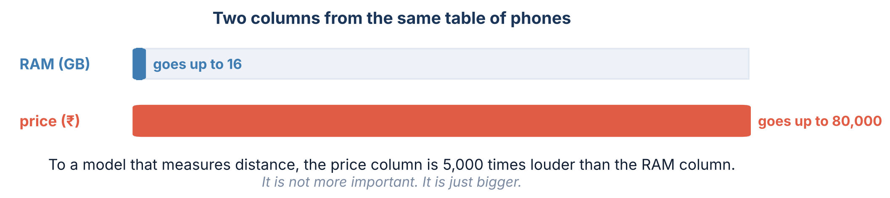
1 / 5 Why scaling matters
1.1 · THE PROBLEM
Two columns, wildly different sizes
Nothing is wrong with the data. Both columns are correct. But any model that measures DISTANCE will barely notice the RAM column exists.
Why distance?
Lots of models work by asking "which other rows look like this one?" To answer that they add up how far apart the columns are — and a column measured in thousands dominates that sum completely.
Srinivasa Sai Chava · Boston University

Slide 6
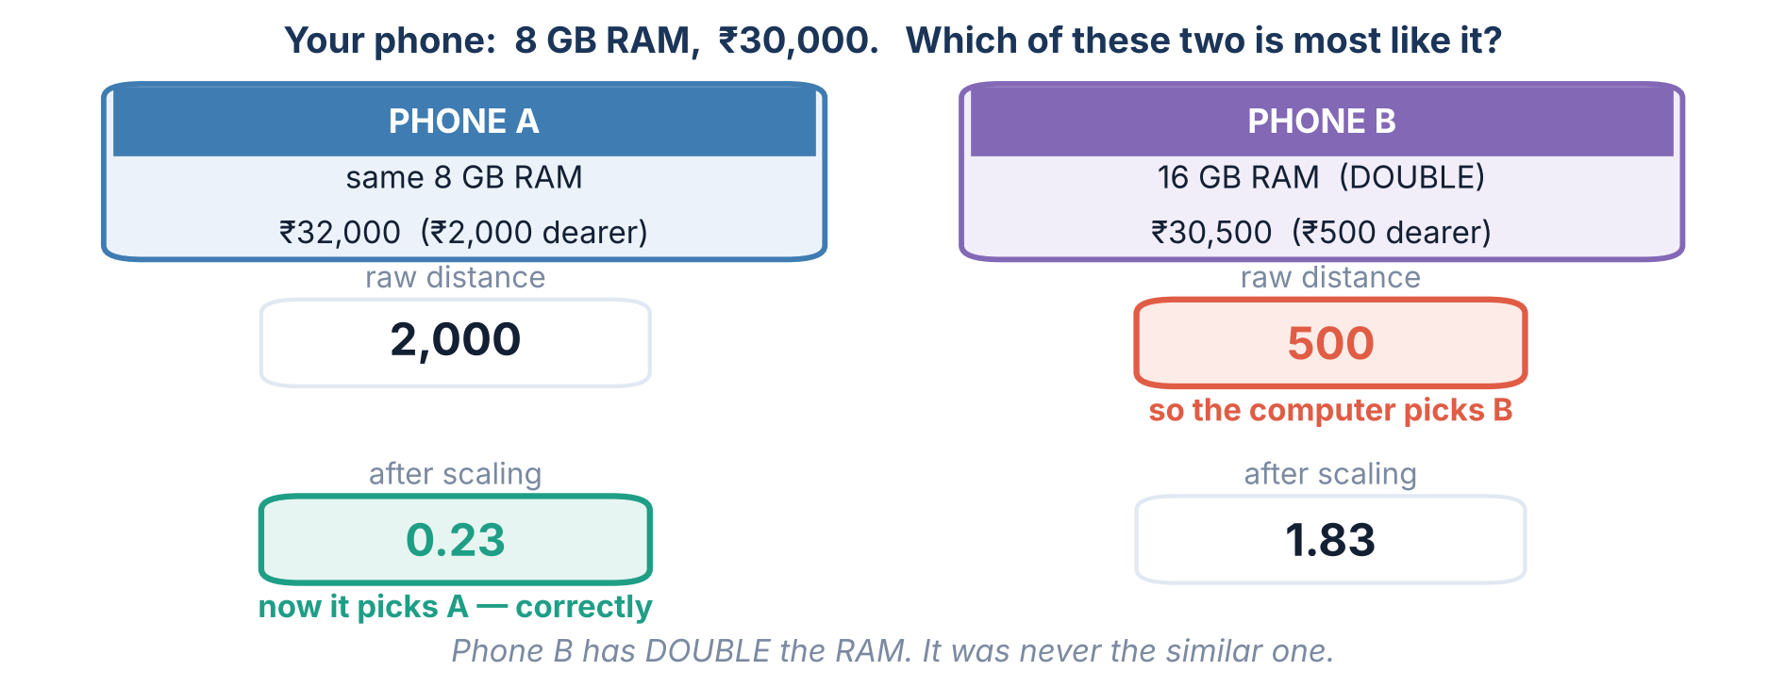
1 / 5 Why scaling matters
1.2 · A REAL MISTAKE
Watch it pick the wrong phone
Phone B has TWICE the RAM. It was never the similar one — the price column was simply louder.
Srinivasa Sai Chava · Boston University

Slide 7
1 / 5 Why scaling matters
Scaling does not make your data better.
It makes every column equally LOUD.
The information is identical afterwards. Only the volume changes.
Srinivasa Sai Chava · Boston University

Slide 8
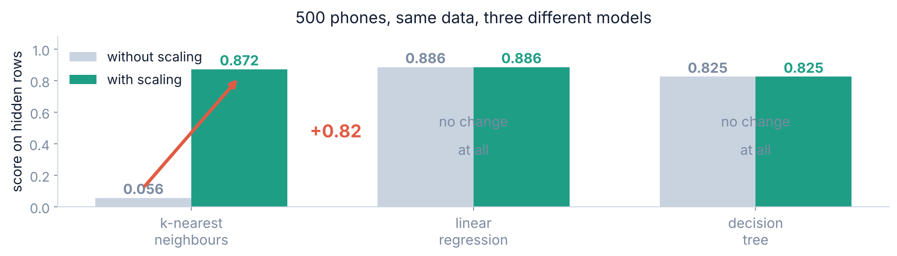
1 / 5 Why scaling matters
1.3 · WHO NEEDS SCALING
So who actually needs it?
YES, badly
NO, never
Yes, but not for accuracy
k-nearest neighbours · SVM · k-means · PCA · neural networks
decision trees · random forests
linear & logistic regression
Anything that measures distance between rows.
A tree asks "is RAM above 8?" — bigger numbers change nothing.
Scale them for speed and readable weights, not for a better score.
Srinivasa Sai Chava · Boston University

Slide 9
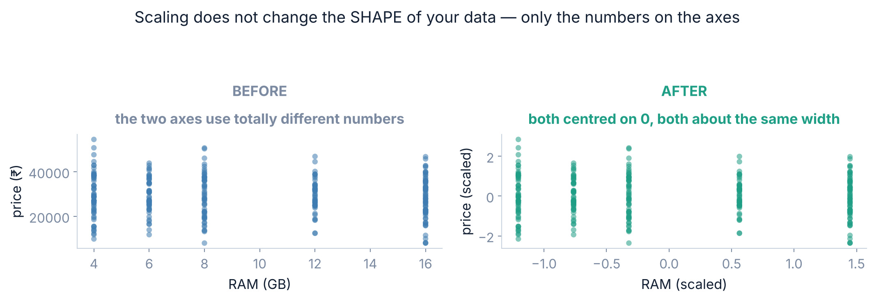
1 / 5 Why scaling matters
1.4 · BEFORE AND AFTER
And what it looks like on the data
Exactly the same cloud of points. Only the numbers on the axes moved. Scaling never throws anything away.
Srinivasa Sai Chava · Boston University

Slide 10
SECTION 2 OF 5
The three scalers
Standard
Min-max
Three ways to do it. Worked by hand on six salaries, so you can see exactly what each one does.
Robust
Which to pick
Srinivasa Sai Chava · Boston University

Slide 11
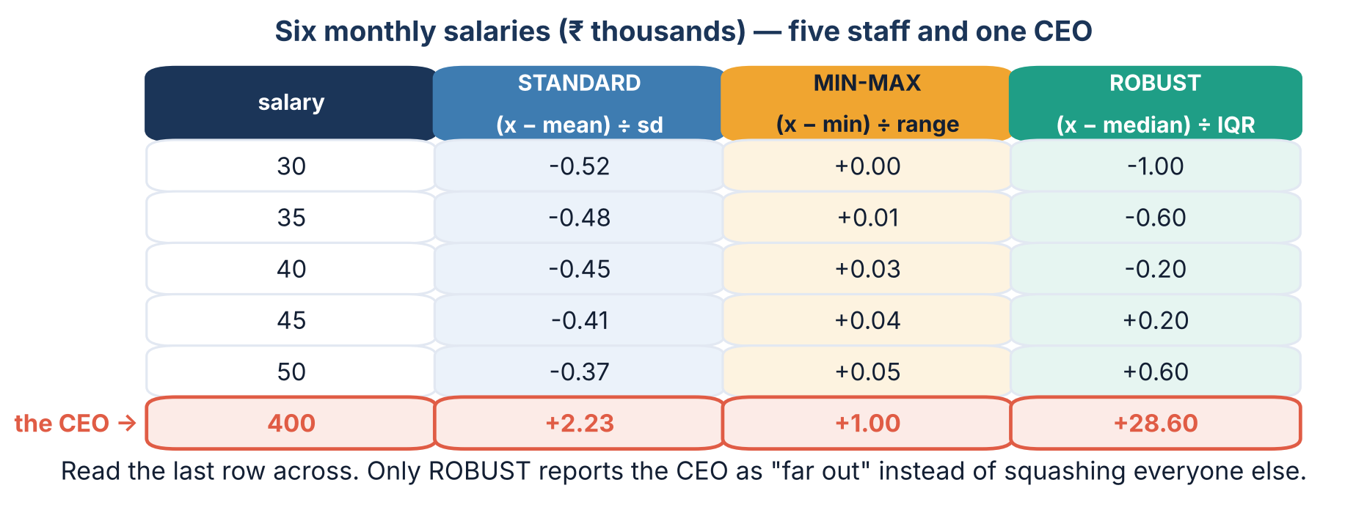
2 / 5 The three scalers
2.1 · SIDE BY SIDE
Six salaries, three scalers, all worked out
All three keep the ORDER. All three keep the information. They differ only in what they are measured against.
Srinivasa Sai Chava · Boston University

Slide 12
2 / 5 The three scalers
2.2 · IN WORDS
What each one is really measuring
STANDARD
"How many standard deviations from average is this?"
(x − mean) ÷ sd
Output centred on 0, usually between −3 and +3. No upper limit.
MIN-MAX
"Where does this sit between the smallest and largest?"
(x − min) ÷ range
Output always between 0 and 1 — but defined by just two values.
ROBUST
"How far from the typical value is this?"
(x − median) ÷ IQR
Uses the middle of the data, so one wild value cannot move it.
Same six numbers in. Three different questions answered.
Srinivasa Sai Chava · Boston University

Slide 13
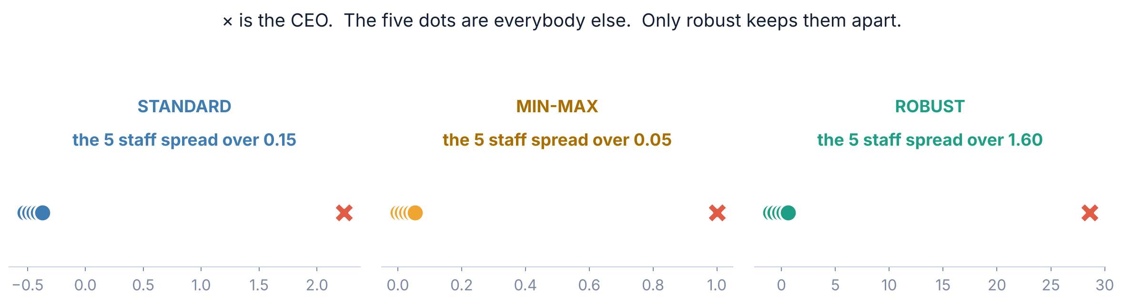
2 / 5 The three scalers
2.3 · THE OUTLIER TEST
⚠️ Now watch what one CEO does to each
0.15
0.05
1.60
STANDARD: the five staff squeezed into this much
MIN-MAX: squeezed into almost nothing
ROBUST: still properly spread out
Min-max is defined by the min and the max — the two values in your data most likely to be wrong.
Srinivasa Sai Chava · Boston University

Slide 14
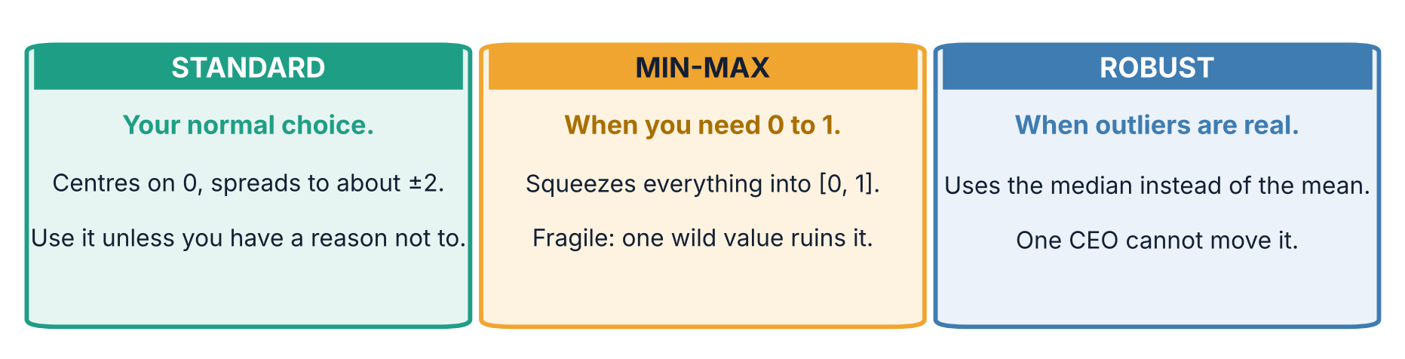
2 / 5 The three scalers
2.4 · THE DECISION
So which one should I use?
from sklearn.preprocessing import StandardScaler
scaler = StandardScaler() # your default, nine times out of ten
If you cannot decide, use StandardScaler. It is almost never the wrong answer.
Srinivasa Sai Chava · Boston University

Slide 15
SECTION 3 OF 5
Making new features
A ratio
A date
Sometimes the column the model needs is not in your table — but you can build it out of the ones that are.
Four recipes
Measuring it
Srinivasa Sai Chava · Boston University

Slide 16
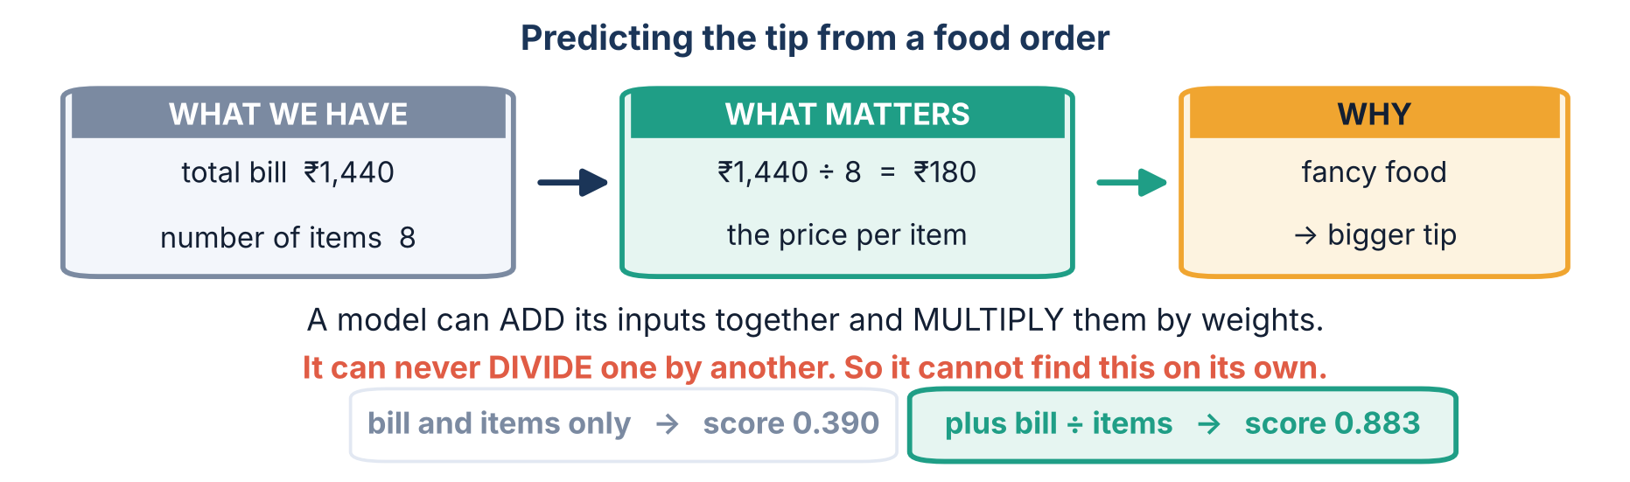
3 / 5 Making new features
3.1 · BUILD A RATIO
A model cannot divide one column by another
0.390
0.883
with the bill and the item count
after adding bill ÷ items
No new measurement was taken. We just rearranged two columns the model already had.
Srinivasa Sai Chava · Boston University

Slide 17
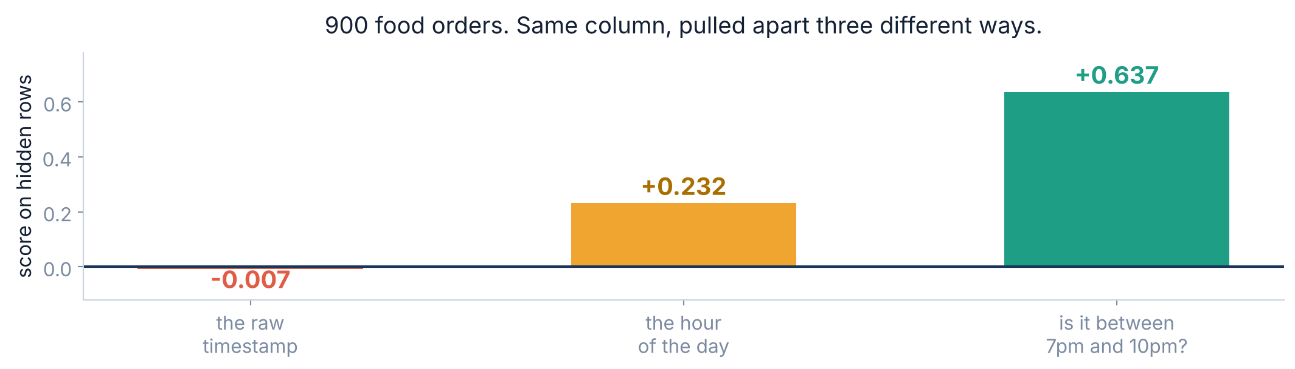
3 / 5 Making new features
3.2 · PULL A DATE APART
A date is never a feature
EXAMPLE
900 food orders. We want to predict how long the delivery will take.
The timestamp as a raw number is worthless — it just counts seconds since January. Pull out the HOUR and it starts working. Ask the real question — "is it dinner time?" — and it works properly.
Srinivasa Sai Chava · Boston University

Slide 18
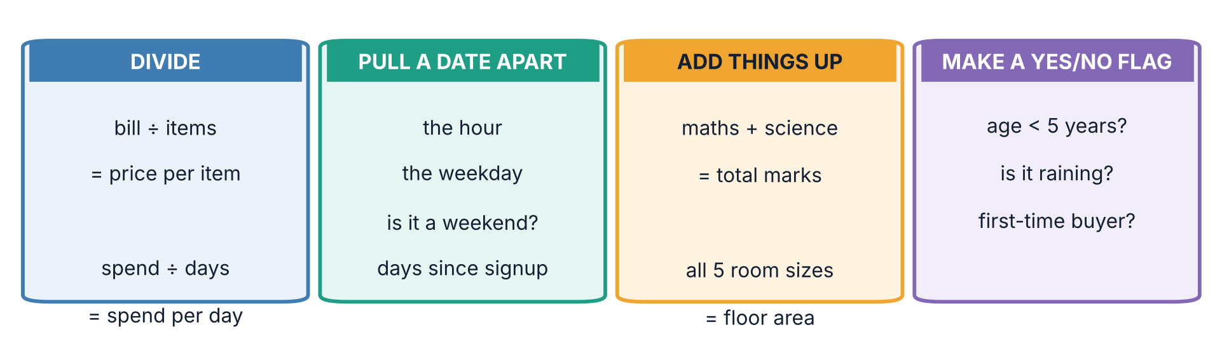
3 / 5 Making new features
3.3 · THE RECIPES
Four recipes you will use again and again
Every one of these is built from columns you already have. You are not adding information — you are putting it in a shape the model can use.
⚠️ One rule
Add features ONE AT A TIME and check the score each time. A feature that does not move the score is a feature you should delete.
Srinivasa Sai Chava · Boston University

Slide 19
SECTION 4 OF 5
Too many features
Piling on junk
Picking the good ones
More columns feels like more information. Past a point it is the opposite.
⚠️ The cheating version
Srinivasa Sai Chava · Boston University

Slide 20
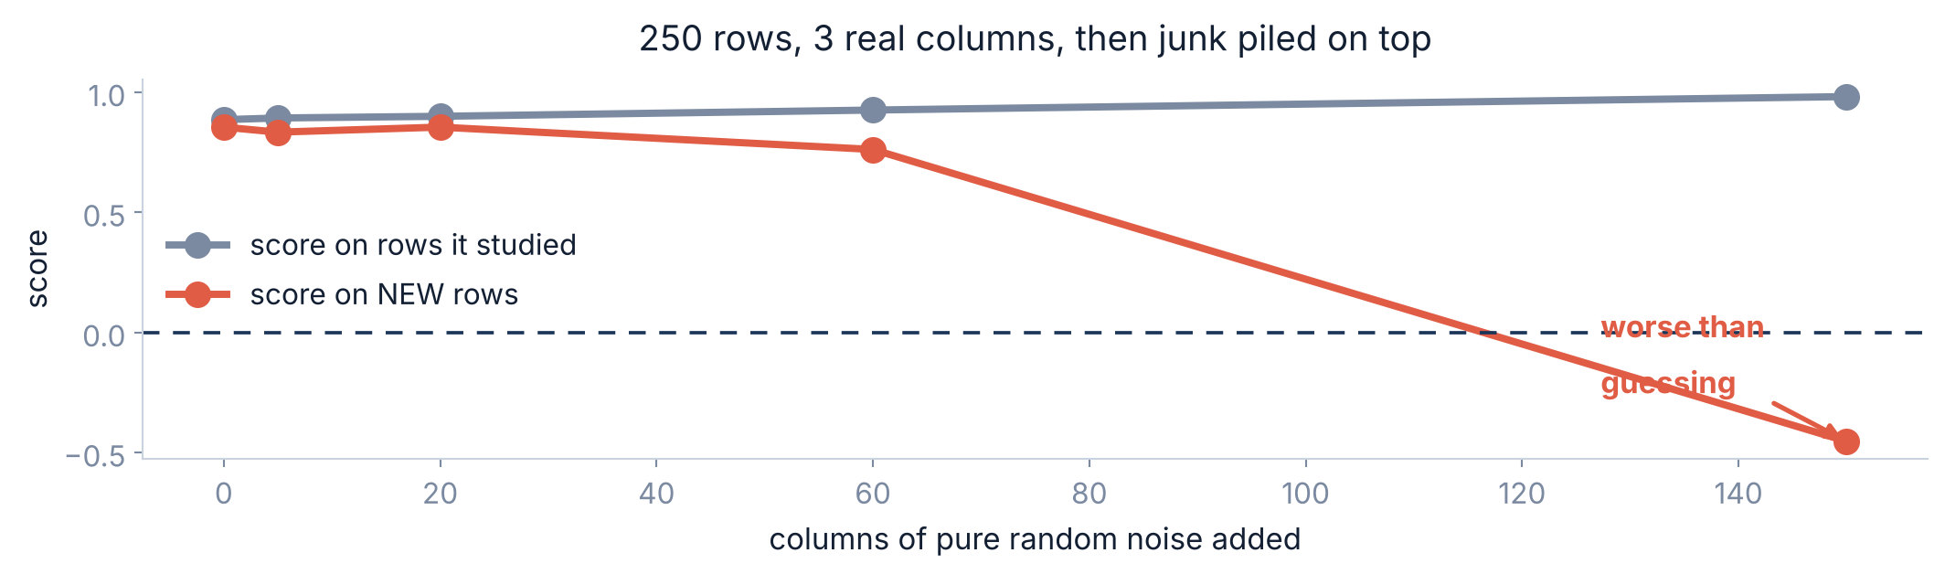
4 / 5 Too many features
4.1 · MORE IS NOT BETTER
What happens when you keep adding columns
The grey line keeps climbing — the model looks better and better on the rows it studied. The red line falls off a cliff.
Why
With 250 rows and 153 columns, the model has nearly one knob per row. It stops finding patterns and starts remembering rows.
Srinivasa Sai Chava · Boston University

Slide 21
4 / 5 Too many features
4.2 · PICKING FEATURES
So keep only the columns that help
Score each column on its own
Keep the ones most related to the answer. Fast, and it is what we use today.
SelectKBest
Let the model decide
Some models shrink useless columns to zero weight all by themselves.
Lasso, tree importances
Try adding and removing
Fit the model again and again with different sets. Thorough, and slow.
RFE
Start with the first one. It is simple, it is fast, and it is right most of the time.
Srinivasa Sai Chava · Boston University

Slide 22
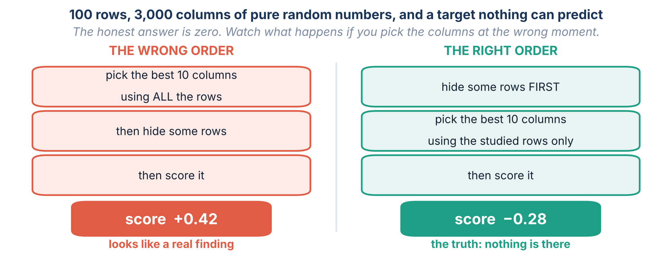
4 / 5 Too many features
4.3 · THE TRAP
⚠️ But pick them at the WRONG moment and you fool yourself
There is genuinely nothing in that data. The +0.42 came entirely from letting the hidden rows help choose the columns.
Srinivasa Sai Chava · Boston University

Slide 23
4 / 5 Too many features
Hide the rows FIRST.
Then do everything else.
Scaling, building features, picking columns — every one of them must learn only from the rows you kept.
Srinivasa Sai Chava · Boston University

Slide 24
SECTION 5 OF 5
Put it together
The right order
The full code
The order to do things in, and the code to do them with.
Mistakes
Practice
Srinivasa Sai Chava · Boston University

Slide 25
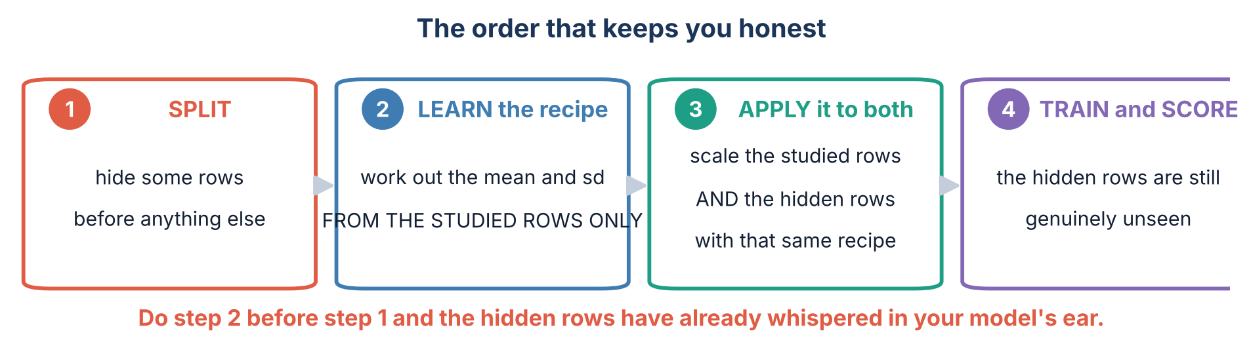
5 / 5 Put it together
5.1 · THE ORDER
The order that keeps you honest
Why it matters for SCALING
Why it matters for PICKING COLUMNS
If you work out the mean using all the rows, the hidden rows have already influenced your model. The damage is usually small — we measured about 0.001 — but it is free to avoid.
Here the damage is enormous. We just turned pure random noise into a score of +0.42 by choosing columns too early.
Srinivasa Sai Chava · Boston University

Slide 26
5 / 5 Put it together
5.2 · THE CODE
The whole of today, in one program
import pandas as pd
from sklearn.model_selection import train_test_split
from sklearn.preprocessing import StandardScaler
from sklearn.neighbors import KNeighborsRegressor
# STEP 2 - build the useful columns first
orders["per_item"] = orders["bill"] / orders["items"]
orders["hour"] = orders["ordered_at"].dt.hour
X = orders.drop(columns=["tip", "ordered_at"])
y = orders["tip"]
# STEP 1 - hide rows BEFORE anything learns from them
X_train, X_hidden, y_train, y_hidden = train_test_split(
X, y, test_size=0.3, random_state=0)
# STEP 3 - learn the recipe from the TRAINING rows only
scaler = StandardScaler().fit(X_train)
X_train_s = scaler.transform(X_train)
X_hidden_s = scaler.transform(X_hidden) # same recipe, not a new one
# STEP 5 - train and score
model = KNeighborsRegressor(7).fit(X_train_s, y_train)
print(model.score(X_hidden_s, y_hidden))
fit vs transform
.fit() LEARNS the mean and sd. .transform() APPLIES them. Learn once, apply twice.
fit on train only
Never .fit() on the hidden rows. That is the whole point of hiding them.
Engineer before splitting?
Yes — a ratio uses only that one row, so it cannot leak. Scaling uses ALL rows, so it must come after.
Trees need none of this
If you are using a random forest, you can skip the scaler entirely.
Srinivasa Sai Chava · Boston University

Slide 27
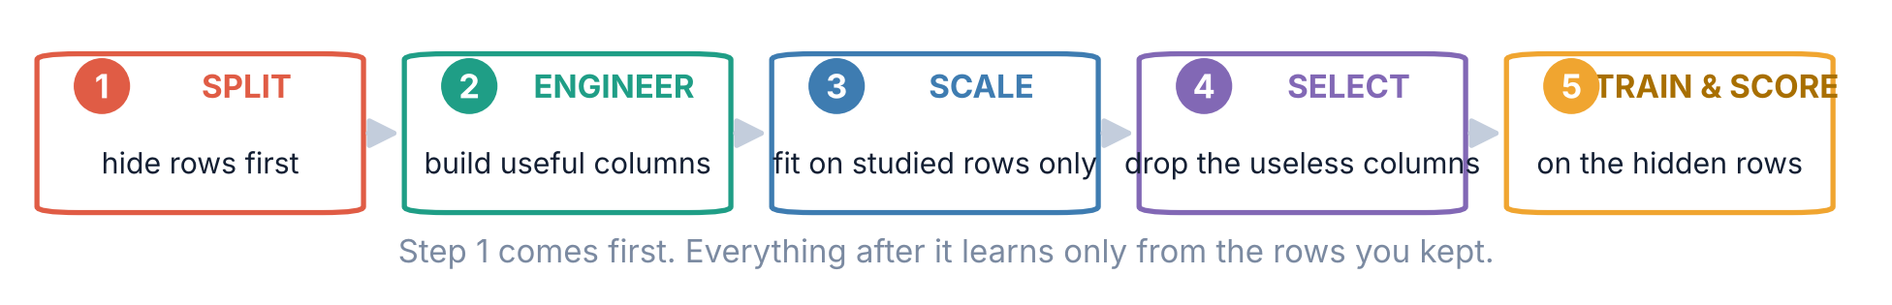
5 / 5 Put it together
5.3 · THE ROUTINE
The five steps, in order
Why SPLIT comes first
Why ENGINEER before SCALE
Why SELECT last
Everything after it must learn from the kept rows only. Get this wrong and every number you report is inflated.
Build the ratio first, then scale it along with everything else. Scaling a column you are about to divide is wasted work.
You can only tell which columns help once they are all built and on a fair footing.
Write these five words down. They are the answer to most "why is my score wrong?" questions.
Srinivasa Sai Chava · Boston University

Slide 28
5 / 5 Put it together
5.4 · DEBUG CORNER
Six mistakes everybody makes once
# | The mistake | What you will see | The fix
1 | Not scaling before kNN | A terrible score for no obvious reason | StandardScaler first
2 | Scaling a decision tree | Nothing. It is harmless, just pointless | Skip it for trees
3 | Min-max on data with outliers | Every real value squashed into a corner | Use RobustScaler
4 | Fitting the scaler on everything | A slightly inflated score, and a bad habit | Fit on train rows only
5 | Picking columns before splitting | +0.42 on data with nothing in it | Split first, always
6 | Adding features without checking | A model that gets worse as you "improve" it | One at a time, score each
Numbers 4 and 5 are the same mistake. Number 5 just happens to be four hundred times more expensive.
Srinivasa Sai Chava · Boston University

Slide 29
5 / 5 Put it together
OVER TO YOU
Practice session — 30 minutes
A
B
C
D
Work it out
Find the mistake
Write the code
Challenge
Scale six numbers by hand, three different ways
Four programs: wrong scaler, wrong order, wrong model
Scale, build features, select, and score honestly
Build five features from scratch, then catch a cheating model
8 questions
4 questions
5 tasks
2 tasks
Your notebook
Three habits to start today
Day32_Practice_Questions.ipynb
Split before anything else
Fit the scaler on train rows only
Add one feature, then check the score
Part A is pen and paper. The numbers are chosen to be easy.
Part D hands you a model scoring 0.97 and asks you to prove it is worth nothing.
Srinivasa Sai Chava · Boston University

Slide 30
Day 32 — the six things to remember
Big is not important
A price column is louder than a RAM column simply because the numbers are bigger.
Scaling changes volume, not information
kNN went from 0.056 to 0.872. Trees did not move at all.
Three scalers, one default
Standard unless you have a reason. Robust when outliers are real.
Build the column the model needs
Bill ÷ items took the score from 0.390 to 0.883 with no new data.
⚠️ More columns is not better
150 junk columns took a good model down to −0.454 on new rows.
⚠️ Split FIRST, then everything else
Picking columns too early scored +0.42 on pure random noise.
Next time — the first real model: teaching a computer to draw the best line.
Srinivasa Sai Chava · Boston University

