Slide 1

MODULE 2 · STATISTICS & PROBABILITY · TOPIC 2.6
The Uniform
Distribution
Day 26 — the simplest distribution, and the one everything else is built from
Boston University
2
1
0
Forms: discrete and continuous
Idea that changes everything: area
Random numbers that are not uniform
Prepared & presented by Srinivasa Sai Chava
Notes:
Day 26. The uniform looks like the easy session - a flat line, what is there to learn? Two things: the idea that probability is AREA, which breaks everyone's intuition once, and the fact that every random number your computer has ever produced started as a uniform.

Slide 2
WHY THIS SESSION
A flat line. What could there possibly be to learn?
What it looks like
What it is actually for
Every outcome equally likely. A fair die. A random number between 0 and 1.
No peak, no tail, no skew. It is the distribution you draw when you have nothing interesting to say.
Where “probability = area” finally makes sense
The honest model when you know only the bounds
The raw material for every other distribution
The thing people assume without checking
Three claims today, in order of how much they will surprise you
1
The probability of any exact value is ZERO
2
The height of the curve can be bigger than 1
3
Every random number your computer makes begins here
Slides by Srinivasa Sai Chava
Notes:
Put the three claims up early and promise to prove all three. The first two sound wrong and the third sounds like an exaggeration; by the end all three are obvious.

Slide 3
WARM-UP · 5 MINUTES
Four questions from Day 25
1
“Out of” or “per” — what does it decide?
→ Binomial if there is a countable n; Poisson if it is a rate.
2
“At least 3” — how do you write it?
→ 1 − cdf(2). Never 1 − cdf(3).
3
Poisson mean and variance?
→ Both equal λ. If var ≫ mean, events are clustering.
4
Why did both distributions go bell-shaped?
→ No answer yet — that is Day 27.
Today is the last distribution before the idea that ties all of them together. Keep question 4 in mind — by the end of this session you will have watched it happen a third time.
Slides by Srinivasa Sai Chava
Notes:
Question 4 is deliberately unanswered. Students should leave Day 25 and 26 with a question they want answered, which is what makes Day 27 land.

Slide 4
SESSION PLAN
How today's two hours are structured
Discrete uniform
15 min
Continuous uniform
30 min
1
2
A die: 1/n, and the two formulas
The rectangle, and why area is everything
Is it really uniform?
20 min
The foundation
20 min
3
4
Testing it, and two famous failures
Every random number starts as U(0,1)
Where it leads
5 min
Practice notebook
30 min
5
6
One uniform is flat; twelve are a bell
You code, I walk around
Section 2 is the one to pay attention to. It contains the single idea that separates discrete from continuous probability, and it is the idea people most often carry a wrong version of for years.
Slides by Srinivasa Sai Chava
Notes:
Flag section 2 as the important one. Everything else today is either easy or a consequence of it.

Slide 5
1
Discrete Uniform
Every outcome 1/n
Mean and variance
Where it genuinely applies
A die, and the two formulas · 15 minutes
Slides by Srinivasa Sai Chava

Slide 6
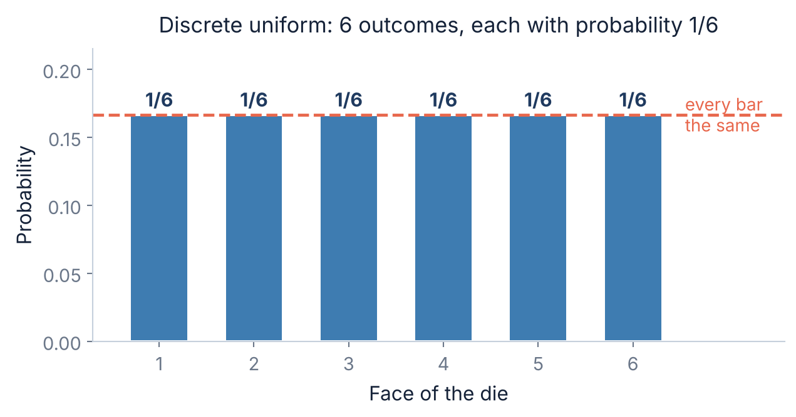
1.1 · A FAIR DIE
Start with the simplest thing in probability
There is nothing to learn here yet
Six outcomes, each equally likely, so each has probability 1/6.
That is the whole discrete uniform distribution. It has one parameter — how many outcomes — and once you know it there is nothing left to compute.
stats.randint(1, 7).pmf(3)
-> 0.16666666
Worth saying out loud: the bars are flat because nothing distinguishes the outcomes. The moment one face is heavier than the others, this stops being the right model — and section 3 is about how you would know.
Slides by Srinivasa Sai Chava
Notes:
Deliberately understate this slide. The discrete uniform really is trivial, and saying so buys credibility for the parts that are not.

Slide 7
1.2 · THE FORMULAS
Mean and spread, for n equally likely values a … b
The mean is the obvious one
The variance is the one to look up
mean = (a + b) / 2
variance = (n² − 1) / 12
Dead centre, because the distribution is symmetric about its middle. For a die: (1 + 6) / 2 = 3.5 — a value the die can never actually show.
Nobody derives this in their head. For a die: (36 − 1) / 12 = 2.9167, so sd = 1.708.
The 12 will turn up again in ten minutes, and again on Day 27.
Check it against scipy rather than trusting either of us
d = stats.randint(1, 7) # a fair die
d.mean() -> 3.5
d.var() -> 2.9166666
d.std() -> 1.7078251
A mean the outcome can never equal is not a mistake — it is the long-run average. Roll a die a thousand times and the running average heads for 3.5 without ever landing on it.
This is the same point as “2.4 children per family”.
Slides by Srinivasa Sai Chava
Notes:
The 3.5 point is worth a beat. Students sometimes think a mean must be achievable; the dice example settles it in one sentence.

Slide 8
2
Continuous Uniform
From bars to a rectangle
Probability is AREA
Density is not probability
The cdf
The rectangle, and why area is everything · 30 minutes
Slides by Srinivasa Sai Chava

Slide 9
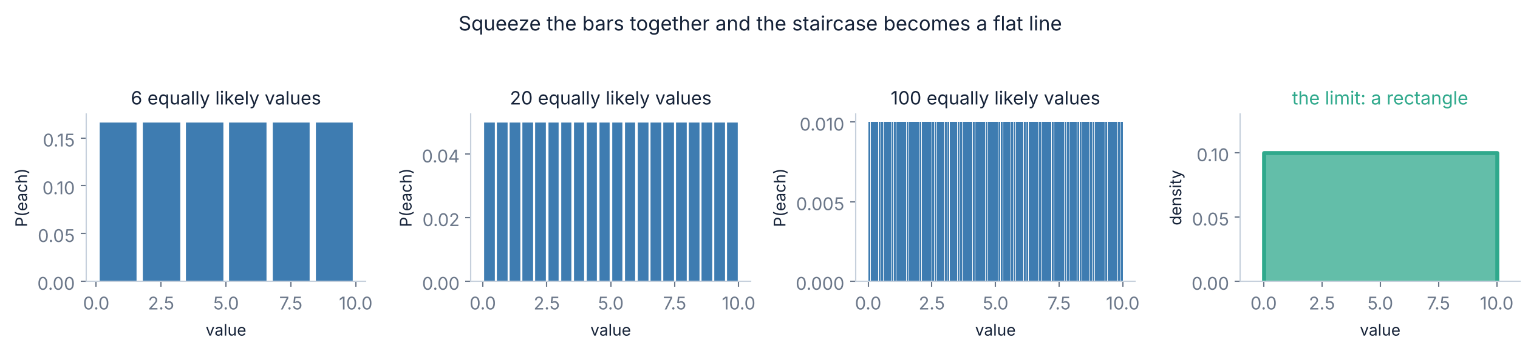
2.1 · THE BRIDGE
What happens when the outcomes get closer together
Watch the height collapse
In the limit there are no bars at all
With 6 outcomes each bar is 1/6 tall. With 100, each is 1/100. Keep going and every individual probability goes to zero — but the total stays 1, because there are more of them.
A value can be anything between 0 and 10 — 3, or 3.1, or 3.14159. There are infinitely many, so asking for the probability of one of them stops making sense.
Something has to replace it.
Slides by Srinivasa Sai Chava
Notes:
This is the conceptual bridge from Day 25 to today. Do not rush it - the next slide only lands if this one did.

Slide 10
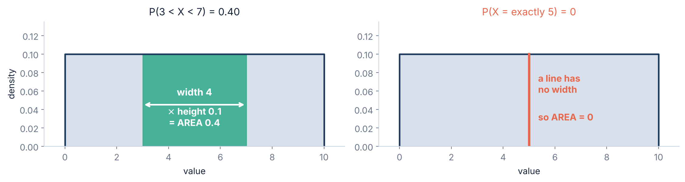
2.2 · THE KEY IDEA
⭐ Probability becomes AREA, not height
A range has an answer
A single point does not
The band from 3 to 7 is 4 wide and 0.1 tall, so its area is 0.4. That is the probability — 40% of values land in there.
“Exactly 5” is a line. A line has zero width, so zero area, so probability exactly 0 — even though 5 is perfectly possible.
Slides by Srinivasa Sai Chava
Notes:
Expect pushback on P(X=5)=0. The resolution is that 'probability zero' is not the same as 'impossible' for continuous variables. Say that explicitly on the next slide.

Slide 11
2.3 · THE OBJECTION
“Probability zero” does not mean “impossible”
The objection, which is a good one
The resolution
“If P(X = 5) = 0 and P(X = 6) = 0 and so on for every value — then nothing can happen. But something does happen every time I draw a number. How?”
This is worth taking seriously. It is the point where continuous probability stops matching everyday intuition.
Something does happen — but you never observe it to infinite precision. Your measurement said 5, meaning somewhere in 4.995 to 5.005, and THAT has probability 0.001.
Every real observation is a range. “Exactly 5” is an idealisation that no instrument has ever reported.
The practical rule
For discrete data, ask “what is the probability of exactly 3?” — it has a real answer. For continuous data, never ask that; ask about a range instead. If your code computes a probability for a continuous variable and gets exactly 0.0, check whether you asked for a point.
Slides by Srinivasa Sai Chava
Notes:
The measurement-precision answer is the one that actually satisfies people. Give the 4.995-5.005 example concretely.

Slide 12
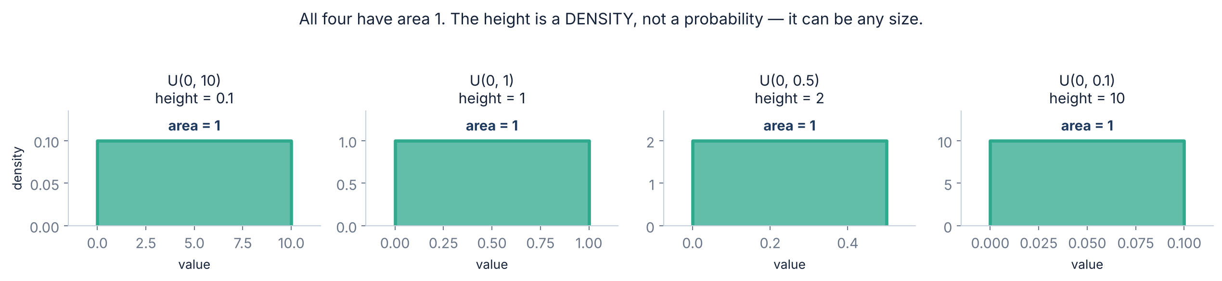
2.4 · DENSITY
⚠ And the height can be bigger than 1
A probability can never exceed 1. A density can.
What the number actually means
Squeeze U(0,1) down to U(0,0.5) and the same amount of probability has to fit into half the width — so the height doubles to 2. Narrow it to U(0,0.1) and the height is 10.
A density is probability PER UNIT of x — like a speed, or a price per kilo. 10 per unit over a width of 0.1 gives 1. Nothing is broken.
So pdf() never returns a probability. Use cdf() for that.
Slides by Srinivasa Sai Chava
Notes:
The 'price per kilo' analogy is the one that fixes this. A price per kilo of 300 is not a contradiction; you just have not bought a kilo.

Slide 13
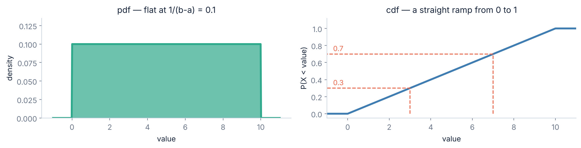
2.5 · pdf AND cdf
The two curves, and which one answers questions
The question | Code | Answer
P(X < 3) | uniform.cdf(3, 0, 10) | 0.30
P(3 < X < 7) | uniform.cdf(7,0,10) - uniform.cdf(3,0,10) | 0.40
P(X = exactly 5) | it is always 0 — do not ask | 0.00
Slides by Srinivasa Sai Chava
Notes:
The cdf being a straight line is specific to the uniform - it is the only distribution where it is. Worth pointing out so students do not generalise.

Slide 14
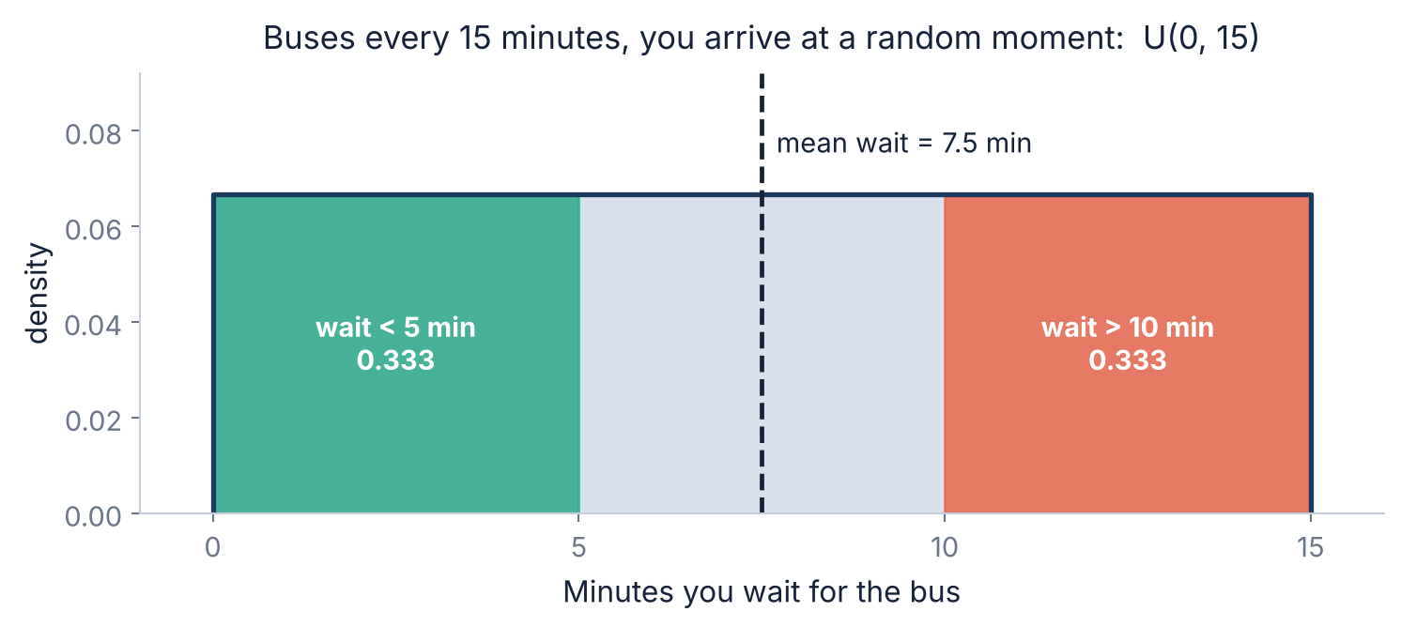
2.6 · A FULL EXAMPLE
Worked through: how long will you wait for the bus?
Why this is uniform
Buses every 15 minutes. You turn up without checking the timetable, so your arrival is equally likely at any point in the gap.
That makes your wait U(0, 15).
Question | Answer
mean wait | 7.5 min
sd | 4.33 min
P(wait < 5) | 0.333
P(wait > 10) | 0.333
The useful version of this: a third of the time you wait under 5 minutes and a third of the time you wait over 10. Quoting “an average wait of 7.5 minutes” hides both. It is the same lesson as yesterday's call centre — an average describes the typical case and says nothing about the cases that annoy people.
Slides by Srinivasa Sai Chava
Notes:
Ask the room first: if buses come every 15 minutes, how long do you wait on average? Many say 15. The answer being half the gap is a nice small surprise.

Slide 15
2.7 · MEAN AND SPREAD
The continuous formulas, and the 12 that keeps appearing
mean = (a + b) / 2
Where the 12 comes from
It falls out of integrating x² across the rectangle. You will not need to do that — but do remember the consequence:
the sd of U(0,1) is 1/√12 = 0.2887, a number you will meet again the moment anyone adds uniforms together.
variance = (b − a)² / 12
For the bus: mean (0+15)/2 = 7.5, variance 225/12 = 18.75, sd 4.33.
⚠ The scipy trap that will catch you at least once
stats.uniform(5, 10) # you probably meant U(5, 10)
.ppf([0, 1]) -> [5., 15.] # it is U(5, 15)
stats.uniform(loc=5, scale=5) -> U(5, 10) # correct
scipy takes loc and SCALE, not the two endpoints. The scale is the WIDTH.
So U(a, b) is uniform(a, b - a). Getting this wrong gives a distribution with the right lower bound and a silently wrong upper one — and a mean that is out by half the width.
Slides by Srinivasa Sai Chava
Notes:
The loc/scale trap is the single most common uniform bug in real code. Make them write uniform(a, b-a) on the board.

Slide 16
3
Is It Really Uniform?
When it is right
Testing a die
How much data you need
Two famous failures
Testing the assumption · 20 minutes
Slides by Srinivasa Sai Chava

Slide 17
3.1 · WHEN TO USE IT
Uniform is a real model, and also a lazy default
✓ Genuinely uniform
✗ Assumed, and wrong
Rounding error
Exam marks across 0–100
Round to the nearest 0.1 and the error really is U(−0.05, 0.05). Provably, not approximately.
Marks cluster. The bounds are not the distribution.
A fair mechanism
Birthdays across the year
A fair die, a well-shuffled deck, a lottery draw — designed to be uniform.
September is busier than February, and not only because it is longer.
Arrival within a known gap
Leading digits of real numbers
You turn up without a timetable: your position in the gap is uniform.
Nowhere near uniform — we look at this shortly.
“All I know is the bounds”
“Customers arrive uniformly”
The honest model when you know the range and nothing else.
Almost never. Lunchtime exists. Use Poisson with a varying rate.
The pattern: uniform is right when something MAKES it uniform. It is wrong whenever it was chosen because nobody looked.
Slides by Srinivasa Sai Chava
Notes:
The rounding-error example is the strongest one - it is uniform as a matter of arithmetic, not approximation.

Slide 18
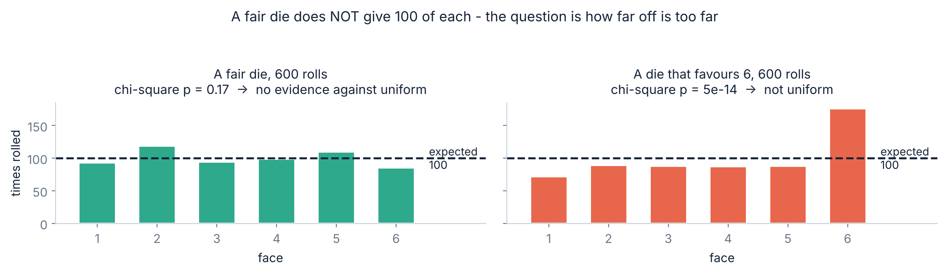
3.2 · TESTING IT
How would you know if a die were loaded?
A fair die does not give 100 of each
The chi-square test asks how far is too far
The fair die above ranged from 85 to 119. That spread is normal. So “the counts are uneven” is not evidence of anything.
stats.chisquare(counts)
fair -> p = 0.17 no evidence
loaded -> p = 5e-14 not uniform
Slides by Srinivasa Sai Chava
Notes:
Emphasise that a small p means 'too uneven to be chance'. A large p does not prove fairness, it just fails to find a problem.

Slide 19
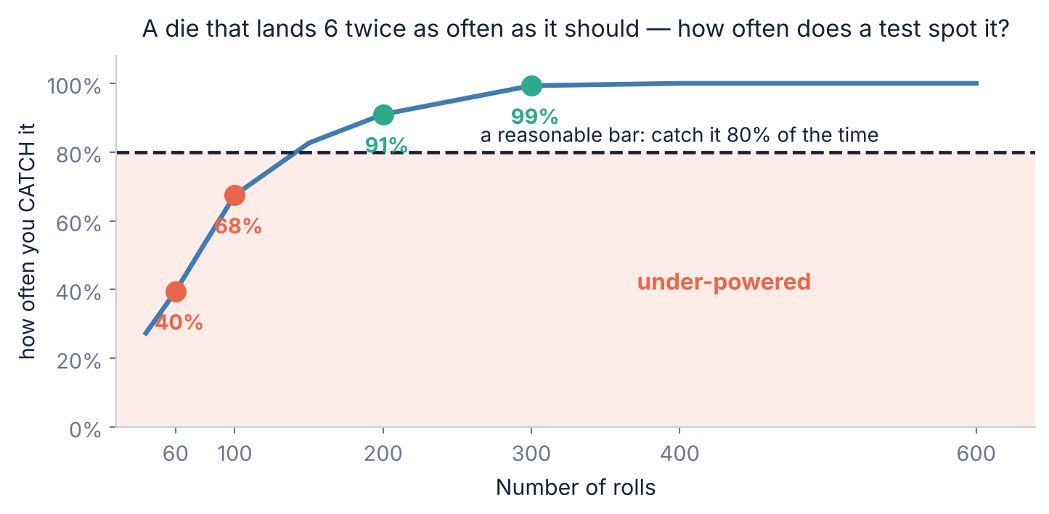
3.3 · SAMPLE SIZE
How many rolls before you could catch it?
A badly loaded die
This die lands on 6 twice as often as it should — 28.6% instead of 16.7%. That is blatant cheating.
With 60 rolls a chi-square test spots it only 40% of the time. You would miss it more often than you caught it.
200 rolls: 91%. 300 rolls: 99%.
The lesson, which is the same one as yesterday's A/B test: “I tested it and found nothing” is only meaningful if you say how much data you had. With 60 rolls you would have missed this blatant cheat 6 times in 10 — so finding nothing told you almost nothing.
Slides by Srinivasa Sai Chava
Notes:
This is the second appearance of the power idea in two days. Say that explicitly - it is one of the most useful habits in applied statistics.

Slide 20
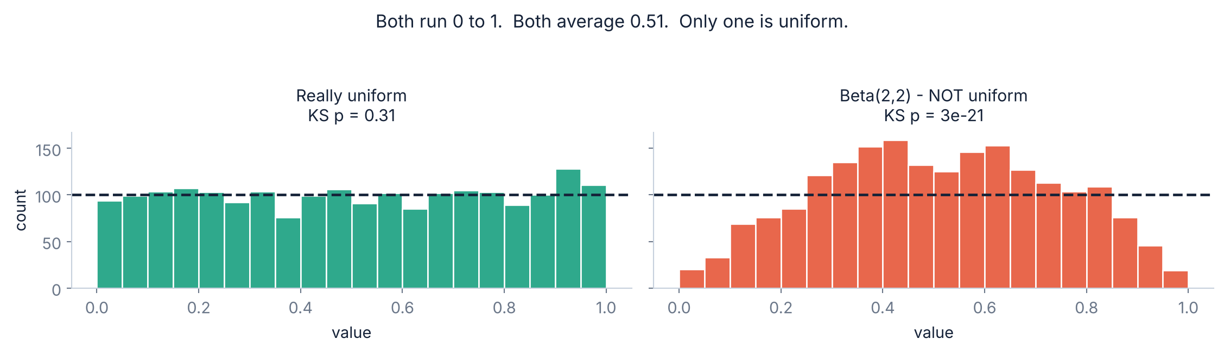
3.4 · CONTINUOUS
Same range, same mean, and not uniform at all
What does NOT prove uniformity
What does: the KS test, or just look
Both samples run from 0 to 1. Both average about 0.51. Checking the bounds and the mean tells you nothing — the shape in between is the whole question.
stats.kstest(data, 'uniform')
really uniform -> p = 0.31
beta(2,2) -> p = 3e-21
Slides by Srinivasa Sai Chava
Notes:
The sd is the quick tell: uniform on 0-1 has sd 0.2887, the beta has 0.227. But a histogram is faster than any test.

Slide 21
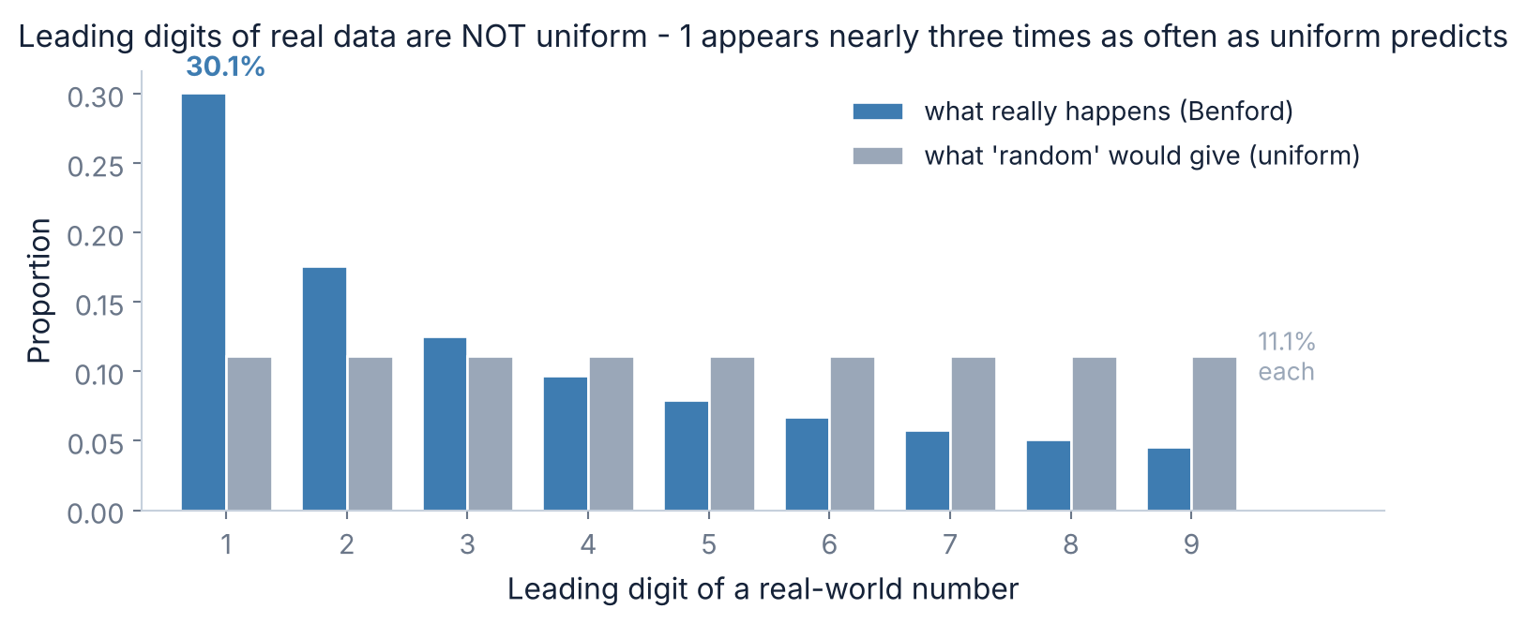
3.5 · BENFORD'S LAW
The most famous thing that is not uniform
Why this happens
Real quantities — revenues, populations, river lengths — spread across orders of magnitude. Something growing from 100 to 200 doubles; from 900 to 1000 it rises 11%.
So a value spends far longer with a leading 1 than a leading 9.
P(d) = log₁₀(1 + 1/d)
This is used to detect fraud. People inventing numbers spread their leading digits roughly evenly, because that is what “random” feels like. Real accounts do not. Auditors run this check on expense claims and tax returns — a dataset that is suspiciously uniform is the red flag.
Slides by Srinivasa Sai Chava
Notes:
Benford is the best possible argument that 'uniform' is not the same as 'random'. It also makes the point that human intuition about randomness is reliably wrong.

Slide 22
4
The Foundation
What your computer actually makes
Inverse transform sampling
Pseudorandom, not random
Every random number starts here · 20 minutes
Slides by Srinivasa Sai Chava

Slide 23
4.1 · THE CLAIM
Your computer can only make one distribution
Underneath, there is only this
Which is a strong claim, so test it
rng.random()
-> 0.7340815... a U(0,1) number
If true, you should be able to build a normal distribution by hand from nothing but rng.random() — no rng.normal anywhere.
And you can. It takes one line, and it works for every distribution with a cdf you can invert.
That method is next.
That is the only random thing the machine does. Every other distribution you have called this term — normal, binomial, Poisson — is a transformation applied to a stream of these.
Why you should care, beyond the trivia
When you meet a distribution scipy does not implement — a custom one from a paper, or an empirical one you measured yourself — you will need to sample from it. This is how. It is also how every simulation and every bootstrap you write from here on actually works underneath.
Slides by Srinivasa Sai Chava
Notes:
Frame this as a claim to be tested rather than a fact to accept. The demonstration is more convincing than the assertion.

Slide 24
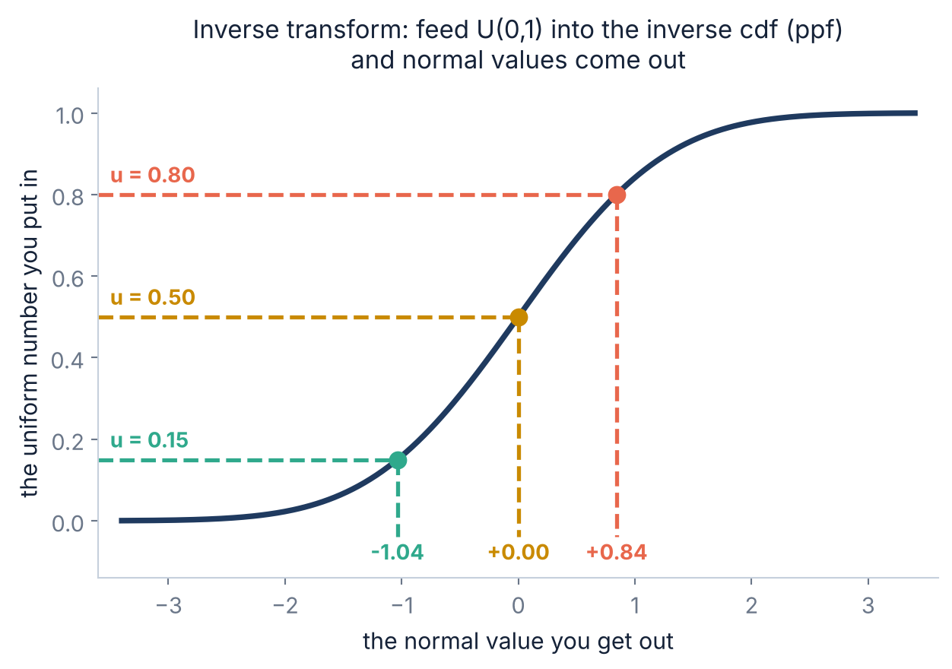
4.2 · INVERSE TRANSFORM
Feed a uniform number into the inverse cdf
Read it from the left
Pick a number between 0 and 1 — that is the vertical axis. Go across to the cdf curve, then drop down. The value you land on is your sample.
u = 0.50 gives 0.00, the middle. u = 0.80 gives +0.84.
Why it works
Where the curve is STEEP, a small slice of the vertical axis maps to a narrow range of x — so values pile up there. Where it is FLAT, the same slice spreads across a wide range, so values are rare.
Steep means likely. That is exactly what a density is.
Slides by Srinivasa Sai Chava
Notes:
The steep-means-likely explanation is the heart of it. Trace a finger up the steep middle of the curve and then the flat tail so they see the difference in spread.

Slide 25
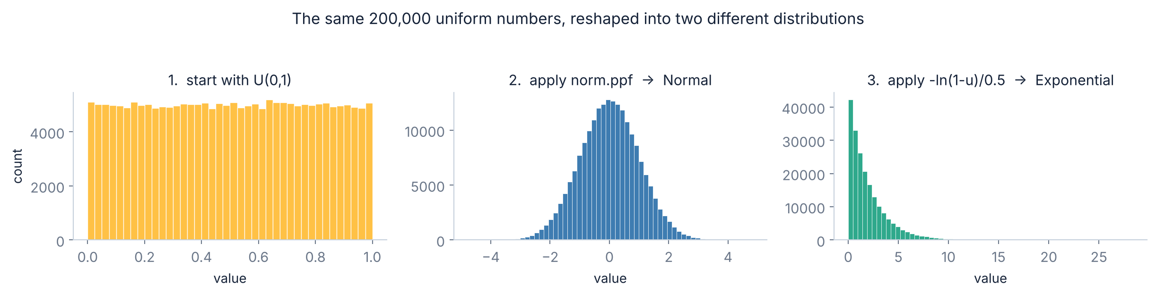
4.3 · IT ACTUALLY WORKS
The same uniform numbers, reshaped twice
u = rng.random(200_000) # ONE source
normal = stats.norm.ppf(u)
expon = -np.log(1 - u) / 0.5
No rng.normal was called
The normal came out with mean −0.001 and sd 1.001. The exponential came out with mean 1.999 against a target of 2. Both built from a flat line.
Slides by Srinivasa Sai Chava
Notes:
Run this live if you can. Seeing a bell curve appear from a flat histogram is the moment the session is remembered for.

Slide 26
4.4 · PSEUDORANDOM
⚠ None of this is actually random
The same seed gives the same “random” numbers
Which is a feature, not a bug
np.random.default_rng(42).random(3)
-> [0.7739, 0.4388, 0.8585]
# run it again. Same three numbers. Always.
Your results reproduce — yours and everyone else's
A failing test fails the same way twice
A reviewer can rerun your notebook and get your numbers
Every figure in this course is seeded for exactly this reason
It is a deterministic formula that produces a sequence which PASSES the uniformity tests. Statistically uniform, not unpredictable.
The one place it matters that these are predictable
Never use numpy.random or Python's random module for anything security-related — passwords, tokens, keys. Given enough output, the sequence can be worked backwards and every future value predicted. Use the secrets module instead. It is slower, and it is not reproducible, and both of those are the point.
Slides by Srinivasa Sai Chava
Notes:
The secrets-module warning is genuinely important and students will meet it in real work. Mersenne Twister state can be recovered from 624 consecutive outputs.

Slide 27
5
Where It Leads
One uniform is flat
Twelve are a bell curve
The last step before Day 27 · 5 minutes
Slides by Srinivasa Sai Chava

Slide 28
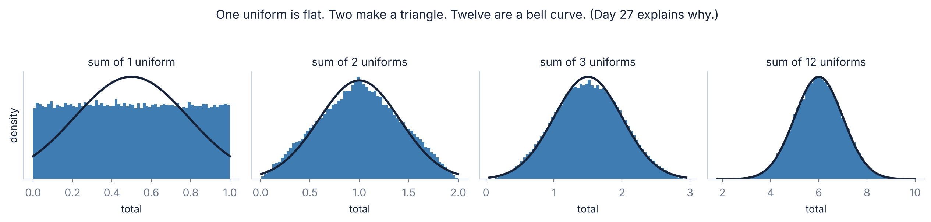
5.1 · → NORMAL
The flattest distribution there is, added to itself
Nothing about a flat line suggests a bell curve
One uniform is flat. Two added together make a triangle — totals near the middle have many ways to happen and totals near the ends have few. Three start to curve. Twelve are indistinguishable from a normal curve.
That is the third time this has happened: the binomial did it as n grew, the Poisson did it as λ grew, and now the flattest distribution of all does it too. Day 27 explains why it is not a coincidence.
Slides by Srinivasa Sai Chava
Notes:
Close the loop set up in the warm-up. Three distributions, three routes to the same curve - that is the strongest possible setup for the CLT.

Slide 29
5.2 · REFERENCE
Module 2 so far — four distributions
 | Normal | Binomial | Poisson | Uniform
Day | 24 | 25 | 25 | 26
Type | continuous | discrete | discrete | either
Answers | how big? | how many out of n? | how many per interval? | equally likely
Parameters | μ, σ | n, p | λ | a, b
Mean | μ | n × p | λ | (a + b) / 2
Variance | σ² | np(1−p) | λ | (b − a)² / 12
Shape | bell | peak at np | right-skewed | flat
scipy | norm | binom | poisson | uniform / randint
The continuous ones use pdf and cdf; the discrete ones use pmf and cdf. uniform takes loc and WIDTH, not the two endpoints.
Slides by Srinivasa Sai Chava
Notes:
Tell them to photograph this one. It is the whole of Module 2's distribution work on a single slide.

Slide 30
RECAP
Debug corner — eight uniform mistakes
You did | What goes wrong | Fix
uniform(5, 10) for U(5, 10) | scipy takes loc and WIDTH: you got U(5, 15) | uniform(5, 5), or uniform(a, b-a)
read pdf() as a probability | it can exceed 1 and is not a probability | cdf for probabilities, pdf for density
asked P(X = 4.7) on continuous data | always exactly 0, silently | ask about a range
randint(1, 6) for a six-sided die | high is EXCLUSIVE: you built a 5-sided die | randint(1, 7)
random.randint vs np.integers | one includes the top, one does not | check which library you are in
assumed uniform without looking | same range and mean, wrong shape | histogram it, then chisquare or kstest
‘the test found nothing, so it is fair’ | 60 rolls miss a blatant cheat 6 times in 10 | say how much data you had
used np.random for a token | the sequence is predictable | the secrets module
Row 1 is the one that will silently change your answer. Row 4 is the one that will change it by exactly one sixth and look plausible.
Slides by Srinivasa Sai Chava
Notes:
Rows 4 and 5 together are worth two minutes. Three libraries, three conventions, and the bug never raises an error.

Slide 31
6 · MINI BUILD
Putting it together — sample any distribution you like
This IS inverse transform
import numpy as np
# GOAL: draw from a loaded die using ONLY rng.random()
# the die should land on 6 half the time
rng = np.random.default_rng(26)
probs = np.array([.1, .1, .1, .1, .1, .5])
# --- 1. the cdf: cumulative probability of each face
cum = np.cumsum(probs)
print(cum) # [.1 .2 .3 .4 .5 1.]
# --- 2. one uniform number per roll
u = rng.random(200_000)
# --- 3. find which band each number landed in
rolls = np.searchsorted(cum, u) + 1
# --- 4. did it work?
freq = np.bincount(rolls, minlength=7)[1:] / len(rolls)
print(freq.round(4))
# [0.1000 0.1006 0.0988 0.1010 0.0999 0.4996]
# no rng.choice, no rng.multinomial - just a flat line
# and a cumulative sum.
searchsorted is the discrete ppf
The band widths ARE the probabilities
6 owns half the interval
cumsum must end at 1.0
otherwise some u lands nowhere
+1 because faces start at 1
searchsorted returns 0-based
200,000 draws to see 4 decimals
fewer and the check is meaningless
Works for ANY probabilities
change the array, nothing else
This is roughly what rng.choice(p=...) does internally. Writing it once means it is no longer magic.
Slides by Srinivasa Sai Chava
Notes:
Draw the [0,1] interval on the board split into six bands, with 6 taking half of it. The code is obvious once the picture is there.

Slide 32
OVER TO YOU
Practice session — 30 minutes
A
Predict the output
8 questions
Your notebook
pdf vs cdf, loc/scale, randint bounds
Day26_Practice_
Questions.ipynb
B
Spot & fix the bug
4 questions
The width trap, a point probability, a bad test
Is it continuous or discrete?
Width or endpoint?
Histogram before you test
Solutions shared after class
C
Write the code
5 tasks
Model it, test it, decide
D
Challenge
2 tasks
Build a sampler, and audit a dataset
Part D asks you to audit a dataset for uniformity. There is no “right answer” printed anywhere — you have to decide, and say what would change your mind.
Slides by Srinivasa Sai Chava
Notes:
The 'say what would change your mind' instruction is worth reading aloud. It is the habit the whole module is trying to build.

Slide 33
TODAY IN TWELVE LINES
Recap
1
Uniform means every outcome equally likely — no peak, no skew.
7
Continuous mean (a+b)/2, variance (b−a)²/12. sd of U(0,1) is 0.2887.
2
Discrete: n outcomes, each 1/n. Mean (a+b)/2, variance (n²−1)/12.
8
⚠ scipy takes loc and WIDTH: U(a,b) is uniform(a, b−a).
3
Continuous: a flat rectangle of height 1/(b−a) over a to b.
9
Same range and same mean do NOT make it uniform. Look at the shape.
4
⭐ Probability is AREA, not height. Width × height.
10
Test it: chisquare for discrete, kstest for continuous — and say your n.
5
So P(X = any exact value) = 0 — which is not the same as impossible.
11
Every random number starts as U(0,1); ppf reshapes it into anything.
6
⚠ A density can exceed 1. U(0, 0.1) has height 10, and area 1.
12
One uniform is flat. Twelve added together are a bell curve.
Homework
Next class — Topic 2.7
Build a sampler for a distribution scipy does not have, using only rng.random() · Take any numeric column from your Day 21 project and test whether its leading digits follow Benford · Find one place in your own code where you assumed uniform without checking
The Central Limit Theorem. Three times now a distribution has turned into a bell curve for no apparent reason. Next class is the one that explains it — and it is the result the whole of the rest of statistics rests on.
Slides by Srinivasa Sai Chava
Notes:
End on the Day 27 promise. Three sessions have now built the same unexplained observation; the payoff is next.

