Slide 1

MODULE 3 · MACHINE LEARNING · DAY 35
Yes or No
Logistic regression
The same line as yesterday, bent into a probability.
Boston University
5
16
1
sections
worked pictures
extra step
Prepared & presented by Srinivasa Sai Chava
Notes:
Today the answer stops being a number and becomes a yes or a no. Everything from the cost-function session yesterday gets used immediately - this is the first model where the choice of cost function really matters.

Slide 2
WHERE WE ARE
Until today, the answer was always a number
1
Day 33
2
Day 34
3
Yesterday
4
TODAY
One column, one line. Errors, least squares, R².
Many columns. One coefficient each.
The cost function, and gradient descent.
The answer is a category. Pass or fail.
You already have every piece of this
The line is Day 34's, unchanged. The idea of a cost function and of walking downhill is yesterday's, unchanged. Today adds exactly two things: a way to turn any number into a probability, and a cost function that is honest about confident mistakes.
Despite the name, logistic regression is a CLASSIFIER. It is the single most used model in industry, and it is the one you should try before anything clever.
Srinivasa Sai Chava · Boston University
Notes:
The name is genuinely confusing. Say out loud: it has 'regression' in the name because of the line inside it, but it answers a yes/no question.

Slide 3
SECTION 1 OF 5
Why a line will not do
Ten students
A line keeps going
The answer is 0 or 1. A line has never heard of that.
What we need instead
Srinivasa Sai Chava · Boston University

Slide 4
1 / 5 Why a line will not do
THE PROBLEM
Ten students. This time the answer is pass or fail.
EXAMPLE
Same question as Day 33 — but instead of a mark out of 100, we only record whether they passed.
hours | 1 | 2 | 3 | 4 | 5 | 6 | 7 | 8 | 9 | 10
passed? | no | no | no | no | YES | no | YES | YES | YES | YES
Note the two awkward ones: somebody passed on 5 hours, somebody failed on 6. Real data always looks like this.
Day 33
→
Today
predict a MARK — a number
predict PASS or FAIL — a category
Most real questions are this shape. Will this customer leave? Is this transaction fraud? Does this scan show a tumour? Yes or no, not how much.
Srinivasa Sai Chava · Boston University
Notes:
Ask the class for three more yes/no questions from their own lives. It takes thirty seconds and it anchors the whole day.

Slide 5
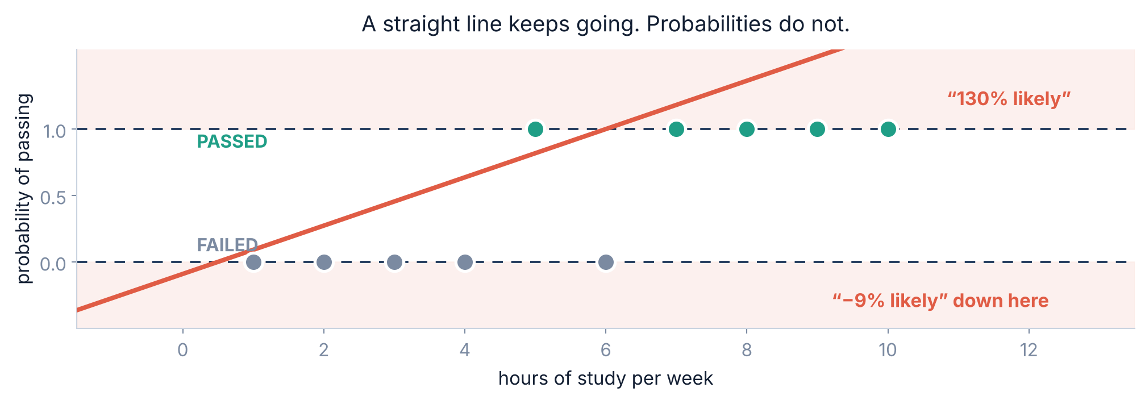
1 / 5 Why a line will not do
THE OBVIOUS ATTEMPT
Put a straight line through it and watch what happens
A line is a ramp that never stops. Probabilities live strictly between 0 and 1. Those two facts cannot both hold — so the line has to be bent.
Srinivasa Sai Chava · Boston University
Notes:
Also worth saying: the line is dragged about by far-away points. One student who studied 40 hours would tilt the whole thing.

Slide 6
1 / 5 Why a line will not do
THE REQUIREMENT
So what do we actually want the model to give us?
A NUMBER BETWEEN 0 AND 1
THAT NEVER ESCAPES
AND STILL BUILT ON A LINE
Not a yes or a no. A probability — “this student has a 0.72 chance of passing”. Much more useful than a bare verdict.
However extreme the input, the answer must stay inside 0 to 1. At 100 hours the answer should approach 1, not sail past it.
We want to keep the coefficients, the interpretability, the speed — everything good about Day 34.
Keep the line. Then run its output through one function that squashes any number — however huge, however negative — into the range 0 to 1. That function is the whole trick.
Srinivasa Sai Chava · Boston University
Notes:
Build the suspense for one slide. They should want the sigmoid before they see it.

Slide 7
SECTION 2 OF 5
Squashing it into 0 to 1
The sigmoid
The two steps
One function does the whole job.
The fitted curve
Reading probabilities
Srinivasa Sai Chava · Boston University

Slide 8
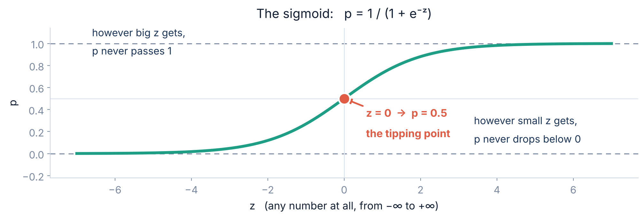
2 / 5 Squashing it into 0 to 1
THE ONE NEW FUNCTION
The sigmoid
Feed it −1,000 and you get 0.0000. Feed it +1,000 and you get 1.0000. Feed it 0 and you get exactly 0.5. It can never leave the range, no matter what you give it.
Srinivasa Sai Chava · Boston University
Notes:
Do the arithmetic for z = 0 on the board: e^0 = 1, so p = 1/(1+1) = 0.5. It takes ten seconds and it makes the formula stop being a symbol.

Slide 9
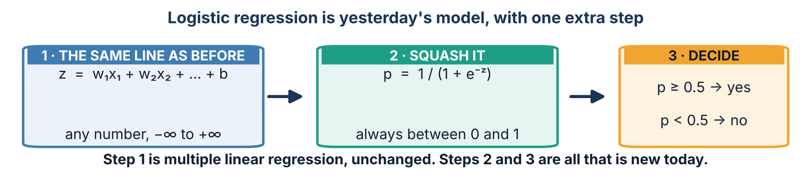
2 / 5 Squashing it into 0 to 1
HOW IT FITS TOGETHER
The whole model, in two steps
An example. A student studies 7 hours. Step 1 gives z = 0.906 × 7 − 4.983 = 1.359. Step 2 gives p = 1 / (1 + e^{−1.359}) = 0.796. Step 3: 0.796 is above 0.5, so we predict a pass — and we can honestly say “about a 4-in-5 chance”.
Srinivasa Sai Chava · Boston University
Notes:
Walk the three steps with a calculator. Nothing here is beyond them - it is one multiplication, one subtraction, one exponential.

Slide 10
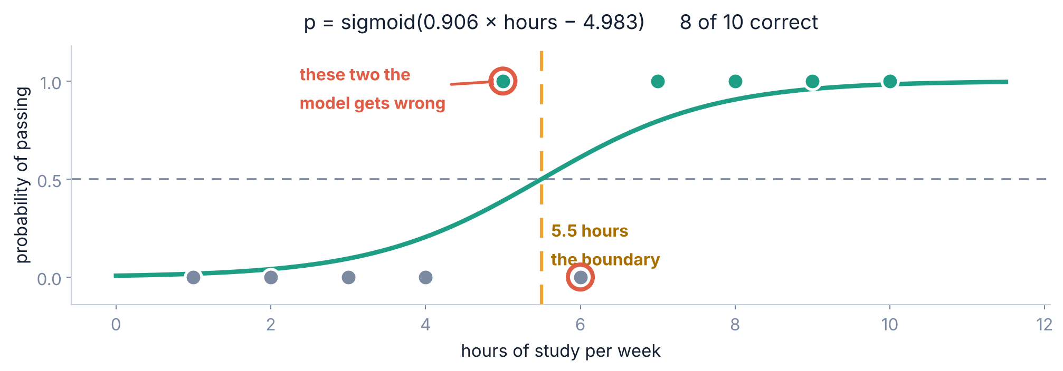
2 / 5 Squashing it into 0 to 1
THE RESULT
Fitted to our ten students
The curve crosses 0.5 at exactly 5.5 hours. Below that the model says fail, above it says pass — and it gets 8 of the 10 right, missing precisely the two awkward students.
Srinivasa Sai Chava · Boston University
Notes:
Point out that missing those two is CORRECT behaviour. A model that got all ten right on data this noisy would be memorising.

Slide 11
2 / 5 Squashing it into 0 to 1
READING THE OUTPUT
The probability for every student
hours | z = 0.906 × hours − 4.983 | p = sigmoid(z) | we predict | truth
1 | −4.077 | 0.017 | fail | fail
3 | −2.265 | 0.094 | fail | fail
5 | −0.453 | 0.389 | fail | PASS ✗
6 | +0.453 | 0.611 | pass | fail ✗
7 | +1.359 | 0.796 | pass | pass
10 | +4.076 | 0.983 | pass | pass
The two it gets wrong are the two closest to the boundary — 0.389 and 0.611. The model was not confident about either, and it was right not to be.
This is why a probability beats a verdict. “Fail” and “fail, probability 0.389” are very different things to tell a student in week three.
Srinivasa Sai Chava · Boston University
Notes:
Hammer this. The probability is the product. The yes/no is just the probability with a threshold stapled on, and the threshold is your choice, not the model's.

Slide 12
SECTION 3 OF 5
A cost that works
Why squared error fails
Log loss
Yesterday's machinery, with the right cost function.
Gradient descent, unchanged
Srinivasa Sai Chava · Boston University

Slide 13
3 / 5 A cost that works
PICKING UP WHERE YOU LEFT OFF
Everything from yesterday carries straight over
YOU ALREADY HAVE
TODAY NEEDS ONE CHANGE
A cost function is a single number saying how wrong the model is.
Gradient descent finds the numbers that make it smallest: guess, measure, step downhill, repeat.
The cost function itself.
Squared error was right for predicting a mark. For predicting a yes or a no it is the wrong tool — and the next two slides show exactly why.
Gradient descent does not change at all today. Same loop, same learning rate, same “walk downhill”. Only what it is walking down is different.
Srinivasa Sai Chava · Boston University
Notes:
Explicit bridge to yesterday's session. Ask them to restate the gradient descent loop in their own words before you move on.

Slide 14
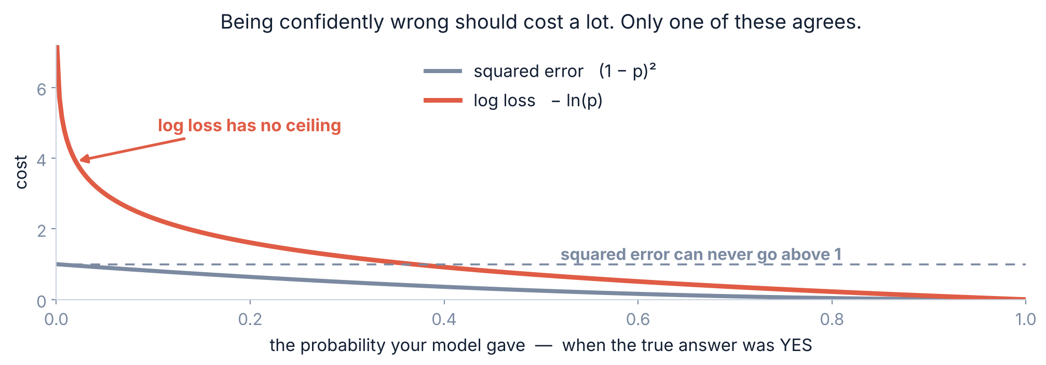
3 / 5 A cost that works
THE PROBLEM
Why squared error is the wrong cost for a yes/no answer
A student really did pass. Your model said 0.001. Squared error charges you 0.998 — barely more than if you had said 0.1. Log loss charges you 6.91.
Srinivasa Sai Chava · Boston University
Notes:
Be precise: squared error is BOUNDED by 1. That is the flaw. The worst possible mistake costs you the same as a fairly bad one.

Slide 15
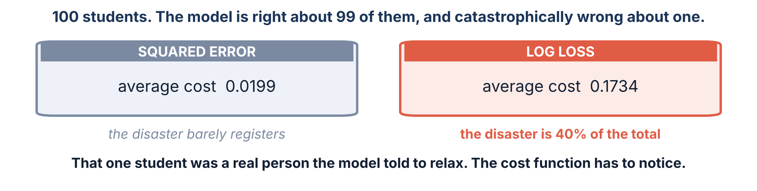
3 / 5 A cost that works
ONE DISASTER IN A HUNDRED
What that ceiling costs you in practice
Be honest about what this does and does not prove. On clean data, fitting by squared error gives almost the same curve as log loss. The argument is not that the fit falls apart — it is that squared error cannot express how bad a confident mistake is, and in medicine, credit and fraud that is exactly the mistake that matters.
Srinivasa Sai Chava · Boston University
Notes:
Do not oversell this. If a student later fits a sigmoid with MSE they will find it works fine on easy data, and they should not think you lied to them.

Slide 16
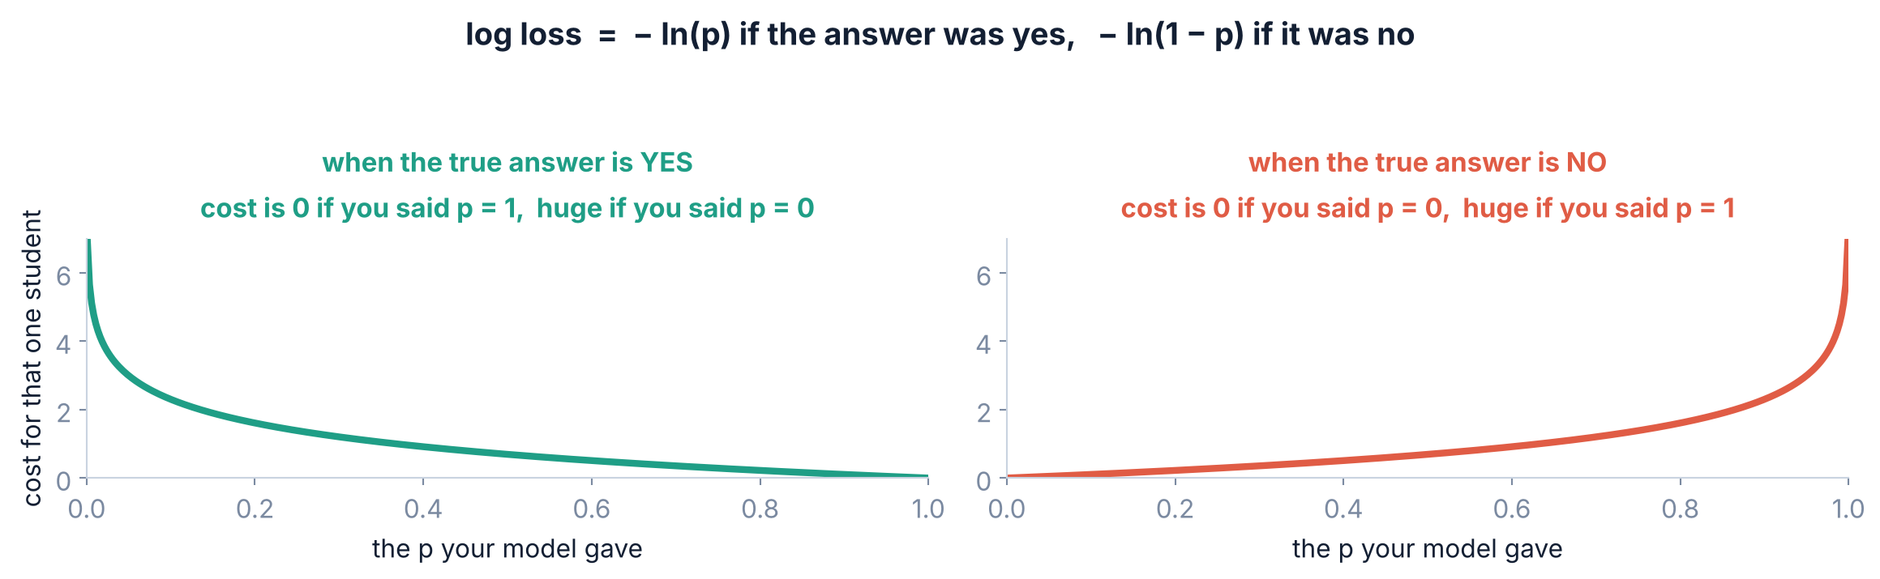
3 / 5 A cost that works
THE FIX
Log loss: the cost that has no ceiling
Every student contributes one of the two. Add them all up, divide by how many — that is the number gradient descent walks down.
Srinivasa Sai Chava · Boston University
Notes:
Also called cross-entropy, and in Module 4 that is the name they will see. Say both words now so it is not a surprise in three weeks.

Slide 17
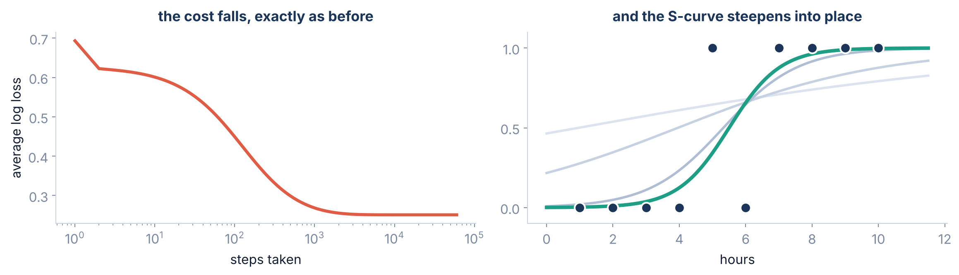
3 / 5 A cost that works
FITTING THE MODEL
Gradient descent, exactly as you learned it
Same loop as yesterday. There is no formula for logistic regression — no shortcut like the one Day 33 had — so walking downhill is not one option among two. It is the only way.
Srinivasa Sai Chava · Boston University
Notes:
This is the payoff for yesterday's session. Day 33 had a formula as an escape hatch; here there is none, and gradient descent earns its place.

Slide 18
3 / 5 A cost that works
WORTH KNOWING NOW
One honest note about what scikit-learn gives you
how it was fitted | coefficient | intercept | boundary
our own gradient descent, run to the end | 1.302 | −7.159 | 5.50 hours
LogisticRegression(C=1e9) | 1.302 | −7.159 | 5.50 hours
LogisticRegression() ← the default | 0.906 | −4.983 | 5.50 hours
The default is not the pure answer. scikit-learn applies a little REGULARIZATION unless you tell it not to — it deliberately shrinks the coefficients to stop the model becoming over-confident. That is why 1.302 becomes 0.906. The boundary is identical either way, and on real data the shrunk version usually generalises better. We give it a full day on Day 48.
Flagging it now so that when you compute a coefficient by hand and scikit-learn disagrees, you know why — and you know the one argument that makes them agree.
Srinivasa Sai Chava · Boston University
Notes:
Students WILL hit this when they check their own gradient descent against sklearn. Telling them now saves an hour of confusion later.

Slide 19
SECTION 4 OF 5
Reading the answer
Not probability
Odds
A coefficient here does not mean what you think.
The boundary
The cut-off
Srinivasa Sai Chava · Boston University

Slide 20
4 / 5 Reading the answer
THE TRAP
The coefficient is 0.906. It is NOT “+0.906 probability”.
WHAT IT IS NOT
WHAT IT IS NOT, EITHER
WHAT IT ACTUALLY IS
“One extra hour adds 0.906 to the probability.”
Impossible — probabilities stop at 1. Two extra hours would take you past certainty.
“One extra hour adds 90.6 percentage points.”
Look at the real numbers: from 4 to 5 hours, p rises by 0.185. From 7 to 8, by 0.110. Different every time.
“One extra hour adds 0.906 to the LOG-ODDS.”
Which sounds like jargon until you undo the log — and then it becomes the cleanest sentence in the whole model.
Odds = p ÷ (1 − p). A probability of 0.8 is odds of 4 — “four times more likely than not”. It is the language bookmakers and doctors already use.
Srinivasa Sai Chava · Boston University
Notes:
Most students have met odds through cricket betting even if they have never called them that. Use that.

Slide 21
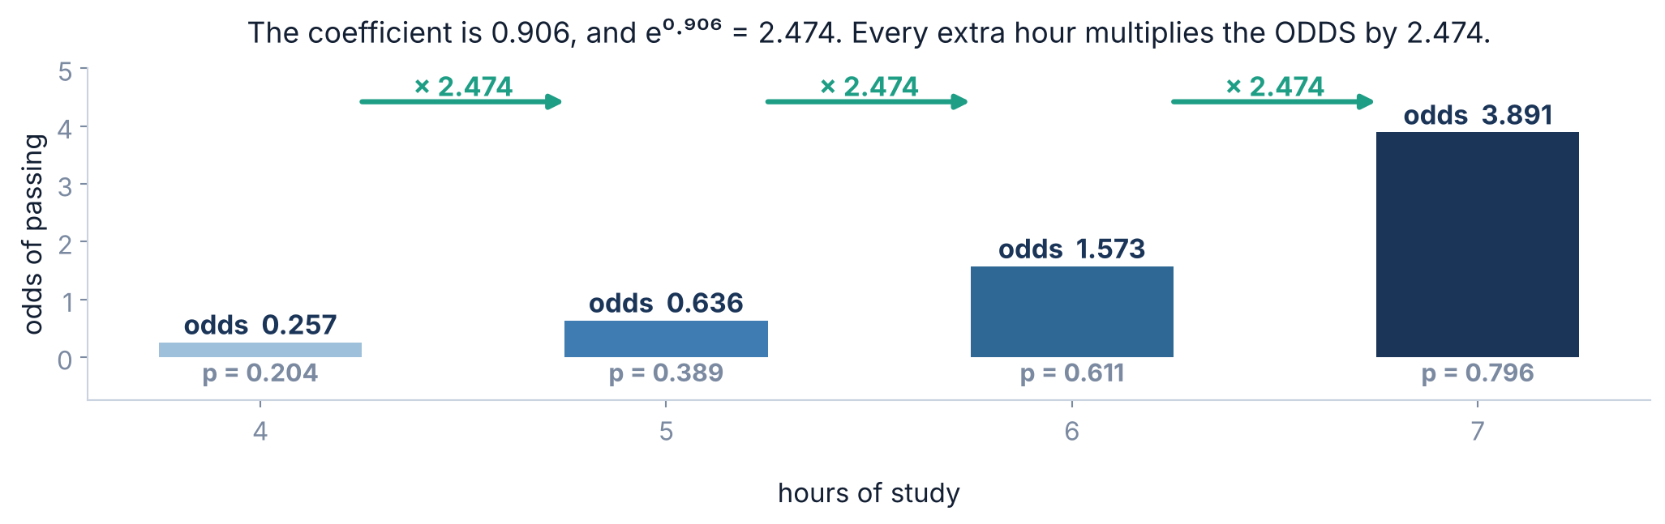
4 / 5 Reading the answer
WHAT IT MEANS
Undo the log and it reads cleanly
e⁰·⁹⁰⁶ = 2.474. Every extra hour of study multiplies your ODDS of passing by 2.474 — the same multiplier at every point on the curve, which is what makes it worth saying.
Srinivasa Sai Chava · Boston University
Notes:
The jump from 0.257 to 0.636 to 1.573 to 3.891 - make them check one of those divisions on a calculator.

Slide 22
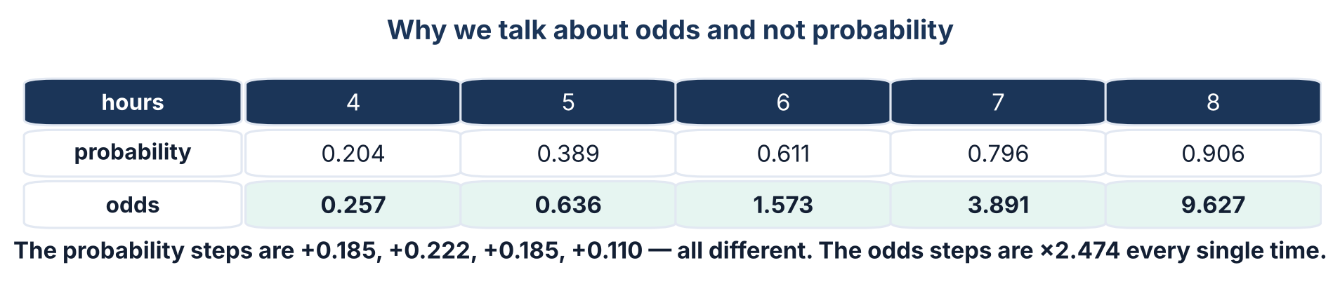
4 / 5 Reading the answer
THE REASON
Why odds, and not just probability?
The model is linear in the log-odds, not in the probability. That is the whole reason logistic regression keeps the clean, Day-34-style interpretation. A single multiplier describes the effect everywhere, instead of a different number at every point on the curve.
Srinivasa Sai Chava · Boston University
Notes:
If they remember one sentence from section 4, make it 'the model is linear in the log-odds'.

Slide 23
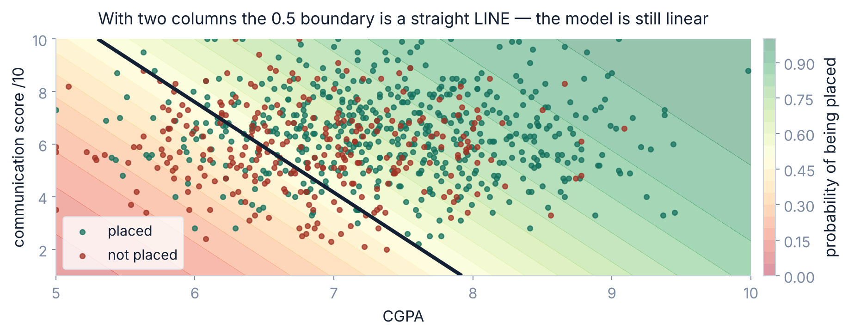
4 / 5 Reading the answer
THE DECISION BOUNDARY
With two columns, the boundary is still a straight line
The CURVE is in the probability. The BOUNDARY is dead straight — which is both why the model is easy to explain, and the first real limit on what it can learn.
Srinivasa Sai Chava · Boston University
Notes:
Foreshadow kNN and trees: those can draw a wiggly boundary. Logistic regression cannot, and sometimes that costs you.

Slide 24
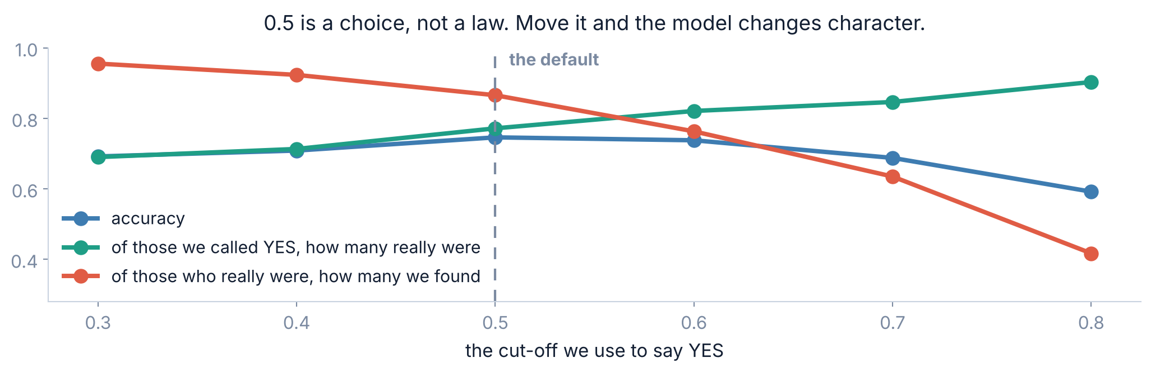
4 / 5 Reading the answer
THE CUT-OFF
0.5 is a choice, not a law
Raise the cut-off and you are right more often when you say yes — but you miss more of the people who deserved a yes. Nothing about the MODEL changed. You changed what you do with it.
Srinivasa Sai Chava · Boston University
Notes:
Give the two real framings: for a cancer screen you want to miss nobody, so lower the cut-off. For a spam filter you must not bin a real email, so raise it.

Slide 25
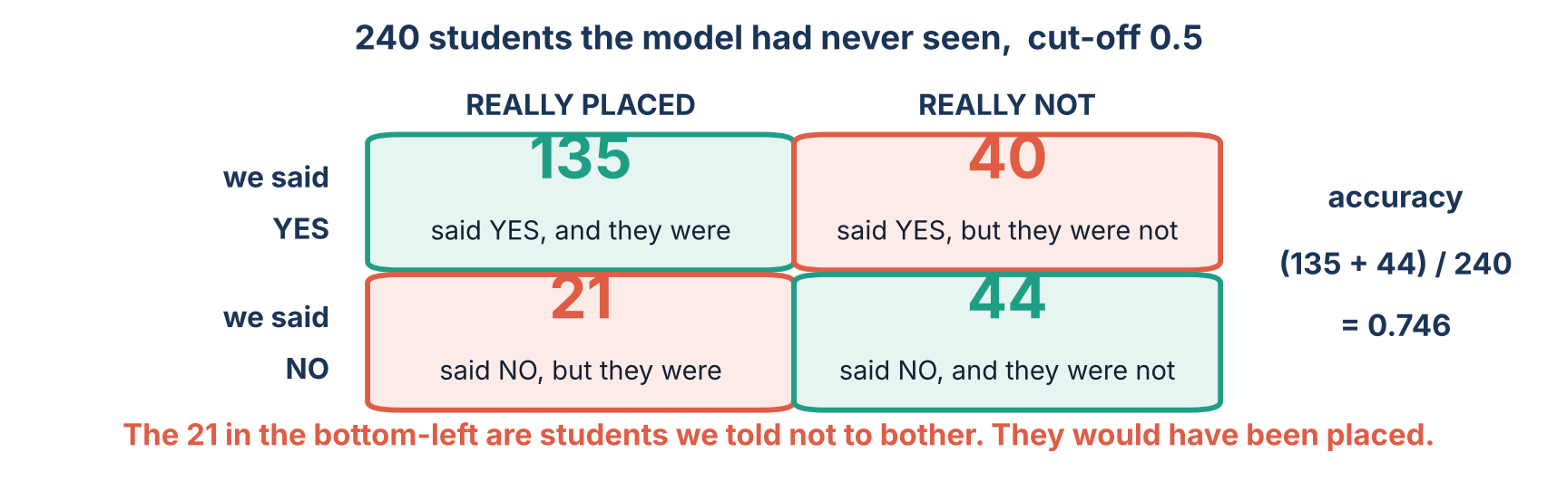
4 / 5 Reading the answer
COUNTING THE MISTAKES
The four ways a yes/no model can be right or wrong
Accuracy 0.746 collapses all four of those boxes into one number — and the two kinds of mistake are not the same mistake. Day 47 is entirely about this table.
Srinivasa Sai Chava · Boston University
Notes:
Do not teach precision and recall today - they get a full day now. Just make the class FEEL that one number is hiding something.

Slide 26
SECTION 5 OF 5
Doing it for real
The code
A real model
Eight hundred students, five columns, and the usual traps.
Comparing columns
Beating the baseline
Srinivasa Sai Chava · Boston University

Slide 27
5 / 5 Doing it for real
SCIKIT-LEARN
The code is one word different from yesterday
from sklearn.linear_model import LogisticRegression
model = LogisticRegression().fit(X, y) # y is 0 / 1, not a number
model.predict(X_new) # the yes/no verdict
model.predict_proba(X_new)[:, 1] # the probability <- use this one
.predict()
.predict_proba()
.coef_
.score()
gives 0 or 1, using a 0.5 cut-off you never chose
gives two columns: P(no) and P(yes). Take column 1
log-odds per unit. Run it through exp() before quoting it
accuracy, not R². Always compare it with the baseline
Reach for .predict_proba(), not .predict(). The probability is the model's real output; the verdict is that probability with somebody's threshold stapled on.
Srinivasa Sai Chava · Boston University
Notes:
The single most common beginner mistake in this topic is using .predict() and never looking at a probability.

Slide 28
5 / 5 Doing it for real
A REAL-SIZED MODEL
800 students: will they be placed?
EXAMPLE
CGPA · internships · backlogs · a mock-interview score out of 10 · and their branch.
column | coefficient | multiply the odds by | in English
cgpa | +1.044 | × 2.84 | one more CGPA point nearly triples the odds
internships | +0.568 | × 1.76 | each internship raises the odds by 76%
backlogs | −0.569 | × 0.57 | each backlog cuts the odds almost in half
mock_score | +0.289 | × 1.33 | each point of communication adds a third
branch_ECE | −0.712 | × 0.49 | about half the odds of a CSE student (the baseline)
Every one of those sentences carries the clause from Day 34: holding the other four columns constant. “Backlogs halve your odds” is only true for two students who match on everything else.
Srinivasa Sai Chava · Boston University
Notes:
Notice the whole Day 34 lesson is load-bearing here. The clause did not go away just because the answer became yes/no.

Slide 29
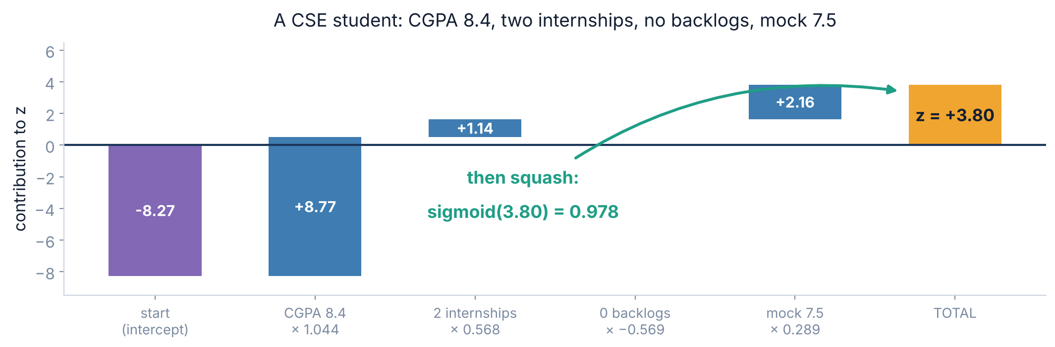
5 / 5 Doing it for real
USING THE MODEL
One student, start to finish
Multiply, add, squash. z = +3.80, so p = 0.978 — this student has about a 98% chance. Five multiplications and one exponential, and you can check every step by hand.
Srinivasa Sai Chava · Boston University
Notes:
Have them do it on a calculator. The exp step is the only new keystroke since Day 34.

Slide 30
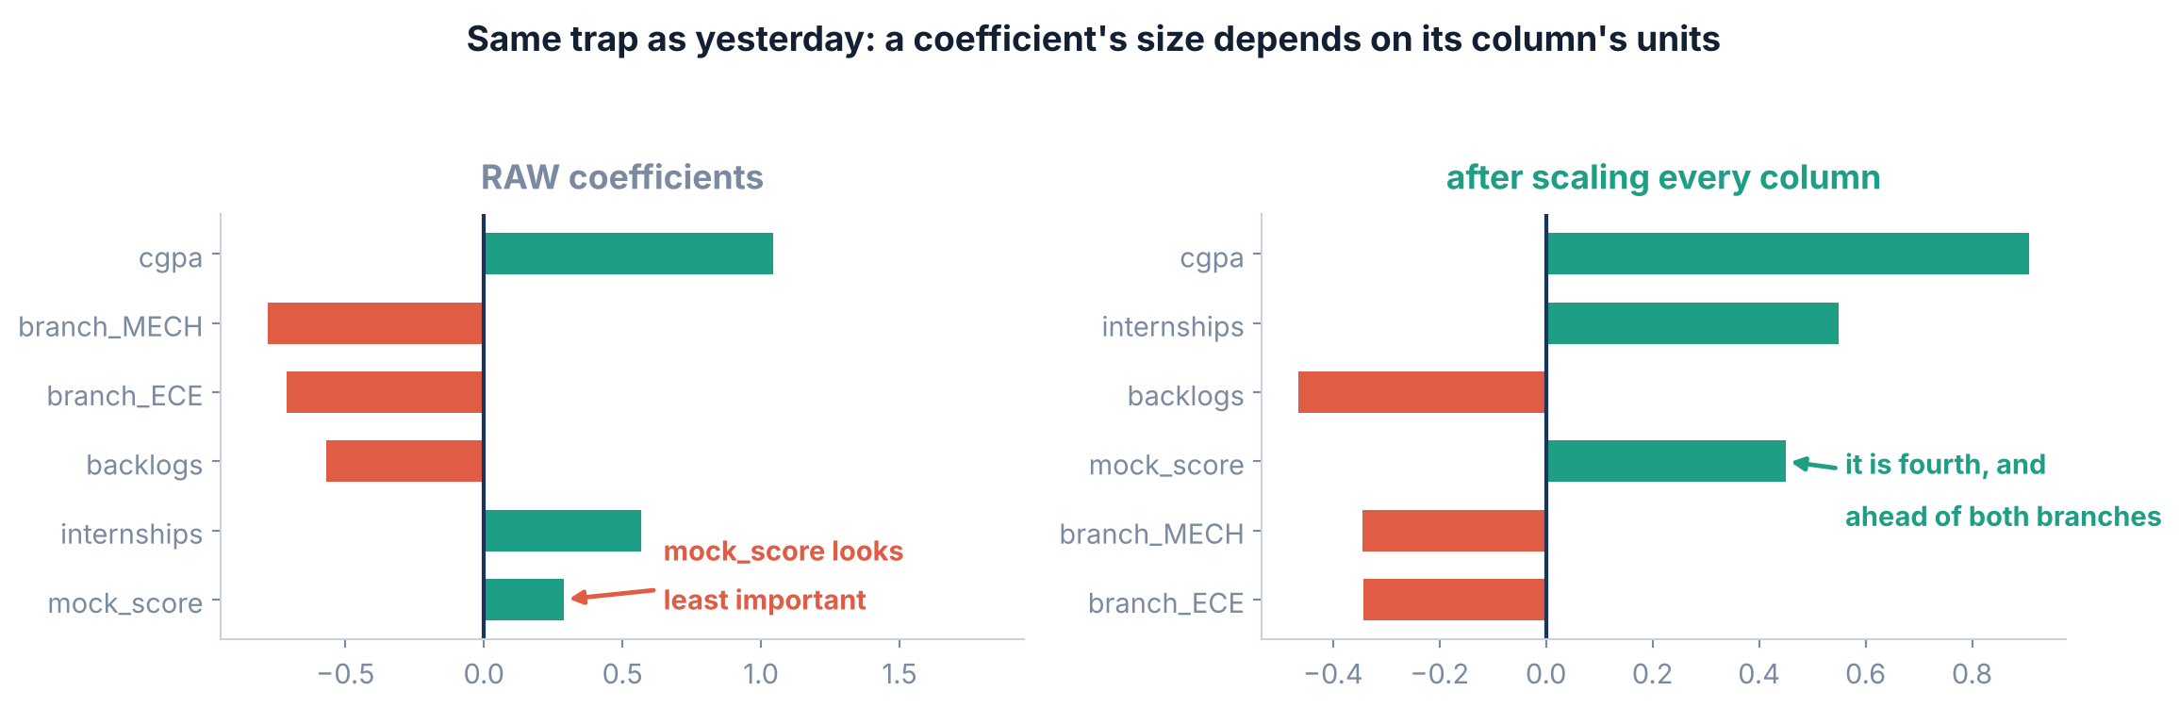
5 / 5 Doing it for real
COMPARING COLUMNS
Which column matters most? Same trap as yesterday.
Raw, mock_score looks like the least important thing in the model. Scaled, it is fourth and ahead of both branch columns — because a “point” of CGPA and a “point” of mock score are nothing like the same size.
Srinivasa Sai Chava · Boston University
Notes:
Same lesson as Day 34, deliberately repeated. It is the mistake students make most often in their own projects.

Slide 31
5 / 5 Doing it for real
ALWAYS ASK WHAT THE BASELINE IS
Is 74.6% accuracy any good?
65.0%
→
74.6%
→
+9.6
just say “placed” to everybody
our model
percentage points earned
That gap is the only thing that means anything. 65% of these students were placed, so a model that blindly says “yes” to everyone is already right about two-thirds of the time. Quote 74.6% on its own and you sound impressive; quote it next to 65% and you are being honest.
⚠️ And this gets much worse with rare events. If 1 in 100 transactions is fraud, a model that says “never fraud” scores 99% — and is completely useless. That is the Imbalanced Data day.
Srinivasa Sai Chava · Boston University
Notes:
The 99% fraud example is the one they remember. Make them sit with it for a moment.

Slide 32
5 / 5 Doing it for real
SPLITTING
One new habit when the answer is a category
train_test_split(X, y, test_size=0.3, random_state=0, stratify=y)
# ^^^^^^^^^^
WITHOUT stratify
WITH stratify=y
The split is random. With a rare class you can end up with very few — or even none — of the YES rows in one half, and the scores become meaningless.
Both halves keep the same mix as the full dataset. Here, 65% placed in the training rows and 65% in the hidden ones.
One word, and it costs nothing. Make it a reflex for every classification problem from today onwards.
Srinivasa Sai Chava · Boston University
Notes:
With a 50/50 target it rarely matters. With 5% positives it matters enormously - and 5% is the normal case in fraud, churn and disease.

Slide 33
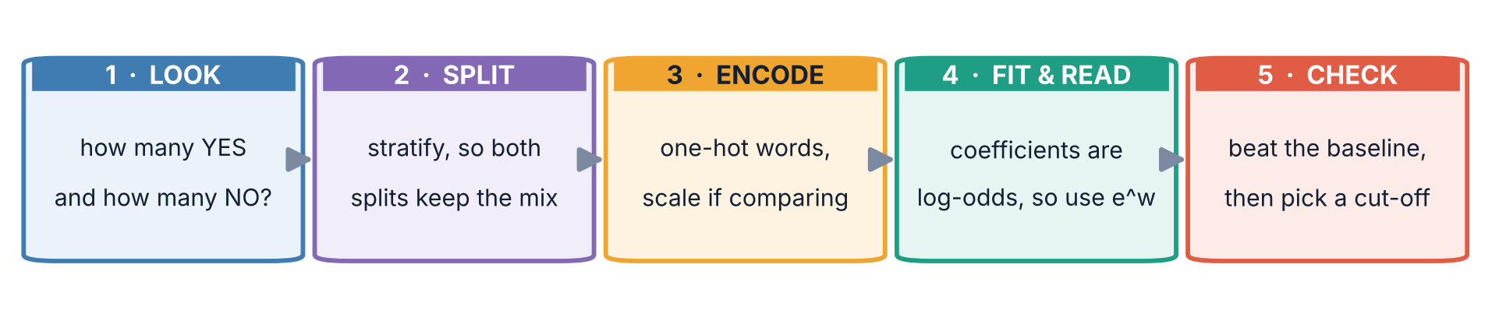
5 / 5 Doing it for real
PUT IT TOGETHER
The five steps, for a yes/no model
Step 1 changed. For a number you drew a scatter plot. For a category, the first thing you do is count: how many YES and how many NO? That single number tells you the baseline you have to beat, and whether the classes are badly imbalanced.
Srinivasa Sai Chava · Boston University
Notes:
`y.value_counts()` is the whole of step 1. Make it the first line they type.

Slide 34
5 / 5 Doing it for real
BEFORE YOU GO
Five mistakes everybody makes once
# | the mistake | what you will see | the fix
1 | Reading a coefficient as probability | “One hour adds 0.906 to the chance” | Run it through exp() — it is odds
2 | Using .predict() and never the probability | A verdict with no idea how confident | Use .predict_proba()[:, 1]
3 | Quoting accuracy with no baseline | “74.6%!” when guessing gives 65% | Always report both numbers
4 | Treating 0.5 as fixed | Missing the cases that actually matter | Choose the cut-off from the cost of each mistake
5 | Forgetting stratify=y | Wild scores on a rare class | Add it. It costs one word
Number 1 is the one that ends up in a report, and number 3 is the one that ends up in a presentation. Both are easy to avoid and neither is forgiven.
Srinivasa Sai Chava · Boston University
Notes:
Mistake 2 is the most common in their code; mistake 1 the most common in their writing.

Slide 35
5 / 5 Doing it for real
SUMMARY
What to remember from today
A line, then a squash | z = w₁x₁ + … + b, exactly as yesterday. Then p = 1/(1 + e⁻ᶻ), which can never leave 0 to 1.
Squared error has a ceiling | However confidently wrong you are, it can never charge more than 1. Log loss charges 6.91 for a p of 0.001.
Gradient descent, unchanged | Same loop as yesterday — and this time there is no formula to fall back on, so it is the only route.
Coefficients are log-odds | 0.906 is not probability. e⁰·⁹⁰⁶ = 2.474, so one extra hour multiplies the ODDS by 2.474, everywhere on the curve.
0.5 is your choice | The model outputs a probability. The threshold is a business decision, and it belongs to you, not to sklearn.
Accuracy needs a baseline | 74.6% against 65% for guessing. The gap is the finding; the number on its own is decoration.
Srinivasa Sai Chava · Boston University
Notes:
Six lines. If they leave with these, the day worked.

Slide 36
5 / 5 Doing it for real
19 QUESTIONS
Tonight's practice
A
Work it out
8 questions
Sigmoid by hand, odds, and reading coefficients correctly
B
Find the mistake
4 questions
Four programs: a misread coefficient, a missing baseline, a bad cut-off
C
Write the code
5 tasks
Fit, read in odds, pick a threshold and defend it
D
Challenge
2 tasks
Build logistic regression from scratch, then judge a model that screens job applicants
Part D asks you to write the gradient descent loop yourself — the one from yesterday, with the sigmoid in it — and confirm it lands where scikit-learn lands.
Srinivasa Sai Chava · Boston University
Notes:
Part D1 is the direct continuation of yesterday's session. If they can write that loop, they have understood both days.

Slide 37
p = 1 / (1 + e⁻ᶻ)
One function, wrapped around the line you already knew how to build. Every classifier for the rest of this course is a different answer to the same question: where do I draw the boundary?
NEXT · DAY 36
Train/test split and cross-validation — how to measure any of this honestly.
Slides & notebooks by Srinivasa Sai Chava · Boston University
Notes:
Tomorrow: cross-validation, and why one split is a noisy measurement.

