Slide 1

MODULE 2 · STATISTICS & PROBABILITY · TOPIC 2.19
A/B Test Design & Analysis
Day 30 — the last statistics session, and the only one where you are allowed to say “caused”
Boston University
BEFORE
DURING
AFTER
Decide the size. The sum takes one line.
Do not look. Three bugs to watch for.
Read the interval, not the verdict.
Prepared & presented by Srinivasa Sai Chava
Notes:
Day 30 closes Module 2. Everything from Day 23 onwards now gets used at once on a single real decision, which is what makes it the right ending.

Slide 2
WHY THIS SESSION
Yesterday: five explanations. Today: how to rule out four of them.
What we were stuck with yesterday
What a coin flip buys you
Chance · confounding · reverse causation · selection · cause.
With observational data you can argue about which one it is, but you can never settle it — because you did not control who got what.
If a coin decides who sees which version, the two groups differ in exactly one way on average — the thing you changed.
Confounding, reverse causation and selection are all switched off by the design. Only chance is left, and chance is what the maths handles.
Four things you will see today
1
The same users give a +21 effect observationally and +2.4 when randomised
2
A small test that “wins” overstates the lift by 3.3× — and it is still “significant”
3
Checking the dashboard 20 times turns a 5% error rate into 25%
4
On revenue, a real +10% lift is invisible at n = 1,000 — 9% power
Slides by Srinivasa Sai Chava
Notes:
Frame the whole module here: Days 23-29 built the tools, and today is the one session where they are all pointed at a single decision someone has to make on Monday.

Slide 3
WARM-UP · 5 MINUTES
Four questions from Day 29
1
What does r actually measure?
→ Tightness around a STRAIGHT line. Nothing else.
2
r = 0.3 — how much is explained?
→ 9%. Report r², always.
3
Name the five explanations.
→ Chance, confounding, reverse, selection, cause.
4
Which one does a coin flip remove?
→ Three of them — and that is today.
Everything from Day 23 onwards gets used today at once: a mean, a standard error, a sampling distribution, a p-value, a confidence interval, power, and the multiplicity problem. An A/B test is the whole module applied to one decision.
Slides by Srinivasa Sai Chava
Notes:
Make the continuity explicit. Students who felt Days 23-29 were disconnected should leave today seeing one pipeline.

Slide 4
SESSION PLAN
How today's two hours are structured
What an A/B test is
15 min
Size it before you run it
20 min
1
2
And what randomising actually buys
MDE, power, and the winner's curse
Running it without breaking it
20 min
Analysing it
20 min
3
4
Peeking, SRM, novelty
The test, revenue, and segments
Deciding and reporting
15 min
Practice notebook
30 min
5
6
Ship, kill, or learn nothing
You design one, then break one
Section 2 is the one that saves you the most time in practice. Most failed A/B tests were doomed before a single user saw them, because nobody did the sum.
Slides by Srinivasa Sai Chava
Notes:
Section 2 before section 4 is deliberate. Sizing is a planning skill and it is where the real leverage is.

Slide 5
1
What an A/B Test Is
Randomisation
The three decisions
The unit
The only design that earns the word “caused” · 15 minutes
Slides by Srinivasa Sai Chava

Slide 6
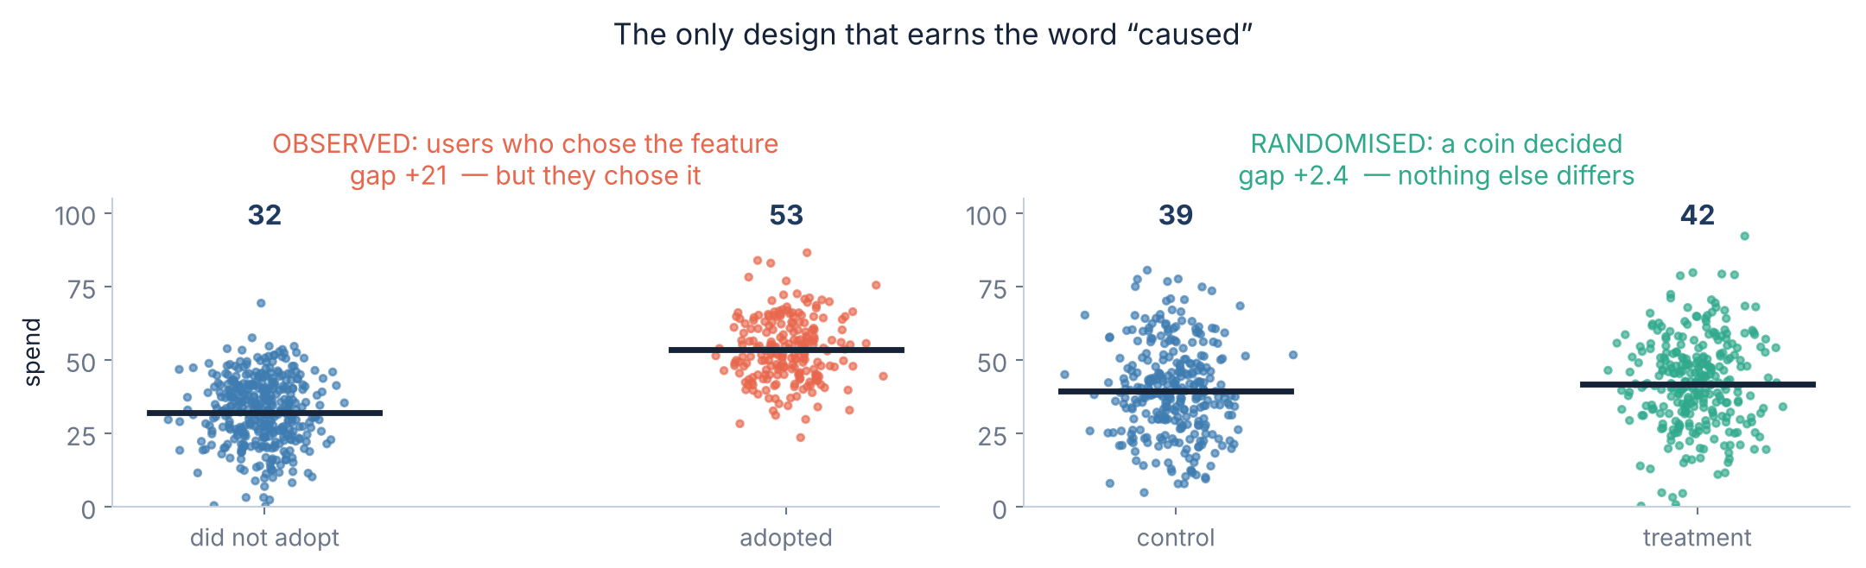
1.1 · RANDOMISATION
⭐ A coin flip is the entire trick
Left: the observational answer
Right: the randomised answer
Users who adopted the feature spend 21 more. But engaged users are the ones who adopt — the gap mostly measures who they already were.
Same users, same engagement. A coin assigns the arm, so engagement is balanced on average. The true effect built into this simulation was +2.0.
Slides by Srinivasa Sai Chava
Notes:
The true effect here is +2.0. The randomised estimate of +2.4 is a third of a standard error from it; the observational estimate of +21 is wrong by a factor of ten. That contrast is the slide.

Slide 7
1.2 · THE GUARANTEE
What the coin fixes — and what it does not
✓ Switched off by the design
✗ Still entirely your problem
Confounding — every variable, including the ones you never measured or thought of, is balanced on average
Reverse causation — the coin came first, in time, so the outcome cannot have caused the assignment
Selection — you decide who is in the test, before anyone has an outcome
Chance — the coin balances things on average, not in your particular test
Too small a test — randomising badly-sized arms answers nothing, correctly
Measuring the wrong thing — a clean test of a metric nobody cares about
Short horizon — you measured a week, and shipped for a year
“Balanced on average” is the exact claim. In any one test the groups will differ by chance — that is precisely the uncertainty the p-value and the interval are measuring.
Slides by Srinivasa Sai Chava
Notes:
Students often think randomisation makes groups identical. It makes them identical in expectation. The whole of statistics is the correction for the difference between those two things.

Slide 8
1.3 · THE DESIGN
Three decisions, all made before the test starts
The unit
Randomise by pageview and the same person sees both versions. They notice, and their pageviews are not independent, so every p-value is wrong.
1
What gets randomised — almost always the USER, not the session or the pageview
The metric
Everything else is a secondary metric or a guardrail, and secondary metrics cannot win the test. They can only lose it.
2
ONE primary metric, written down before you look
The size
This is section 2. It takes one line of code and it is the step that is almost always skipped.
3
How many users, worked out from the smallest effect worth shipping
Write all three in a one-page plan and have somebody sign it. After the data arrives, every one of these decisions becomes negotiable — and that is how tests get p-hacked without anyone deciding to cheat.
Slides by Srinivasa Sai Chava
Notes:
The pre-registration point matters more than any formula today. Nobody sets out to p-hack; they just make reasonable-sounding decisions after seeing the data.

Slide 9
2
Size It Before You Run It
MDE and sample size
The formula
The winner's curse
The sum that saves the whole test · 20 minutes
Slides by Srinivasa Sai Chava

Slide 10
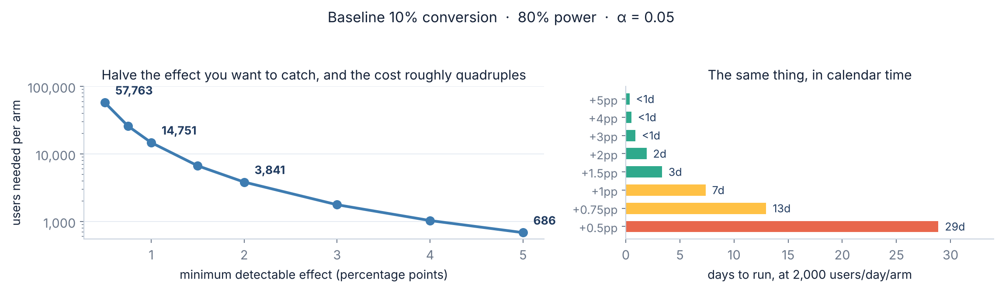
2.1 · SIZING
Not “how many users?” but “how small an effect?”
Start from the business, not the stats
The quadrupling rule
Ask: what is the smallest lift that would make us ship this? That is the MDE. Everything else follows from it mechanically.
Halve the effect you want to catch and you need roughly four times the users. +2pp costs 3,841 per arm; +1pp costs 14,751; +0.5pp costs 57,763 and a month.
Slides by Srinivasa Sai Chava
Notes:
The quadrupling comes from n scaling as 1/MDE-squared. Say it out loud - it is the single most useful piece of planning intuition in the session.

Slide 11
2.2 · THE FORMULA
The sum itself — one line, four inputs
The four inputs
from scipy import stats
import numpy as np
def n_per_arm(p0, mde, power=0.80, alpha=0.05):
"""Users needed in EACH arm of a two-sided proportion test."""
p1 = p0 + mde
pbar = (p0 + p1) / 2
za = stats.norm.ppf(1 - alpha/2) # 1.96
zb = stats.norm.ppf(power) # 0.84
num = (za*np.sqrt(2*pbar*(1-pbar)) +
zb*np.sqrt(p0*(1-p0) + p1*(1-p1)))**2
return int(np.ceil(num / mde**2))
n_per_arm(0.10, 0.01) # -> 14751
p0
your current rate — look it up, do not guess
mde
smallest lift worth shipping — a business call
power
0.80 — chance of catching a real effect
alpha
0.05 — chance of a false alarm
Checked against statsmodels
This hand-written version gives 14,751 where statsmodels' NormalIndPower gives 14,745 — a 0.04% difference from a different variance convention. Either is fine. Write it yourself once so you know what the inputs mean, then use the library.
Slides by Srinivasa Sai Chava
Notes:
Showing the hand version next to the library version is the point: students should be able to reproduce the number, then stop reproducing it.

Slide 12
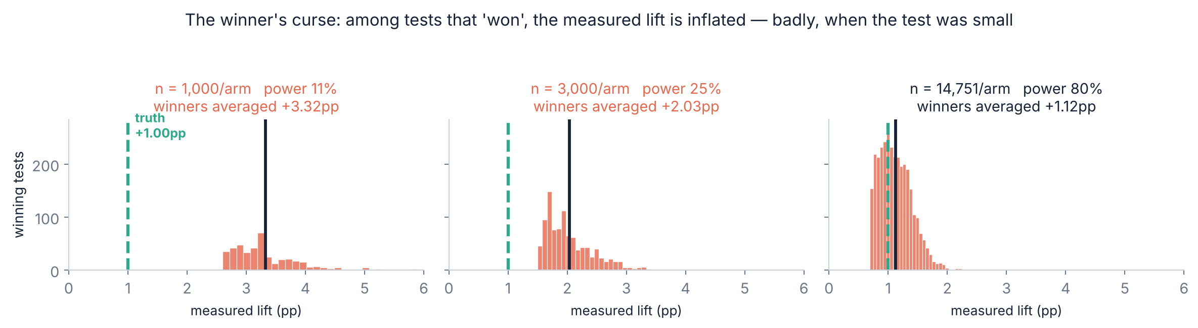
2.3 · THE WINNER'S CURSE
⚠ An underpowered test does not just miss — it lies about the size
Every one of those tests was correct
Why this matters on Monday
The true lift is +1.00pp in all three panels. At n = 1,000 the only tests that reach p < 0.05 are the ones where noise happened to push the gap up — so the winners average +3.32pp. That is a 3.3× overstatement, with a significant p-value attached.
This is why shipped features so often fail to deliver the lift the test promised — and why a properly sized test (right-hand panel, 80% power) overstates by only 1.12×. Power is not just about finding effects. It is about measuring them.
Slides by Srinivasa Sai Chava
Notes:
Note the 80% power in the right panel is an independent check on the sample-size formula - 14,751 was computed for 80% and the simulation measured 80%.

Slide 13
3
Running It Without Breaking It
Peeking
Sample ratio mismatch
Novelty
Three ways a clean design goes wrong · 20 minutes
Slides by Srinivasa Sai Chava

Slide 14
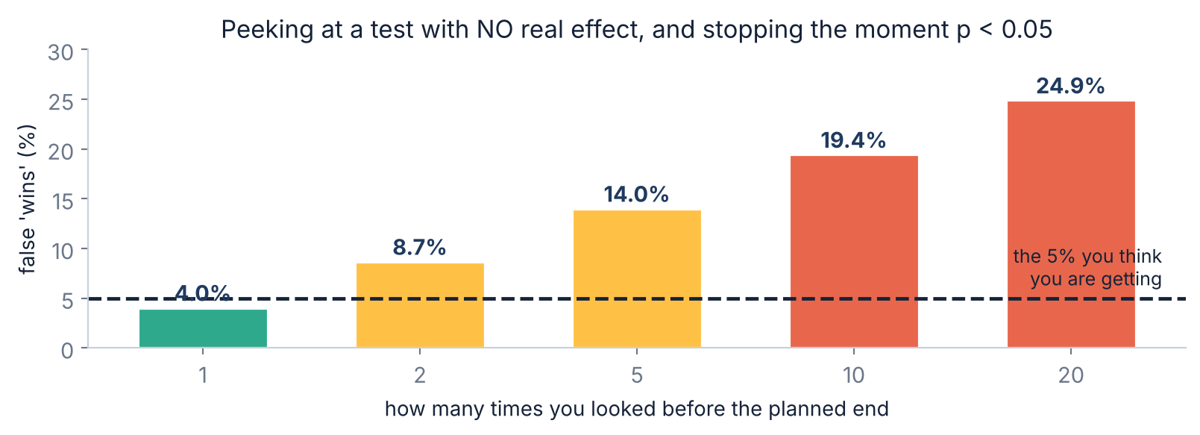
3.1 · PEEKING
⚠ Watching the dashboard is a statistical procedure
Why it happens
The three honest options
The p-value wanders as data arrives. Stop the moment it dips under 0.05 and you have given yourself twenty chances to catch a fluctuation instead of one. Nobody intends this — it is just what happens when a dashboard exists.
1. Fix the end date from the sample-size sum and do not look.
2. Look, but only at guardrails — crashes, errors, refunds.
3. Use a method built for it: sequential testing, or always-valid p-values. Not a plain t-test checked daily.
Slides by Srinivasa Sai Chava
Notes:
Option 2 is the practical one. Teams do need to watch for disasters; the rule is that you may stop for harm, never for success.

Slide 15
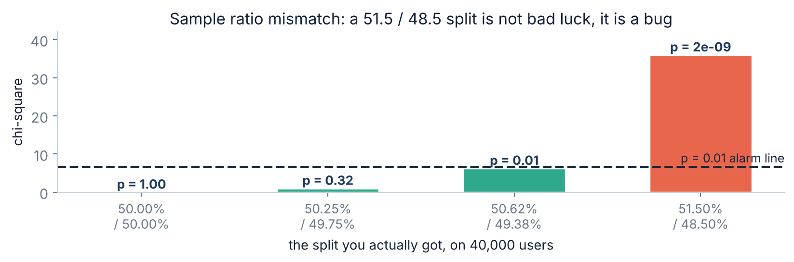
3.2 · SRM
Sample ratio mismatch — the best five minutes you will spend
What it is
⚠ It invalidates the whole test
You asked for a 50/50 split. Check whether you got one, with a chi-square test on the two counts. On 40,000 users, 51.5/48.5 gives p = 2e-9 — that cannot be bad luck.
A bad split means users were lost unevenly — a redirect that timed out, a bot filter that hit one arm, logging that dropped slow sessions. Whatever was lost was not random, so the groups are no longer comparable. Fix the bug and rerun; do not analyse it.
Slides by Srinivasa Sai Chava
Notes:
SRM is the single highest-value automated check in an experimentation platform. At large tech companies it catches a meaningful fraction of all experiments.

Slide 16
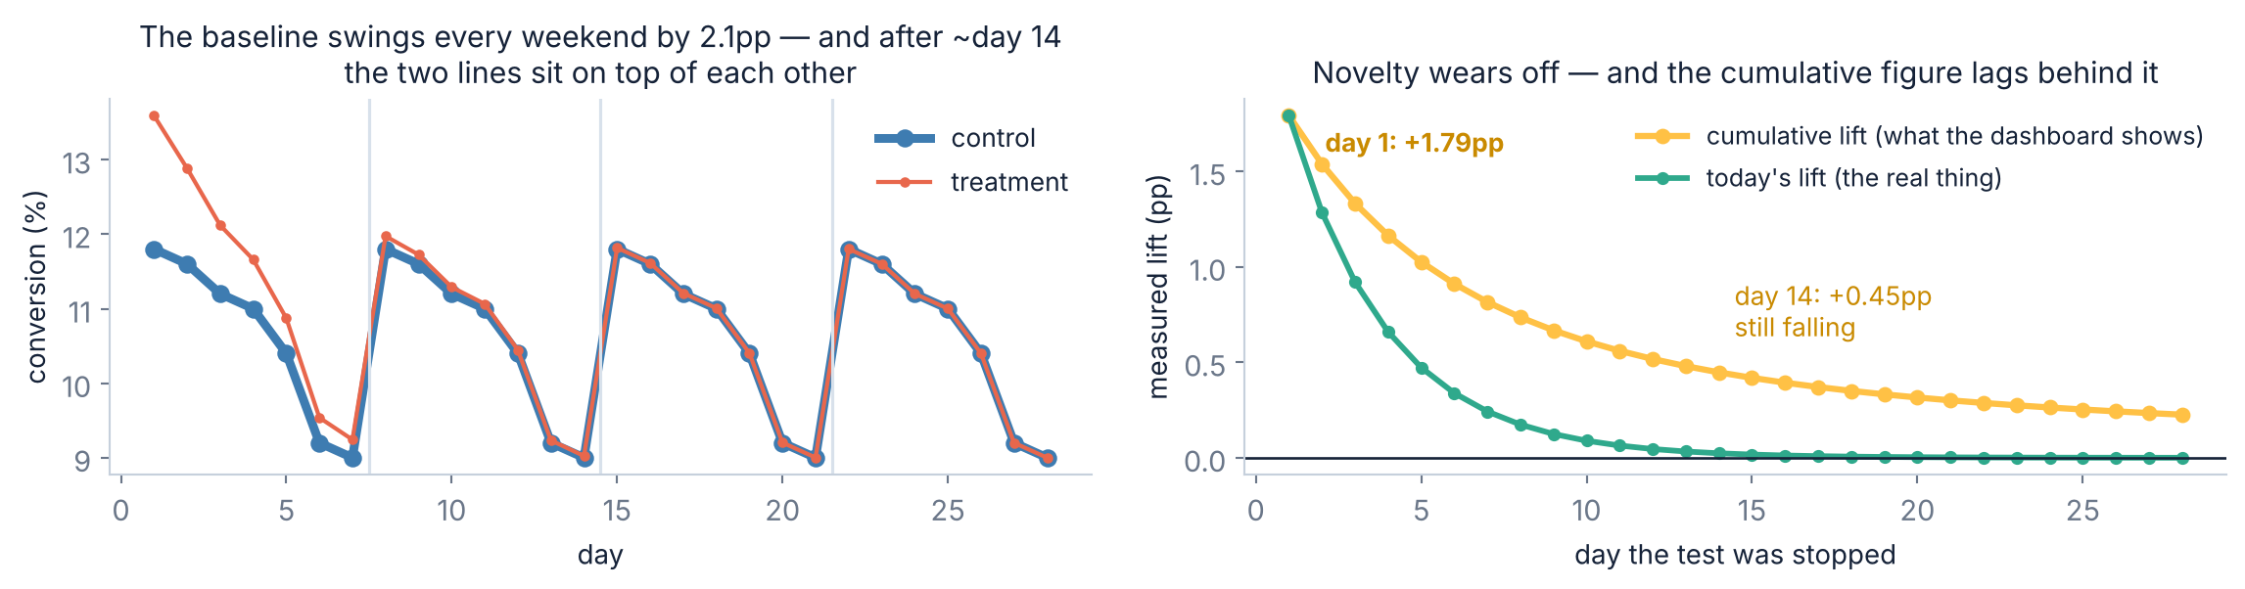
3.3 · TIME
⚠ Novelty, weekends, and why you run whole weeks
The dashboard lags the truth
Two rules that follow
Day 1 shows +1.79pp. By day 14 the daily lift is +0.02pp — effectively gone — but the cumulative figure still reads +0.45pp, because it is still averaging in week one.
Run in WHOLE WEEKS — the baseline swings 2.1pp between weekdays and weekends, so a Monday-to-Friday test measures a different population.
And plot the DAILY lift, not only the cumulative one. A decaying daily line means you have not reached the long-run effect yet.
Slides by Srinivasa Sai Chava
Notes:
The daily-versus-cumulative distinction is the practical takeaway. Most experiment dashboards show only the cumulative line, which is exactly the one that hides novelty decay.

Slide 17
4
Analysing It
The test
Revenue metrics
Segments
The easy part, and its three traps · 20 minutes
Slides by Srinivasa Sai Chava

Slide 18
4.1 · THE TEST
The analysis is five lines. That was always the easy part.
Two details worth the minute
def two_prop(c_a, n_a, c_b, n_b, alpha=0.05):
p_a, p_b = c_a/n_a, c_b/n_b
diff = p_b - p_a # ABSOLUTE lift
# pooled SE for the test (assumes H0 true)
pbar = (c_a + c_b) / (n_a + n_b)
z = diff / np.sqrt(pbar*(1-pbar)*(1/n_a + 1/n_b))
p = 2 * (1 - stats.norm.cdf(abs(z)))
# UNpooled SE for the interval (does not assume H0)
se = np.sqrt(p_a*(1-p_a)/n_a + p_b*(1-p_b)/n_b)
c = stats.norm.ppf(1 - alpha/2)
return diff, p, (diff - c*se, diff + c*se)
Pooled vs unpooled SE — the test assumes the null is true, so it pools the two rates. The interval does not assume that, so it must not pool. Using one for both is a common and quiet error.
Absolute vs relative — “+1.5 percentage points” and “+15%” are the same result. Pick one, label it, and never mix them in a sentence.
For a continuous metric — time on page, items per order — use stats.ttest_ind(a, b, equal_var=False) instead. Day 28's lesson still applies: Welch, always.
Slides by Srinivasa Sai Chava
Notes:
The pooled/unpooled distinction is the kind of thing that never gets taught and then shows up as a reviewer comment. Two minutes here saves it.

Slide 19
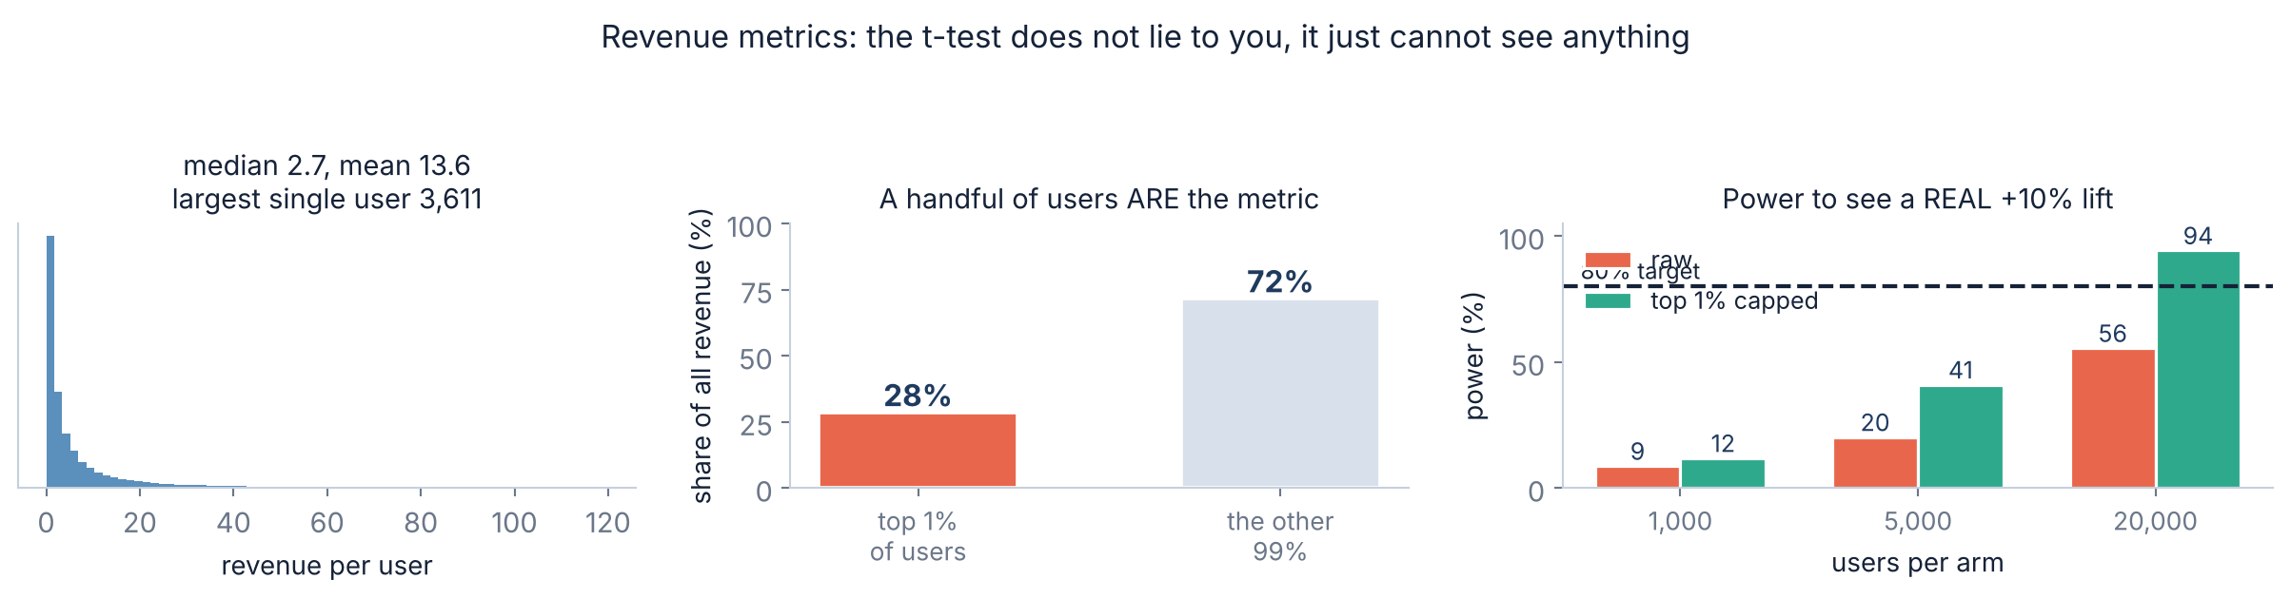
4.2 · HEAVY TAILS
⚠ Revenue metrics: the test is honest, it is just blind
The number that should worry you
What actually helps
A REAL +10% revenue lift, at 1,000 users per arm: 9% power. You would miss it nine times out of ten. The same +10% on a well-behaved metric at the same n: 96% power.
Cap the top 1% before testing, decided in advance: power at 20,000/arm goes from 56% to 94%. Or test conversion rate instead, which is far better behaved. The false-positive rate was never the problem — it measured 3.4–4.3%, slightly under the nominal 5%.
Slides by Srinivasa Sai Chava
Notes:
Correct a common myth here: people say heavy tails 'break' the t-test's error rate. Measured, it is conservative, not anti-conservative. The real cost is power, and that is a much bigger practical problem.

Slide 20
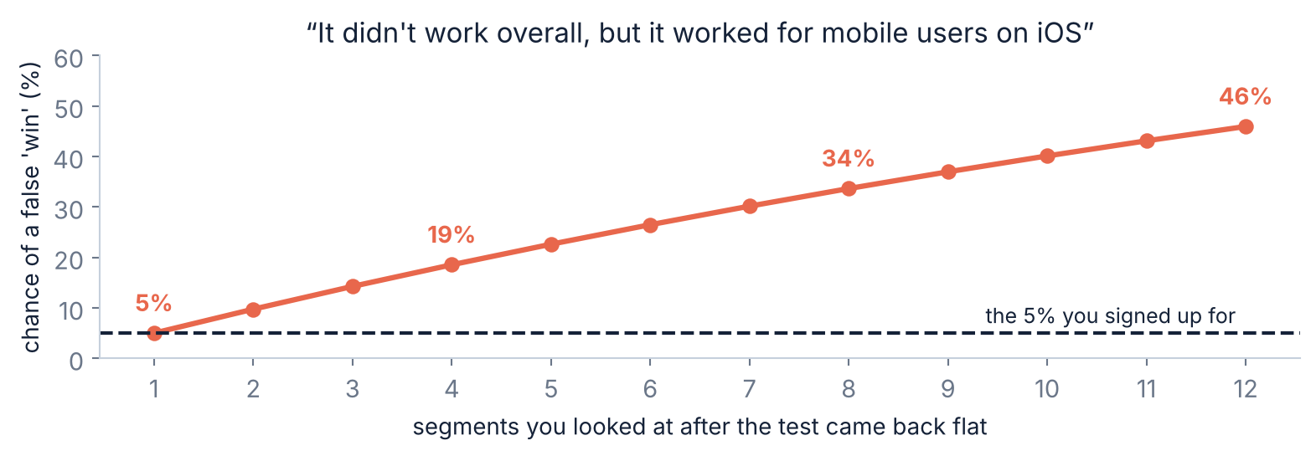
4.3 · SEGMENTS
⚠ “It didn't work overall, but it worked for …”
Day 28 and Day 29, again
The rule
Slice a flat test eight ways and you have a 34% chance of finding a “winning” segment in data with no effect in it. Twelve ways and it is 46%.
Segments named in the plan BEFORE the test are hypotheses. Segments found afterwards are observations — report them as “worth a follow-up test”, never as a result, and correct for how many you looked at.
Slides by Srinivasa Sai Chava
Notes:
This is the single most common way a dead A/B test gets resurrected in a meeting. Students will meet it within a month of starting work.

Slide 21
5
Deciding and Reporting
Reading a flat result
The decision
The report
Ship, kill, or admit you learned nothing · 15 minutes
Slides by Srinivasa Sai Chava

Slide 22
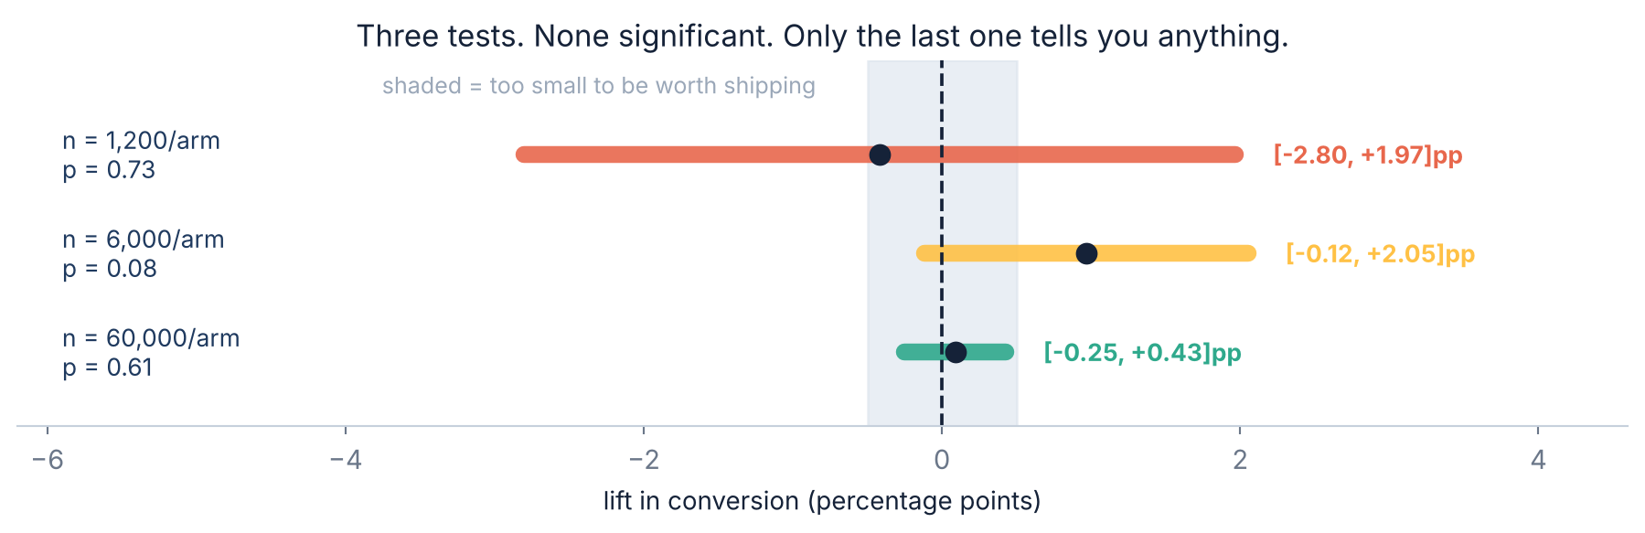
5.1 · READING A FLAT TEST
⭐ “Not significant” is three different results
n = 1,200: nothing
n = 6,000: still nothing
n = 60,000: a real answer
The interval allows a +2pp win and a −2.8pp disaster. You spent two weeks to learn nothing at all.
p = 0.08, and a +2pp win is still entirely compatible with the data. This is the one people wrongly call “no effect”.
Anything above +0.43pp is ruled out. Below the ship threshold, so: do not ship. That is a finding.
Slides by Srinivasa Sai Chava
Notes:
All three have the same verdict and completely different information content. The interval is what separates them, and the p-value cannot.

Slide 23
5.2 · SHIP OR KILL
The decision is about the interval, not the verdict
Where the 95% interval sits | What it means | Decision
Entirely above the ship threshold | a win big enough to be worth it | SHIP
Crosses the threshold, excludes zero | real, but maybe too small to pay for | judgement call — weigh the cost
Entirely inside ± the threshold | any effect is too small to matter | KILL, and you have learned something
Wide, crossing everything | the test was too small | INCONCLUSIVE — do not call it “no effect”
Entirely below zero | the change actively hurt | KILL, and understand why
Statistical ≠ practical
A kill is a success
A significant +0.05pp on 10 million users is real and not worth the engineering. Decide the threshold BEFORE the test, with the people who pay for it.
Most tested ideas do not work. A well-powered test that rules out anything worth shipping has saved the team months, and that is the common outcome, not the failure case.
Slides by Srinivasa Sai Chava
Notes:
Industry figures for the share of A/B tests that produce a shippable win are typically quoted around 10-30%. The exact number varies by company; the point is that killing ideas is the normal output.

Slide 24
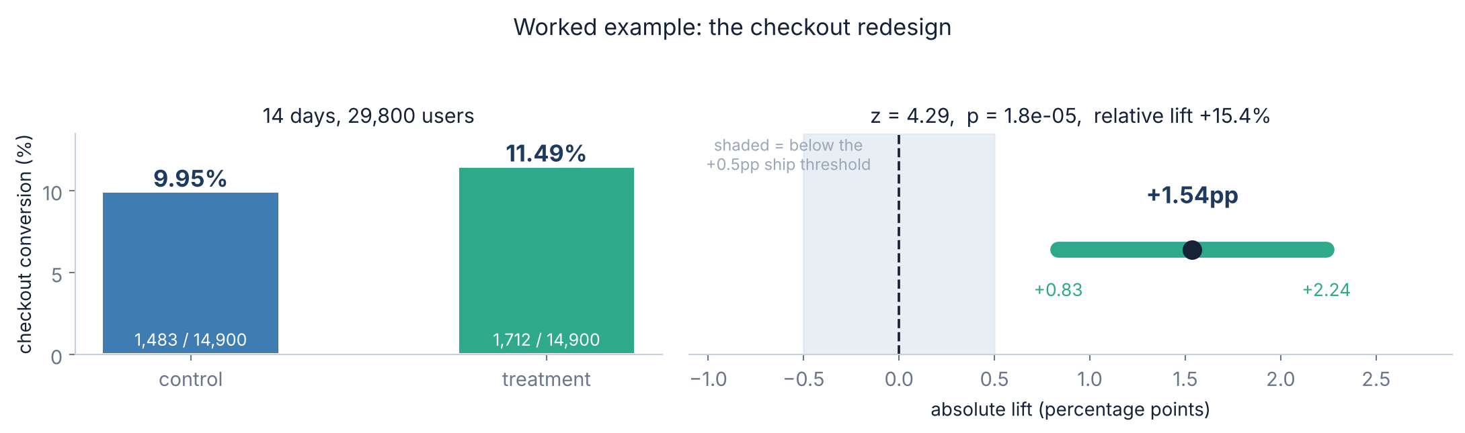
5.3 · A FULL EXAMPLE
Worked through: a checkout redesign, start to finish
Planned, before any data
Checks passed
Decision: SHIP
Baseline 10%. Smallest worthwhile lift +1pp → 14,751/arm → 7.4 days → round up to 14, two whole weeks.
SRM: 14,900 vs 14,900, p = 1.00. Ran 14 whole days. Nobody peeked.
The whole interval (+0.83 to +2.24pp) sits above the +0.5pp threshold. Not just significant — big enough.
Slides by Srinivasa Sai Chava
Notes:
The true lift built into this simulation was +1.20pp and the test measured +1.54pp, comfortably inside its own interval. Worth saying out loud: even a clean, well-powered test lands a little off the truth, which is exactly what the interval is for.

Slide 25
5.4 · THE REPORT
What to write when it is over
The paragraph
Everything it contains
“We tested a checkout redesign against the current page, randomised by user, 14,900 users per arm over 14 days (planned for 14,751 to detect +1pp at 80% power). Checkout conversion rose from 9.95% to 11.49%: an absolute lift of +1.54pp, 95% CI +0.83 to +2.24pp (p = 1.8e-05), a relative lift of +15.4%. The split passed an SRM check. Revenue per user rose +2.33 (p = 0.033), which we treat as directional. The interval sits entirely above our +0.5pp ship threshold, so we recommend shipping.”
What was changed, and the unit
n per arm, and the planned n
Both rates, not just the lift
Absolute lift AND its interval
Relative lift, clearly labelled
The exact p, not “p < 0.05”
The SRM check
Secondary metrics, marked as secondary
The decision, and the threshold it was judged against
And one line that is harder to write: “We looked at N segments / ran M tests this quarter.” Nothing else in the report tells the reader how much searching went into it, and nothing else changes how they should read it as much.
Slides by Srinivasa Sai Chava
Notes:
Read the paragraph aloud. It is about eighty words and it contains everything. Students consistently believe honest reporting is long; it is not.

Slide 26
RECAP
Reference — the test, the trap, the fix
Metric or situation | What to use | scipy / formula
Conversion rate, two arms | two-proportion z-test | two_prop(ca, na, cb, nb)
Time, items, value per user | Welch t-test | ttest_ind(a, b, equal_var=False)
Revenue (heavy tailed) | cap the top 1% first | np.minimum(x, cap)
Did the split come out right? | chi-square on the counts | stats.chisquare([na, nb])
How many users do I need? | power calculation | n_per_arm(p0, mde)
More than two arms | correct for the comparisons | alpha / n_comparisons
I want to stop early | sequential test, not a t-test | # plan it in advance
Always report together: both rates, n per arm, the absolute lift with its 95% interval, the exact p, the relative lift, and the SRM check. Six numbers, and a reader can judge the whole test.
Slides by Srinivasa Sai Chava
Notes:
The last row matters: if you want to stop early you must choose that design before you start. There is no valid way to bolt it on afterwards.

Slide 27
RECAP
Debug corner — eight ways an A/B test goes wrong
You did | What goes wrong | Fix
ran it until it looked significant | 20 looks → 25% false positives | fix the end date from the sum
skipped the sample-size sum | winners overstate the lift 3.3× | n_per_arm(p0, mde) — one line
randomised by pageview | one user sees both arms; p is wrong | randomise by user id
never checked the split | a 51.5/48.5 split invalidates it | chi-square on the two counts
ran Monday to Friday | the baseline swings 2.1pp at weekends | run whole weeks
stopped on day 3 | novelty, not effect: +1.33pp vs +0.02 | plot the daily lift, not cumulative
sliced it 8 ways after it went flat | 34% chance of a fake winner | pre-specify segments, or correct
reported “no significant difference” | hides whether you learned anything | report the interval
Rows 1, 5 and 6 all disappear if you fix row 2: do the sample-size sum first, and write the end date in the calendar before the test launches.
Slides by Srinivasa Sai Chava
Notes:
Three of the eight failures are the same root cause. Make that the one thing they remember.

Slide 28
6 · MINI BUILD
Putting it together — one function for the whole test
SRM is checked first
def ab_test(c_a, n_a, c_b, n_b, ship_threshold=0.005, alpha=.05):
"""Analyse a conversion A/B test and recommend a decision."""
# 0. SRM first - if the split is broken, nothing else matters
tot = n_a + n_b
srm_p = stats.chisquare([n_a, n_b], [tot/2, tot/2]).pvalue
if srm_p < 0.01:
return print(f"STOP: sample ratio mismatch (p={srm_p:.1e}). "
f"Fix the bug and rerun - do not analyse this.")
p_a, p_b = c_a/n_a, c_b/n_b
diff = p_b - p_a
pbar = (c_a + c_b) / tot # pooled, for the test
z = diff / np.sqrt(pbar*(1-pbar)*(1/n_a + 1/n_b))
p = 2*(1 - stats.norm.cdf(abs(z)))
se = np.sqrt(p_a*(1-p_a)/n_a + p_b*(1-p_b)/n_b) # unpooled, for the CI
lo, hi = diff - 1.96*se, diff + 1.96*se
print(f"control {p_a:.3%} ({c_a:,}/{n_a:,}) | treat {p_b:.3%} ({c_b:,}/{n_b:,})")
print(f"lift {diff*100:+.3f}pp 95% CI [{lo*100:+.3f}, {hi*100:+.3f}]pp")
print(f"relative {diff/p_a:+.2%} p = {p:.3e} SRM p = {srm_p:.2f}")
t = ship_threshold
verdict = ("SHIP" if lo > t else
"KILL - hurts" if hi < 0 else
"KILL - too small to matter" if (lo > -t and hi < t) else
"JUDGEMENT CALL - real but maybe too small" if lo > 0 else
"INCONCLUSIVE - underpowered, not 'no effect'")
print("->", verdict)
a broken split voids everything after
Pooled for z, unpooled for CI
the two answer different questions
Both rates printed
a lift with no baseline is unreadable
The interval, not just p
it is what the decision uses
A threshold, not zero
significant ≠ worth shipping
“Inconclusive” is a verdict
and never “no effect”
What it cannot do is size the test for you before it runs. That is n_per_arm(), and it is the half that matters most.
Slides by Srinivasa Sai Chava
Notes:
Point out that the function refuses to analyse an SRM-failing test rather than printing a warning. A warning gets ignored; a refusal does not.

Slide 29
OVER TO YOU
Practice session — 30 minutes
A
Predict the output
8 questions
Your notebook
Sizing, lift, intervals, SRM
Day30_Practice_
Questions.ipynb
B
Spot & fix the bug
4 questions
Peeking, pageview units, segment mining
Size it before you run it
Check the split first
Decide from the interval
Solutions shared after class
C
Write the code
5 tasks
Size it, test it, check it, decide it
D
Challenge
2 tasks
Design one from scratch, then audit a bad one
Part D gives you a real-looking experiment write-up with four separate things wrong with it, and asks you to find them and say what each one does to the conclusion. That is the job.
Slides by Srinivasa Sai Chava
Notes:
Part D is an audit exercise. Reading someone else's experiment critically is the skill they will actually be paid for.

Slide 30
TODAY IN TWELVE LINES · AND THE END OF MODULE 2
Recap
1
⭐ A coin flip removes confounding, reverse causation and selection at once.
7
⚠ Peeking 20 times turns a 5% false-positive rate into 25%.
2
It does NOT remove chance — that is what the p-value and interval are for.
8
⚠ A 51.5/48.5 split on 40,000 users is p = 2e-9. It is a bug, not luck.
3
Decide three things first: the unit, ONE primary metric, and the size.
9
⚠ Novelty: day 1 read +1.79pp; by day 14 the daily lift was +0.02pp.
4
Randomise by USER. By pageview, one person sees both arms.
10
⚠ A real +10% revenue lift had 9% power at n = 1,000. Cap the top 1%.
5
Halve the effect you want to catch → roughly 4× the users. +1pp = 14,751/arm.
11
⚠ Eight segments on a flat test → 34% chance of a fake winner.
6
⚠ At 11% power, winning tests overstated a +1.00pp lift as +3.32pp.
12
Decide from the INTERVAL against a threshold. “Not significant” ≠ “no effect”.
Homework
Module 2 ends here — next: Topic 2.20
Write a one-page test plan for a change you would actually make — unit, primary metric, MDE, n per arm, end date · Find a published A/B result and work out what is missing from the report · Take a feature you believe works and name the smallest lift that would justify it
The statistics mini project: hypothesis testing on business data, then the Module 2 assessment. After that, Module 3 — Machine Learning, where today's “decide the threshold before you look” becomes train/test discipline.
Slides by Srinivasa Sai Chava
Notes:
Close the module deliberately. Days 23-29 built the parts; today assembled them. The habit that carries into Module 3 is deciding the rule before seeing the data.

